Slide 1
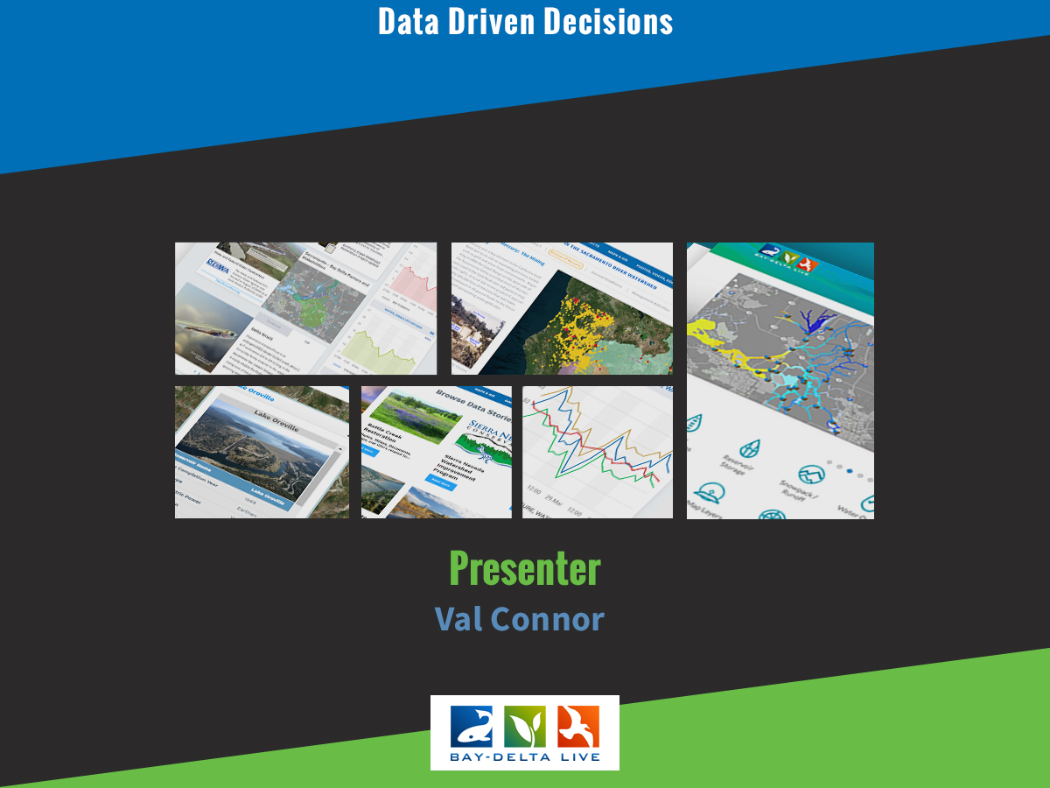

Slide 2
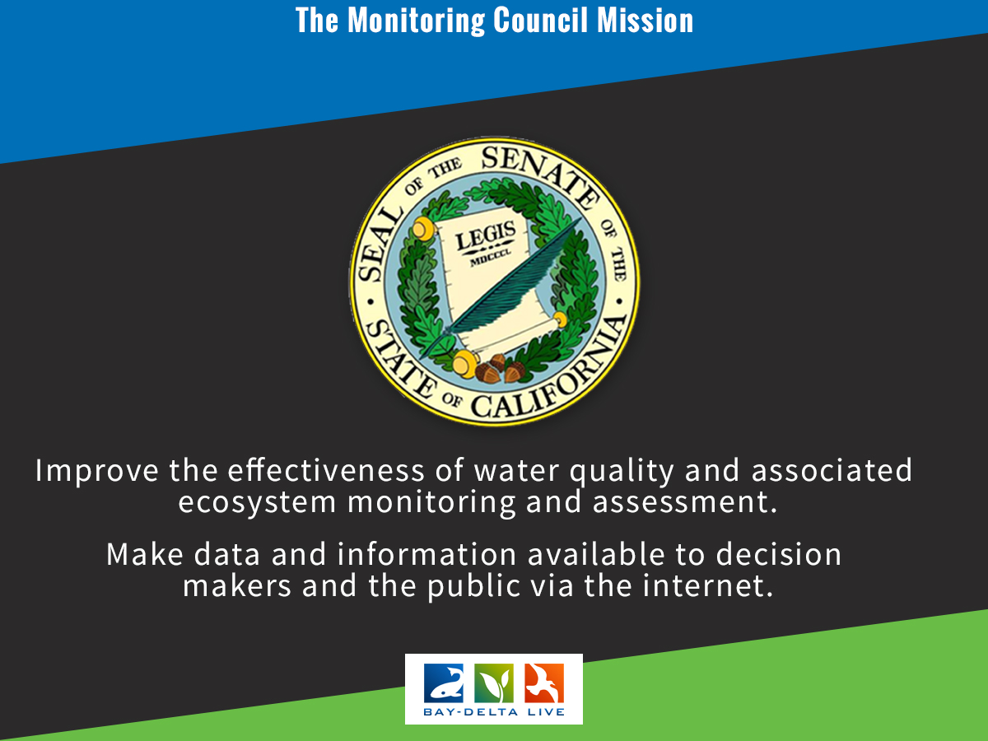

Slide 3
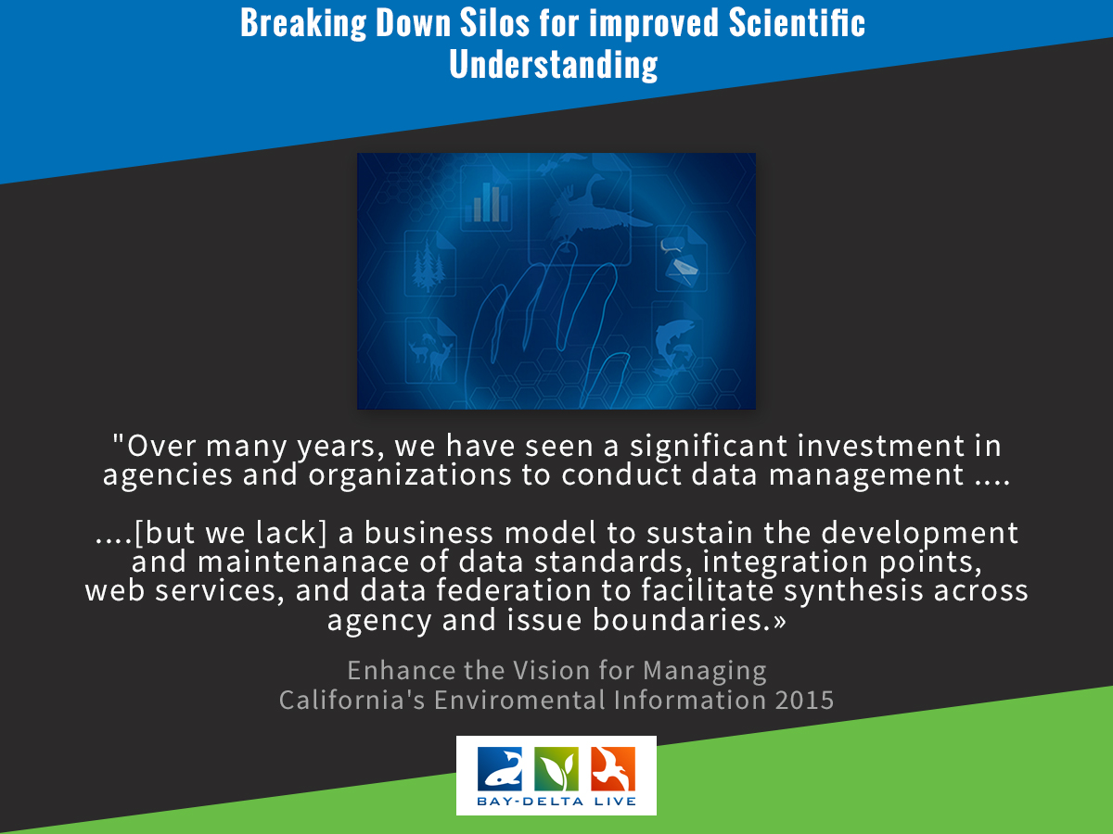

Slide 4
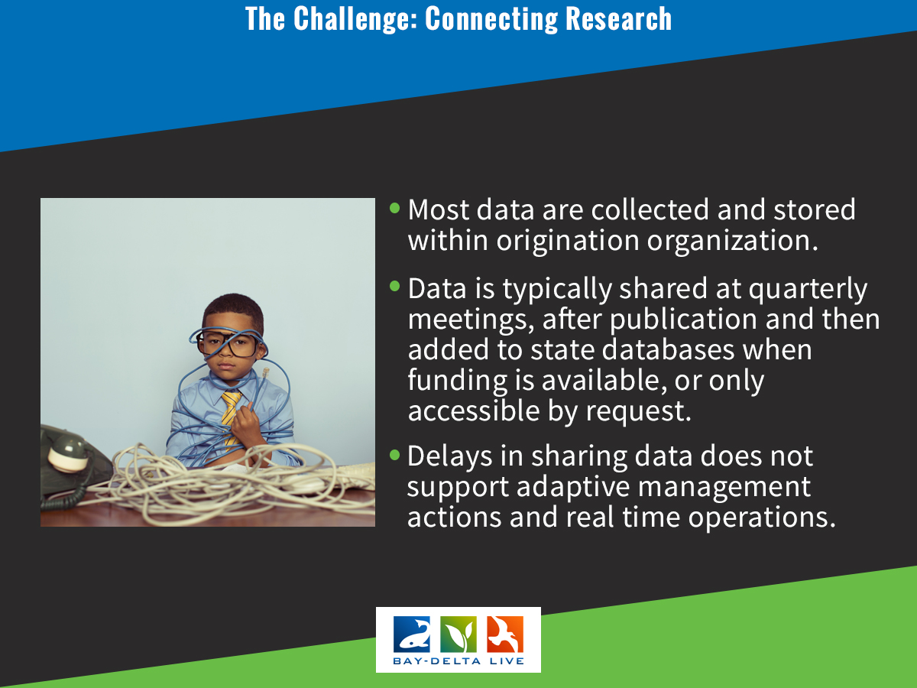

Slide 5
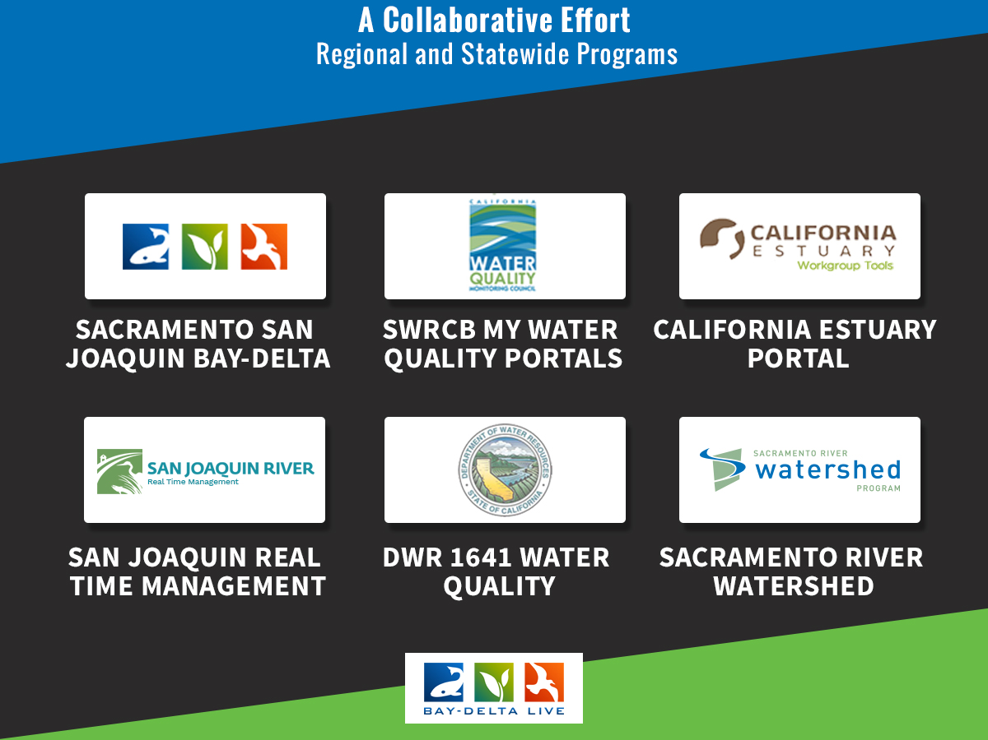

Slide 6
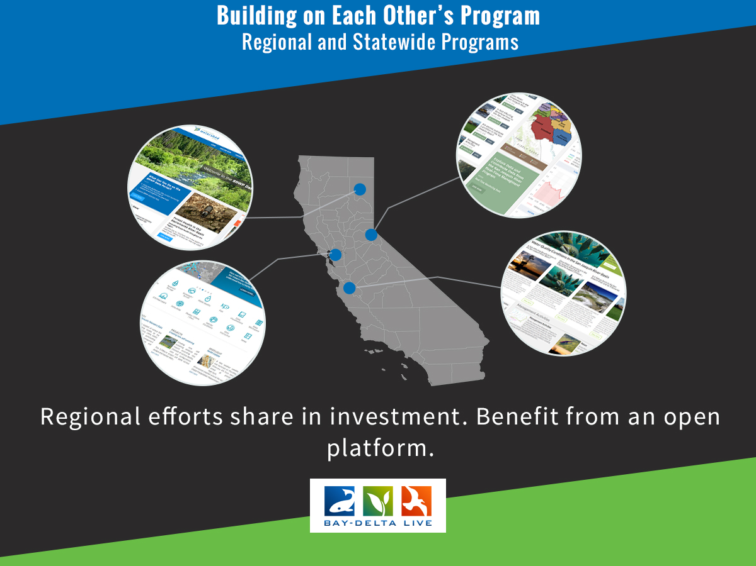

Slide 7
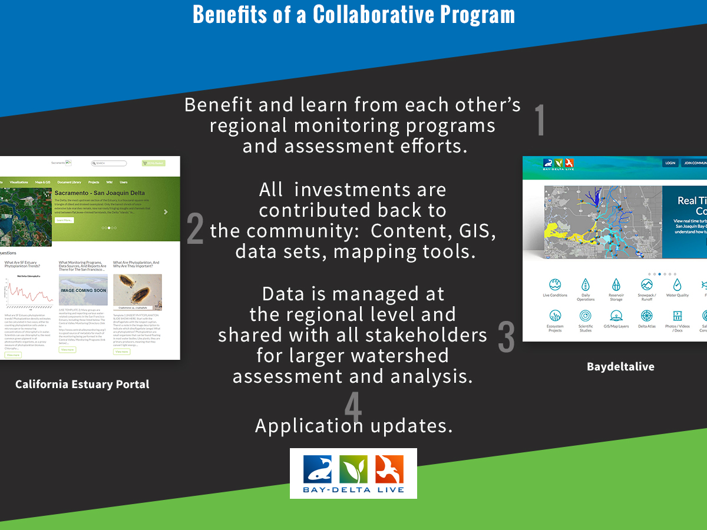

Slide 8
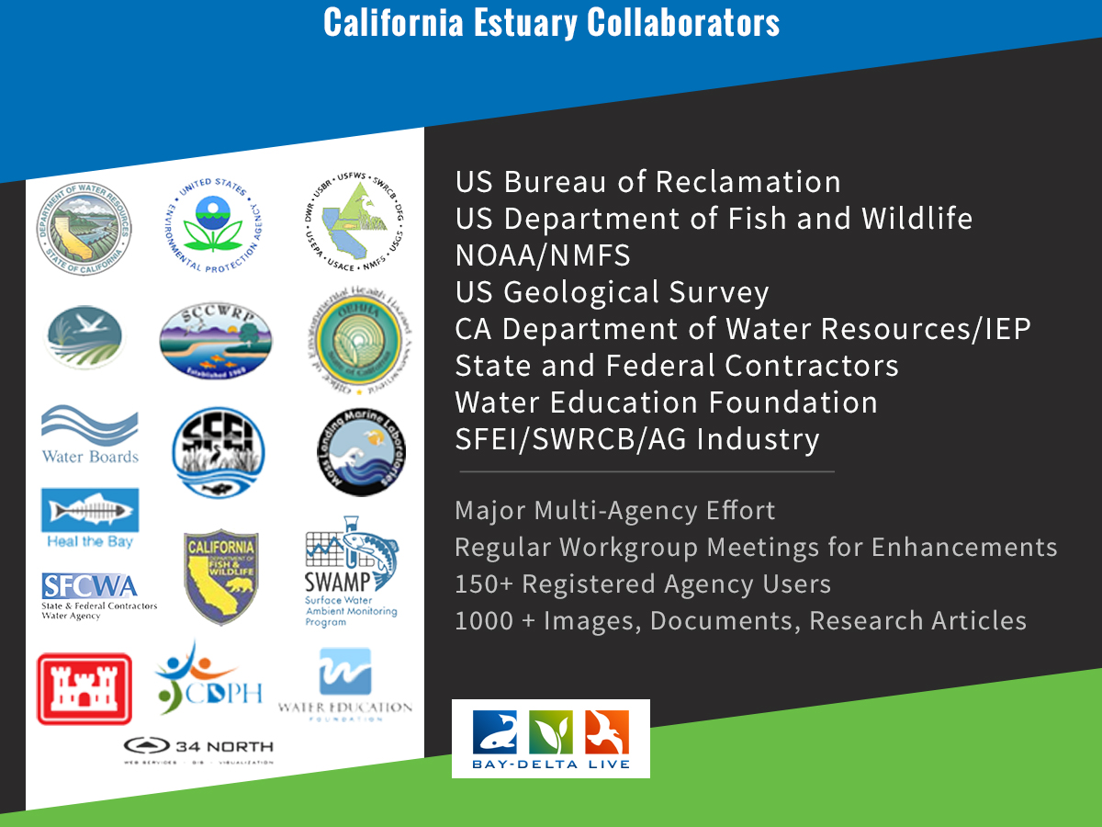

Slide 9
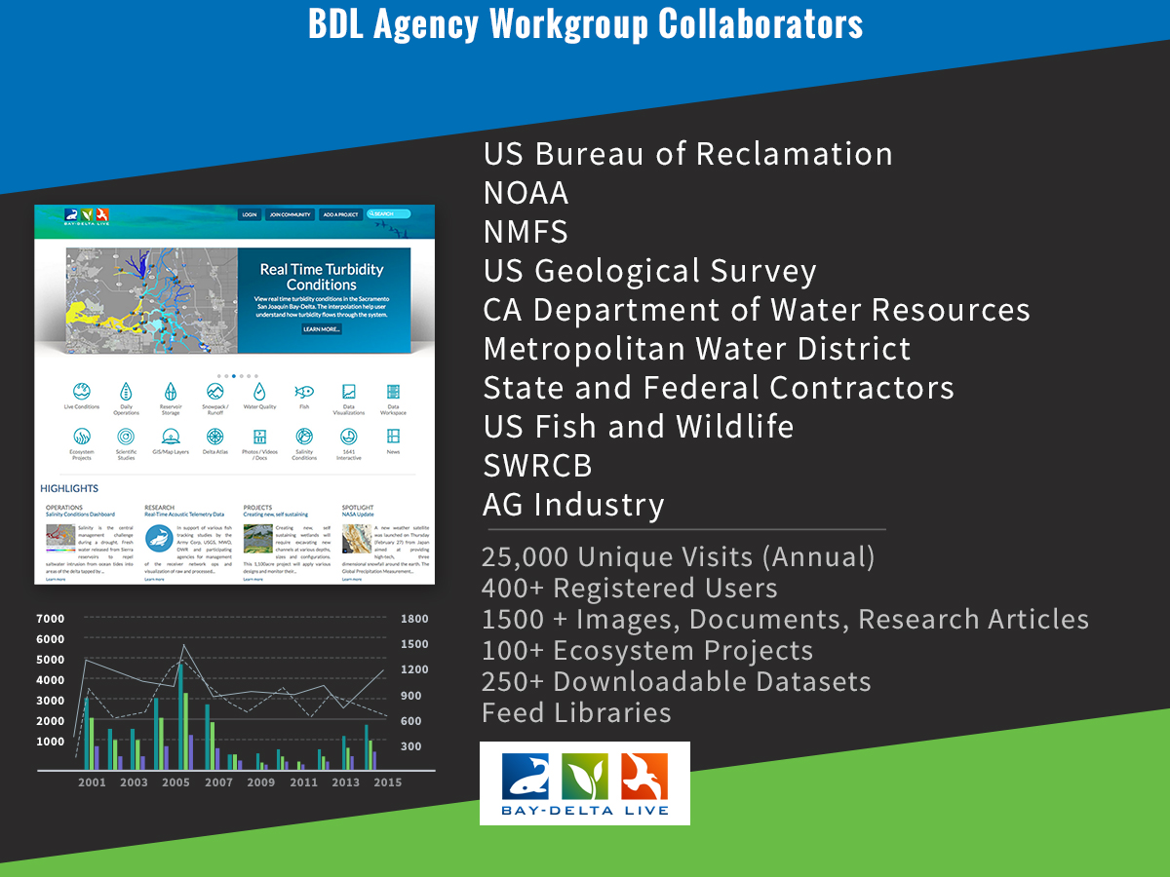

Slide 10
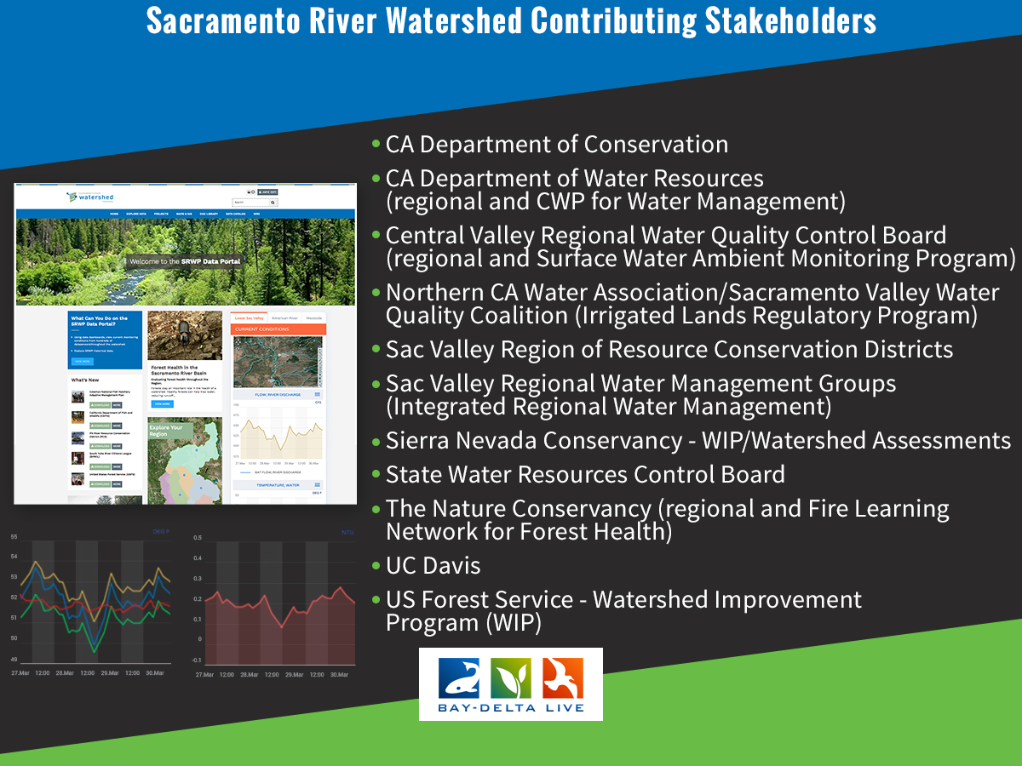

Slide 11
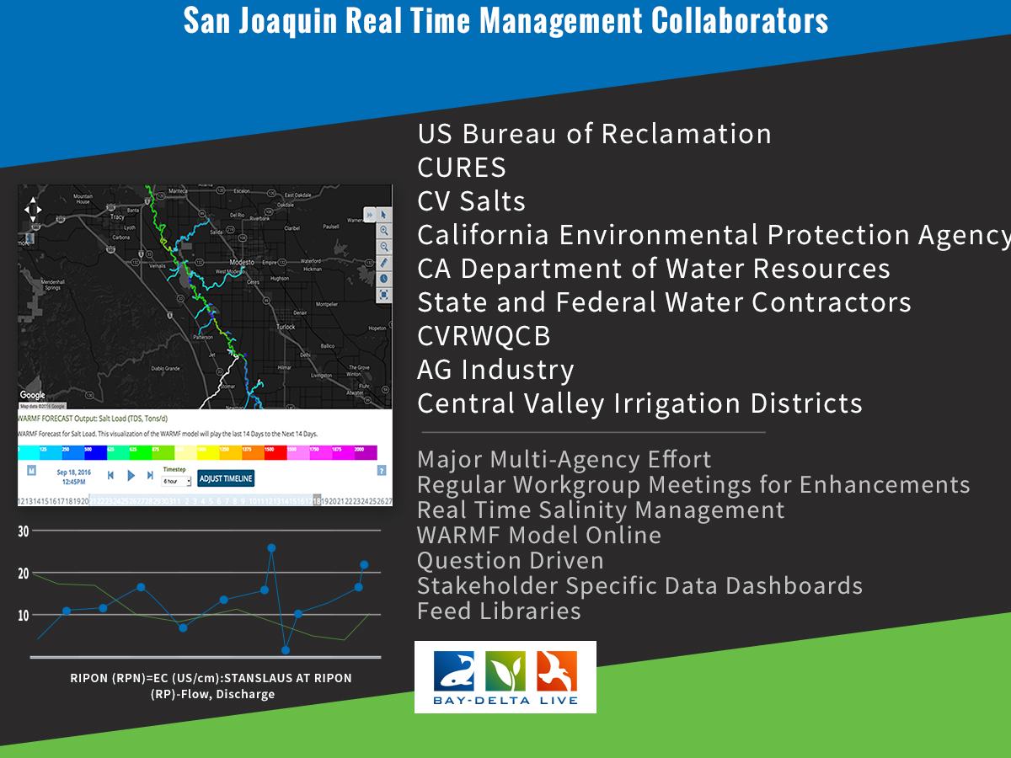

Slide 12
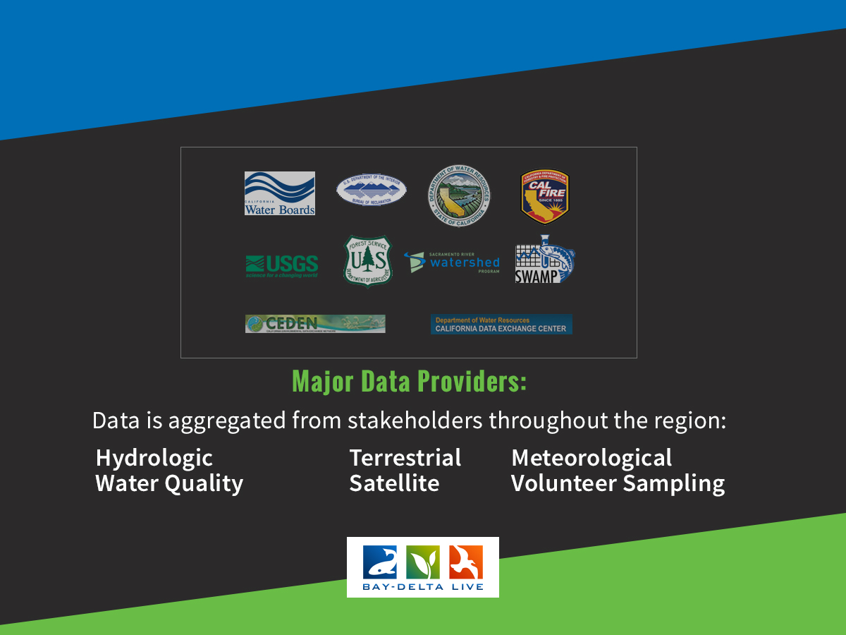

Slide 13
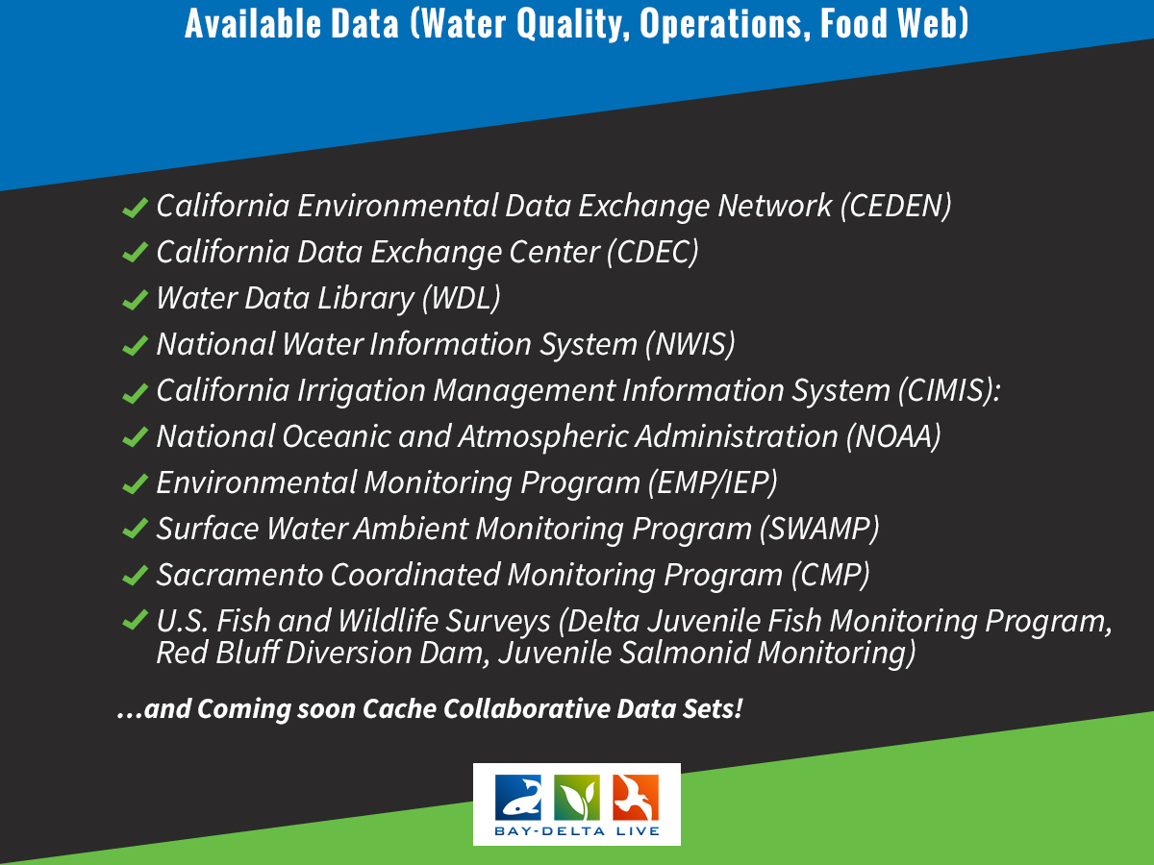

Slide 14
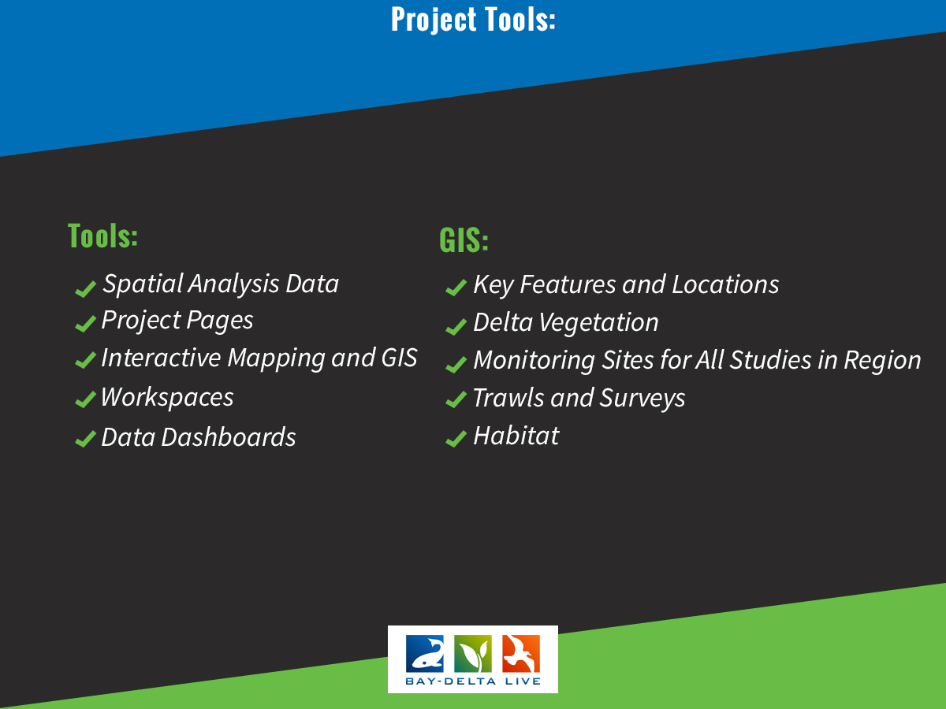

Slide 15
Data Product Exampleses

Slide 16
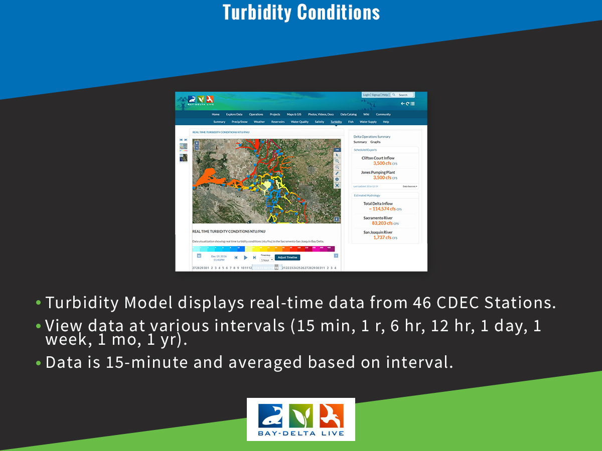

Slide 17
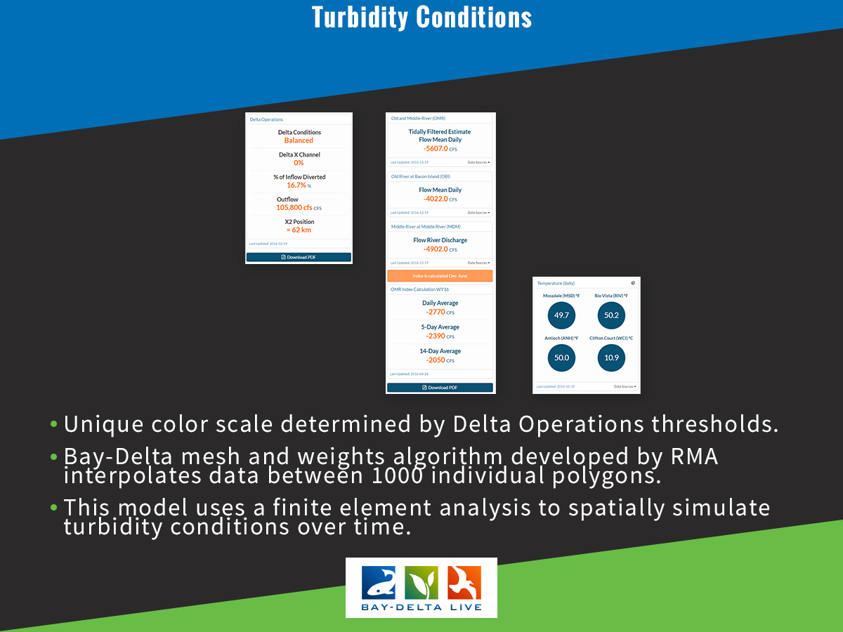

Slide 18
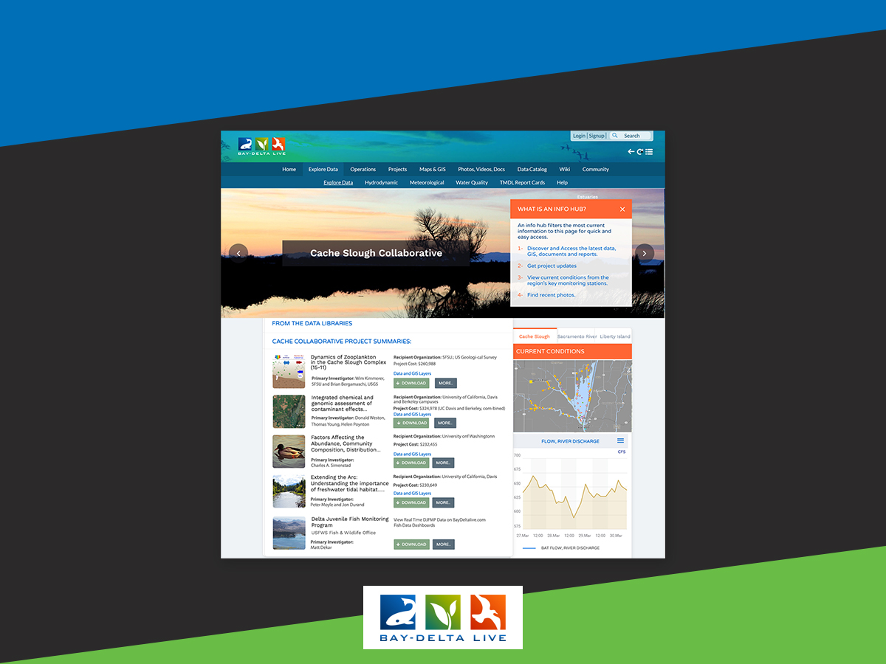

Slide 19
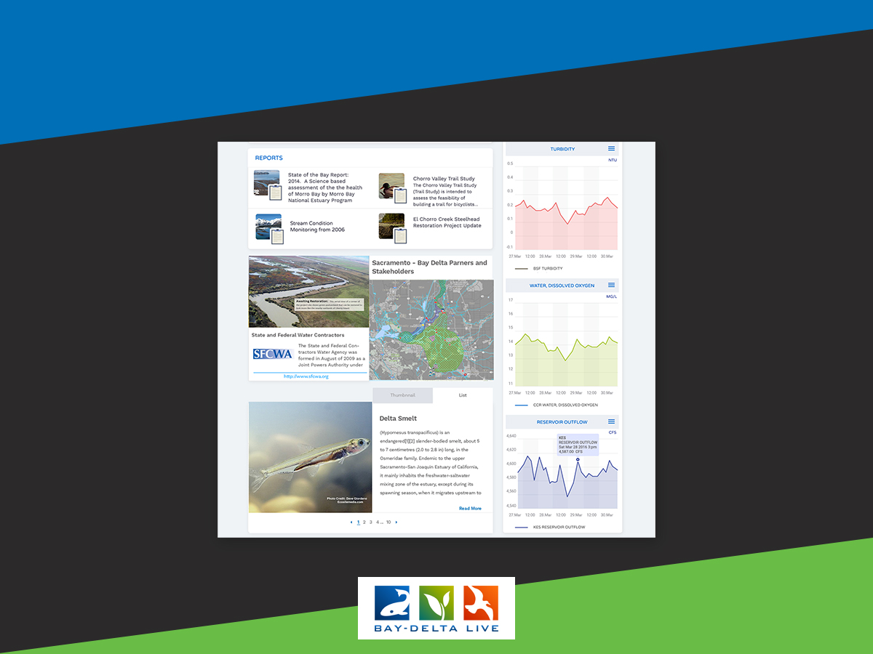

Slide 20
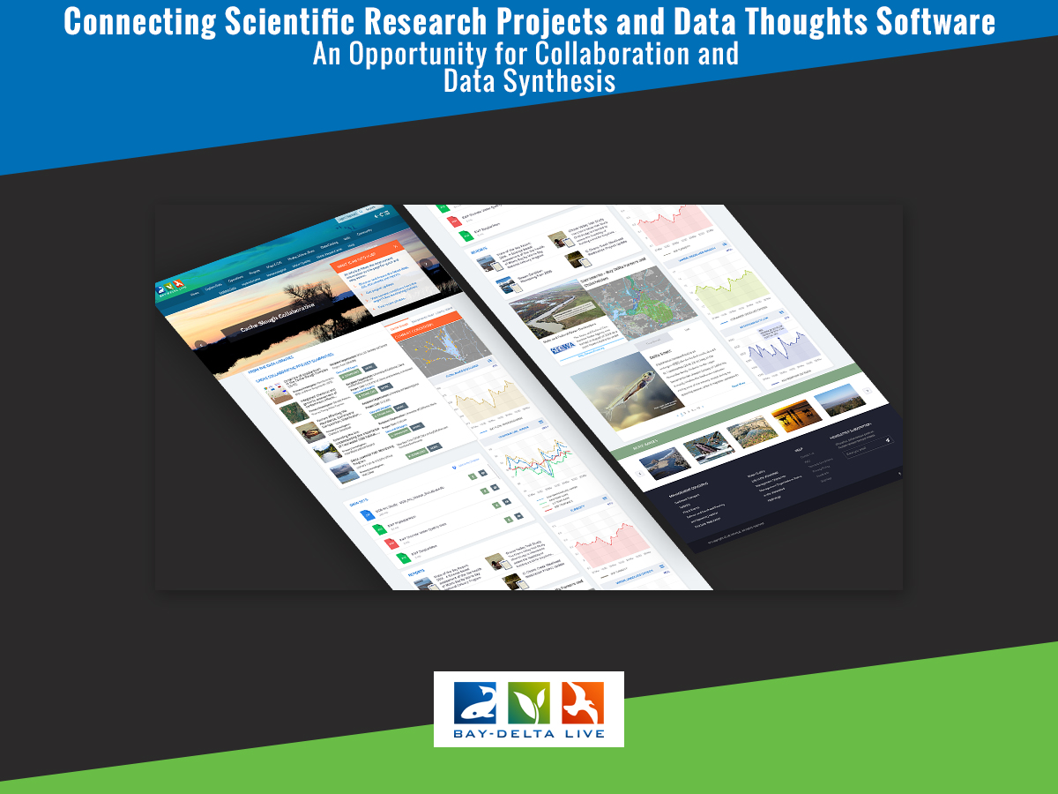

Slide 21
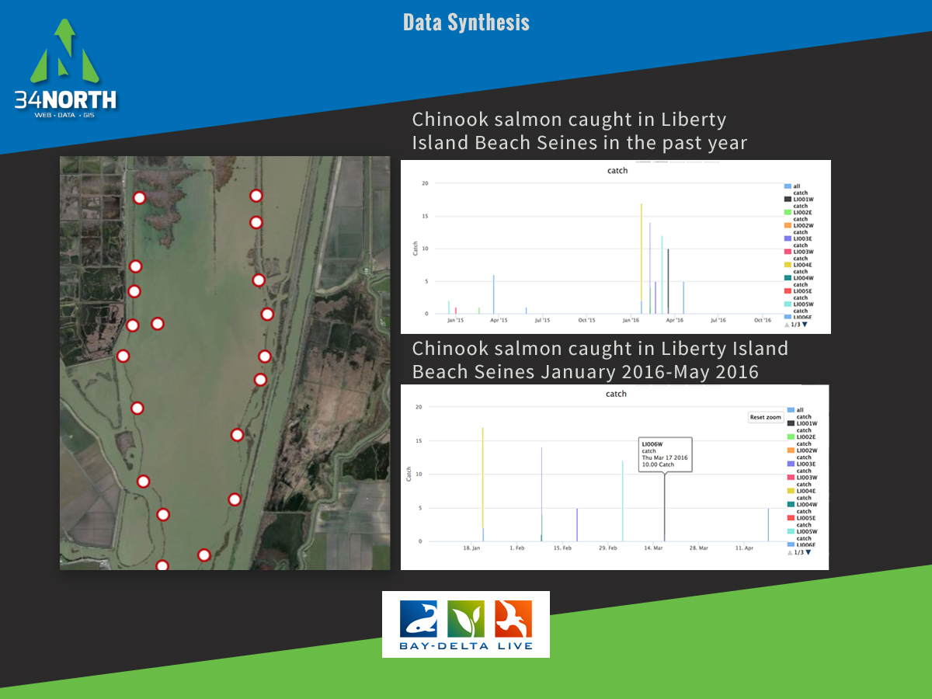

Slide 22
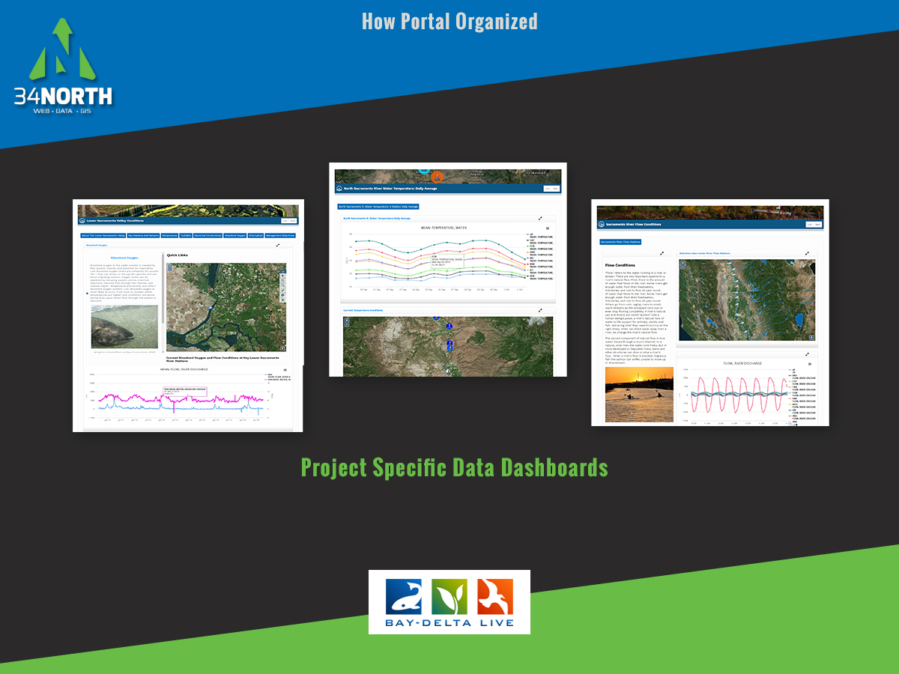
Notes:
A data dashboard is being developed for each study and monitoring programs

Slide 23
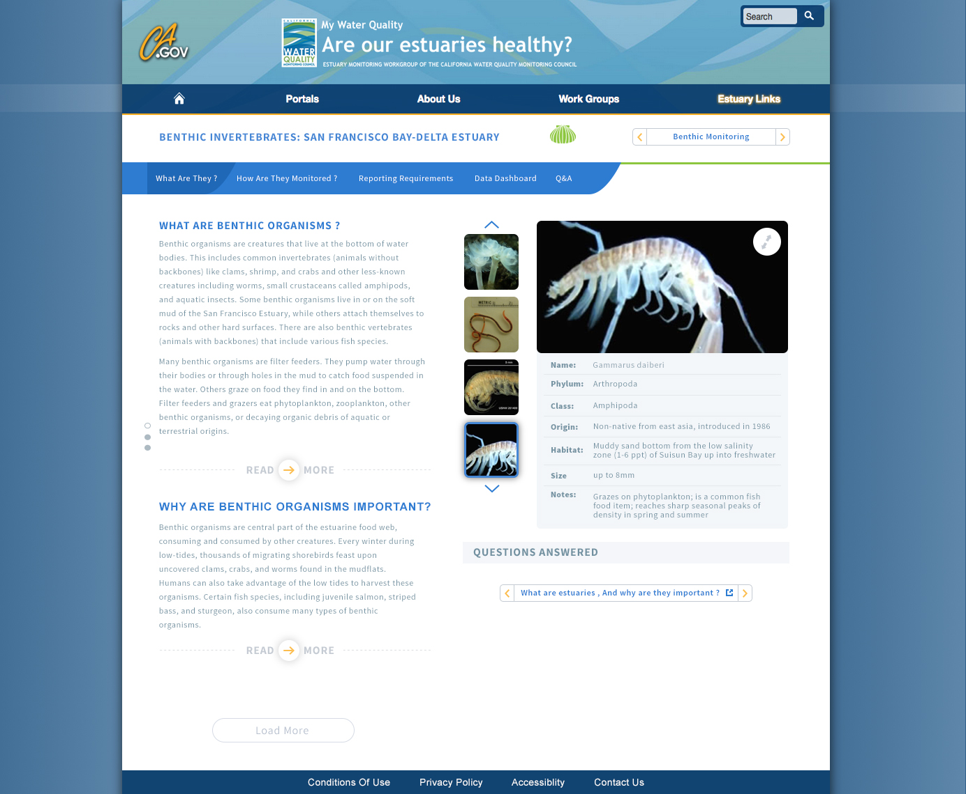
Notes:
Set up a species database for the viewer widget

Slide 24
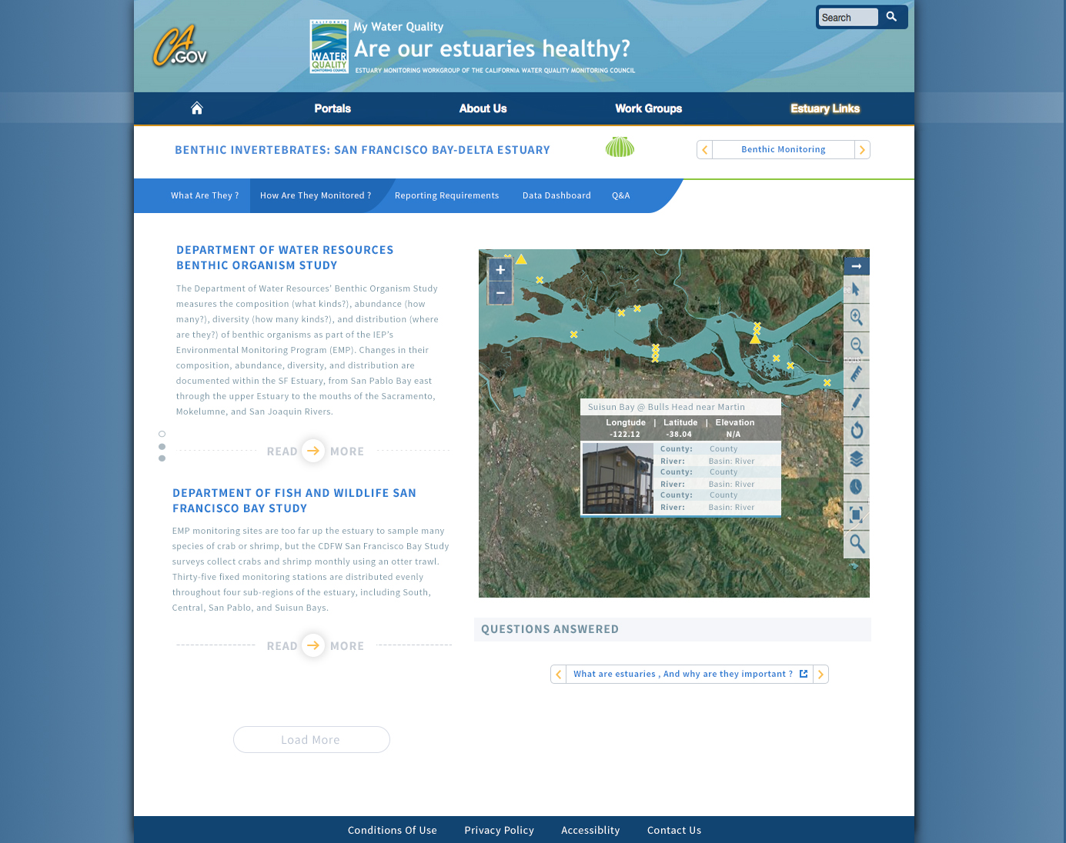

Slide 25
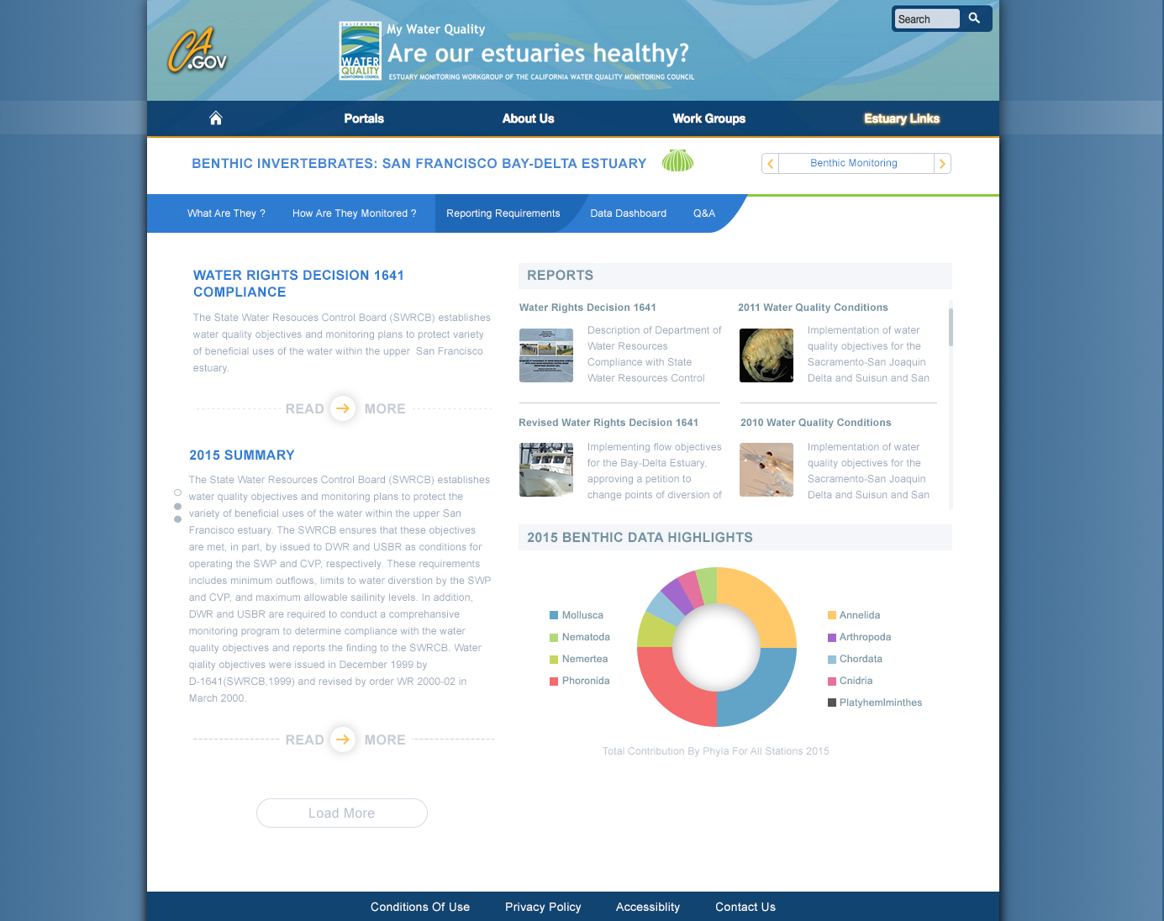
Notes:
Pro-Source Sans

Slide 26
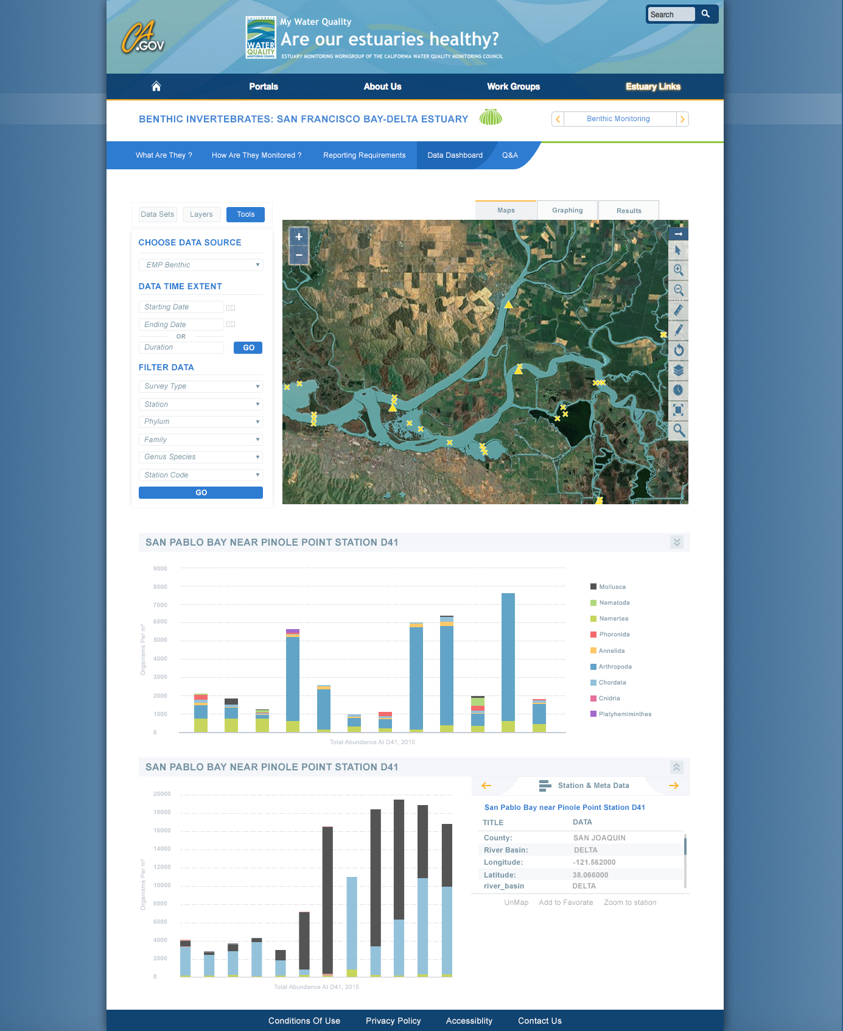

Slide 27
To be styled

Slide 28
Collaborative Effort has Produced the Following Products:
5 Portals all sharing data and information
Delta Operations for Salmon and Sturgeon Reporting Dashboards
Delta Conditions Team Dashboard
Delta Juvenile Fish Monitoring and EDSM Reporting and Web Services
Operations Dashboards
Salinity and Turbidity Dashboards
By the Numbers
EMP Monitoring 1641 Reporting
Cache Collaborative Workspace and Data Hub
My Water Quality Portal: Estuaries
Agency Support for Web Service Development
WARMF and DSM2 Model Visualization and Reporting
Real Time Salinity Management Tools
BDL IPhone Application

Slide 29
Decision Support
Delta Operations for Salmon and Sturgeon
Delta Conditions Team
Delta Smelt Working Group
Sacramento River Forest Health (Restoration)
Delta Operations

Slide 30
Statewide Impact
Statewide Impact
Available to Public | BDL | SRWP | SJRRTM | CAESTUARIES
Active Projects | 121 | 450 | 45 | 51
Documents, Research Images, Video | 2,200 | 950 | 276 | 924
Knowledge Articles (Wiki) | 200 | 98 | 32 | 475
GIS | 157 | 489 |  | 157
Datasets | 135 | 135 | 139 | 135
Members | 410 | 215 | 176 | 205
Stakeholder Groups | 47 | 55 | 23 | 22
Steering Committee | Yes | Yes | Yes | Yes
Page Views | 274,264 | 32,986 | 16,345 | N/A

