Slide 1
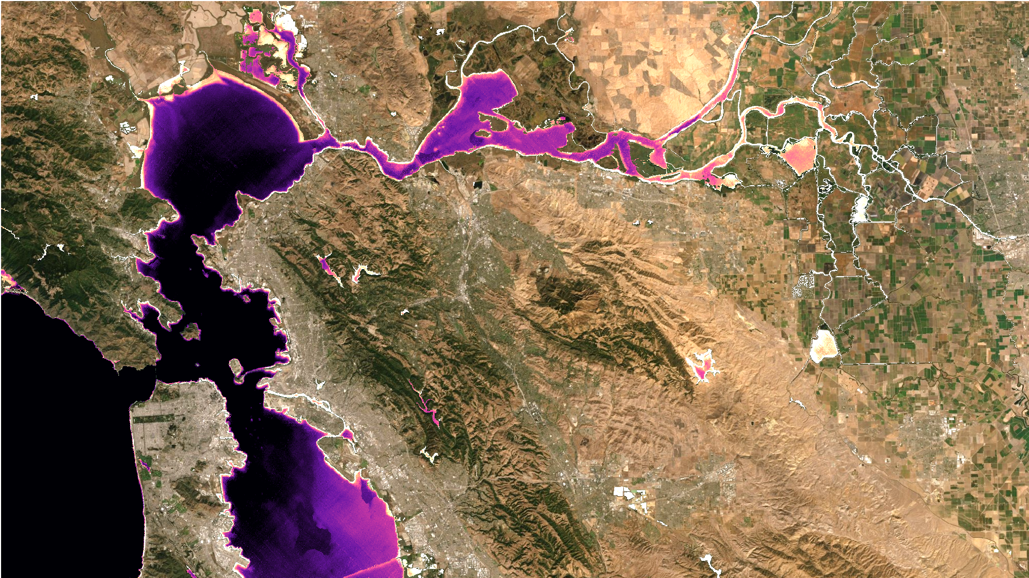
Smelt Habitat Suitability and Thermal Refugia in the San Francisco Bay Delta as Seen by Landsat and ECOSTRESS with Comparison to CDEC
Gregory Halverson¹
Christine Lee¹
Glynn Hulley¹, Kerry-Anne Cawse-Nicholson¹, Brenden Palmieri², Amye Osti², Erin Hestir³, Christiana Ade³, Shawn Acuña⁴, Brian Bergamaschi⁵, Nick Tuffilaro⁶, Robert Radocinski¹, Gerardo Rivera¹
¹NASA Jet Propulsion Laboratory ²34 North ³University of California, Merced ⁴Metropolitan Water District of Southern California, ⁵United States Geological Survey, ⁶Oregon State University

Slide 2
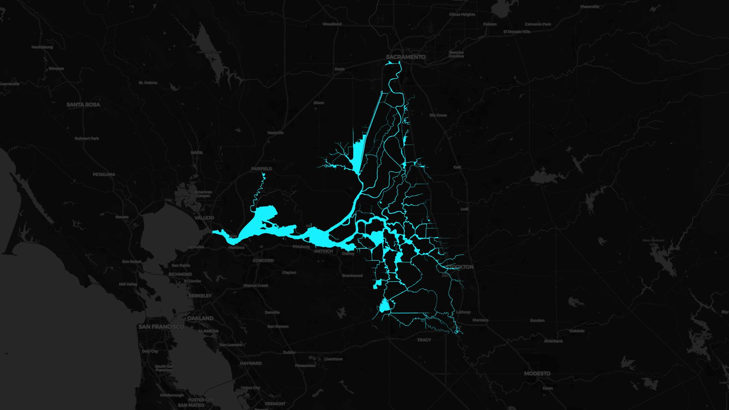
Water management decisions affecting smelt habitat here can be informed by salinity, turbidity, and temperature.
San Francisco Estuary
biodiversity hotspot
home of the endangered delta smelt
Sacramento-San Joaquin Delta
Suisun Marsh and Bay
Water temperature is a driving factor of habitat suitability for fish, and we want to put forward remotely sensed surface temperature as an indicator of habitat suitability.

Slide 3
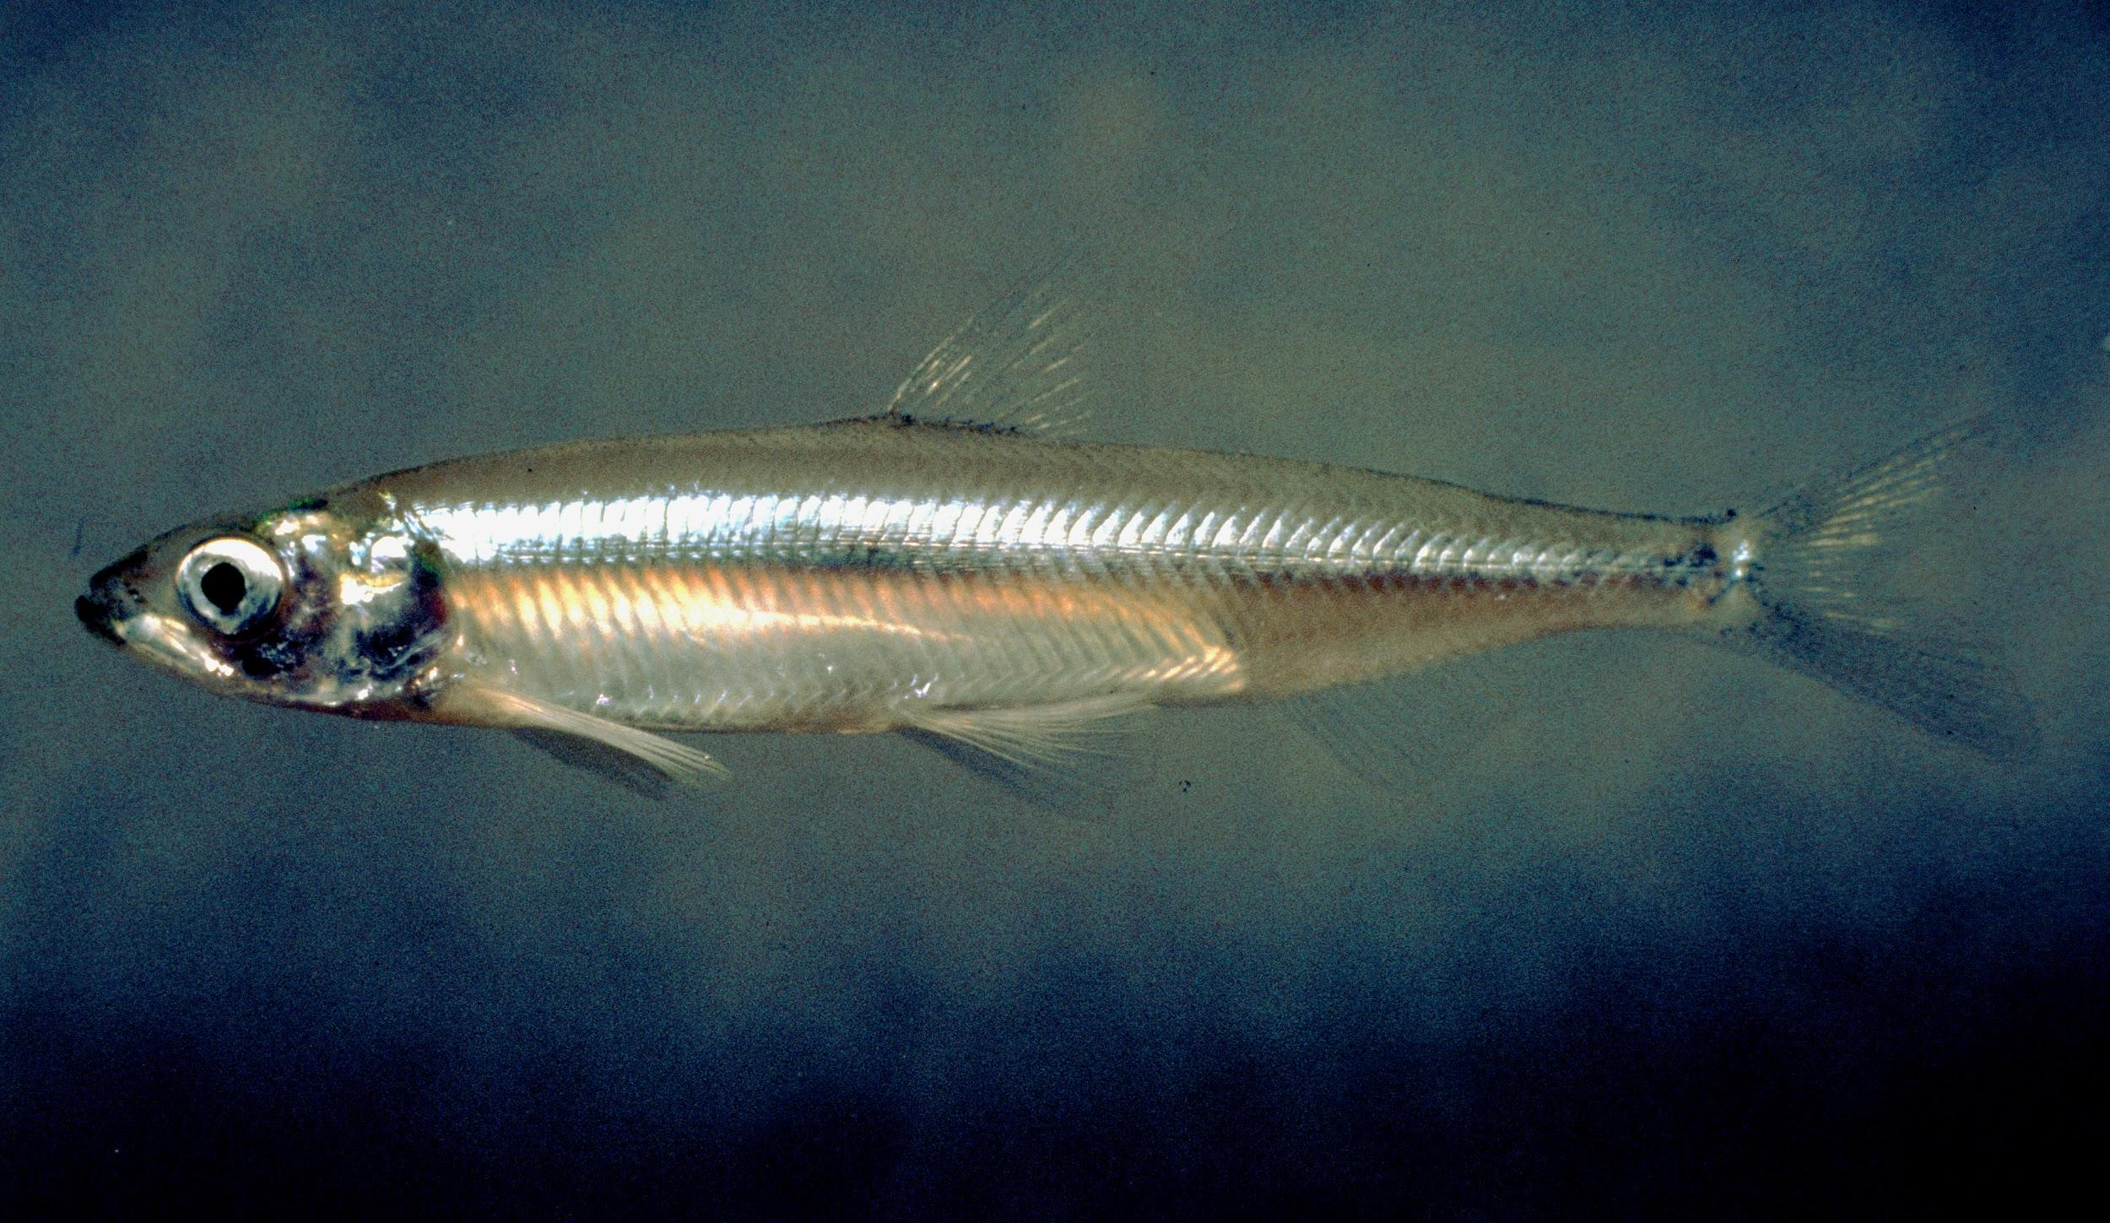

The delta smelt are endemic to the SFE and critically endangered.
CTmax: 28.6°C
Davis et al. 2019
Delta Smelt
Hypomesus transpacificus
In decline due to reduced outflow, entrainment in pumps, and competition with invasive species.
Moyle et al. 2016
U.S. Fish and Wildlife Service
https://en.wikipedia.org/wiki/Delta_smelt#/media/File:Hypomesus_transpacificus.jpg

Slide 4
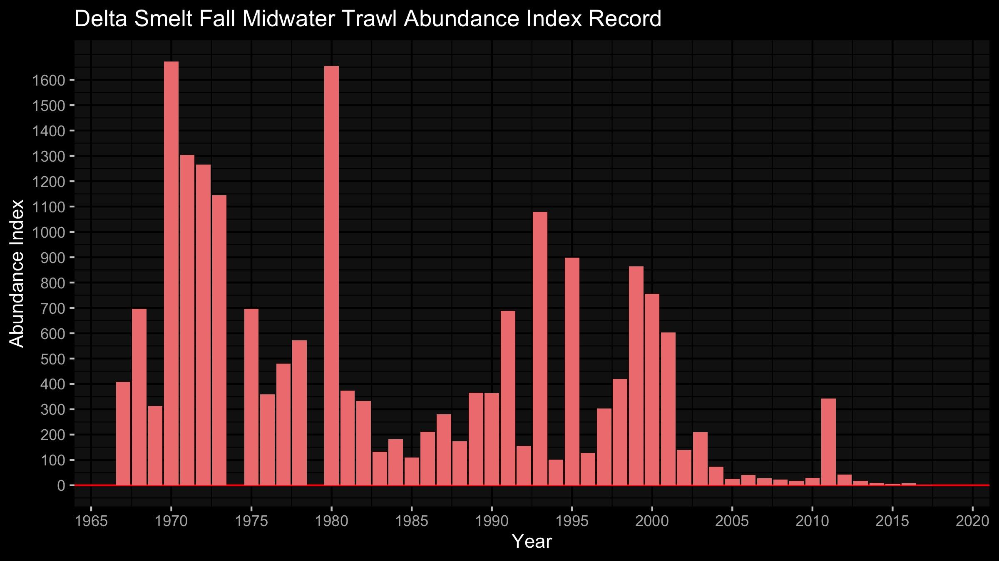
California Department of Fish & Wildlife
https://www.dfg.ca.gov/delta/data/fmwt/indices.asp
Abundance Index hit zero for the first time in 2018

Slide 5
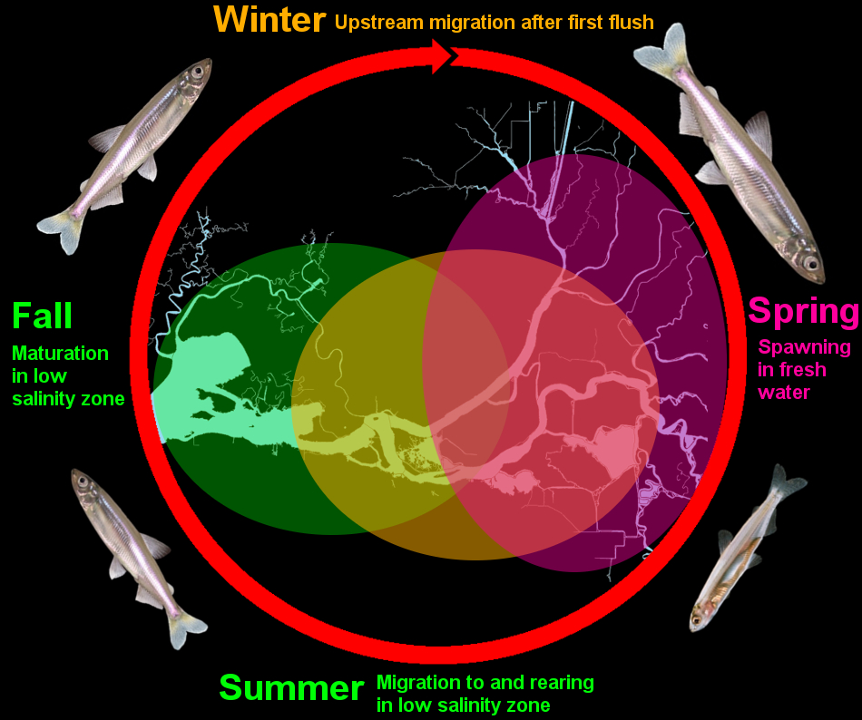
California Department of Fish & Wildlife
https://www.wildlife.ca.gov/Portals/0/Images/InlandFisheries/DeltaSmelt/DeltaSmeltLifeStages_JW.jpg

Slide 6
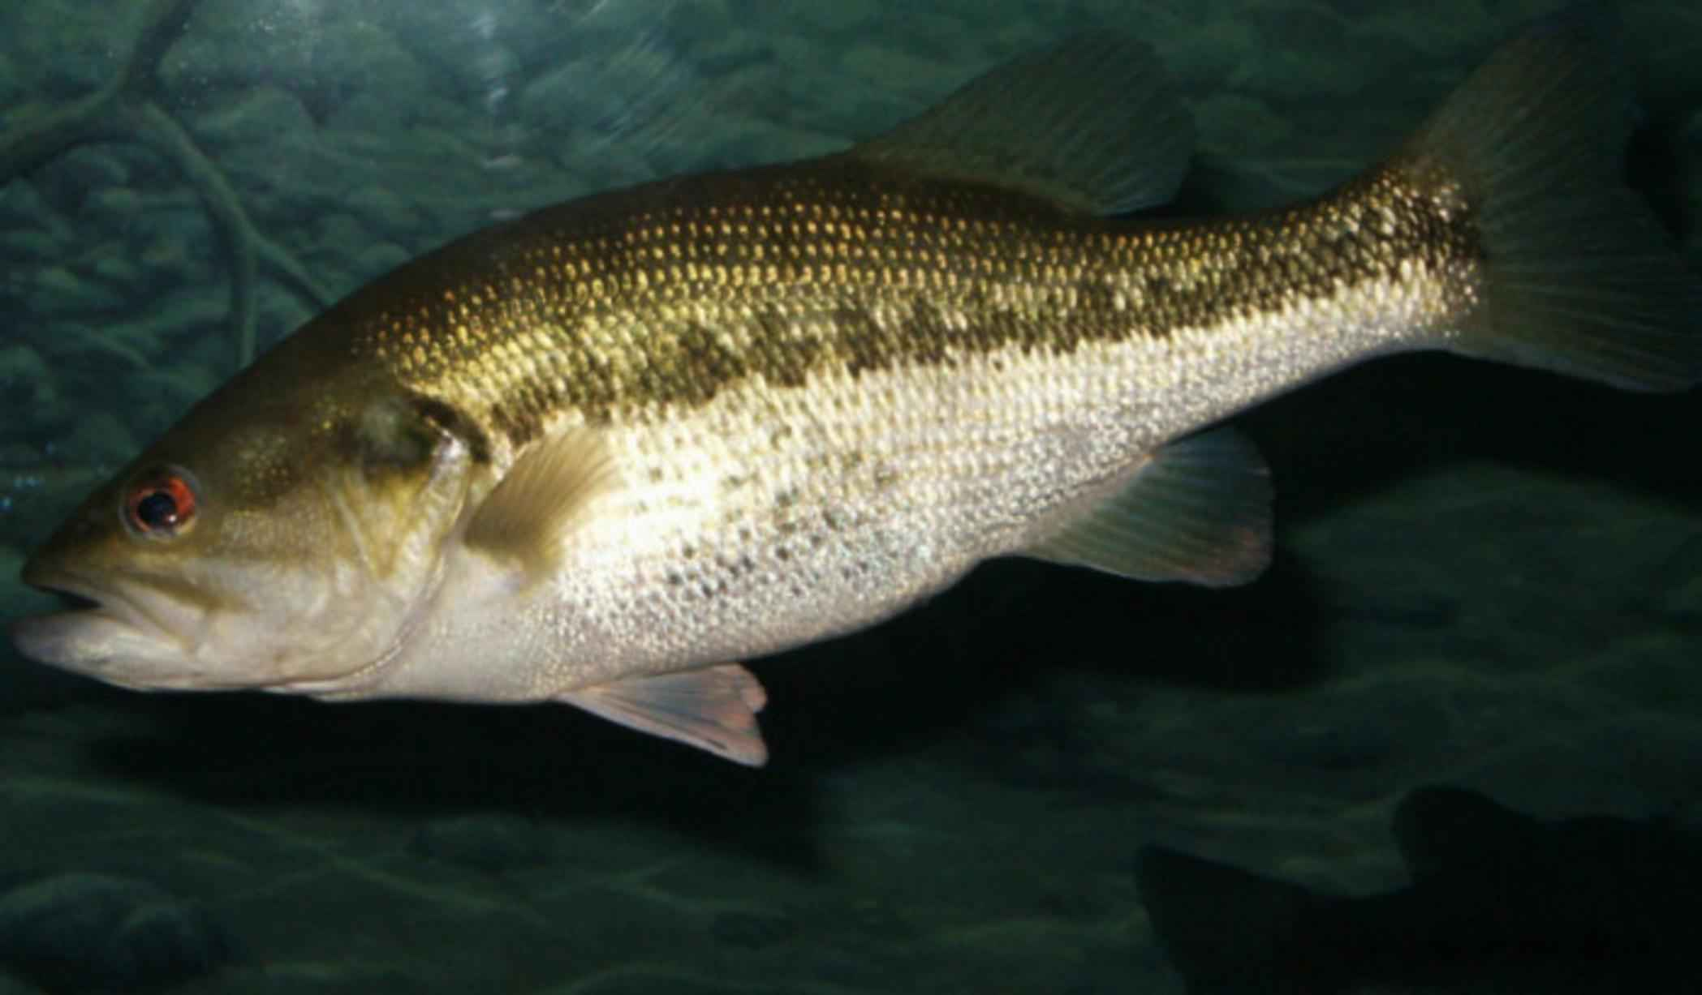
CTmax: 33.3°C
Davis et al. 2019
Largemouth Bass
Micropterus salmoides
Invasive with high thermal tolerance
U.S. Fish and Wildlife Service
https://en.wikipedia.org/wiki/Largemouth_bass#/media/File:Largemouth_bass_fish_underwater_animal_in_natural_habitat_micropterus_salmoides.jpg

Slide 7
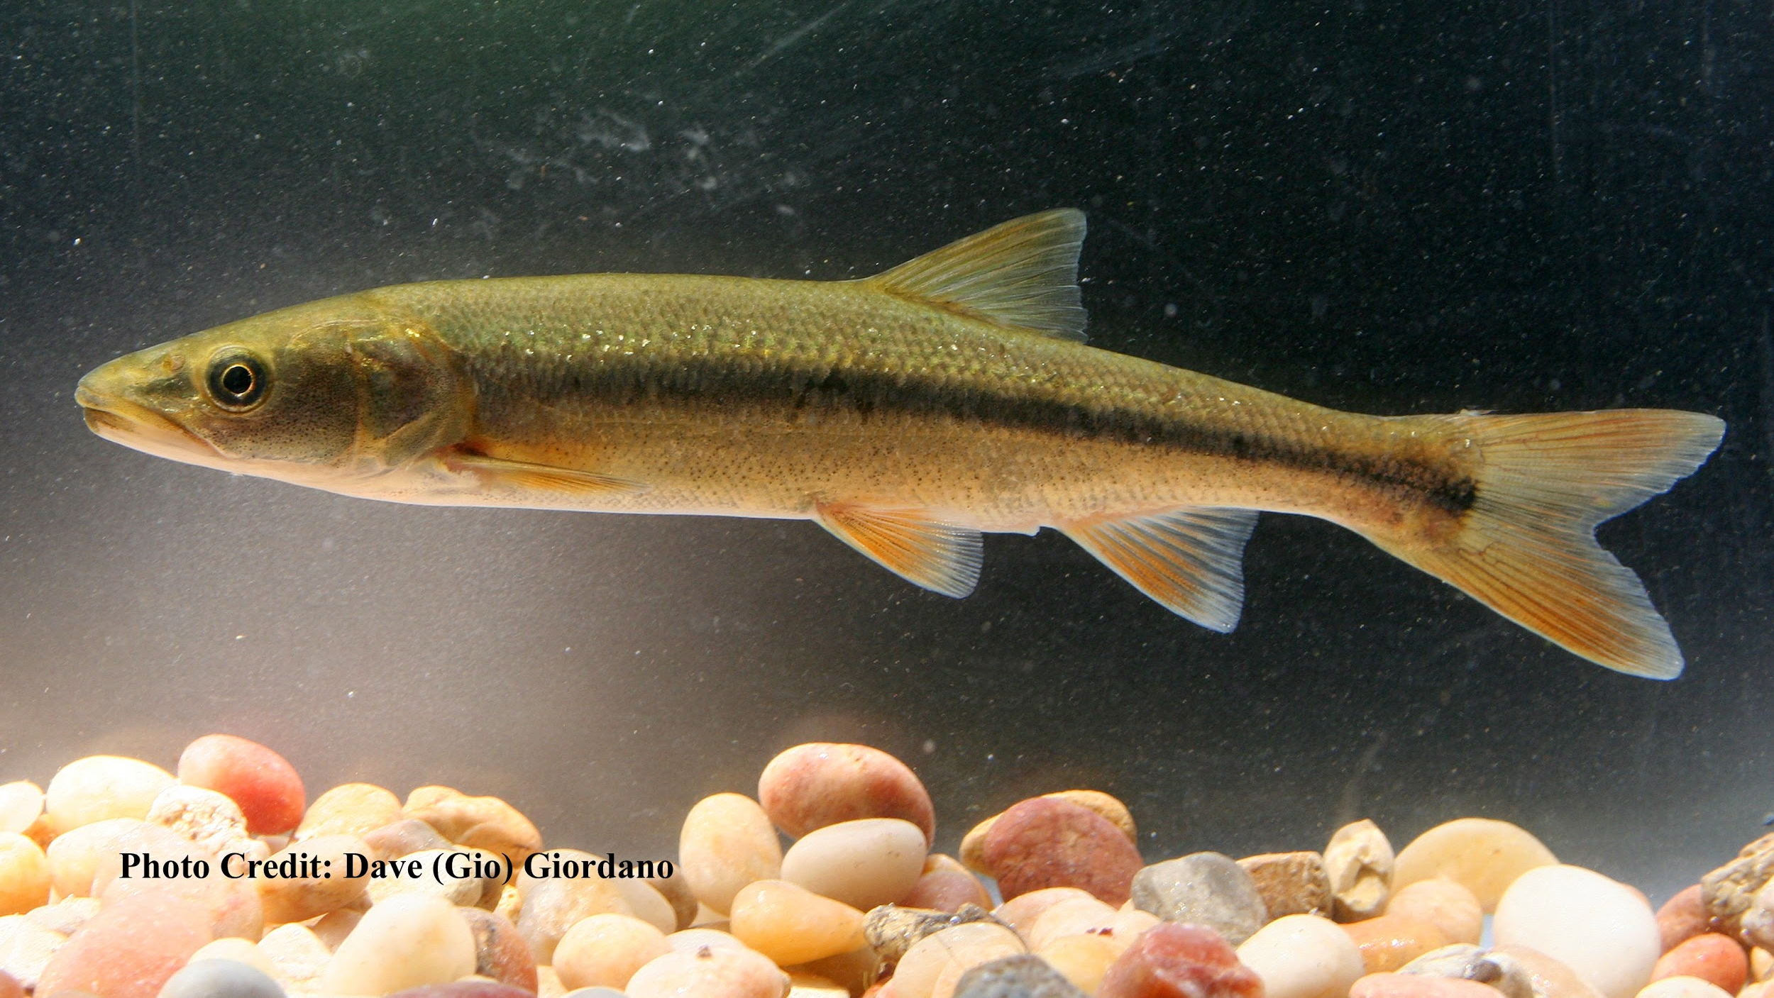
Mississippi Silverside
Menidia beryllina
CTmax: 34.1°C
Davis et al. 2019
Invasive with high thermal tolerance

Slide 8
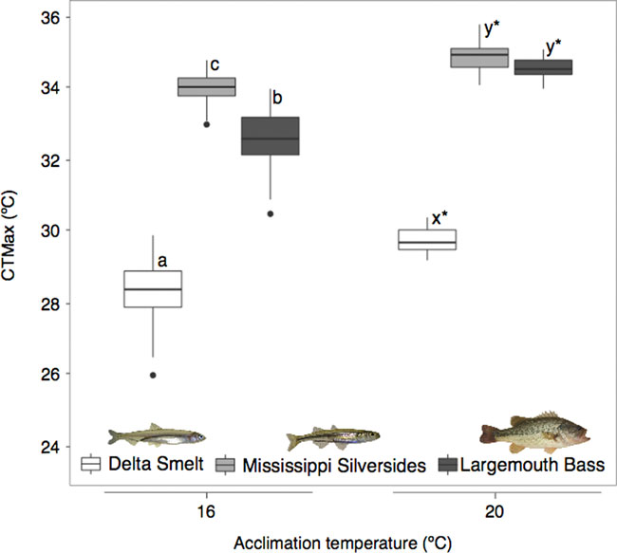
The invasive species considered here have higher thermal tolerances than the smelt.
Davis et al. 2019

Slide 9
This Presentation’s Inquiry
How has thermal habitat suitability for endemic and invasive fish species changed over time?
Laboratory-based studies of thermal tolerance for SFE fish: bass, silverside, smelt
Long-term Landsat 5, 7, 8 record for water surface temperature
On-Going Considerations
How can we use this information to inform water management and ecosystem restoration?

Slide 10
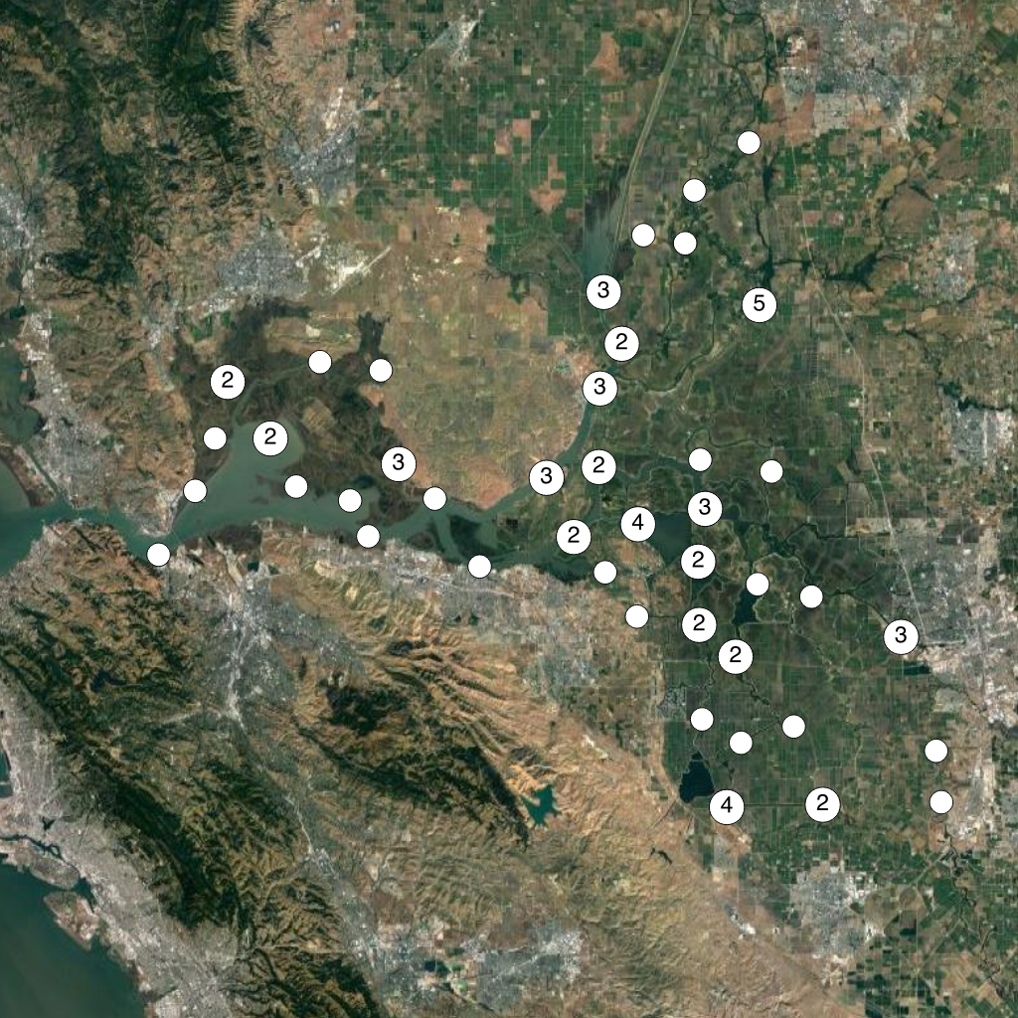
California Data Exchange Center
Ground observations of bulk water temperature are available at 80 sites across the San Francisco Estuary from the California Data Exchange Center (CDEC).
good indicator of temperature in aquatic environment
spatially sparse, making it difficult to track habitat
Department of Water Resources
https://info.water.ca.gov/index.html

Slide 11
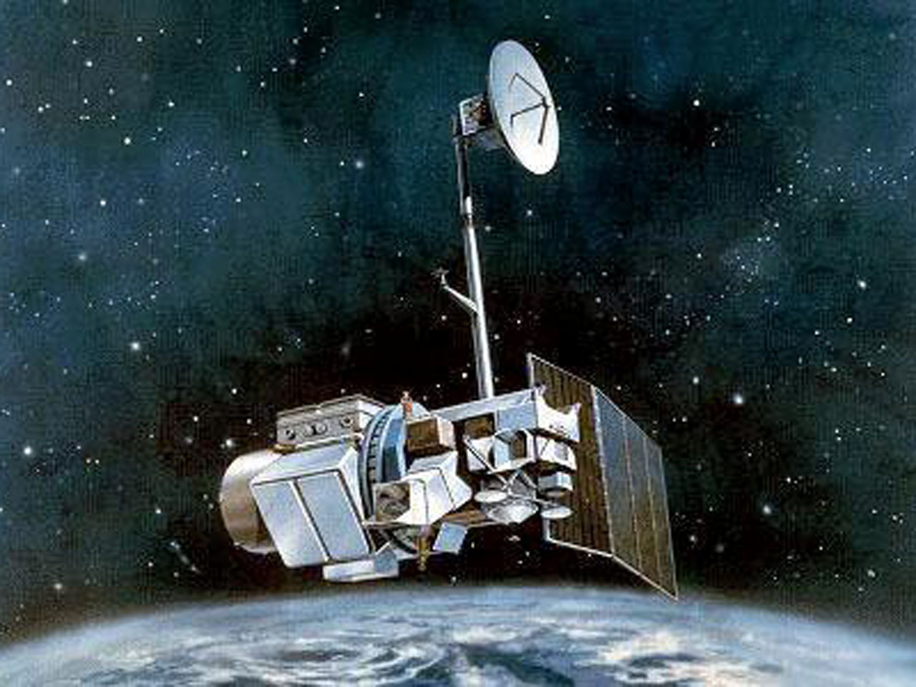
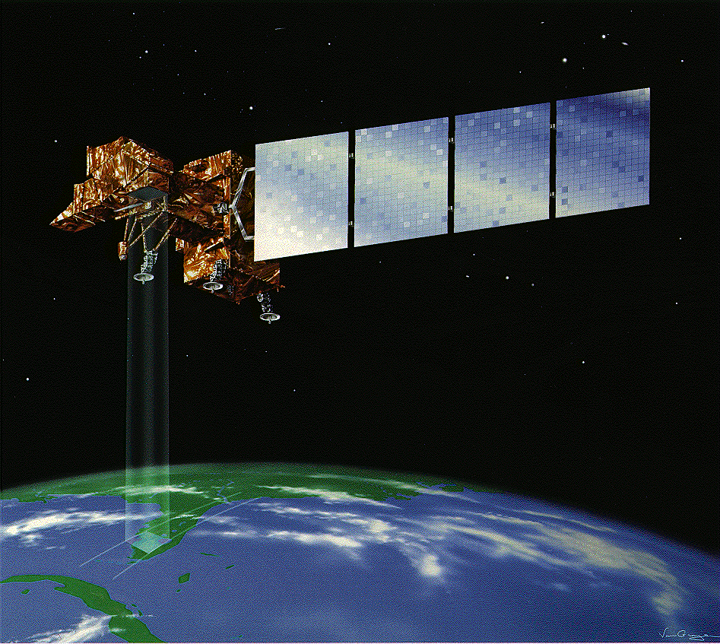
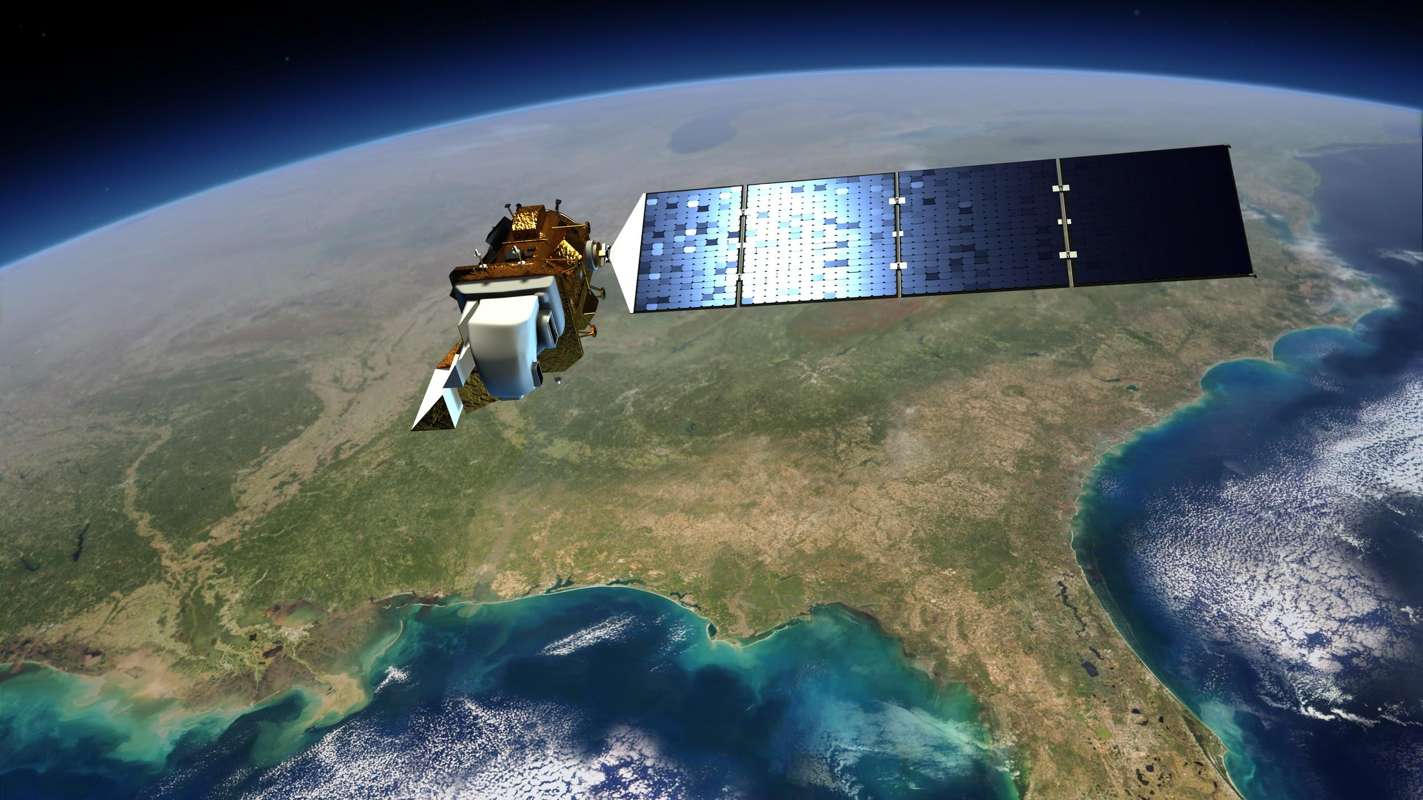
We would like to introduce the Landsat series of satellites as a remote sensing source of water temperature data for the SFE. Landsat 5, 7, and 8 provide a continuous record of surface temperature from 1984 to the present.
Landsat 5
Landsat 7
Landsat 8
60m, 1984-2011
60m, 1999-
100m, 2013-

Slide 12
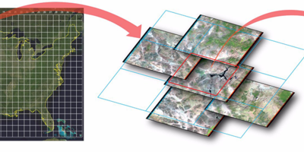
We processed Landsat level 1 thermal radiance into water surface temperature using the methods described in Malakar et al., 2018 and deployed in the Landsat Analysis Ready Dataset (ARD).
The first collection of the ARD had some issues over water surface, so we processed temperature in-house.

Slide 13
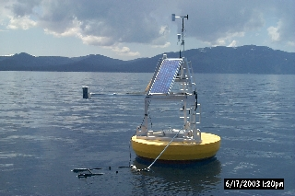
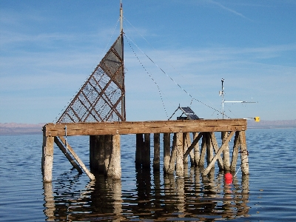
Validation
We validated our Landsat surface temperature output using water-surface radiometer sites at Lake Tahoe and the Salton Sea.
Skin-Surface Radiometers at Tahoe and Salton
Lake Tahoe
Salton Sea

Slide 14
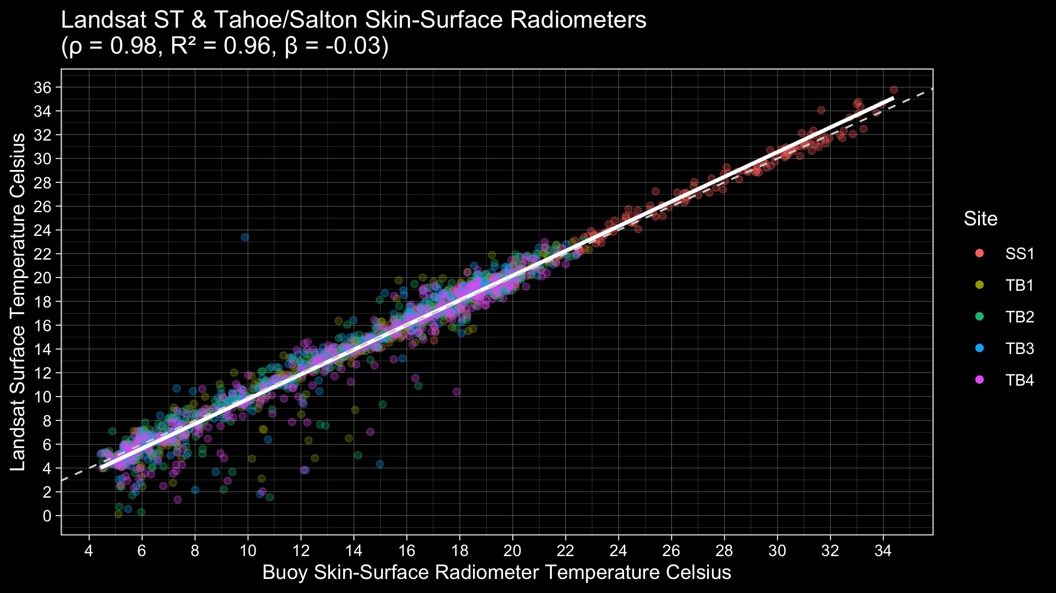
Landsat water surface temperature estimates match very well with Tahoe and Salton radiometers, with very high correlation and coefficient of determination and very low bias.

Slide 15
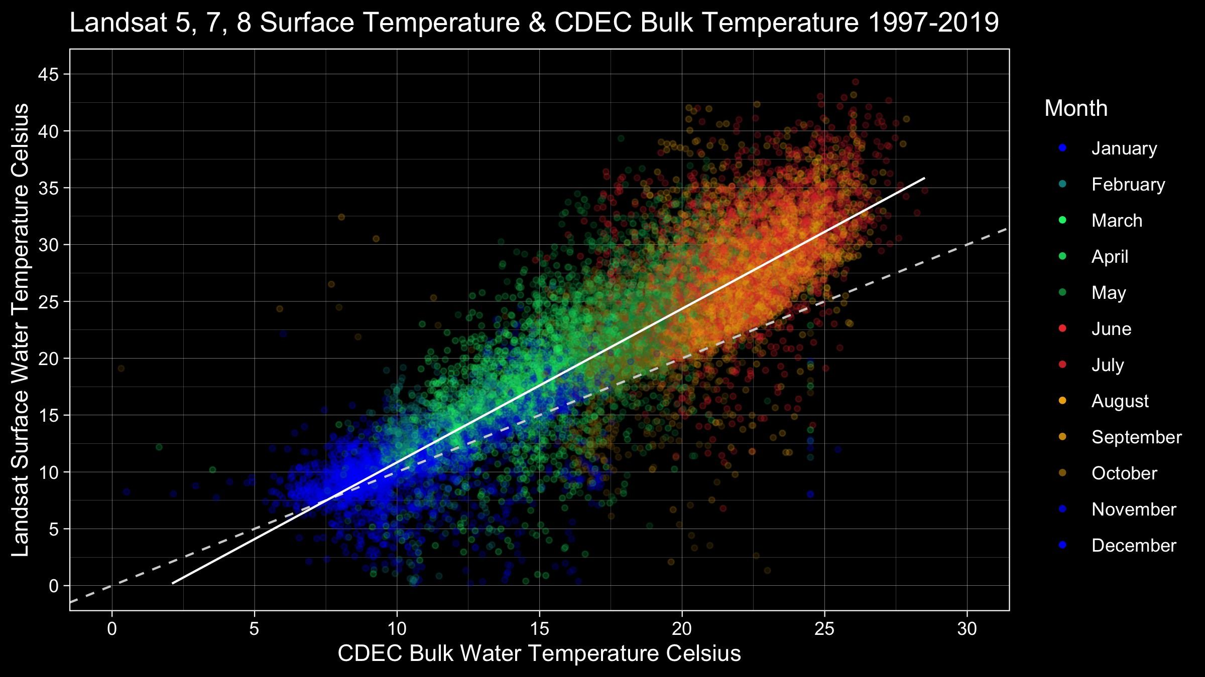
Surface temperatures seen by Landsat are also reasonable predictors of bulk temperature observed at CDEC stations.
Surface and bulk temperatures tend to converge at lower temperatures and diverge at higher temperatures.
Our remote sensing analysis of habitat applies only to the surface, but there is the potential to better model or predict bulk temperature using remote sensing.

Slide 16
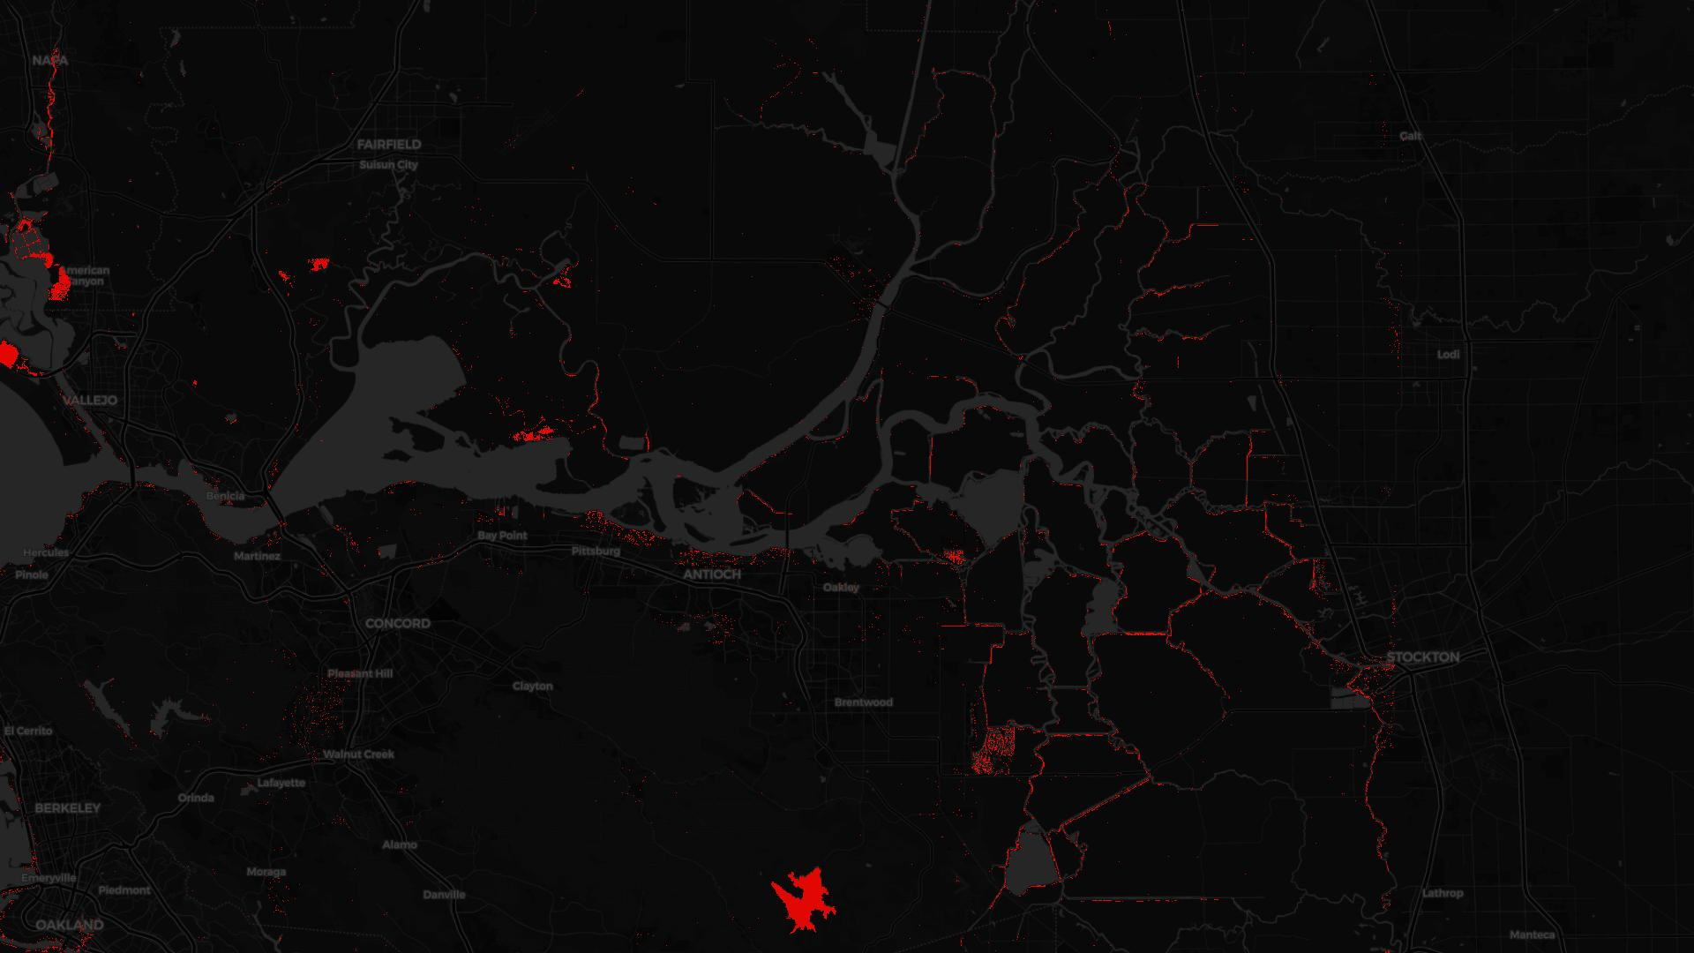
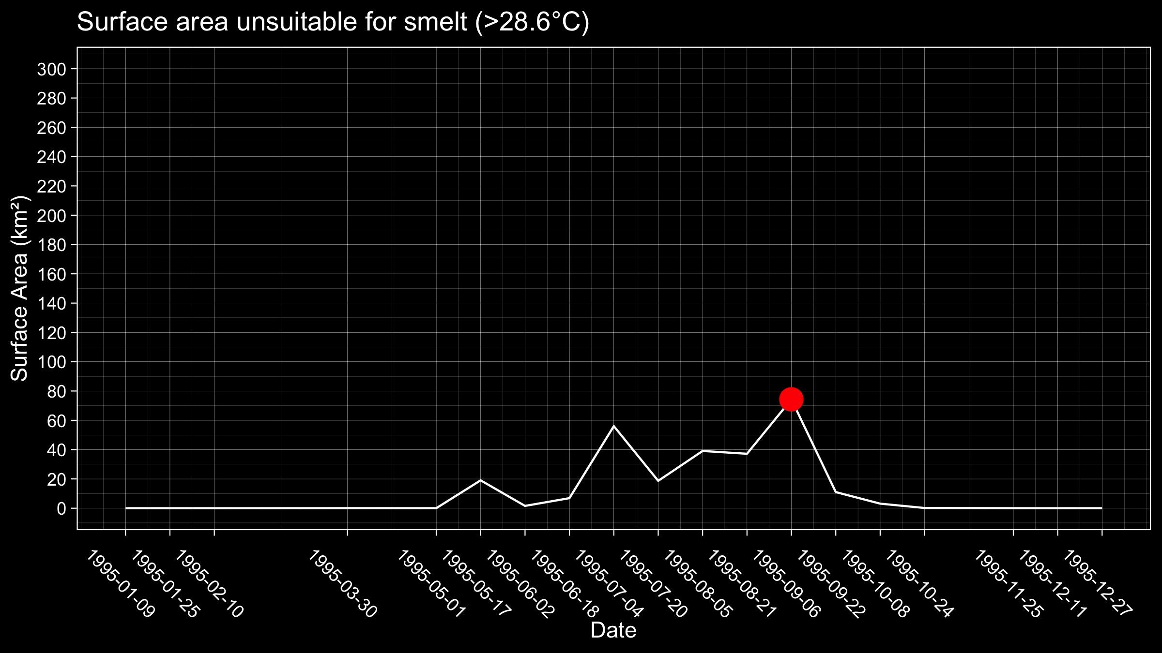
Unsuitable
Surface
Area
> CTmax ?
We quantified unsuitable surface area by counting the number of 30 m by 30 m pixels in each Landsat image with a surface temperature greater than CTmax. We selected the image with the largest surface area to represent each year.
30 m
30 m
This Landsat 5 image from summer 1995 is the inter-annual low point of annual maximum thermally unsuitable surface area for smelt.
Summer 1995

Slide 17
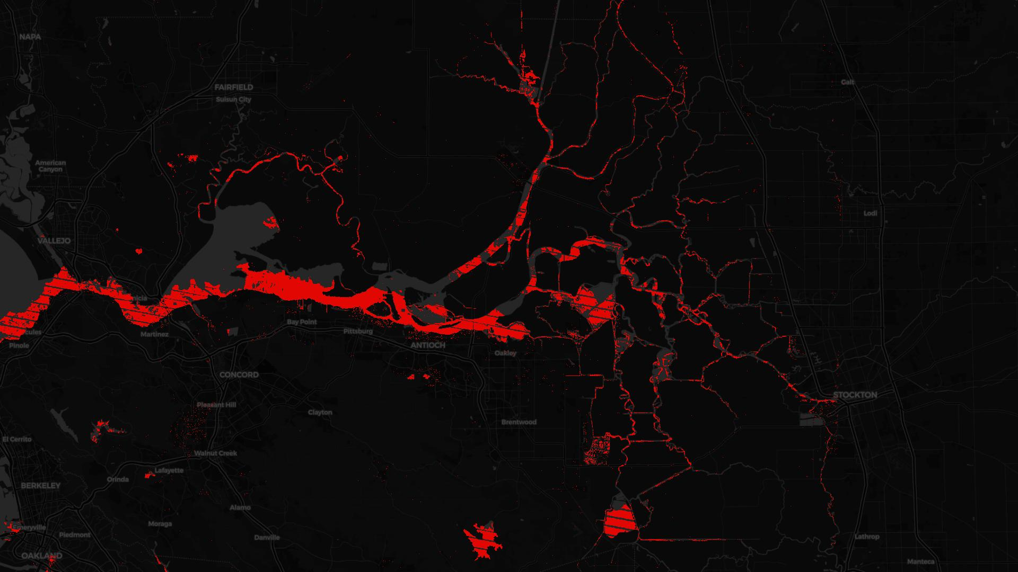
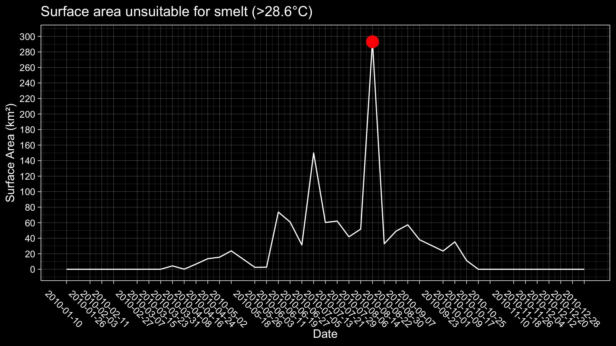
Fifteen years later in the summer of 2010, this Landsat 7 image represents the largest surface area exceeding the CTmax of smelt.
Much of the smelt habitat appears to be affected by high surface temperatures in this year.
Summer 2010

Slide 18
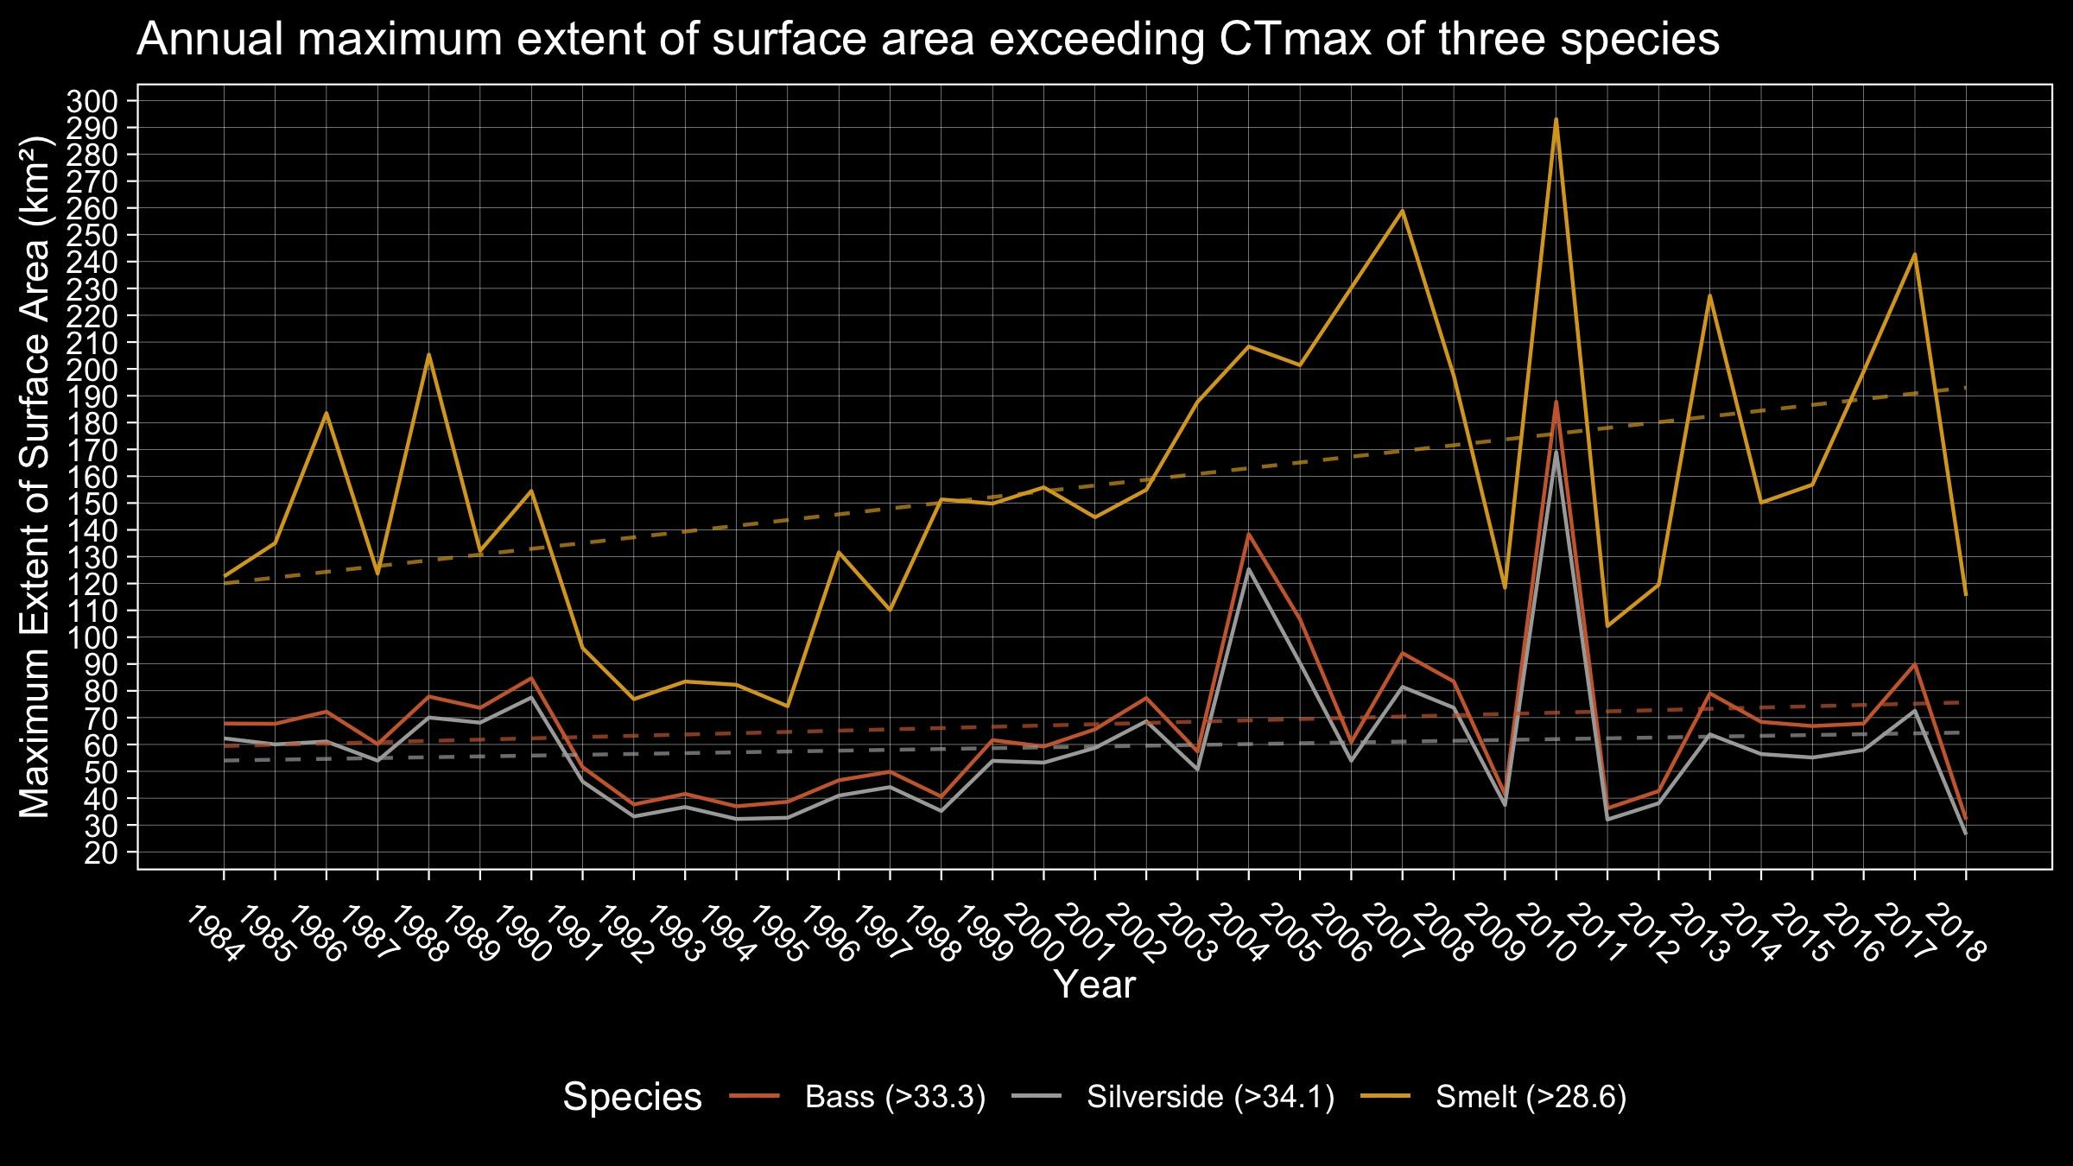
Areas where surface temperature exceeds the thermal tolerance of smelt are on an expanding trend from the mid-80s to the present at about 2.2 square kilometers per year.
The two invasive species considered here have more stable trends, under half a square kilometer per year.

Slide 19
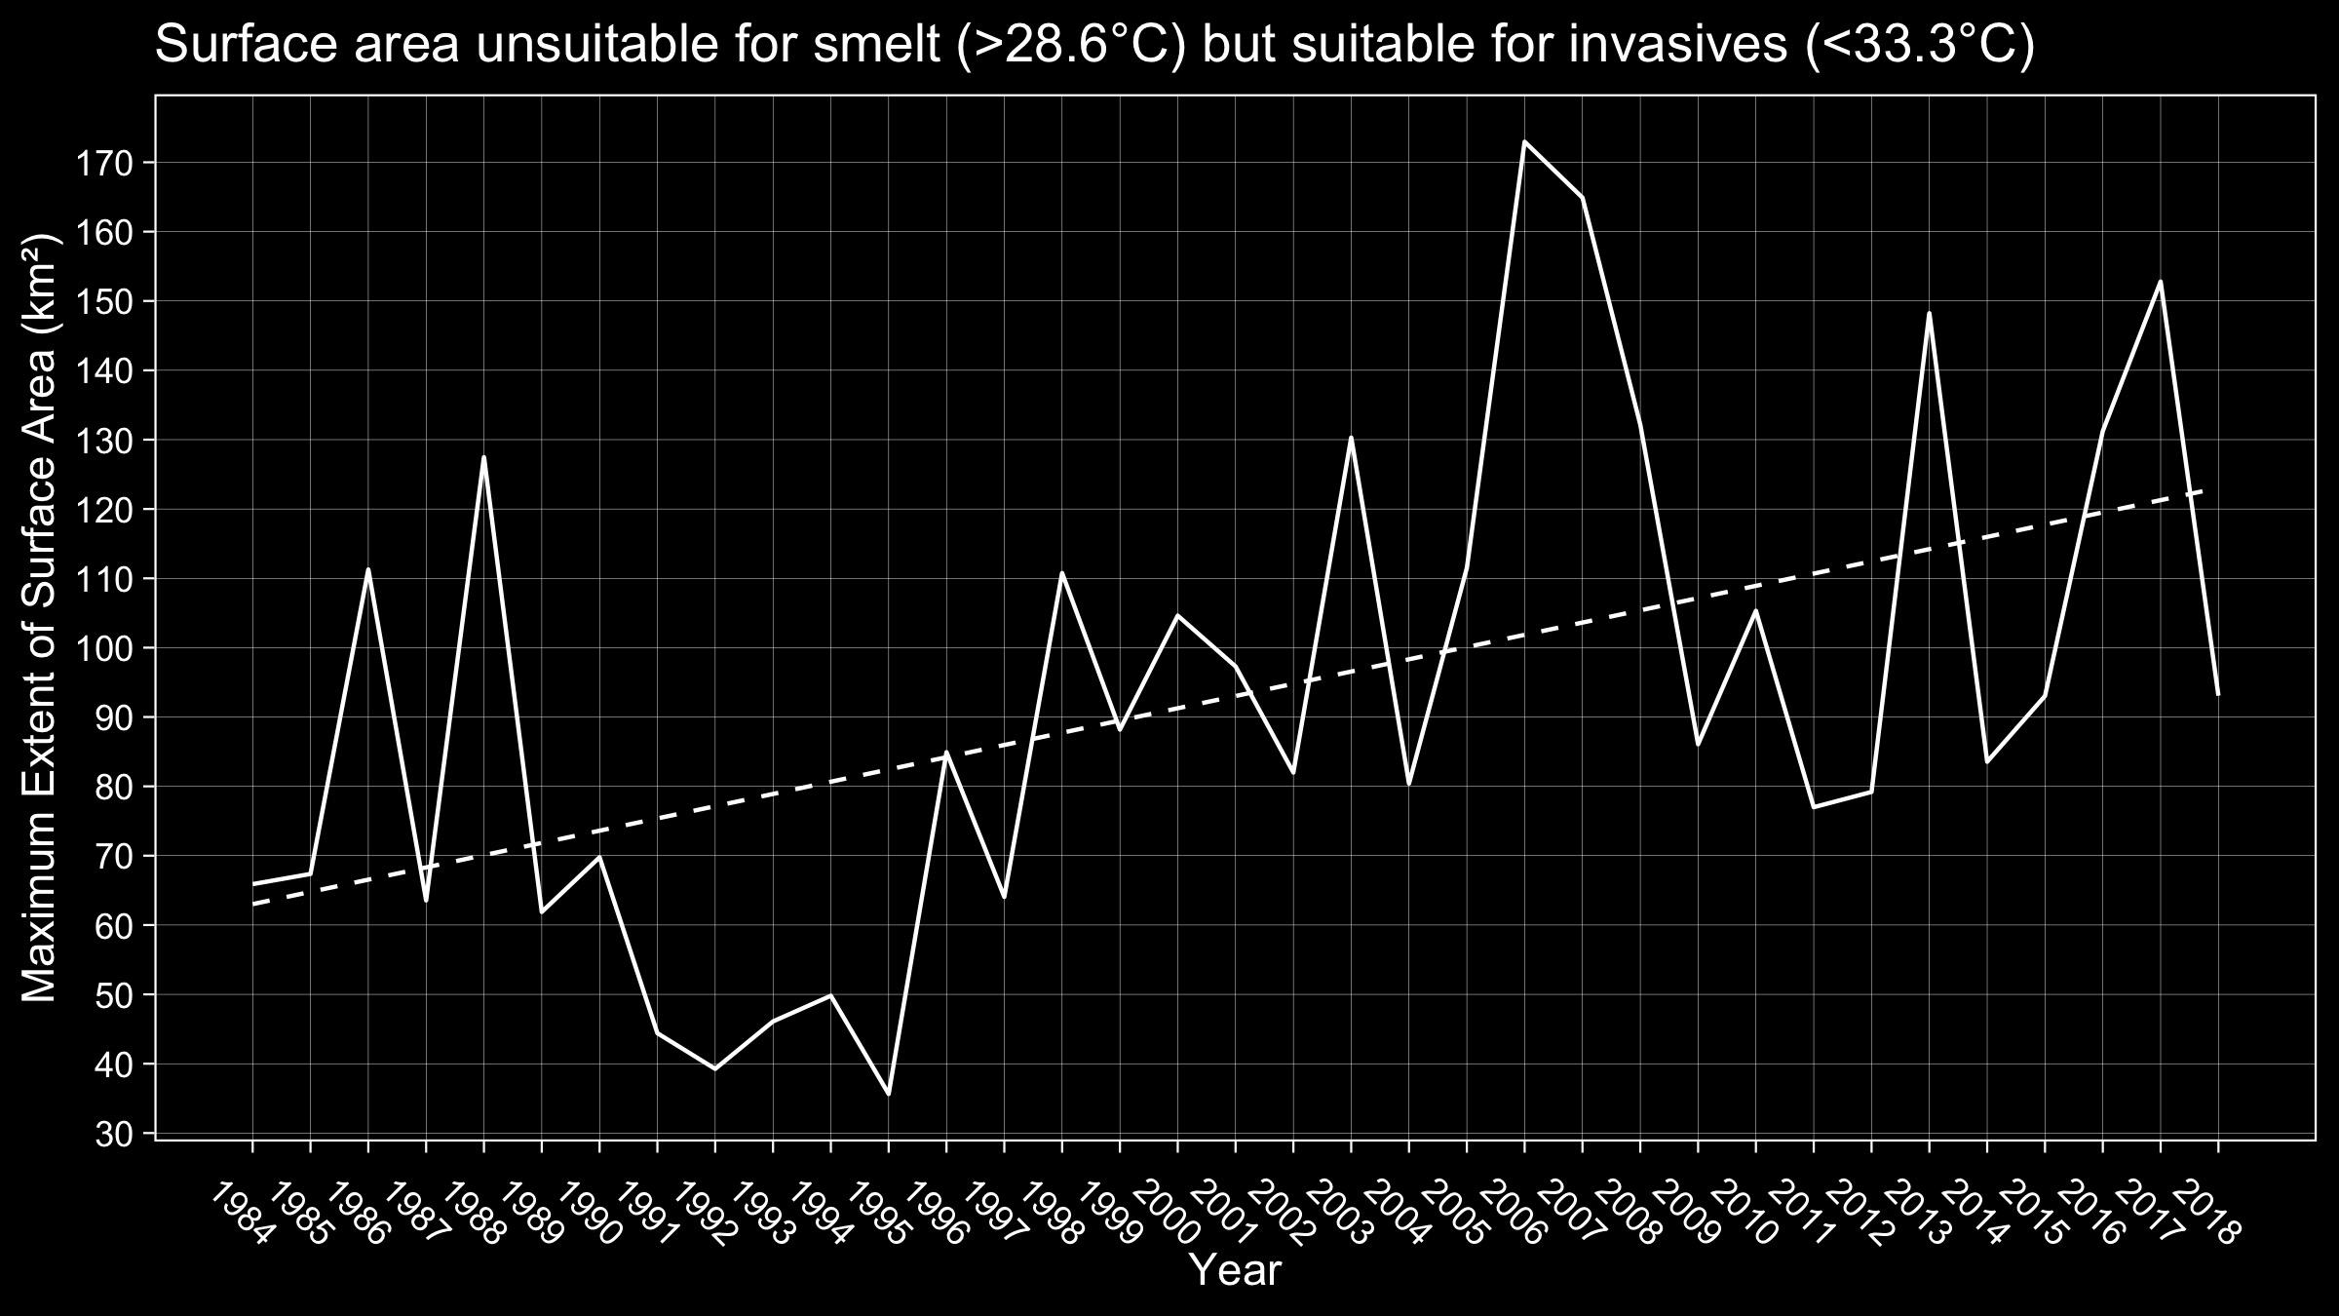
There is an increasing trend in surface area that is hotter than the thermal tolerance of smelt but still below thermal maximum for bass and silverside, at a rate of 1.8 square kilometers per year.

Slide 20
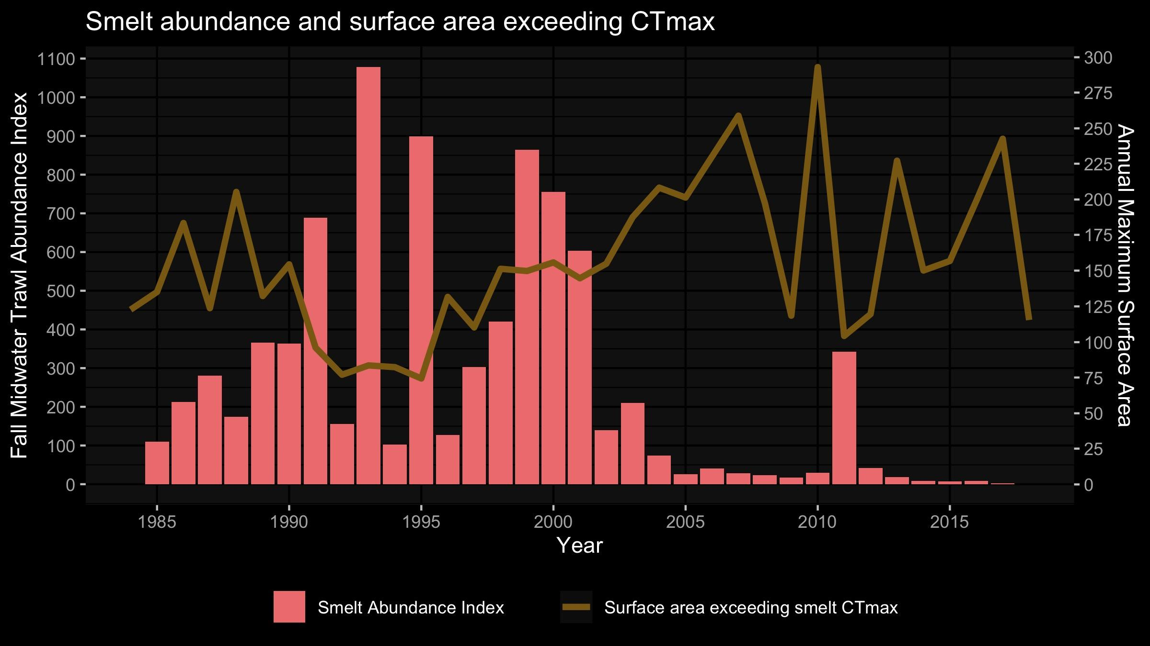
Extended periods of decrease in smelt abundance tend to co-incide with periods of expanded thermally unsuitable surface area.
Note that we are not claiming a causal relationship until we control for turbidity and other factors.

Slide 21
Findings
There is an increase in thermally unsuitable habitat for Delta Smelt from 1984 to the present. This is based on the skin-surface temperature, not accounting for refugia that may be under the surface.
There is an increasing trend in surface area not tolerable to smelt but potentially tolerable to invasive competitors over the same time period.
Periods of increase in extent of water surface thermally unsuitable to delta smelt correspond to low abundance. Temperature may be a factor along with salinity and turbidity.

Slide 22
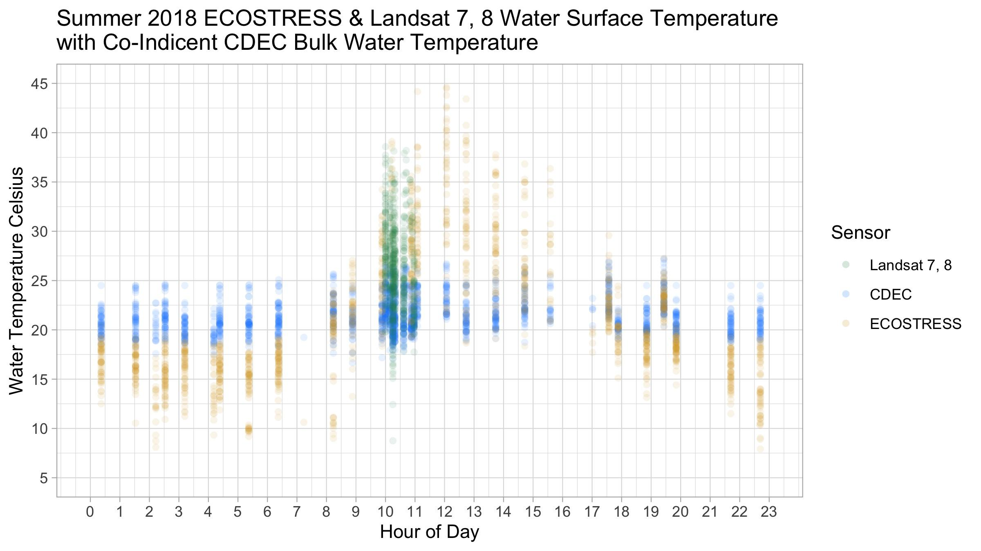
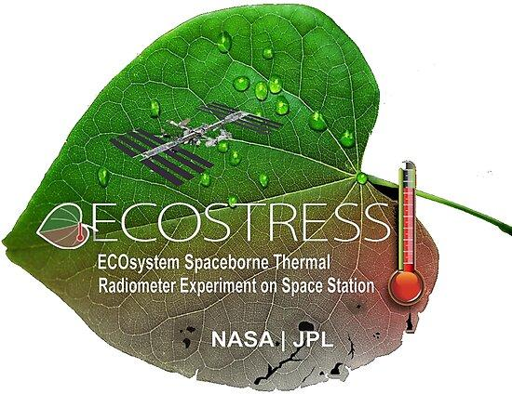
Future Work with ECOSTRESS
Using ECOSTRESS surface temperature is to observe the skin effect compared to CDEC bulk temperature
Look into ways to model bulk temperature from remotely sensed surface temperature
70m, 2018-Present

Slide 23
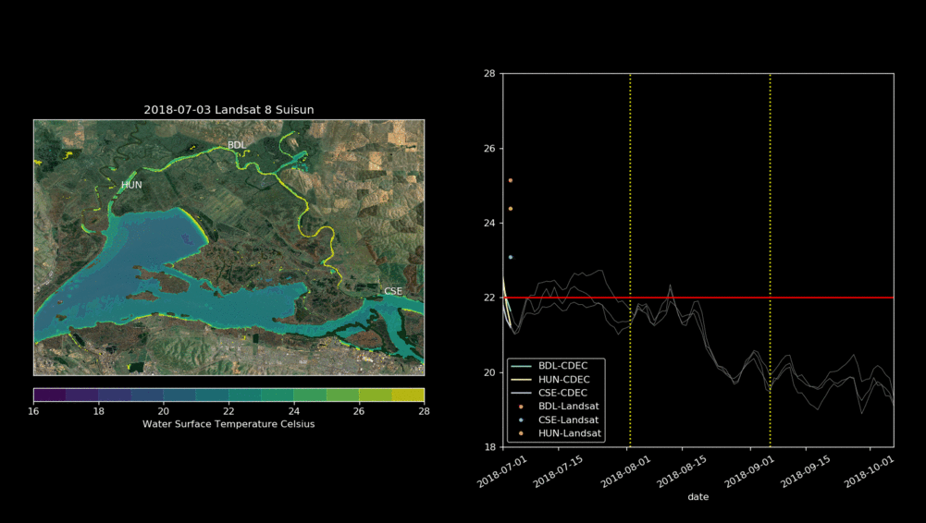
Future Work with
Control Gates
Examining changes in bulk and surface temperature in Suisun Marsh during an experimental continuous control gate operation in 2018.
How can temperature data be used to monitor and mitigate changes in thermally suitable habitat?

Slide 24

We’re working with 34 North and the Bay Delta Live collaboration to make an decision support dashboard using temperature, turbidity, and chlorophyll.

Slide 25
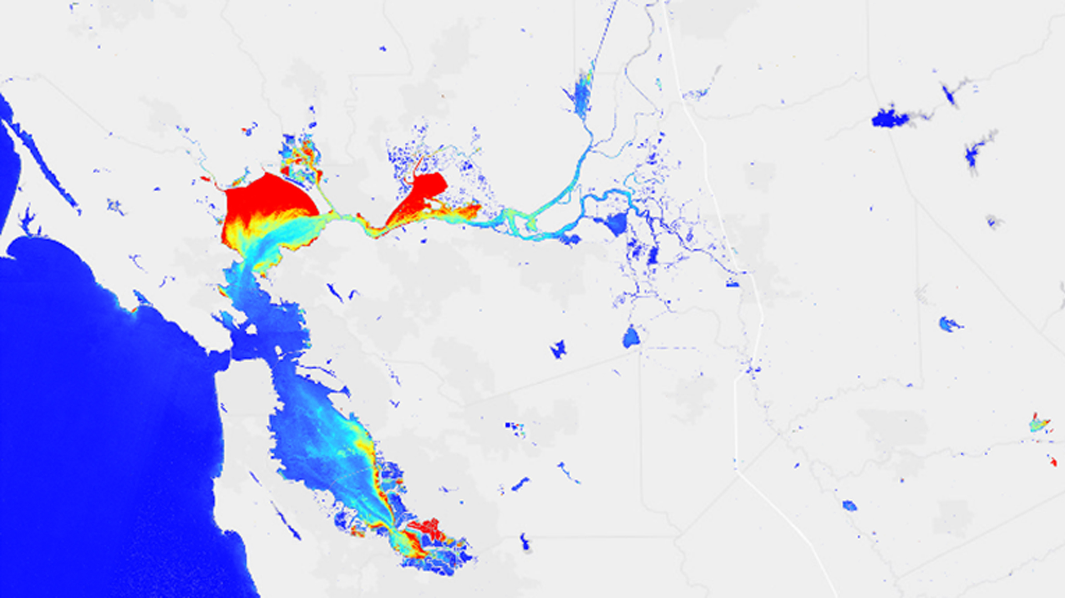
Future Work with Turbidity
We would like to consider a multi-variate analysis with turbidity and possibly salinity in order to determine the influence of temperature on habitat suitability.
Utilizing NASA and ESA Earth Observations to Monitor Turbidity Conditions in the San Francisco-Bay Delta
https://develop.larc.nasa.gov/2017/summer/SanFranciscoBayDeltaWater.html

Slide 26
Acknowledgements
References
Algorithm
Glynn Hulley
Validation
Kerry Cawse-Nicholson
Robert Radocinski
Gerardo Rivera
Science Discussion
Erin Hestir
Shawn Acuña
Brian Bergamaschi
Nick Tuffilaro
Applications
Brenden Palmieri
Amye Osti
Brittany E Davis, Dennis E Cocherell, Ted Sommer, Randall D Baxter, Tien-Chieh Hung, Anne E Todgham, and Nann A Fangue. Sensitivities of an endemic, endangered California smelt and two non-native fishes to serial increases in temperature and salinity: implications for shifting community structure with climate change. Conservation Physiology, 2019.
Peter B. Moyle, Bruce Herbold, Donald E. Stevens, and Lee W. Miller. Life history and status of delta smelt in the sacramento-san joaquin estuary, california.Transactions of the American Fisheries Society, 1991.
Nabin K. Malakar, Glynn C. Hulley, Simon J. Hook, Kelly Laraby, Monica Cook, and John R. Schott. An Operational Land Surface Temperature Product for Landsat Thermal Data: Methodology and Validation. IEEE Transactions on Geoscience and Remote Sensing, 2018.

Slide 27
Smelt Habitat Suitability and Thermal Refugia in the San Francisco Bay Delta as Seen by Landsat and ECOSTRESS with Comparison to CDEC
Gregory Halverson¹
Christine Lee¹
Glynn Hulley¹, Kerry-Anne Cawse-Nicholson¹, Brenden Palmieri², Amye Osti², Erin Hestir³, Christiana Ade³, Shawn Acuña⁴, Brian Bergamaschi⁵, Nick Tuffilaro⁶, Robert Radocinski¹, Gerardo Rivera¹
¹NASA Jet Propulsion Laboratory ²34 North ³University of California, Merced ⁴Metropolitan Water District of Southern California, ⁵United States Geological Survey, ⁶Oregon State University

Slide 28
