Slide 1
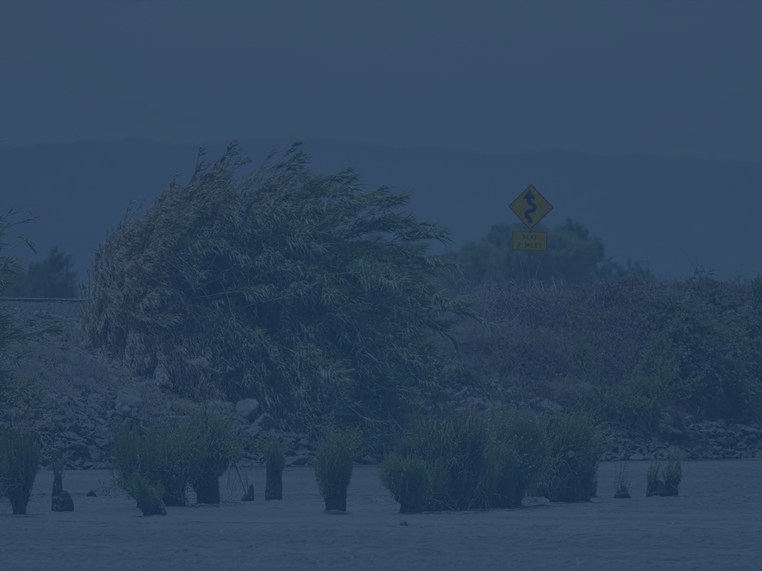
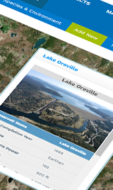
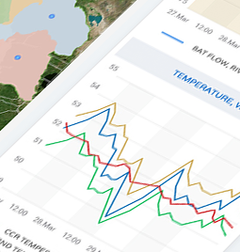
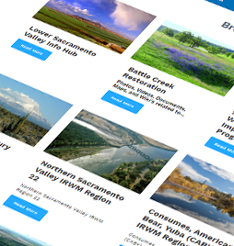
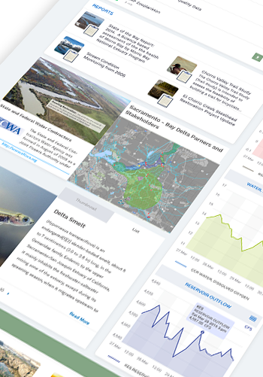
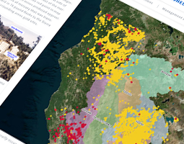
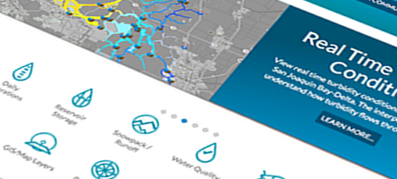


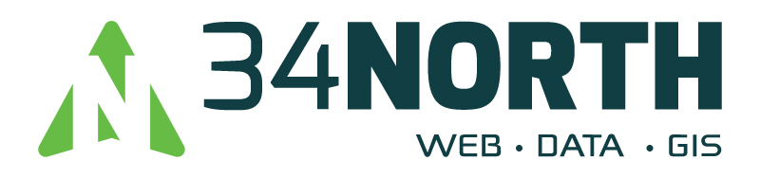
BayDeltaLive, A Use Case for Increasing Discoverability and Accessibility of California Environmental Data
Open Data and Regional Data Federations
Amye Osti, 34 North

Slide 2


Increase Resolution of the Problem
Most data are collected and stored within origination organization.
Data is typically shared at quarterly meetings, after publication and then added to state databases when funding is available, or only accessible by request.
Delays in sharing data does not support adaptive management actions and real time operations.
Notes:
Leverage existing data platforms.
Publish and share data on these
platforms. Combine studies
with existing data, GIS, projects
and documents.
Researchers can easily
discover related projects,
data integration plans, support
resources (Map & GIS, Reports,
images).
Improve regional knowledge by
simplifying access to information.

Slide 3
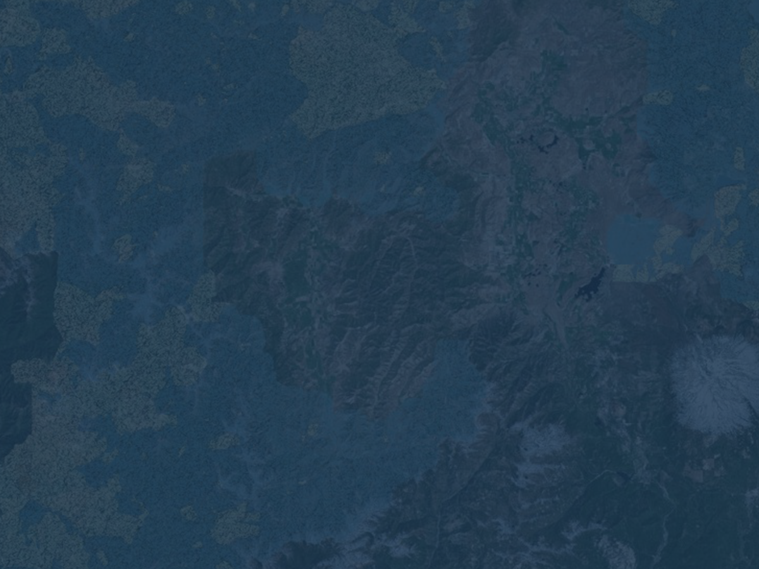
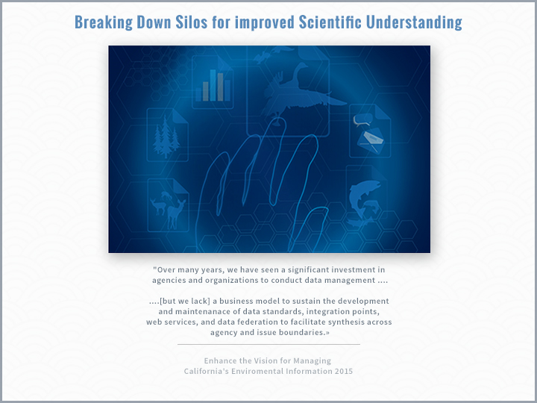
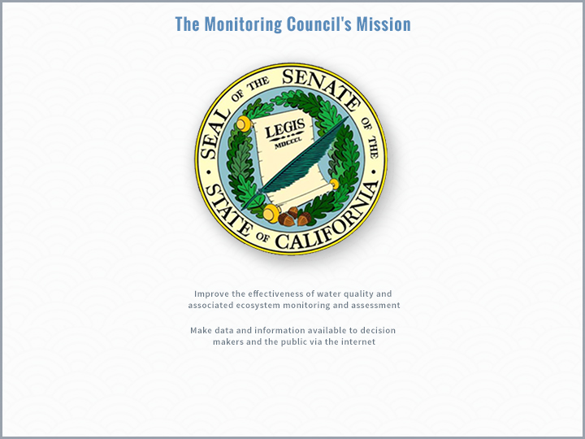
Notes:
The State has taken steps to outline key principles for making data and information open and available to ALL stakeholders.
Senate Bill 1070 and the California Monitoring Council is one of the first major open data efforts to improve the effectiveness of water quality and associated ecosystem monitoring and assessment. The program resulted in the mywaterquality portals that have used workgroups to improve data collection, processing and communication to the public.
1755 Open Data Legislation

Slide 4
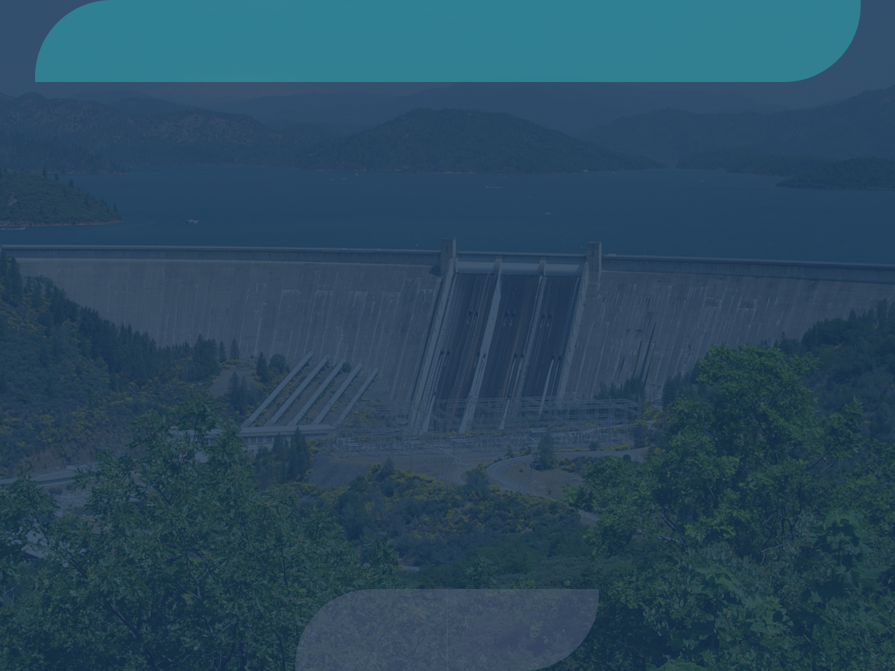

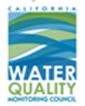



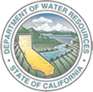

A Collaborative Effort
Regional and Statewide Programs
SACRAMENTO SAN JOAQUIN BAY-DELTA
SWRCB MY WATER QUALITY PORTALS
CALIFORNIA ESTUARY
PORTAL
SAN JOAQUIN REAL TIME MANAGEMENT
DWR 1641 WATER
QUALITY
SACRAMENTO RIVER
WATERSHED

Slide 5
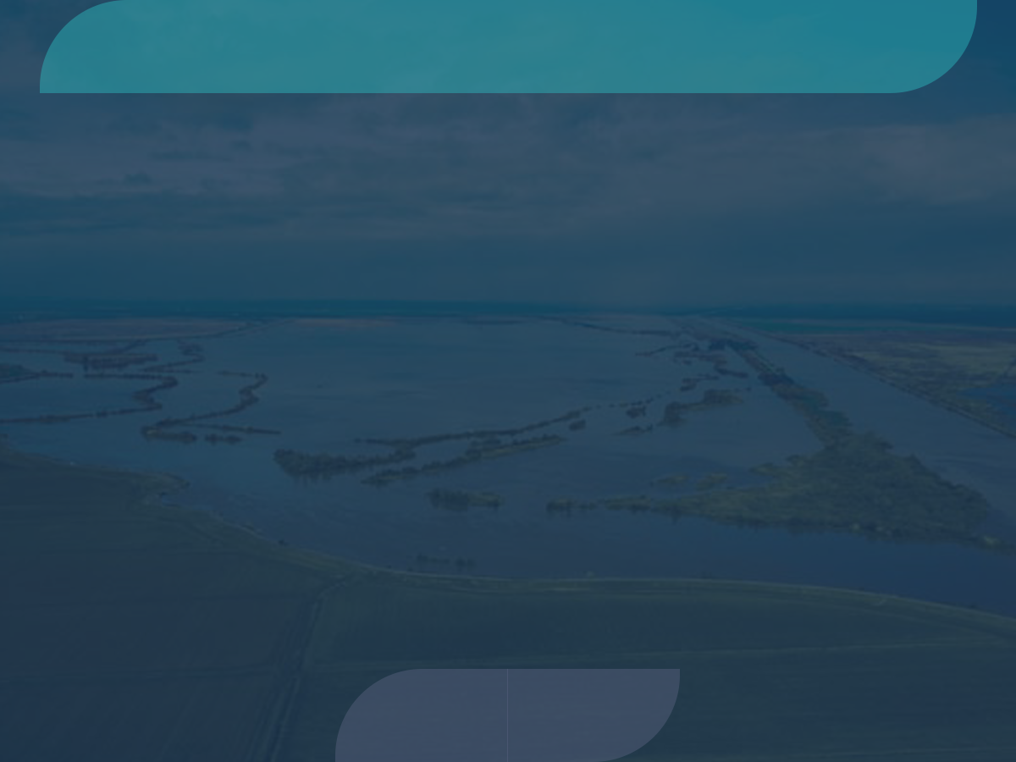
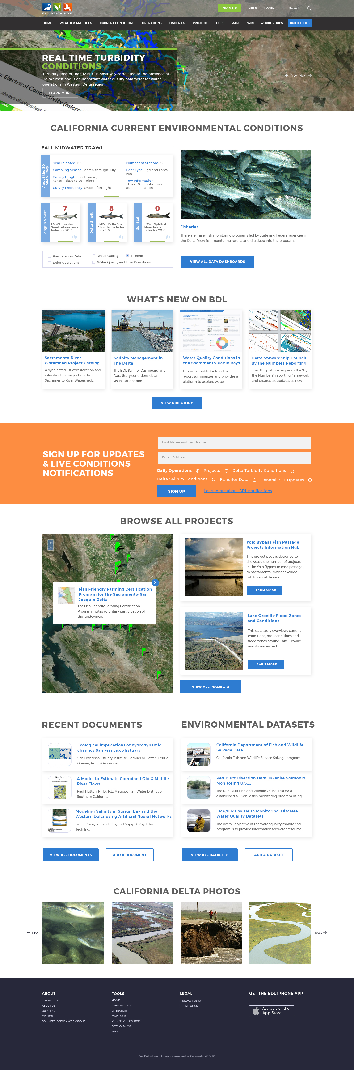
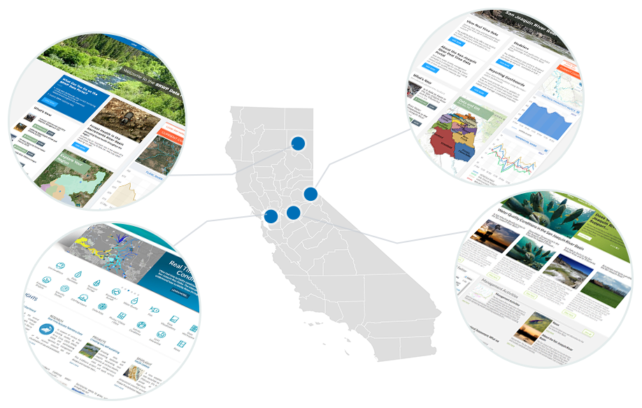
Building on Each Other’s Program
Regional and Statewide Programs
Notes:
The Aspen Institute Internet of Water Outlines:
Principle: 3.1 Control and responsibility over data is best maintained by data producers.
Principle 3.2: A federated system of public water data hubs provides scalability and financial stability to better meet the diverse needs of data users.
Principle 3.3: A backbone organization should link data hubs and facilitate governance of the system, but not govern the production or use of data.
Introduce BDL. Regional efforts share in investment. Benefit from an open platform.
BDL is managed by a multi-agency collaborative workgroup. Data, information and implementation of new features, projects etc are brought to the workgroup for discussion and prioritization.

Slide 6
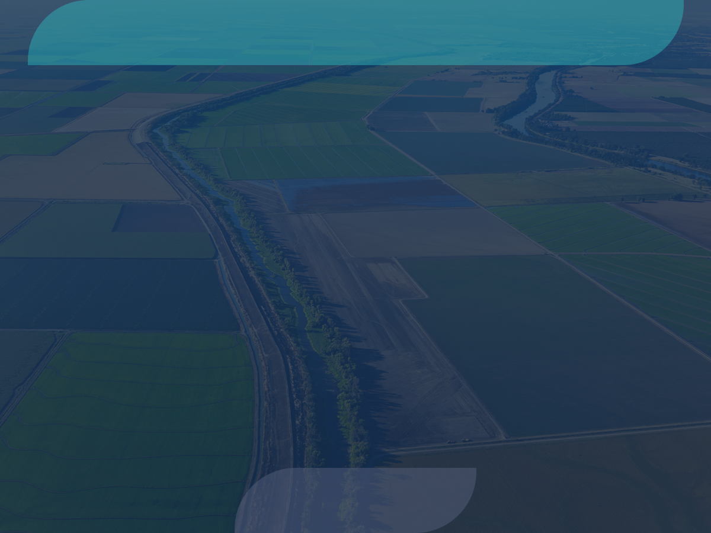

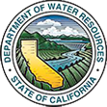









Major Data Providers
Data is aggregated from stakeholders throughout the region:
Hydrologic
Water Quality
Satellite
Meteorological
Terrestrial
Volunteer Sampling

Slide 7
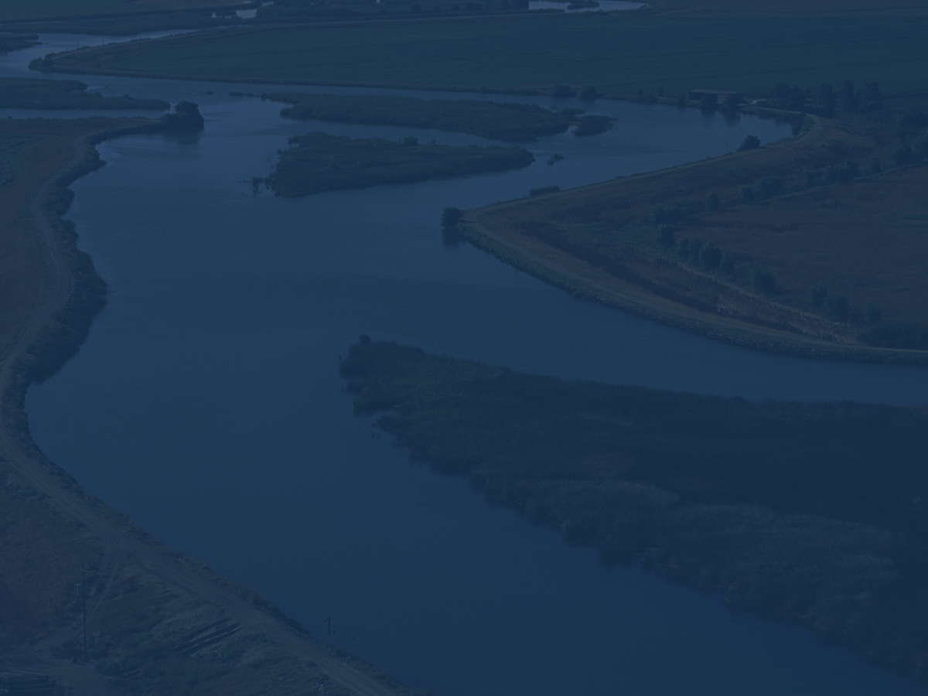
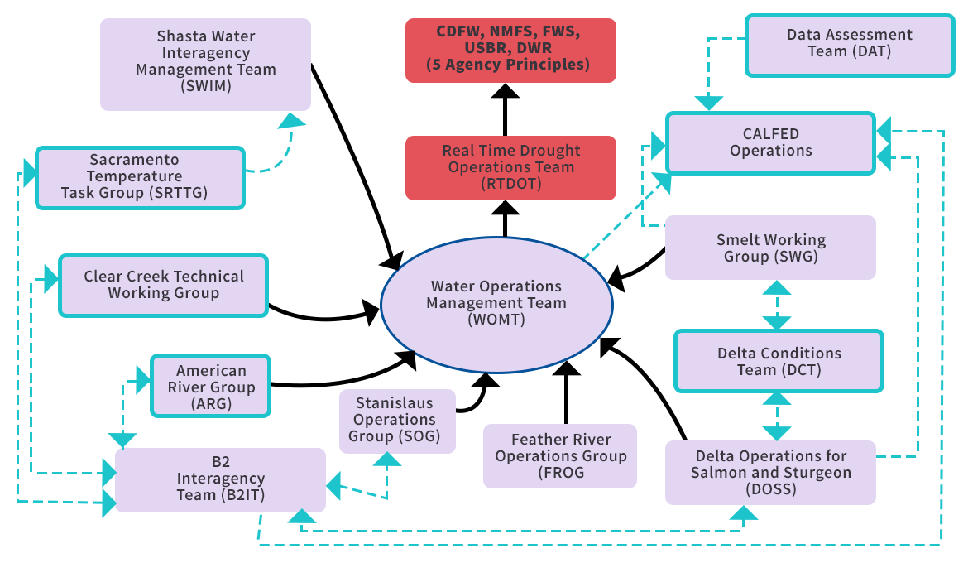
Water Operations Decision Making

Slide 8
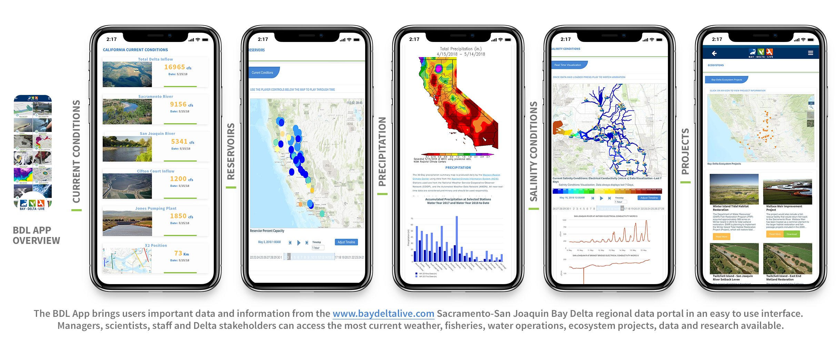

Slide 9
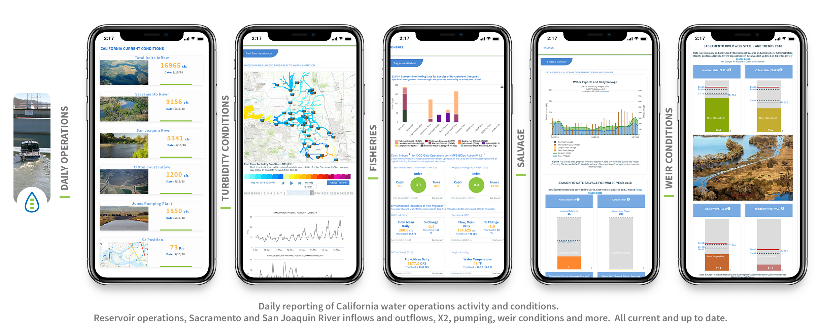

Slide 10
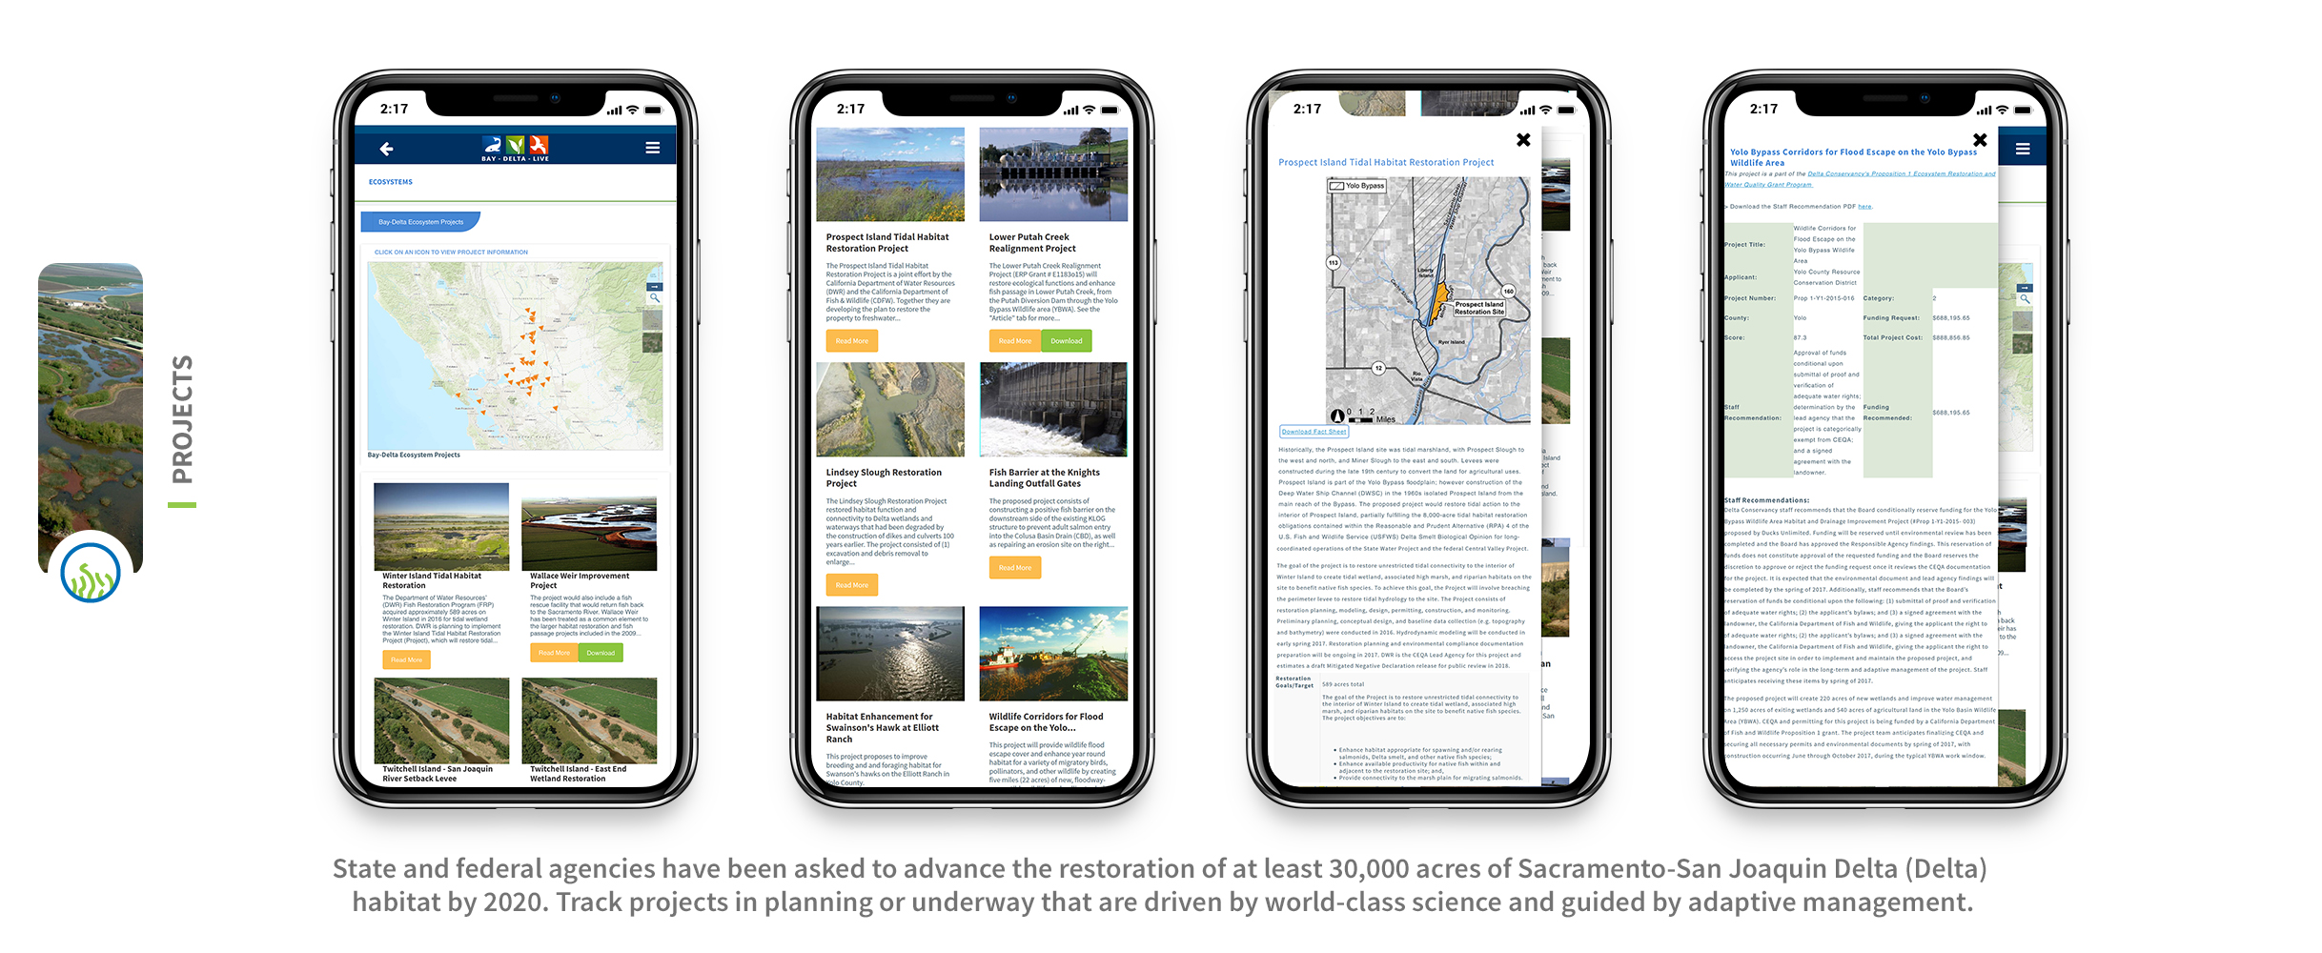

Slide 11
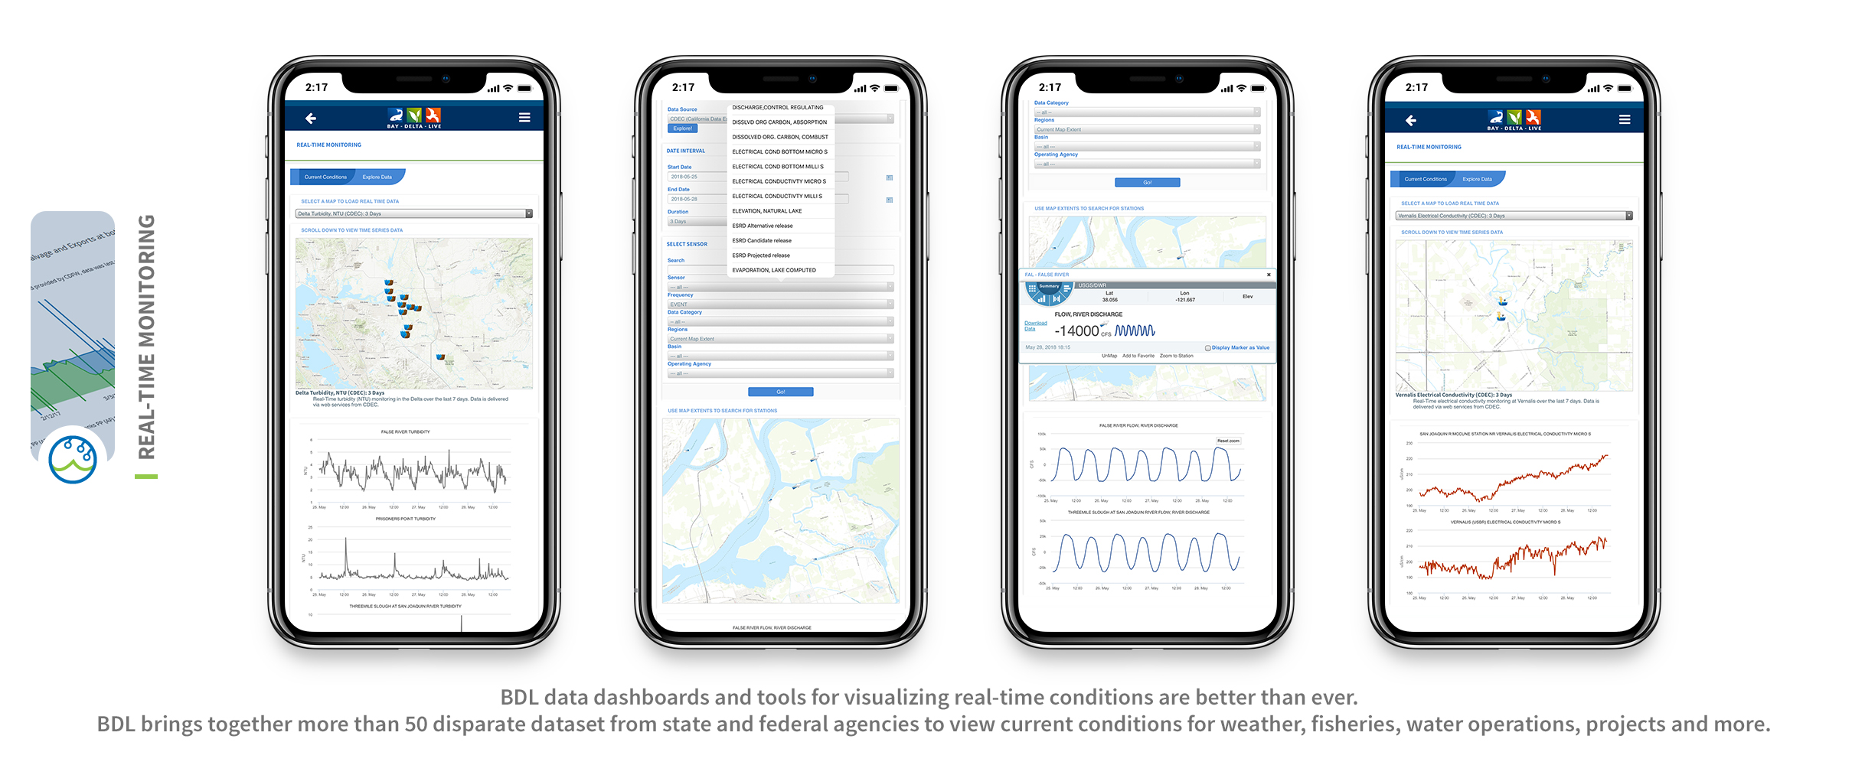

Slide 12
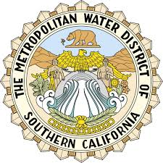
For More Information
BDL Development
BDL Workgroup
Amye Osti, 34 North
Amye Osti, 34 North
amye@34north.com
Russel Ryan , Metropolitan Water District of Southern California
rryan@mwdh2o.com

Slide 14
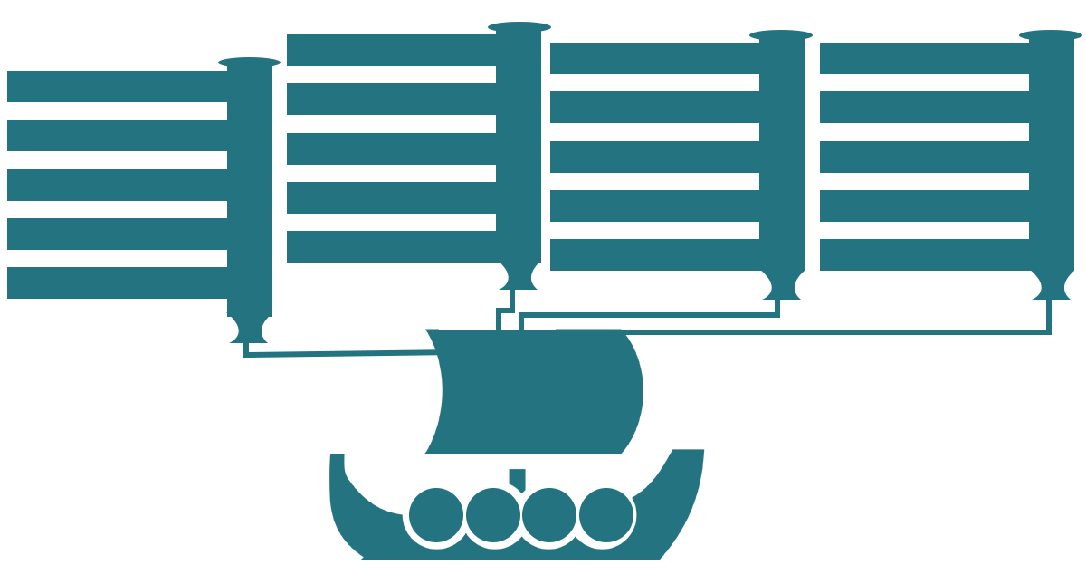

OpenNRM
Estuary Portal
Fisheries Dashboards
WARMF Modeling
SRWP Monitoring Programs
1641 Reporting
DOSS and DCT
Real Time Management
Forest Health and Fire
Ca Estuaries
BDL
Cache Collaborative
DSM2 Modeling
Compliance Monitoring
SJRRTM
Ecosystem Restoration
SRWP
EMP Monitoring
Real Time Operations
Reporting Dashboards
Region Data Hubs
State Estuaries Template
By the Numbers
Collaborative Management
Temperature Compliance
OPEN
NRM
Data
Research
Projects
Tools

