Slide 1
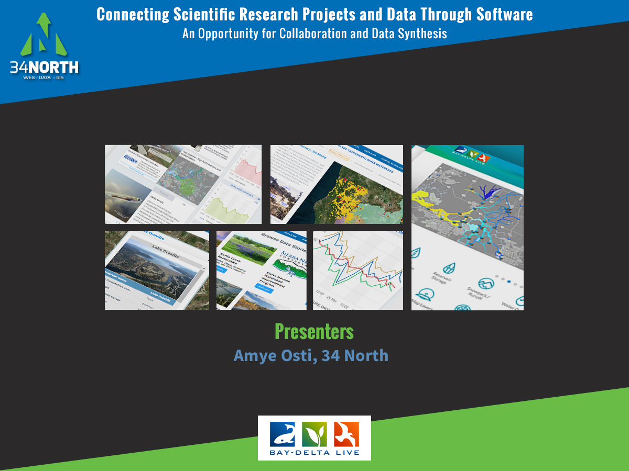
Notes:
Thank you for joining us this afternoon. Today I am going to talk about “Connecting Scientific Research Projects and Data Through Software. An Opportunity for Collaboration and Data Synthesis.

Slide 2
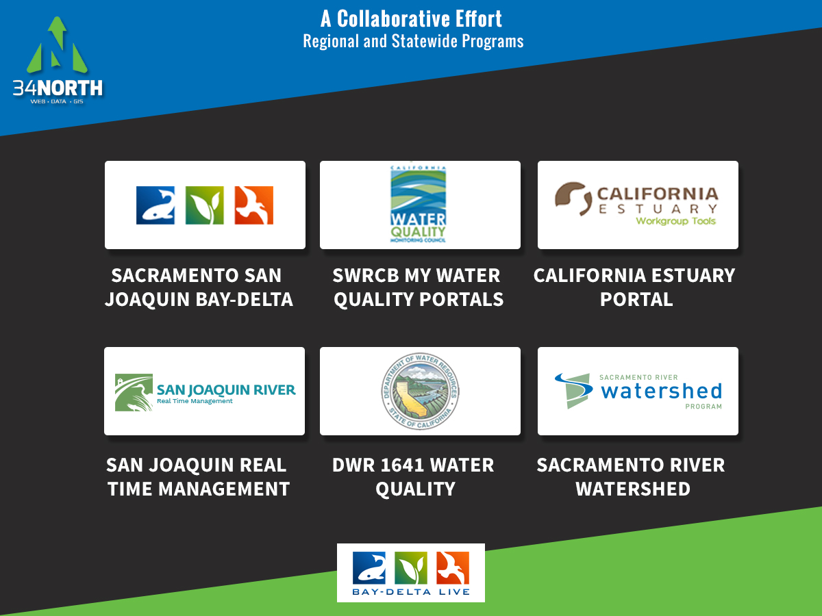
Notes:
Many of your are already familiar with the projects shown on this slide. This project I am going to show you today, builds on the above collaborative efforts. Each effort has contributed significantly to the overall data platform including improving access to data, regional and system wide datasets, expanding on information libraries, developing dashboards and much more.

Slide 3
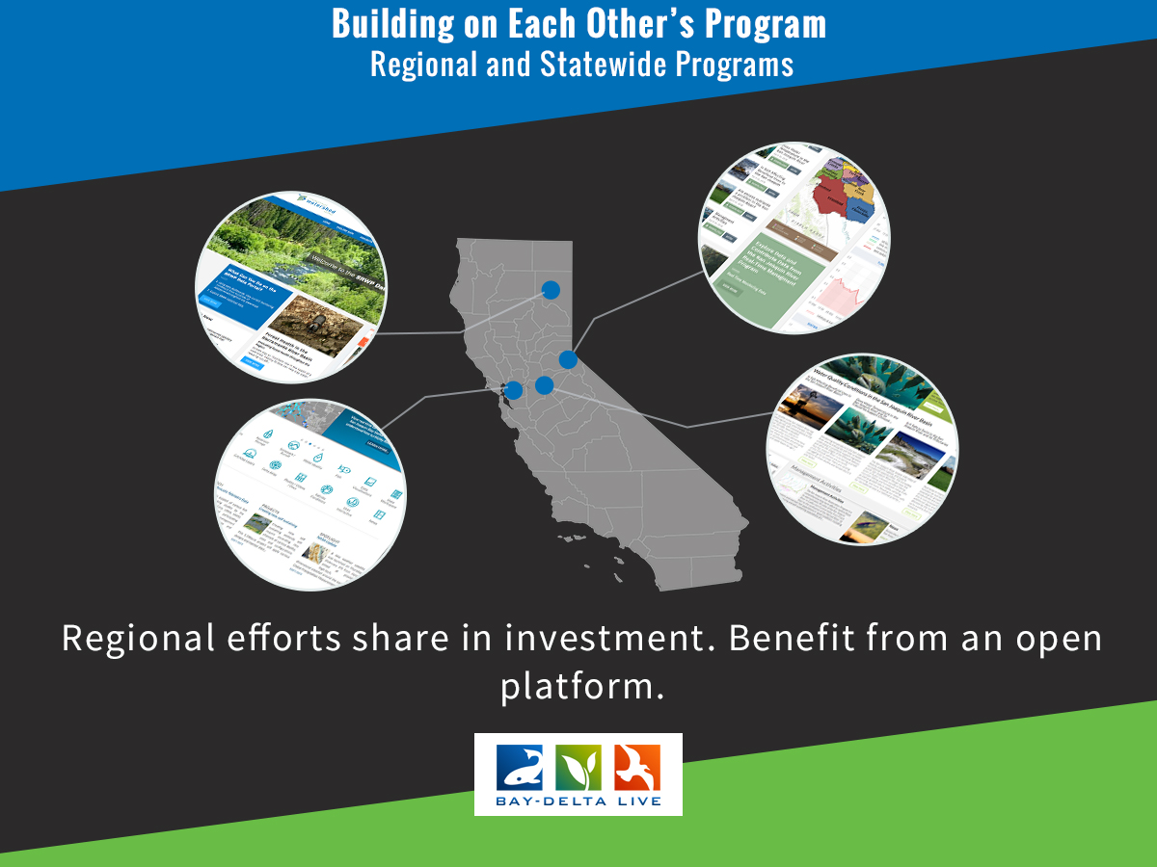

Slide 4
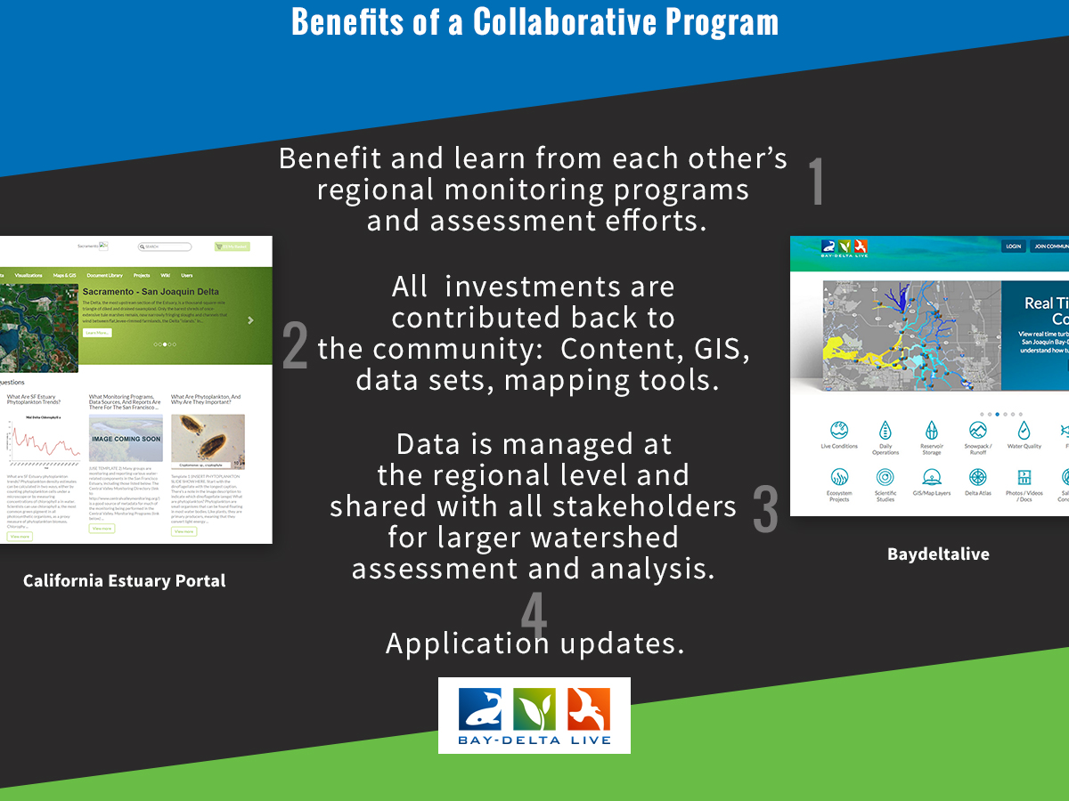

Slide 5
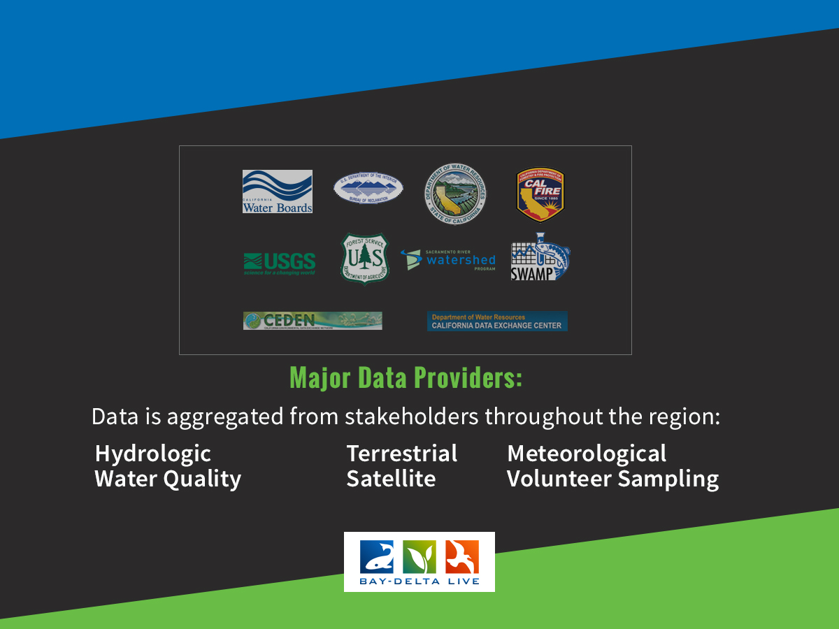
Notes:
These collaborative efforts have made hundreds of datasets accessible to this community

Slide 6
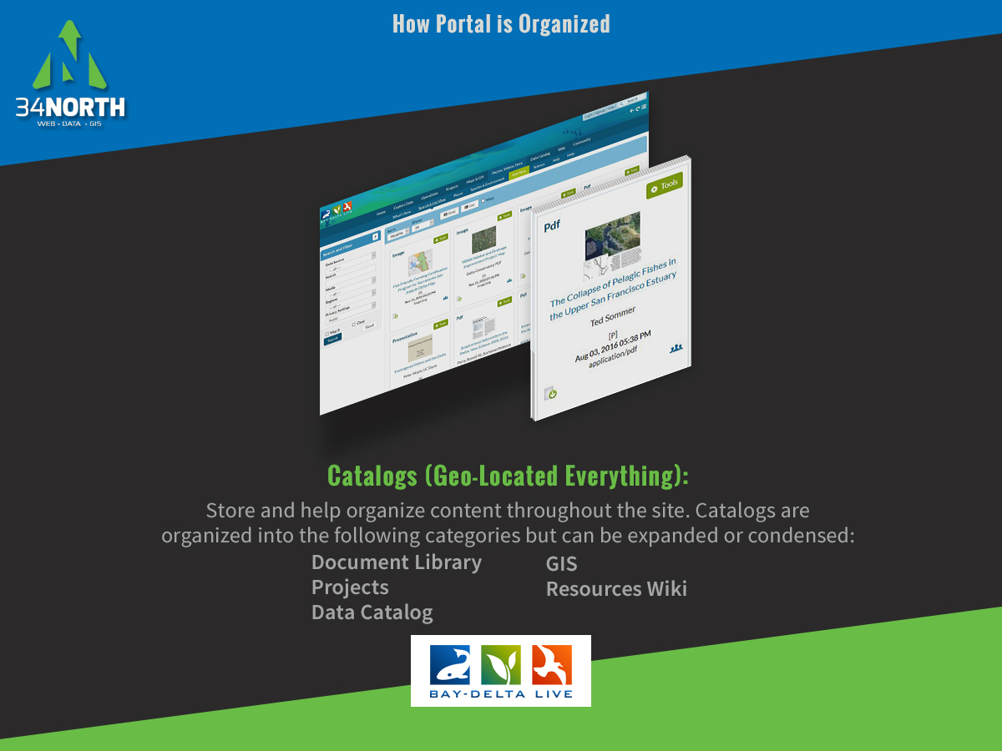

Slide 7
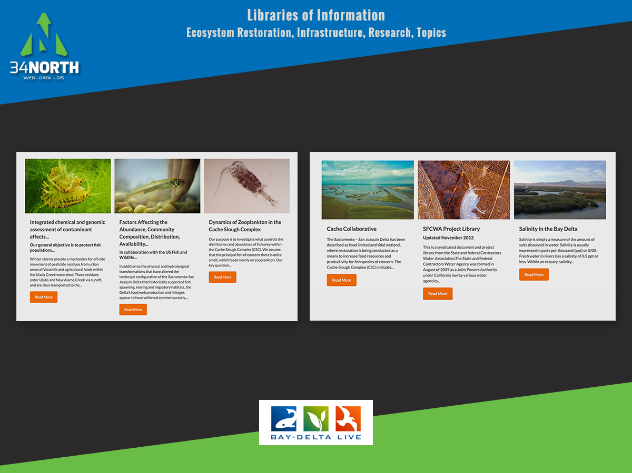

Slide 8
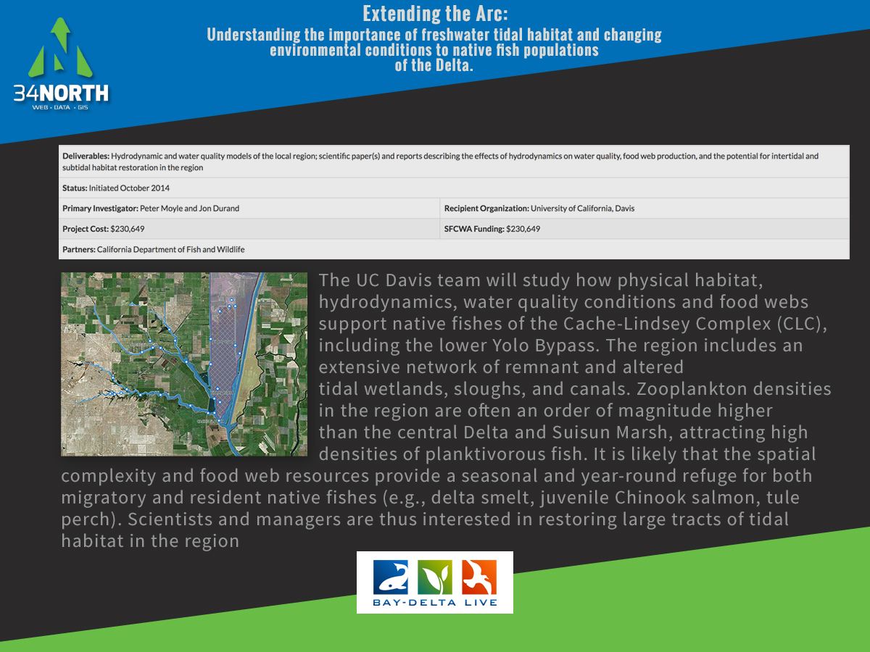

Slide 9
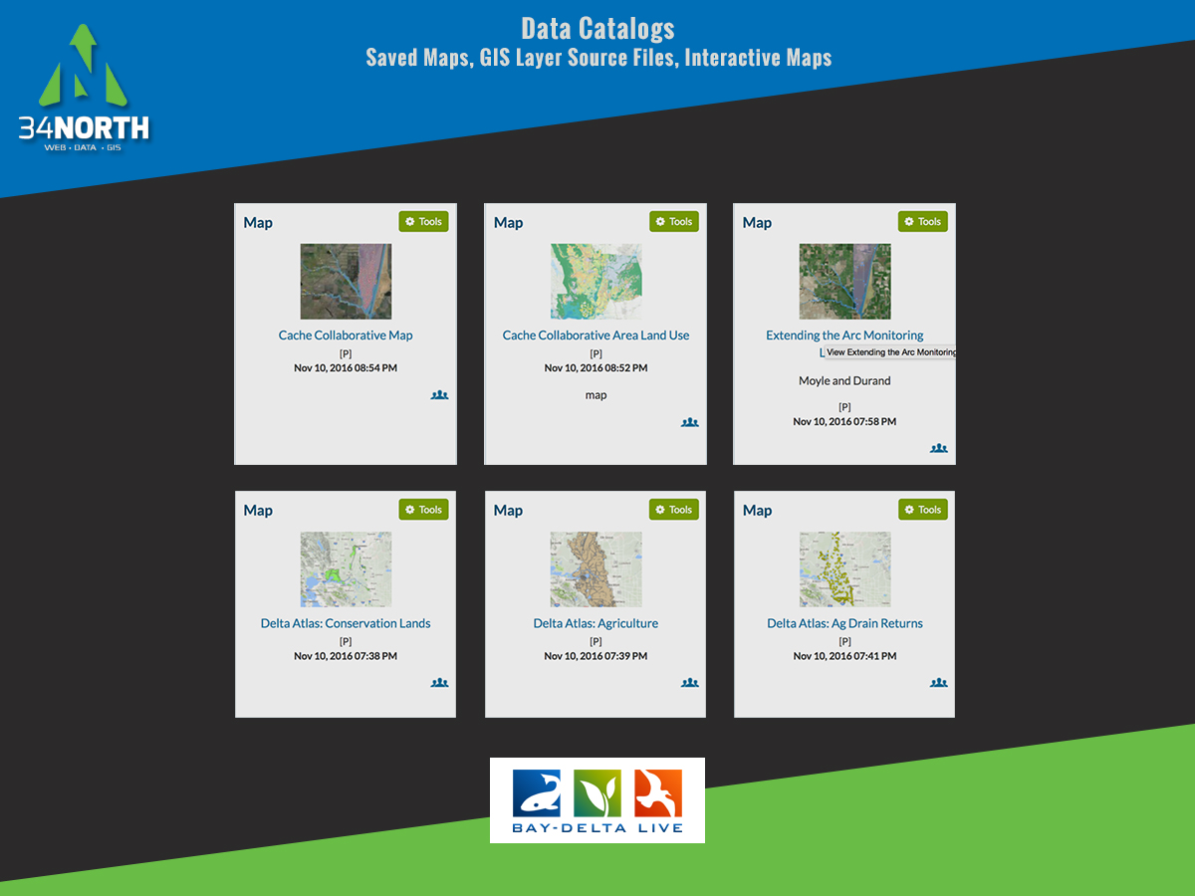

Slide 10
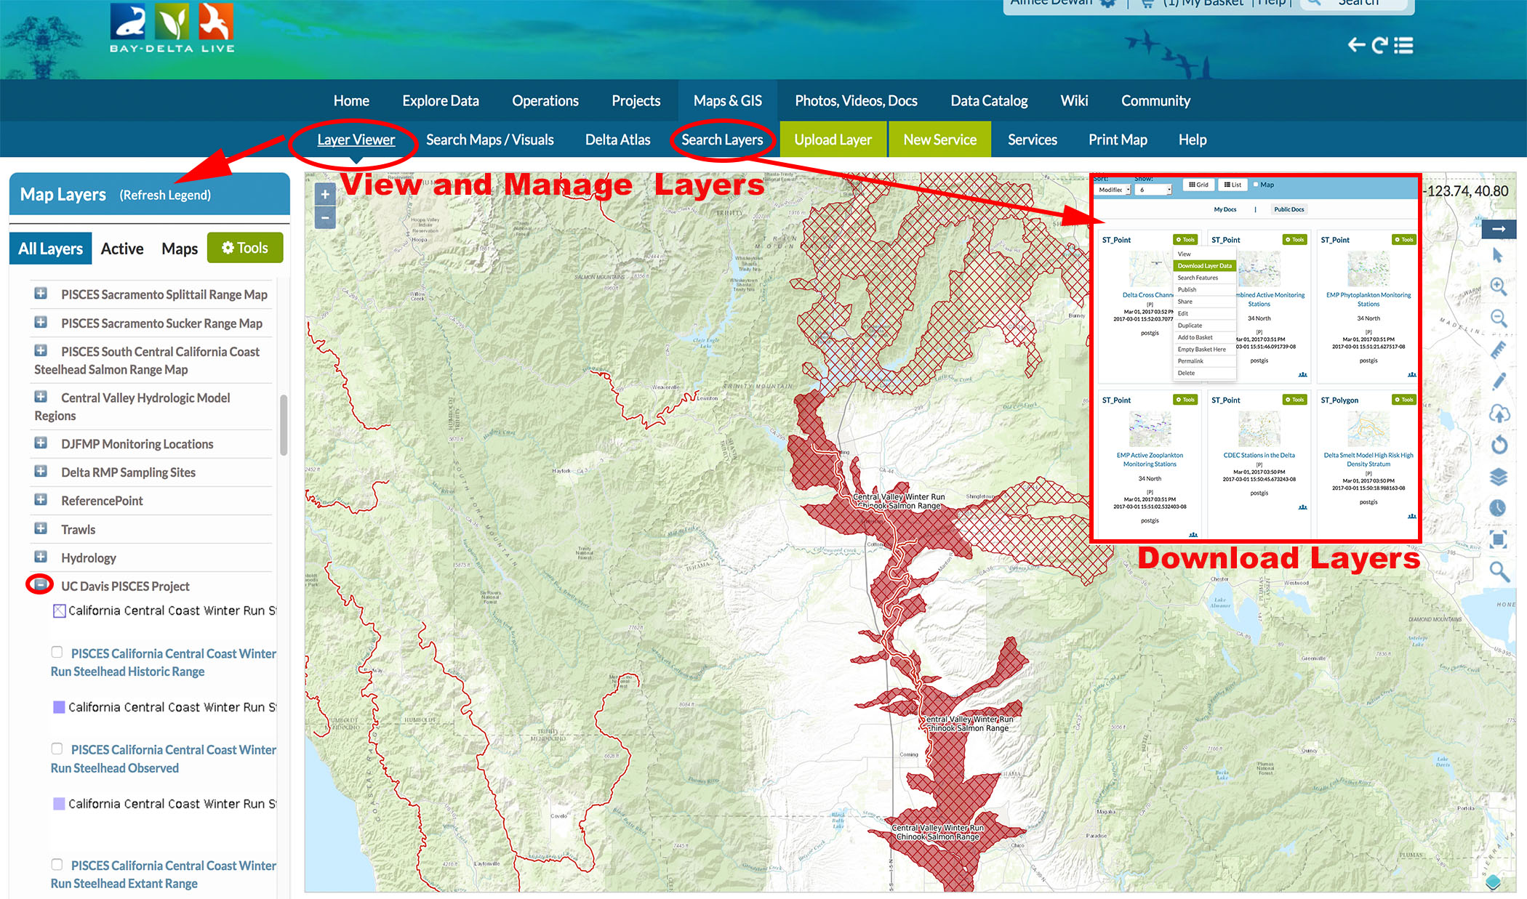

Slide 11
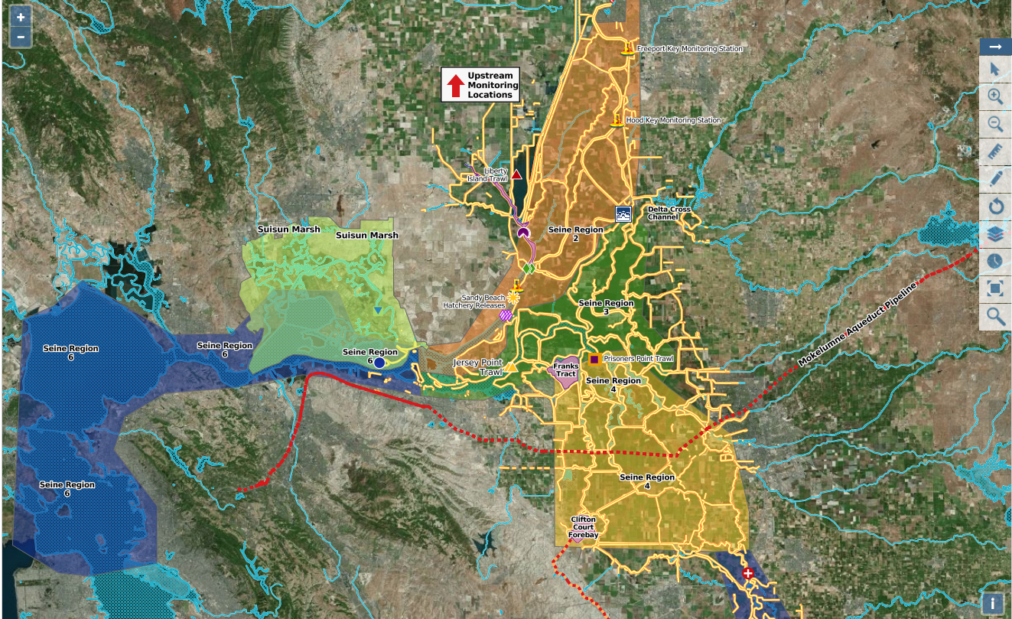

Slide 12
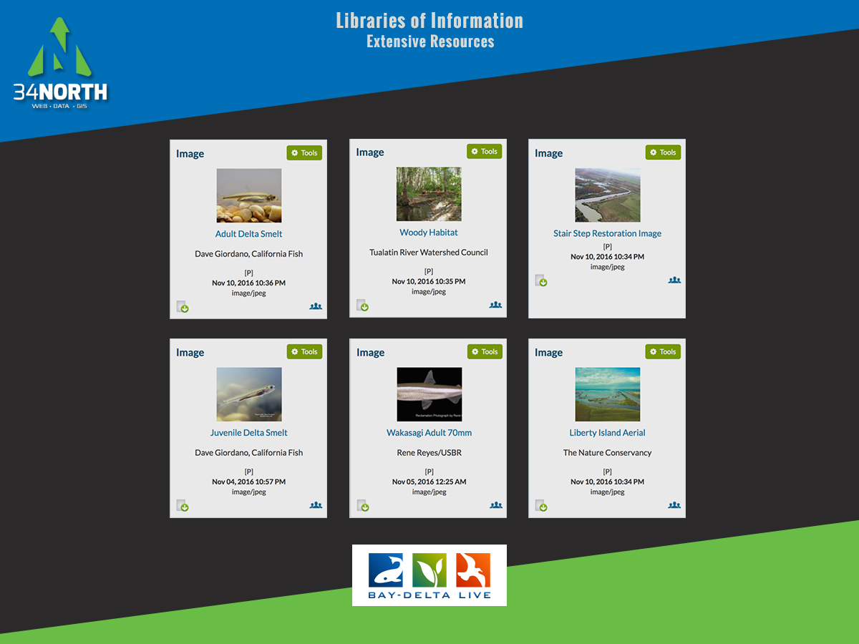

Slide 13
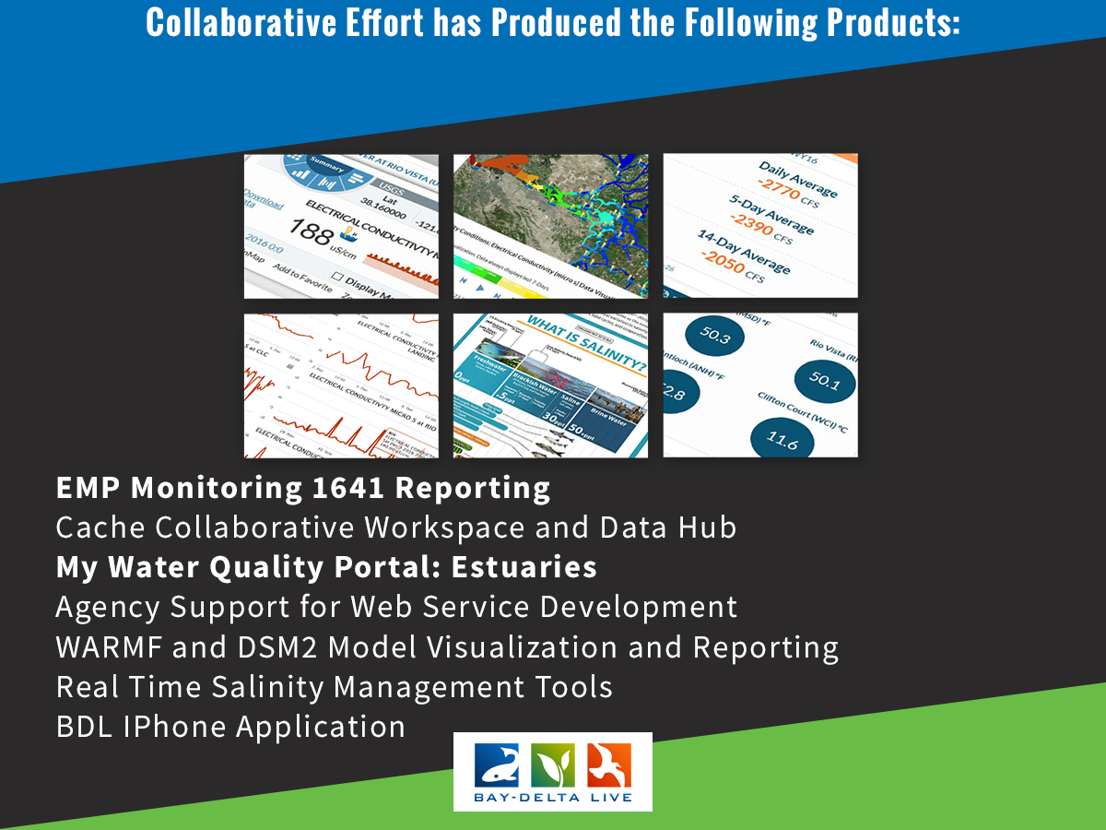

Slide 14
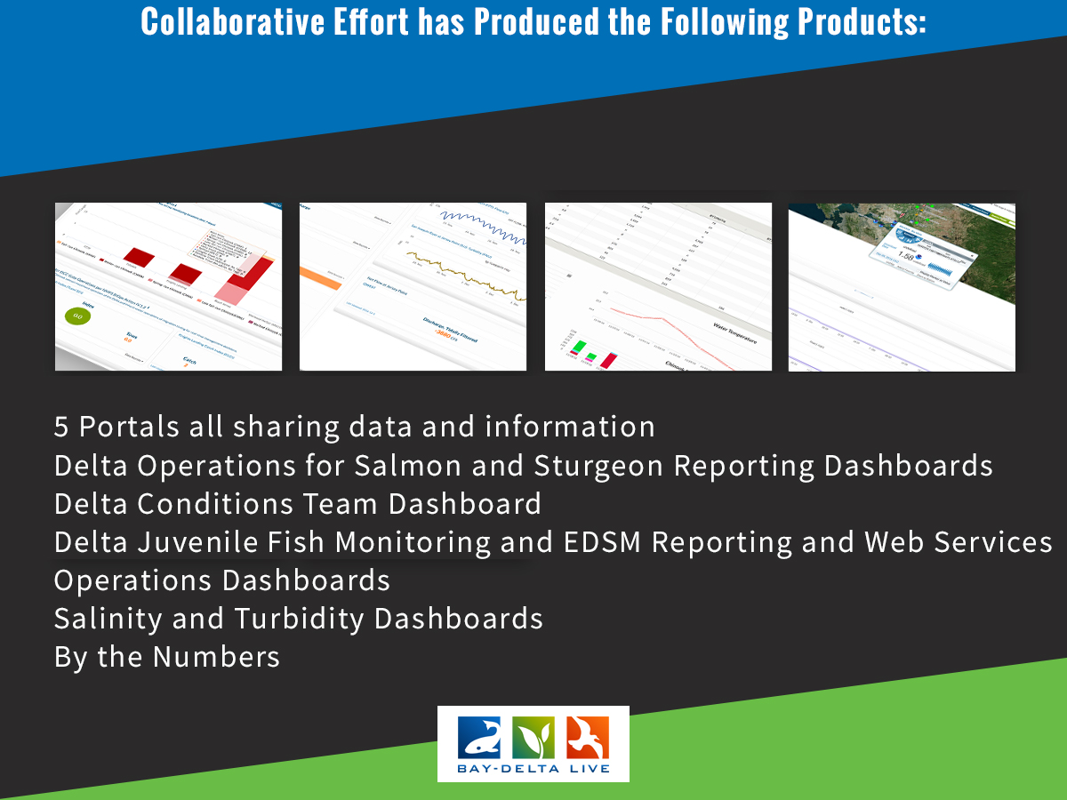

Slide 15
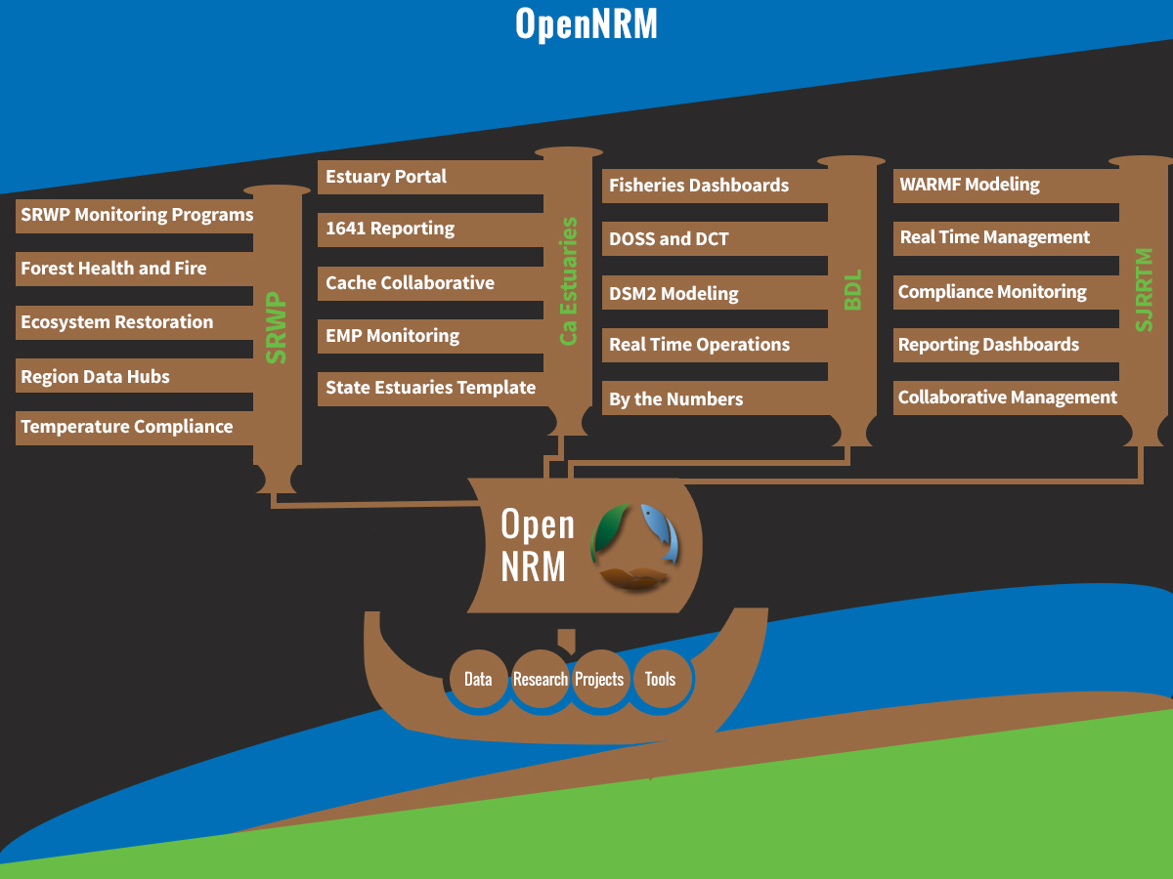

Slide 16
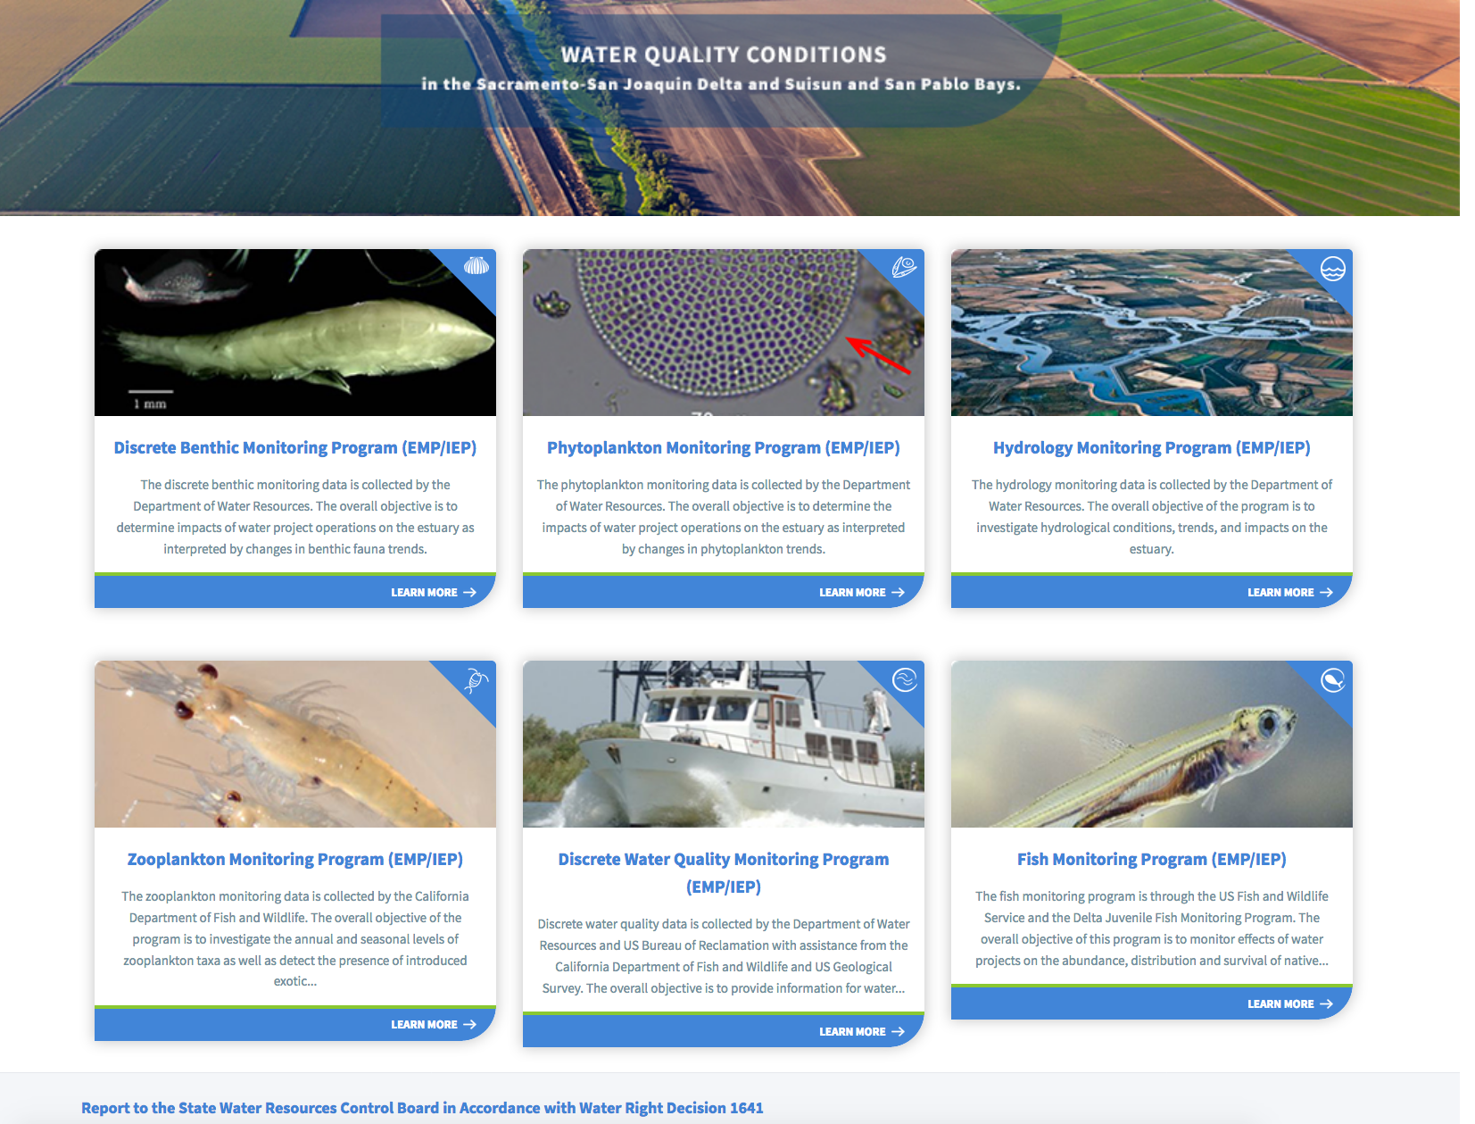

Slide 17
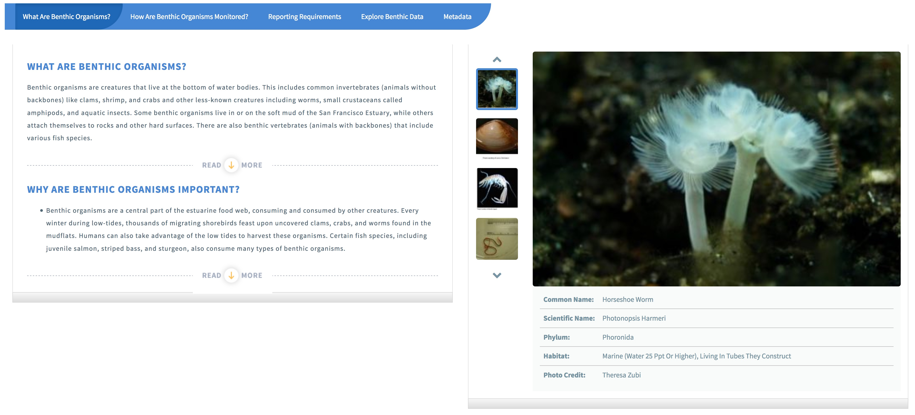
Notes:
The first tab of each of the 6 living resource projects gives a general overview of Program. Here we have an example from the Benthic Monitoring Section. This Tab, What Are Benthic Organisms?, gives the user a general description of benthic organisms and their ecological importance. The Photo carousel highlights important species and gives general information about each organism. Here we have a picture of the Horseshoe worm.

Slide 18
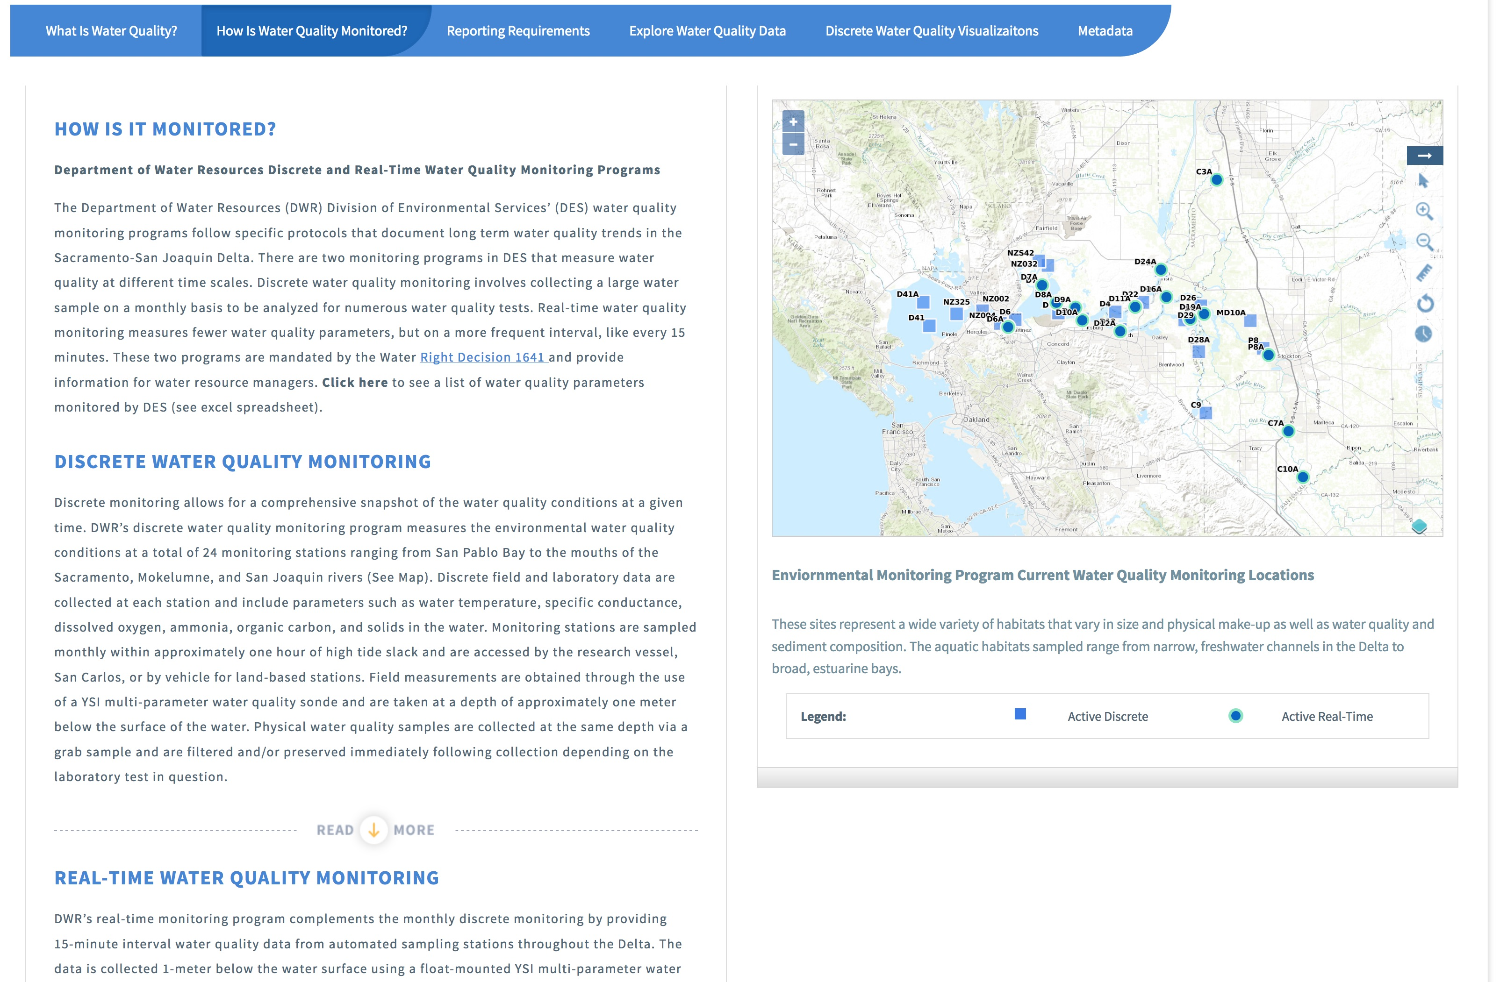
Notes:
The second tab of each program details how the data is collected. In this example of water quality we have text descriptions of both the discrete and continuous water quality monitoring programs. The interactive map with custom gis on the right displays all active discrete and continuous water quality monitoring locations. The gis files, as well as all other gis files, can be downloaded as a zip file with all components you would need to then upload that data into your desktop gis program such as ARCGIS or QGIS

Slide 19
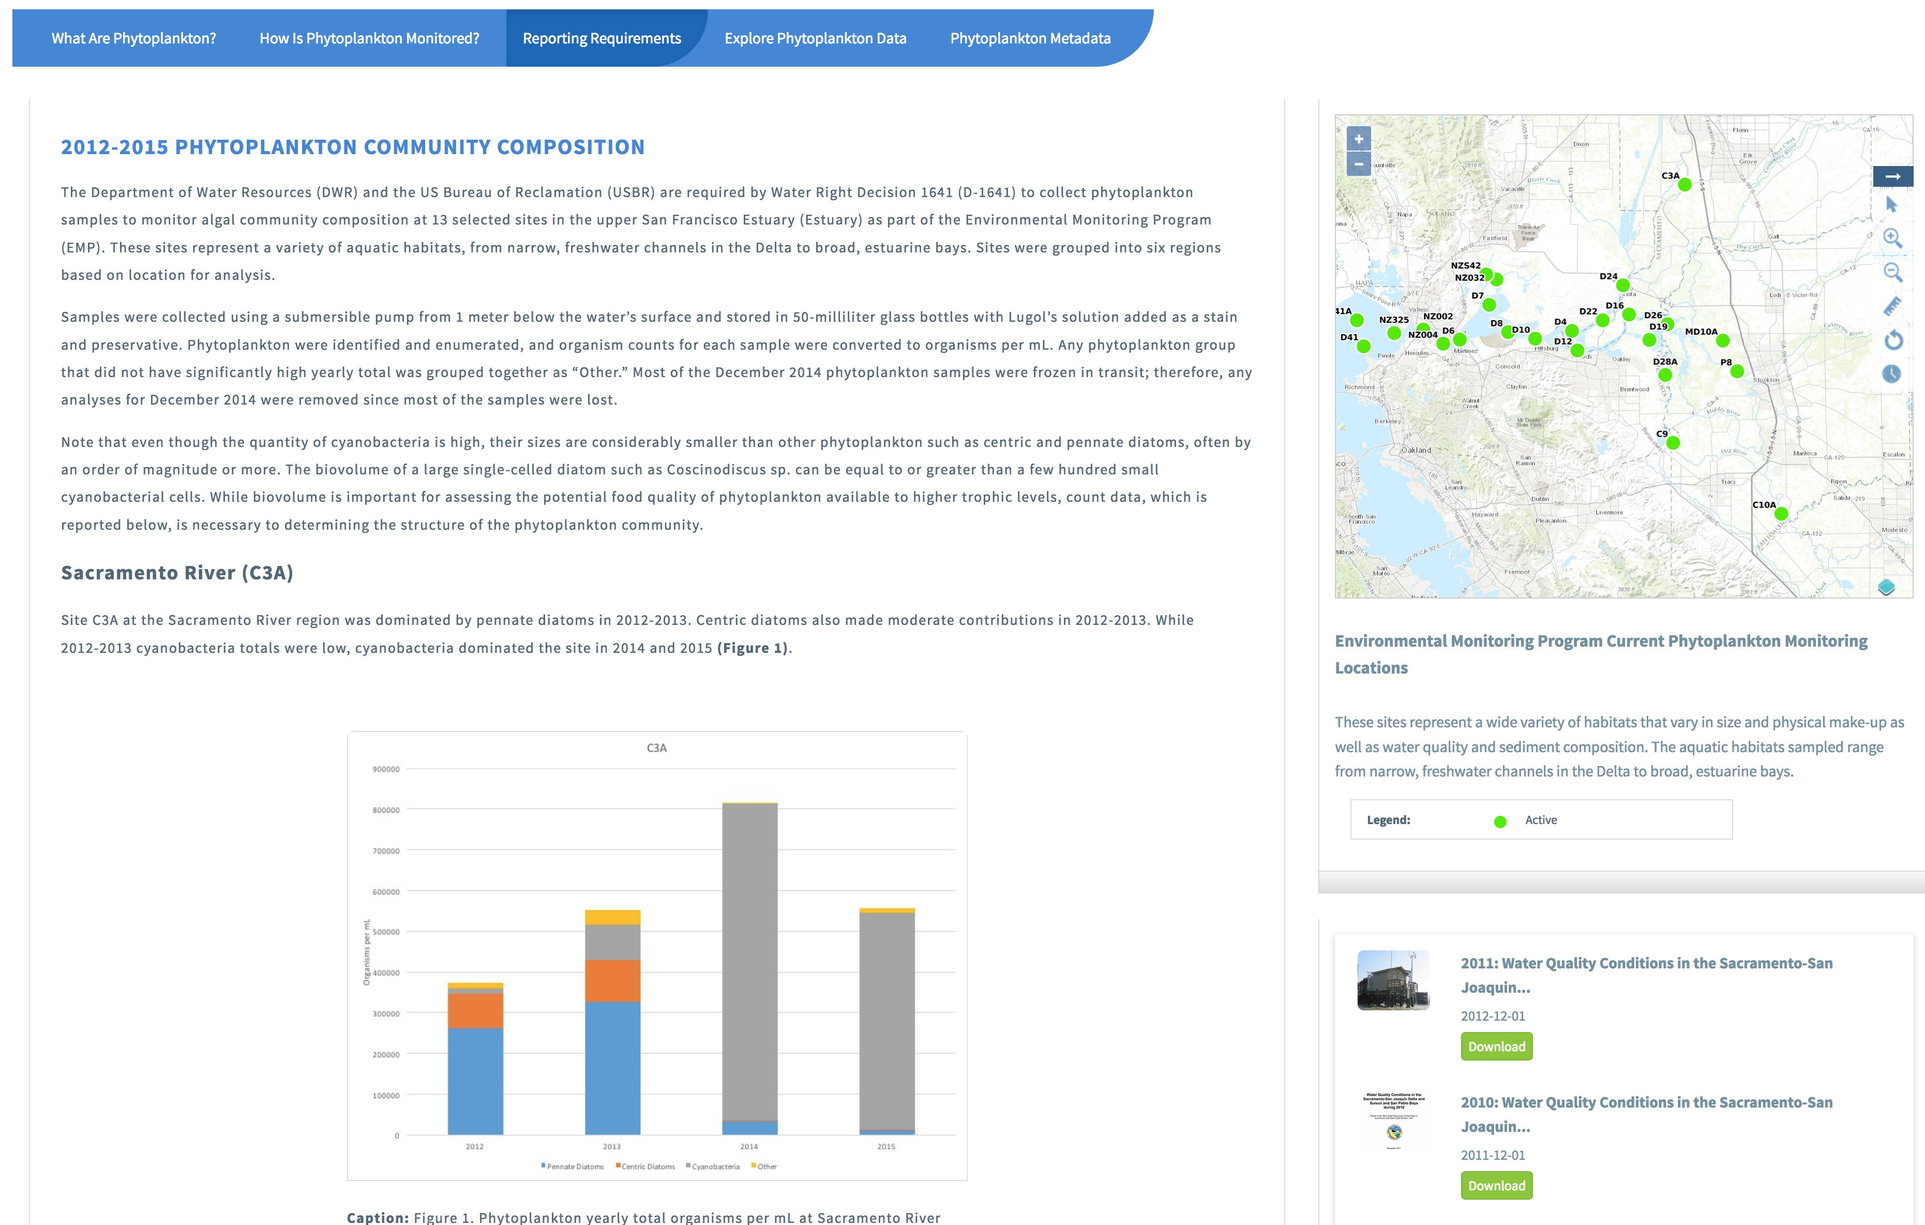
Notes:
Using our content management system the program leads are able to customize a reporting requirement tab. This example showcases the Phytoplankton reporting tab. The last Water Quality Report was published in 2011 and this reporting tab shows the conditions and trends in the time since that last report, 2012-2015 (2016 data is still being processed in the lab). For reference we have also included a map with sampling locations and an archive of the previous water quality reports that can be downloaded from the site.

Slide 20
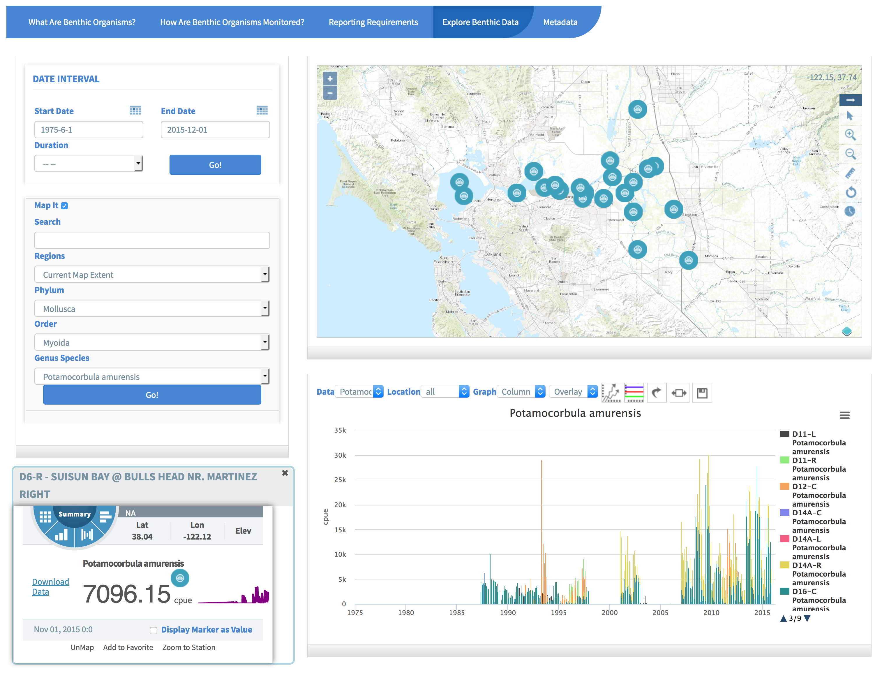
Notes:
Using the dynamic explore data filters we can select a species of interest. Here period of record data is displayed for the overbite clam. The graph units on the y axis are CPUE and the time scale is in months, due to the large amount of data only the year markers are showing on the x axis. In the graph you can see the periods of increased invasion of the clam. In the interactive map you can click on an individual station to see the most recent CPUE value as well as a sparkline of trends over time.

Slide 21
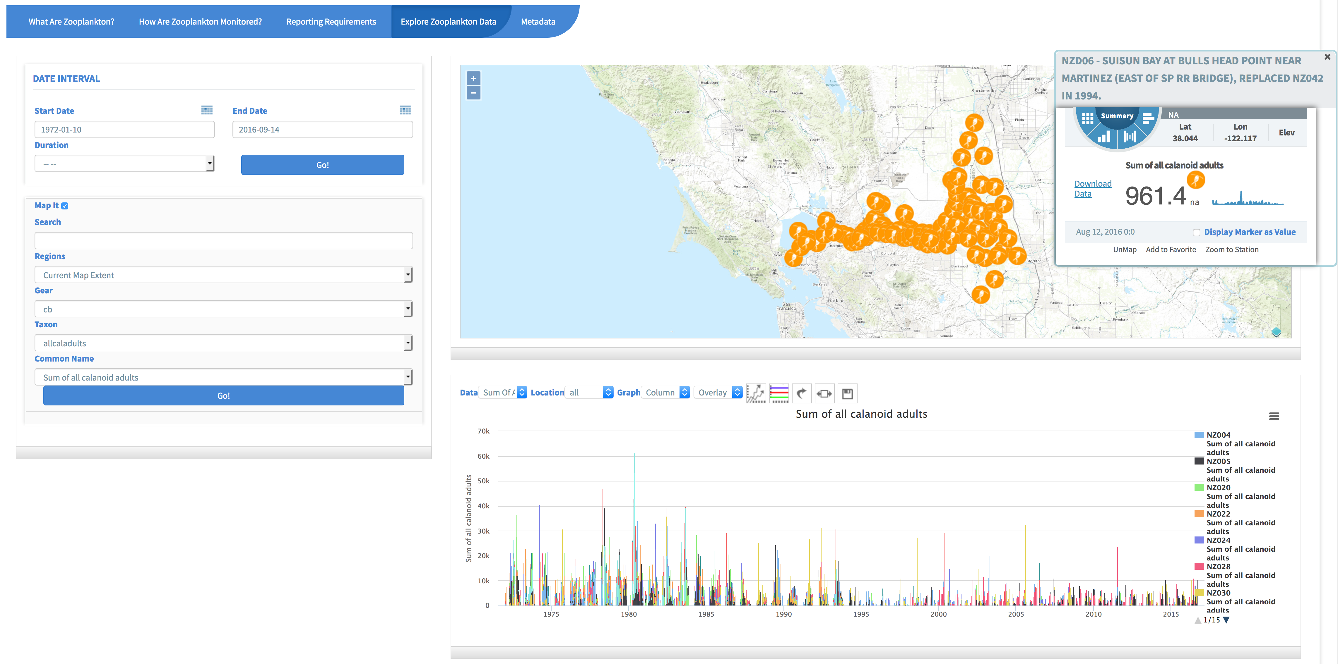
Notes:
Corresponding with the introduction and subsequent invasion of the overbite clams was a decline in abundance of calanoid copepods, which is shown here through the explore data in the zooplankton section of the data platform. The custom filters reflect the data structure of zooplankton data where the first filter is to select a gear type then a taxon or common name. Each of the items in the graph can be turned off or on with a click and all data and graph images can be downloaded.

Slide 22
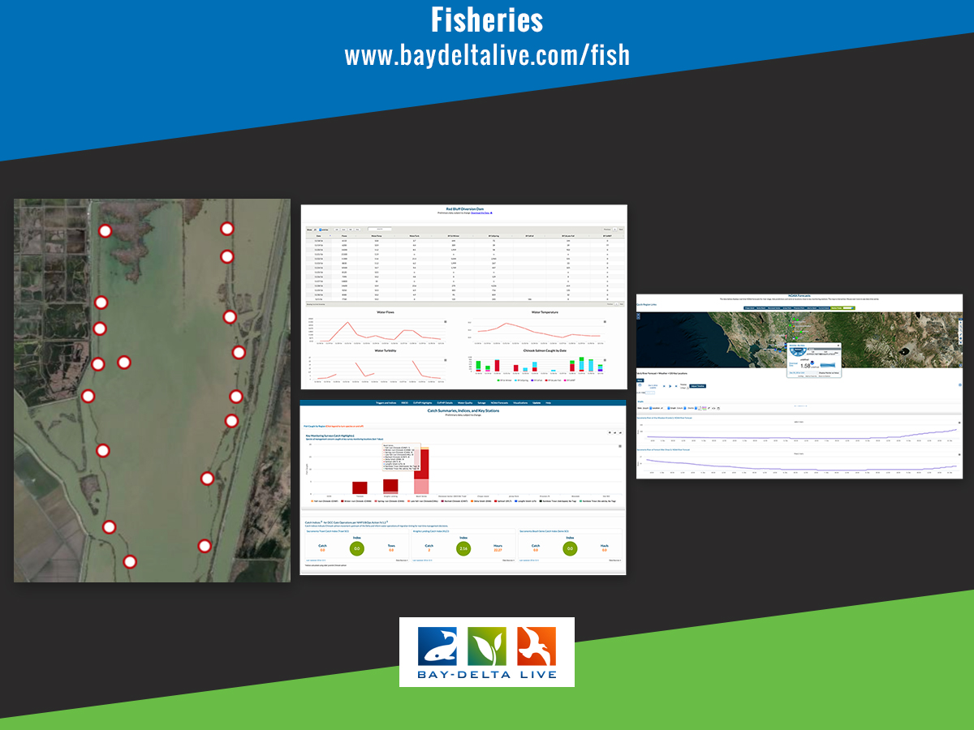
Notes:
Data supports: BiOps Review and Analysis, RPA’s Drought Operations, DOSS Team, General Water and Trawl Operations, Fish Monitoring
Jersey Point trawl, Prisoners Point trawl, Chipps Island Trawl, Sacramento Trawl, Sacramento Trawl Catch Index (STCI), Sacramento Beach Seines, Sacramento Beach Seine Catch Index (SBCI), All DJFMP beach seine data, Mossdale Trawl, Knights Landing RST, Knights Landing Catch Index (KLCI), Tisdale RST, Glenn-Colusa Irrigation District (GCID) RST, Red Bluff Diversion Dam (RBDD) RST, Red Bluff Diversion Dam (RBDD) RST, Delta Smelt Monitoring, Mill Creek flow, Deer Creek flow, Wilkins flow, Knights Landing water temperature, OMR, Salvage Operations Data, CDEC Conditions data, Expanded Delta Smelt Monitoring

Slide 23
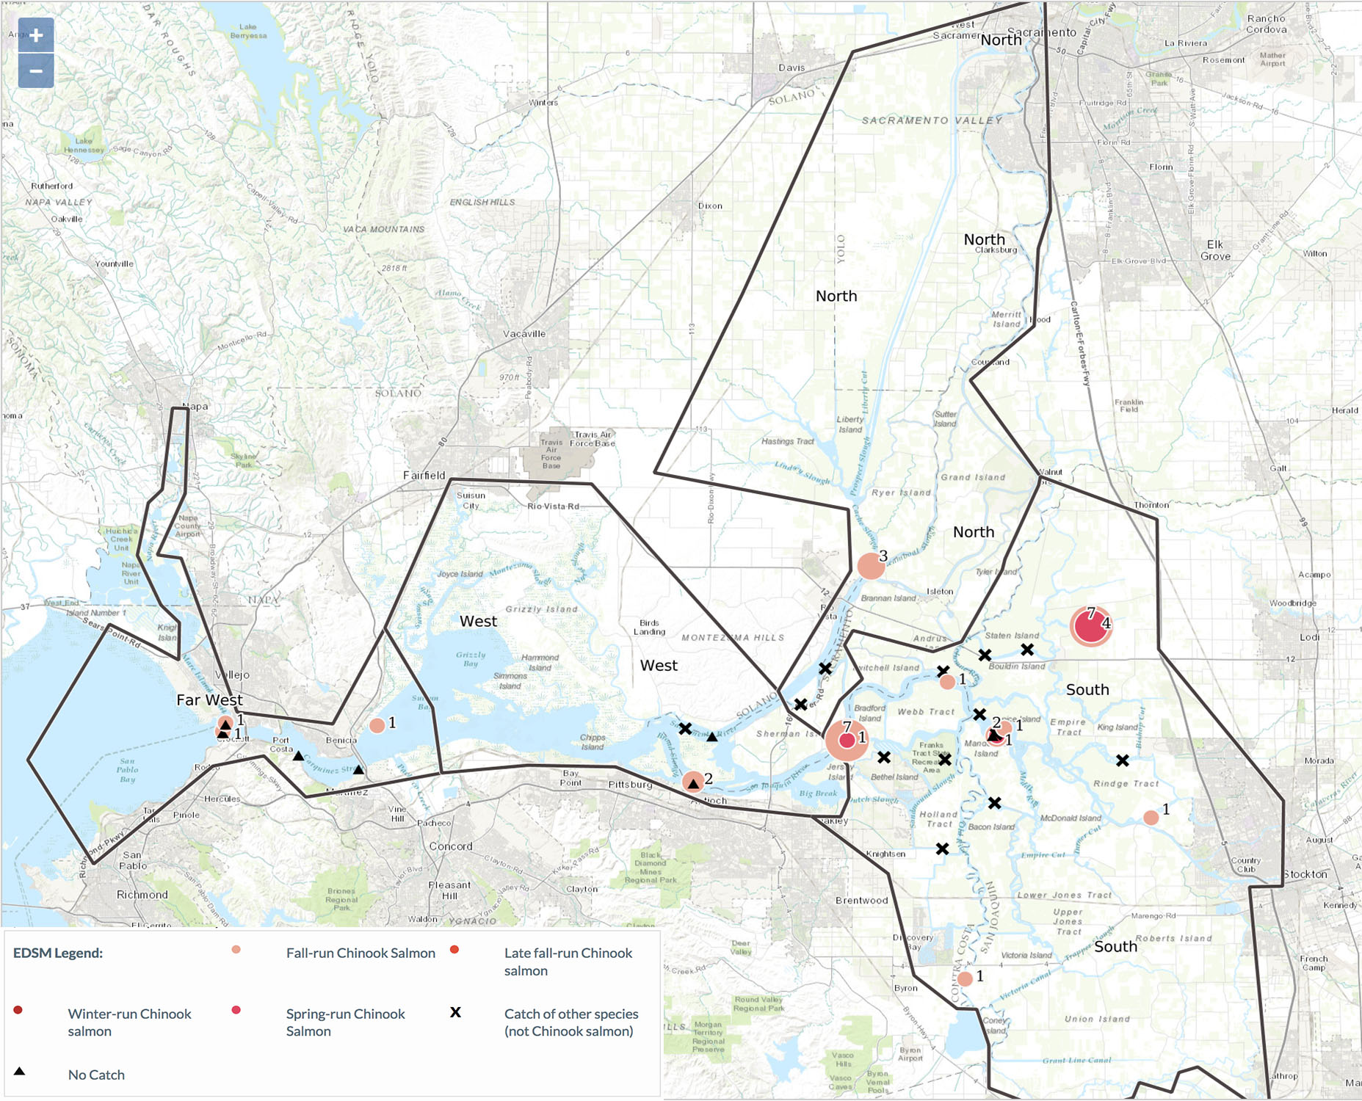
Notes:
Weekly summary for Chinook catch for the week 2/20/17 to 2/24/17
This image is a layer with the weekly summary of chinook catch (all runs) for the week February 20 to 24, 2017 (with region outline).

Slide 24
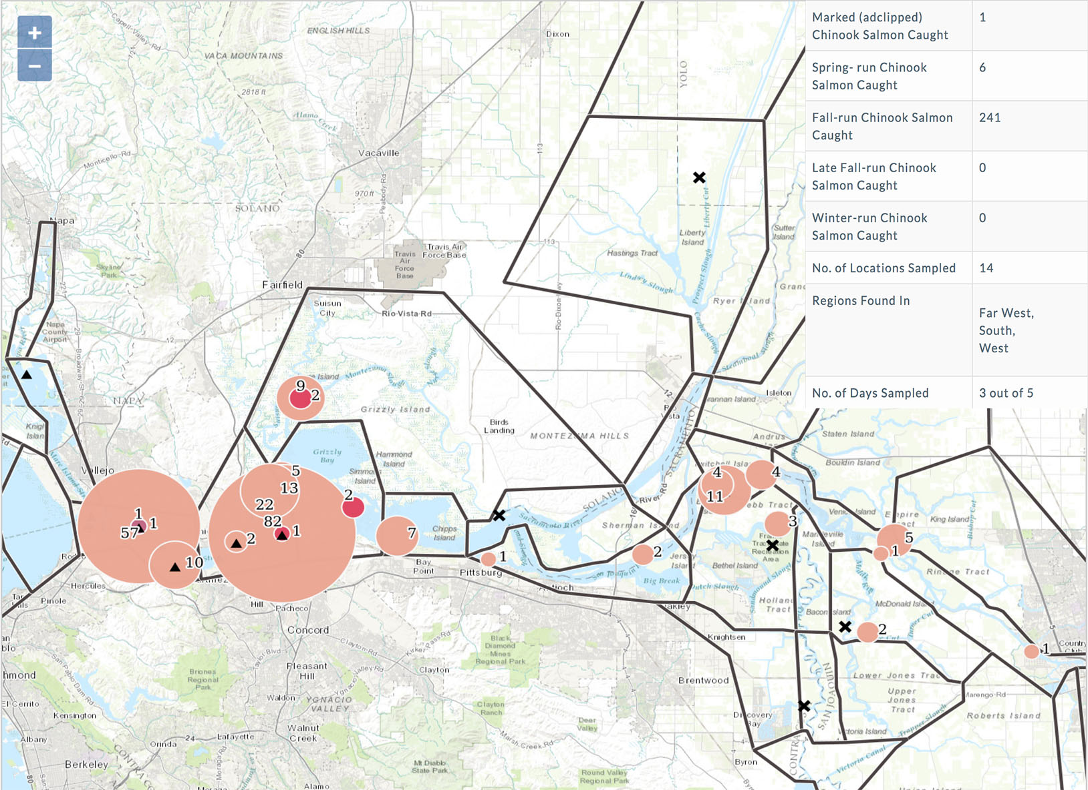
Notes:
EDSM Data Story for Species Weekly Summaries, Chinook Feb 13 to Feb 17
This image comes from the EDSM data story for weekly summaries by species. This shows chinook , all races, with a summary table overlaid. The table shows total catch by run, number of locations sampled total (by week), what regions the fish were found in and number of days sampled that week.

Slide 25
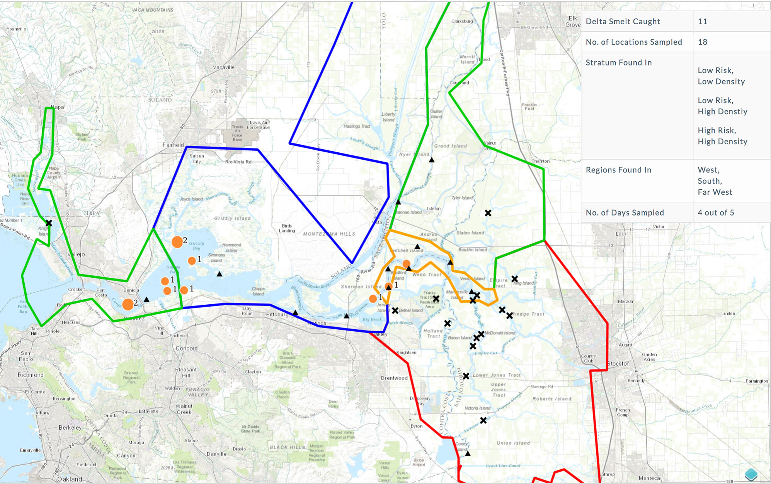
Notes:
EDSM Data Story Weekly Summary for Delta Smelt Catch Feb 6 – Feb 10
This is a screen grab from the EDSM data story for weekly species catch summaries.
This image shows Delta Smelt cumulative catch for the week 2/6 – 2/10. The summary table is overlaid with catch #, number of locations sampled (total – whole week), what stratum the smelt were found in, what regions the smelt were found in and the number of days sampled that week.

Slide 26
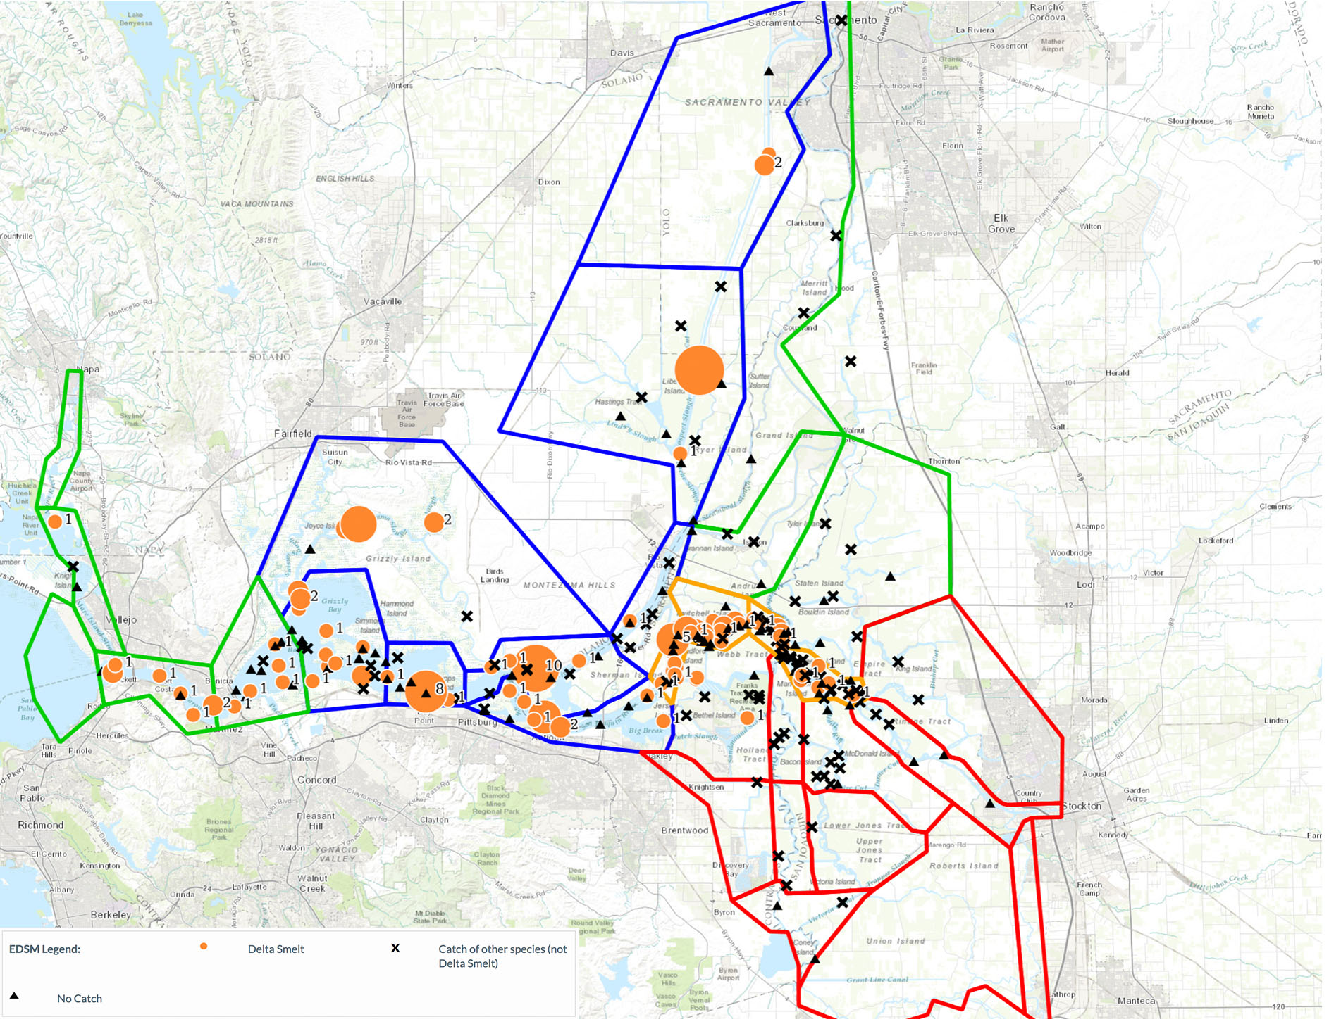
Notes:
EDSM Delta Smelt Cumulative Season Catch
This image shows the cumulative delta smelt catch over the season, with sub-region outlines.

Slide 28
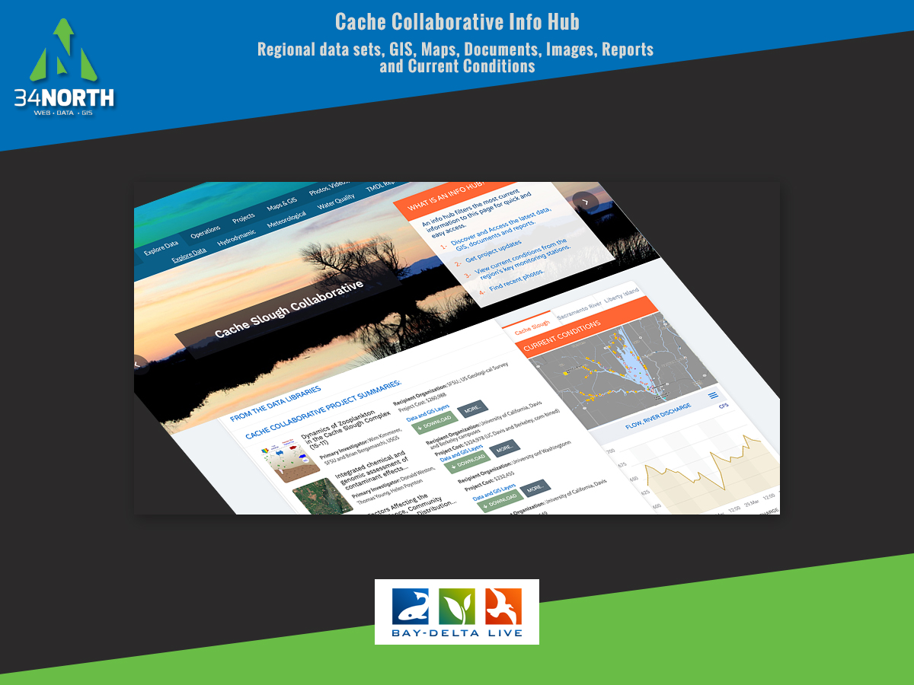
Notes:
Data, images, research, projects, GIS for the cache region in one place.

Slide 29
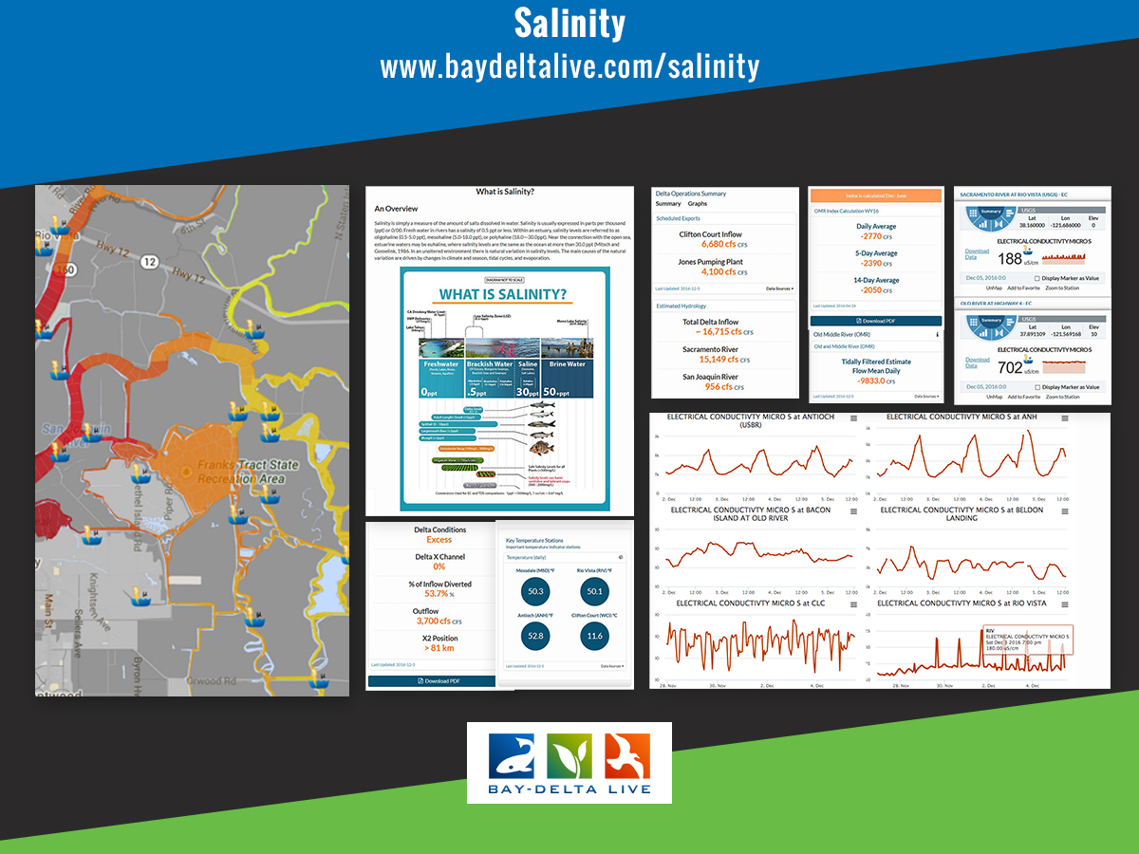
Notes:
The Salinity in the Sacramento San Joaquin Bay-Delta data story gives you an in depth look at salinity, beneficial uses, related conditions and how salinity is managed to protect California’s ecosystem and water supply. In addition, managers are provided a look at EC conditions using a Real Time Salinity Conditions Visualization and Salinity Data Dashboard with Key Hydrology Data, OMR Flows and Indices and general Delta WQ Conditions. The data story dig deeper to provide users EC conditions compared with flow and turbidity as well as reservoir conditions at Shasta, Oroville and Folsom. The key key reservoirs for salinity ops.

Slide 30
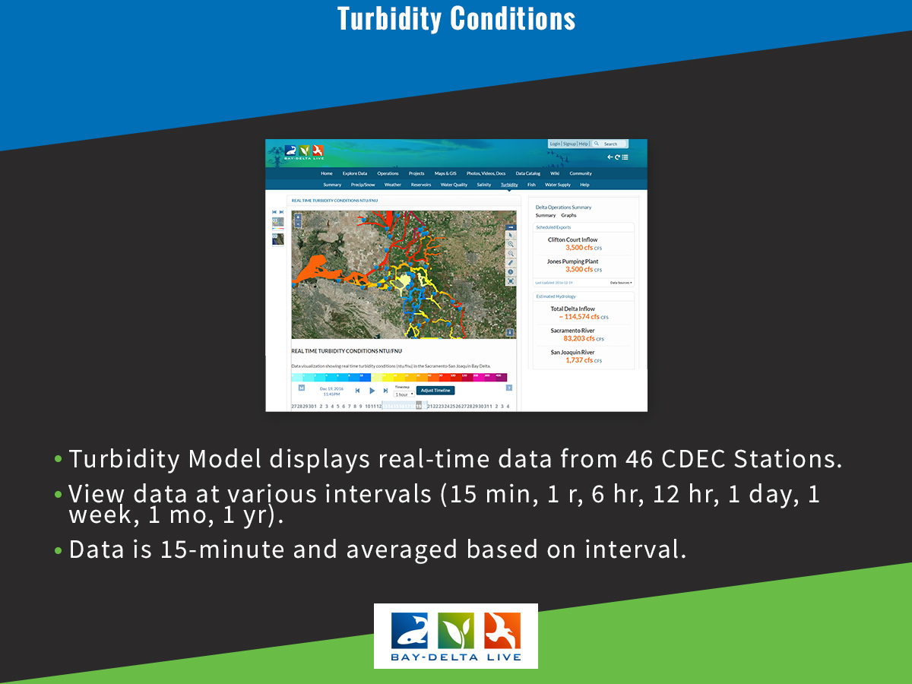

Slide 31
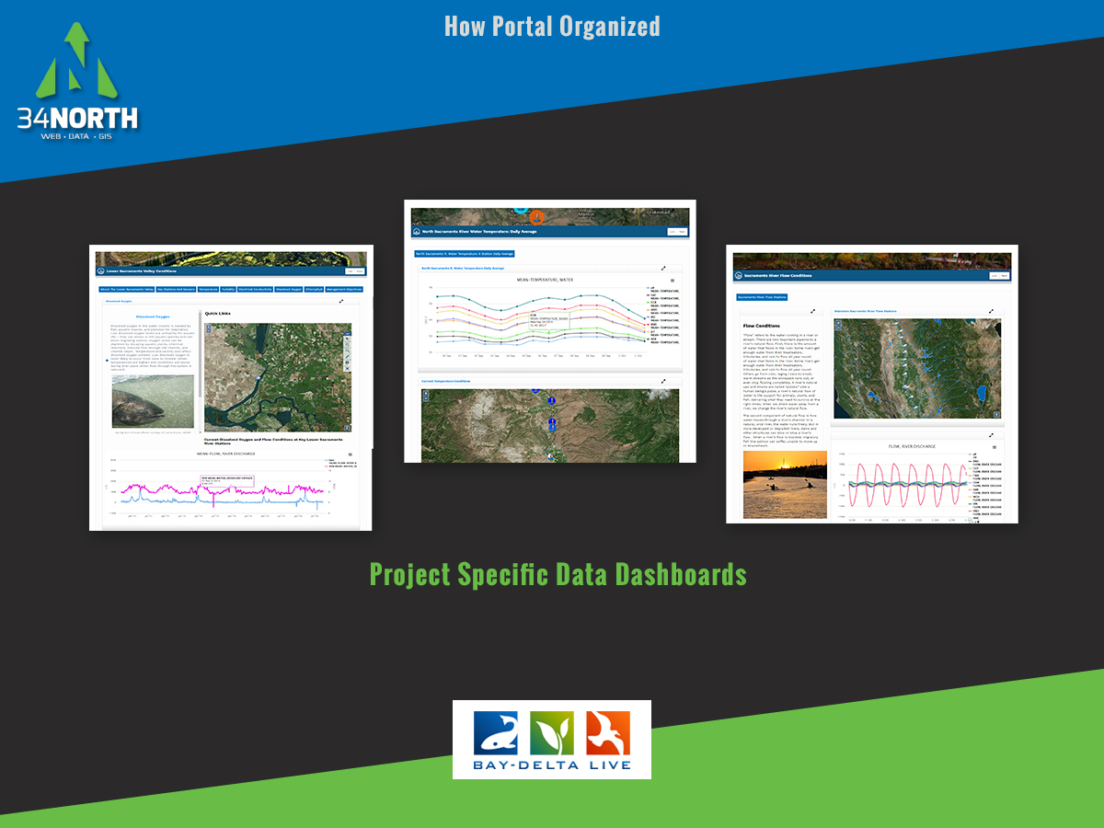
Notes:
A data dashboard is being developed for each study and monitoring programs

Slide 32
