Slide 1

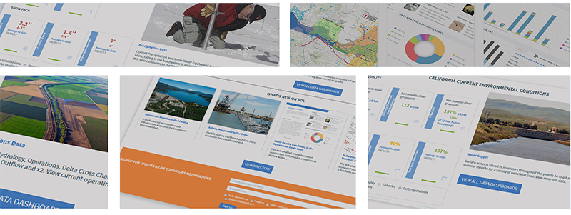
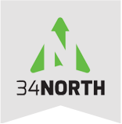
Connecting Scientific Research Projects and Data
An Opportunity for Collaboration and Data Synthesis
Karly Rodriguez
November 30, 2017

Slide 2



The Challenge: Connecting Research
Most data are collected and
stored within origination
organization.
Data is typically shared at
quarterly meetings, after
publication and then added to
state databases when funding is
available, or only accessible by
request.
Delays in sharing data does not
support adaptive management
actions and real time operations.

Slide 3
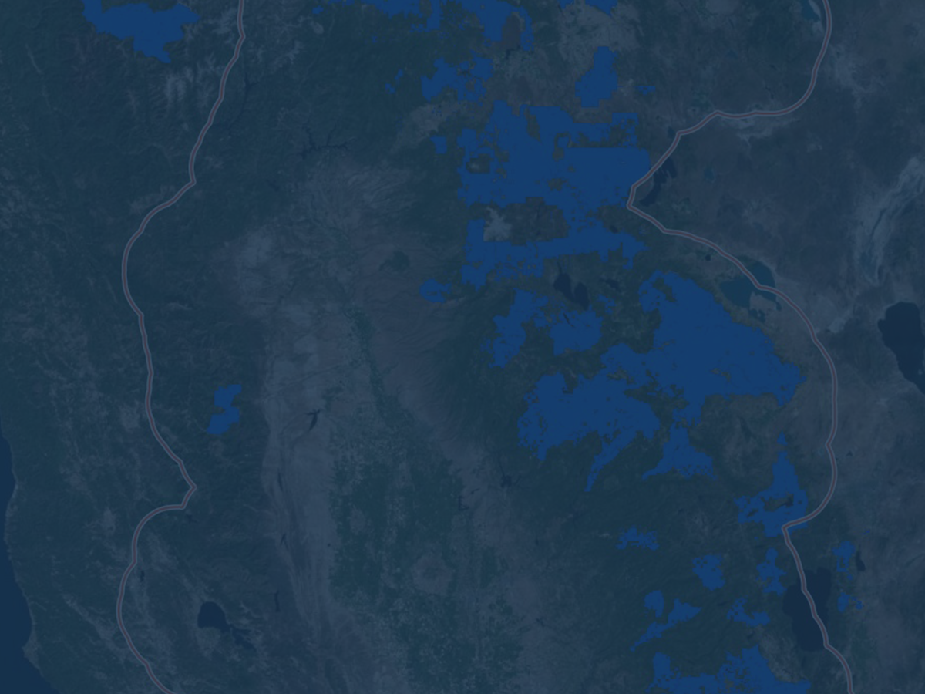






What does the Platform OPENNRM do?
Projects
Explore Data
Catalogs
(Geo-Located
Everything)
Data
Dashboards
Interactive Map
Tools
Data Stories
Community

Slide 4

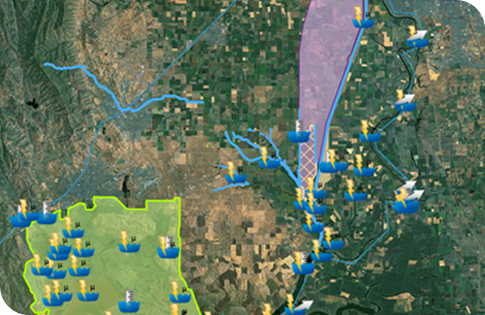
Data Aggregation: Real-time Data
Real-time data sensors parameters include:
Electrical Conductivity
Turbidity
River Stage
Flow
Water Temperature
Combine with GIS layers of key locations in the Cache Slough Complex and the surrounding

Slide 5

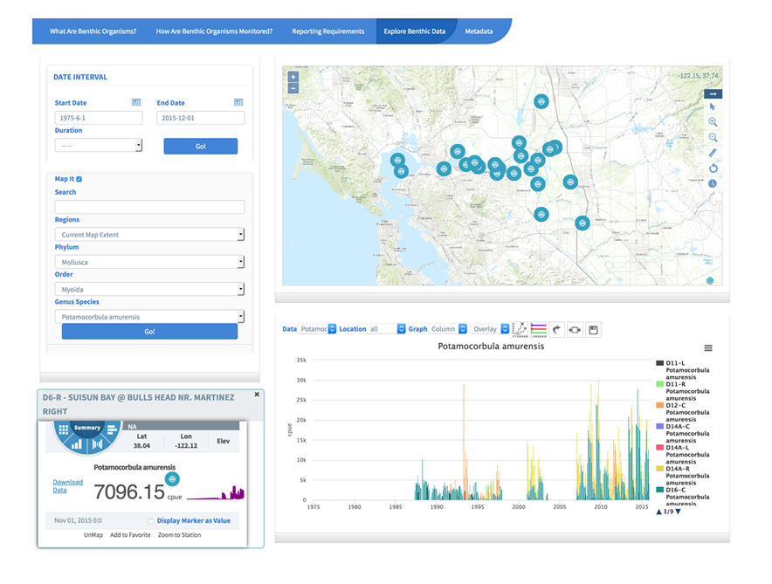
Discrete Environmental Data

Slide 6
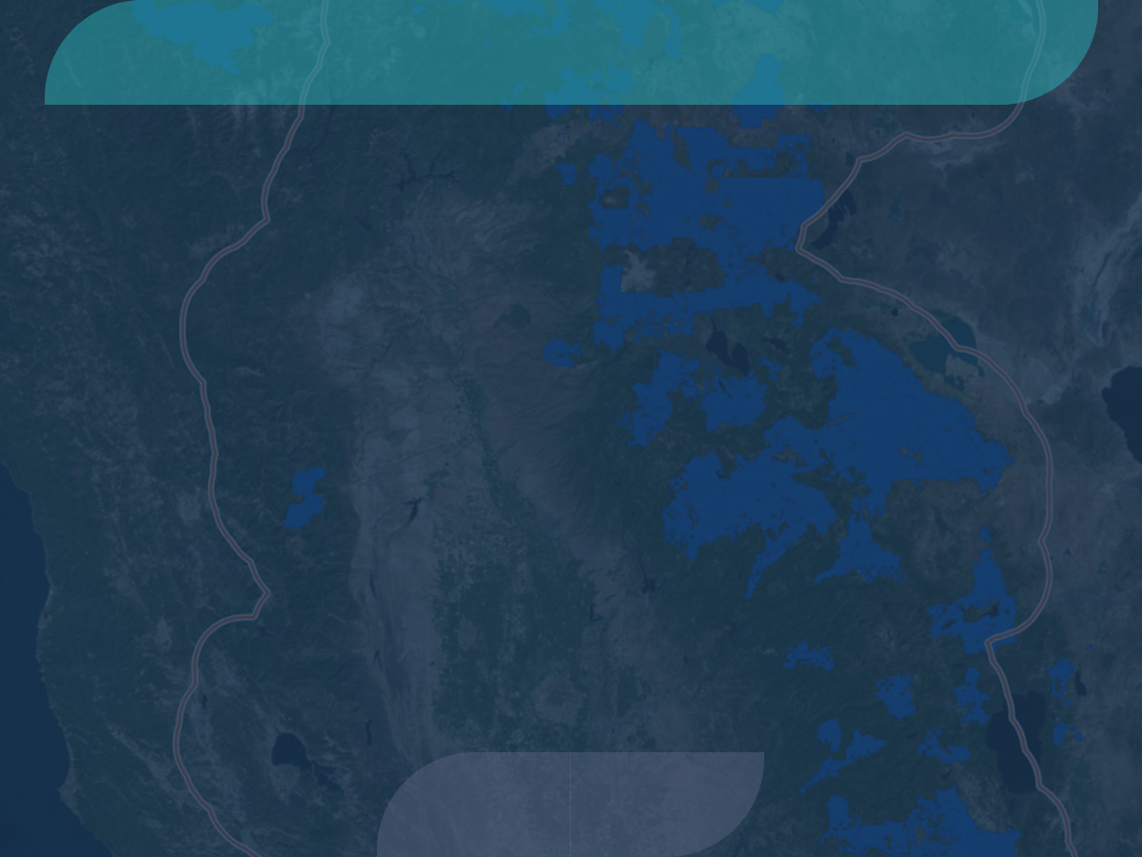
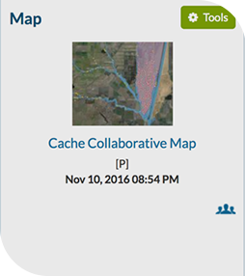
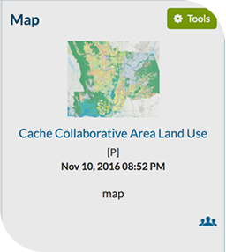
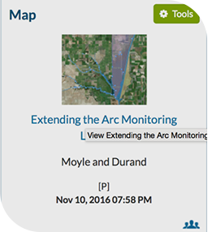
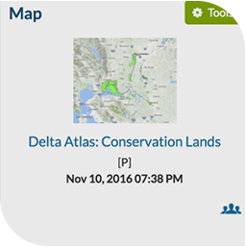
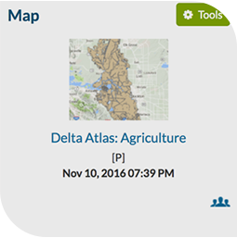
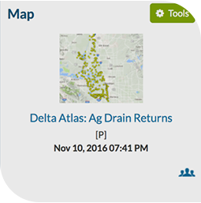
Data Catalogs
Saved Maps, GIS Layer Source Files, Interactive Maps

Slide 7

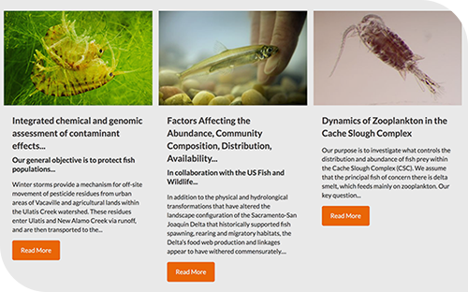
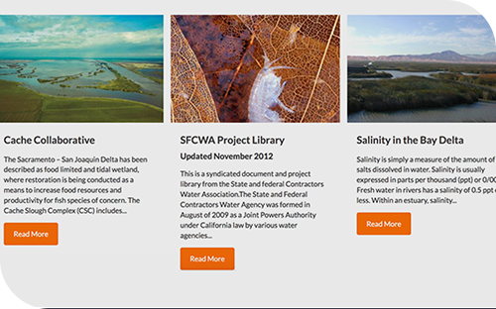
Project Tools
Ecosystem Restoration, Infrastructure, Research, Topics

Slide 8
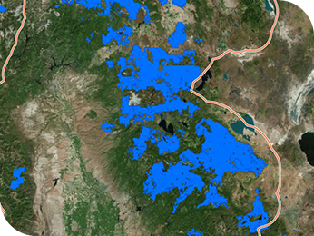
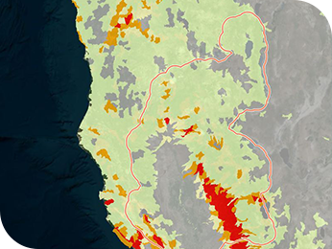
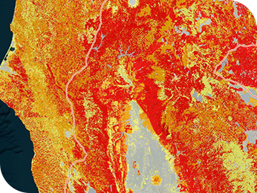
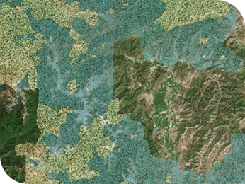
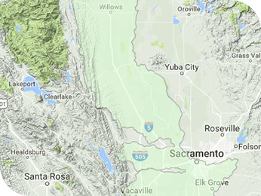
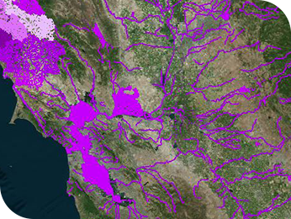
Interactive Map Tools
Tools to explore a region spatially
Layers can be combined

Slide 9
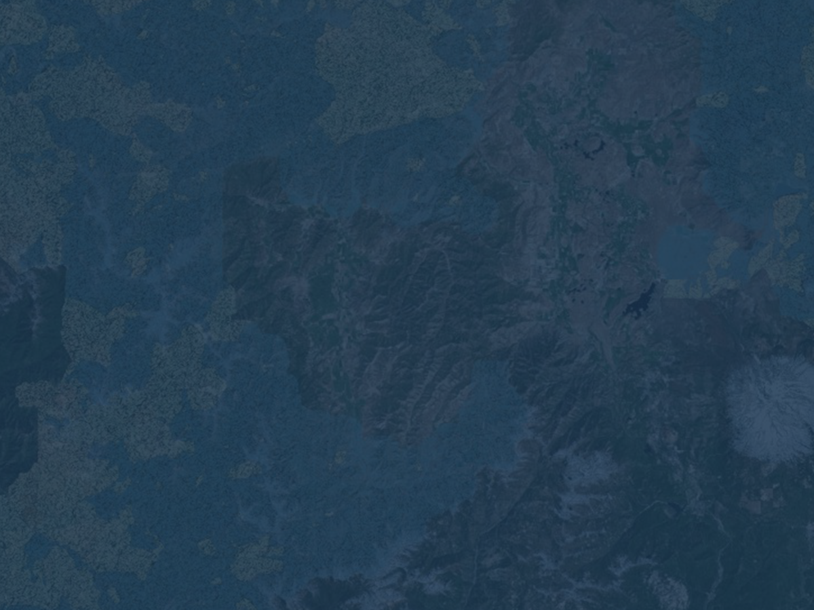
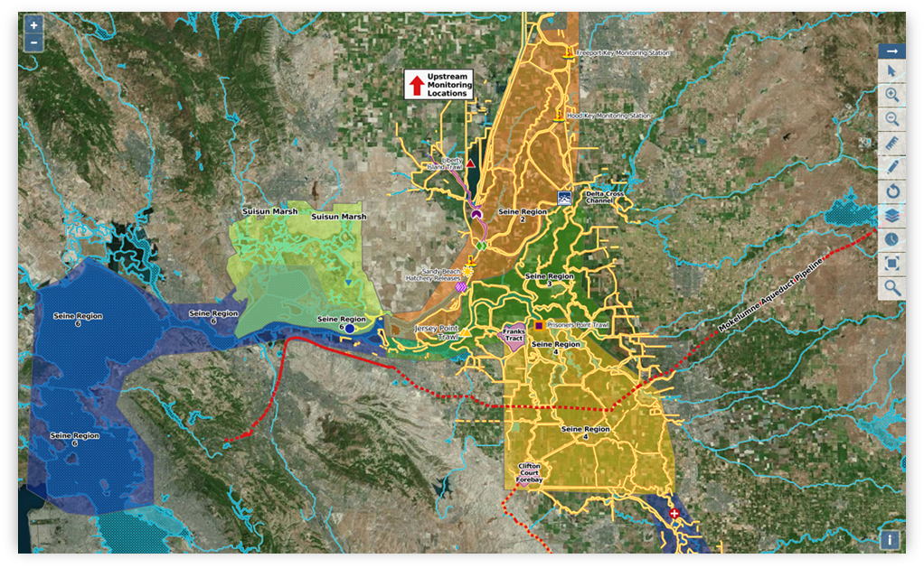

Data Visualizations

Slide 10
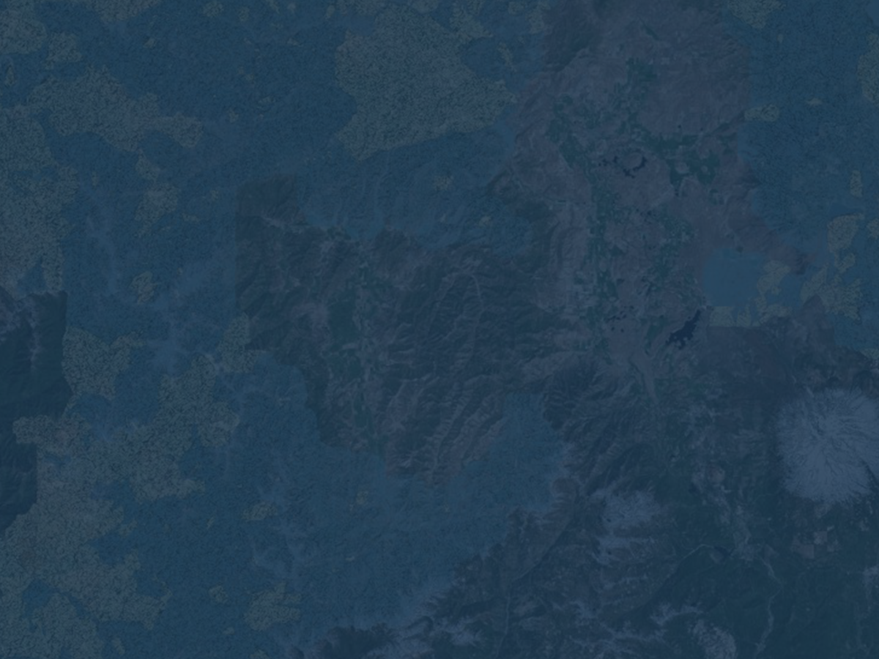
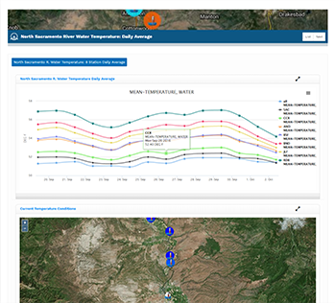
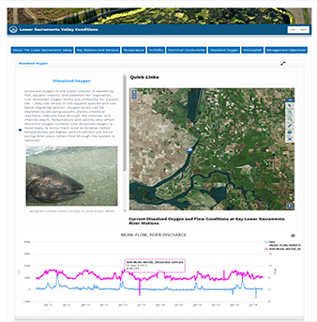
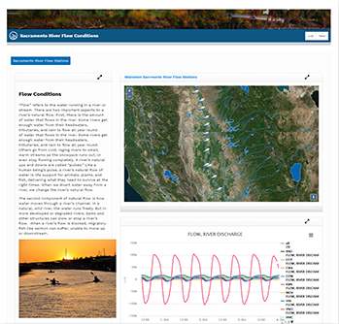
Data Dashboards and Stories
Fisheries, Reservoir Conditions, Water Quality

Slide 11

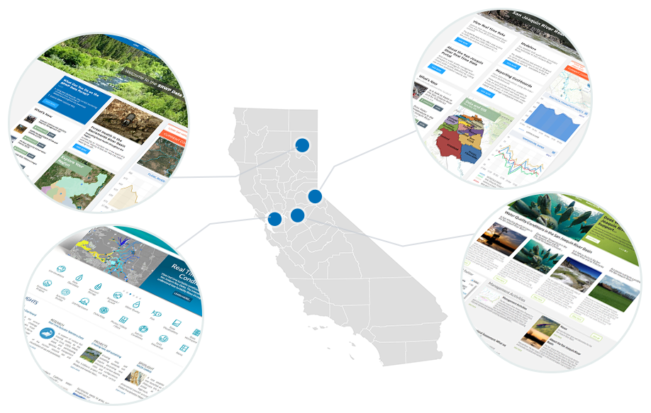
The California Use Case
Building a Collaborative Tool
Regional efforts share in investment. Benefit from an open
platform.

Slide 12
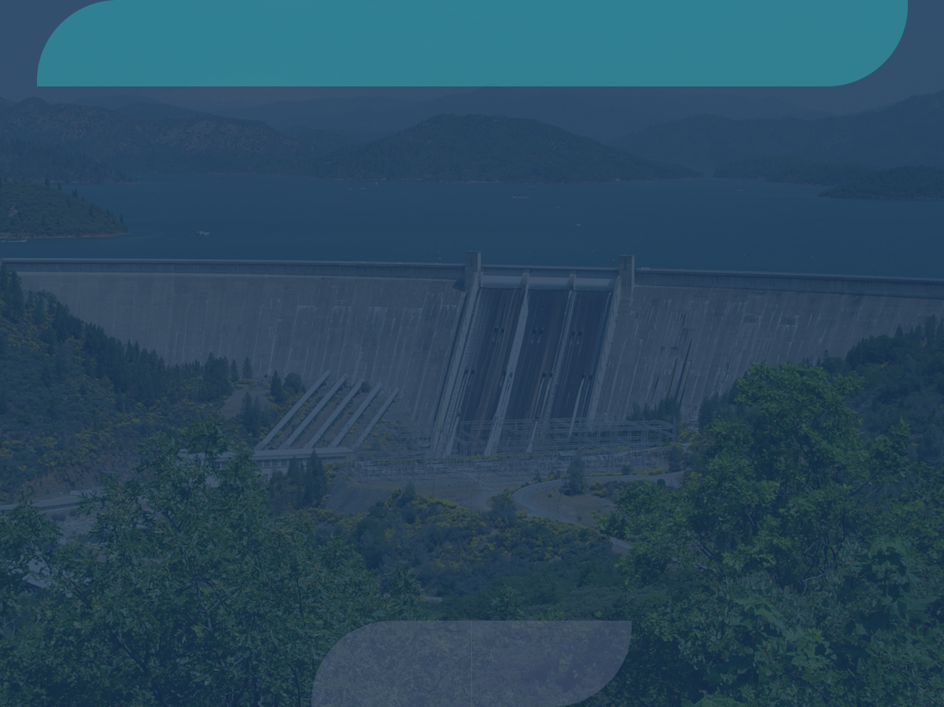

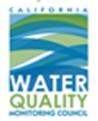



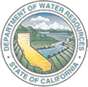

A Collaborative Effort
Regional and Statewide Programs
SACRAMENTO SAN JOAQUIN BAY-DELTA
SWRCB MY WATER QUALITY PORTALS
CALIFORNIA ESTUARY
PORTAL
SAN JOAQUIN REAL TIME MANAGEMENT
DWR 1641 WATER
QUALITY
SACRAMENTO RIVER
WATERSHED
Notes:
Regional portal approach provides a platform for local data programs

Slide 13
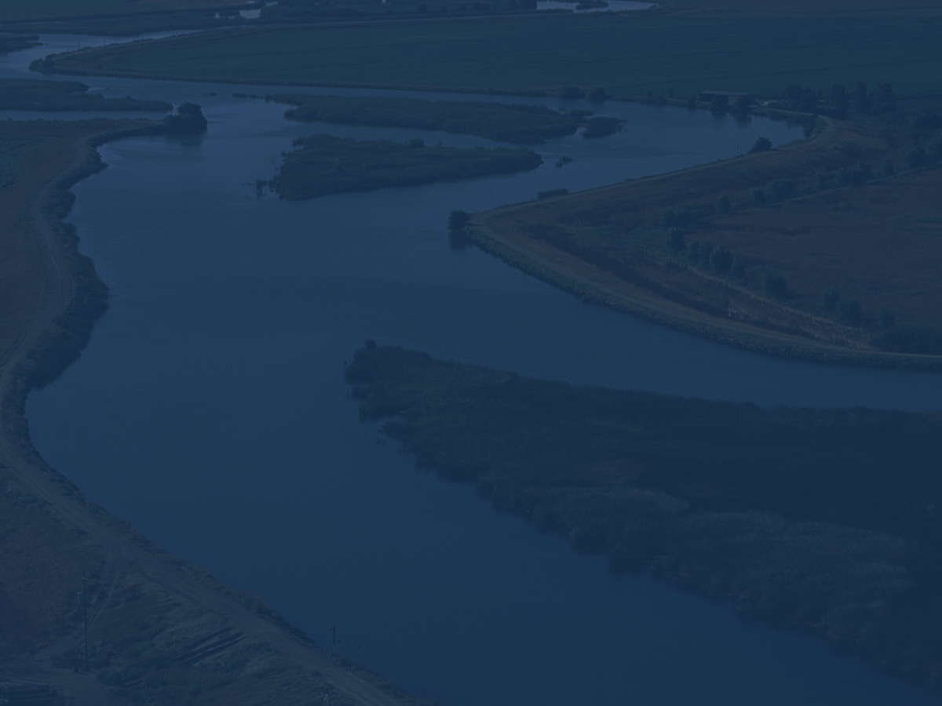
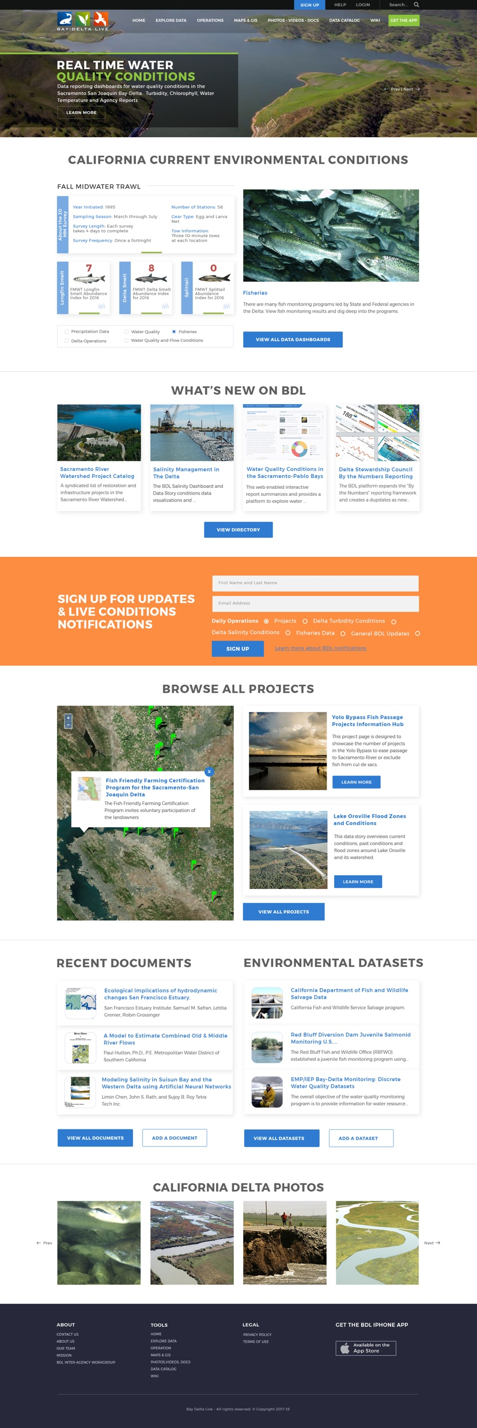
How the California is using OPENNRM
-Collaborative Resource Management and Planning
-Ecosystem Restoration
Collaborative Science
-Water Operations
-Monitoring Programs
-Watershed and Estuary Management
-Fisheries Management
-Inter-Agency Collaboration
-Climate Adaptation
-Conservation
-Policy and Outreach

Slide 14
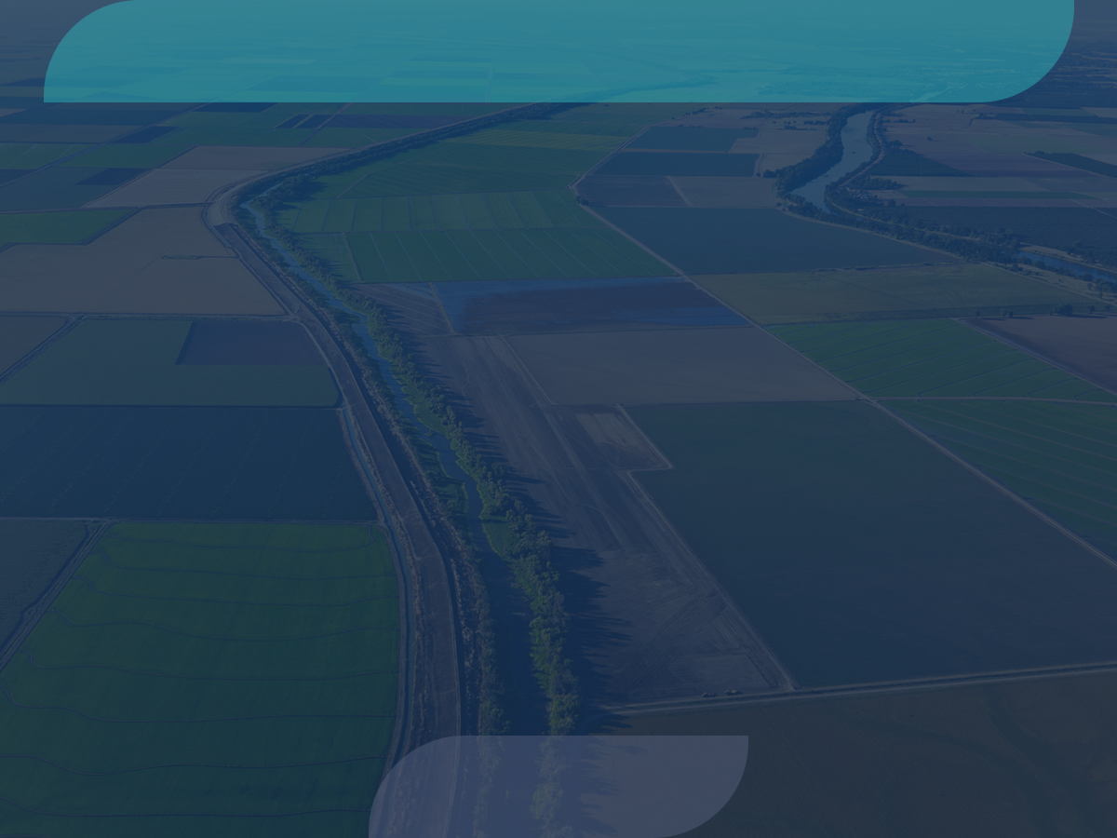

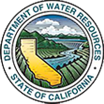









Creating a Complete Data Picture for California
Data is aggregated from stakeholders throughout the region:
Hydrologic
Water Quality
Satellite
Meteorological
Terrestrial
Volunteer Sampling

Slide 15
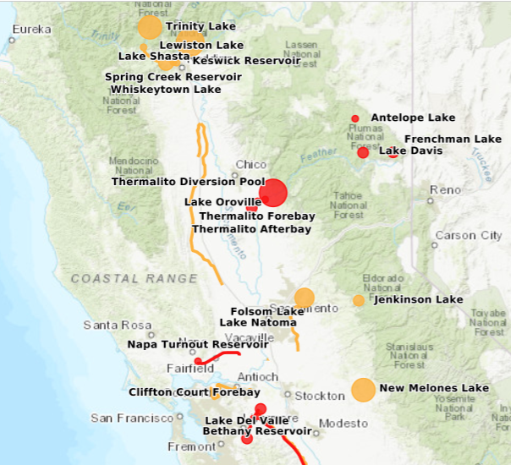
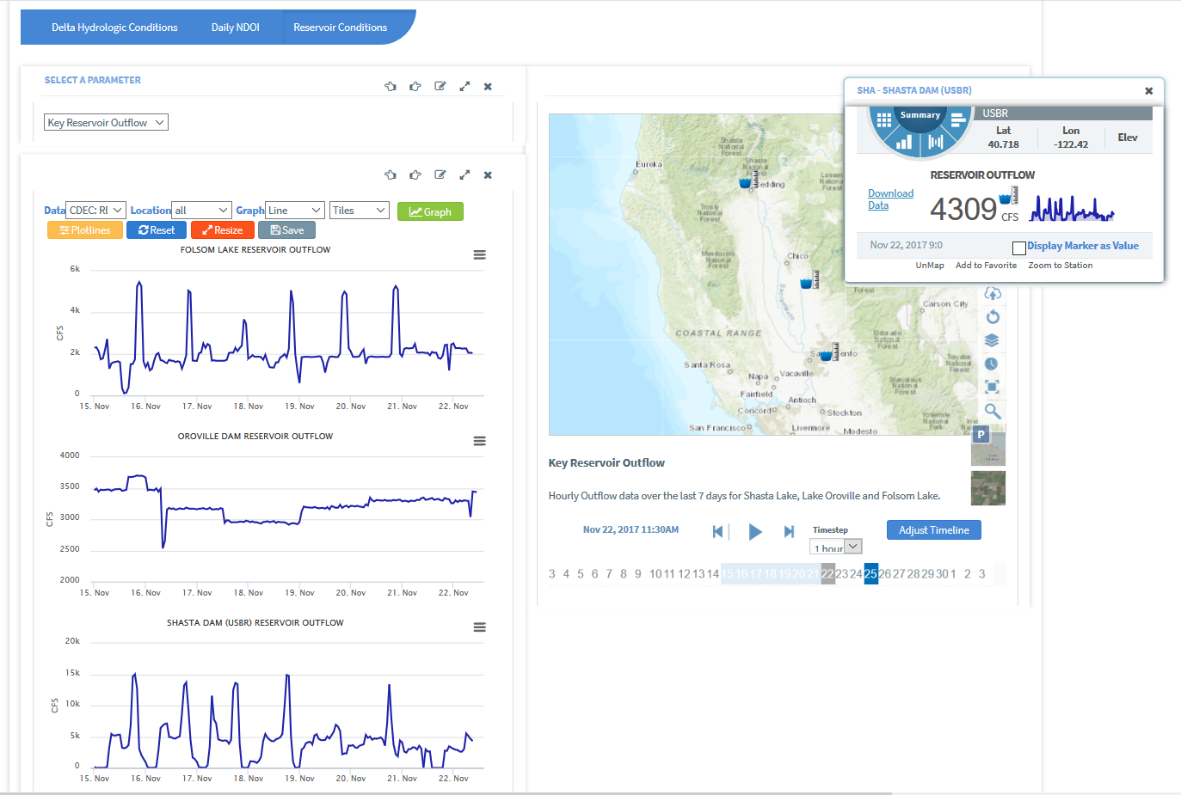
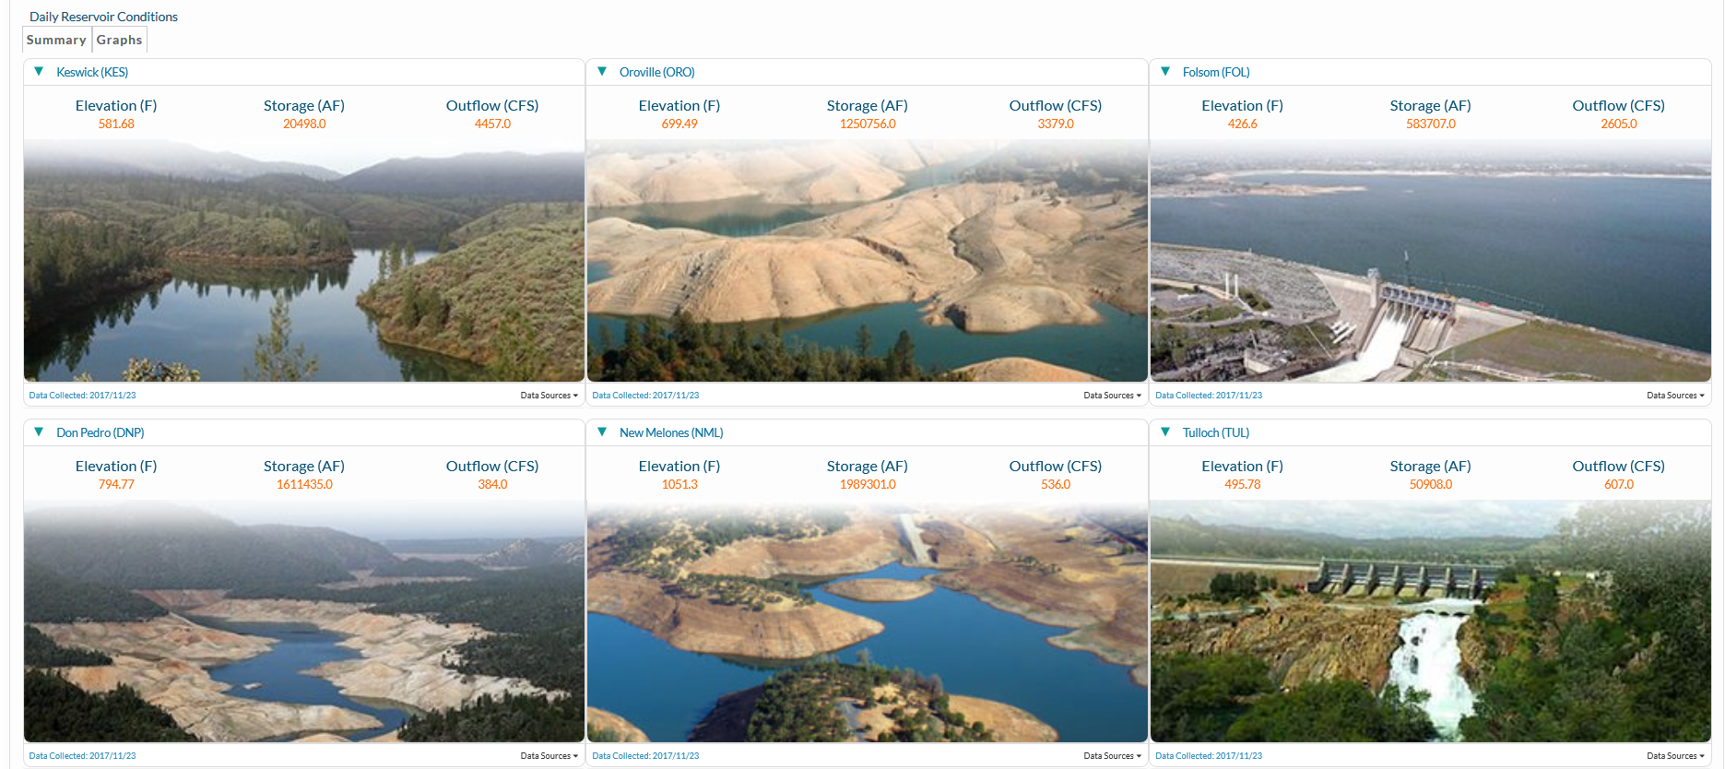
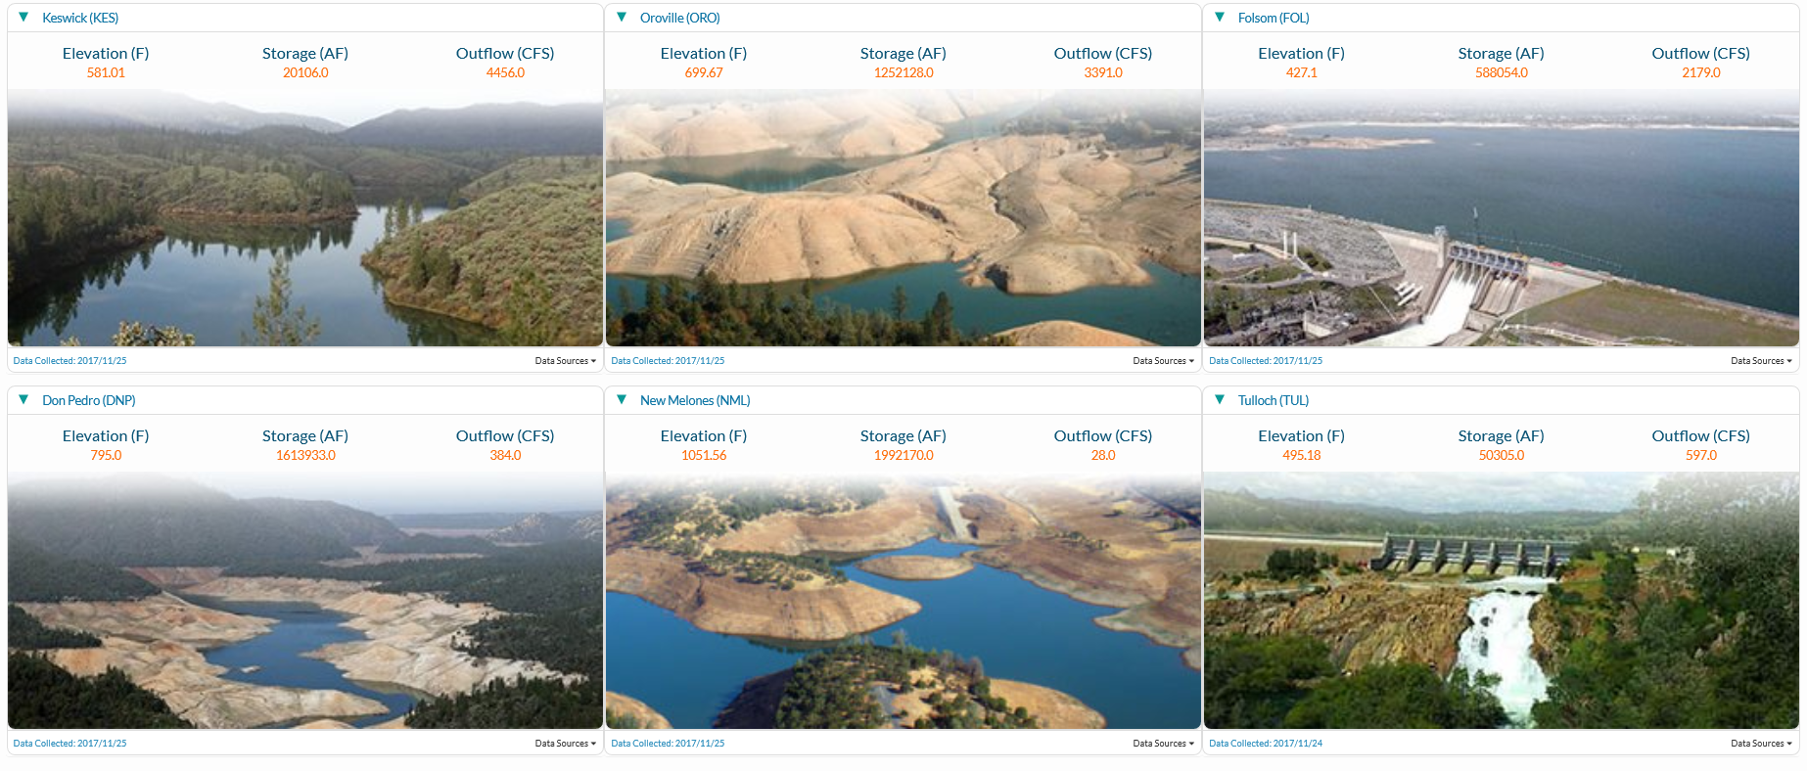
Water Operations
Notes:
In California large reservoirs are the starting point for water operations. The timing, temperature, and amount of water released has state-wide impacts.

Slide 16
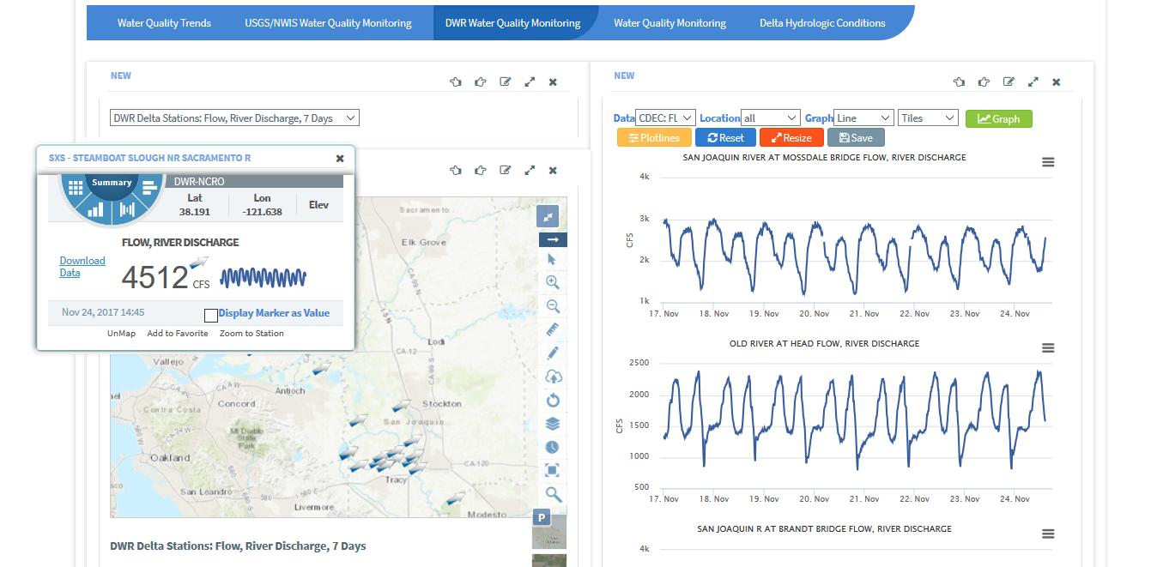
Water Quality Reporting

Slide 17
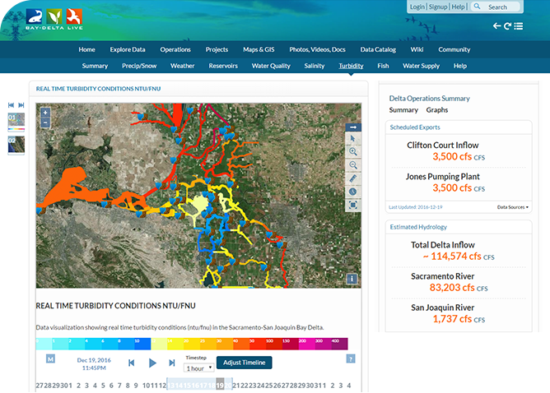
Turbidity Management
Turbidity Model displays real-time data from 46 CDEC Stations.
View data at various intervals (15 min, 1 r, 6 hr, 12 hr, 1 day, 1 week, 1 mo, 1 yr).
Data is 15-minute and averaged based on interval.

Slide 18

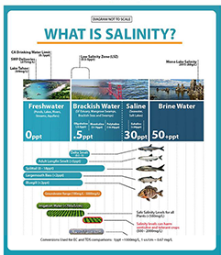
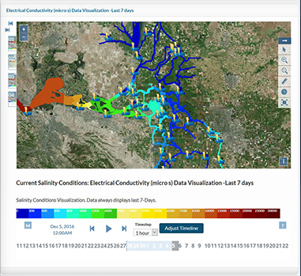
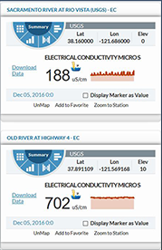
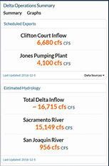
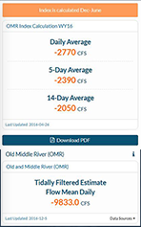
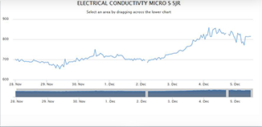
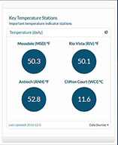
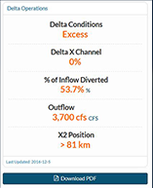
Salinity

Slide 19
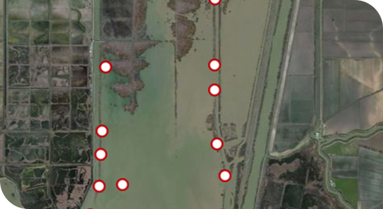
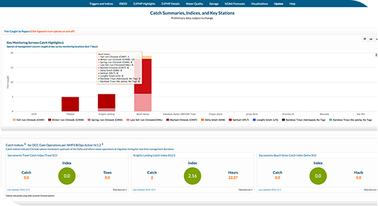


Fisheries
www.baydeltalive.com/fish

Slide 20


Delta Smelt Monitoring

Slide 21


Regulatory Reporting

Slide 22



Forest Health Initiative

Slide 23

Ecosystem Project Management and Collaboration
Notes:
Prepared a data interoperability report for funder and PI’s. How to connect research efforts in the same location collecting related data but with different goals in mind so tools, sampling effort, data collection frequency, etc are different across programs.

Slide 24


NASA/JPL: Remote Sensing to Inform Water Operations
Notes:
Early phase project: using remote sensing data to inform water decisions in the Delta and guide operation decisions. Reduce data collection efforts (often in bad weather) inform the space between in situ sensors, mid channel data.

Slide 25
Visit Example Projects
Bay Delta Live
www.baydeltalive.com
Sacramento River
Watershed Data Portal
data.sacrriver.org
San Joaquin Real Time
Management
sjrrtm.opennrm.org
California Estuary
Portal
www.mywaterquality.ca.gov
San Joaquin River
Monitoring
www.sanjoaquinwaterquality.com
Notes:
Thanks, links to portals

Slide 26


34 NORTH and OPENNRM
Notes:
Weekly summary for Chinook catch for the week 2/20/17 to 2/24/17
This image is a layer with the weekly summary of chinook catch (all runs) for the week February 20 to 24, 2017 (with region outline).

Slide 27


Helping to Make Connections
Leverage existing data platforms. Publish and share data on these platforms. Combine studies
with existing data, GIS, projects
and documents.
Researchers can easily
discover related projects,
data integration plans, support
resources (Map & GIS, Reports,
images).
Improve regional knowledge by
simplifying access to information.

