Slide 1
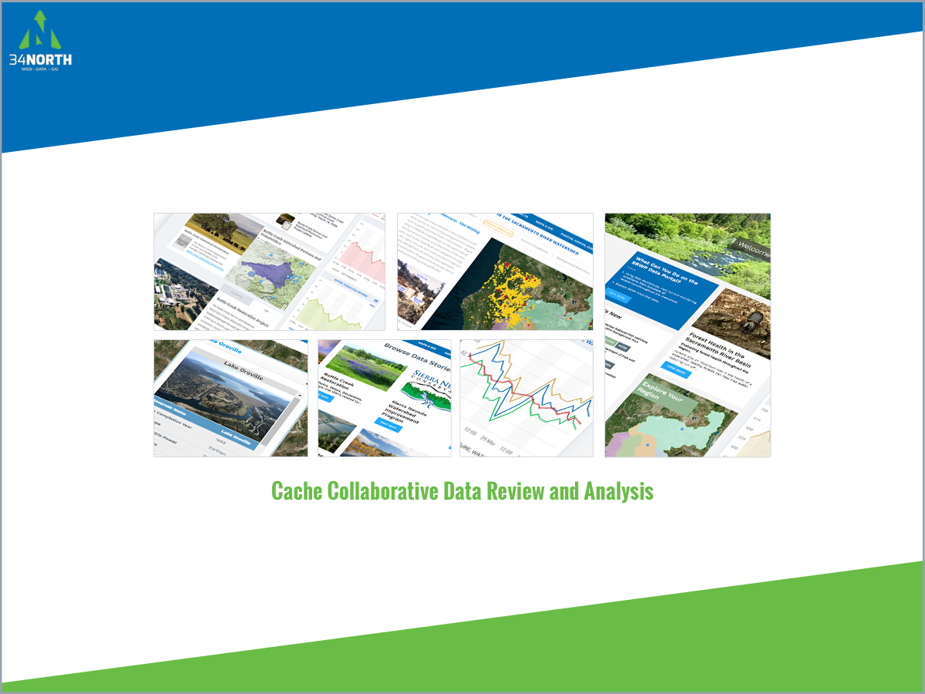
New title:
Connecting Scientific Research Projects and Data through Software: An Opportunity for Collaboration and Data Synthesis
Presenter:
Amye Osti, 34 North
Add BDL logo to bottom right corner
**This project is for BDL so we need to make sure it is BDL everywhere

Slide 2
The Challenge: Connecting Research
Most data are collected and stored within origination organization
Data is typically shared at quarterly meetings, after publication, added to state databases when funding is available, or only accessible by request
Data is often hard to find and delays in sharing data does not support real time, adaptive management actions and operations.
I am making an image for here
2. Do not use bullets in final design

Slide 3
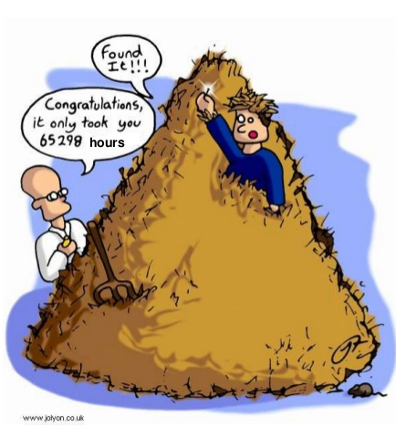
Helping to Make Connections
On-going efforts can leverage existing data platforms: Datasets, GIS, Project Data, Documents and more
Researchers can easily discover related projects, data plans, support resources (Maps & GIS, reports, images)
Improve regional knowledge by simplifying access to information.
Notes:
Regional data efforts are often used to support finding of research projects. BDL has more than X datasets (databases, GIS, available for use. Example NOAA tides and forecasts, CIMIS and CDEC precipitation. Flow. Reservoir releases.
Talk about how

Slide 4
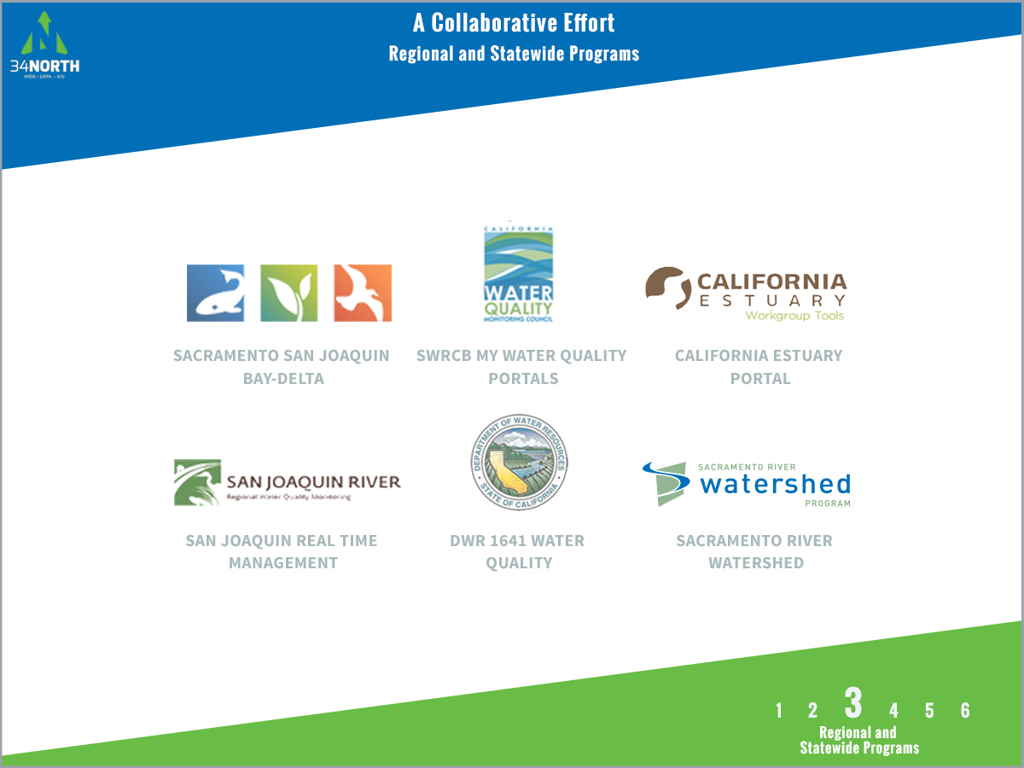

Slide 5
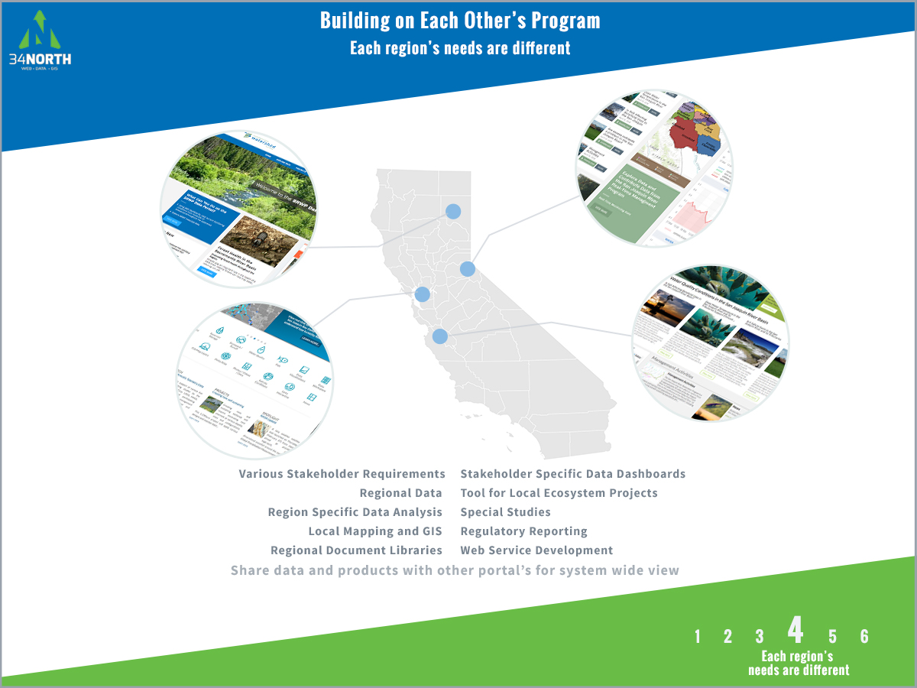

Slide 6

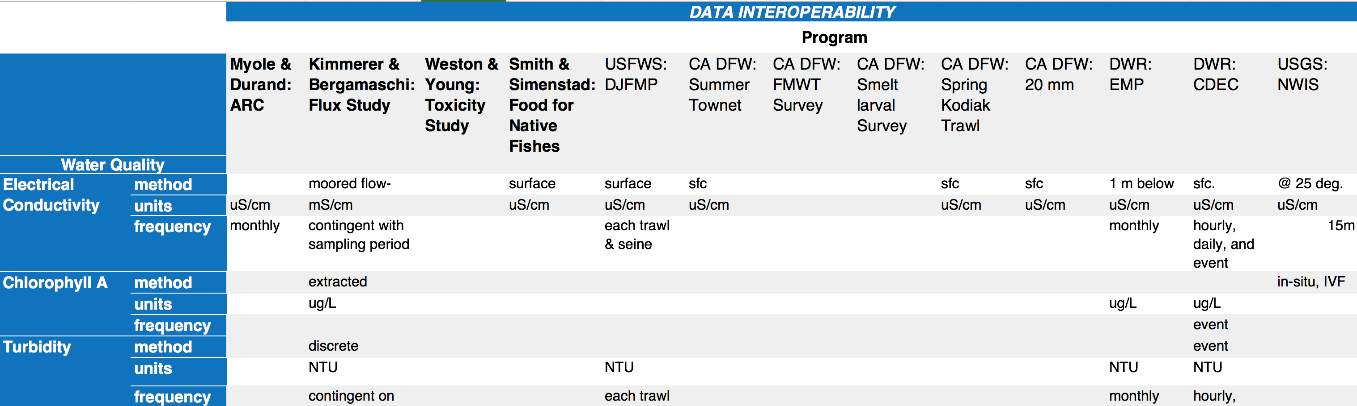
Scaling and Preparing the Platform
Cache Complex Monitoring Review Report: Current monitoring within the cache region.
    Water Quality
    Meteorological
    Food Web
    Hydrology
Data Integration Plan: Data integration documentation and schema for project stakeholders. Includes data types, owners, methods comparison, parameters library, collection frequency, etc.
Notes:
To bring a regional data platform to the landscape scale we were ask to do the following

Slide 7
Data Integration Plan
Data Integration Plan
Custom GIS and Database: Building on the BDL and Ca Estuaries data platforms, 34 North is making accessible all monitoring and key data from Cache projects, project areas and other data currently available in the region. This includes monitoring programs, custom GIS, project datasets, reports, related projects and real time data.
Project Tools: Working with project Pis project pages were developed for each project with general project data, documents, reports, data, GIS and related projects.
Cache Collaborative Info Hub: A dashboard collective synthesizing and informing all projects.
Notes:
IV. Data Comparison of the research projects included in the Cache Collaborative project.
This table outlines the geographical extent, time frame, and methods of each study. With the methods, it shows specifically how sampling was conducted for each specific parameter collected. Also included in the table are other research projects being conducted or previously conducted in the area that relate to the project but are not included in the Cache Collaborative.
V. Methods Comparison
Shows how the four Cache Collaborative research projects and the other programs sampling fish, zooplankton, phytoplankton, and water quality (Including CDEC and NWIS) are conducting their sampling, with what frequency, and how they are recording their data. The focus of this table is on data interoperability: how net and mesh sizes vary for different efforts, where units are different and how they may be converted for comparison across all studies.

Slide 8
If you can make this a nice table?
Data Interoperability:
Water Quality

Slide 9
If you can make this a nice table?
Data Interoperability:
Food Web

Slide 10
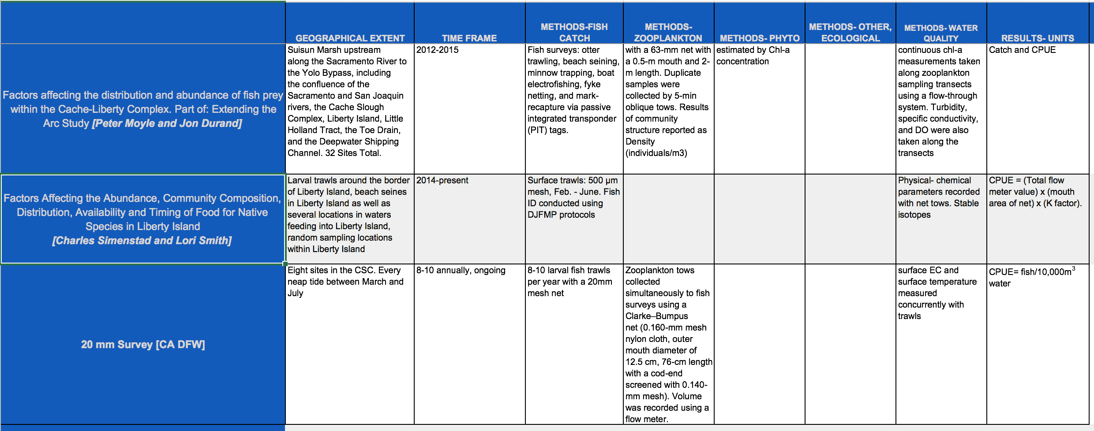
If you can make this a nice table?
Methods Comparison

Slide 11
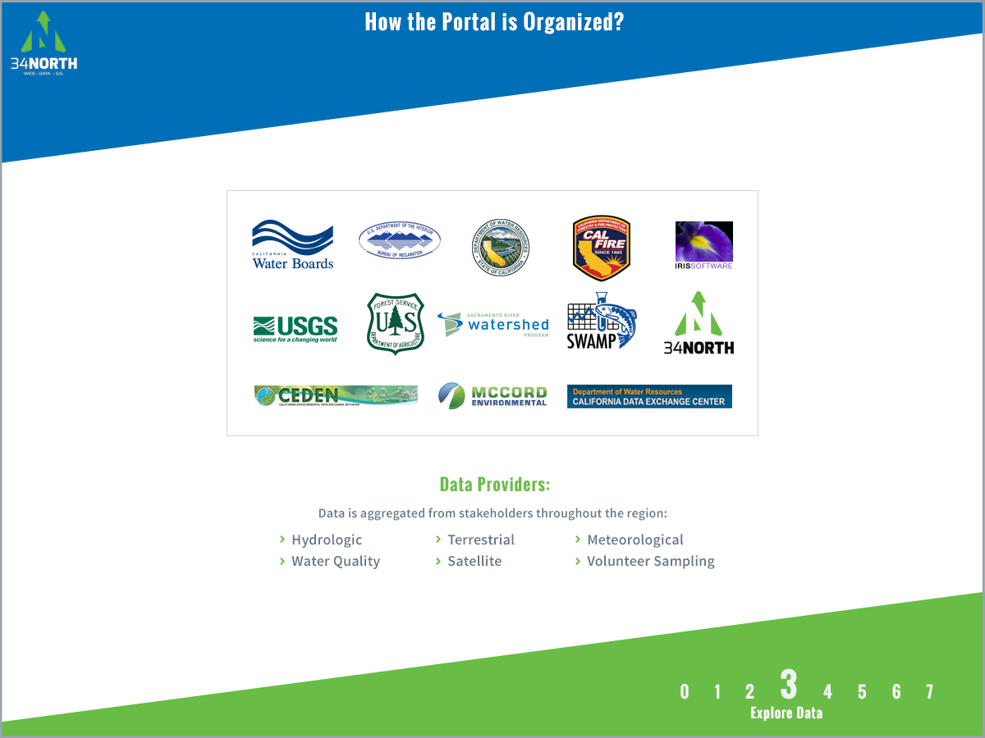

Slide 12
Data Set Name | Description | Source
CDEC | Real-time sensor data for key parameters include: Flow, Dissolved Oxygen, Chlorophyll A, River Stage, Turbidity, Electrical Conductivity, and Water Temperature | DWR
CIMIS | California Irrigation Management Information System manages a network of automated weather stations | DWR
NOAA National Weather Service | Weather forecasting stations | NOAA
NOAA River Forecasting | River flow and stage forecasting | NOAA
NOAA Tide Prediction | Tide forecasting stations | NOAA
USFWS DJFMP | Delta Juvenile Fish Monitoring Program recent and historic fish and environmental parameter information for the Delta | USFWS
USGS National Water Information Service | Real-time sensor data for key parameters include: Flow, Dissolved Oxygen, Chlorophyll A, River Stage, Turbidity, Electrical Conductivity, and Water Temperature | USGS
EMP Benthic Monitoring | Recent and historic benthic monitoring and environmental data at discrete locations in the Delta | DWR
Available Data

Slide 13
EMP Zooplankton Monitoring | Recent and historic zooplankton monitoring and environmental data at discrete locations in the Delta | CA DFW
EMP Discrete Water Quality Monitoring | Recent and historic water quality monitoring discrete locations in the Delta (key parameters: Secchi Depth, Temperature, Tide, Wind, Electrical Conductance, and pH) | DWR
CEDEN Benthic |  | CEDEN
CEDEN Habitat |  | CEDEN
CEDEN Water Quality |  | CEDEN
CEDEN Toxicity |  | CEDEN
CEDEN Tissue |  | CEDEN
CA DFW Fish Monitoring | Recent and Historic Catch data (fish and other aquatic organisms) and environmental data from multiple CA DFW Surveys, including: Spring Kodiak Trawl, Fall Midwater Trawl, 20 MM Trawl, Summer Townet, Smelt Larval Survey, and San Francisco Bay Study. | CA DFW
Available Data

Slide 14
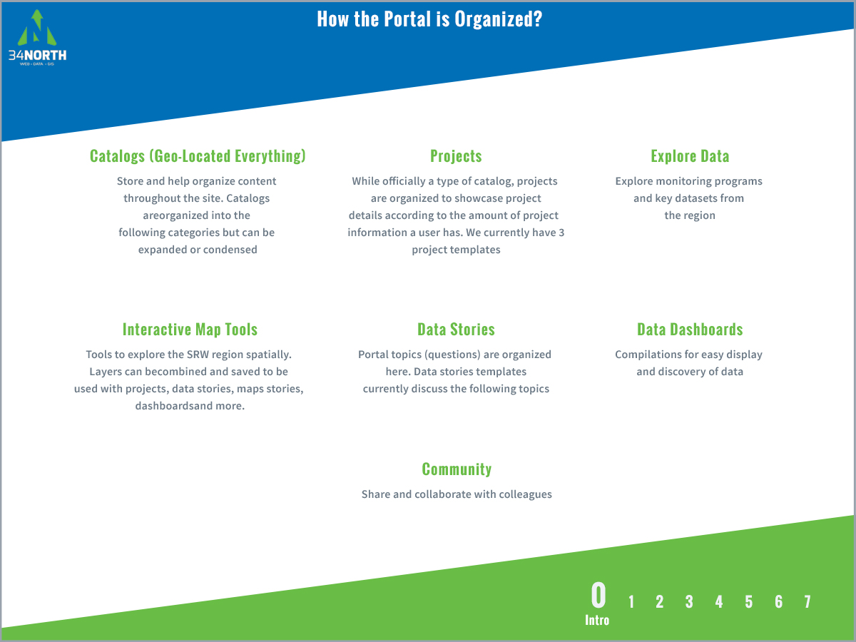

Slide 15
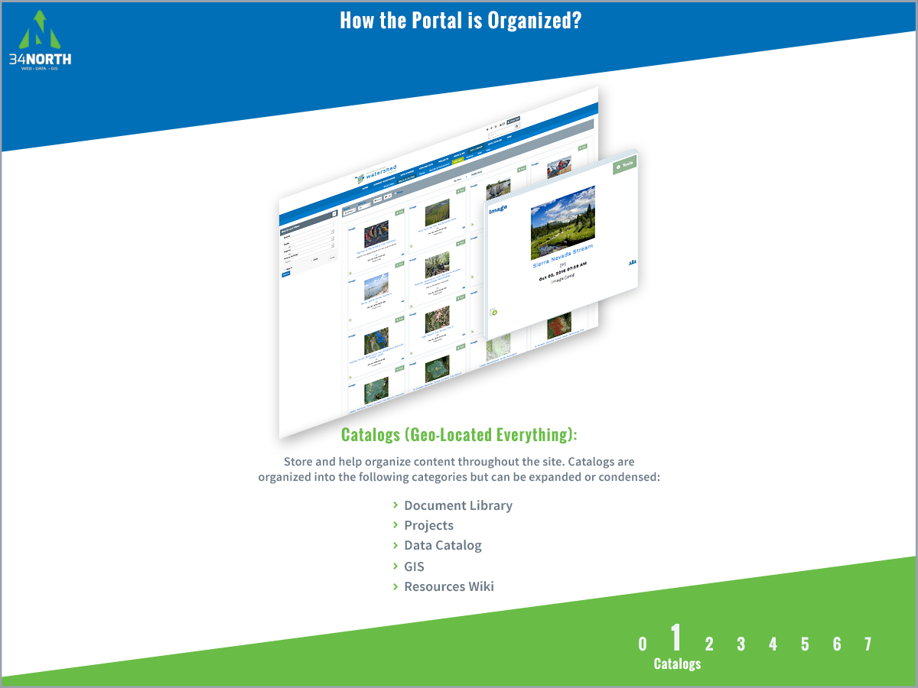

Slide 16
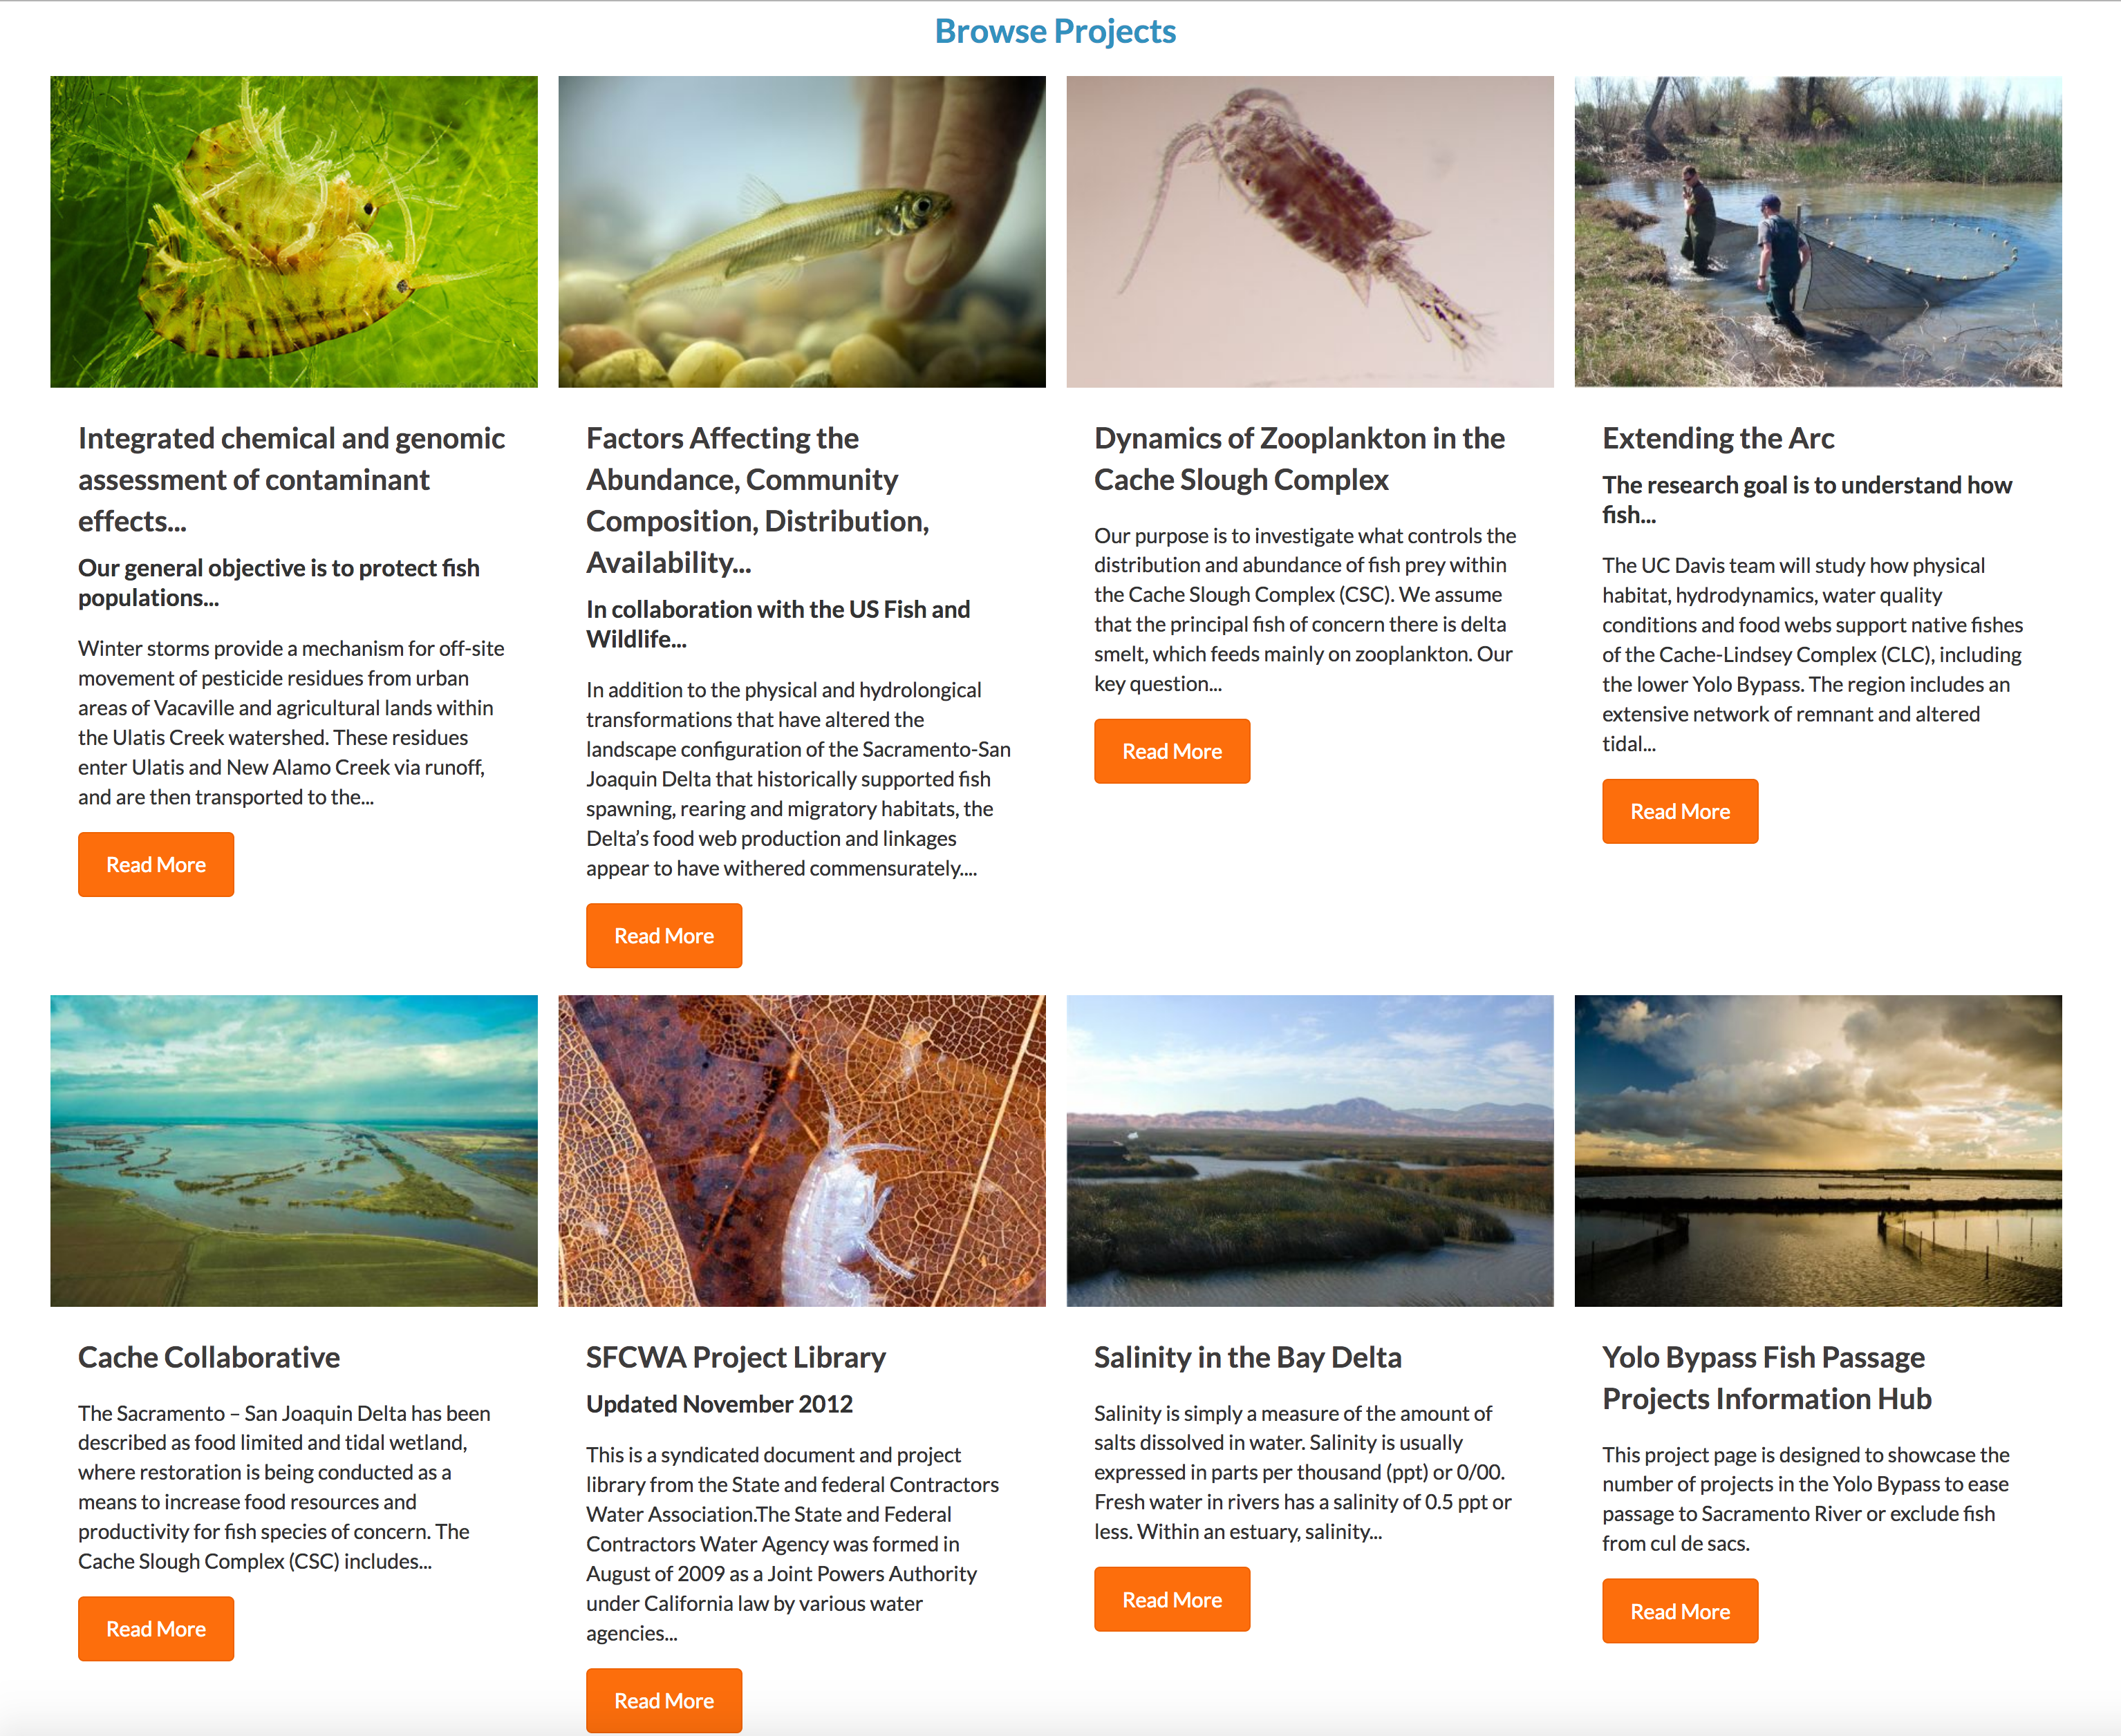
Notes:
Project Catalog

Slide 17
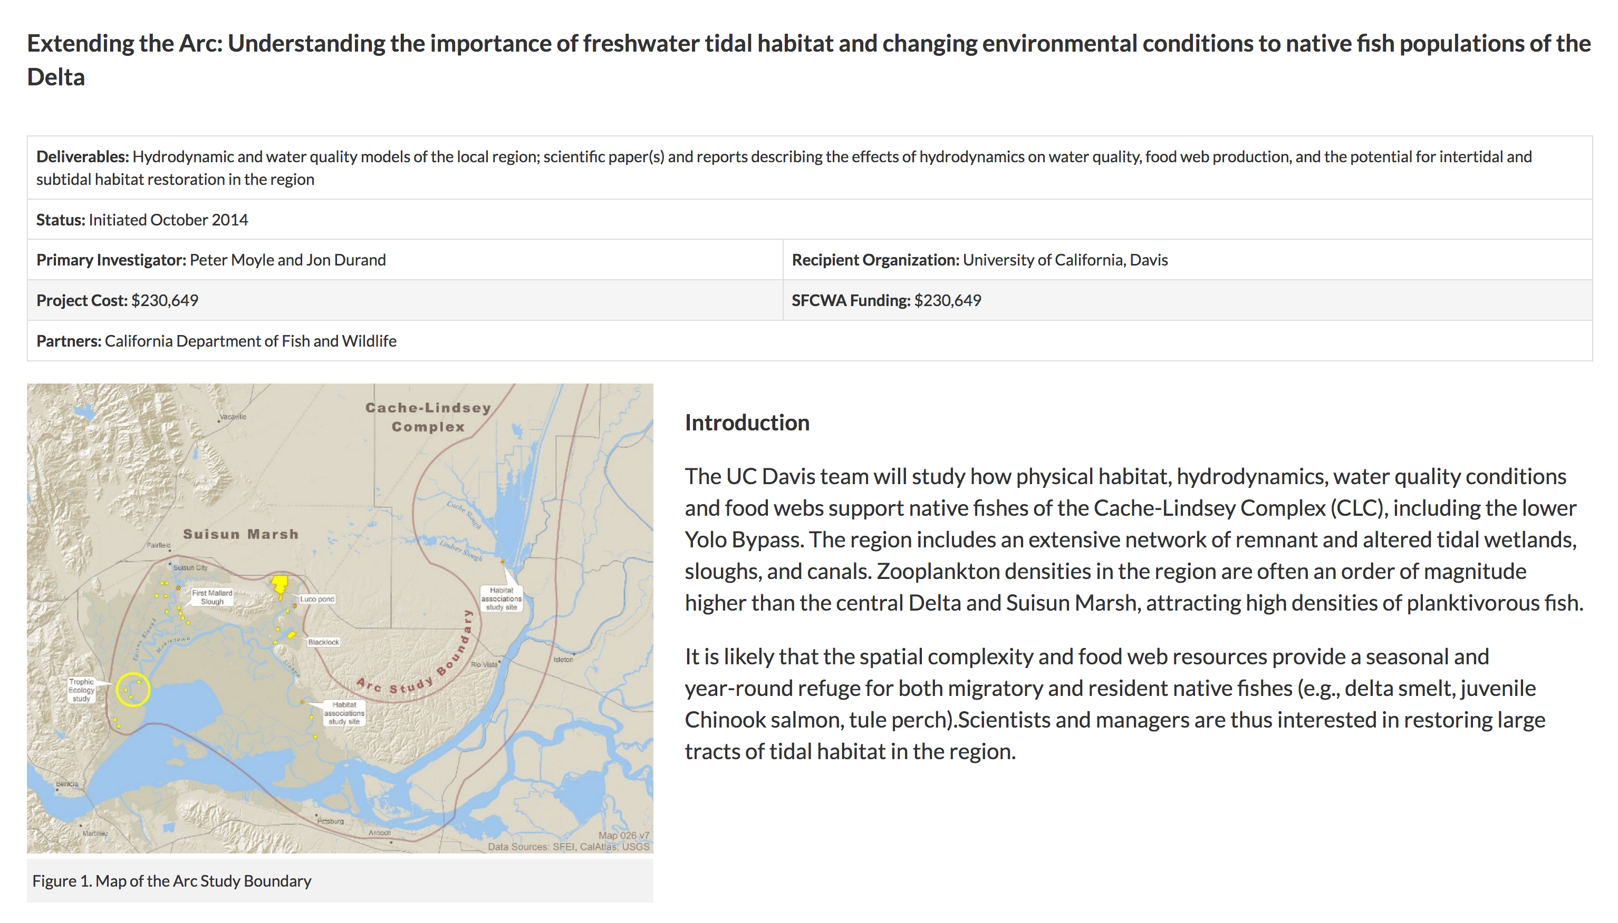
Notes:
Project article

Slide 18
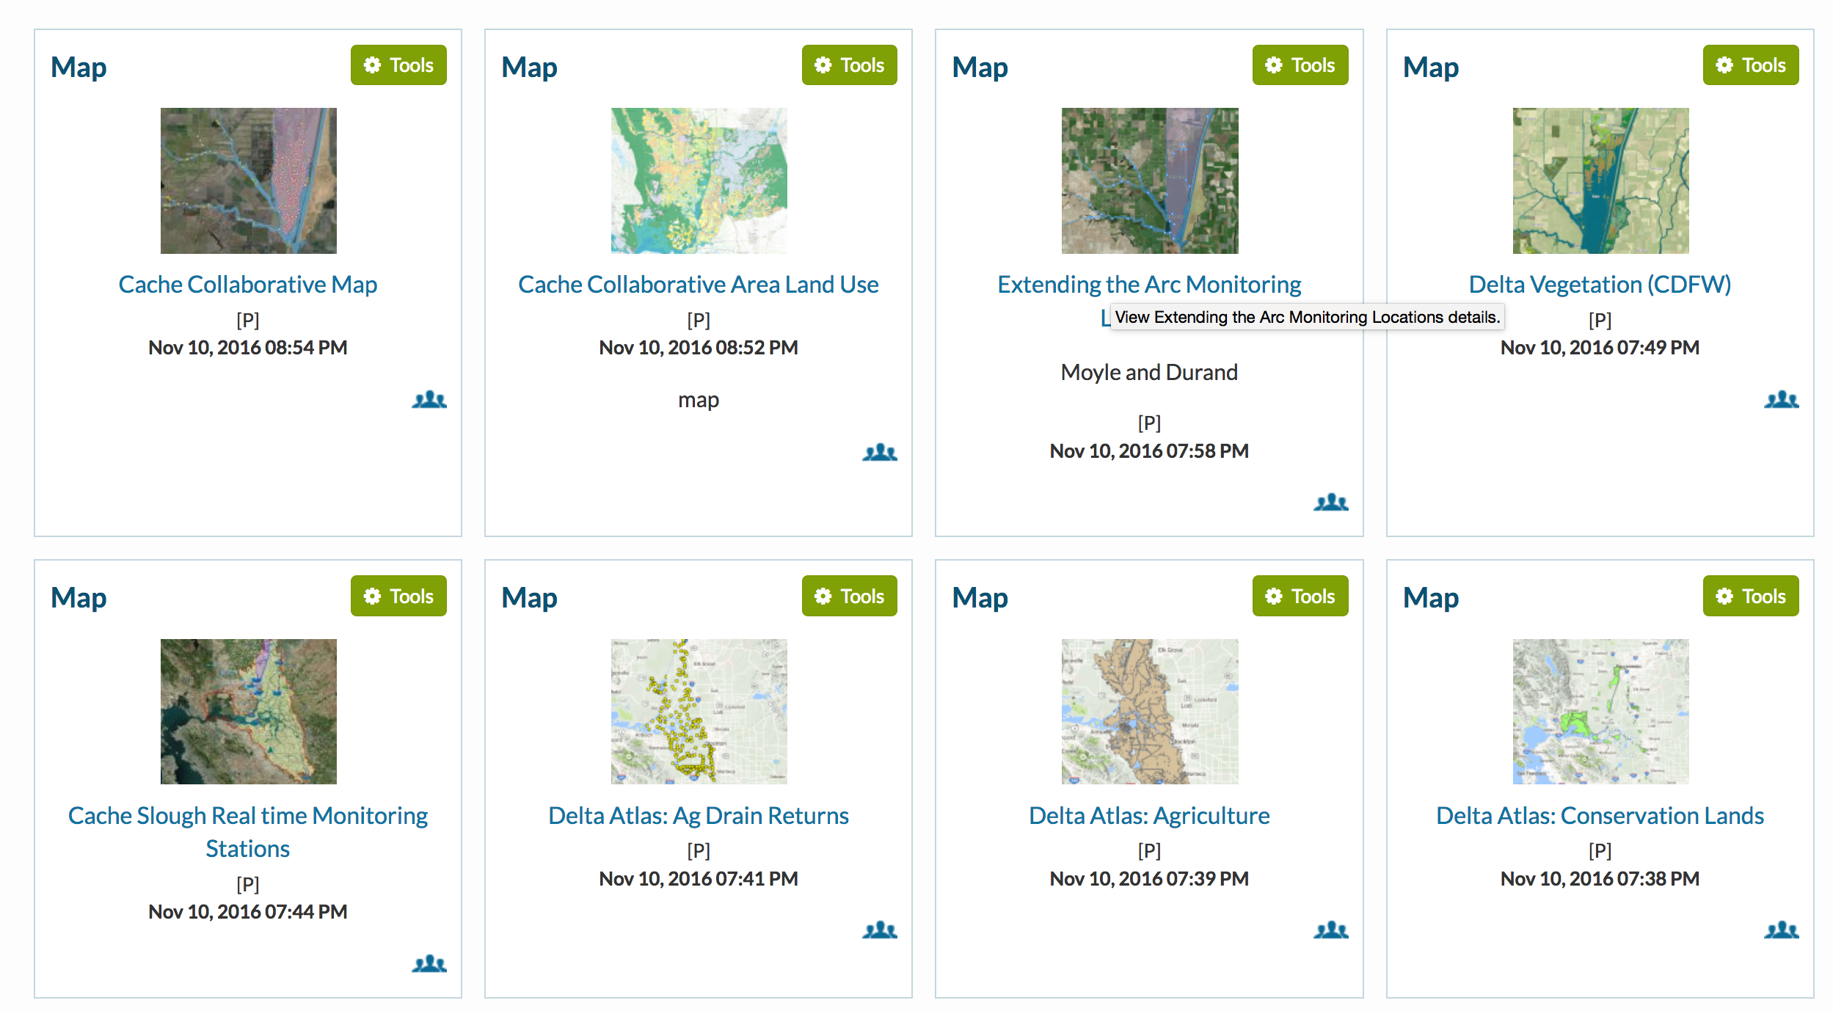
Notes:
Maps and GIS related to the Project

Slide 19
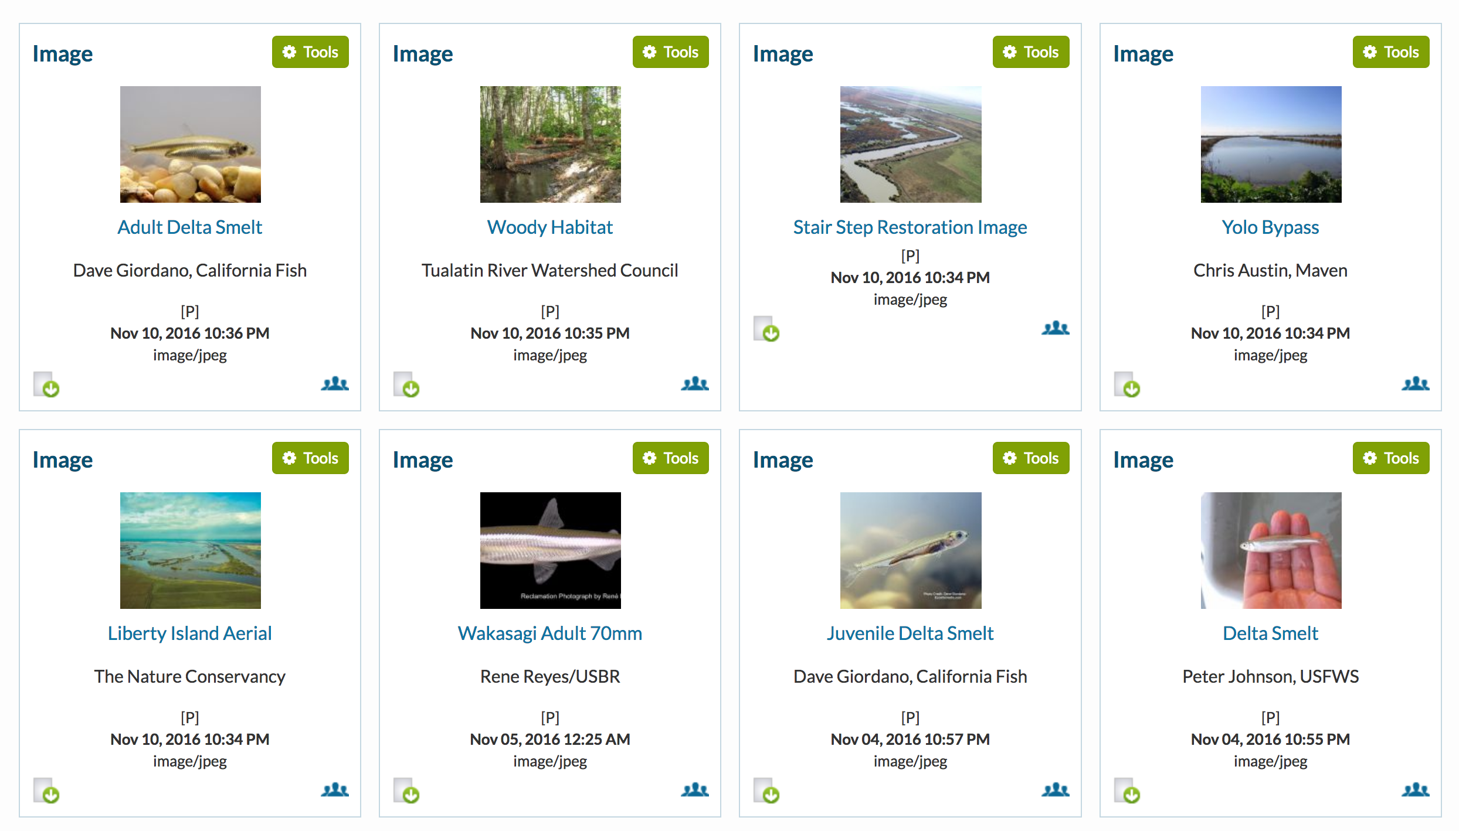
Notes:
Images

Slide 20
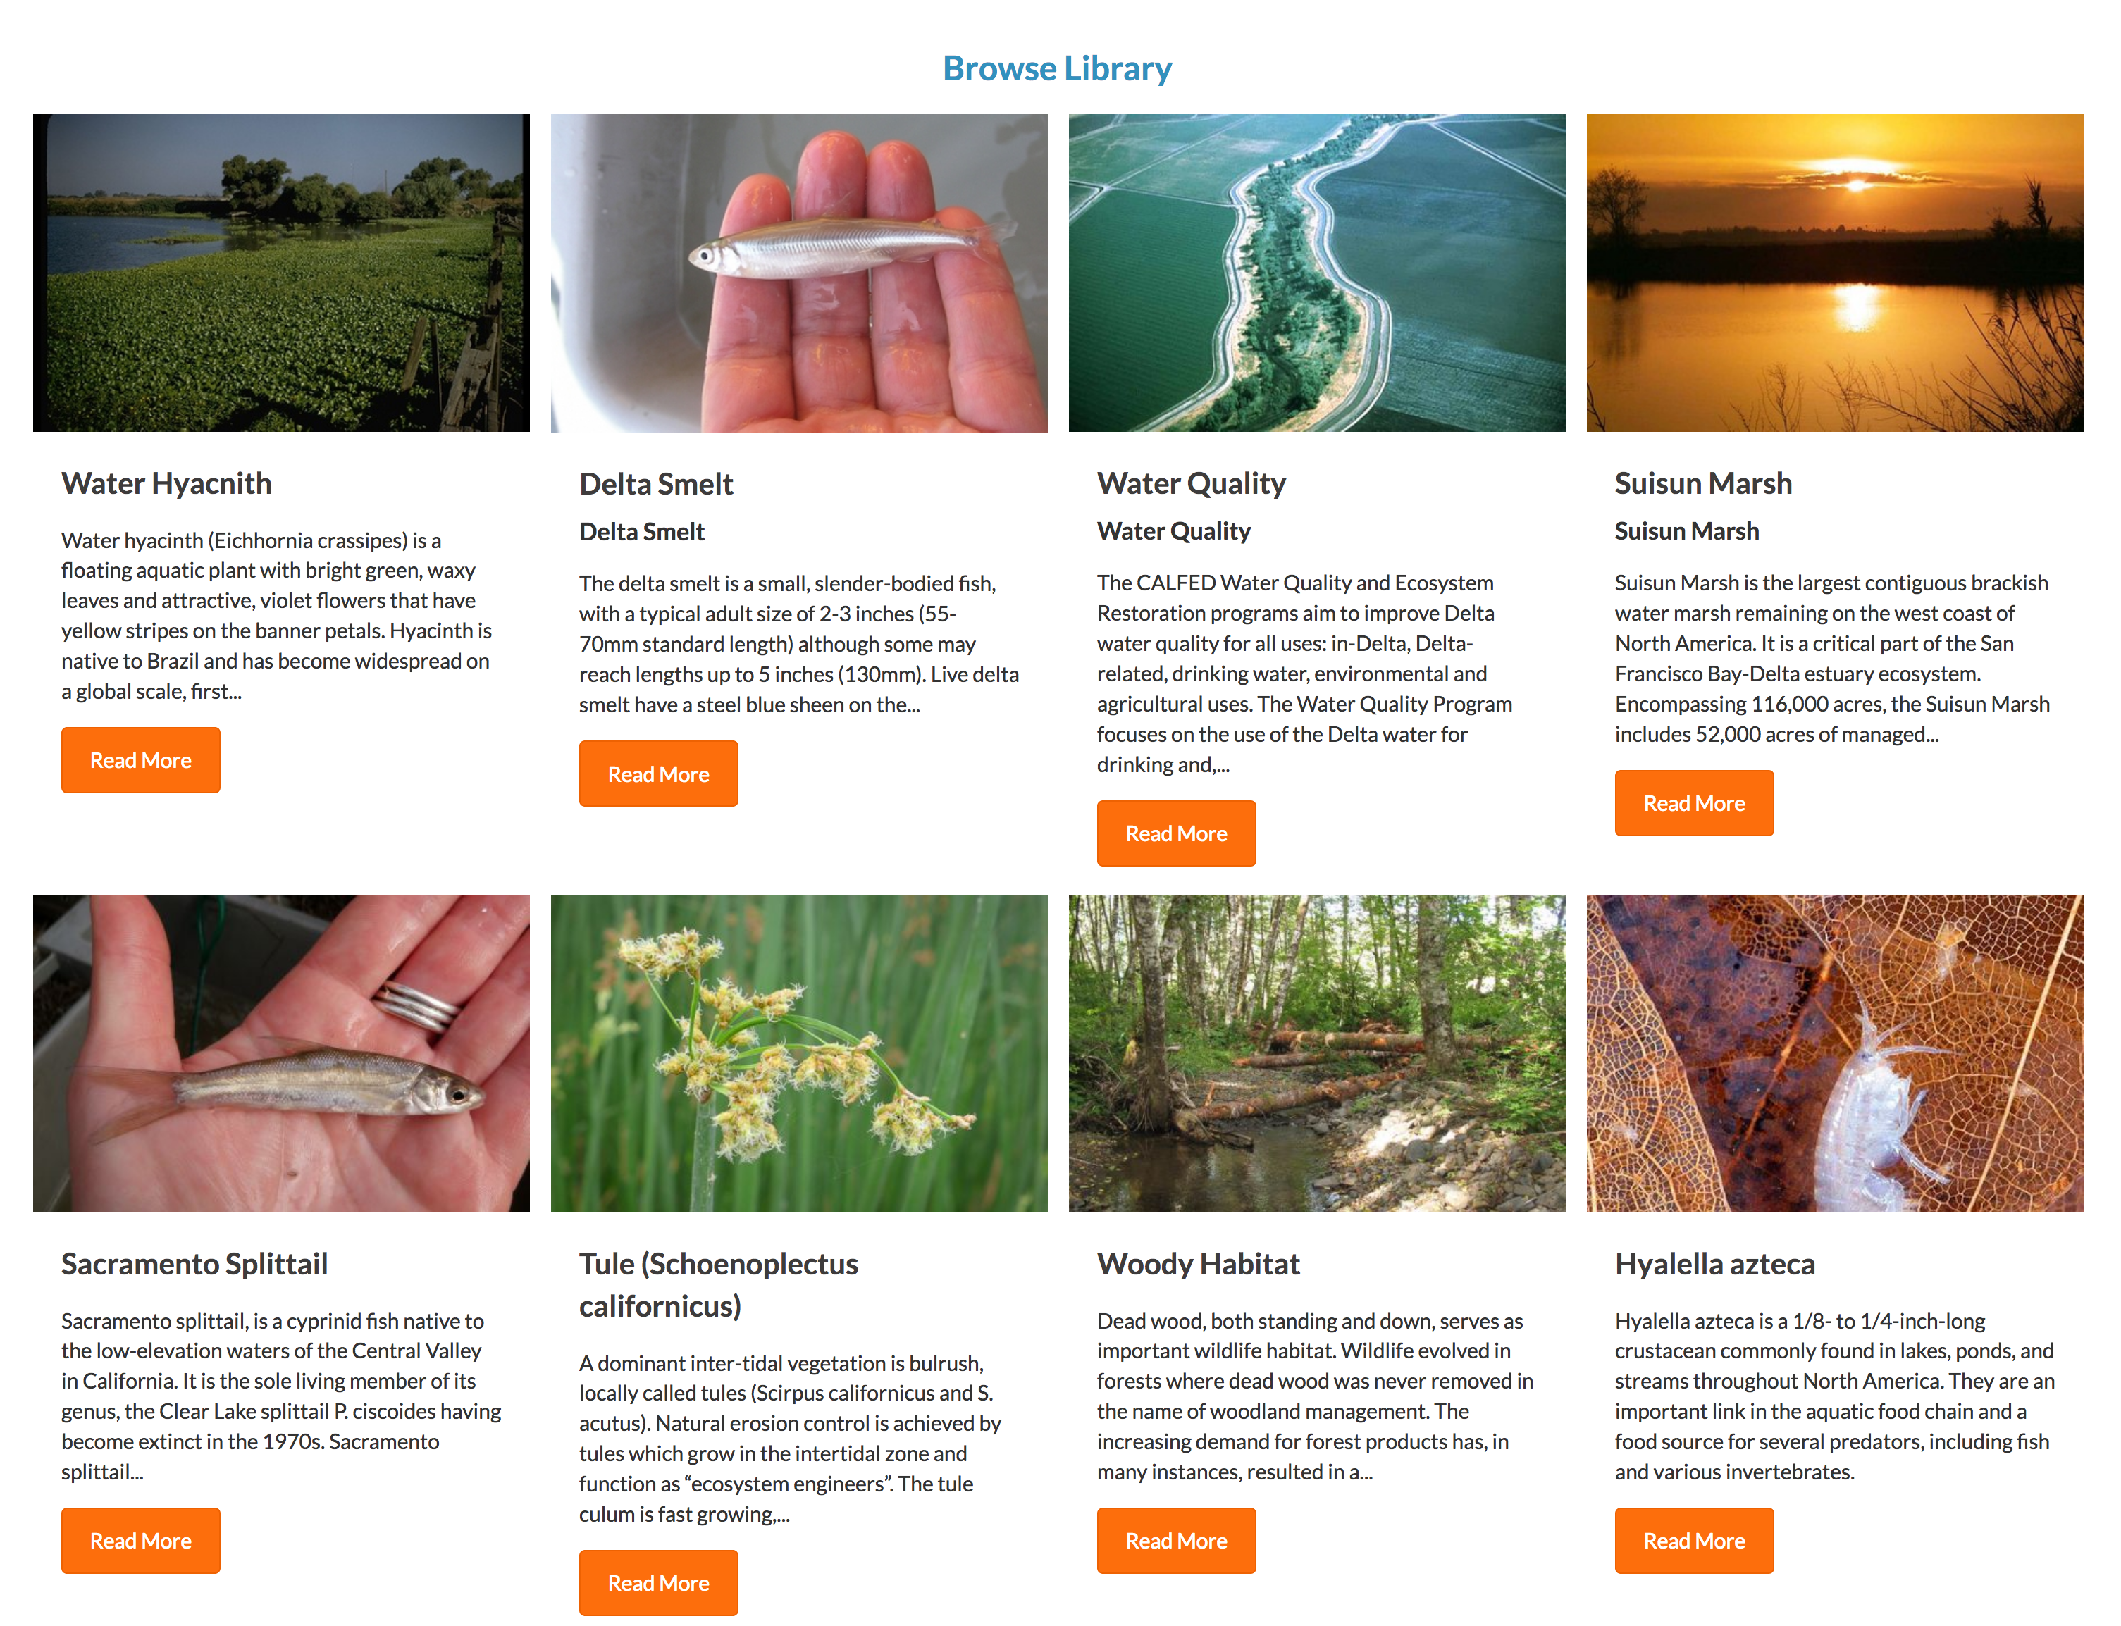
Notes:
Wiki Catalog

Slide 21
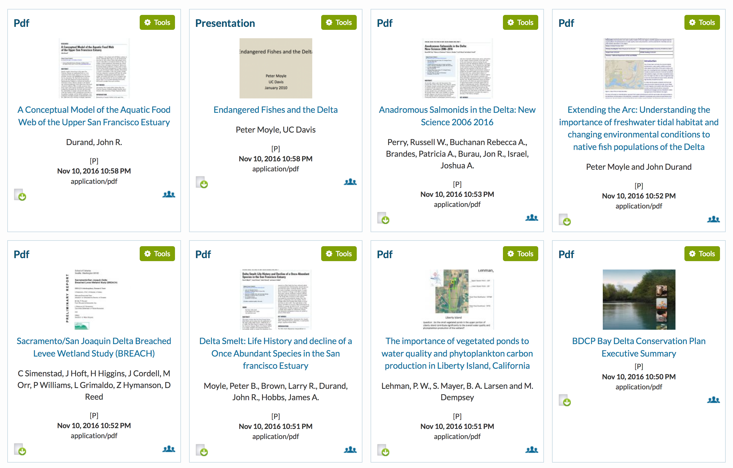

Slide 22
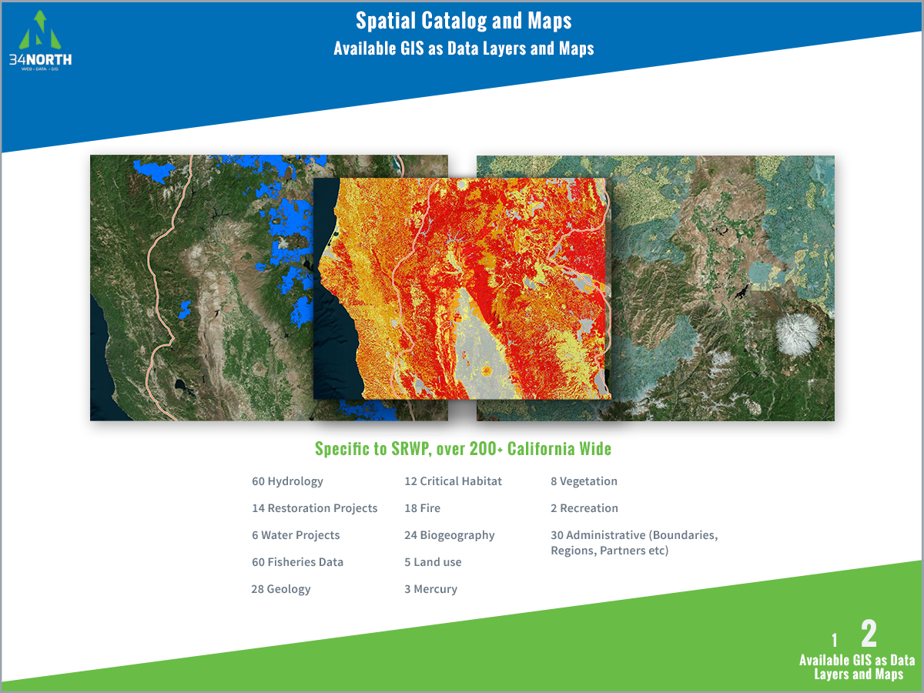
Change text to: Resources Specific to the Cache Region, over 200 California Wide

Slide 23
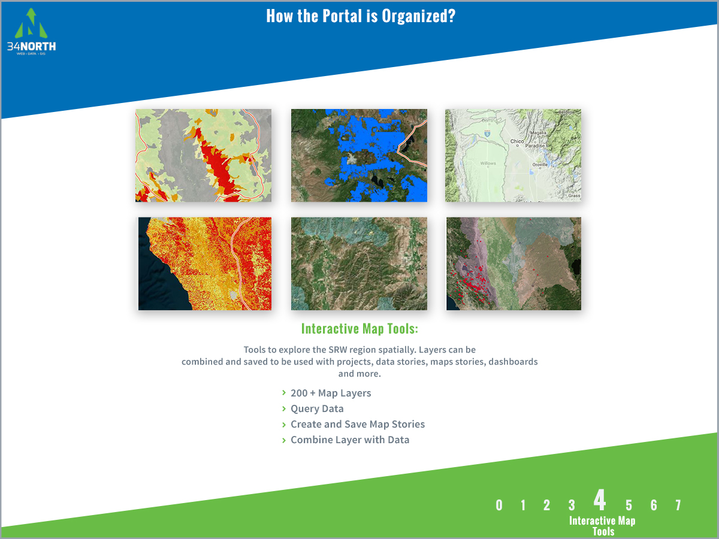
Change text to:
Interactive Map Tools
Tools to explore a region spatially. Layers can be combined….

Slide 24
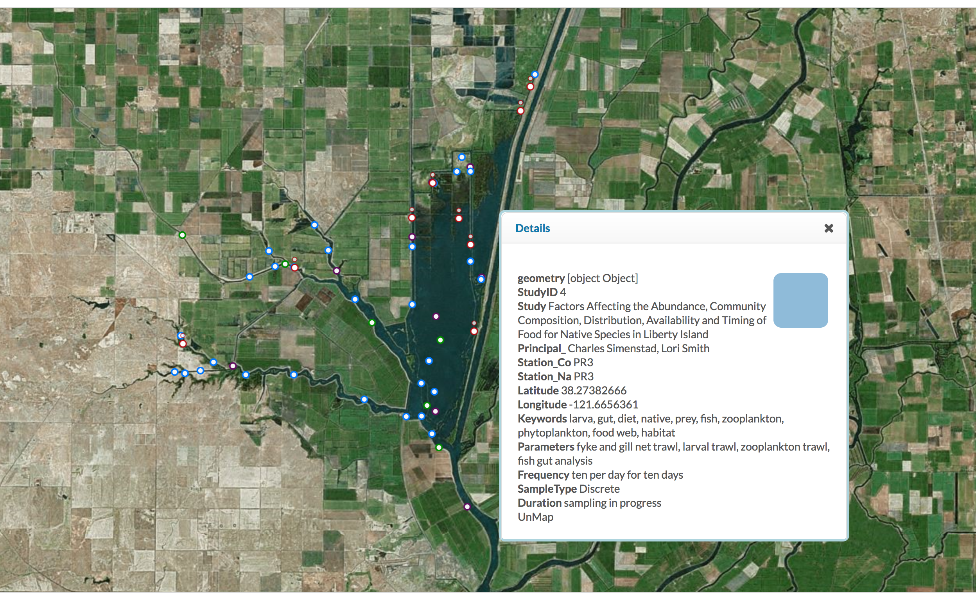
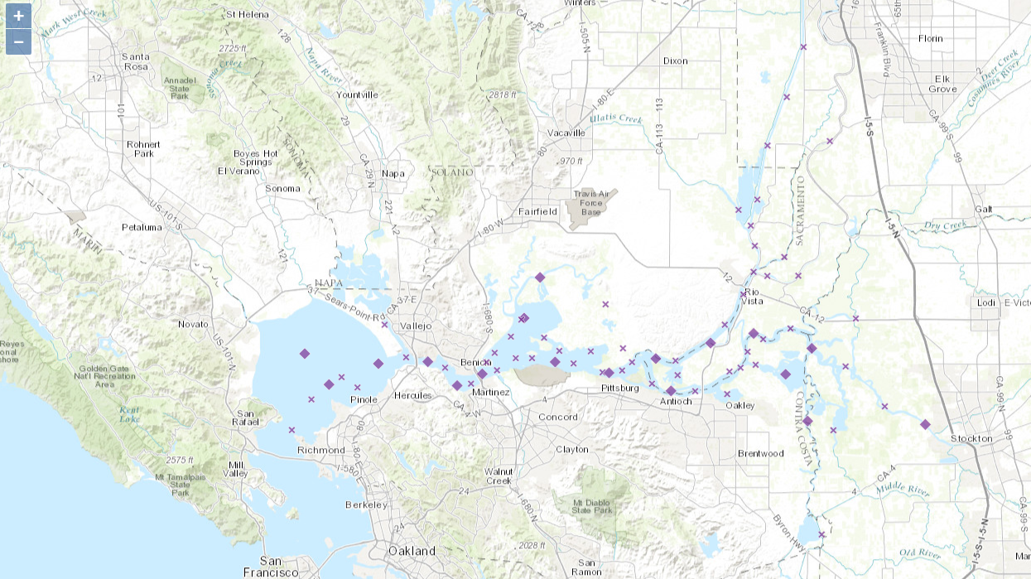
Cache Collaborative Monitoring Locations with Station Metadata

Slide 25
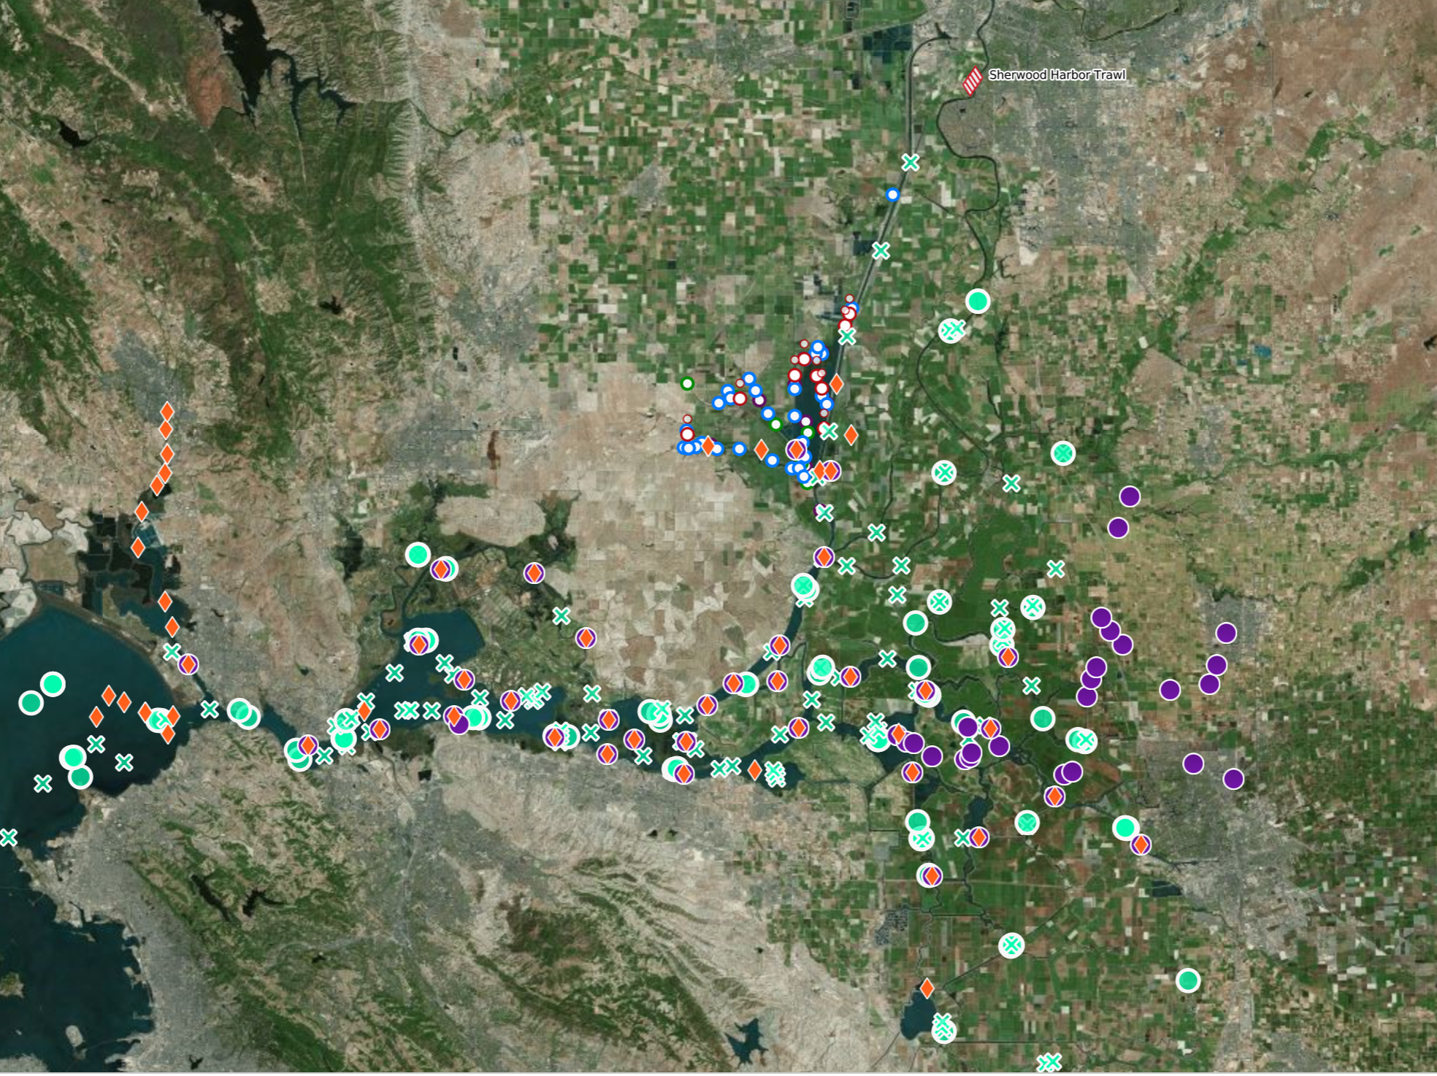
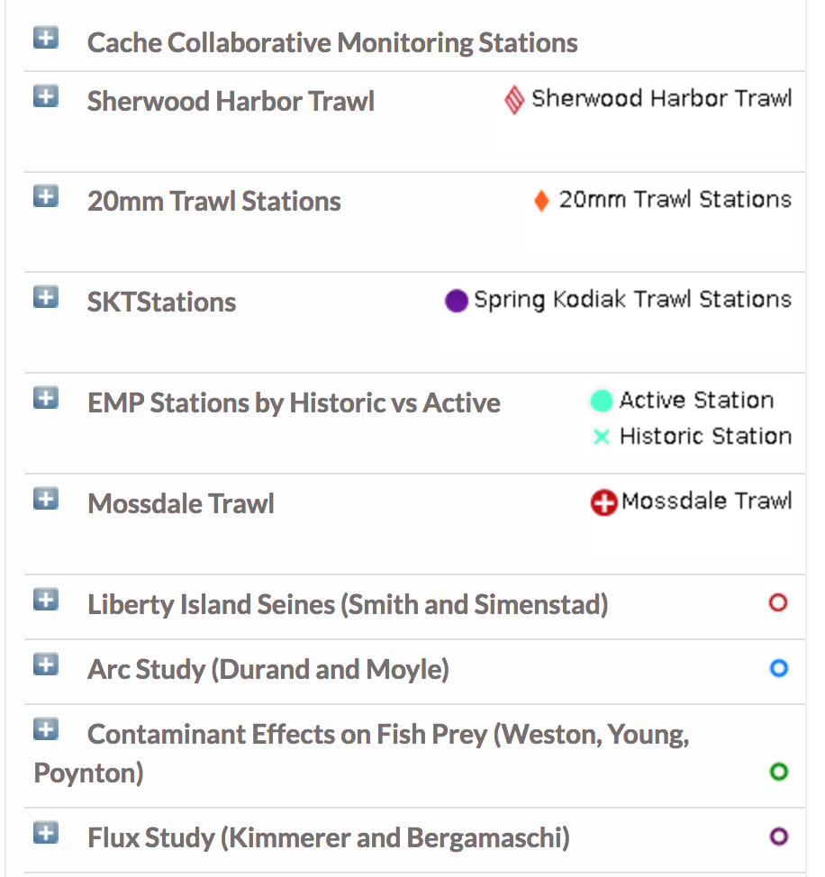
Sampling locations of Programs collecting Biologic Data (Zooplankton, Phytoplankton, Benthic, and Fish)

Slide 26
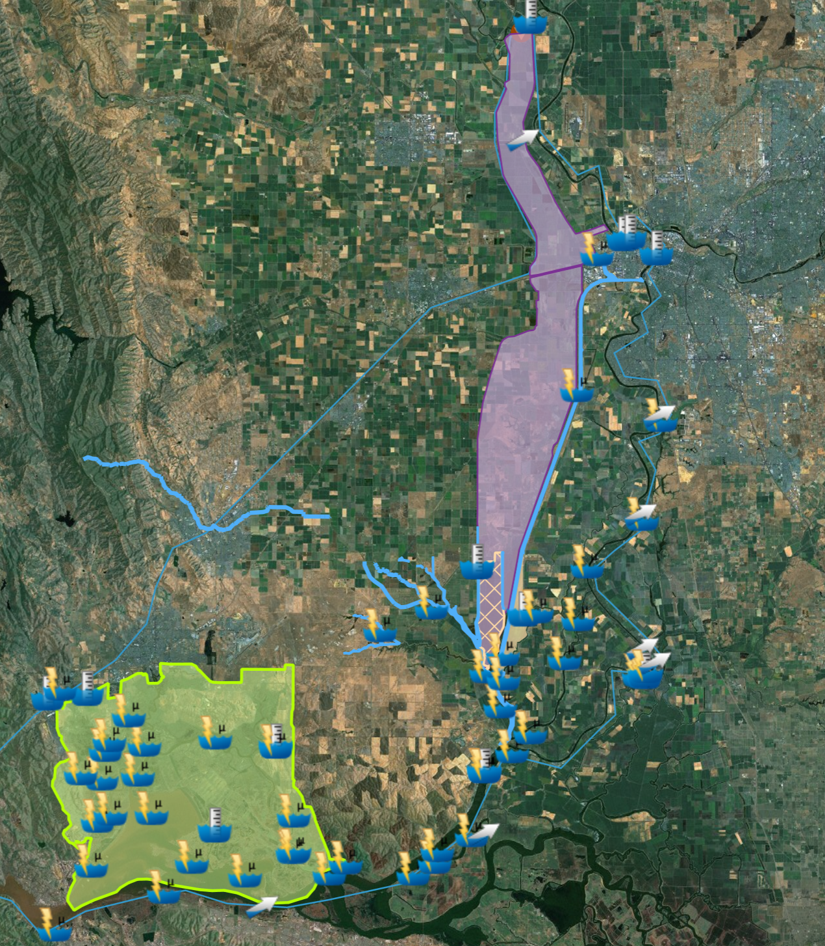
Real-time data collection sensors (Parameters include: Electrical Conductivity, Turbidity, River Stage, Flow, and Water Temperature) mapped with GIS layers of key locations in the Cache Slough Complex and the surrounding areas.

Slide 27
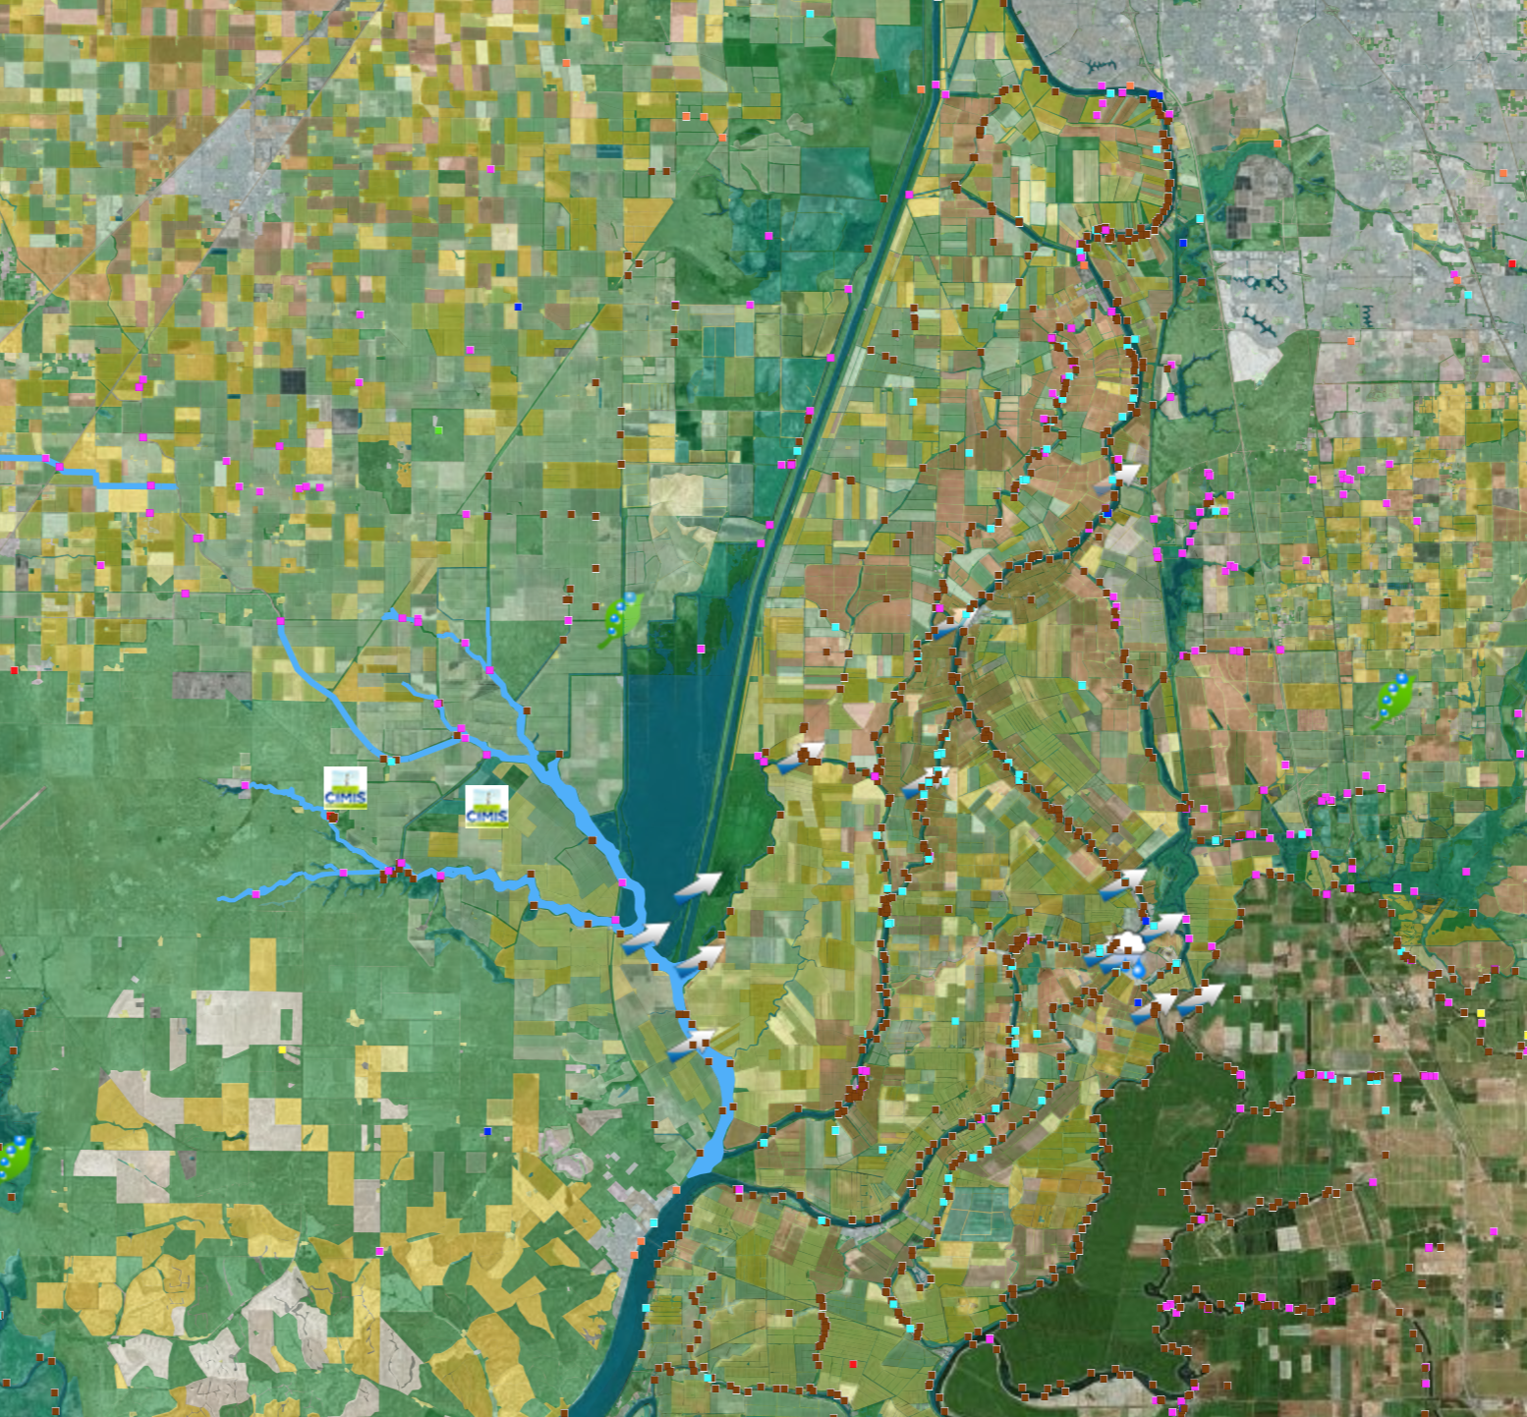
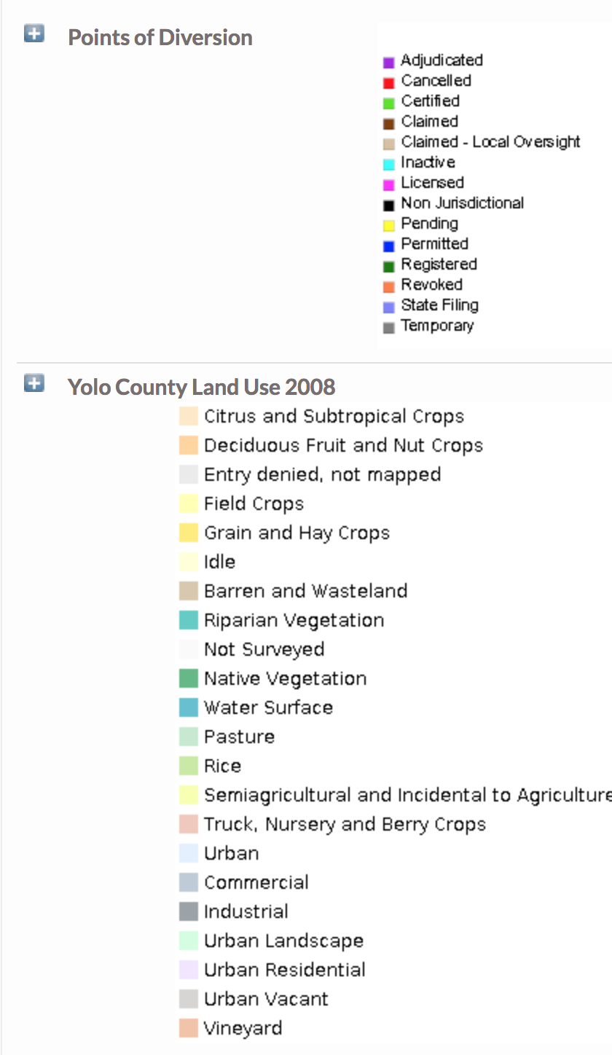
Land Use, Points of Diversion, Flow and Precipitation Data for the Cache Slough Complex

Slide 28
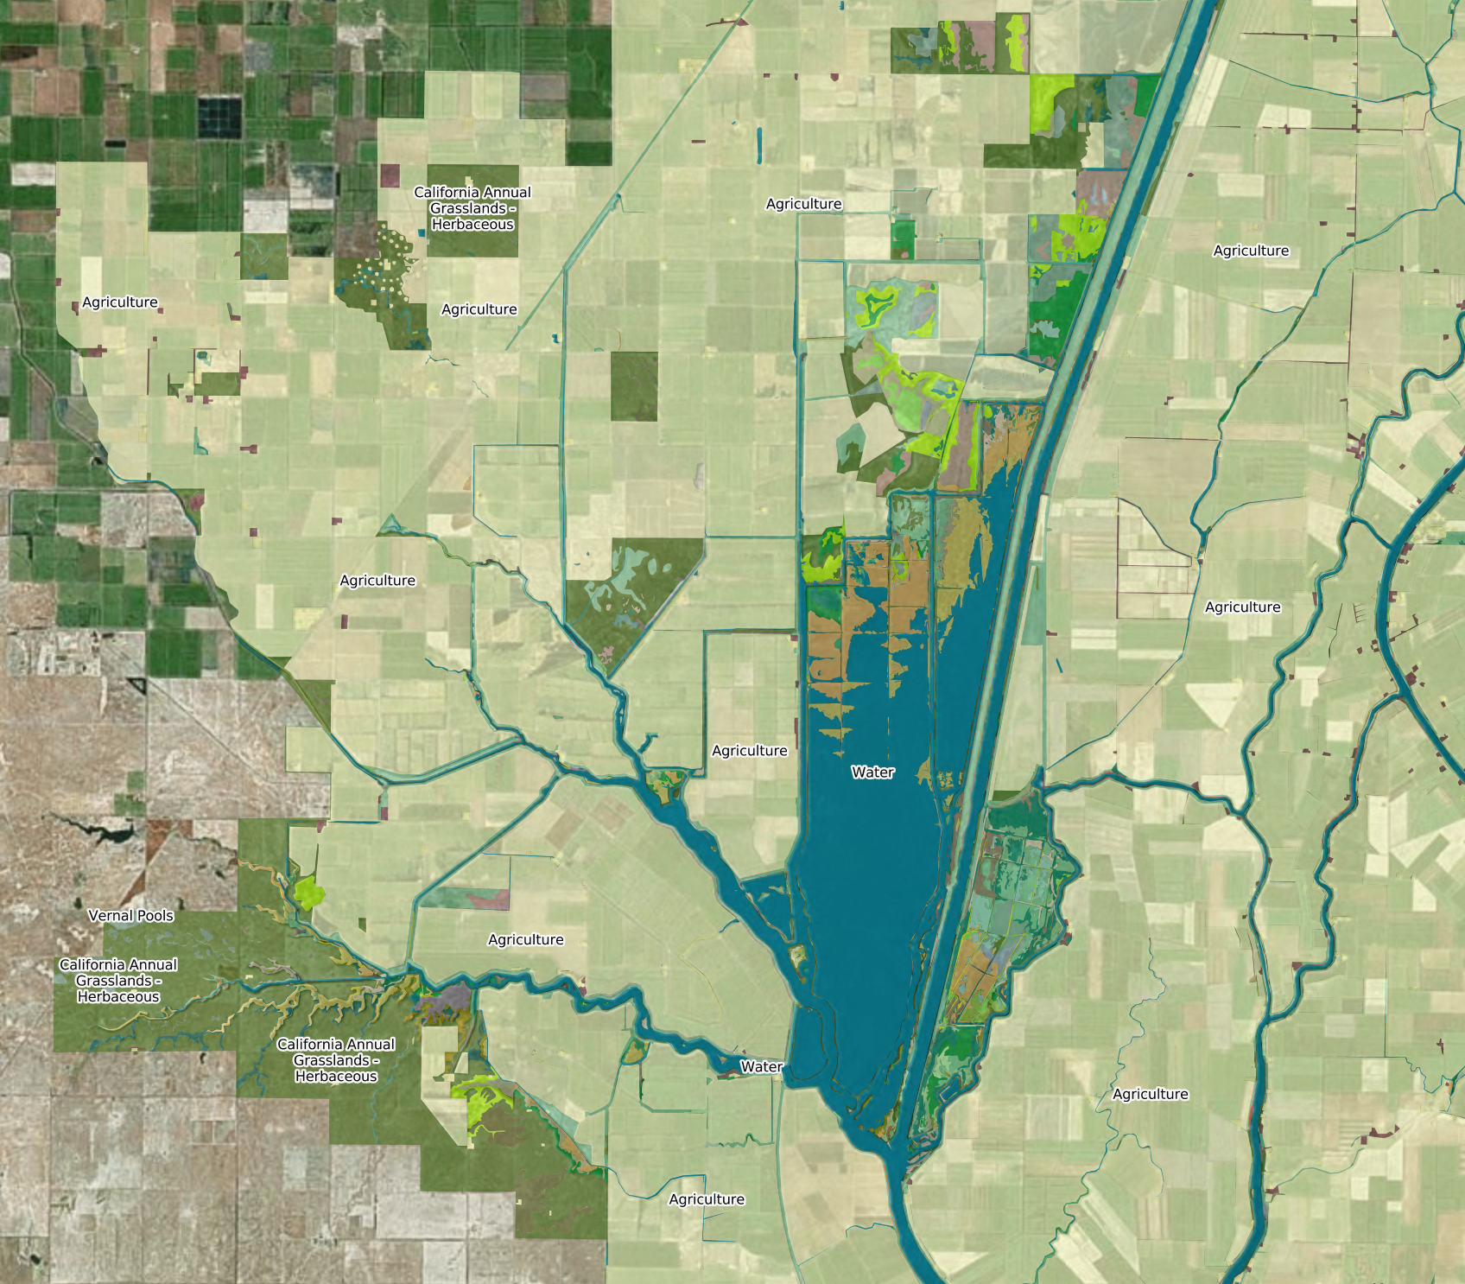
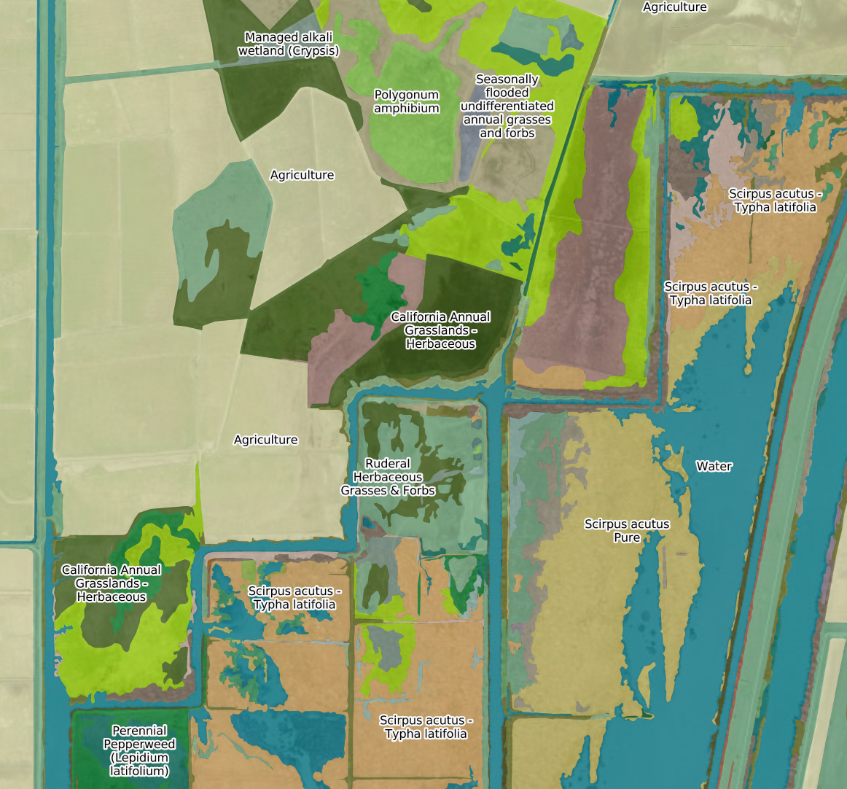
Delta Vegetation
Source: California Department of Fish and Wildlife
Stair-step Vegetation

Slide 29
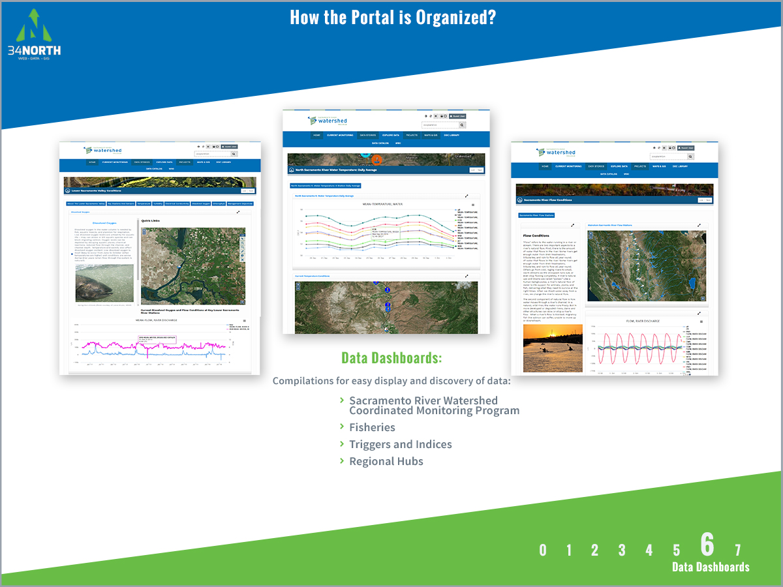
Change Title to: Project Specific Data Dashboards
Remove the SRWP header and title, just show data dashbaord
Remove bulleted text
Remove #s on all slides and add BDL logo

Slide 30
