Slide 1





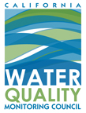

Regional Data Federations

Slide 2

A COLLABORATIVE EFFORT
SWRCB MY WATER QUALITY PORTALS
CALIFORNIA ESTUARY PORTAL
SACRAMENTO SAN JOAQUIN BAY-DELTA
SAN JOAQUIN RIVER REGIONAL MONITORING PROGRAM
SAN JOAQUIN REAL TIME MANAGEMENT
DWR 1641 WATER QUALITY INTERACTIVE
SACRAMENTO RIVER WATERSHED
Notes:
Multi Stakeholder Collaboration
Data Aggregation and Data Management
Data Analysis and Visualizations Mapping and GIS
Regional Document Libraries Operations Dashboards
Ecosystem Projects
Special Studies
Acoustic Telemetry Nutrients
Web Service Development
Regulatory Reporting

Slide 3
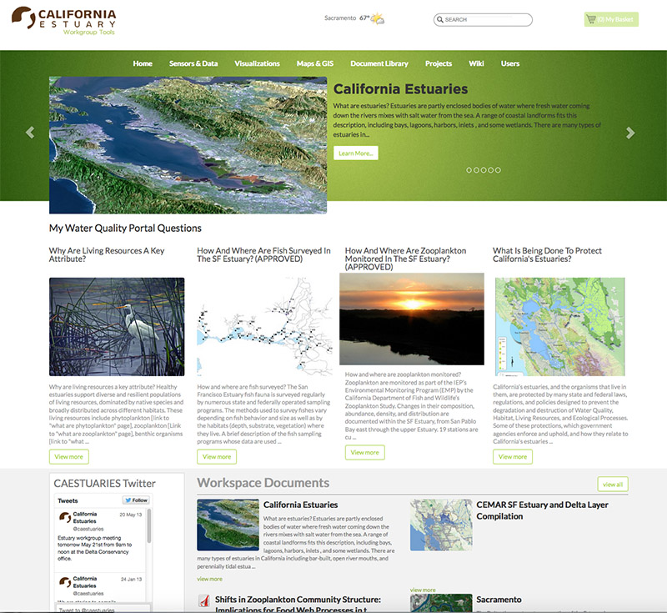
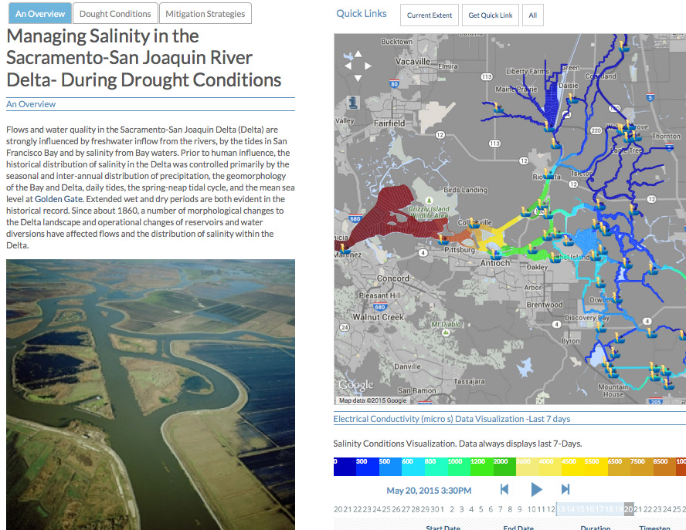
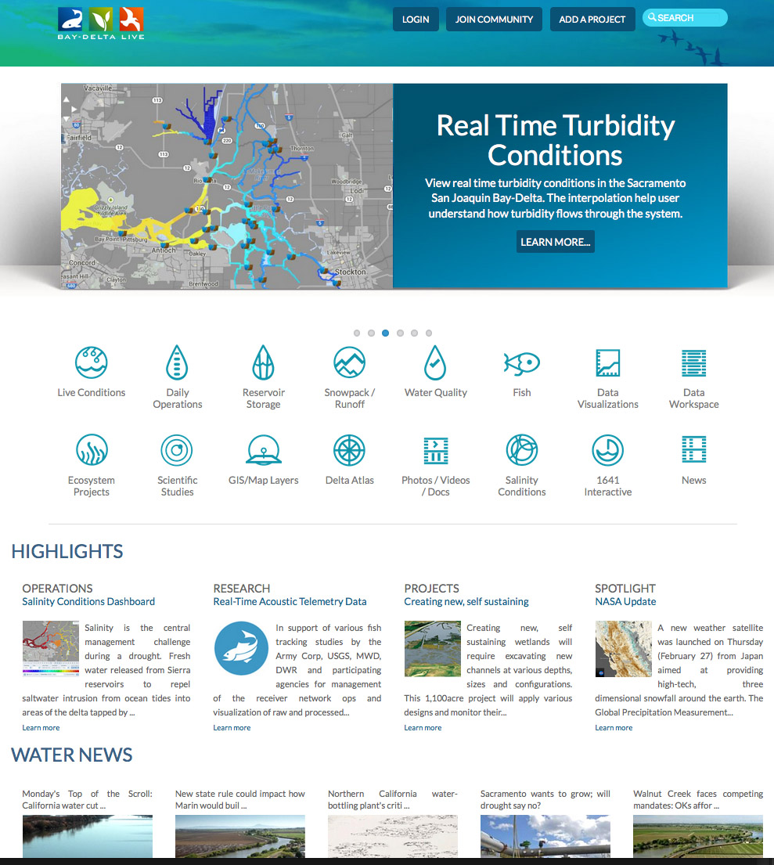
BUILDING ON EACH OTHER’S PROGRAMS
  Each region’s needs are different:
  Various Stakeholder Requirements
  Regional Data
  Region Specific Data Analysis
  Local Mapping and GIS
  Regional Document Libraries
  Stakeholder Specific Data Dashboards
  Tool for Local Ecosystem Projects
  Special Studies
  Regulatory Reporting
  Web Service Development
  …Share data and products with other portal’s for system wide view
Notes:
The SRWP is participating in a on-going regional monitoring and resource management tool development initiative: OPENNRM. SRWP is building on the current portal platform developed for managing data for Ca Estuaries, The San Joaquin Regional Monitoring Program, San Joaquin River Real Time Management Program, The Bay delta: Baydeltalive.com and DWR’s 1641 interactive reporting tools for California. New SRWP development investments are contributed back to community portals. The primary objective of the initiative is provide regional stakeholders with the tools to manage their own data. These data are then made available to the larger community for broader assessment of the California watershed.

Slide 4
BUILDING ON EACH OTHER’S PROGRAMS
Benefit and learn from each other’s regional monitoring programs and assessment efforts
All investments are contributed back to the community: Content, GIS, data sets, mapping tools
Data is managed at the regional level and shared with all stakeholders for larger watershed assessment and analysis
Notes:
The SRWP is participating in a on-going regional monitoring and resource management tool development initiative: OPENNRM. SRWP is building on the current portal platform developed for managing data for Ca Estuaries, The San Joaquin Regional Monitoring Program, San Joaquin River Real Time Management Program, The Bay delta: Baydeltalive.com and DWR’s 1641 interactive reporting tools for California. New SRWP development investments are contributed back to community portals. The primary objective of the initiative is provide regional stakeholders with the tools to manage their own data. These data are then made available to the larger community for broader assessment of the California watershed.

Slide 5
BENEFITS OF A COLLABORATIVE PROGRAM
Benefit and learn from each other’s regional monitoring programs and assessment efforts
All investments are contributed back to the community: Content, GIS, data sets, mapping tools
Data is managed at the regional level and shared with all stakeholders for larger watershed assessment and analysis
Application updates
Notes:
The SRWP is participating in a on-going regional monitoring and resource management tool development initiative: OPENNRM. SRWP is building on the current portal platform developed for managing data for Ca Estuaries, The San Joaquin Regional Monitoring Program, San Joaquin River Real Time Management Program, The Bay delta: Baydeltalive.com and DWR’s 1641 interactive reporting tools for California. New SRWP development investments are contributed back to community portals. The primary objective of the initiative is provide regional stakeholders with the tools to manage their own data. These data are then made available to the larger community for broader assessment of the California watershed.

Slide 6

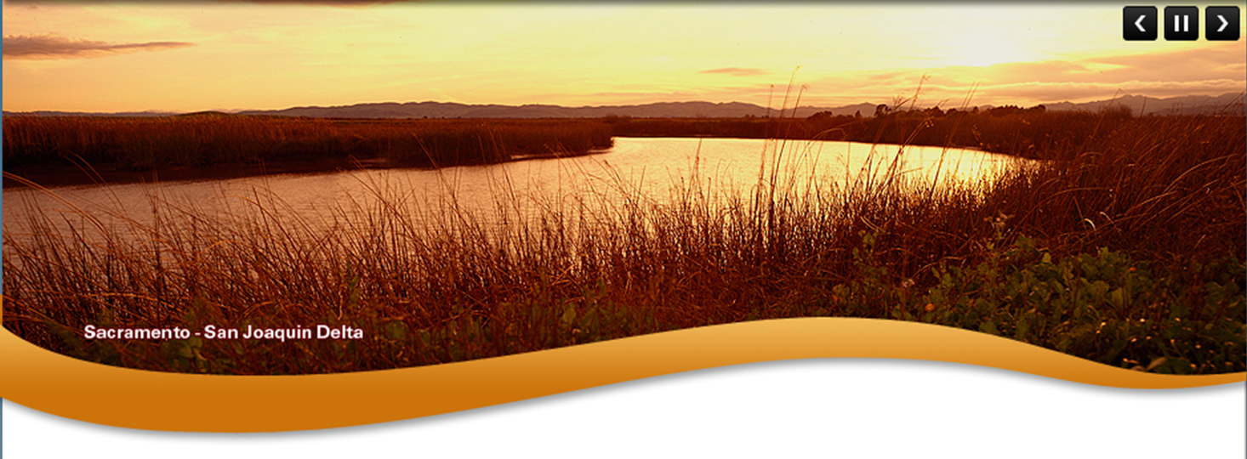
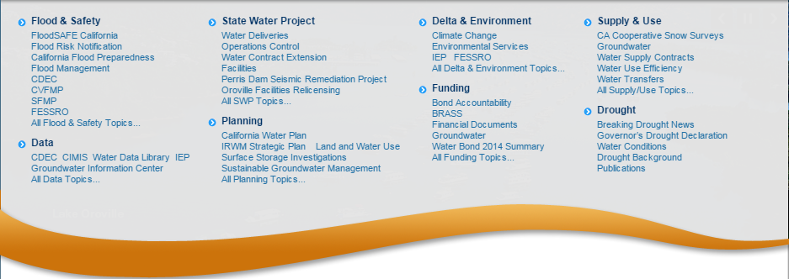



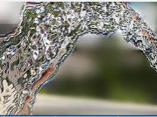
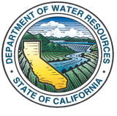


CALIFORNIA’S ESTUARIES
WATER QUALITY MONITORING COUNCIL
CALIFORNIA ESTUARIES PORTAL
Search
PORTALS
CA ESTUARIES
LEARN THE ISSUES
REPORTING
MANAGEMENT TOOLS
San Francisco Estuary
  Benthic Invertebrates
Santa Monica Bay
Elkhorn Slough
Morro Bay Estuary
Smith River Estuary
Klamath River Estuary
Mad River Estuary
Noyo River Estuary
Eel River Estuary
Russian River Estuary
New California Estuaries Portal Design
Safe
ABOUT US
STEWARDSHIP
WATER NEWS
What is the Estuary Monitoring Workgroup?
What is being done to protect California’s Estuaries?
What are headlines in California’s water news?
The California Estuary Monitoring Workgroup, is tasked with identifying key questions to assess the
It is every citizen’s responsibility acting as a steward in protecting the environment. The Sacramento
A new weather satellite was launched (February 27) from Japan aimed at providing high-tech, three
Ecological health of California’s Estuaries, the data and methods available and needed to address the questions, and the methods to access these data. Learn more
Regional County Sanitation District is in the process of purchasing and restoring habitat surrounding the their treatment plant…. Learn more
Dimensional snowfall around the earth. The Global Precipitation Measurements…. Learn more
HIGHLIGHTS
Safe
REPORTING
MANAGEMENT TOOLS
RESEARCH
What is the Water Quality Conditions Report?
How is salinity being managed during the drought?
How are tagged fish being used in the Delta?
This report summarizes the results of water quality monitoring and special studies conducted by the
Building data stories to communicate complicated topics. Learn about Salinity, why it is important and the
In support of various fish tracking studies by the Army Corp, USGS, MWD, DWR and participating
Environmental Monitoring Program within the Sacramento-San Joaquin Delta and Suisun Marsh, as mandated by Water Rights Decision 1641 (D-1641). Learn more
Management options available to the resource agencies. See real time conductivity conditions, visualize the salt field and spatially view….. Learn more
Agencies for management of receiver network ops and visualization of raw processed…. Learn more

Slide 7
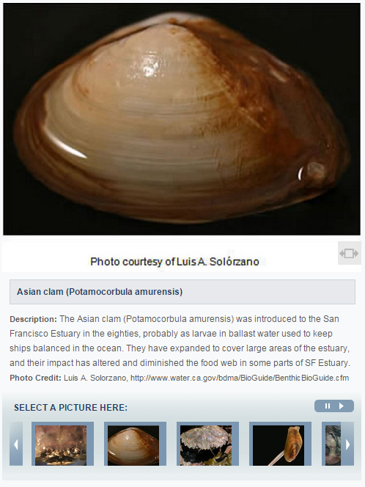
WATER QUALITY MONITORING COUNCIL
CALIFORNIA ESTUARIES PORTAL
Search
PORTALS
CA ESTUARIES
LEARN THE ISSUES
REPORTING
MANAGEMENT TOOLS
New California Estuaries Portal Design
Benthic Invertebrates
What Are they?
How are they monitored?
Reporting
SAN FRANCISCO BAY DELTA ESTUARY
Benthic organisms are creatures that live at the bottom of water bodies. They include common invertebrates (animals without backbones) like clams, shrimp, and crabs and other less recognized creatures including worms, little crustaceans called amphipods, and aquatic insects. These organisms live in or on the soft mud of the Estuary, while others attach themselves to rocks and other hard surfaces. There are also benthic vertebrates (animals with backbones) that include various fish species among other creatures.
Many benthic organisms are filter feeders. They pump water through their bodies or through holes they have burrowed in the mud to catch food suspended in the water. Others graze on food they find in and on the surface of the bottom. Filter feeders and grazers eat phytoplankton, zooplankton, other benthic organisms, and/or decaying organic debris washed in from the surrounding watershed.
Why Are Benthic Organisms Important?
Benthic organisms are important part of the estuarine food web. They consume and are consumed by other creatures. Every winter during low-tides, thousands of migrating shorebirds feast themselves upon uncovered clams, crabs, and worms found in the mudflats. Humans, as well, take advantage of the low-tides to harvest their own feast. Certain fish species, including juvenile salmon, striped bass, and sturgeon, also consume many types of benthic organisms.
A large percentage of the benthic organisms found in the SF Estuary are invasive and thus can have negative effects on the health of the estuary.
Filter feeding benthic organisms pump immense amounts of water through their bodies, consuming large amounts of the available phytoplankton biomass in the estuary.
Historically, bay shrimp supported a large commercial fishery in the Bay, and California’s commercial crab fishery still depends upon crabs that spend the first two years of their life growing in the SF Estuary.
Changes in benthic organisms’ populations also can be indications of larger changes in the physical conditions of the SF Estuary, including alterations in freshwater inflows, salinity, and sediment composition. These changes can then affect other living things and general water quality.

Slide 8
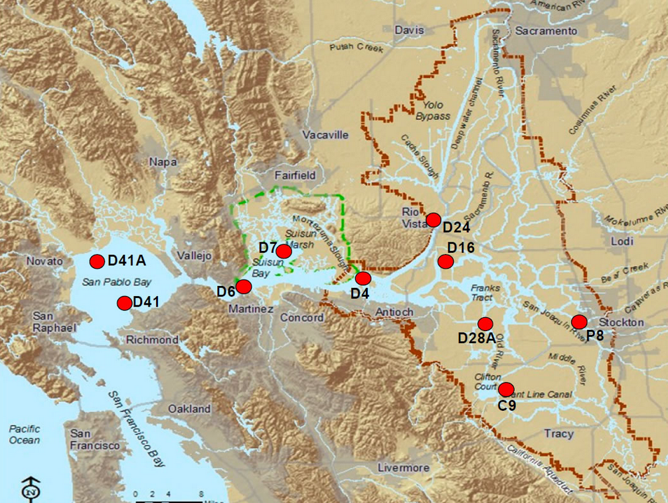
WATER QUALITY MONITORING COUNCIL
CALIFORNIA ESTUARIES PORTAL
Search
PORTALS
CA ESTUARIES
LEARN THE ISSUES
REPORTING
MANAGEMENT TOOLS
New California Estuaries Portal Design
Benthic Invertebrates
What Are they?
How are they monitored?
Reporting
SAN FRANCISCO BAY DELTA ESTUARY
Department of Water Resources Benthic Organism Study
The California DWR Benthic Organism Study measures the composition (what kinds?), abundance (how many?), diversity (how many kinds?), and distribution (where are they?) of benthic organisms as part of the IEP’s Environmental Monitoring Program (EMP). Changes in their composition, abundance, diversity, and distribution are documented within the SF Estuary, from San Pablo Bay east through the upper Estuary to the mouths of the Sacramento, Mokelumne, and San Joaquin Rivers.
Ten sites are currently sampled. Because different benthic species live in different parts of the Estuary, the sites represent a wide range of habitats of varying sizes and physical conditions, including different types of salinity and sediment composition. Sites range from narrow, freshwater channels in the Delta to broad, estuarine bays.
Samples are collected monthly. From 1975 to 1979, biannual sampling was conducted in late spring and fall. Monthly sampling started in June 1980 and ended in October 2003. Samples were collected quarterly from October 2003 through October 2005, after which monthly sampling was resumed. Sediment samples are also collected at each site for sediment analysis.
Learn more about the methods used to measure benthic organisms.
Department of Fish and Wildlife San Francisco Bay Study
EMP monitoring sites, however, are not as good for accurately sampling shrimp and crabs, but the CDFW San Francisco Bay Study surveys collect crabs and shrimp monthly using an otter trawl. Thirty-five fixed monitoring stations are distributed evenly throughout four sub-regions of the estuary, including South, Central, San Pablo, and Suisun Bays.
More information on benthic organisms and their monitoring can be found in the DWR Benthic Organism Meta Data ,the Benthic BioGuide, the Benthic Dictionary, and the CDFW San Francisco Bay Study.
For more information regarding sediment composition data, please contact Karen Gehrts.
Rather than having interactive maps, users will select monitoring program to populate a static map above.
To view the locations of phytoplankton and chlorophyll-a monitoring stations in the map above, please select:
Monitoring Program?

Slide 9

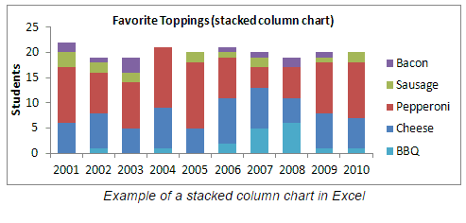
WATER QUALITY MONITORING COUNCIL
CALIFORNIA ESTUARIES PORTAL
Search
PORTALS
CA ESTUARIES
LEARN THE ISSUES
REPORTING
MANAGEMENT TOOLS
User’s will be able to access “Reporting” information and data in various ways.
Benthic Invertebrates
SELECT DATA
What Are they?
How are they monitored?
Reporting
Where?
SAN FRANCISCO BAY DELTA ESTUARY
When?
A brief introductory paragraph will be provided for D1641 (or other mandated reporting)
Water Rights Decision 1641 Compliance
The SWRCB establishes water quality objectives and monitoring plans to protect the variety of beneficial uses of the water within the upper San Francisco estuary (estuary). The SWRCB ensures that these objectives are met, in part, by inclusion of water quality monitoring requirements into water rights decisions issued to DWR and USBR as conditions for operating the SWP and CVP, respectively. These requirements include minimum outflows, limits to water diversion by the SWP and CVP, and maximum allowable salinity levels. In addition, DWR and USBR are required to conduct a comprehensive monitoring program to determine compliance with the water quality objectives and report the findings to the SWRCB. Water quality objectives were issued in December 1999 by D-1641 (SWRCB, 1999) and revised by order WR 2000-02 in March 2000.
2015 Summary
The benthic monitoring program is designed to document the distribution, diversity, and abundance of benthic (bottom dwelling) organisms in the estuary. Geographic coverage of the sampling sites ranges from the eastern region of San Pablo Bay through the Delta to the mouths
of the Sacramento, Mokelumne, and San Joaquin rivers. The benthic community of the estuary is a diverse assemblage of organisms, which includes worms, crustaceans, insects, and molluscs. This program monitors both benthic macrofauna (organisms larger than 0.5 mm) and sediment composition (Lehman et al., 2001). General trends in sediment composition are documented at the same sites where benthic samples are collected.
To view prior year ‘s summaries or an archive of prior reports, please click here.
What Species?
Understanding the relative abundance and distribution of benthic invertebrates in the San Francisco Bay Delta Estuary.
Station: D41
X
Y
The current year’s summary will be provided (updated annually). Users will be able access prior summaries and annual reports via link to (DWR?).
Species A
Count
Species B
Species C
Species D
Species E
Download: Graph Data Metadata
Station: D28A
X
Y
Species A
Count
Species B
Species C
Species D
Species E
Download: Graph Data Metadata
Station: P8
X
Y
Species A
Count
Species B
Species C
Species D
Species E
Download: Graph Data Metadata

Slide 10
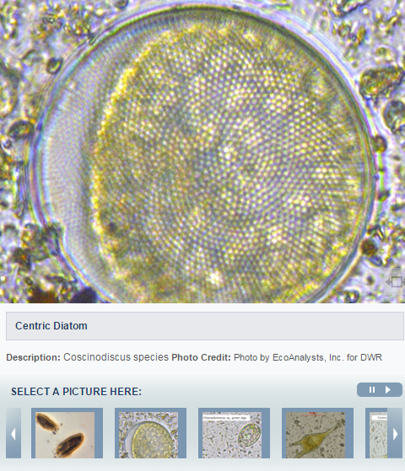
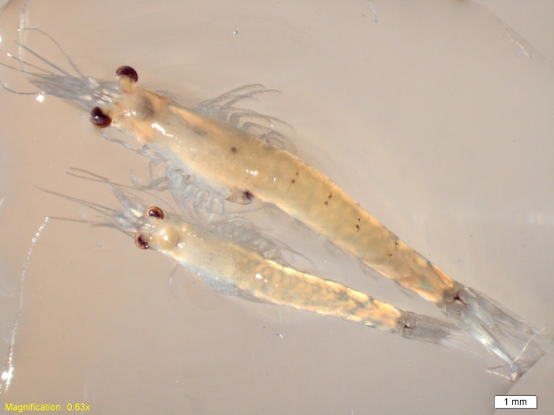
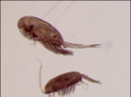
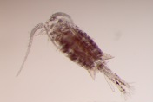
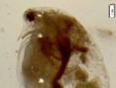
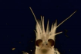
WATER QUALITY MONITORING COUNCIL
CALIFORNIA ESTUARIES PORTAL
Search
PORTALS
CA ESTUARIES
LEARN THE ISSUES
REPORTING
MANAGEMENT TOOLS
New California Estuaries Portal Design
Zooplankton
What Are they?
How are they monitored?
Reporting
SAN FRANCISCO BAY DELTA ESTUARY
Zooplankton are small aquatic invertebrates (animals without backbones) that drift in the water with prevailing currents. Although they do not have the ability to swim against currents, they use behaviors such as vertical migration to maintain their approximate positions in the estuary. They include mysids (sometimes referred to as opossum shrimp because of the pouch they use to carry their eggs and their resemblance to tiny shrimp), some amphipods, copepods, cladocerans, and rotifers.
Zooplankton are pelagic and live in the open-water portions of the estuary, some are epibenthic and are found near the bottom of the water column, and some are associated with submerged aquatic vegetation and are found clinging to vegetation. Some zooplankton are grazers that eat phytoplankton, ciliates, and detritus. Other zooplankton are predatory and eat smaller zooplankton.
Why Are Zooplankton Important?
Zooplankton is an important component of the estuarine food web. They eat phytoplankton and in turn are eaten by other zooplankton, aquatic insects, and fish; thereby providing an important trophic link between primary producers and fish. Most larval and juvenile fish eat zooplankton and some smaller fish, such as Delta Smelt and Longfin Smelt, rely on zooplankton for food throughout their lives.
Most of the zooplankton in the upper San Francisco Estuary have declined in abundance since monitoring began in 1972, particularly native species. Currently most of the abundant zooplankton are non-native invasive species, some of which are not good fish food.
The introduced clam Potamocorbula amurensis drastically reduced the available phytoplankton in the low salinity zone of the estuary, which reduced food availability for zooplankton and caused many zooplankton species to decline. This resultant zooplankton decline has been implicated as one of the many causes of the Pelagic Organism Decline (POD), which described the dramatic decline of several pelagic fish species concurrently.
Changes in the abundance, distribution, and community composition of zooplankton in the estuary can be indications of larger changes in the physical conditions of the SF Estuary, including alterations in freshwater flows, salinity, and temperature.
Species X

Slide 11
WATER QUALITY MONITORING COUNCIL
CALIFORNIA ESTUARIES PORTAL
Search
PORTALS
CA ESTUARIES
LEARN THE ISSUES
REPORTING
MANAGEMENT TOOLS
New California Estuaries Portal Design
Zooplankton
What Are they?
How are they monitored?
Reporting
SAN FRANCISCO BAY DELTA ESTUARY
Department of Fish and Wildlife’s Zooplankton Study
The California Department of Fish and Wildlife’s Zooplankton Study determines the composition (what kinds?), abundance (how many?), and distribution (where are they?) of zooplankton in the upper San Francisco Estuary as part of the Interagency Ecological Program’s Environmental Monitoring Program (EMP). The Zooplankton Study monitors zooplankton in the upper San Francisco Estuary from San Pablo Bay east through the Delta.
Between seventeen and twenty fixed sites are currently sampled monthly (Figure 1), depending on the electrical conductance of the water. Additional floating (non-fixed) sites are sampled in the entrapment zone; the locations of these sites varies monthly and is determined by the electrical conductivity of the water (a surrogate for salinity). Entrapment zone stations are sampled where the bottom electrical conductivity is two milliSiemens per centimeter and six milliSiemens per centimeter. When the entrapment zone is located upstream of the confluence of the Sacramento and San Joaquin rivers, the entrapment zones in each of these rivers are sampled separately.
Since 1995, zooplankton samples from each site have been collected monthly during the DWR Water Quality Run. Prior to 1995, the winter months, December through February, were not always sampled. During some years from 1972 through 1993, the spring and summer months were sampled twice monthly. Water quality and phytoplankton samples are collected at each site.
Three gear types are used at each sampling site to target different sizes of zooplankton: 1) a pump for sampling microzooplankton <1.0 mm long, including rotifers, copepod nauplii, and adult copepods of the genus Limnoithona; 2) a modified Clarke-Bumpus (CB) net for sampling mesozooplankton 0.5-3.0 mm long, including cladocerans, copepodids (immature copepods), and adult copepods; and 3) a macrozooplankton net for sampling zooplankton 1-20 mm long, which targets mysid shrimp.
Learn more about the methods used to sample zooplankton.
More information on zooplankton monitoring in the upper San Francisco Estuary can be found on the CDFW Zooplankton Study website, as well as the EMP Zooplankton Metadata.
To view the locations of zooplankton monitoring stations in the map above, please select:
Monitoring Program?

Slide 12
WATER QUALITY MONITORING COUNCIL
CALIFORNIA ESTUARIES PORTAL
Search
PORTALS
CA ESTUARIES
LEARN THE ISSUES
REPORTING
MANAGEMENT TOOLS
New California Estuaries Portal Design
34N—need to figure out way of select data from multiple surveys, gear types etc. (zoo/fish data)
Zooplankton
SELECT DATA
What Are they?
How are they monitored?
Reporting
Where?
SAN FRANCISCO BAY DELTA ESTUARY
When?
Water Rights Decision 1641 Compliance
The SWRCB establishes water quality objectives and monitoring plans to protect the variety of beneficial uses of the water within the upper San Francisco estuary (estuary). The SWRCB ensures that these objectives are met, in part, by inclusion of water quality monitoring requirements into water rights decisions issued to DWR and USBR as conditions for operating the SWP and CVP, respectively. These requirements include minimum outflows, limits to water diversion by the SWP and CVP, and maximum allowable salinity levels. In addition, DWR and USBR are required to conduct a comprehensive monitoring program to determine compliance with the water quality objectives and report the findings to the SWRCB. Water quality objectives were issued in December 1999 by D-1641 (SWRCB, 1999) and revised by order WR 2000-02 in March 2000.
2015 Summary
The Zooplankton Study was designed to monitor the abundance and distribution of zooplankton in order to assess trends in fish food resources in the upper San Francisco Estuary. Geographic coverage of the sampling sites ranges from the eastern region of San Pablo Bay through the Delta. The zooplankton community is comprised of a diverse assemblage of organisms, which includes mysids, copepods, amphipods, cladocerans, and rotifers.
To view prior year ‘s summaries or an archive of prior reports, please click here.
What Species?
Understanding the relative abundance and distribution of Zooplankton in the San Francisco Bay Delta Estuary.
Station: D41
X
Y
Species A
Count
Species B
Species C
Species D
Species E
Download: Graph Data Metadata
Station: D28A
X
Y
Species A
Count
Species B
Species C
Species D
Species E
Download: Graph Data Metadata
Station: P8
X
Y
Species A
Count
Species B
Species C
Species D
Species E
Download: Graph Data Metadata

Slide 13
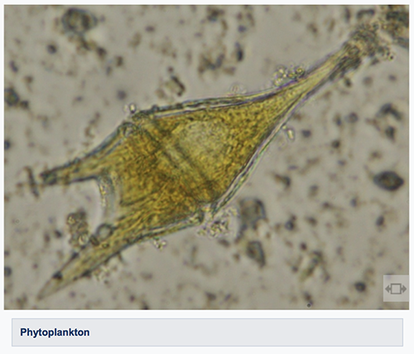
WATER QUALITY MONITORING COUNCIL
CALIFORNIA ESTUARIES PORTAL
Search
PORTALS
CA ESTUARIES
LEARN THE ISSUES
REPORTING
MANAGEMENT TOOLS
New California Estuaries Portal Design
Phytoplankton
What Are they?
How are they monitored?
Reporting
SAN FRANCISCO BAY DELTA ESTUARY
Phytoplankton are small organisms that can be found floating in most water bodies. Like plants, they are primary producers; they convert light energy from the sun and carbon dioxide into the living matter of their cells through photosynthesis. Phytoplankton from the San Francisco Estuary fall into four broad categories: cyanobacteria, diatoms, green algae, and various flagellate groups.
Why Are Phytoplankton Important?
Phytoplankton are the foundation of the aquatic food web. They feed a diverse array of organisms, ranging from microscopic zooplankton to large pelagic fish. Small fish and benthic organisms also graze on phytoplankton, and are in turn consumed by larger organisms such as birds. Changes in phytoplankton in the San Francisco Estuary can have cascading effects throughout the food web.
Phytoplankton can affect elements of water quality, including:
pH
Dissolved oxygen
Taste and odor of drinking water
Water transparency
Large algal blooms, both toxic and non-toxic, can have adverse effects on the water quality parameters listed above. They can also have negative aesthetic effects by forming large, floating surface scums.
Monitoring changes in phytoplankton can be useful in assessing water quality trends. It is important to note, however, that because of the transient and patchy nature of phytoplankton, their use as water quality indicators is limited and should be interpreted in conjunction with chemical, physical, and biological data.
Chlorophyll-a is the primary photosynthetic product made by phytoplankton and plants, and gives them their green color. Sometimes the green color is masked by secondary pigments, and these phytoplankton often appear brown or red instead of green. Chlorophyll-a is also a measure of the biomass that is directly available to organisms that prey on phytoplankton, such as clams and zooplankton.

Slide 14
WATER QUALITY MONITORING COUNCIL
CALIFORNIA ESTUARIES PORTAL
Search
PORTALS
CA ESTUARIES
LEARN THE ISSUES
REPORTING
MANAGEMENT TOOLS
New California Estuaries Portal Design
Phytoplankton
What Are they?
How are they monitored?
Reporting
SAN FRANCISCO BAY DELTA ESTUARY
Department of Water Resources Phytoplankton and Chlorophyll-a Monitoring
The California DWR Phytoplankton and Chlorophyll-a Monitoring measures the composition (what kinds?), abundance (how many?), diversity (how many kinds?), and distribution (where are they?) of phytoplankton as part of the IEP’s Environmental Monitoring Program (EMP). It also measures phytoplankton biomass as chlorophyll-a. Changes in phytoplankton composition, abundance, diversity, distribution, and biomass are documented throughout the San Francisco Estuary, from San Pablo Bay east through the upper Estuary to the mouths of the Sacramento, Mokelumne, and San Joaquin Rivers.
Thirteen fixed sites are currently sampled (Figure 1), with two additional sites sampled where the bottom specific conductance is 2,000 and 6,000 micro-Siemens, respectively. Specific conductance is used as a proxy for salinity, with higher values corresponding to higher salinity. The physical location of these sites varies based on where the target specific conductance values are found. Because different phytoplankton species live in different parts of the Estuary, the sites represent a wide range of habitats of varying physical conditions, including wide ranges of salinity and temperature. Sites range from narrow, freshwater channels in the Delta to broad, estuarine bays.
Currently samples are collected monthly. Water is sampled from 1 meter below the surface. Whole water samples are collected for phytoplankton composition; water is filtered onto glass carbon fiber filters for chlorophyll-a analysis.
Learn more about the methods used to analyze phytoplankton and chlorophyll-a.
To view the locations of phytoplankton and chlorophyll-a monitoring stations in the map above, please select:
Monitoring Program?

Slide 15
WATER QUALITY MONITORING COUNCIL
CALIFORNIA ESTUARIES PORTAL
Search
PORTALS
CA ESTUARIES
LEARN THE ISSUES
REPORTING
MANAGEMENT TOOLS
New California Estuaries Portal Design
Phytoplankton
SELECT DATA
What Are they?
How are they monitored?
Reporting
Where?
SAN FRANCISCO BAY DELTA ESTUARY
When?
Phytoplankton and Chlorophyll-a Monitoring
Phytoplankton samples are counted using an inverted microscope. Phytoplankton are identified to the lowest taxonomic level possible (usually genus or species) and counted. The counts are used to calculate organisms per milliliter.
There is often a large number of different genera and species in a single sample, so phytoplankton are usually grouped at a higher taxonomic level for reporting purposes (e.g. diatoms, cyanobacteria). While individual species can be restricted to certain habitats with specific physico-chemical characteristics, higher taxonomic groups such as diatoms are often widespread and cosmopolitan.
Chlorophyll-a varies widely throughout the San Francisco Estuary, and is affected by factors such as day length, temperature, nutrients, turbidity, and residence time (how long phytoplankton are in one location). In Suisun Bay, filtering by the clam Potamocorbula amurensis has drastically altered the planktonic community since 1987, and chlorophyll-a levels in this region remain very low compared to other areas of the Estuary.
In some upstream areas of the Estuary, chlorophyll-a has increased in recent years, but still remains below historical levels. Chlorophyll-a below 10 µg/L is considered food-limiting for some zooplankton.
See more tools for exploring phytoplankton and chlorophyll-a data.
What Species?
Understanding the relative abundance and distribution of phytoplankton in the San Francisco Bay Delta Estuary.
Tabs can be used to visualize additional data and figures.
Station: D41
Phyto
Chl-a
Species A
Count
Species B
Species C
Species D
The default graph on page will be summary figure to accompany annual summary in text (TBD). Alternatively, users can load figures using the “select data” interface above.
Species E
Download: Graph Data Metadata
Station: D28A
Phyto
Chl-a
Species A
Species B
Concentration
Species C
Species D
Species E
Download: Graph Data Metadata
Station: P8
Phyto
Chl-a
Species A
Count
Species B
Species C
Species D
Species E
Download: Graph Data Metadata

Slide 16
CA ESTUARIES PORTAL
Multi-Agency Workspace
Source project for critical estuary data: EMP, Estuary GIS, 1641 and Trawl Data
50+ GIS files
    85+ question driven WQ pages on mywaterquality.ca.gov
    Assessment
    TMDL Report Cards
Notes:
The caestuaries workspace and stakeholder group is responsible for the development of:
25+ Key datasets: IEP data, trawl and salvage data, 1641 reporting project
85+ question driven WQ pages on mywaterquality.ca.gov
Important space for incubation of ideas, assessment criteria and concepts.
Key development of data visualization tools.

Slide 17
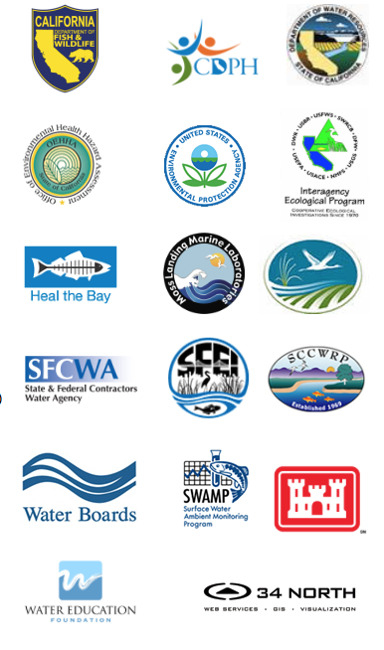
CA ESTUARIES COLLABORATORS
US Bureau of Reclamation
US Department of Fish and Wildlife
NOAA
NMFS
US Geological Survey
CA Department of Water Resources
IEP
State and Federal Contractor
Water Education Foundation
SWRCB
AG Industry
______________________________
Major Multi-Agency Effort
Regular Workgroup Meetings for Enhancements
150+ Registered Agency Users
1000 + Images, Documents, Research Articles
Host for 85+ State Question Pages
50+ Downloadable Datasets
1641 Interactive
Home to All California Estuaries
Feed Libraries
Home to Trawl Data 2016
Notes:
Clients include: Honeywell, USGS, DWR, MWD, History Channel,

Slide 18
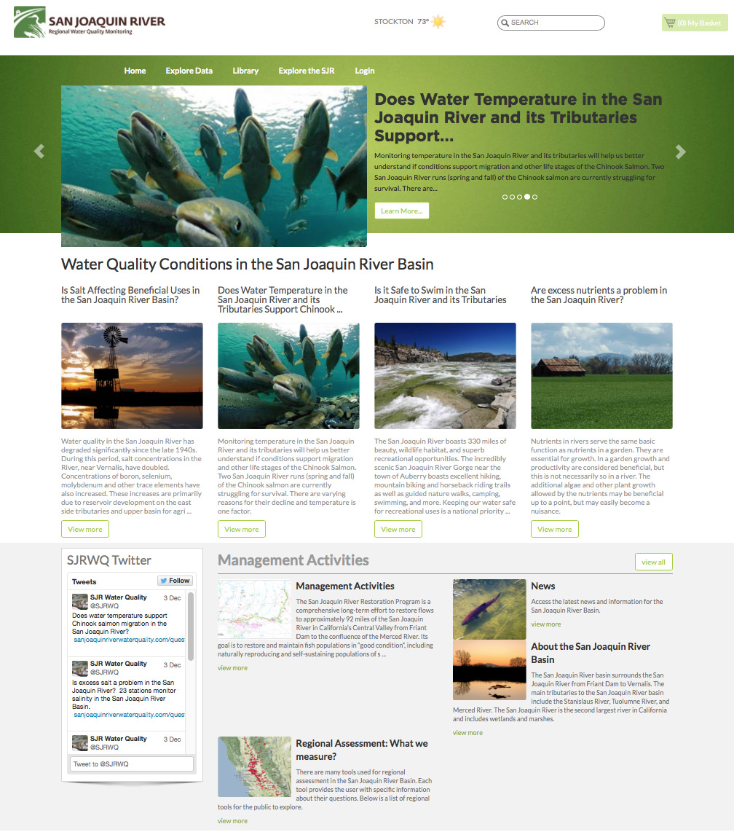
SJR REGIONAL MONITORING AND REAL TIME MANAGEMENT
50+ Datasets contributed for multi-stakeholder use and evaluation
Real Time WQ Assessments for Temperature, Salinity, Nutrients, etc. available to the public
Current phase SJR Real Time WQ Management
View model results and data dashboards
Notes:
SRWP will have access to data and GIS: Specifically NWIS and CIMIS that was contributed to the community by this project
SRWP will build on and improve upon question templates for data assessments developed by the SJRRMP. Benefit from stakeholder knowledge developed during this process.
3SRWP will benefit from and build on important data filters and analysis tools for examining WQ criteria: ex: Temperature calculations for fish migration during specific life stages, analysis of salinity discharges and the effects on water quality, data presentation methods for understanding pesticides and other contaminant data in the Sac River watershed.
This knowledge will then be contributed back to other regions for use in local initiatives.

Slide 19
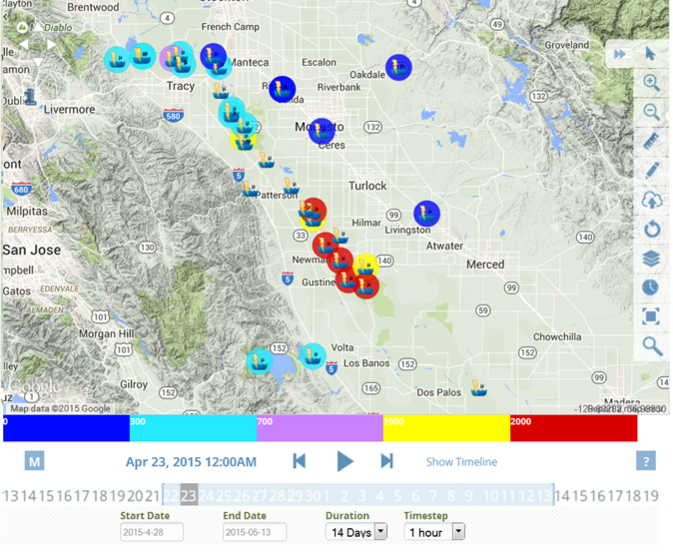
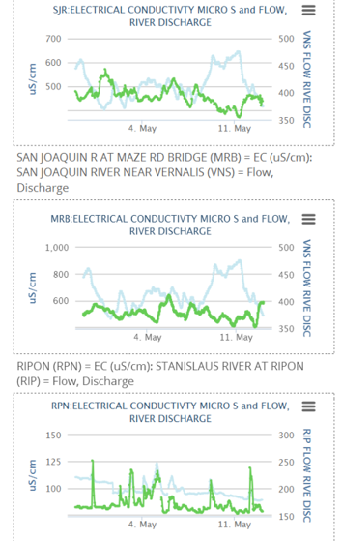
SAN JOAQUIN RMP COLLABORATORS
US Bureau of Reclamation
CURES
CV Salts
California Environmental Protection Agency
CA Department of Water Resources
State and Federal Water Contractors
CVRWQCB
AG Industry
Central Valley Irrigation Districts
_________________________________
Major Multi-Agency Effort
Regular Workgroup Meetings for Enhancements
Real Time Salinity Management
WARMF Model Online
Question Driven
Stakeholder Specific Data Dashboards
Feed Libraries

Slide 20
BAYDELTALIVE.COM
Data central to the Delta
Extensive libraries for Delta data, photos, reports
Real time reporting dashboards: salinity, WQ
Weekly survey results, fish tracking
Relevant news
Collaborator workspace
Ecosystem projects
Delta Community
Post and view model results
Notes:
1. Primary project

Slide 21
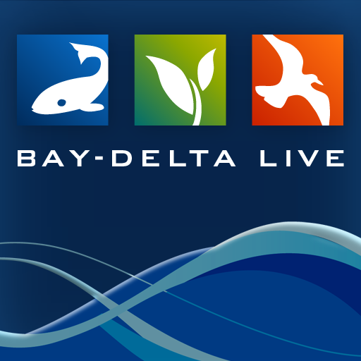

BDL WORKGROUP COLLABORATORS
US Bureau of Reclamation
NOAA
NMFS
US Geological Survey
CA Department of Water Resources
Metropolitan Water District
State and Federal Contractor
US Fish and Wildlife Service
SWRCB
AG Industry
______________________________
25,000 Unique Visits (Annual)
400+ Registered Users
1500 + Images, Documents, Research Articles
100+ Ecosystem Projects
250+ Downloadable Datasets
Feed Libraries
“Directing development and new data investments”
Notes:
Clients include: Honeywell, USGS, DWR, MWD, History Channel,

Slide 22
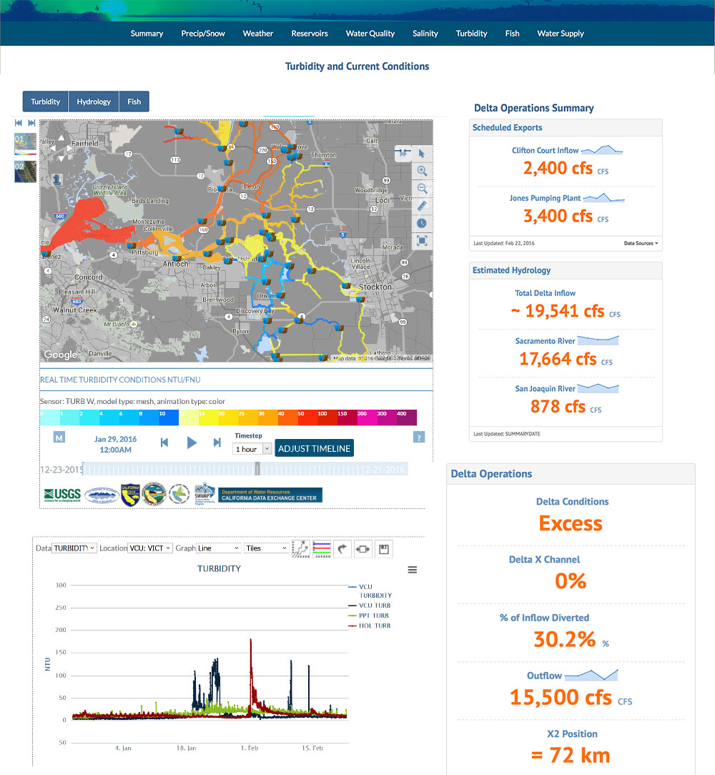
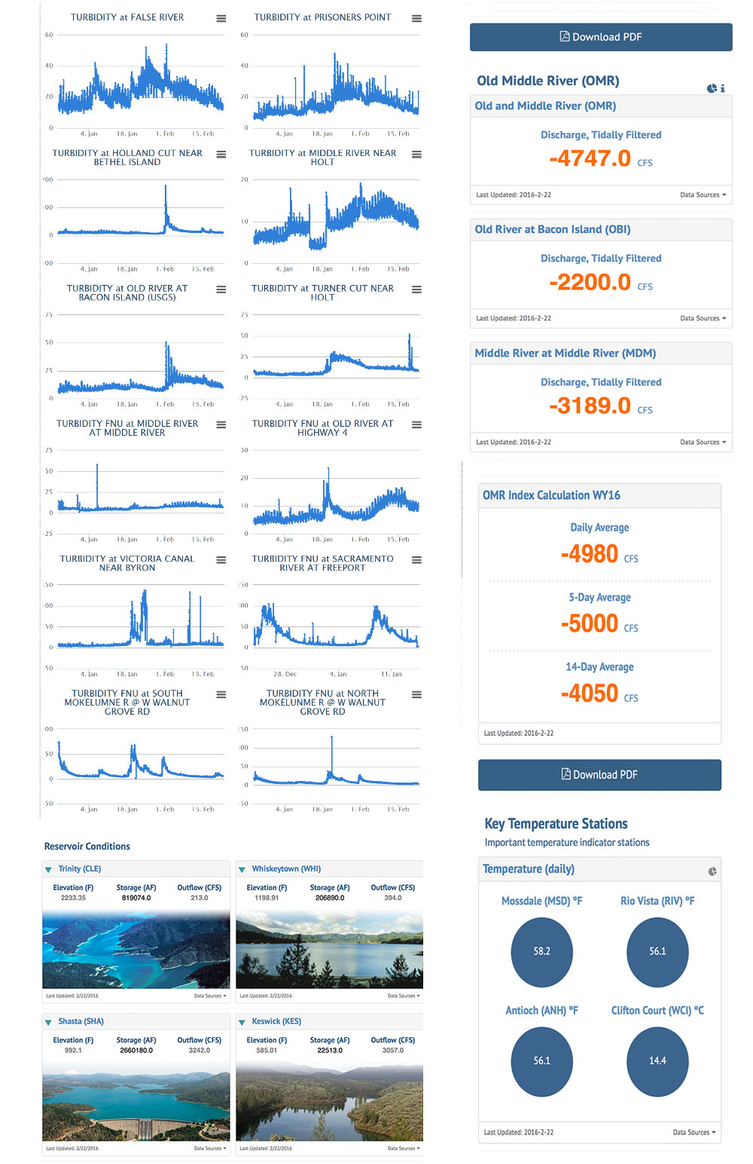
Delta Turbidity and Current Conditions

Slide 23
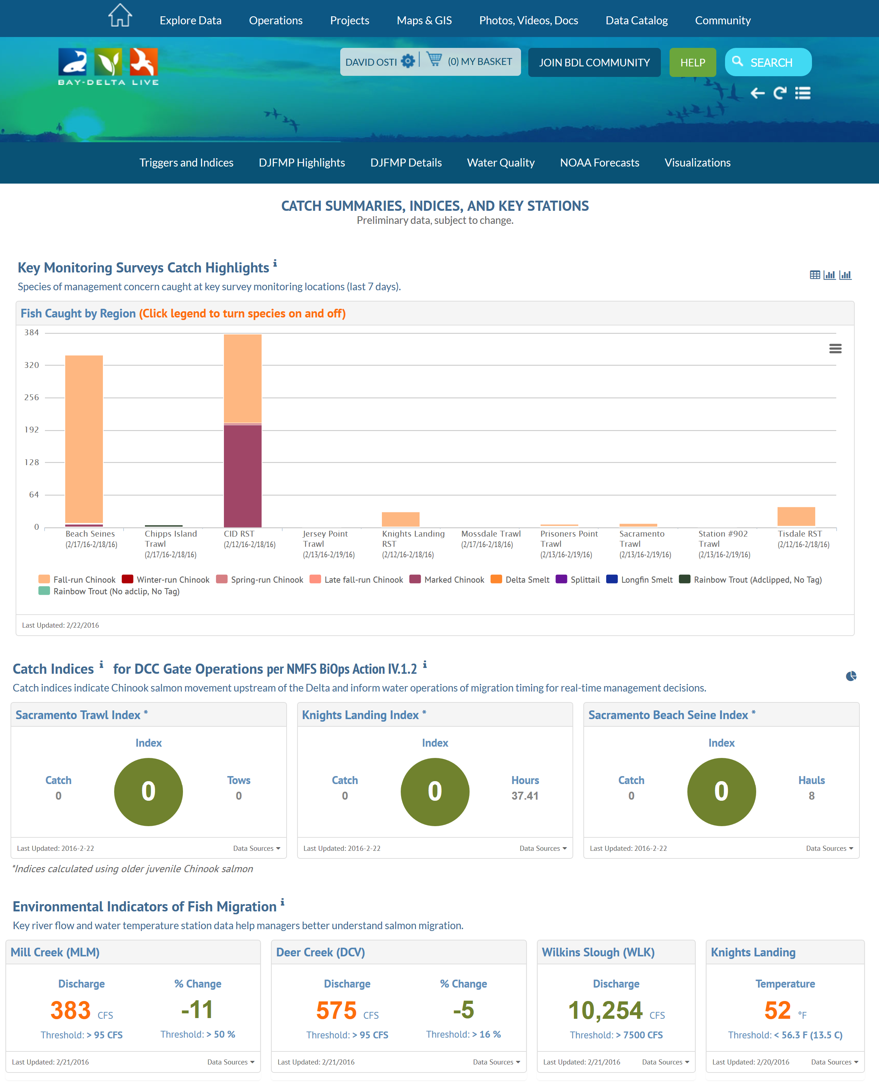
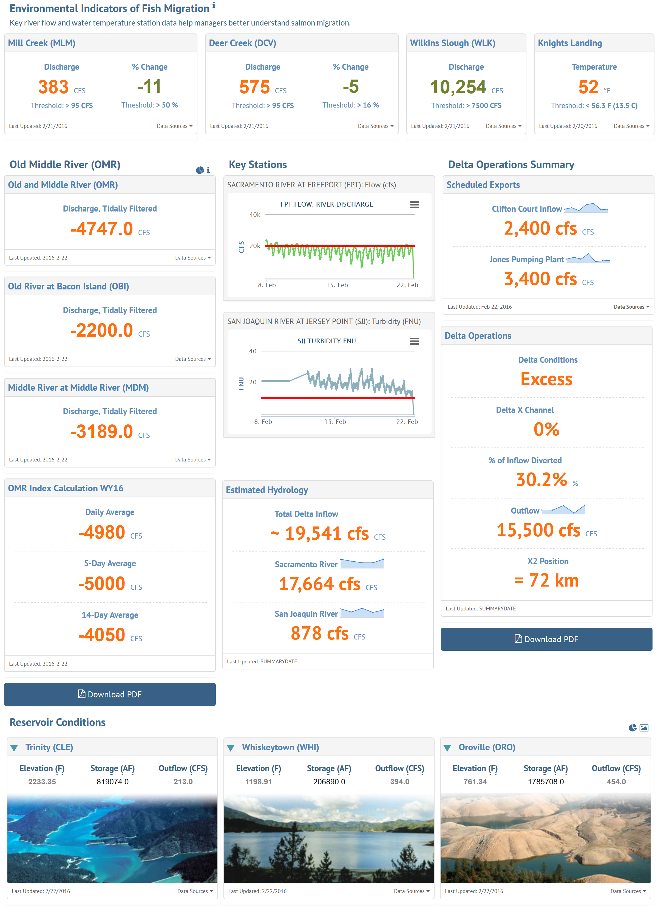
Fish Monitoring Surveys and Current Conditions

Slide 24
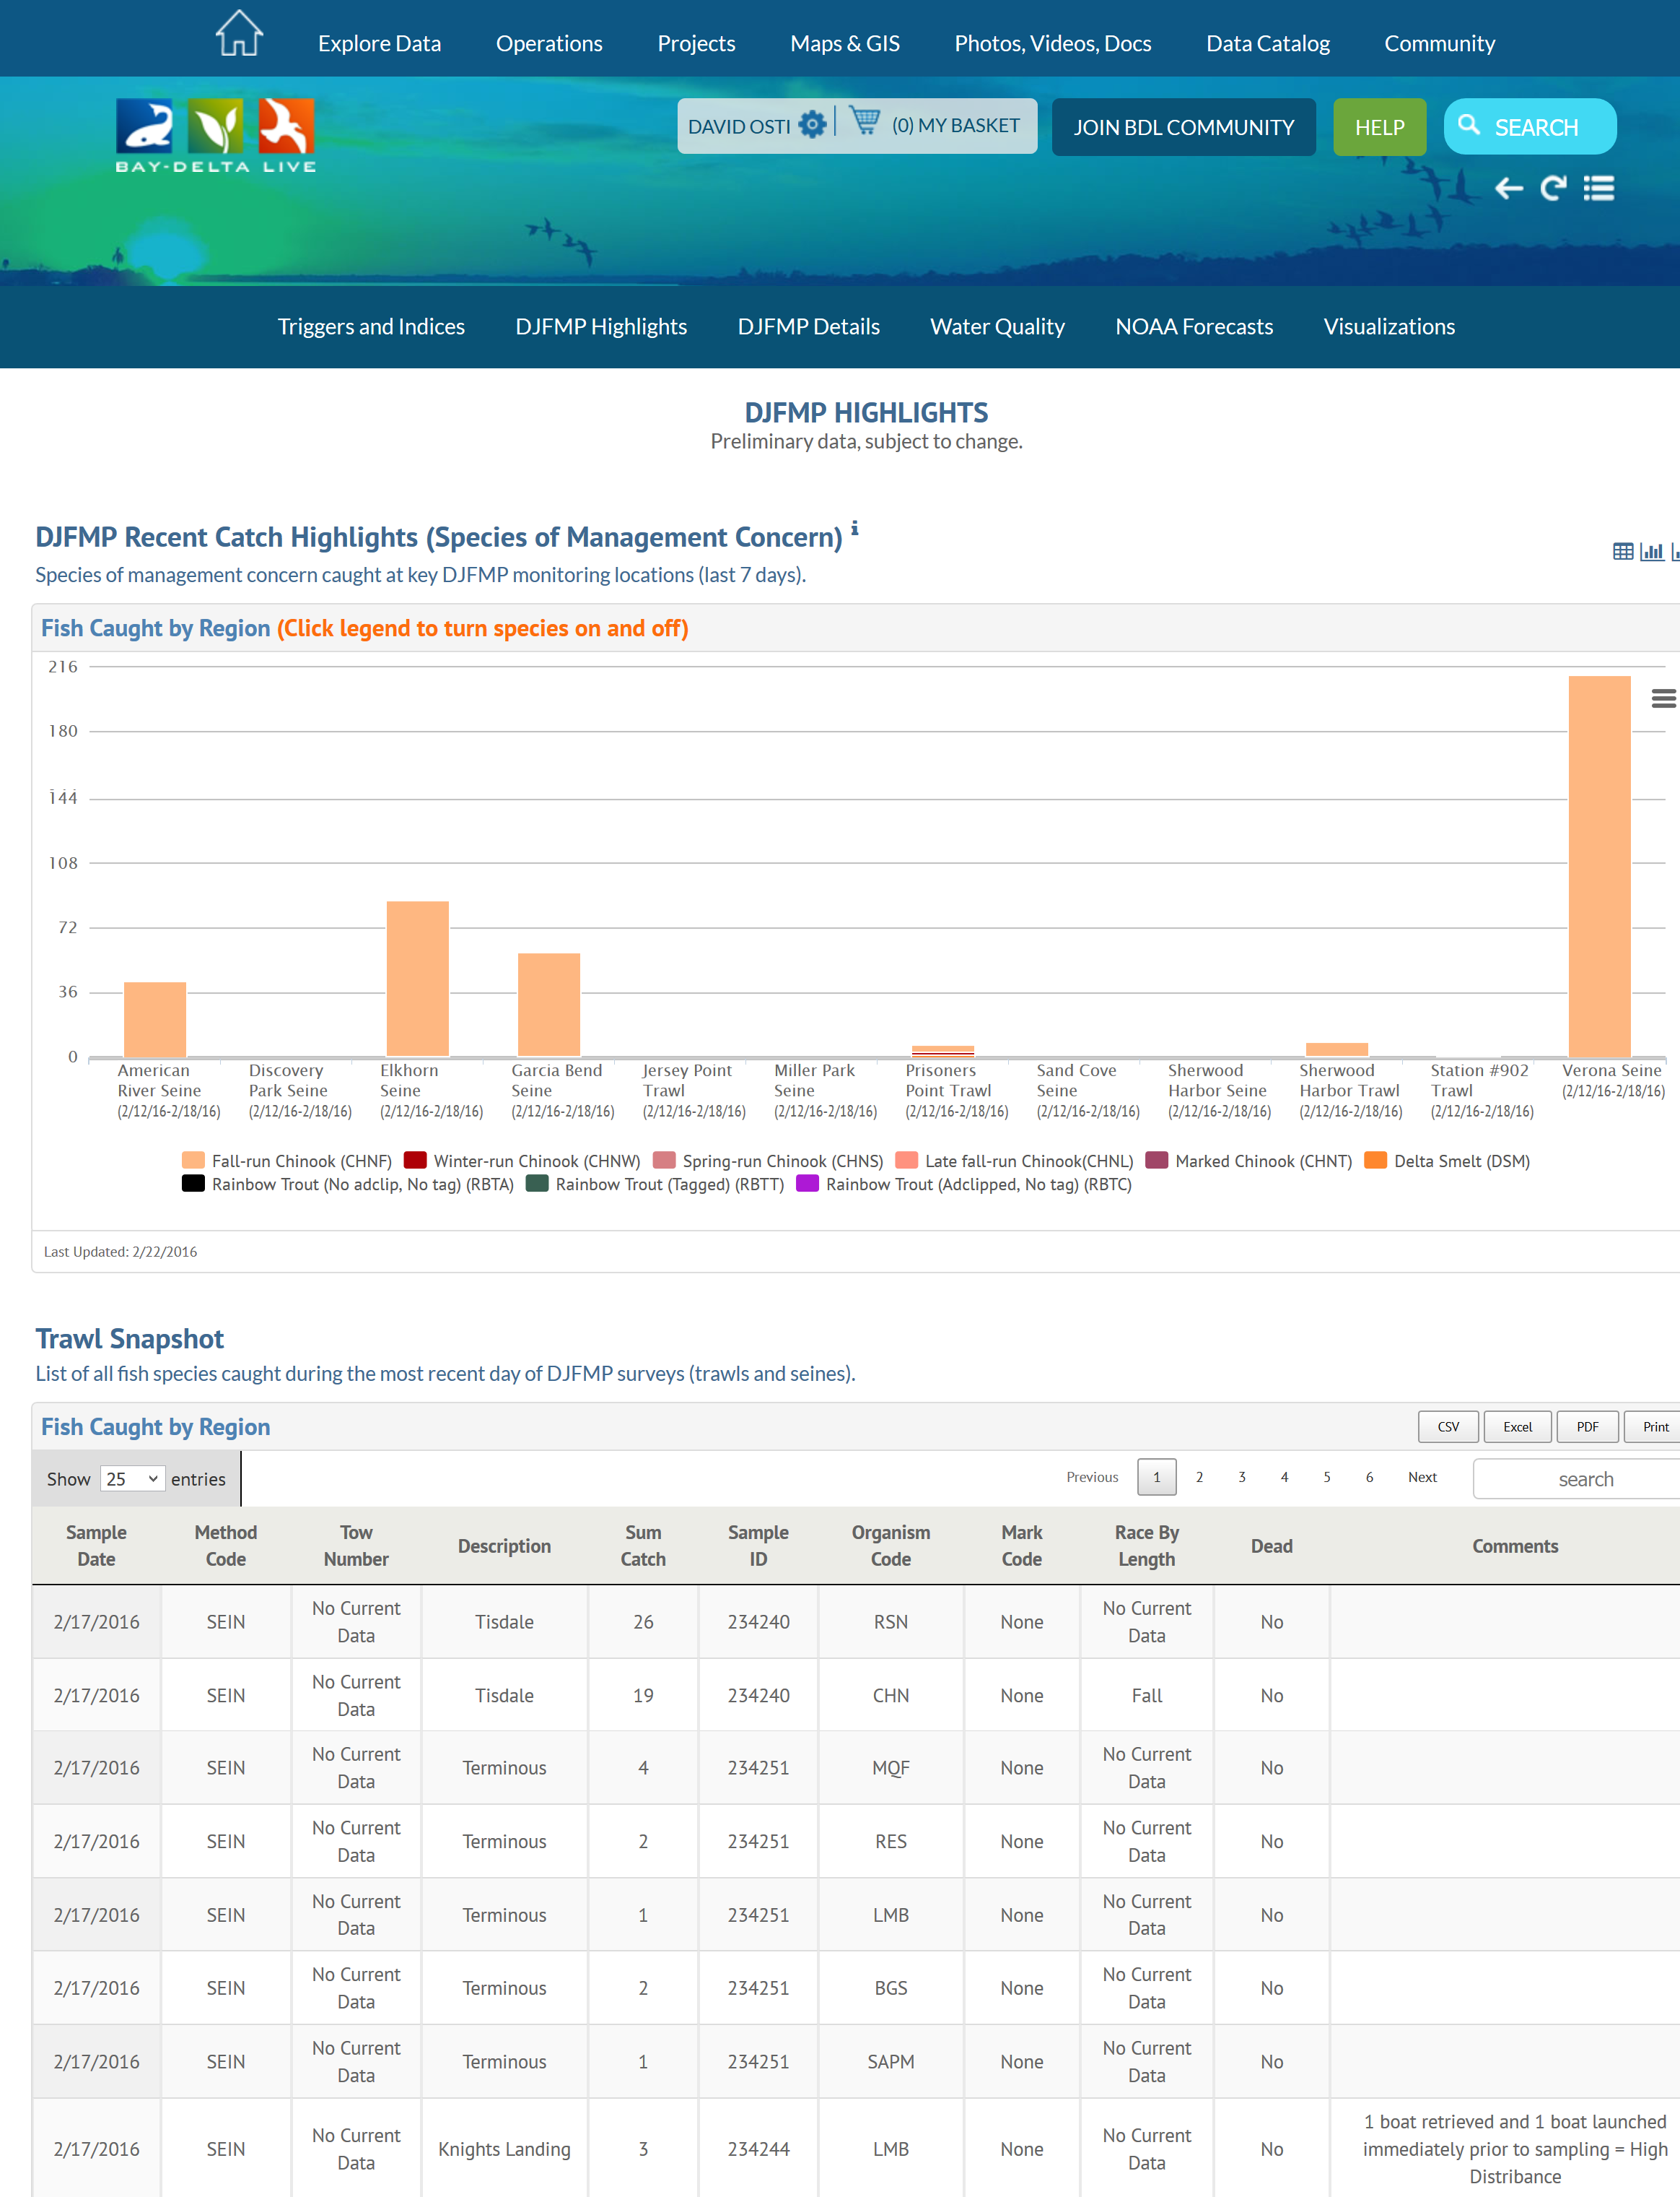
Fish Monitoring Surveys and Current Conditions
Fish Data and Current Conditions

Slide 25
Survey Details and Current Conditions

Slide 26
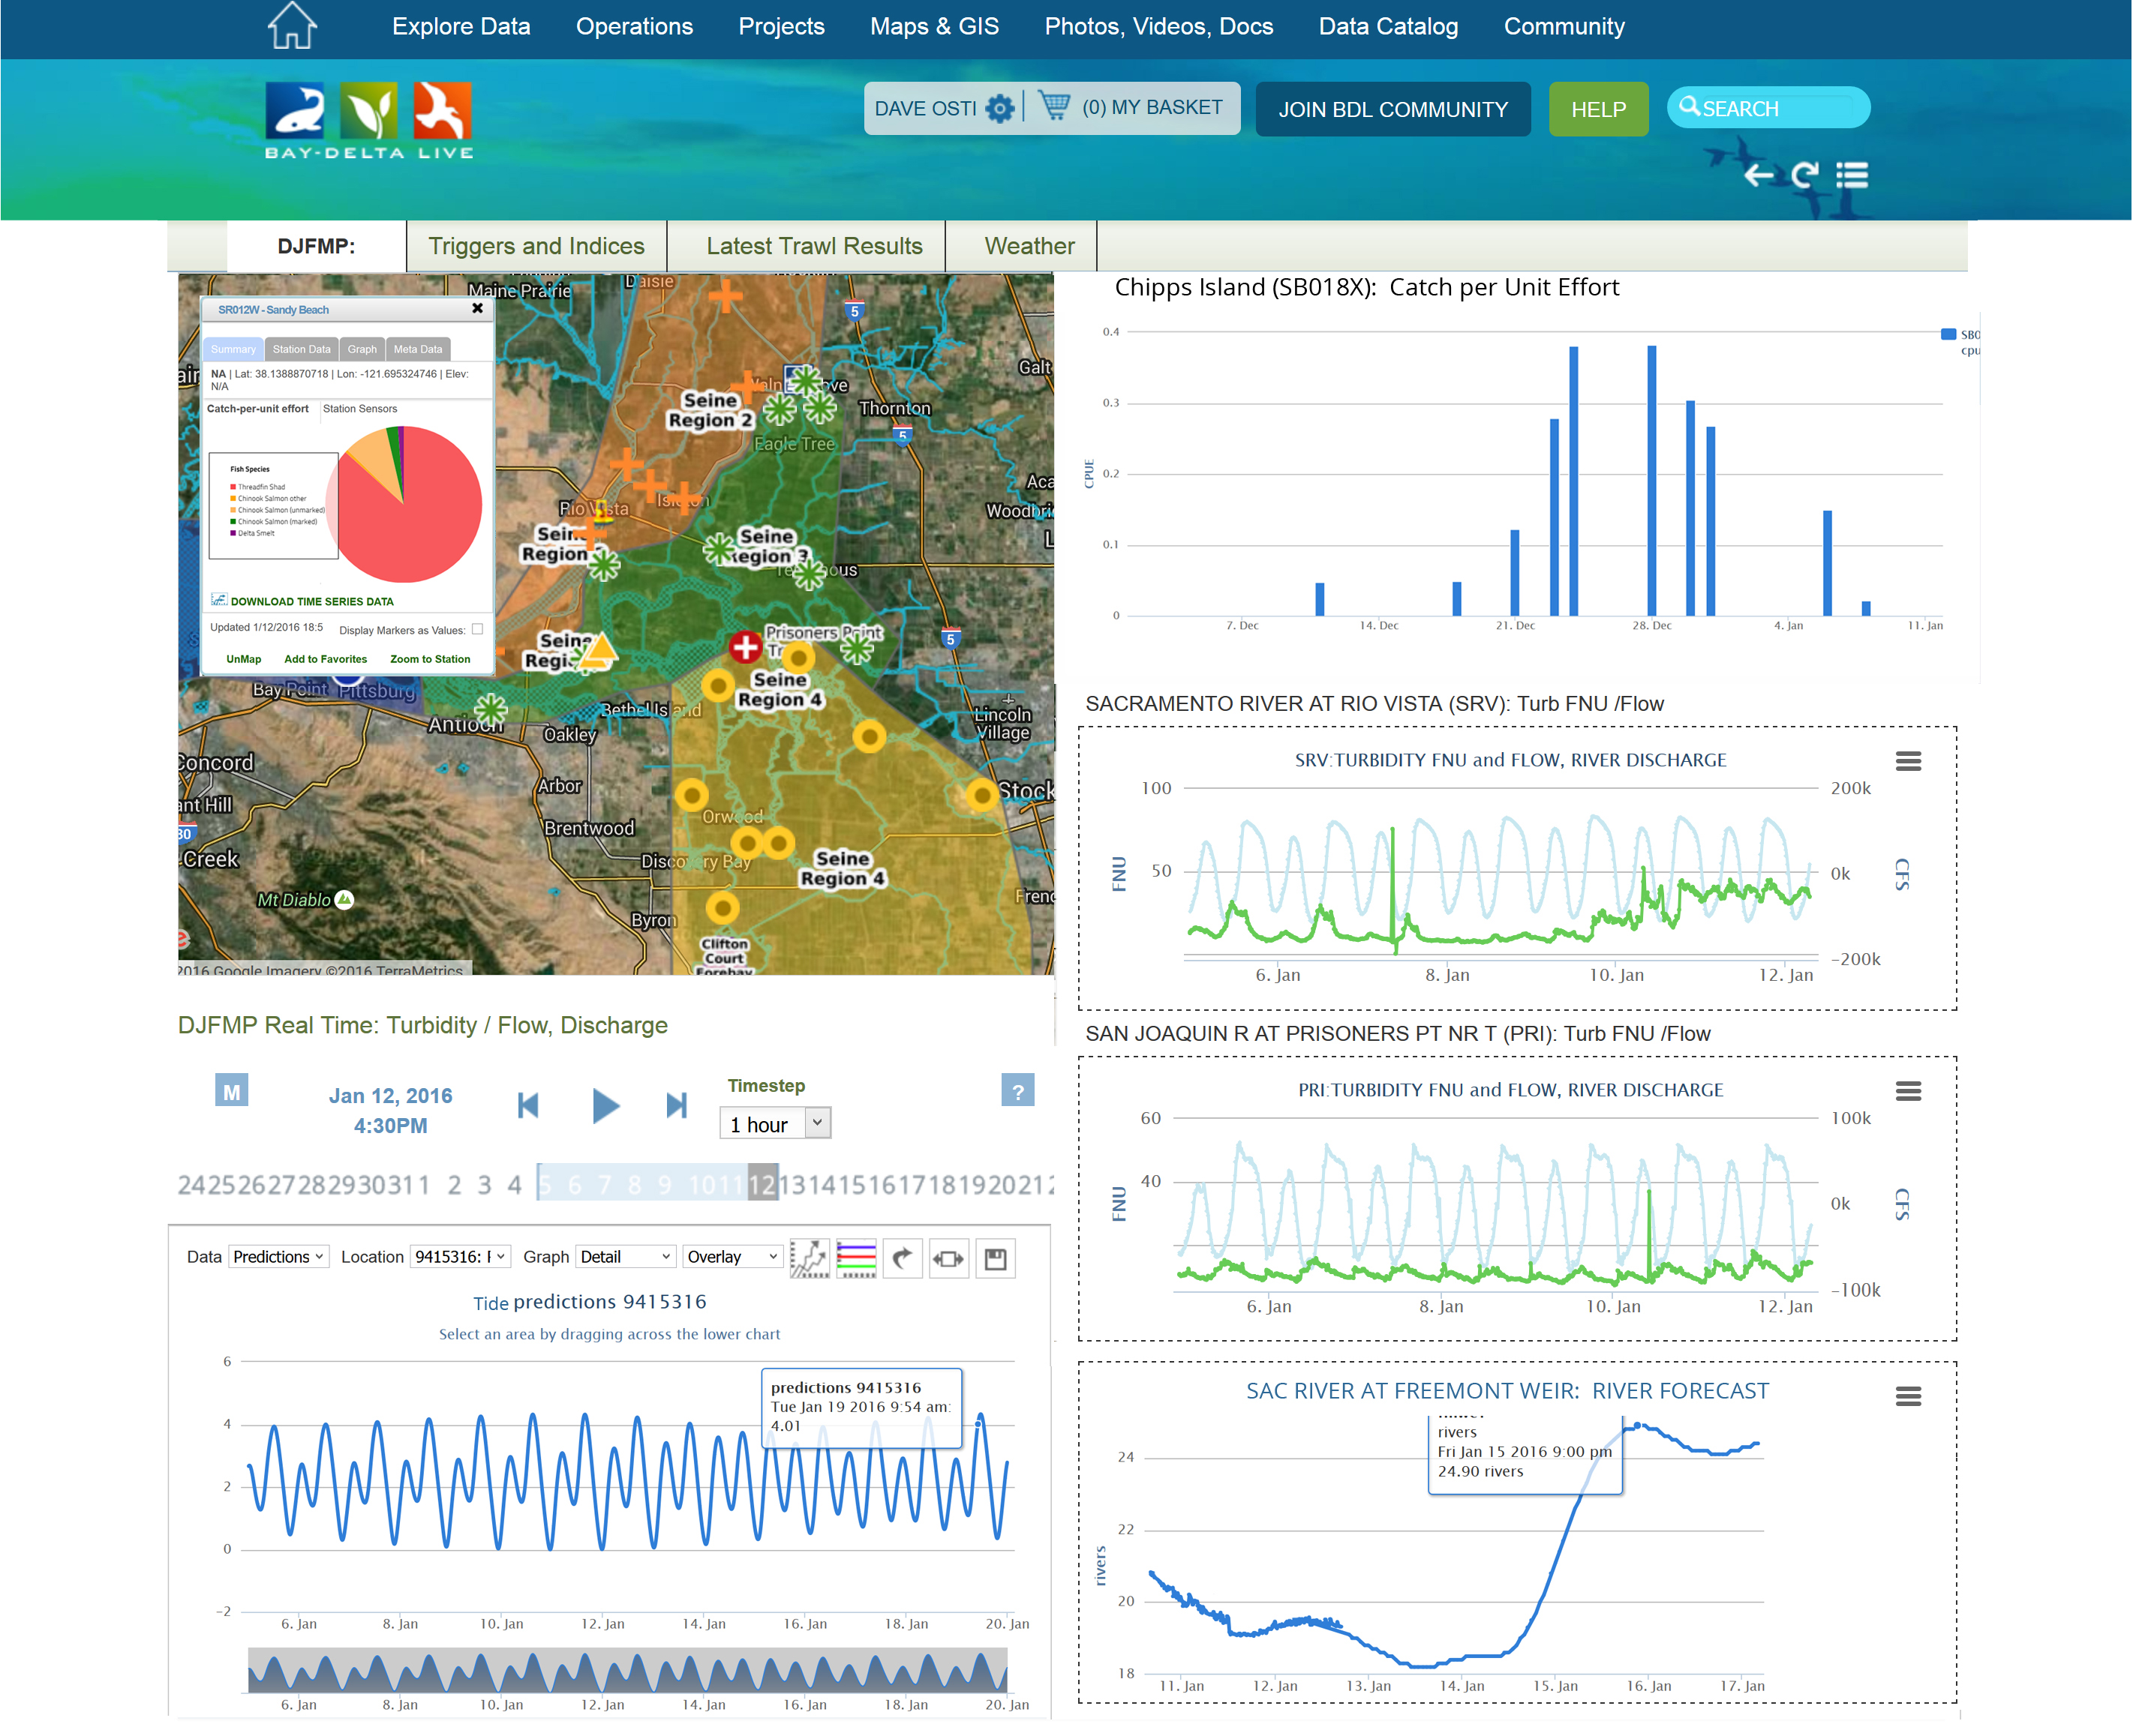
Survey Regions and Current Conditions

Slide 27
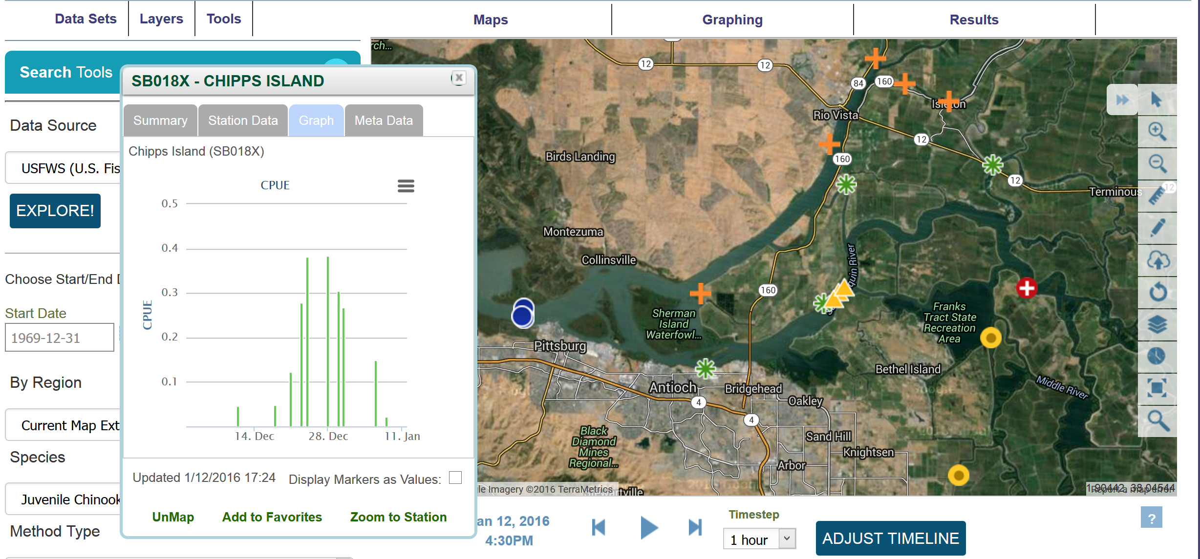

Fish Data Catch and CPUE

Slide 28
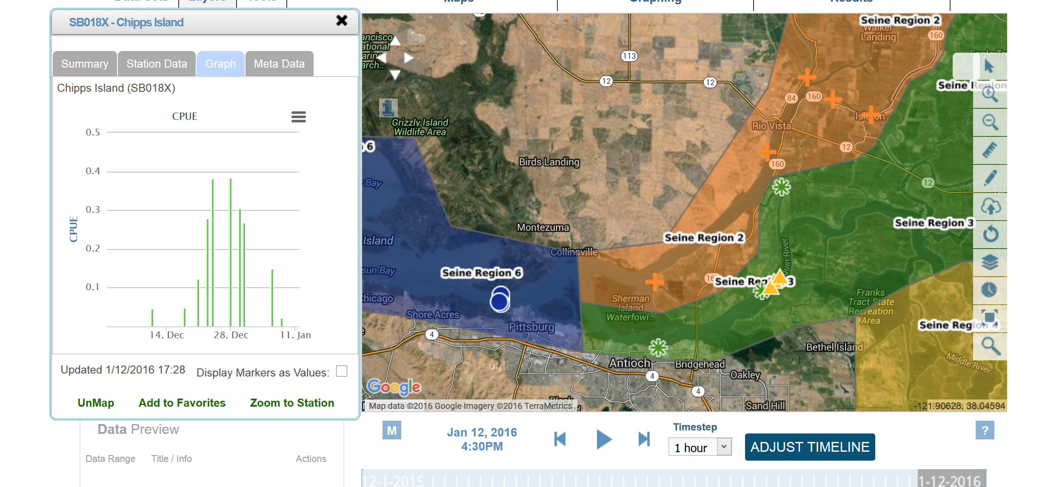
Fish Data CPUE by Region

Slide 29
SRWP PORTAL
(In-Development)
Notes:
The CA estuaries workspace and stakeholder group is responsible for the development of:
25+ Key datasets: IEP data, trawl and salvage data, 1641 reporting project
85+ question driven WQ pages on mywaterquality.ca.gov
Important space for incubation of ideas, assessment criteria and concepts.
Key development of data visualization tools.

Slide 30
SRWP PORTAL TOPICS AND DATA
Drought Management
Domestic, Municipal and Industrial Supply
Monitoring Program Management
Sustainable Ground Water Management Act (5 high priority sub-basins and 16 medium priority)
Federal Clean Water Act/Porter-Colonge (Beneficial uses)
Regional Water Quality Control Plans
1641 Water Quality
Nutrients
Recreation
Fish and Wildlife
Hydropower and Fire

Slide 31

SRWP KEY FEATURES AND TOOLS
Data Catalogs
Data Management Tools
Interactive GIS
Access to 120+ GIS Layers
Document Management (400+ Records)
Projects Management
Data Dashboards
Regulatory Reporting Templates
Question Templates
Data Story Templates
Real Time Management Tools
Notes:
To address these challenges we are developing these tools

