Slide 1

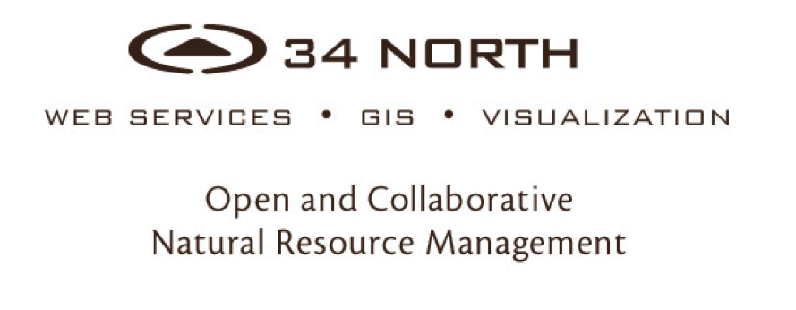

Slide 2
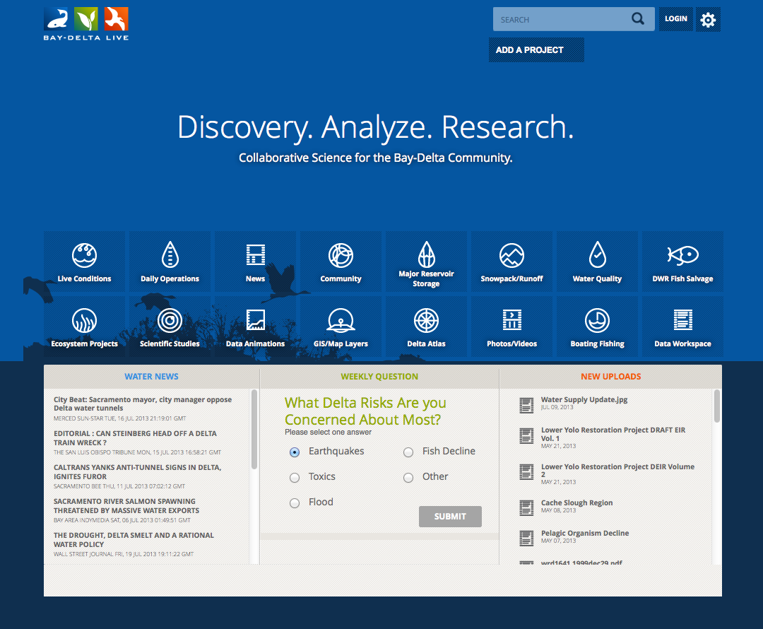
Notes:
Telling the story of a complicated system.
Interpreting results to managers and stakeholders
Easily share data stories, project data, monitoring results, document libraries, interactive maps and datasets.

Slide 3
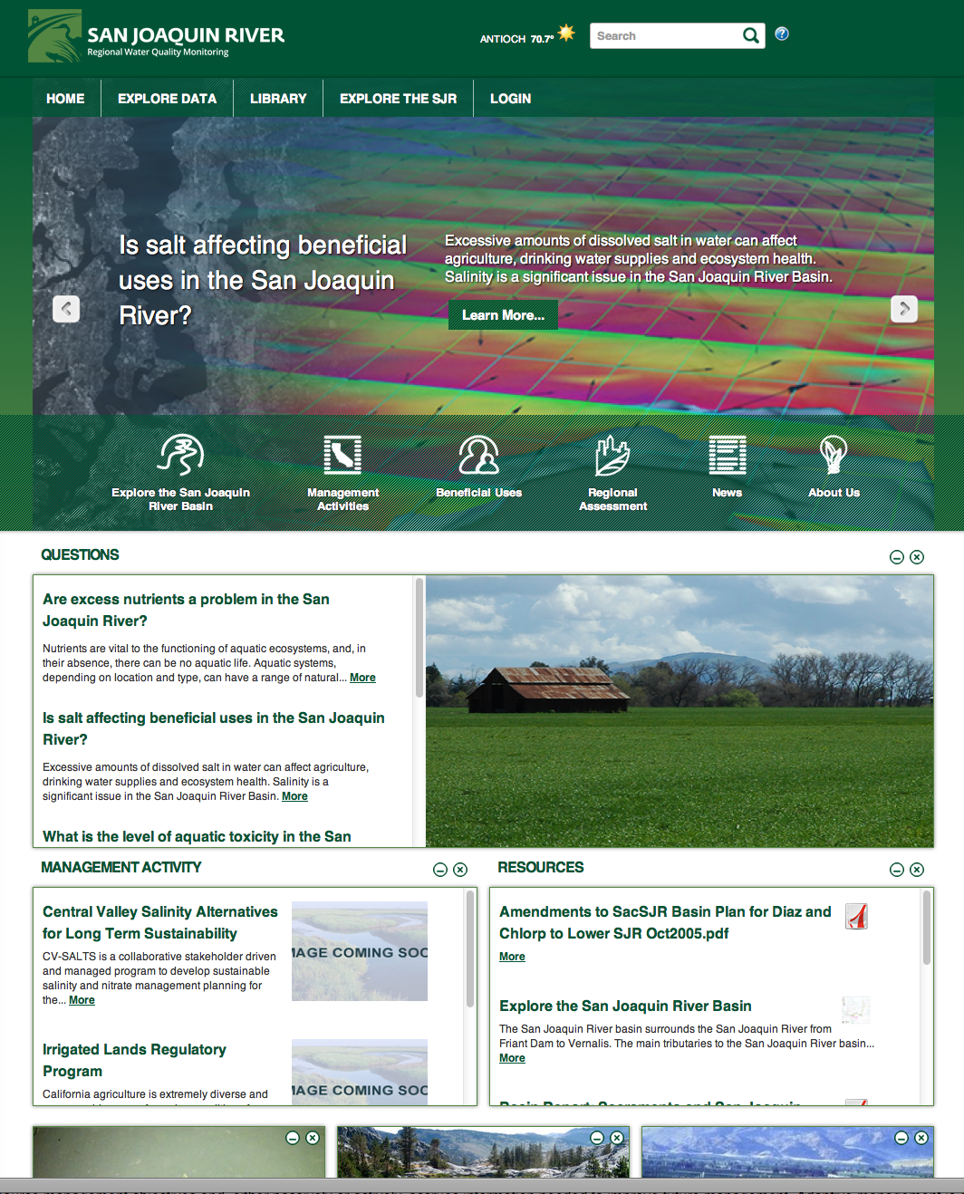
Notes:
Telling the story of a complicated system.
Interpreting results to managers and stakeholders
Easily share data stories, project data, monitoring results, document libraries, interactive maps and datasets.

Slide 4
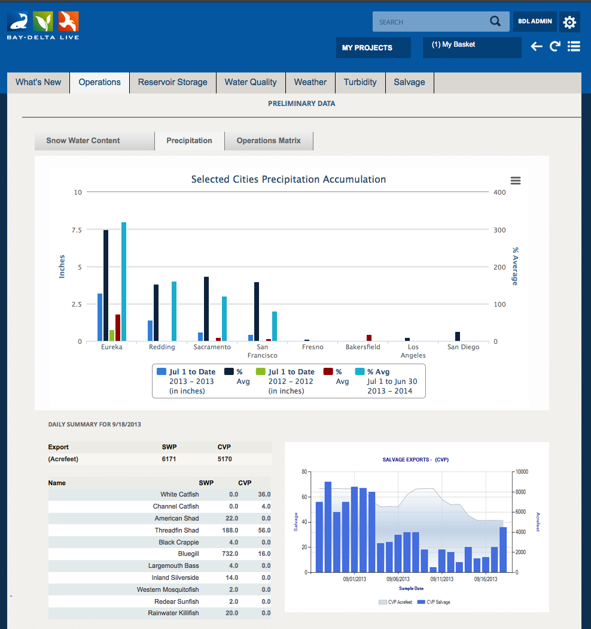

OPERATIONS DASHBOARD

Slide 5
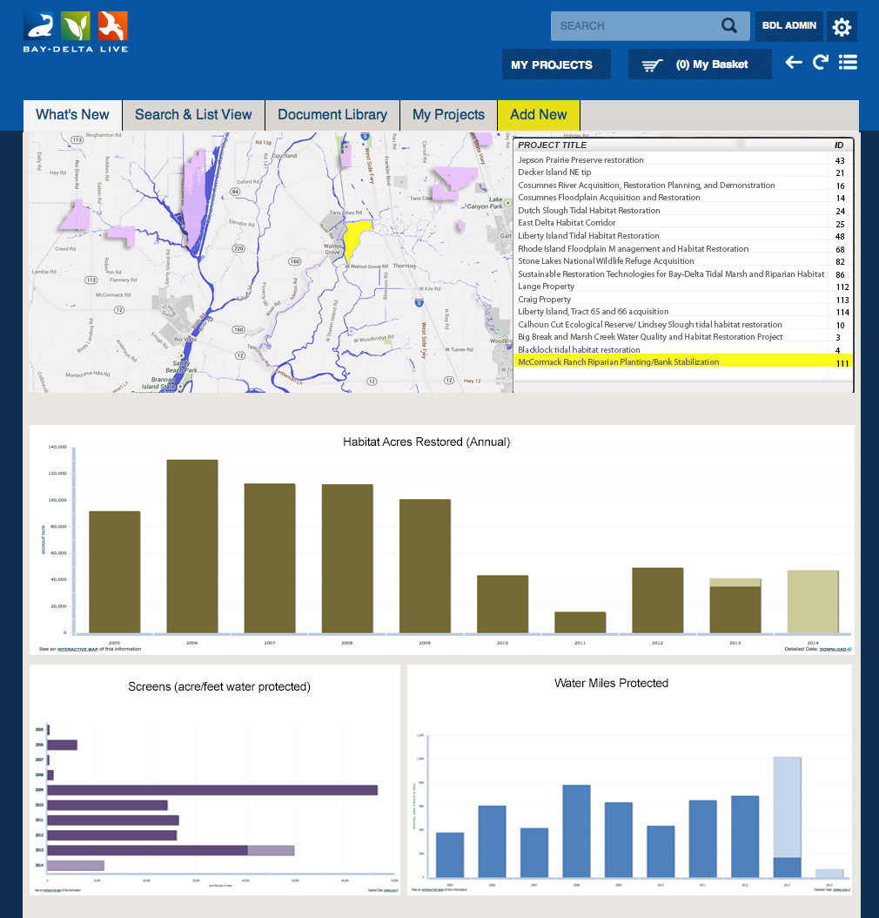
PROJECTS DASHBOARD

Slide 6
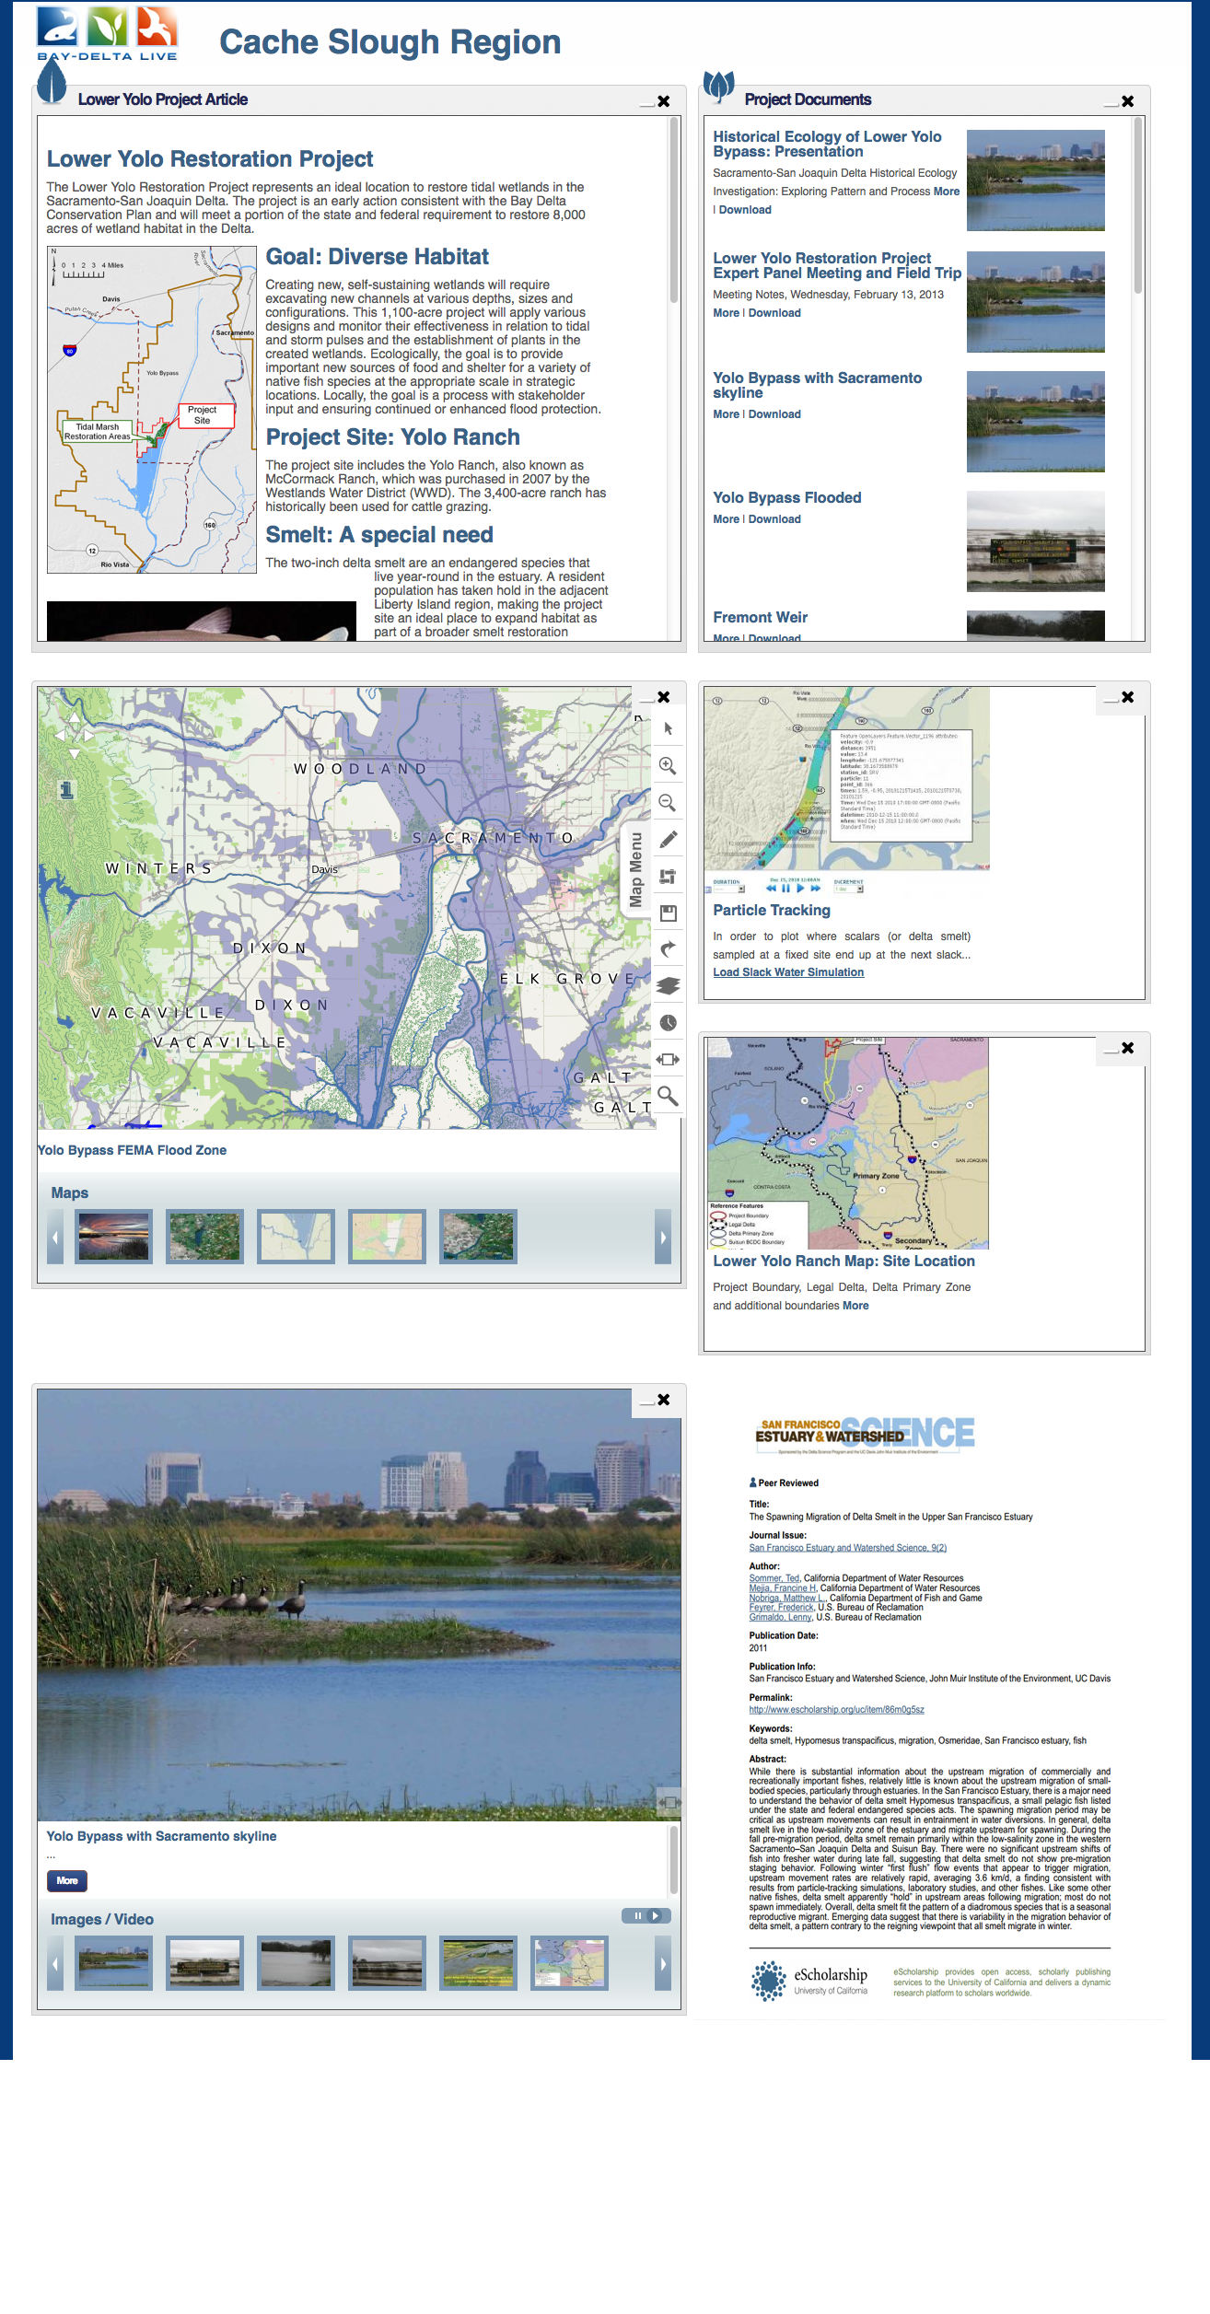
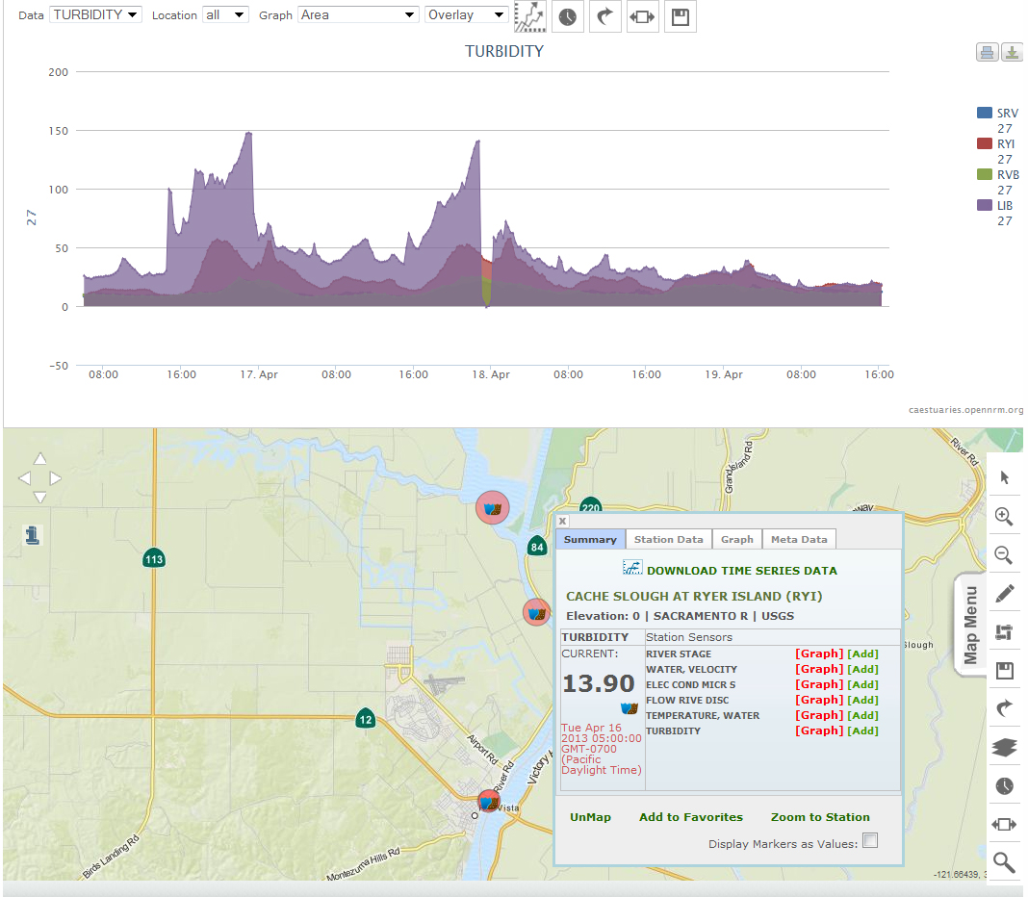
Notes:
What is OpenNRM? Built using many of the OS projects you see here this week, OpenNRM is a collection of integrated components to help natural resource managers, scientists, policy makers, conservationists, SEE AND MANAGE THE BIG PICTURE. The platform is made up of: ……

Slide 7
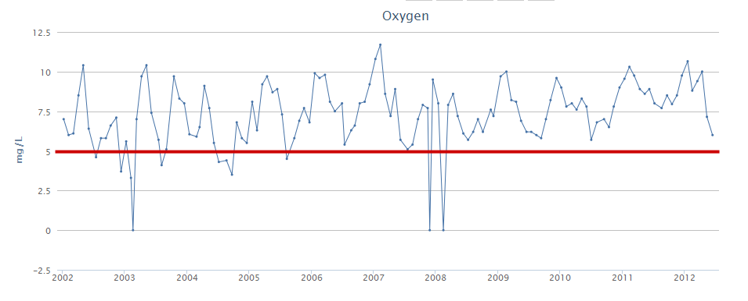
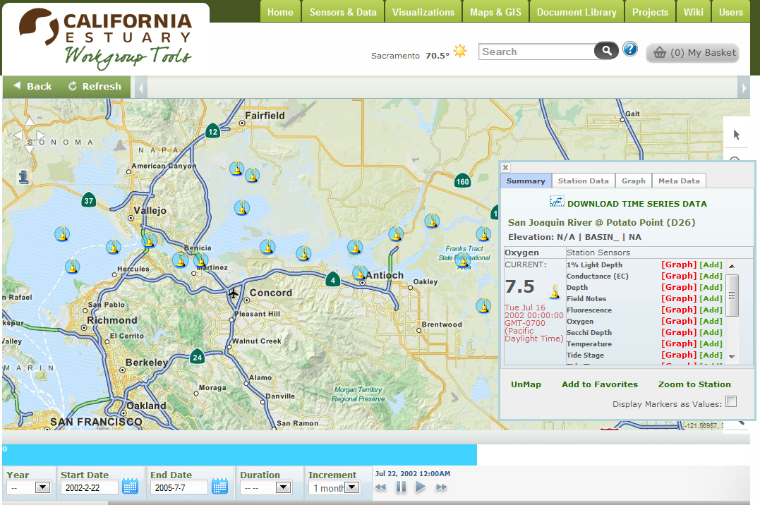
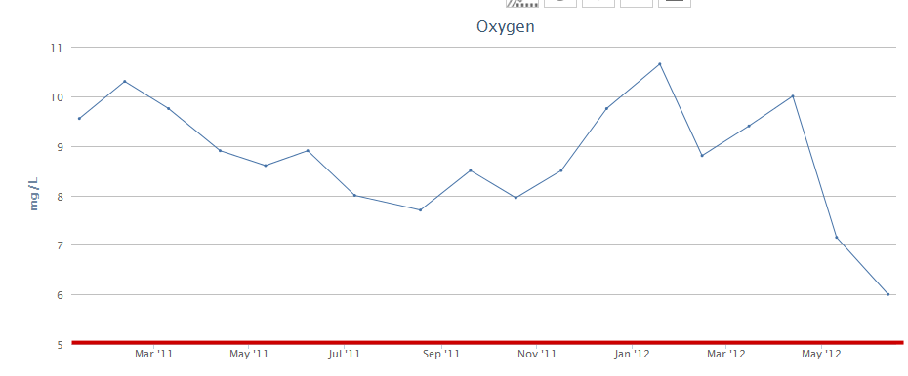
Dissolved Oxygen Stockton Ship Channel (RRI)
2002-2012

Slide 8
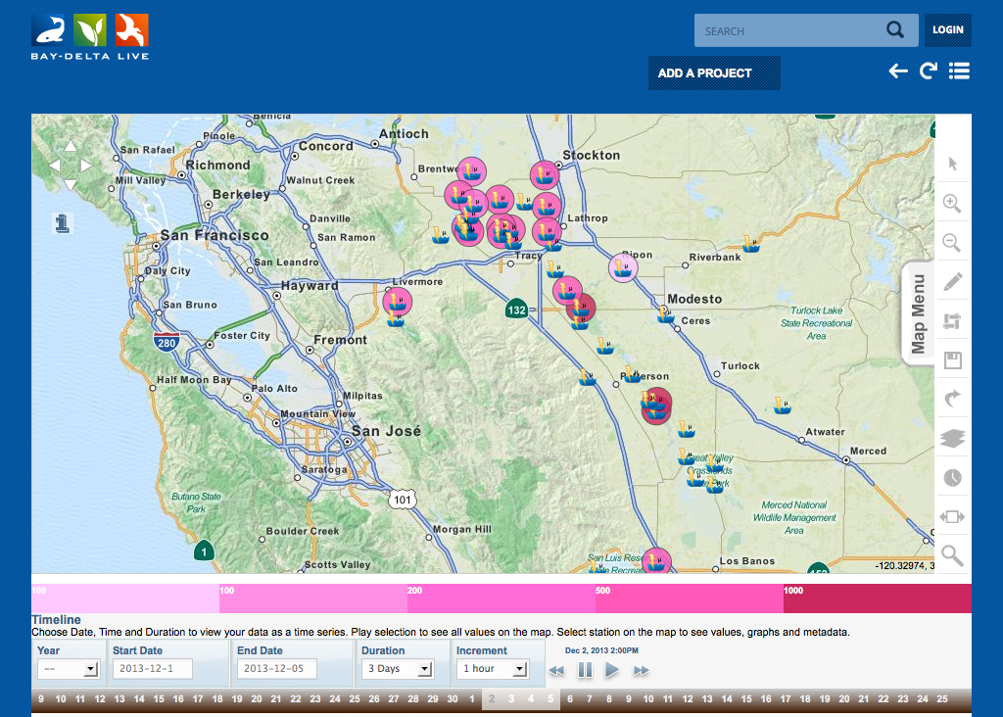
COLLABORATIVE

Slide 9
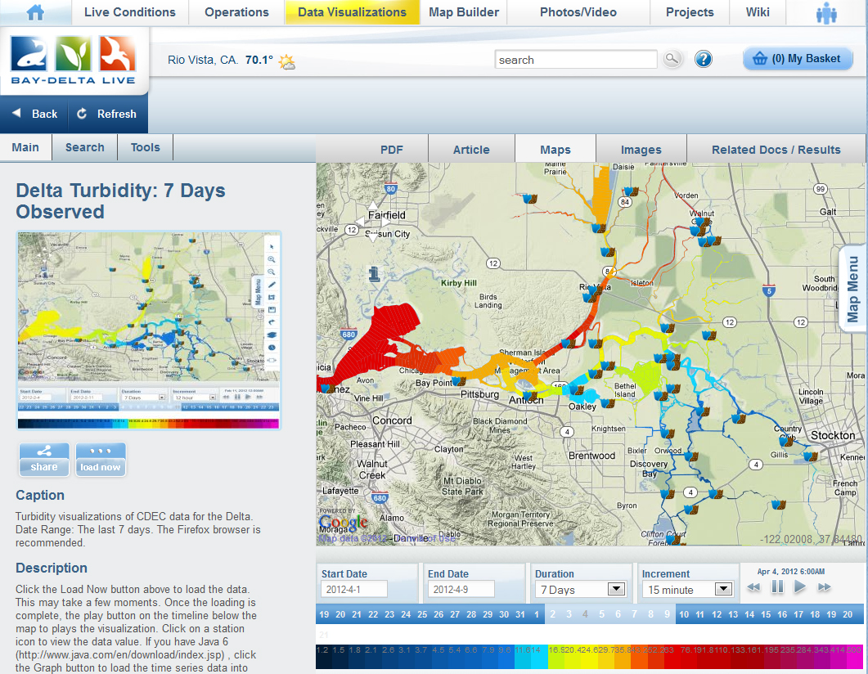
Notes:
What is OpenNRM? Built using many of the OS projects you see here this week, OpenNRM is a collection of integrated components to help natural resource managers, scientists, policy makers, conservationists, SEE AND MANAGE THE BIG PICTURE. The platform is made up of: ……

Slide 10
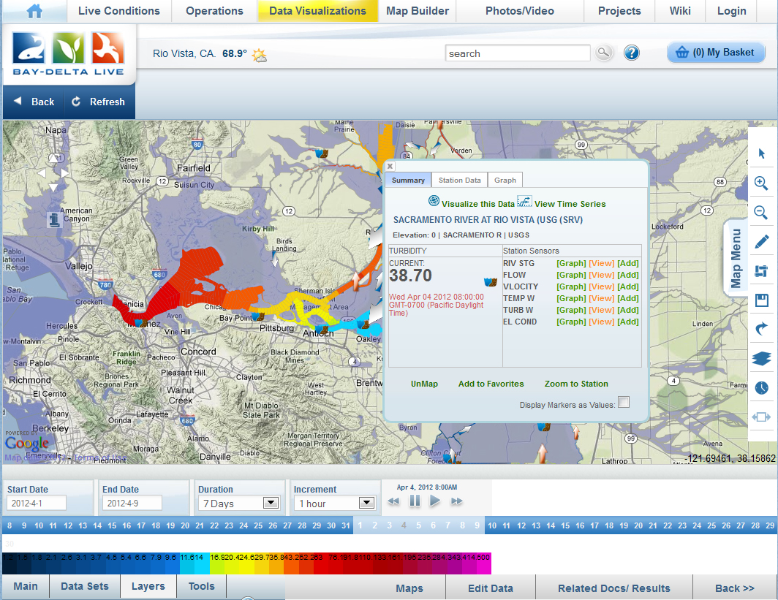
Notes:
What is OpenNRM? Built using many of the OS projects you see here this week, OpenNRM is a collection of integrated components to help natural resource managers, scientists, policy makers, conservationists, SEE AND MANAGE THE BIG PICTURE. The platform is made up of: ……

Slide 11
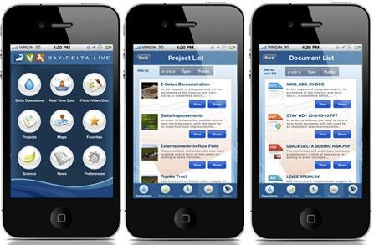
MOBILE APPLICATIONS
Notes:
What is OpenNRM? Built using many of the OS projects you see here this week, OpenNRM is a collection of integrated components to help natural resource managers, scientists, policy makers, conservationists, SEE AND MANAGE THE BIG PICTURE. The platform is made up of: ……

Slide 12
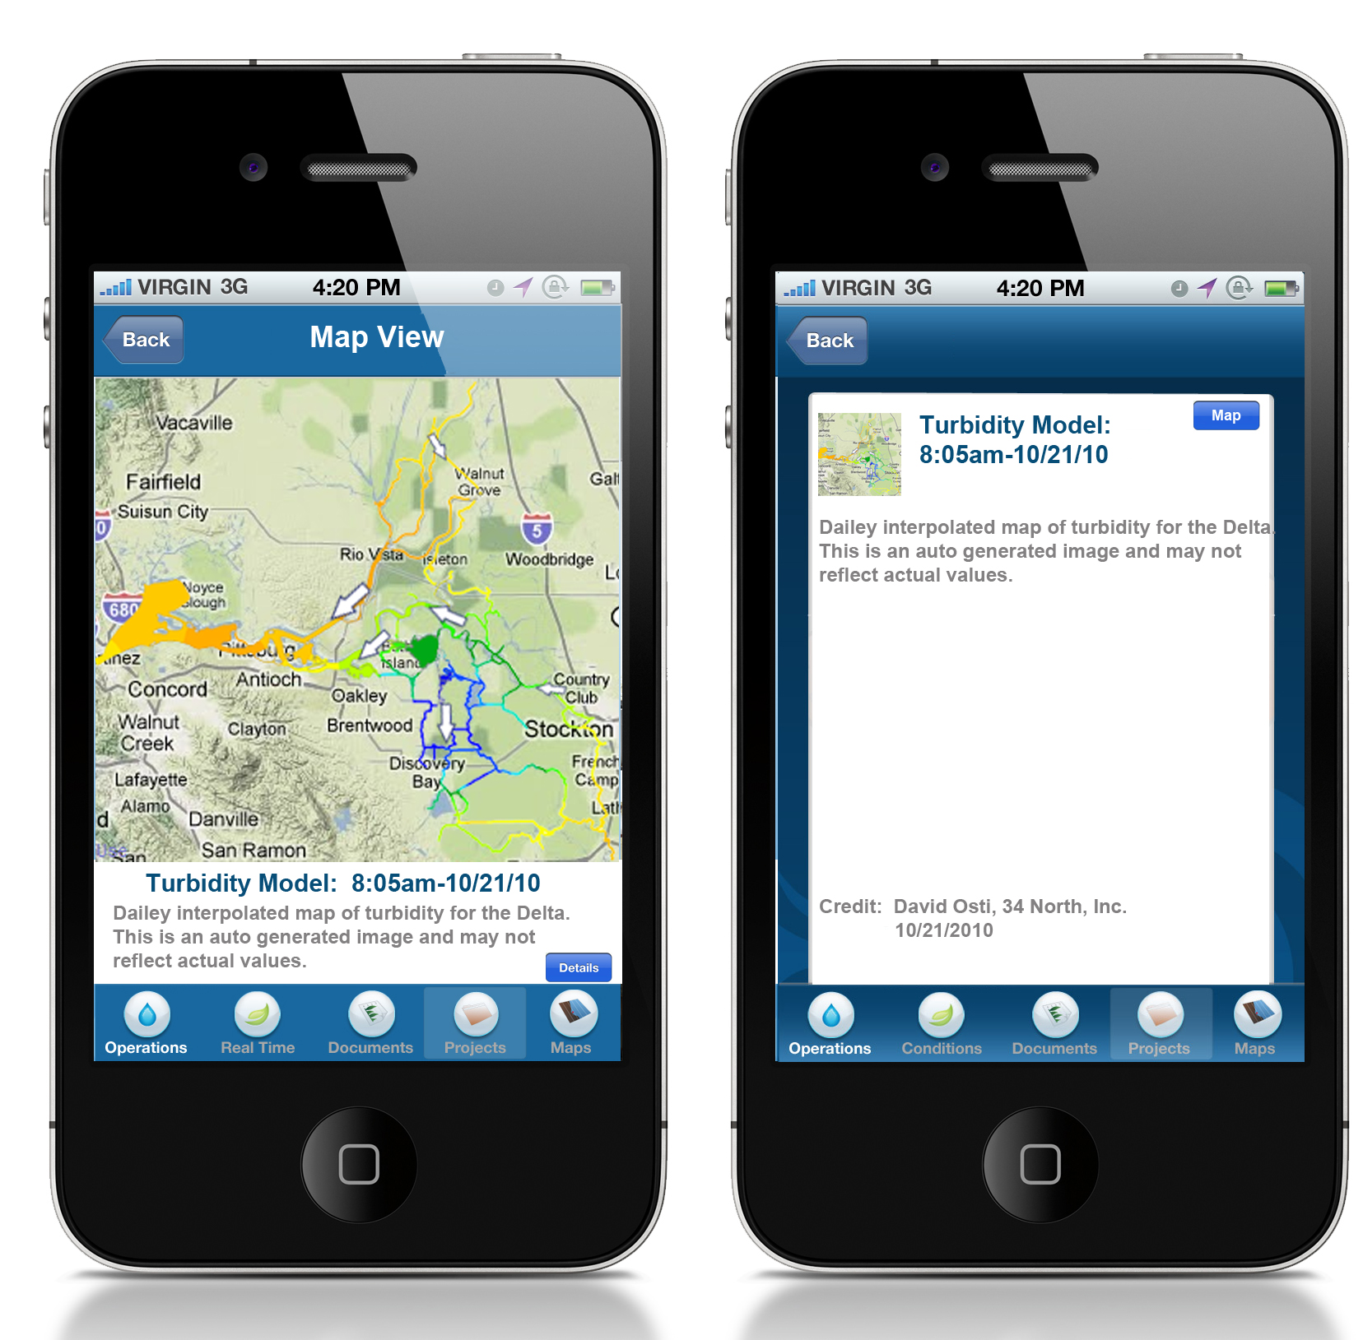
MOBILE APPLICATIONS
Notes:
What is OpenNRM? Built using many of the OS projects you see here this week, OpenNRM is a collection of integrated components to help natural resource managers, scientists, policy makers, conservationists, SEE AND MANAGE THE BIG PICTURE. The platform is made up of: ……

