Slide 1


BDL CAMT/DOSS
& Project Updates

Slide 2

Overview
Data Inventory: Review datasets required for early warning and RPA/BiOps. Determine if we are missing anything
Review Tasks Completed: Detailed review of tasks completed and timeline for access.
GIS, Dashboards and Data Presentation: Demonstrate current dashboard layouts and design. Also a sneak peek at “explore data” features.
Questions and Comments? Schedule hands on review for 21st or 22nd in Sac?

Slide 3
CAMT/DOSS
Data Inventory

Slide 4
Data Widget | Description | Parameter (units) | Data Source | Data Location
Catch Indices | Catch Indices for Sacramento Trawl, Knights Landing RST, and Sacramento Seine; water quality information (D-1641 compliance met Y/N), DCC gate open/closed | DJFMP Catch Data for Sacramento River Trawl and Sacramento Area Beach Seines (index) | DJFMP USFW | http://www.fws.gov/Lodi/DJFMP/
 |  | Knights Landing RST catch data (index) | CDFW | Excel
 |  | DCC gate status (%) | DWR | http://www.water.ca.gov/SWP/operations control/docs/delta/deltaops.pdf
 |  | D-1641 WQ criteria met (Y/N) | NFMS | Personnal Communication
Reservoir | Select parameters for key reservoirs (Trinity, Shasta, Whiskeytown, Keswick, Oroville, Folsom, New Melones, Don Pedro, McClure (Exchequer), San Luis) | Capacity (AF) | CDEC | http://cdec.water.ca.gov/reservoir.html
 |  | Storage (AF) | CDEC | http://cdec.water.ca.gov/reservoir.html
 |  | Outflow (cfs) | CDEC | http://cdec.water.ca.gov/reservoir.html

Slide 5
Data Widget | Description | Parameter (units) | Data Source | Data Location
Delta Operations and Conditions | Key delta operations stations and conditions | Delta Cross Channel gate (%) | DWR | http://www.water.ca.gov/swp/operationscontrol/docs/delta/deltaops.pdf
 |  | Delta Conditions (status) | DWR | http://www.water.ca.gov/swp/operationscontrol/docs/delta/deltaops.pdf
 |  | X2 Position (> or < 81 km) | DWR | http://www.water.ca.gov/swp/operationscontrol/docs/delta/deltaops.pdf
 |  | Delta Outflow (cfs) | DWR | http://www.water.ca.gov/swp/operationscontrol/docs/delta/deltaops.pdf
 |  | Delta Inflow (cfs) | DWR | http://www.water.ca.gov/swp/operationscontrol/docs/delta/DeltaHydrology.pdf
 |  | Delta Diversions (%) | DWR | http://www.water.ca.gov/swp/operationscontrol/docs/delta/deltaops.pdf
 |  | Qwest (cfs) | DWR | http://www.water.ca.gov/swp/operationscontrol/docs/delta/DeltaHydrology.pdf
Old and Middle River (OMR) Flow | OMR tidally filtered gage and index data (daily, 5-day, and 14-day averages) | OMR tidally filtered (5 and 14 day), Index (daily, 5, and 14 day average) | DWR | http://www.usbr.gov/mp/cvo/vungvari/OMR_Jan2016.pdf
 |  | OMR Gage (Station Code: OMR) | CDEC | http://cdec.water.ca.gov/cgi-progs/queryDaily?OMR
 |  | 2 gages which are used in the OMR Index calculations (OBI and MDM) | CDEC | http://cdec.water.ca.gov/cgi-progs/staMeta?station_id=OBI, http://cdec.water.ca.gov/cgi-progs/staMeta?station_id=MDM

Slide 6
Data Widget | Description | Parameter (units) | Data Source | Data Location
Triggers to close DCC gates per Bi Ops RPA Action IV.1.1 | Environmental indicators of fish migration (RPA) | Flow at Mill Creek (MLM) (cfs) | CDEC | http://cdec.water.ca.gov/cgi-progs/staMeta?station_id=MLM
 |  | Flow at Deer Creek (DCV) (cfs) | CDEC | http://cdec.water.ca.gov/cgi-progs/staMeta?station_id=DCV
 |  | Flow at Wilkins Slough (WLK) (cfs) | CDEC | http://cdec.water.ca.gov/cgi-progs/staMeta?station_id=WLK
 |  | Temperature at Knights Landing (F) from Knights landing RST data sheet | CDFW | Manual in excel
Key Delta Temperature stations | Water temperature at select locations | San Joaquin River @ Mossdale Bridge (MSD) | CDEC | http://cdec.water.ca.gov/cgi-progs/staMeta?station_id=MSD
 |  | Sacramento River @ Rio Vista (RIV) | CDEC | http://cdec.water.ca.gov/cgi-progs/staMeta?station_id=RIV
 |  | San Joaquin river @ Antioch (ANH) | CDEC | http://cdec.water.ca.gov/cgi-progs/staMeta?station_id=ANH
 |  | Clifton Court Forebay ( WCI) | CDEC | http://cdec.water.ca.gov/cgi-progs/staMeta?station_id=WCI

Slide 7
Data Widget | Description | Parameter (units) | Data Source | Data Location
Water Quality Concern Stations (during Drought Ops) | 4 stations used to monitor water quality (EC) in the delta during Drought Operations for the Catch Indices | Jersey Point EC (SJJ), with threshold @ 1.8 mmhos/cm | CDEC | http://cdec.water.ca.gov/cgi-progs/staMeta?station_id=SJJ
 |  | Bacon Island EC (BAC), with threshold @ 1.0 mmhos/cm | CDEC | http://cdec.water.ca.gov/cgi-progs/staMeta?station_id=BAC
 |  | Bethel Island EC (BET), with threshold @ 0.8 mmhos/cm | CDEC | http://cdec.water.ca.gov/cgi-progs/staMeta?station_id=BET
 |  | Holland Tract EC (HLL), with threshold @ 0.7 mmhos/cm | CDEC | http://cdec.water.ca.gov/cgi-progs/staMeta?station_id=HLL
Triggers for Turbidity Events | 2 stations that trigger a change in delta turbidity and or fish movement | Freeport (cfs) (FPT) with threshold line at 20,000 cfs | CDEC | http://cdec.water.ca.gov/cgi-progs/staMeta?station_id=FPT
 |  | Jersey Point (SJJ) turbidity with threshold line at 10 NTU | CDEC | http://cdec.water.ca.gov/cgi-progs/staMeta?station_id=SJJ

Slide 8
Data Widget | Description | Parameter (units) | Data Source | Data Location
7 Day Weather Forecast for Delta Conditions | Weather forecast from NOAA | > 1/4 " precipitation | NOAA | Web Services
 |  | Weather (cloud,sun,partly cloudy, etc) | NOAA | Web Services
 |  | Wind speed and direction | NOAA | Web Services
 |  | Air pressure | NOAA | Web Services
Tide Forecasting | Tide forecast | NOAA tide forecast for Sacramento River @ Rio Vista (RIV) | NOAA | Web Services
Salvage Estimates | Salvage for the John E. Skinner Delta Fish Protective Facility (SWP) and Tracy Fish Collection Facility (CVP). | Salvage estimates for chinook salmon (marked and unmarked), Delta Smelt, Steelhead (marked and unmarked) | CDFW | ftp://ftp.dfg.ca.gov/salvage/DOSS_Salvage_Tables/

Slide 9
Data Widget | Description | Parameter (units) | Data Source | Data Location
USFW DJFMP Trawl and Seine Catch Results | Recent and retrospective catch results for all DJFMP Trawl and Seines: Seine Region 1-7, Jersey Point, Prisoners Point, Liberty Island, Mossdale, Chipps Island, Sherwood Harbor, Sandy Beach, Site #707, Site #711, Site #714 | Catch is expressed as both raw catch and CPUE, catch can be viewed by species or by region/trawl | USFW | http://www.fws.gov/Lodi/DJFMP/
CADFW Trawl Catch Results | Recent and retrospective trawl Catch results for CDFW Trawls: SKT, FMWT, 20 MM Trawl | Catch is expressed as both raw catch and CPUE, catch can be viewed by species or by trawl | CDFW | https://www.wildlife.ca.gov/Conservation/Delta

Slide 10
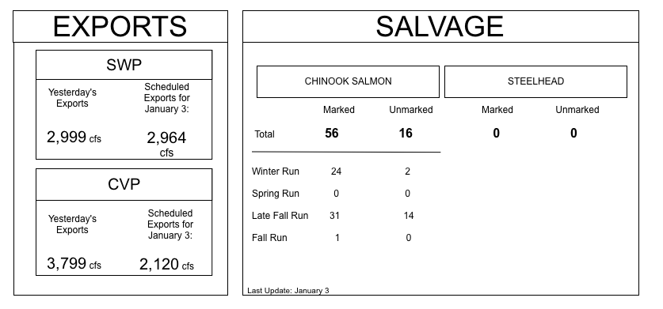
Sidebar Data Analysis Underway
Data Analysis
Wireframes
Key Decision Trees Wire Framed:
DCC Triggers (RPAs)
D-1641 WQ Parameters
Salmon Decision Tree
Drought Contingency Plan
JER and PPT Trigger Matrix
Water year classifications
Outflow

Slide 11
Tasks Completed
Data Management
Data Presentation
Data Analysis:
CPUE, RPAs/Biop/Decision Trees, All Trawl Data Comparison, Database Analysis, Indices,
Database and Web Services:
Database (master table) for Trawls, Traps, Ops, Trigger data, Indices Archive, Salvage
NOAA Weather and River Forecasting Services
Catch Indices
OMR Flows and Indices
Fish migration indicator stations: MLK, DCV, WLK, KN
Key Temperature and Indicator Stations
Dashboard HTML: Completed HTML and CSS for :
DJFMP Ops Dashboard
Recent Trawl Results
Weather and River Forecasting
Dashboard Integration: Link final services to templates.
Page Load Optimization: TBD. We will have a better idea about timeline these after all web services have been tested at scale.
TBD

Slide 12
DJFMP web Services (Tasks Completed)
Data Management
Data Management
The stationInfo service selects stations within a geographic bounding box.
It returns detailed information about the seine and trawl locations used through out the Delta.
Details include location name, identifier, and type of activities : seine, trawl and type of water quality measurements.
This service is mostly used to build getData requests which are listed below.
The getData service selects actual time series for the DJFMP locations.
Time series are available for catch, cpue, number of tows, dissolved oxygen, electrical conductivity, temperature, and secchi.
The service accepts time parameters indicating the start and end dates of the time series.
The results of this service may be used for reports, graphs, and animations.

Slide 13
DJFMP web Services (To Do)
Data Management
Data Services
New Stations
Database standardization
markCode for the getData request
RaceByLength for the getData request: Not Raced, Fall, LateFall, Adult, Spring, Winter, Hybrid, Late-Fall, Not required
regionCode: Catch and CPUE
Composite organismCode

Slide 14
Data (To Do)
Catch Highlights
 | GCID RST | Tidsdale RST | Knights Landing RST | Sacramento Trawl | Beach Seines | Sandy Beach Trawl | Chipps Island Midwater Trawl | Jersey Point Trawl | Prisoners Point Trawl | Mossdale Kodiak Trawl
Sample Date | 10/22-10/28 | 10/22-10/28 | 10/22-10/28 | 10/22-10/28 | 10/22-10/28 | 10/22-10/28 | 10/22-10/28 | 10/22-10/28 | 10/22-10/28 | 10/22-10/28
Total Catch | 321 | 3 | 5 | 3 | 3 | 0 | 0 | 2 | 4 | 0
Chinook (Fall-Run) | 1 | 0 | 1 | 1 | 1 | 0 | 0 | 0 | 0 | 0
Chinook (Winter Run) | 0 | 0 | 0 | 2 | 1 | 0 | 0 | 1 | 0 | 0
Chinook (Spring Run) | 2 | 0 | 0 | 0 | 0 | 0 | 2 | 0 | 0 | 0
Chinook (Late Fall Run) | 2 | 0 | 2 | 3 | 0 | 0 | 0 | 0 | 0 | 0
Chinook (Ad-Clipped) | 1 | 0 | 0 | 0 | 0 | 1 | 0 | 0 | 1 | 1
Delta Smelt | 1 | 0 | 0 | 0 | 0 | 0 | 0 | 0 | 1 | 0
Splittail | 0 | 1 | 0 | 0 | 2 | 0 | 0 | 0 | 1 | 0
Longfin Smelt | 0 | 0 | 4 | 2 | 0 | 0 | 1 | 1 | 0 | 0
Steelhead (Ad-Clipped) | 1 | 0 | 0 | 0 | 0 | 0 | 0 | 0 | 0 | 1
Steelhead (Wild) | 2 | 1 | 0 | 1 | 0 | 0 | 0 | 0 | 0 | 1

Slide 15
Timeline
Web Services: “Almost” complete. Denver to complete services requests for 4-10. These services are critical for filtering out races and developing compositions. Finalize new stations added.
34N estimate 40 hours
Data Processing: Complete composition and catch summaries queries. Testing with web services. Finalize time filtering methods.
34N estimate 30 hours
Dashboard Integration: Link final services to templates.
34N estimate 40 hours
Page Load Optimization: TBD. Will have a better idea about timeline these after all web services have been tested at scale.
TBD
Additional Data: Glenn Colusa, Salvage, Tidsdale, Knights landing TBD (approximately 2 weeks)

Slide 16
CAMT/DOSS
GIS

Slide 17
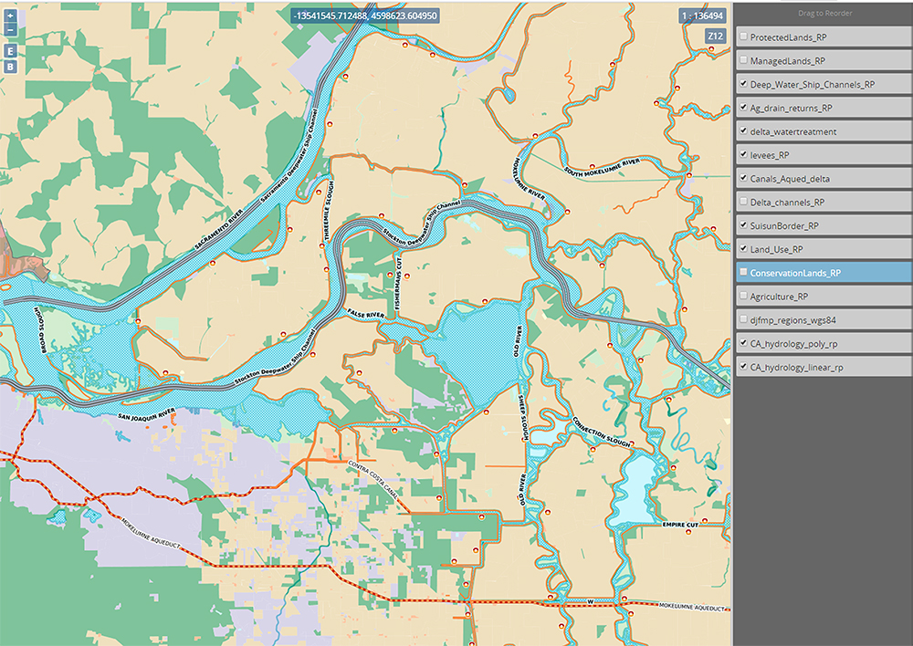

Slide 18
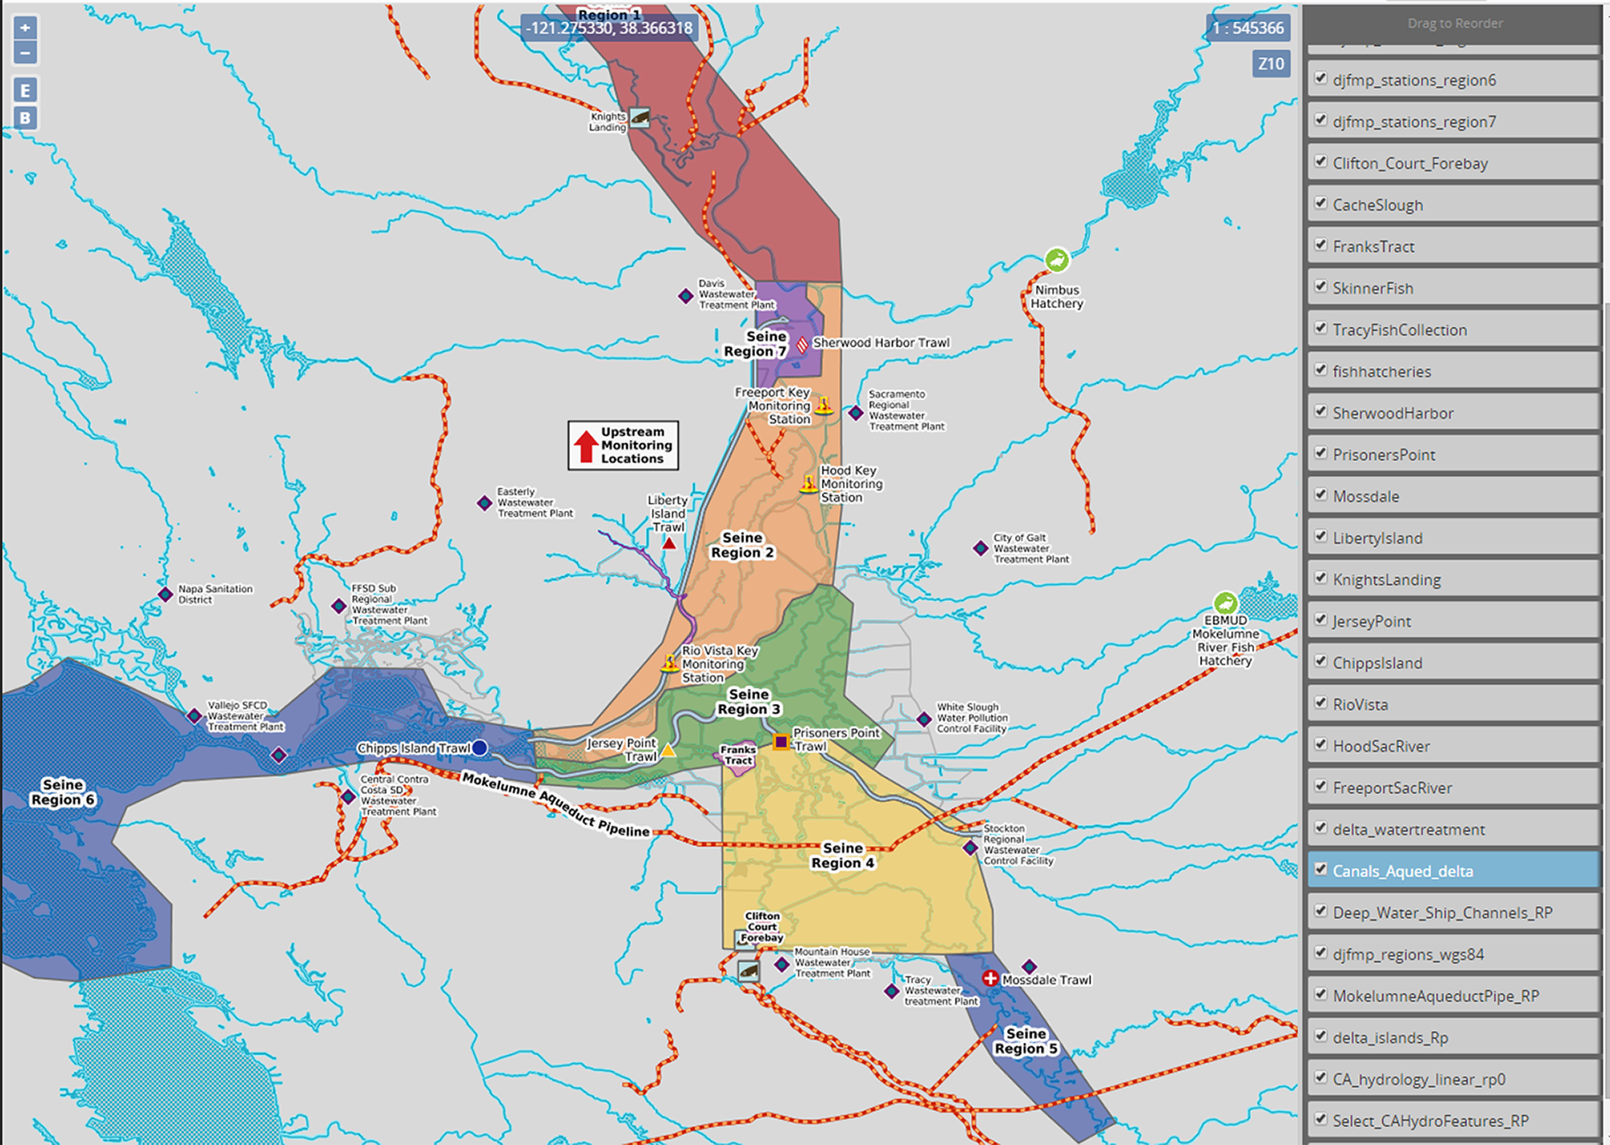

Slide 20
CAMT/DOSS Dashboard
Comps

Slide 21
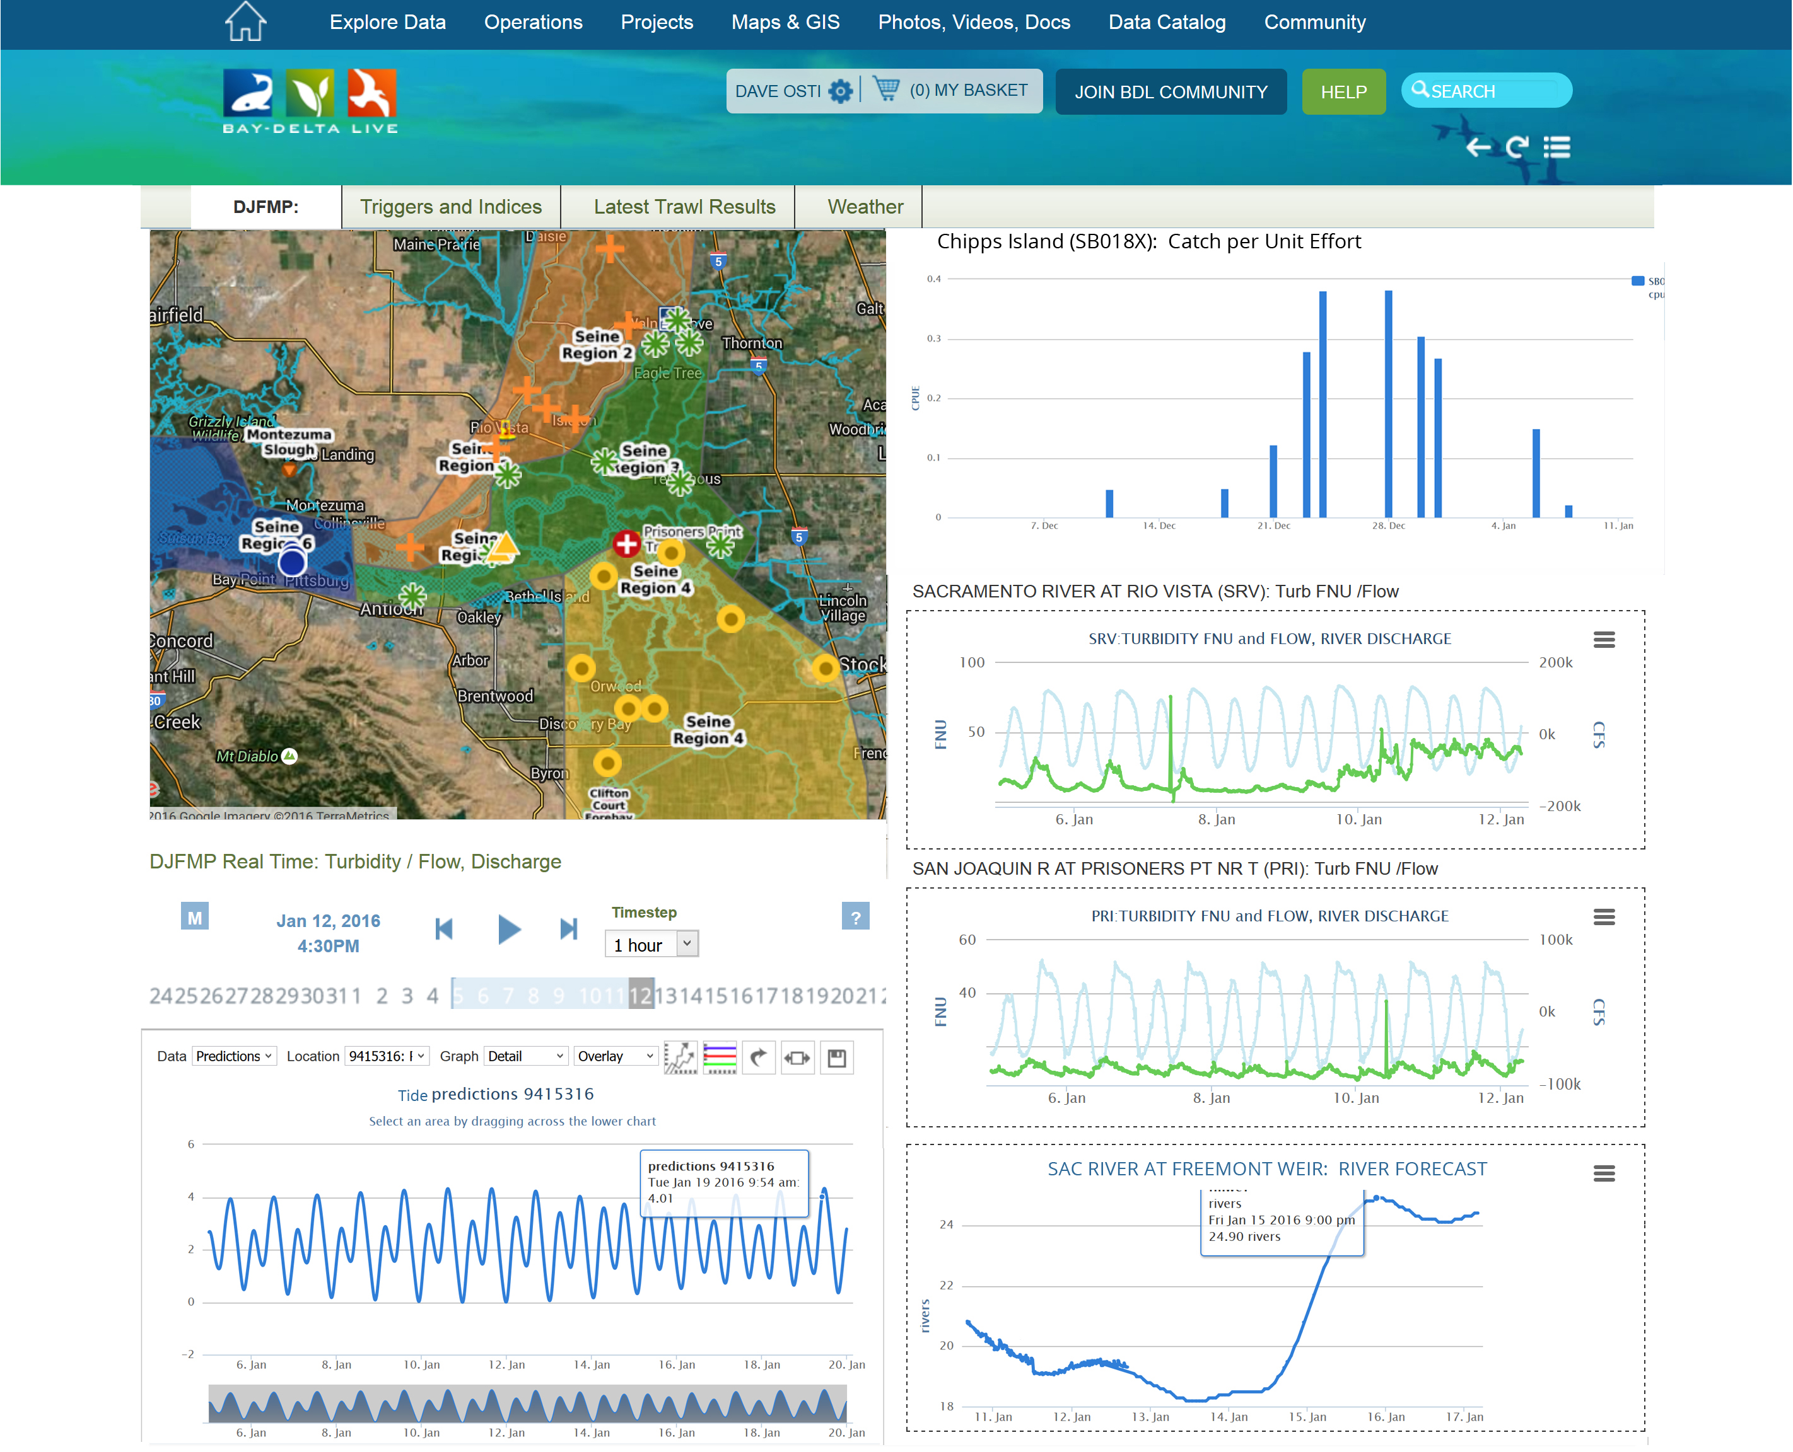

Slide 22
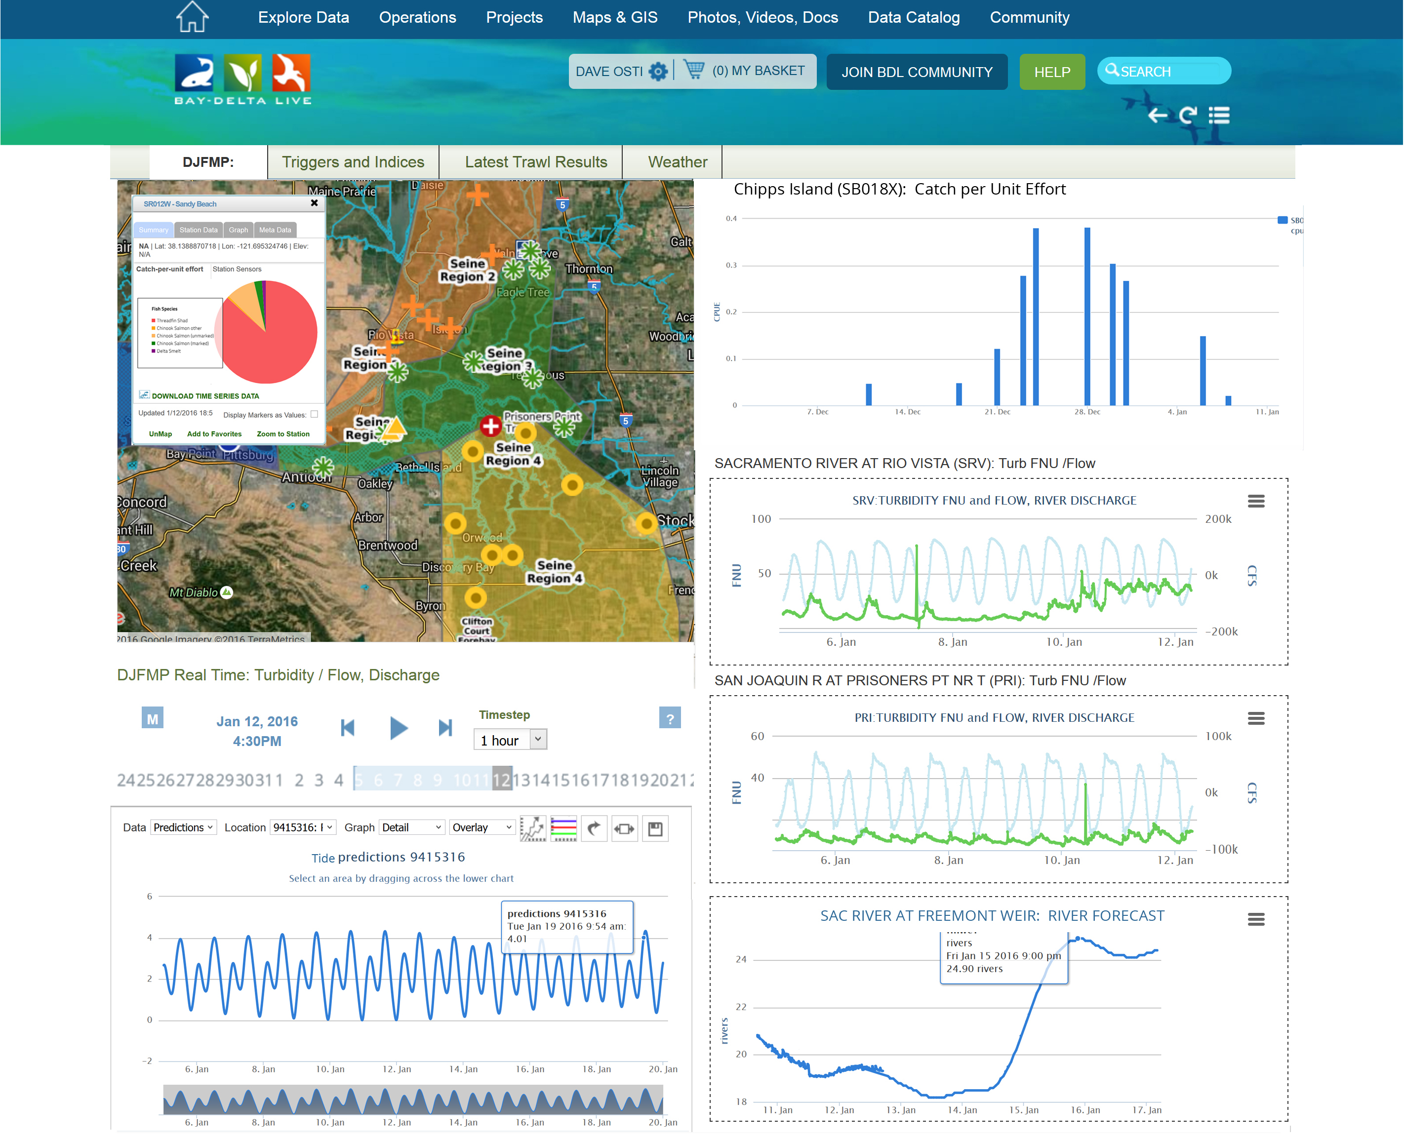

Slide 23
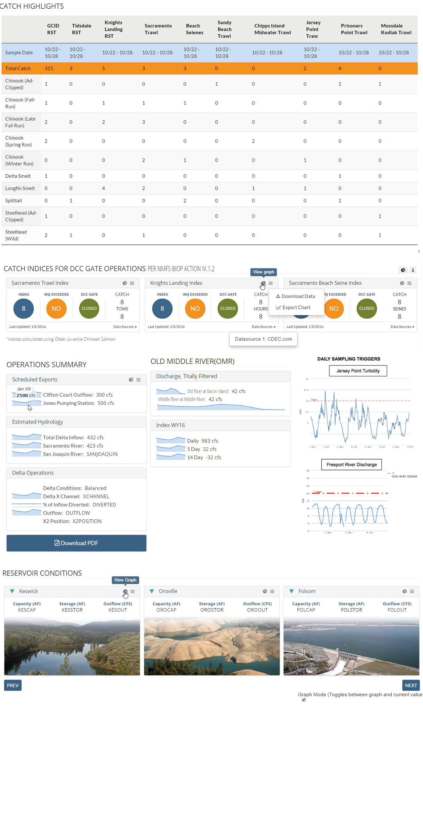

Slide 26
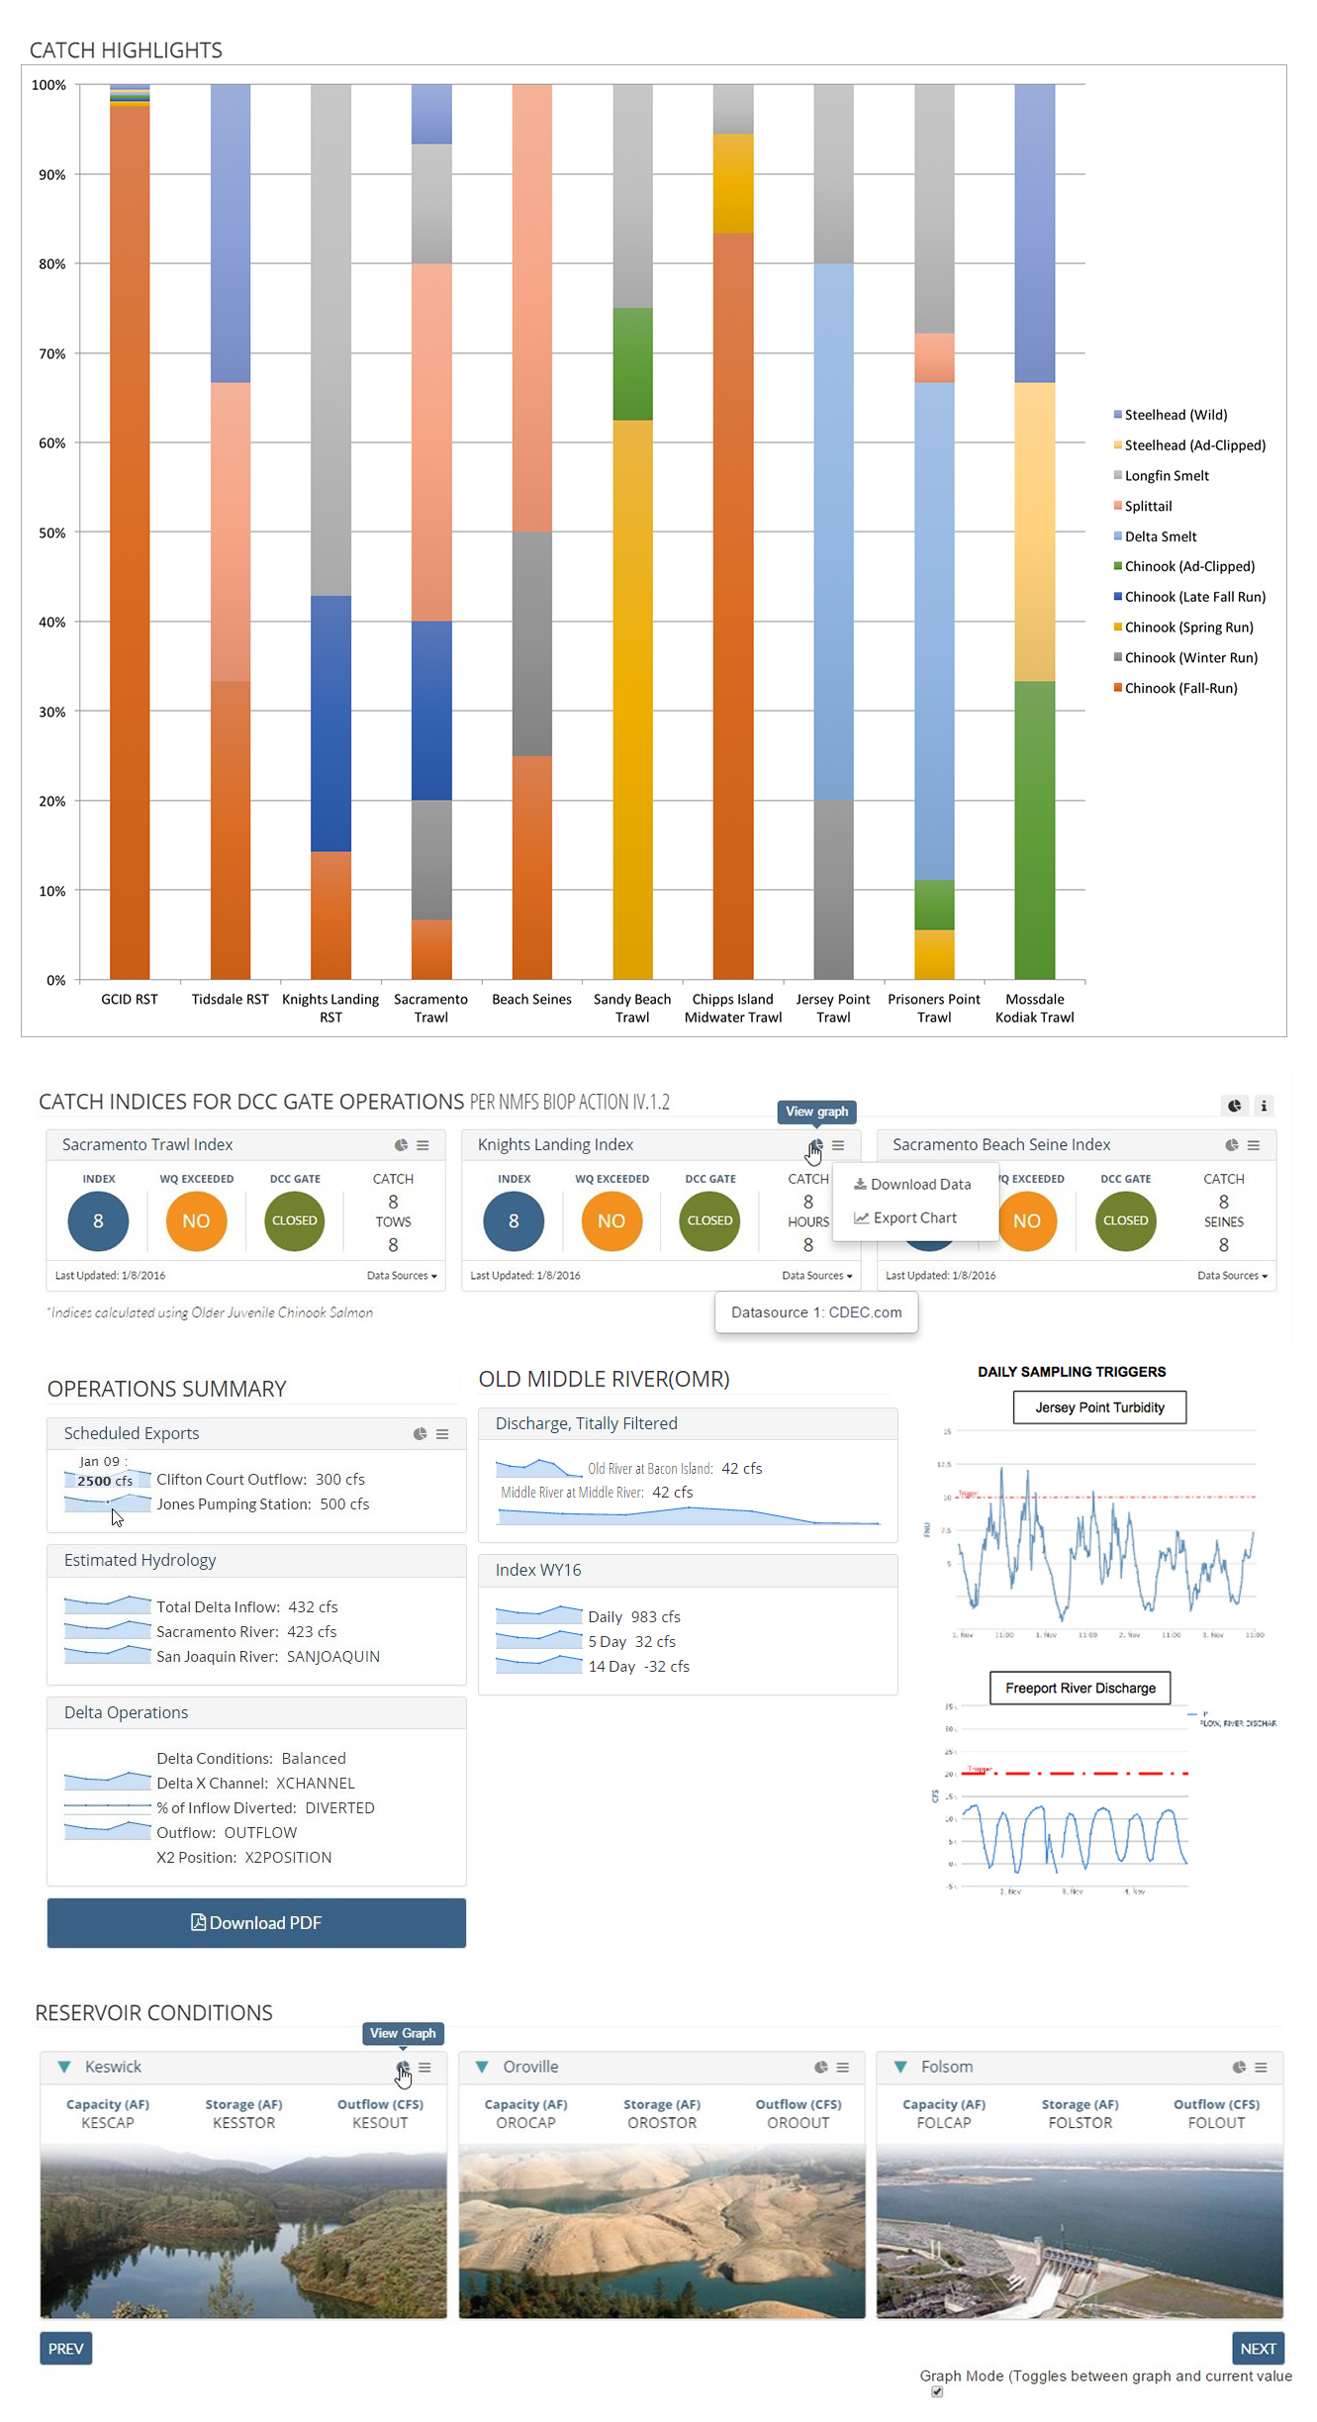

Slide 27
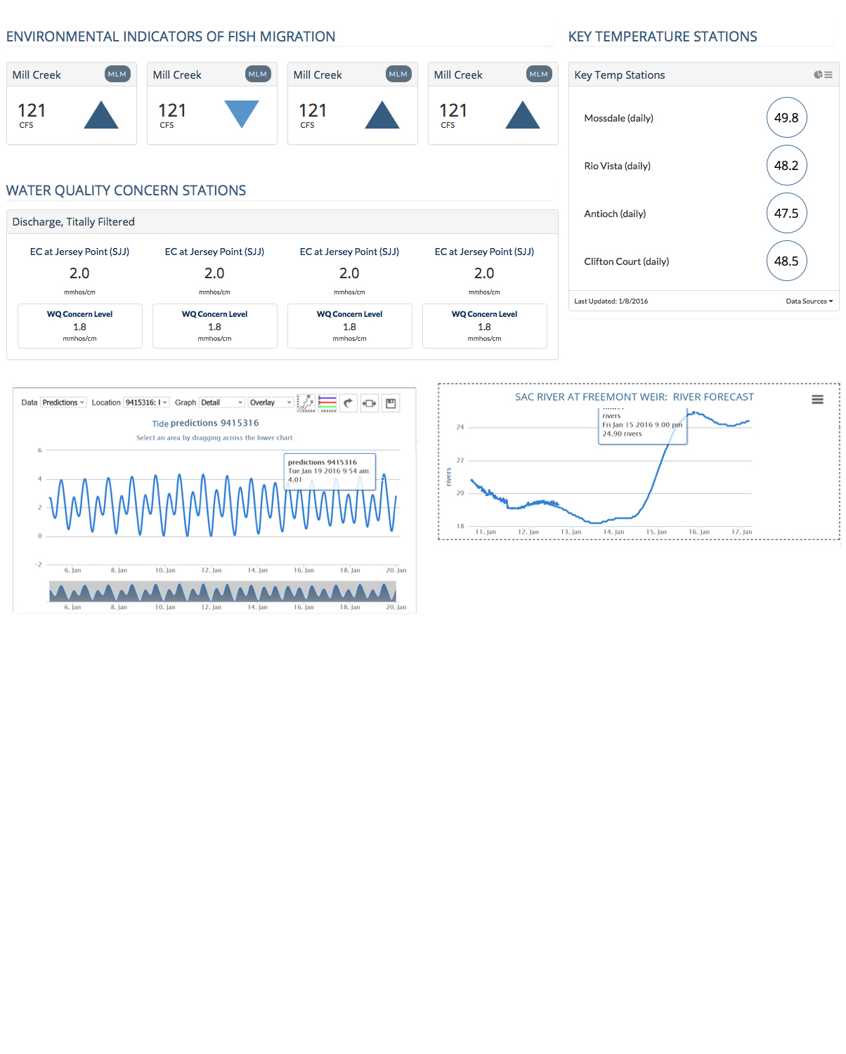

Slide 28
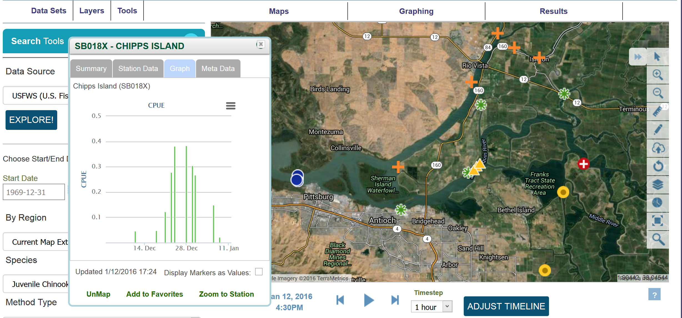

Slide 29
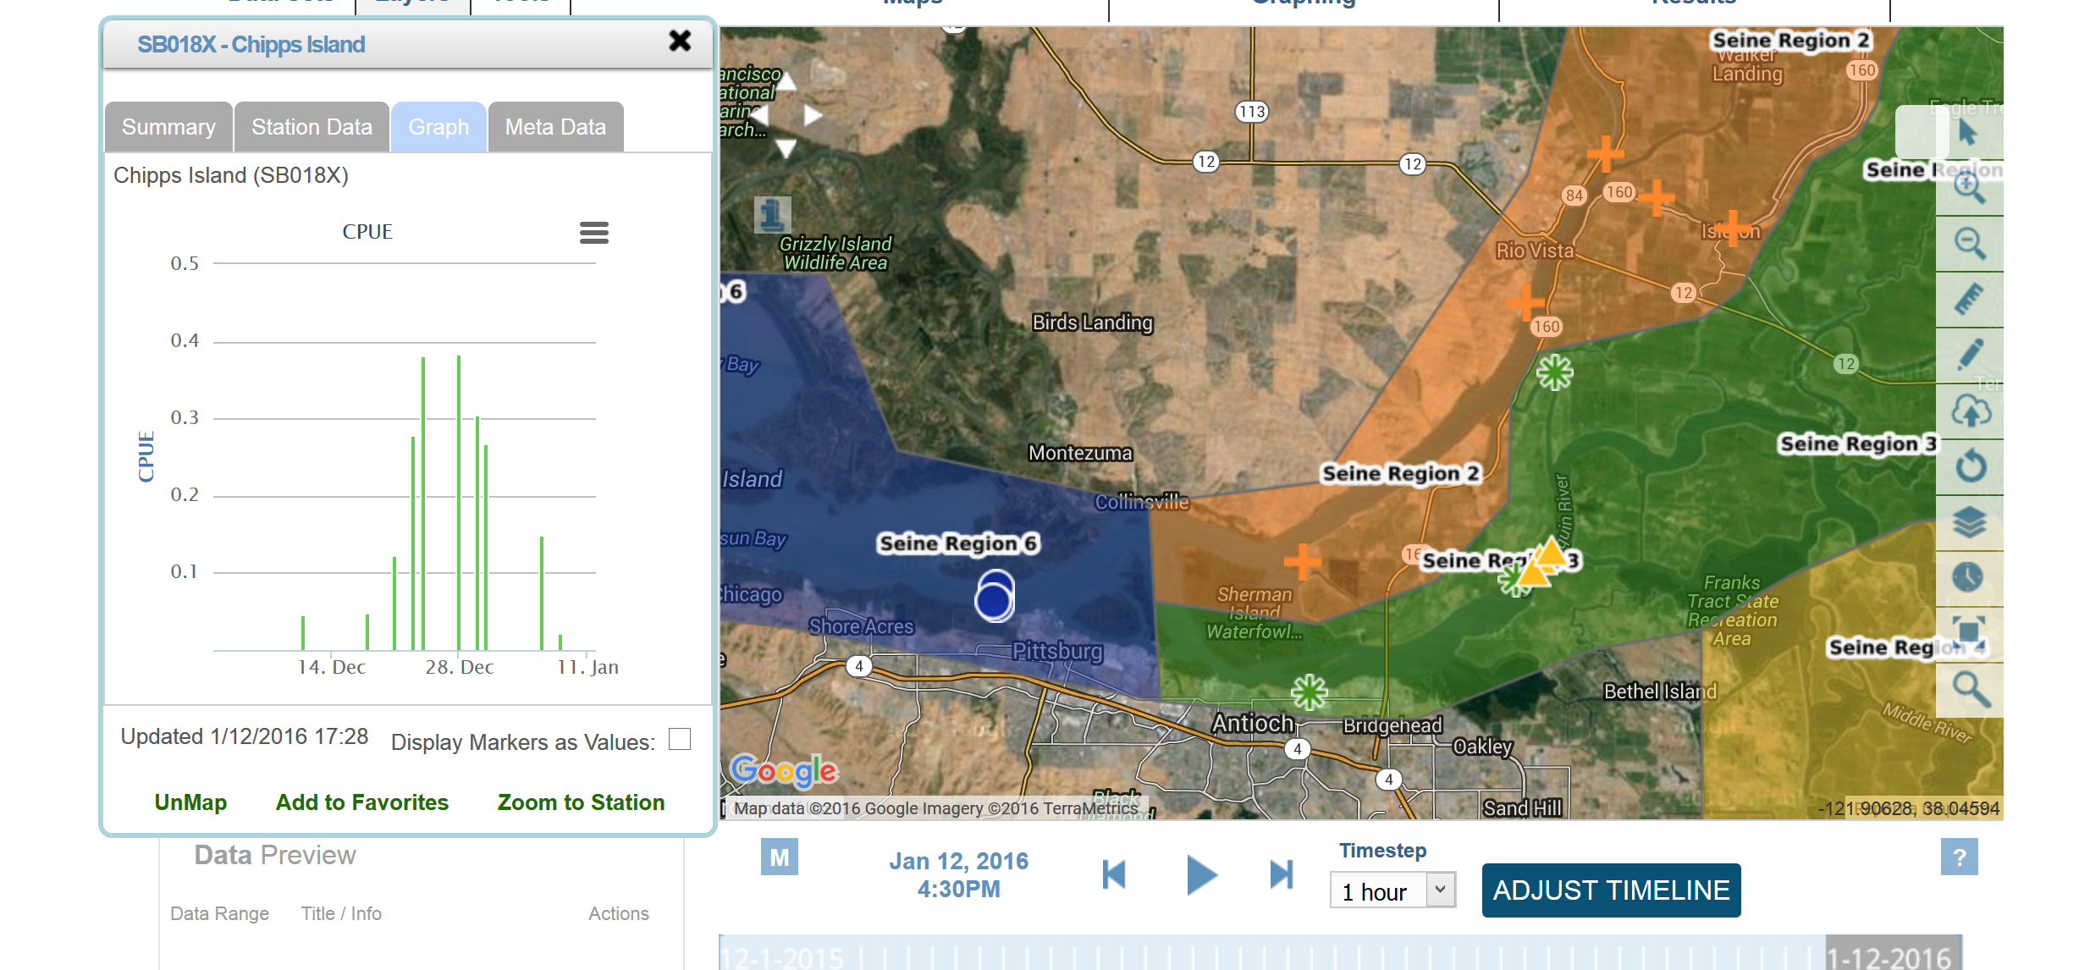

Slide 30
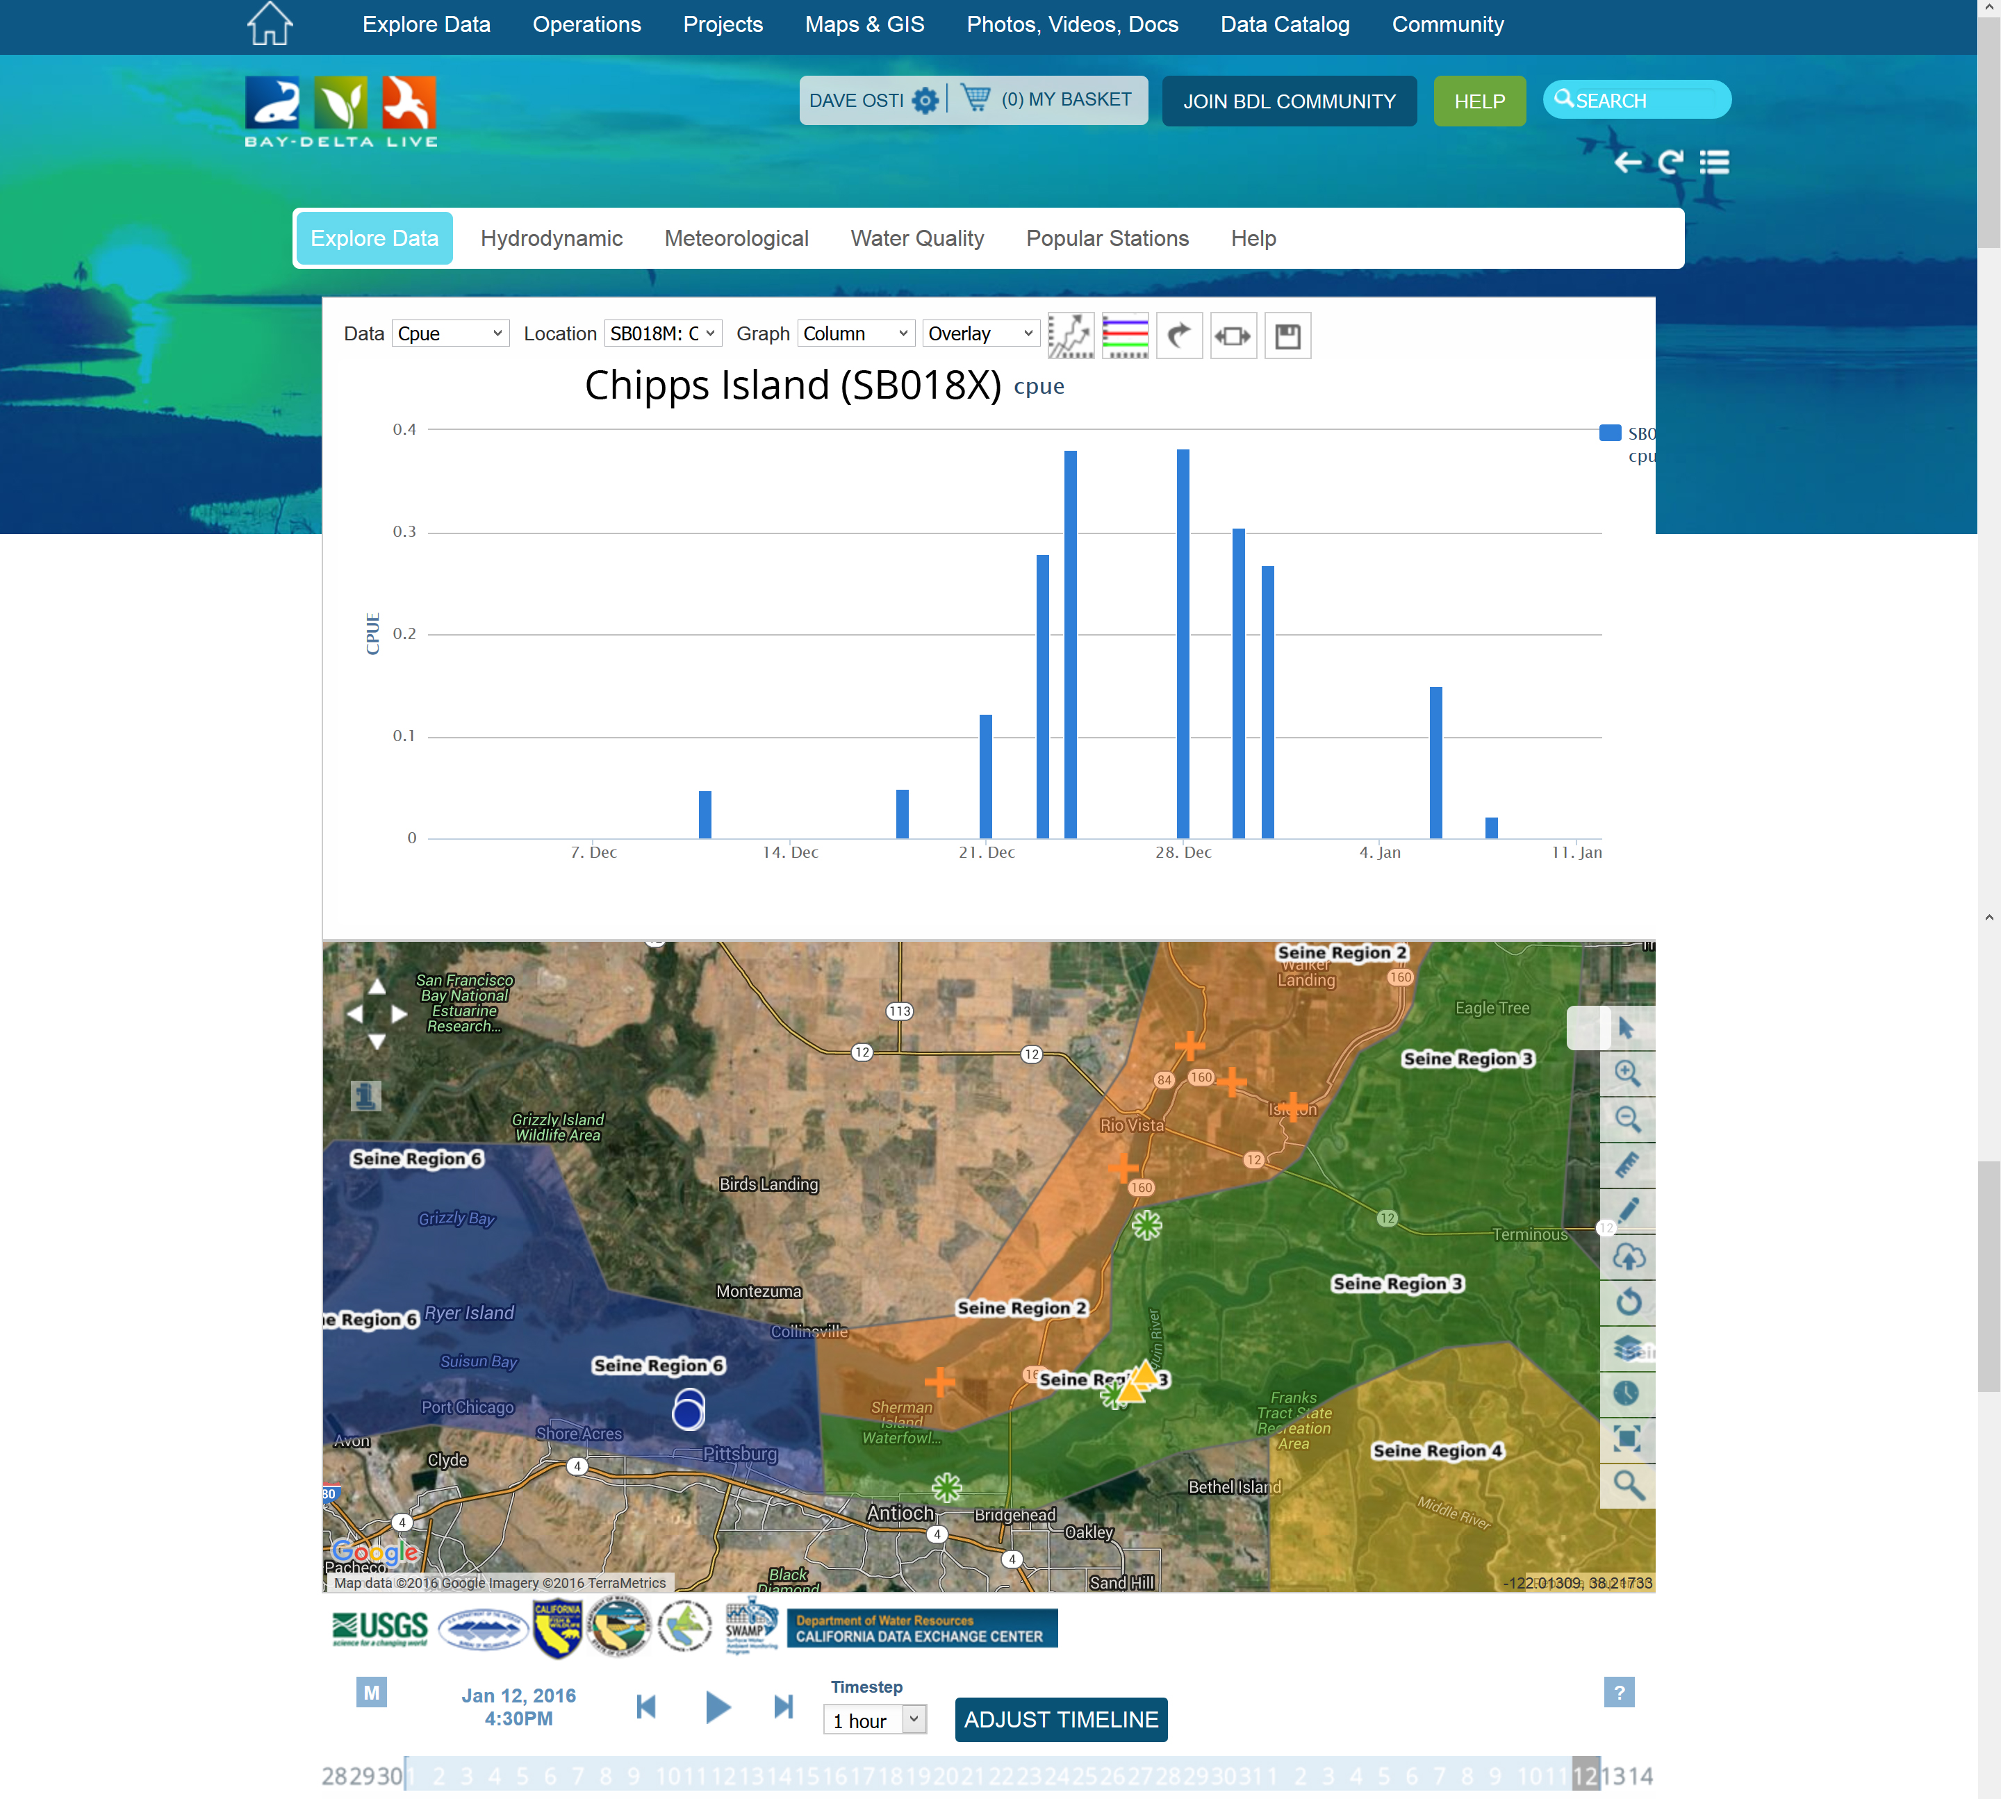

Slide 31
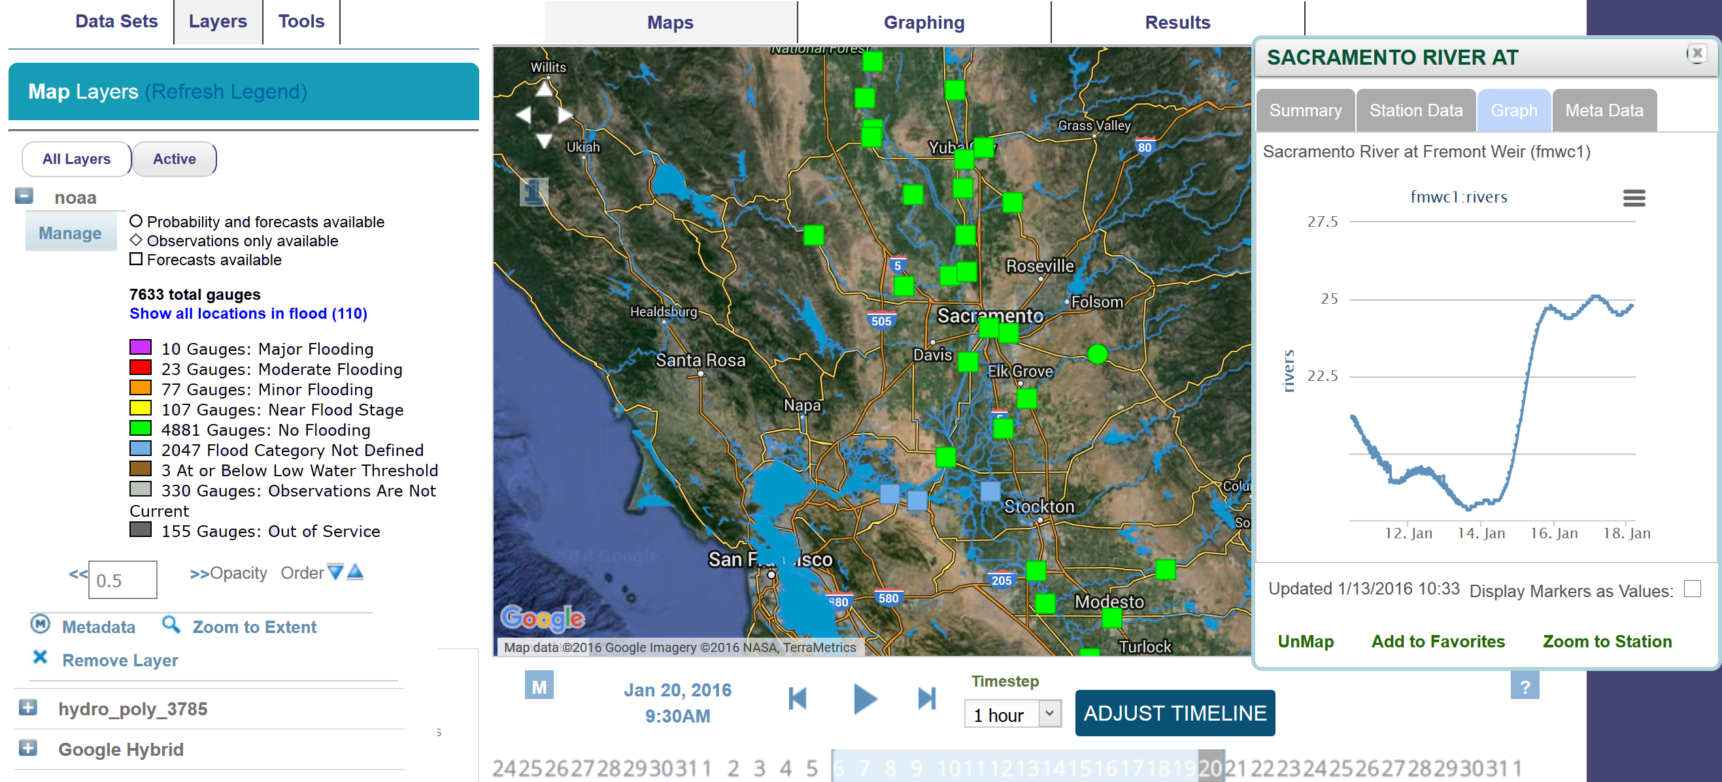

Slide 32
BDL Data
Survey

Slide 33
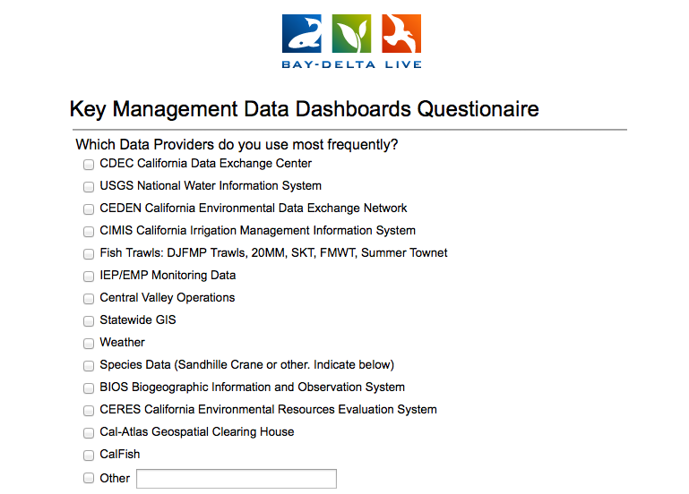

Slide 34
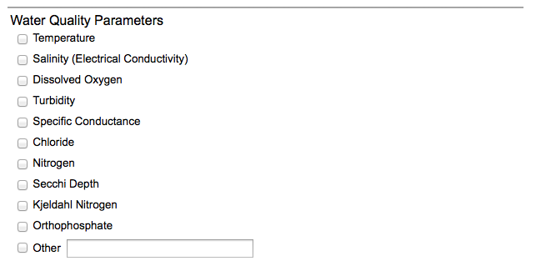
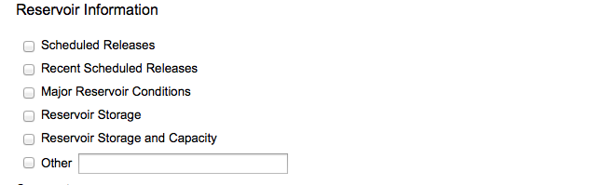

Slide 35
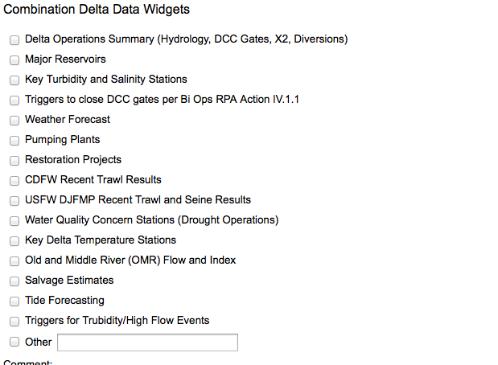

Slide 36
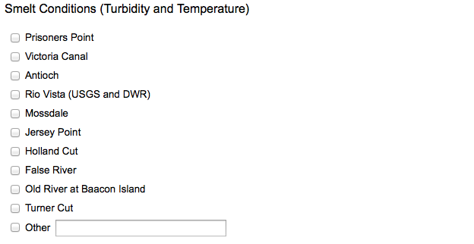
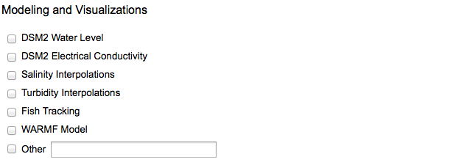

Slide 37
