Slide 1
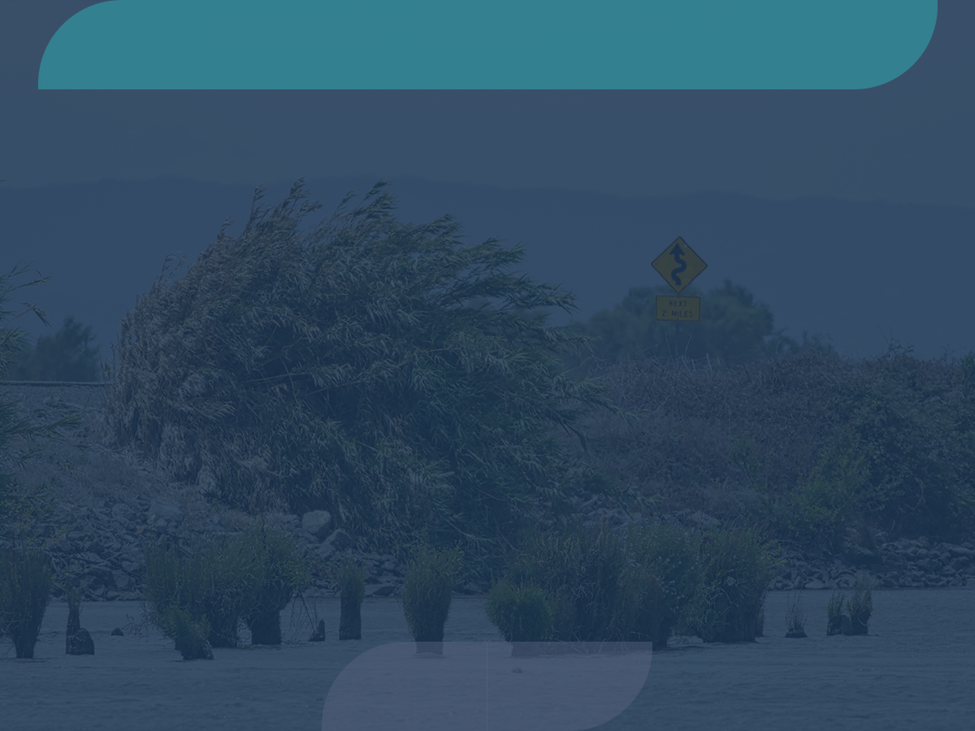
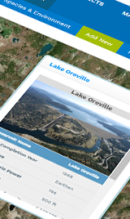
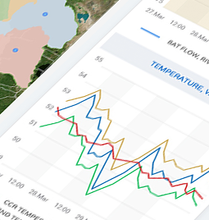
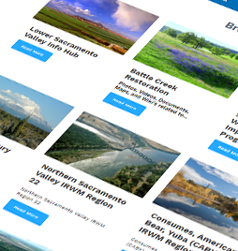
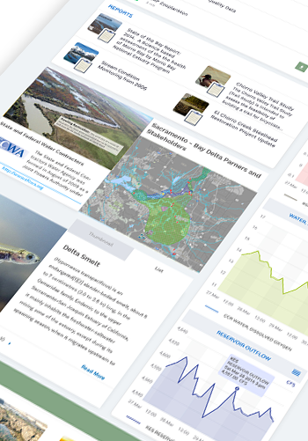
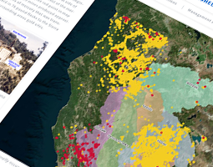
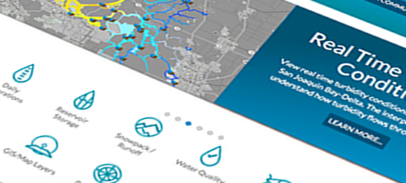

Connecting Scientific Research Projects and Data Through Software
An Opportunity for Collaboration and Data Synthesis
Presenter

Slide 2
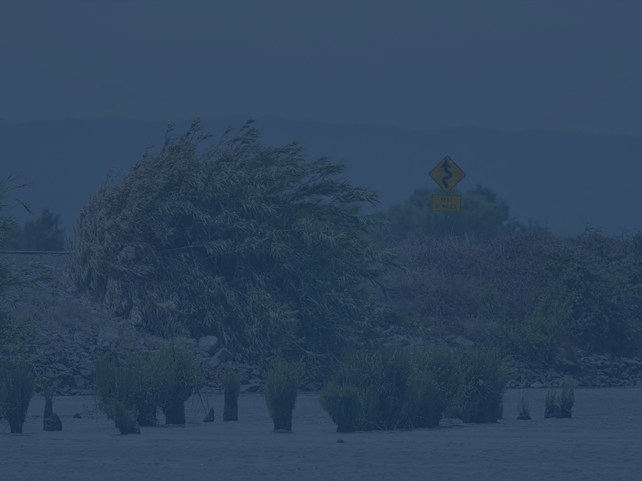

Presenter
Val Connor, SFCWA

Slide 3
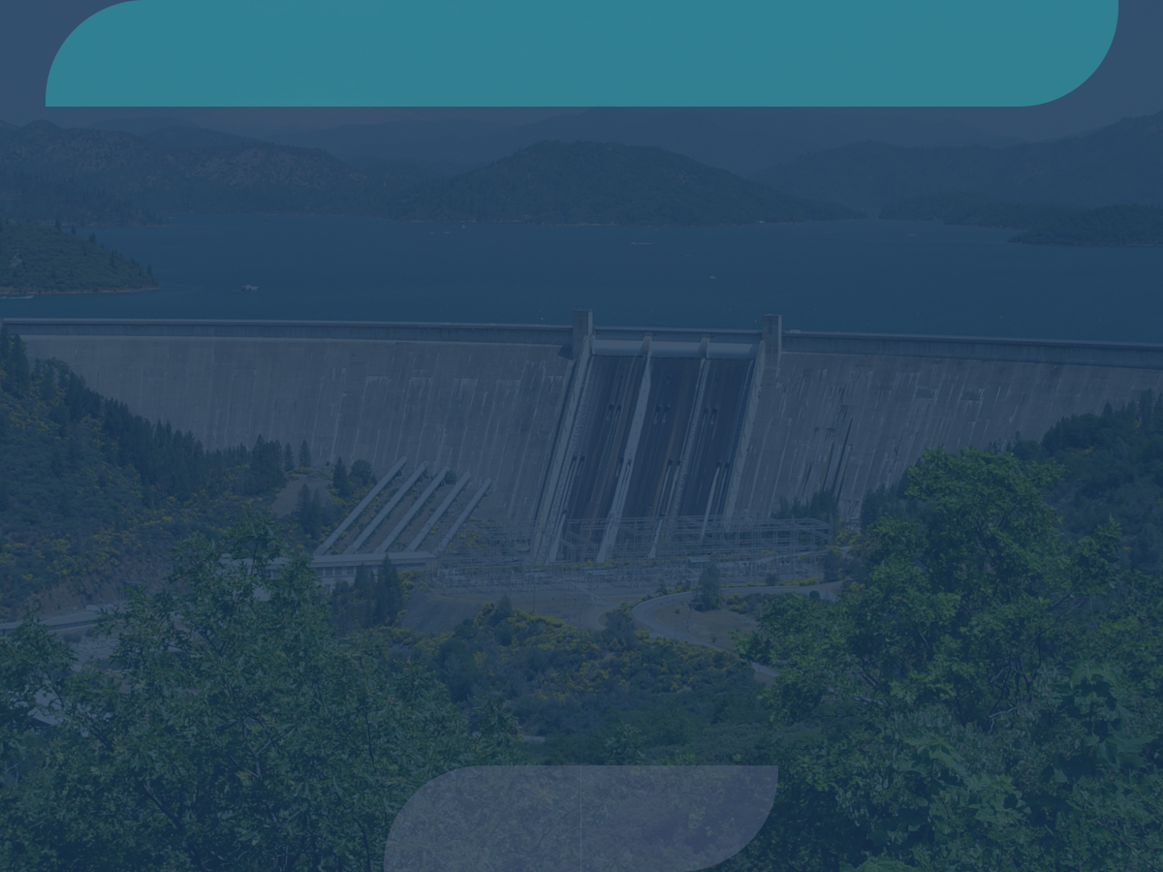





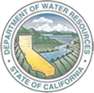

A Collaborative Effort
Regional and Statewide Programs
SACRAMENTO SAN JOAQUIN BAY-DELTA
SWRCB MY WATER QUALITY PORTALS
CALIFORNIA ESTUARY
PORTAL
SAN JOAQUIN REAL TIME MANAGEMENT
DWR 1641 WATER
QUALITY
SACRAMENTO RIVER
WATERSHED

Slide 4
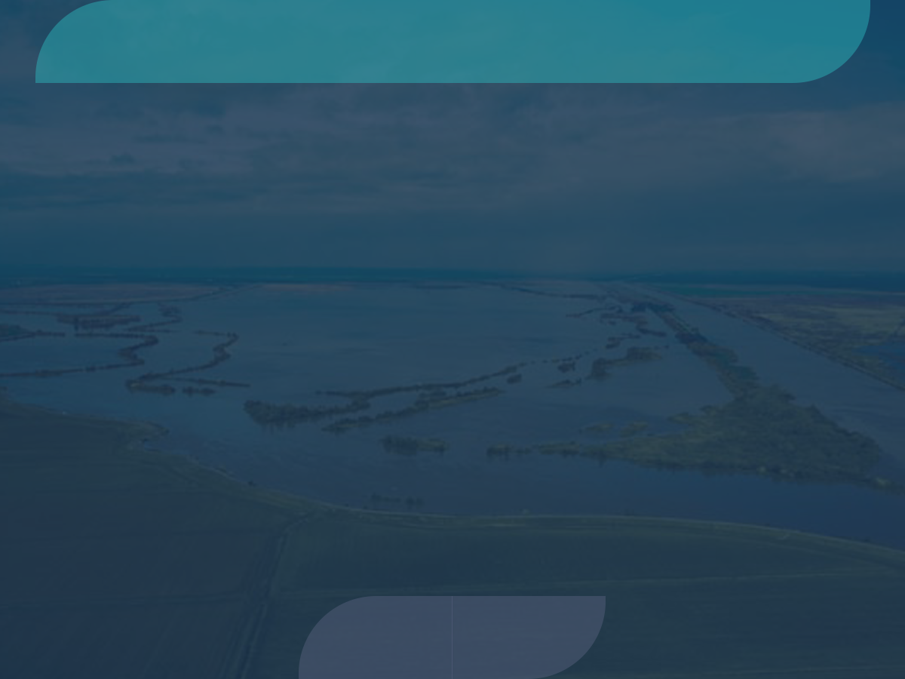
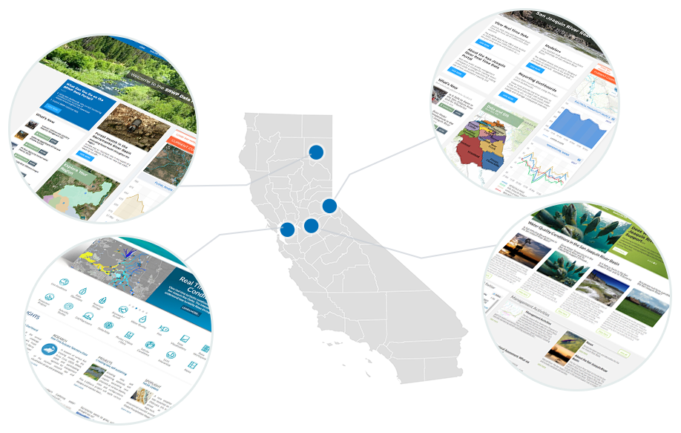
Building on Each Other’s Program
Regional and Statewide Programs
Regional efforts share in investment. Benefit from an open
platform.

Slide 5
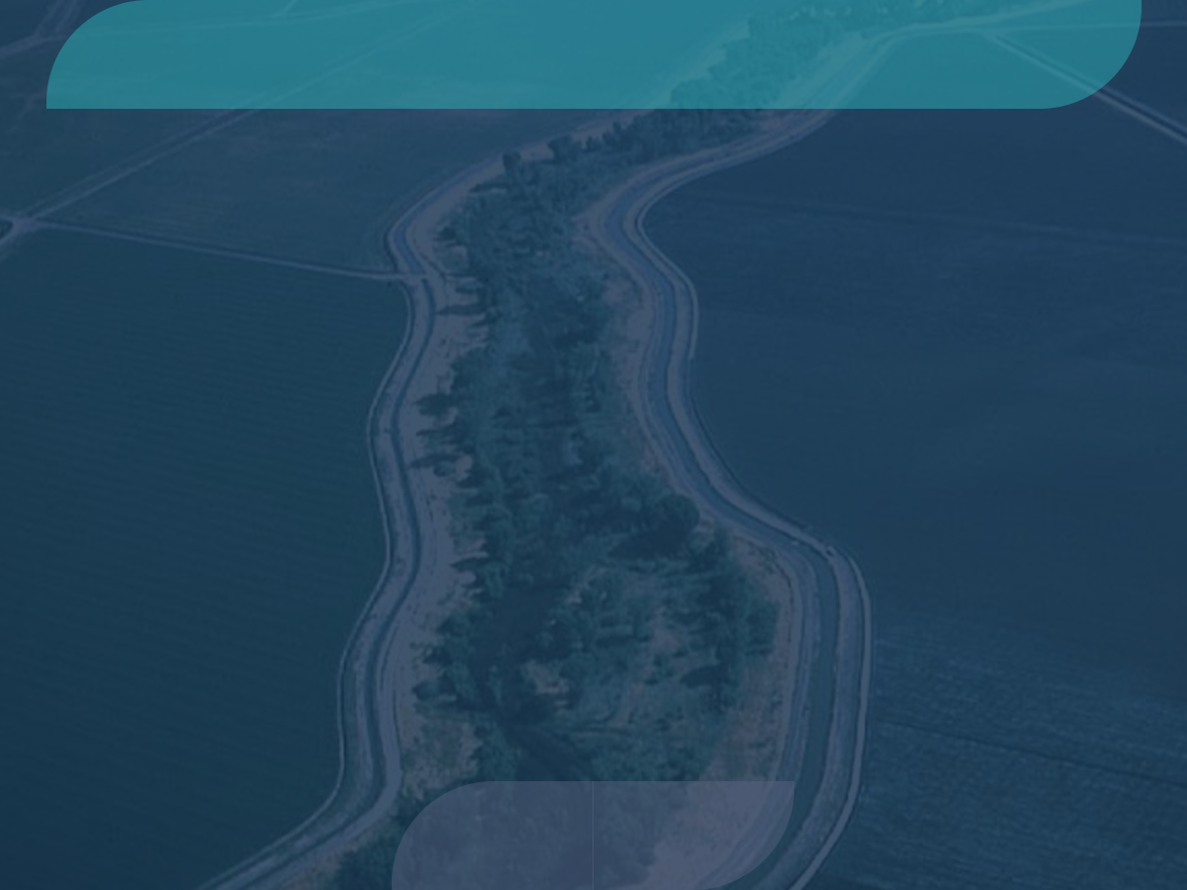
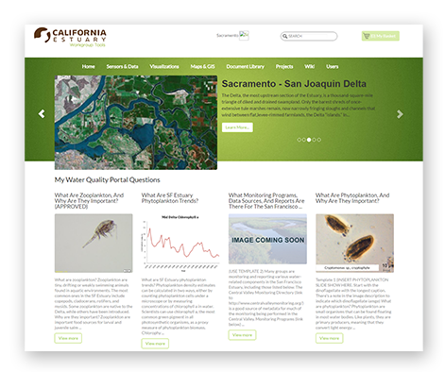
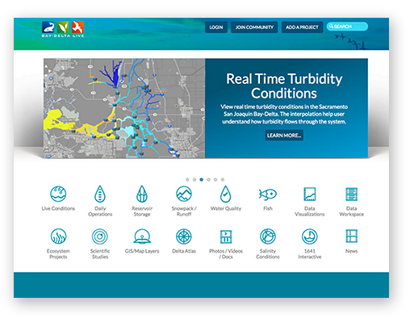
Benefits of a Collaborative Program
1
Benefit and learn from each other’s regional monitoring programs and assessment efforts.
All investments are
contributed back to
the community: Content, GIS,
data sets, mapping tools.
2
Data is managed at
the regional level and
shared with all stakeholders
for larger watershed
assessment and analysis.
3
4
Application updates.

Slide 6
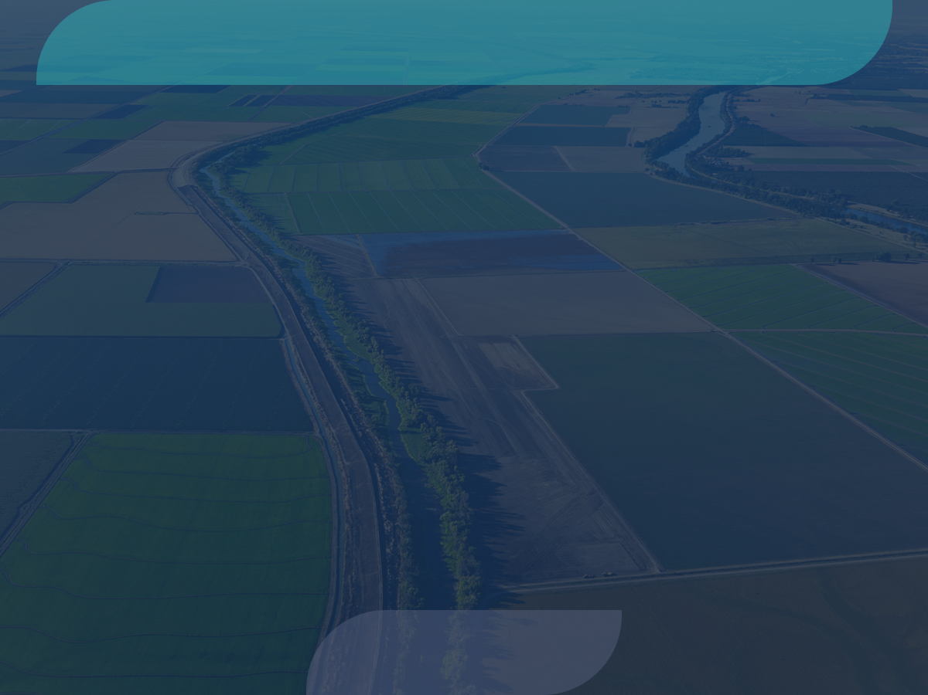

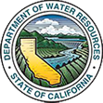
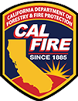








Major Data Providers
Data is aggregated from stakeholders throughout the region:
Hydrologic
Water Quality
Satellite
Meteorological
Terrestrial
Volunteer Sampling

Slide 7
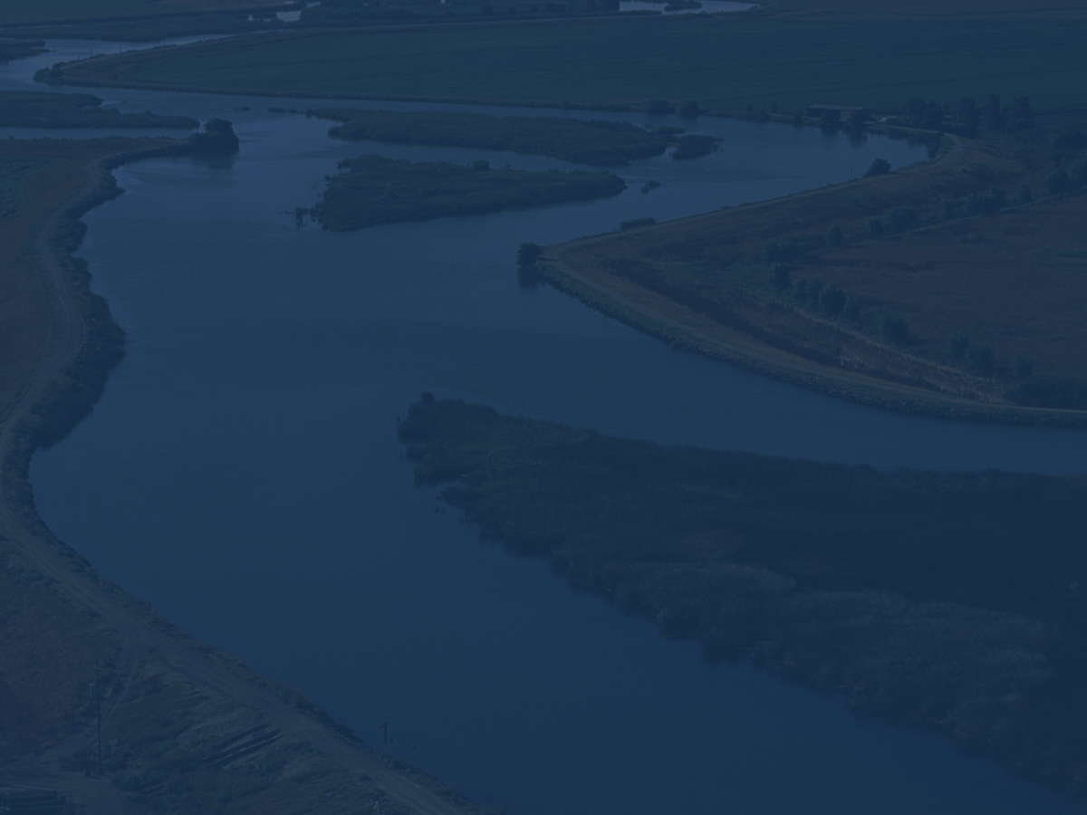
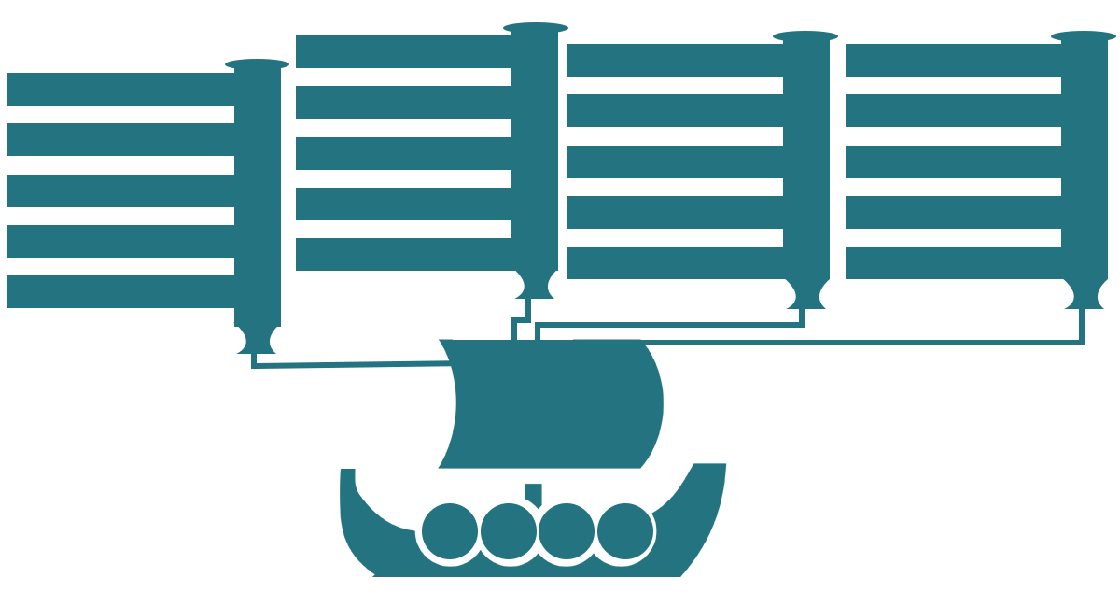

OpenNRM
Estuary Portal
Fisheries Dashboards
WARMF Modeling
SRWP Monitoring Programs
1641 Reporting
DOSS and DCT
Real Time Management
Forest Health and Fire
Ca Estuaries
BDL
Cache Collaborative
DSM2 Modeling
Compliance Monitoring
SJRRTM
Ecosystem Restoration
SRWP
EMP Monitoring
Real Time Operations
Reporting Dashboards
Region Data Hubs
State Estuaries Template
By the Numbers
Collaborative Management
Temperature Compliance
OPEN
NRM
Data
Research
Projects
Tools

Slide 8
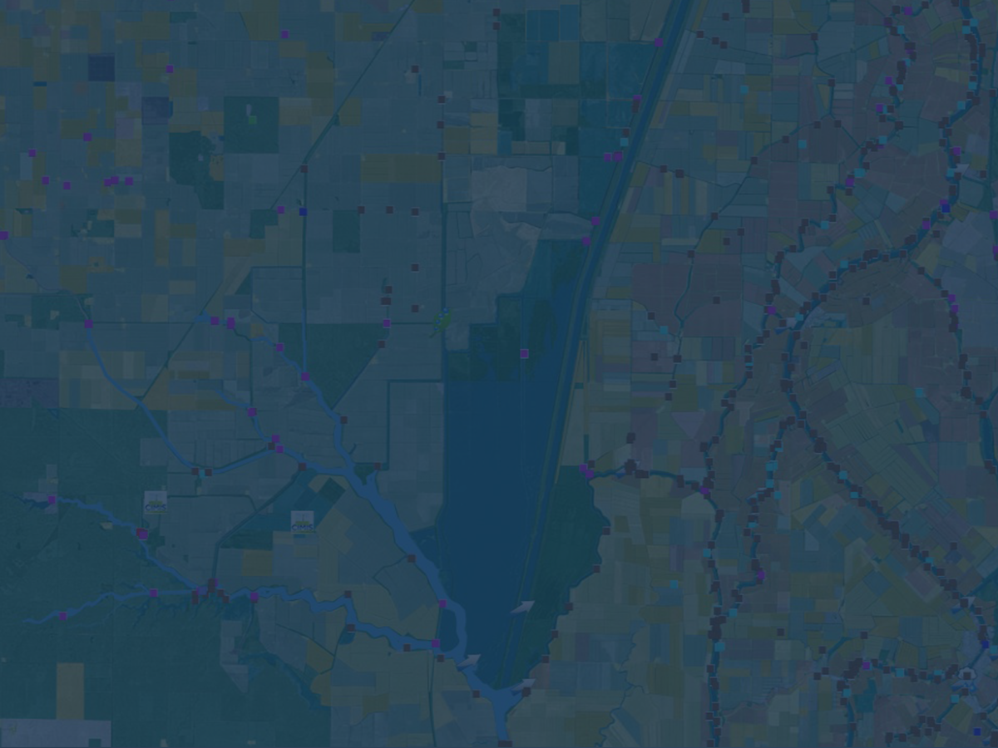
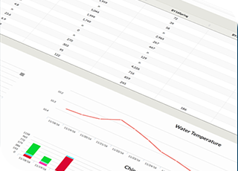
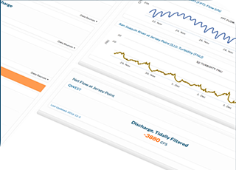
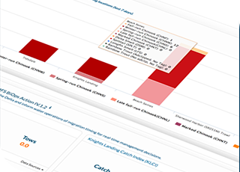
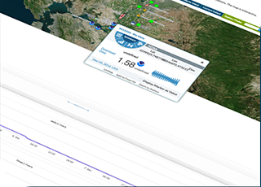
Collaborative Effort has Produced
the Following Products:
5 Portals all sharing data and information
Delta Operations for Salmon and Sturgeon Reporting Dashboards
Delta Conditions Team Dashboard
Delta Juvenile Fish Monitoring and EDSM Reporting and Web Services
Operations Dashboards
Salinity and Turbidity Dashboards
By the Numbers

Slide 9
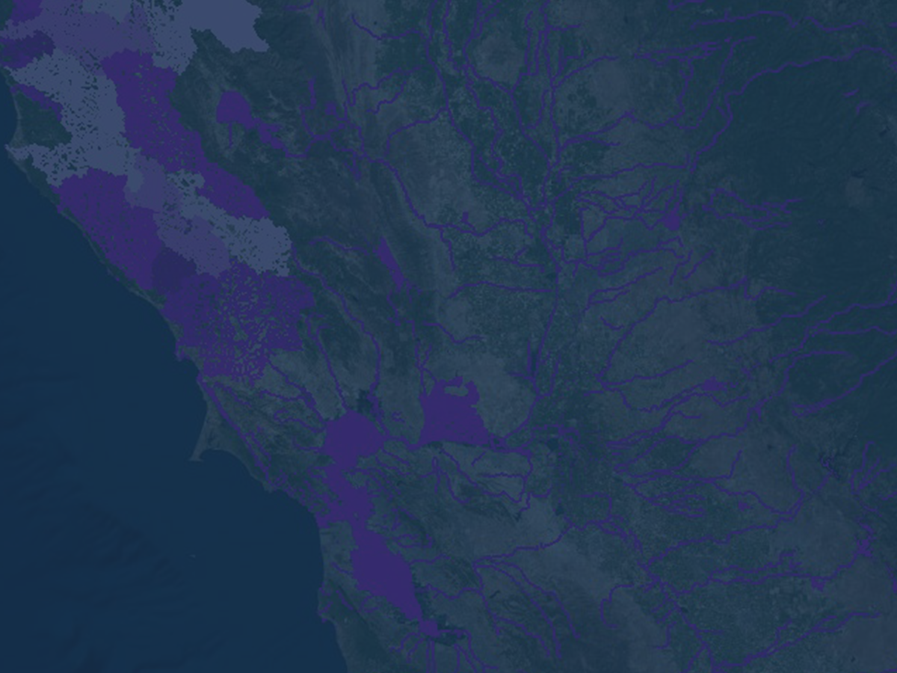
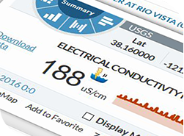
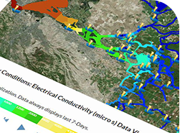
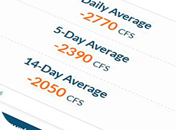
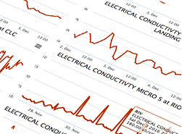
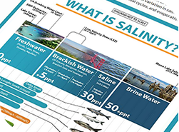
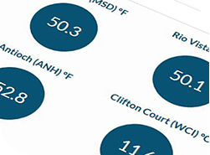
Collaborative Effort has Produced
the Following Products:
EMP Monitoring 1641 Reporting
Cache Collaborative Workspace and Data Hub
My Water Quality Portal: Estuaries
Agency Support for Web Service Development
WARMF and DSM2 Model Visualization and Reporting
Real Time Salinity Management Tools
BDL IPhone Application

Slide 10
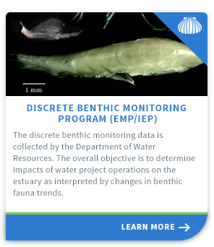
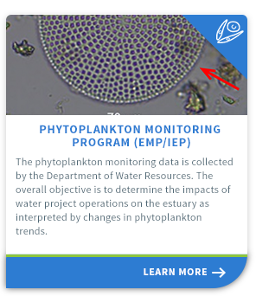
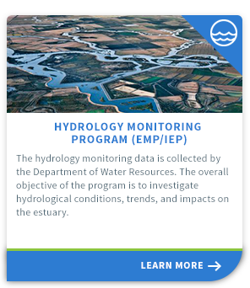
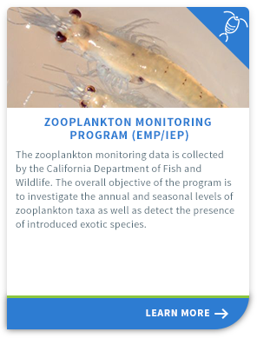
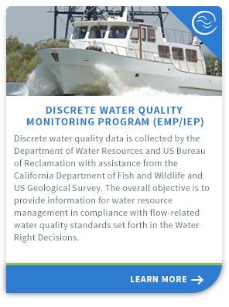
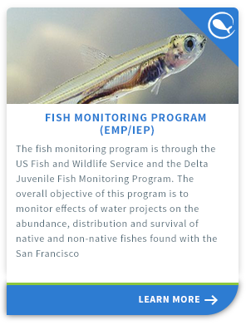
BayDeltaLive
DWR Environmental Monitoring Program Report

Slide 11
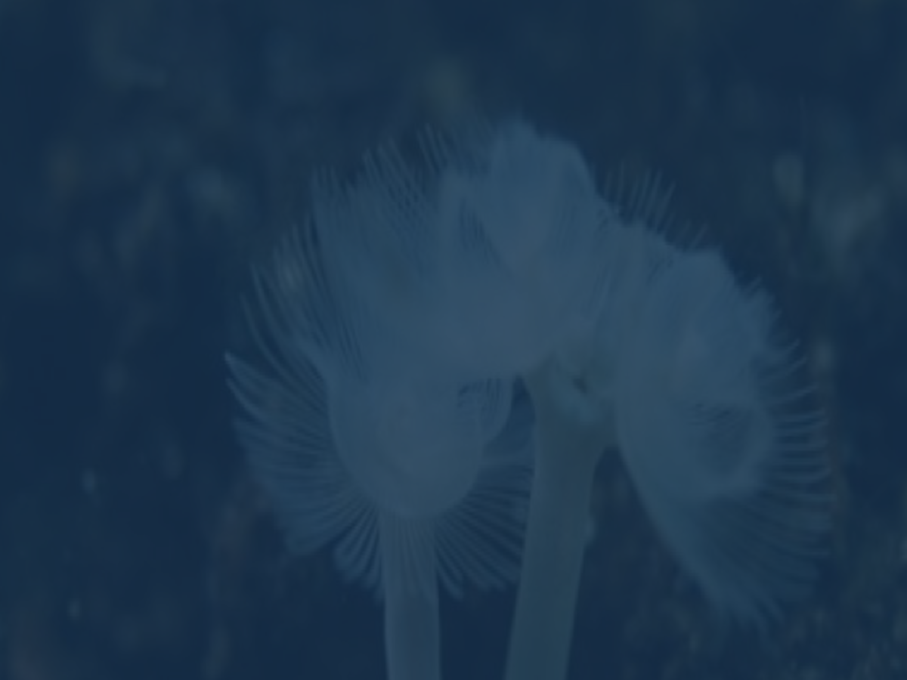
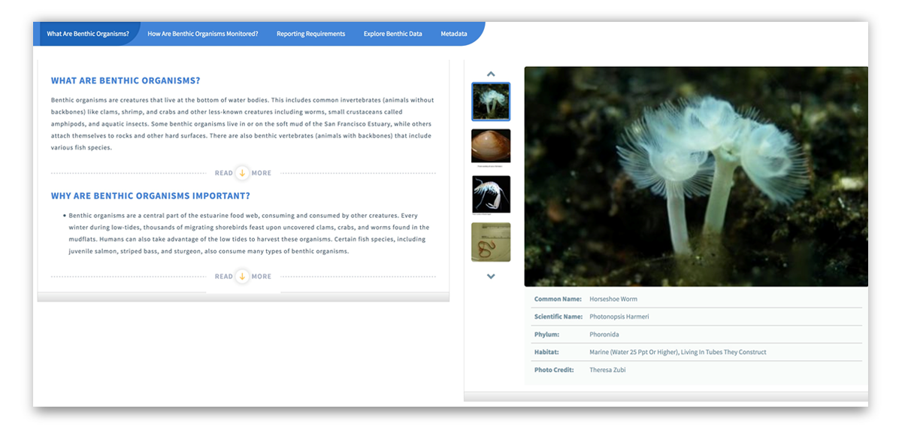
What Are They?

Slide 12
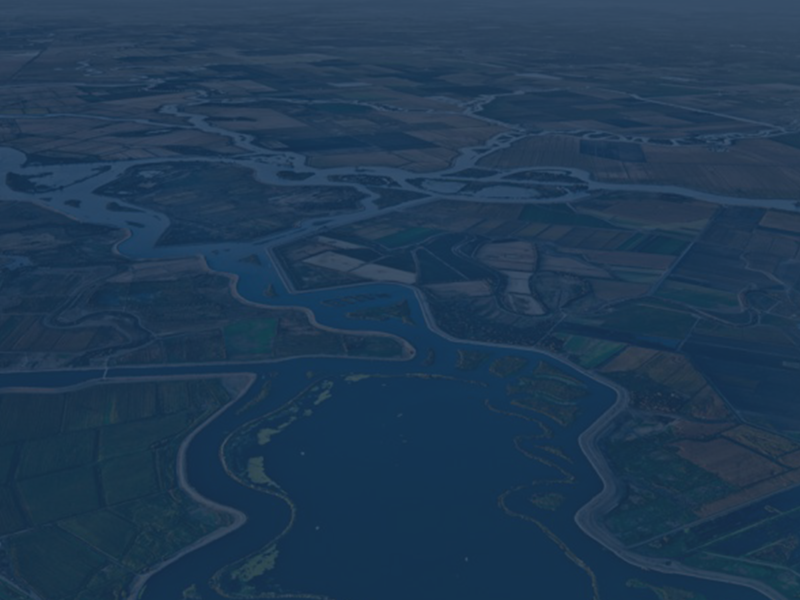
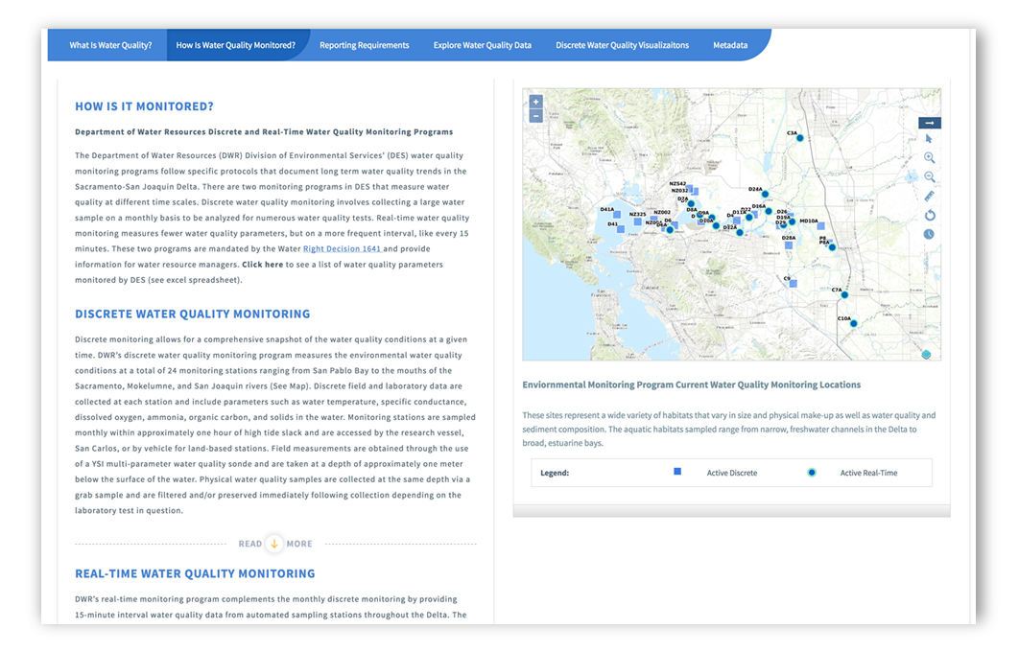
How Are They Monitored?

Slide 13
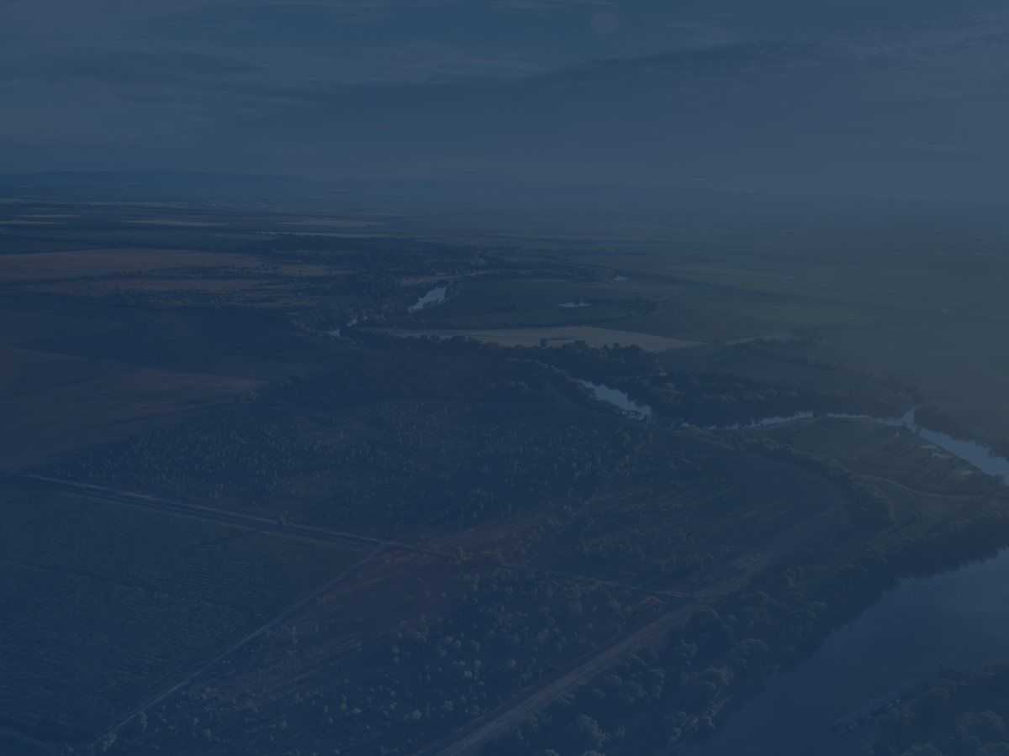
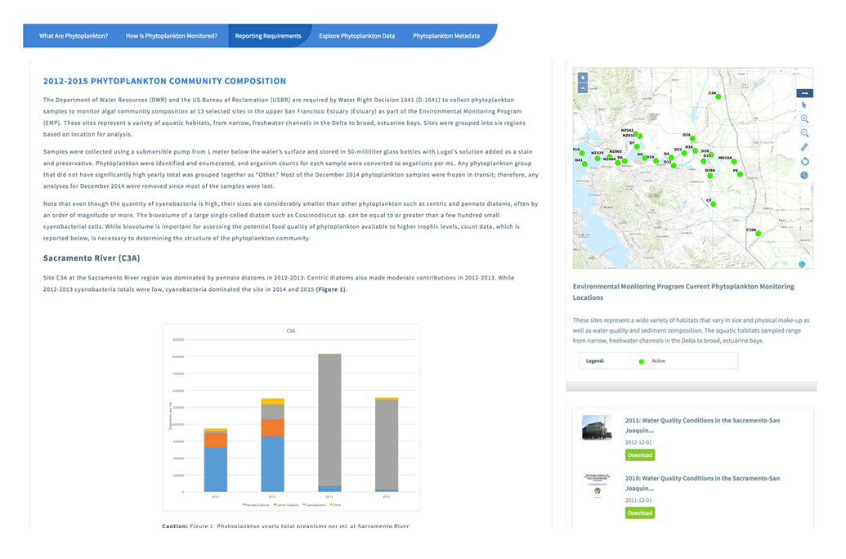
Reporting Requirements

Slide 14

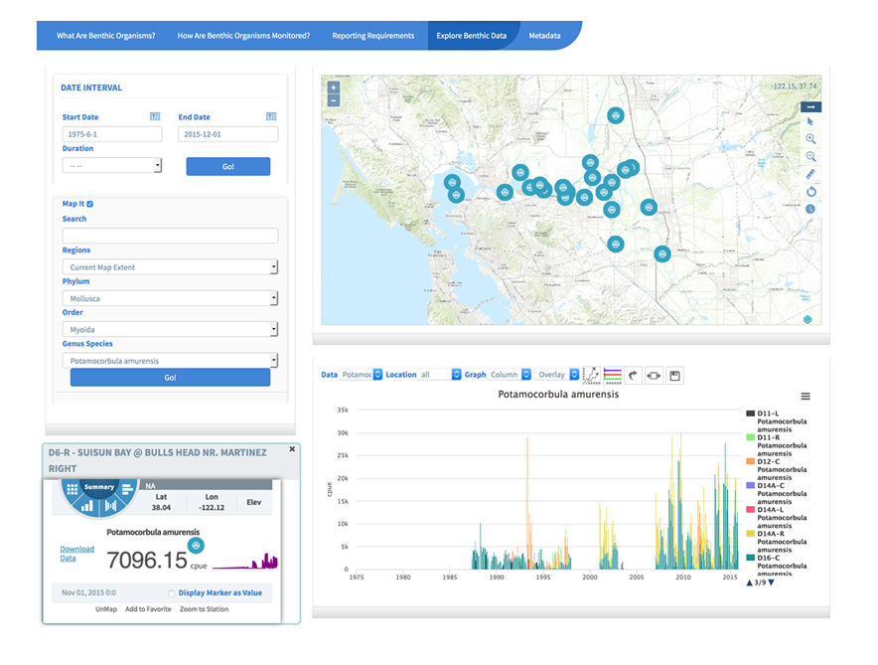
Explore Data

Slide 15
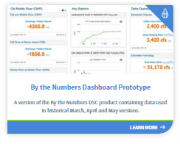
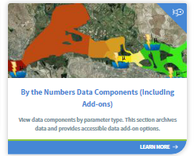
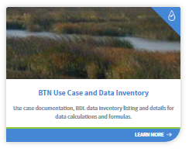
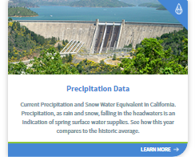
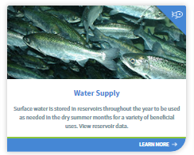

By The Numbers
Delta Conditions Reporting for the DSC

Slide 16









Salinity
www.baydeltalive.com/salinity

Slide 17


Turbidity Conditions
Turbidity Model displays real-time data from 46 CDEC Stations.
View data at various intervals (15 min, 1 r, 6 hr, 12 hr, 1 day, 1 week, 1 mo, 1 yr).
Data is 15-minute and averaged based on interval.

Slide 18




Fisheries
www.baydeltalive.com/fish

Slide 19



Data Dashboards and Stories
Fisheries, Reservoir Conditions, Water Quality

Slide 20


Cache Collaborative Info Hub
Regional data sets, GIS, Maps, Documents, Images, Reports
and Current Conditions

Slide 21








How is the Portal is Organized?
Projects
Explore Data
Catalogs
(Geo-Located
Everything)
Data
Dashboards
Interactive Map
Tools
Data Stories
Community

Slide 22
How is the Portal is Organized?
Catalogs (Geo-Located Everything)
Projects
Explore Data
While officially a type of
catalog, projects are
organized to showcase
project details according
to the amount of project
information a user has.
Explore monitoring
programs and key
datasets from the region.
Store and help organize content throughout the site. Catalogs are organized into the
categories but can be
expanded or condensed.
Data Dashboards
Compilations for easy
display and discovery
of data.
Interactive Map
Data Stories
Tools to explore the
Cache region spatially.
Layers can be combined
and saved to be used
with projects, data stories, maps stories, dashboards and more.
Portal topics (questions)
are organized here. Data
story templates combine
storytelling and data
dashboards.
Community
Share and collaborate
with colleagues.

Slide 23


How Portal is Organized
Catalogs (Geo-Located Everything):
Store and help organize content throughout the site. Catalogs are organized
into the following categories but can be expanded or condensed:
Document Library
Projects
Resources Wiki
GIS
Data Catalog

Slide 24



Project Tools
Ecosystem Restoration, Infrastructure, Research, Topics

Slide 25







Data Catalogs
Saved Maps, GIS Layer Source Files, Interactive Maps

Slide 26


Real-time Data
Real-time data sensors parameters include:
Electrical Conductivity
Turbidity
River Stage
Flow
Water Temperature
Combine with GIS layers of key locations in the Cache Slough Complex and the surrounding

Slide 27

Explore Data

Slide 28






Interactive Map Tools
Tools to explore a region spatially
Layers can be combined

Slide 29


GIS Tools
Build and Share Interactive Maps

Slide 30







Libraries of Information
1000+ Documents, Images, Reports and Videos

Slide 31



Libraries of Information
Research, Reports, Documents, Images, Video

Slide 32

EDSM Cumulative Catch of Rainbow Trout

Slide 33


EDSM Data Story for Species Weekly Summaries,
Chinook Feb 13 to Feb 17

Slide 34

EDSM Data Story Weekly Summary for Delta Smelt
Catch Feb 6 – Feb 10

Slide 35


EDSM Delta Smelt Cumulative Season Catch

Slide 36
Data Dashboards and Stories
Bay Delta Live
www.baydeltalive.com
Sacramento River
Watershed Data Portal
data.sacrriver.org
San Joaquin Real Time
Management
sjrrtm.opennrm.org
California Estuary
Portal
www.mywaterquality.ca.gov
San Joaquin River
Monitoring
www.sanjoaquinwaterquality.com

Slide 37


The Challenge: Connecting Research
Most data are collected and
stored within origination
organization.
Data is typically shared at
quarterly meetings, after
publication and then added to
state databases when funding is
available, or only accessible by
request.
Delays in sharing data does not
support adaptive management
actions and real time operations.

Slide 38


Helping to Make Connections
Leverage existing data platforms.
Publish and share data on these
platforms. Combine studies
with existing data, GIS, projects
and documents.
Researchers can easily
discover related projects,
data integration plans, support
resources (Map & GIS, Reports,
images).
Improve regional knowledge by
simplifying access to information.

Slide 39

Scaling and Preparing the Platform
Custom GIS and Databases:
Building on the BDL and Ca Estuaries
data platforms, 34 North is aggregating all monitoring and key data
from Cache Region research projects, nearby project areas and other data
currently available in the region. This includes fish and food web monitoring
programs, custom GIS, project datasets, reports, related projects
and real time data.
Project Tools:
Working with project Principal Investigators project pages were developed
for each study with general project data, documents, reports, data, GIS and
saved maps with live data.
Cache Collaborative Info Hub:
A dashboard collective synthesizing and informing all projects

Slide 40



Land Use, Points of Diversion, Flow and
Precipitation Data for the Cache Slough Complex

Slide 41

Connecting Scientific Research Projects and
Data Thoughts Software
An Opportunity for Collaboration and Data Synthesis

Slide 42


Delta Vegetation
Source: California Department of Fish and Wildlife
Stair-step Vegetation

Slide 43


Programs Collecting Biological Data

Slide 44



Available Data
Food Web
EMP Zooplankton Monitoring | Recent and historic zooplankton monitoring and environmental data at discrete location in the Delta | CA DFW
EMP Discrete Water Quality Monitoring | Recent and historic water quality monitoring discrete location in the Delta (Key parameters: Secchi Depth, Temperature, Tide, Wind, Electrical Conductance, and pH) | CEDEN
CEDEN Benthic |  | DWR
CEDEN Habitat |  | CEDEN
CEDEN Water Quality |  | CEDEN
CEDEN Toxicity |  | CEDEN
CEDEN Tissue |  | CEDEN
CA DFW Fish Monitoring | Recent and Historic Catch data (fish and other aquatic organisms) and environmental data from multiple CA DFW Surveys, including: Spring Kodiak Trawl, Fall Midwater Trawl, 20 MM Trawl, Summer Townet, Smelt Larval Surveym and San Francisco Bay Study | CA DFW

Slide 45



Extending the Arc:
Understanding the importance of freshwater tidal habitat and changing
environmental conditions to native fish populations of the Delta.
The UC Davis team will study how physical habitat, hydrodynamics, water quality conditions and food webs support native fishes of the Cache-Lindsey Complex (CLC), including the lower Yolo Bypass. The region includes an extensive network of remnant and altered tidal wetlands, sloughs, and canals. Zooplankton densities in the region are often an order of magnitude higher than the central Delta
and Suisun Marsh, attracting high densities of planktivorous fish. It is likely that the spatial complexity and food web resources provide a seasonal and year-round refuge for both migratory and resident native fishes (e.g., delta smelt, juvenile Chinook salmon, tule perch). Scientists and managers are thus interested in restoring large tracts of tidal habitat in the region

Slide 46







Scaling and Preparing the Platform
 | GEOGRAPHICAL EXTENT | TIME FRAME | METHODS-FISH CATCH | METHODS- ZOOPLANKTON | METHOD-WATER QUALITY | RESULTS- UNITS
Factors affecting distribution and abundance of fish prey within the Cache-Liberty Complex, Part of:Extending the Arc Study [Peter Moyle and Jon Durand] | Suisun Marsh upstream along the Sacramento River to the Yolo Bypass, including the confluence of the Sacramento and San Joaquin river, the Cache Slough Complex, Liberty Island, Little Holland Tract, the Toe Drain, and the Deepwater Shipping Channel, 32 Sites Total | 2012- 2015 | Fish surveys: otter trawling, beach seining minnow trapping, boat electrofishing, fyke netting, and mark-recapture via passive integrated transponder (PIT)tags. | With a 63-mm net with a 0.5-m mouth and 2-m length, Duplicate samples were collected by 5-min oblique tows, Results of community structure reported as Density (individuals/m3) | Continuous chi-a measurements taken along zooplankton sampling transects using a flow-through system. Turbidity, specific conductivity, and DO were also taken along the transects | Catch and CPUE
Factor Affecting the abundance, Community Composition, Distribution, Availability and Timing of Food for Native Species in Liberty Island [Charles Simenstad and Lori Smith] | Larval trawls around the border of Liberty Island, beach seines in Liberty Island as well as several locations in waters feeding into Liberty Island, random sampling locations within Liberty Island | 2014- present | Surface trawls: 500 μm mesh, Feb. June. Fish ID conducted using DJFMP protocols | Physical- chamical parameters recorded with net tows. stable isotopes |  | CPUE= (Total flow meter value) x (mouth area of net) x (K factor).
20mm Survey [CA DFW] | Eight siteas in the CSC. Every neap tide between March and July | 8-10 annually, ongoing | 8-10 larval fish trawls per year with a 20mm mesh net | Zooplankton tows collected simutaneously to fish surveys using a Clarke-Bumpus net (0.160-mm mesh nylon cloth, outer mouth diameter of 12.5 cm, 76-cm length screened with 0.150-mm mesh). Volume was recorded using a flow meter) | surface EC and surface teperature measured concurrently with trawls | Catch and CPUE

Slide 47












Scaling and Preparing the Platform
 |  | Myole & Durand: ARC | Kimmerer & Bergmasch: Flux Study | Weston & Young: Toxicity Study | Smith & Simenstad: Food for Navtive Fishes | USFWS DJFMP | CA DFW Summer Townet | CA DFW Spring Kodiak Trawl | CA DFW 20mm | DWR EMP | DWR CDEC | USGS NWIS
 | Methods |  | moored flow- |  | Surface | Surface | sfc | sfc | sfc | 1m below | sfc | @ 25 deg.
 | Units | uS/cm | uS/cm |  | uS/cm | uS/cm | uS/cm | uS/cm | uS/cm | uS/cm | uS/cm | uS/cm
 | Frequency | monthly | contingent with sampling period |  |  | each trawl & seine |  |  |  | monthly | hourly, daily, and event | 15 m
 | Methods |  | extracted |  |  |  |  |  |  |  |  | in-situ,IVF
 | Units |  | ug/L |  |  |  |  |  |  | ug/L | ug/L
 | Frequency |  |  |  |  |  |  |  |  |  | event
 | Methods |  | discrete |  |  |  |  |  |  |  | event
 | Units |  | NTU |  |  | NTU |  |  |  | NTU | NTU
 | Frequency |  | contingent on |  |  | contingent on |  |  |  | monthly | hourly
Electrical
Conductivity
Chlorophyll A
Turbidity
Cache Complex Monitoring
Review Reports:
Data Integration Plan:
Data integration documentation and
schema for project stakeholders. Includes
data types, owners, Methods comparison,
parameter library, collection frequency, etc.
Current monitoring
within the cache
region.
Water Quality
Meteorological
Food Web
Hydrology

Slide 48
Data Interoperability
 |  | Myole & Durand: ARC | Kimmerer & Bergmasch: Flux Study | Weston & Young: Toxicity Study | Smith & Simenstad: Food for Navtive Fishes | USFWS DJFMP | CA DFW Summer Townet | CA DFW Spring Kodiak Trawl | CA DFW 20mm | DWR EMP | DWR CDEC | USGS NWIS
 | Methods |  | moored flow- |  | Surface | Surface | sfc | sfc | sfc | 1m below | sfc | @ 25 deg.
 | Units | uS/cm | uS/cm |  | uS/cm | uS/cm | uS/cm | uS/cm | uS/cm | uS/cm | uS/cm | uS/cm
 | Frequency | monthly | contingent with sampling period |  |  | each trawl & seine |  |  |  | monthly | hourly, daily, and event | 15 m
 | Methods |  | extracted |  |  |  |  |  |  |  |  | in-situ,IVF
 | Units |  | ug/L |  |  |  |  |  |  | ug/L | ug/L
 | Frequency |  |  |  |  |  |  |  |  |  | event
 | Methods |  | discrete |  |  |  |  |  |  |  | event
 | Units |  | NTU |  |  | NTU |  |  |  | NTU | NTU
 | Frequency |  | contingent on |  |  | contingent on |  |  |  | monthly | hourly
Electrical
Conductivity
Chlorophyll A
Turbidity

Slide 49


GIS Resources
200 + GIS files for users to explore and use

