Slide 1

CAMT, DOSS & DJFMP
Triggers, Indices, and Objectives
Decision Tree Diagrams

Slide 2
Triggers For Daily Sampling at Jersey Point and Prisoners Point
Source: 2011 amended NMFS BiOp_Delta RPA actions only

Slide 3
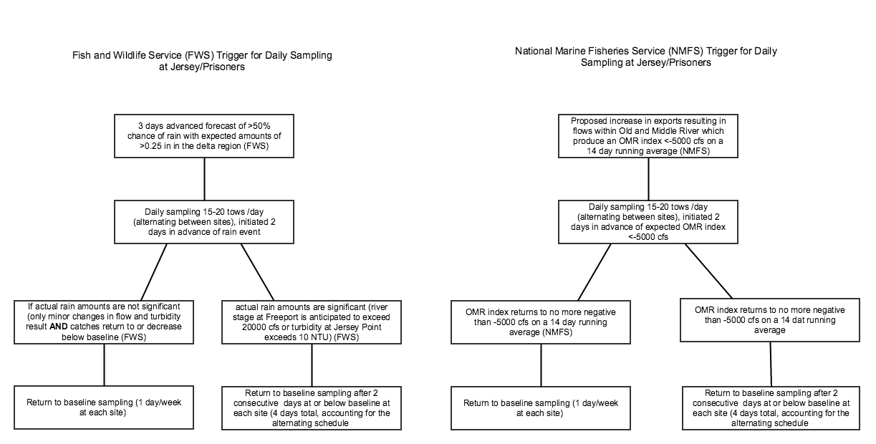

Slide 4
Delta RPA by month timeline
Source: 2011 amended NMFS BiOp Delta RPA actions only

Slide 5
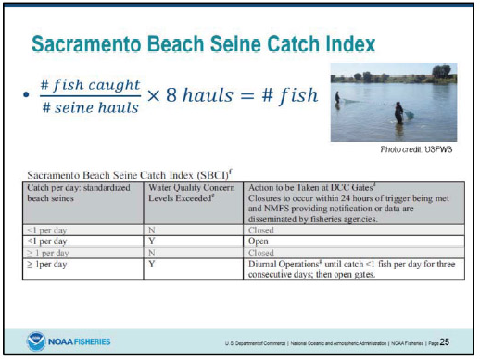
Sacramento Beach Seine Catch Index
Source:

Slide 6
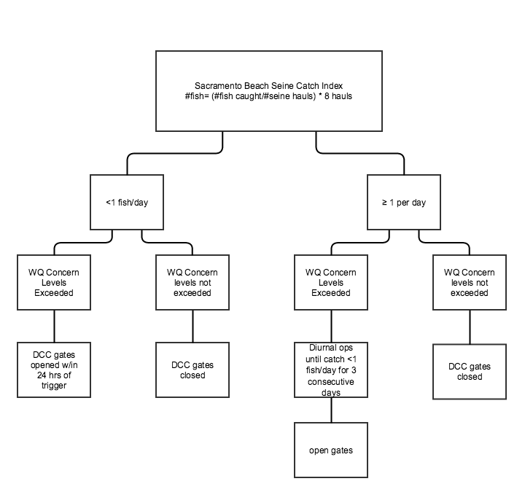

Slide 7
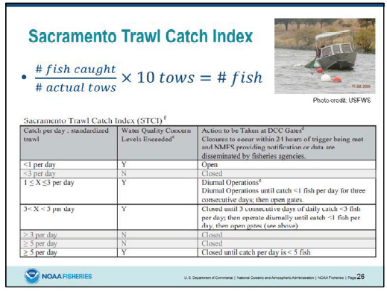
Sacramento Trawl Catch Index
Source:

Slide 8
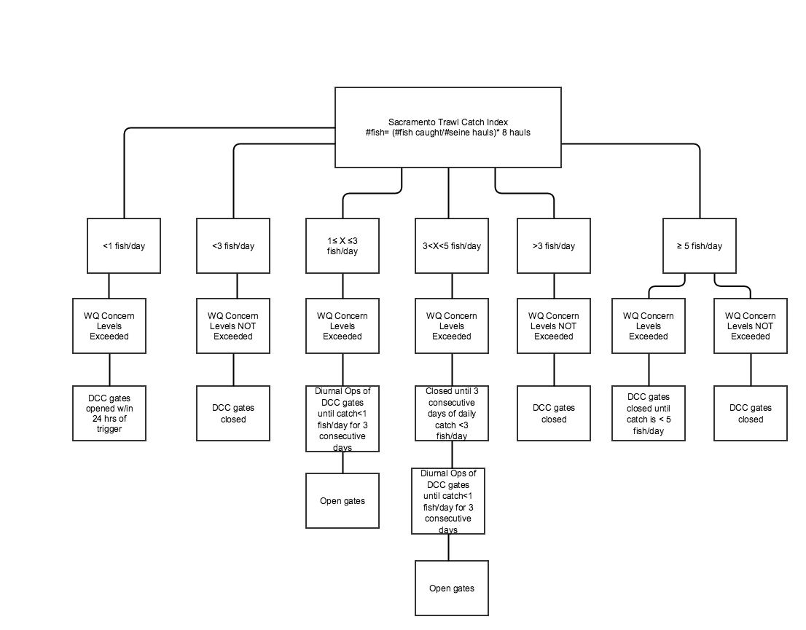

Slide 9
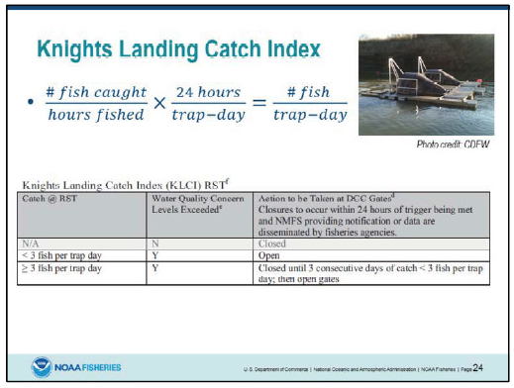
Knights Landing Catch Index
Source:

Slide 10
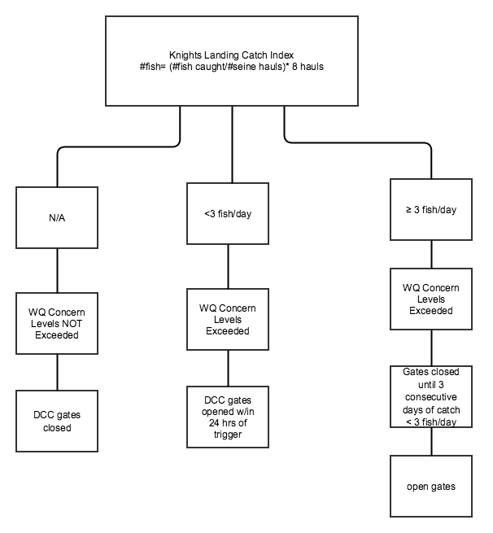

Slide 11
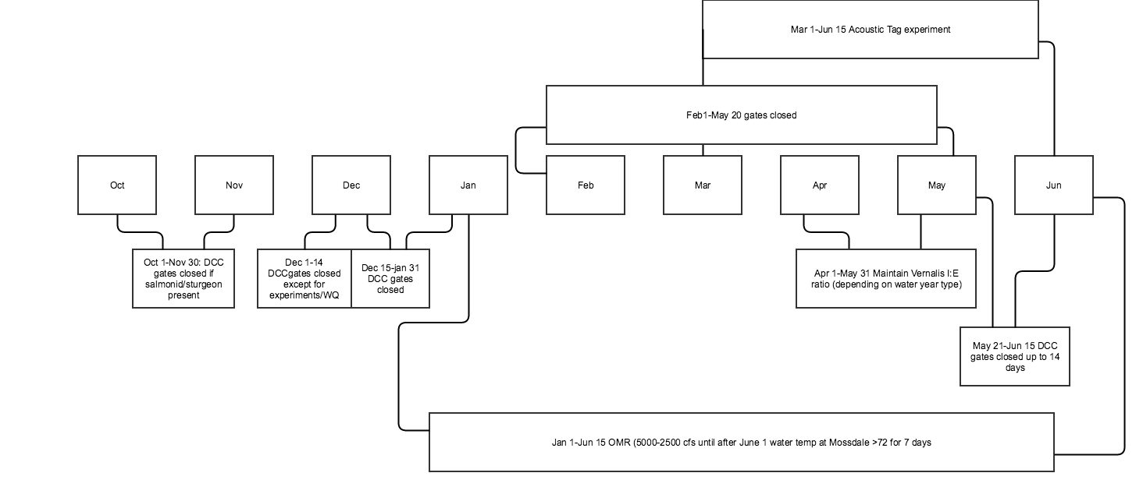

Slide 12
Delta Cross Channel Ops
Source: 2011 amended NMFS BiOp_Delta RPA actions only and D-1641 Water Quality Control Plan for the San Francisco Bay/Sacramento-San Joaquin Delta Estuary

Slide 13
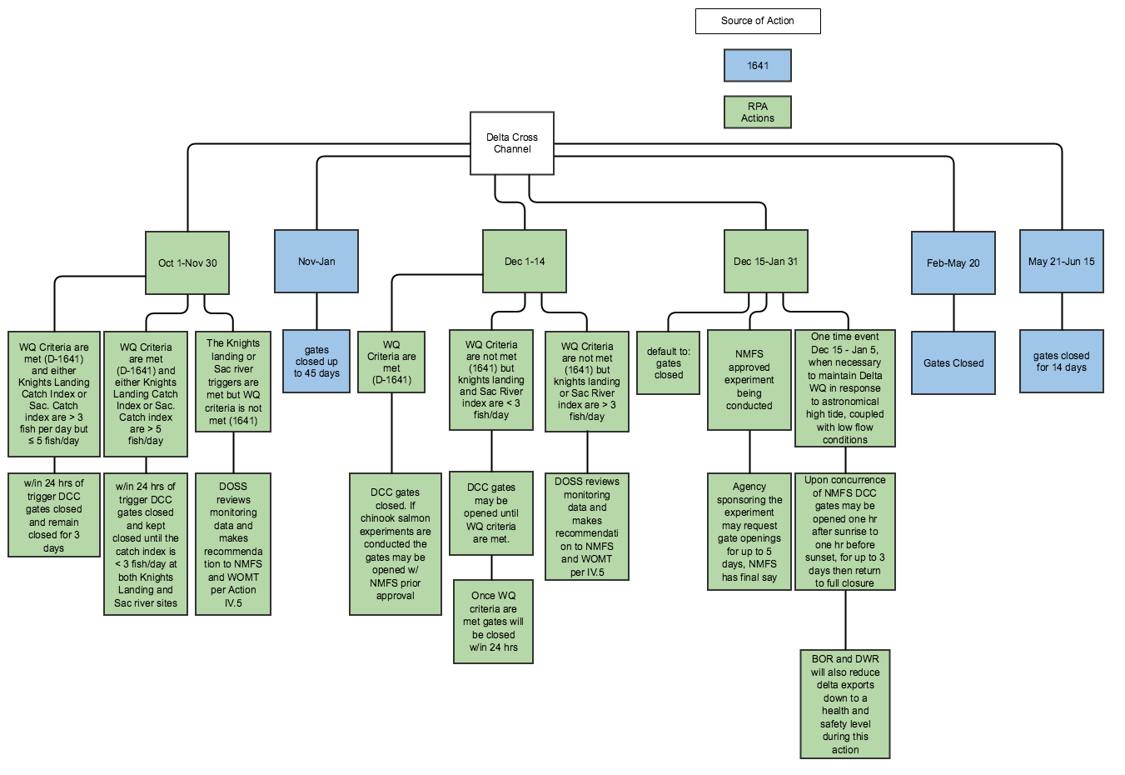

Slide 14
Net Delta Outflow Index (NDOI)
Source: D-1641 Water Quality Control Plan for the San Francisco Bay/Sacramento-San Joaquin Delta Estuary

Slide 15
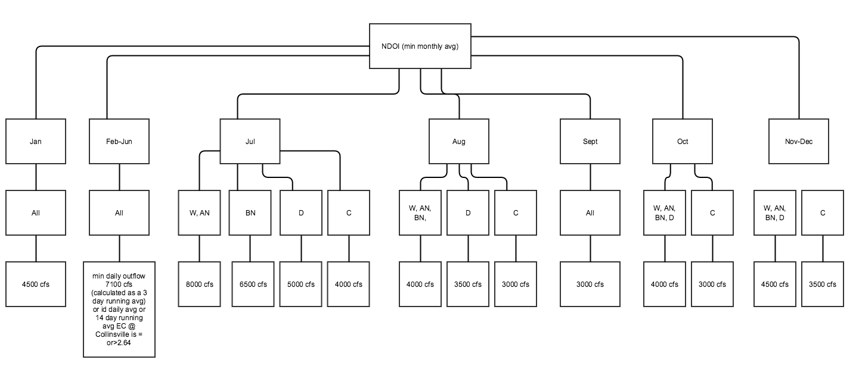

Slide 16
San Joaquin River at Vernalis Flow Objectives
Source: D-1641 Water Quality Control Plan for the San Francisco Bay/Sacramento-San Joaquin Delta Estuary

Slide 17
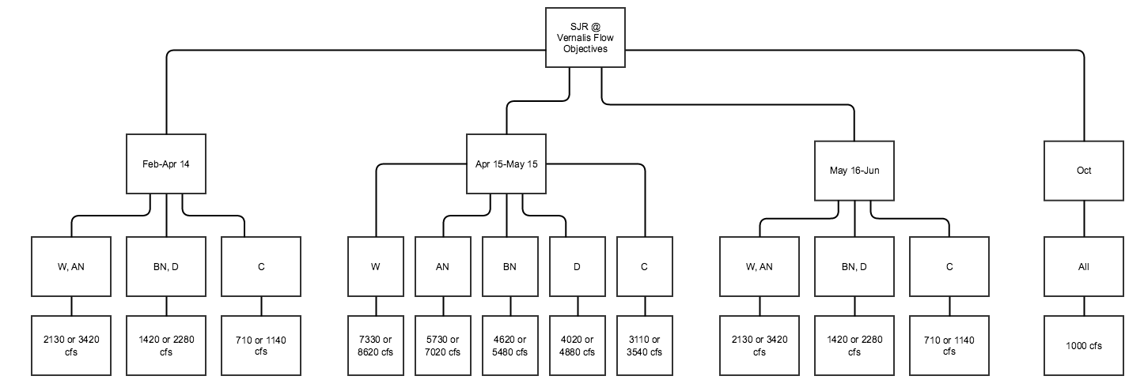

Slide 18
Sacramento River at Rio Vista Flow Objectives
Source: D-1641 Water Quality Control Plan for the San Francisco Bay/Sacramento-San Joaquin Delta Estuary

Slide 19
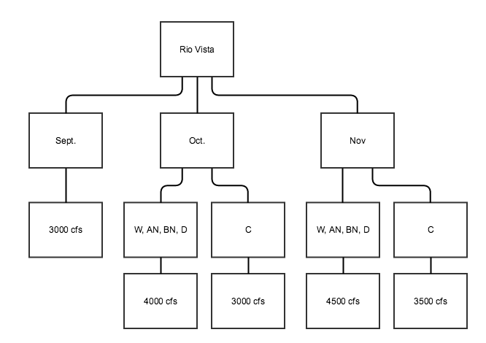

Slide 20
Dissolved Oxygen
Source: D-1641 Water Quality Control Plan for the San Francisco Bay/Sacramento-San Joaquin Delta Estuary

Slide 21
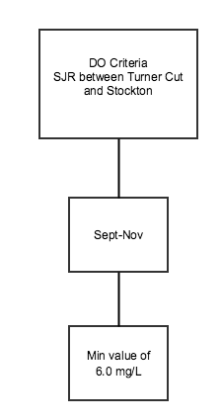

Slide 22
Delta Export Limits
Source: D-1641 Water Quality Control Plan for the San Francisco Bay/Sacramento-San Joaquin Delta Estuary

Slide 23
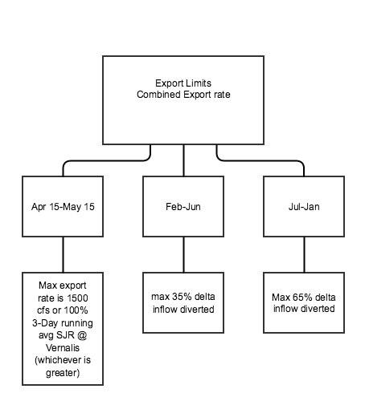

Slide 24
Eastern Suisun Marsh Salinity
Source: D-1641 Water Quality Control Plan for the San Francisco Bay/Sacramento-San Joaquin Delta Estuary

Slide 25
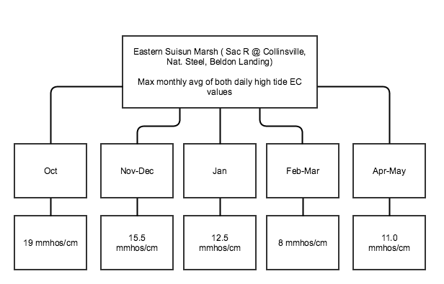

Slide 26
San Joaquin River at Jersey Point Salinity
Source: D-1641 Water Quality Control Plan for the San Francisco Bay/Sacramento-San Joaquin Delta Estuary

Slide 27
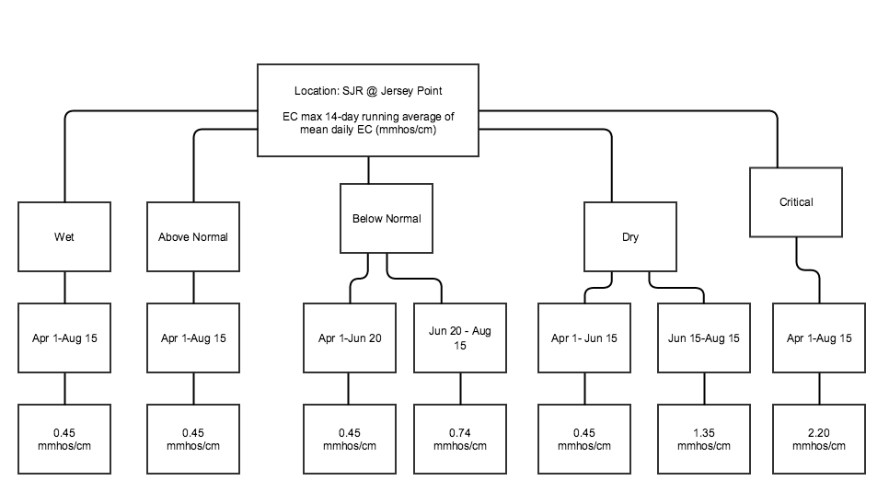

Slide 28
Western Suisun Marsh Salinity
Source: D-1641 Water Quality Control Plan for the San Francisco Bay/Sacramento-San Joaquin Delta Estuary

Slide 29
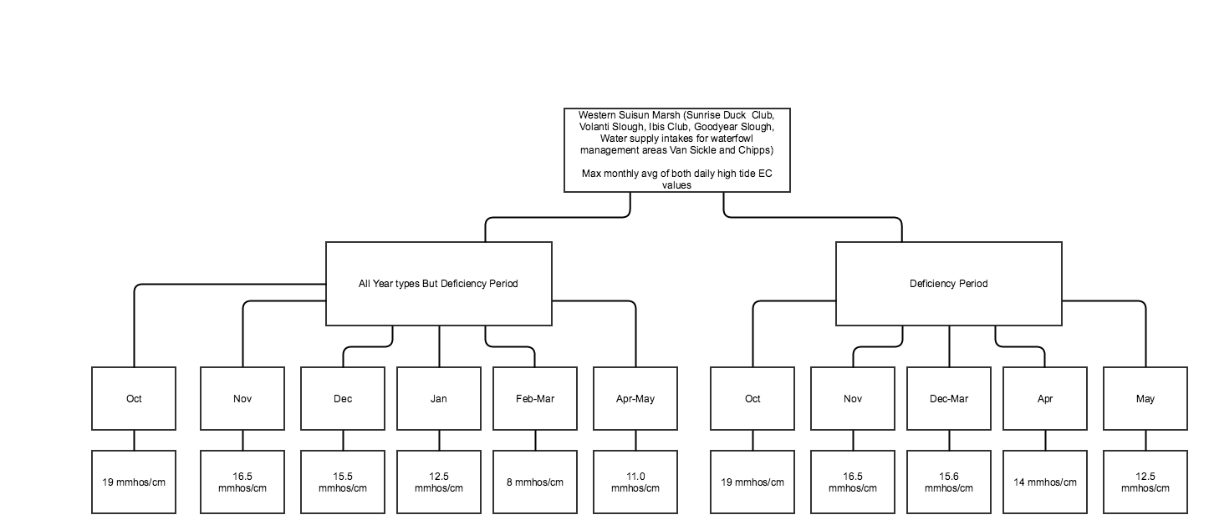

Slide 30
Sacramento River at Emmaton Salinity
Source: D-1641 Water Quality Control Plan for the San Francisco Bay/Sacramento-San Joaquin Delta Estuary

Slide 31
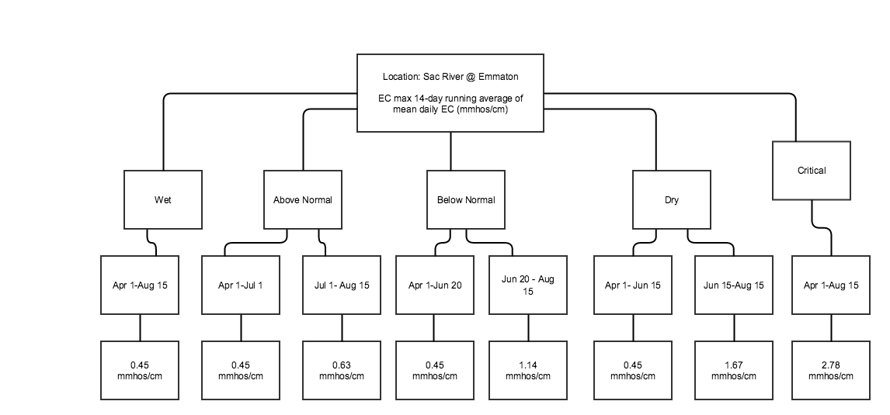

Slide 32
San Joaquin River Salinity
Source: D-1641 Water Quality Control Plan for the San Francisco Bay/Sacramento-San Joaquin Delta Estuary

Slide 33
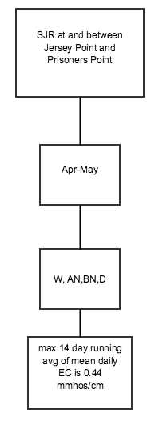

Slide 34
South Fork Mokelumne River at Terminous Salinity
Source: D-1641 Water Quality Control Plan for the San Francisco Bay/Sacramento-San Joaquin Delta Estuary

Slide 35
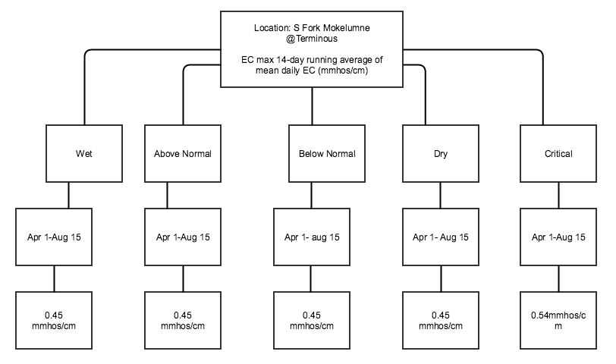

Slide 36
San Joaquin at San Andreas Landing Salinity
Source: D-1641 Water Quality Control Plan for the San Francisco Bay/Sacramento-San Joaquin Delta Estuary

Slide 37
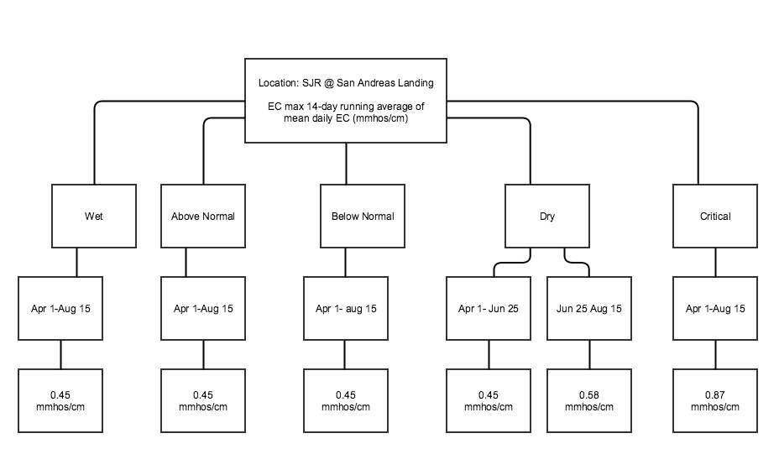

Slide 38
Southern Delta Salinity
Source: D-1641 Water Quality Control Plan for the San Francisco Bay/Sacramento-San Joaquin Delta Estuary

Slide 39
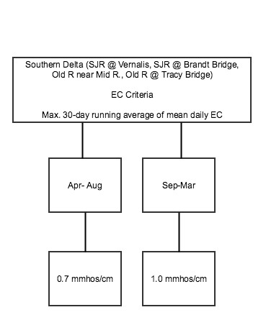

Slide 40
Bay Delta Plan/D-1641 timeline
Source: D-1641 Water Quality Control Plan for the San Francisco Bay/Sacramento-San Joaquin Delta Estuary

Slide 41
San Joaquin River Index
Source: D-1641 Water Quality Control Plan for the San Francisco Bay/Sacramento-San Joaquin Delta Estuary

Slide 42
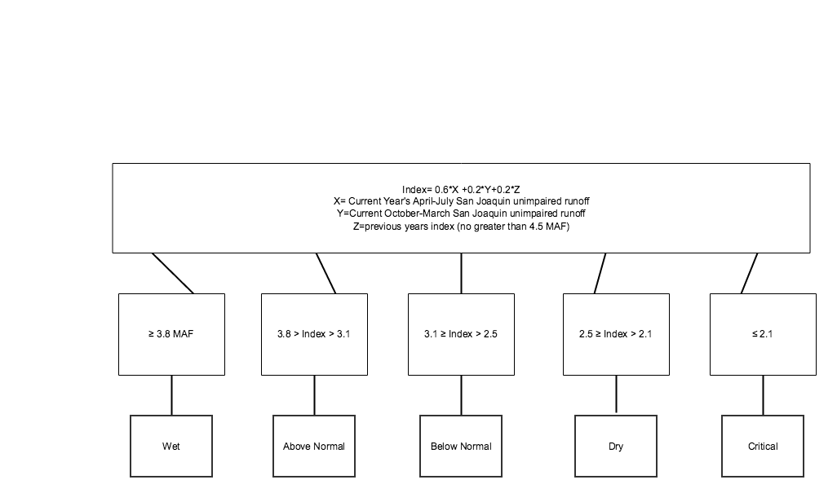
San Joaquin River Index

Slide 43
Sacramento River Index
Source: D-1641 Water Quality Control Plan for the San Francisco Bay/Sacramento-San Joaquin Delta Estuary

Slide 44
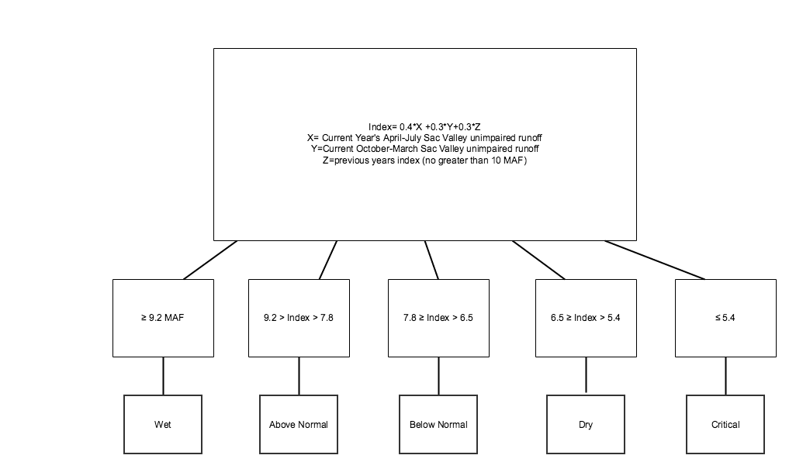
Sacramento River Index

Slide 45
