Slide 1
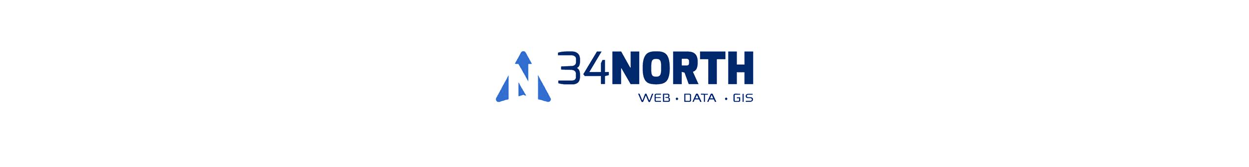
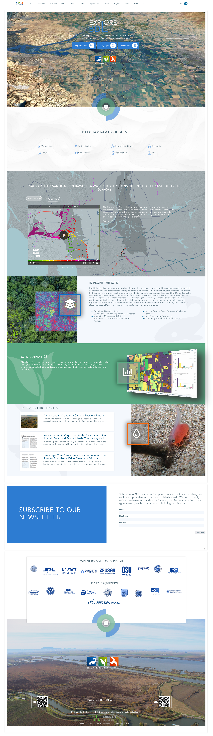
Harnessing AI for User Defined Data Dashboards and Maps: Enhancements in Natural Resource Management, Operations, and Reporting
Presenter: Amye Osti

Slide 2
www.baydeltalive.com (BDL)
Overview
The BDL Ecosystem, Partners and Investment
What is BDL
What are the Challenges?
How is AI Changing the Data Landscape?
How is BDL Using AI Tools?
See the Data!
2024-25 New Data and Tools
Notes:
Today I will give a briefing on the BayDeltaLive data portal. Review
1. User Community Numbers
2. Elements of the BDL site
3. BDL powered sub domains
-NASA/JPL
-BDL iPhone and Android App
-CSAMP Website

Slide 3
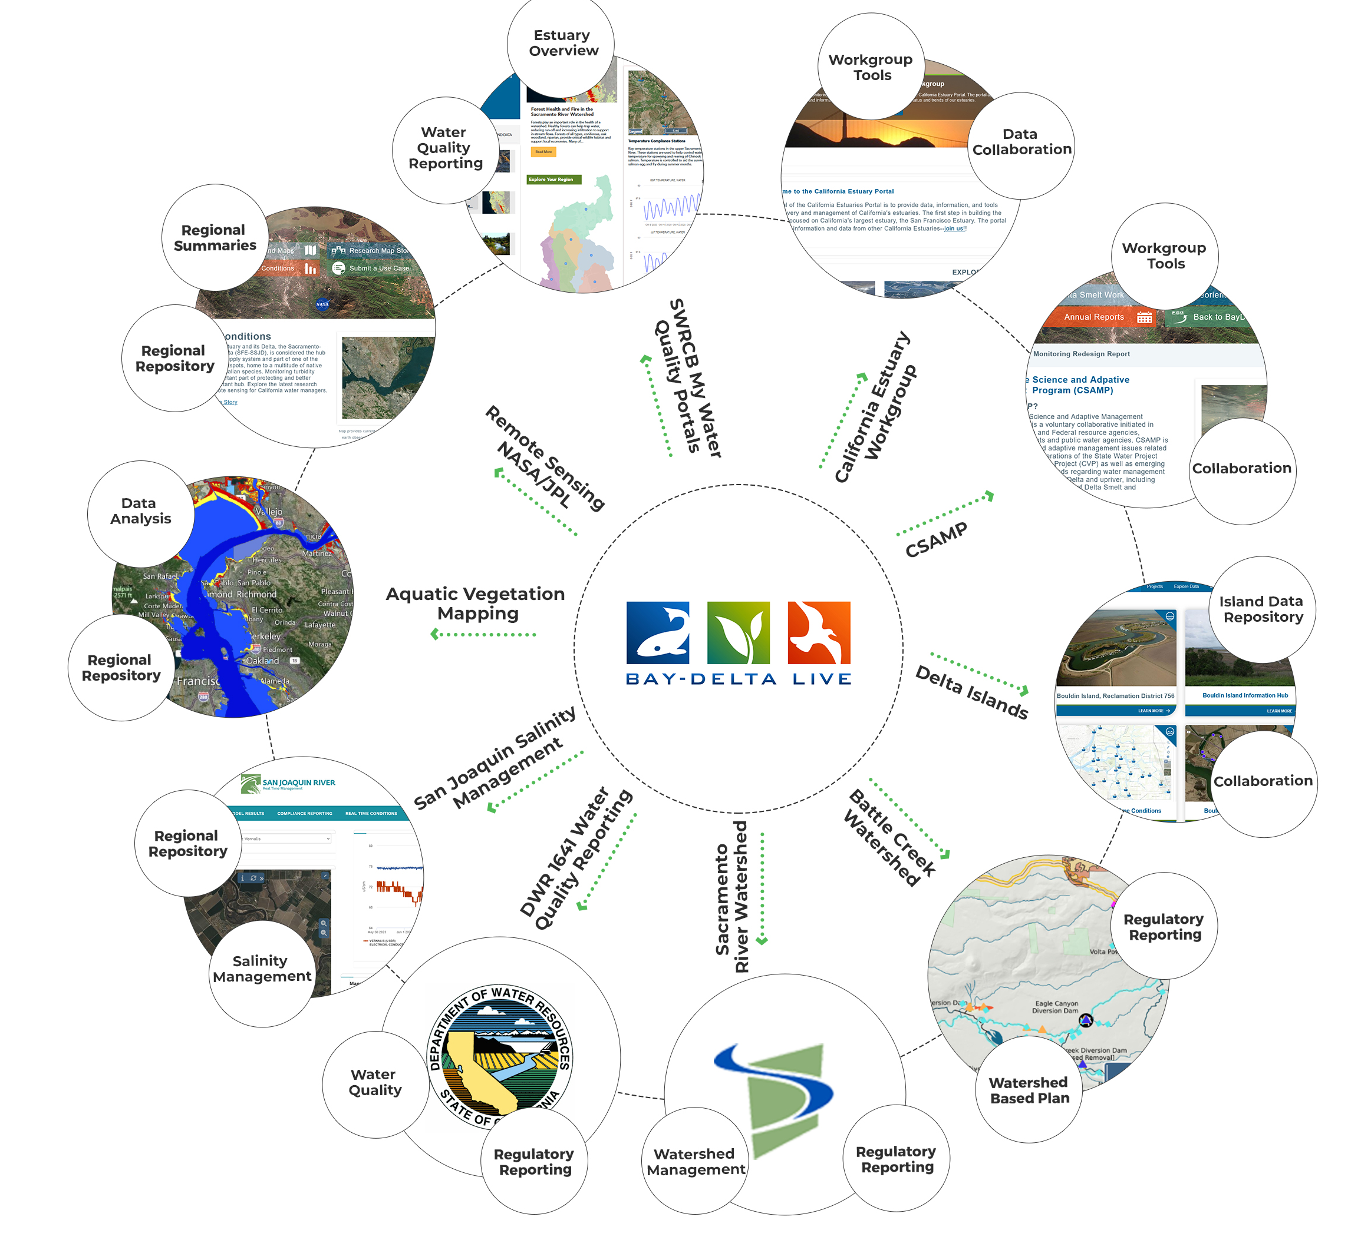















BDL & Regional Programs
Community Investment
SWC
DWR Environmental Monitoring
State Water Contractors
MWD
JPL/NASA
CalFire
Sierra Nevada Conservancy
Battle Creek Conservancy
SWRCB
RCDs & FSCs
Delta Science Council
USBR
Notes:
Funding and PORTAL EcoSystem

Slide 4
What is BDL?
Open Data Access and Visualization Platform
API Consumer- Data Federation that consolidates data from hundreds of diverse data streams. NWIS, CDEC, NOAA, DWR, USBR, USFWS, CADFWS, Academia, NGOs, NASA, OpenET, AGOL
Creates a Common Operating Picture with current conditions
Web application provides tools use federated data through custom templates, dashboards, maps
Sensor network observations. View many monitoring programs in one location
Map based/spatial data analytics
Provides collaborative and special project workspaces (Forest Health, Battle Creek, Fisheries, CSAMP, Islands, Estuary Workgroup, Remote Sensing)
Notes:
with an integrated and holistic approach to water management that recognizes the interconnectedness of water resources and aims to optimize their use for the benefit of both human and environmental needs

Slide 5
What are the Challenges?
1. Data Often Resides with Reporting Agencies
Different organizations or agencies typically collect data related to their specific reporting requirements making it difficult to combine datasets and create a common operating picture. Leading to inefficiencies, and gaps in understanding the bigger picture.
2. Inconsistent Data Formats
Datasets from different sources often come in different formats and structures (e.g., different units of measurement, time intervals, or geospatial coordinates). Harmonizing these inconsistencies manually was time-consuming and error-prone.
3. Manual Data Entry and Collection
A significant portion of data collection is done manually, requiring people to physically enter or upload data into systems, often leading to human errors. Sensor data, where available, was often stored in localized systems, meaning it needed to be manually gathered and processed for use.
Notes:
with an integrated and holistic approach to water management that recognizes the interconnectedness of water resources and aims to optimize their use for the benefit of both human and environmental needs

Slide 6
How is AI Changing the Data Landscape?
Efficient data collection with less manual effort. AI-powered tools can now handle the integration of disparate data sources more efficiently, cleaning and harmonizing data formats for better usability. This means fewer manual processes, reducing errors, and saving time.
Accurate and predictive insights using AI. AI is being leveraged to run predictive models that help forecast environmental outcomes, such as hydrological changes or species population shifts. These models can use historical and real-time data to offer more accurate predictions.
Customizable reporting for different stakeholder needs.
Real-time monitoring for proactive management of natural resources.
Reducing costs to aggregate and maintain significant amount of information.
Things are just getting started..
Notes:
with an integrated and holistic approach to water management that recognizes the interconnectedness of water resources and aims to optimize their use for the benefit of both human and environmental needs

Slide 7
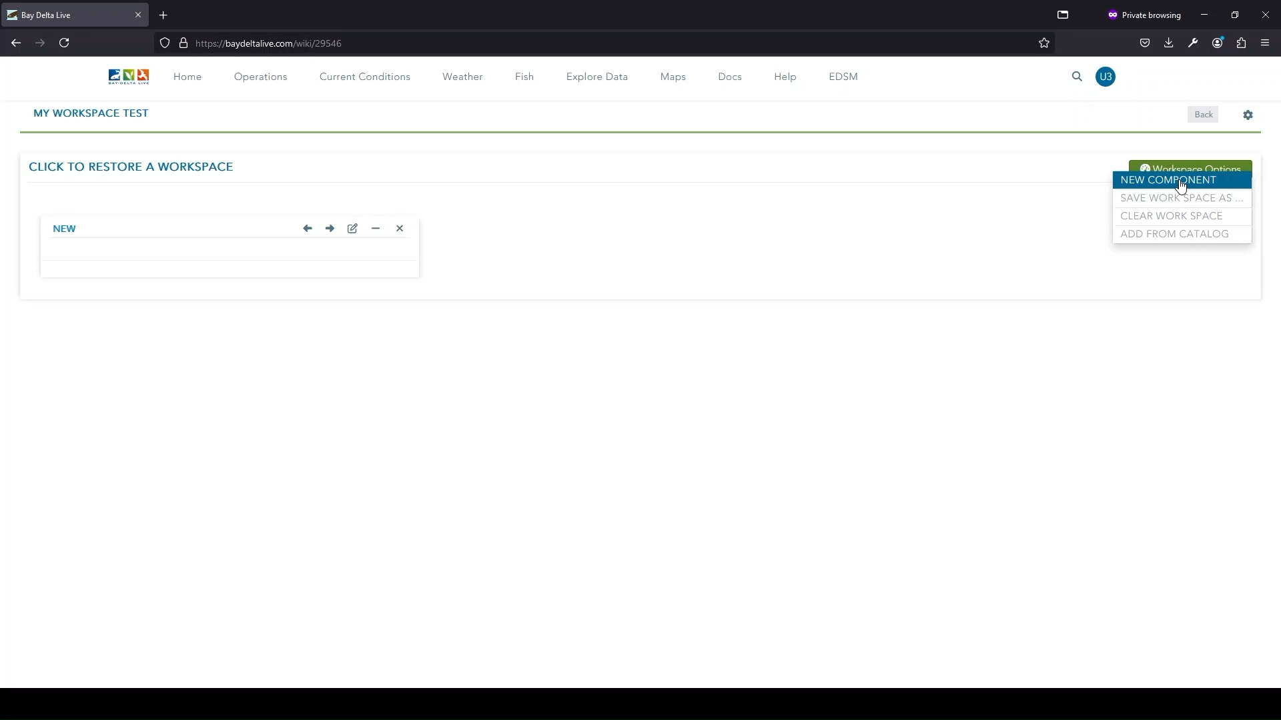
How BDL Using AI?
Introduction to the new dashboard and mapping tools.
Personalization and customization of data for different user needs (stakeholders, researchers, agencies).
Real-time data integration, offering dynamic and interactive analysis tools.
Notes:
with an integrated and holistic approach to water management that recognizes the interconnectedness of water resources and aims to optimize their use for the benefit of both human and environmental needs

Slide 8
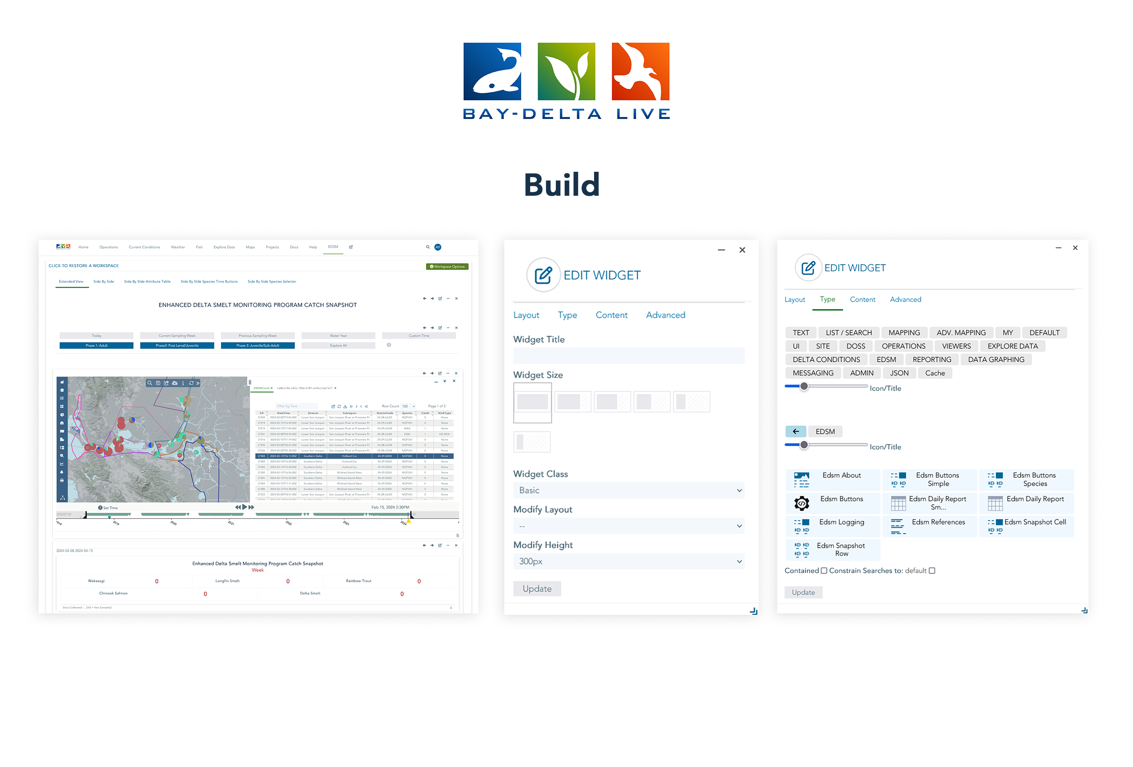

Slide 9
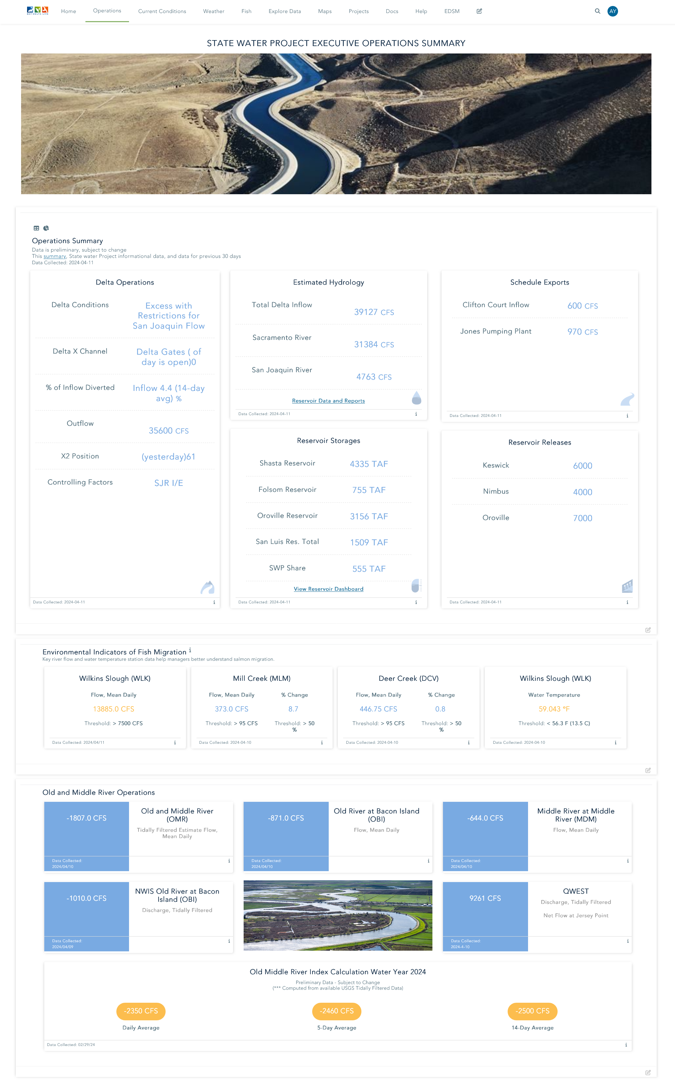
Operations Data
What Will be Available?
Daily Operations
River and Reservoir Conditions
Key Indicators and Indices
Reports as Available
Gate Status and X2
Who is Using it?
Managers
Mobile App Community
Workgroups
Operations

Slide 11
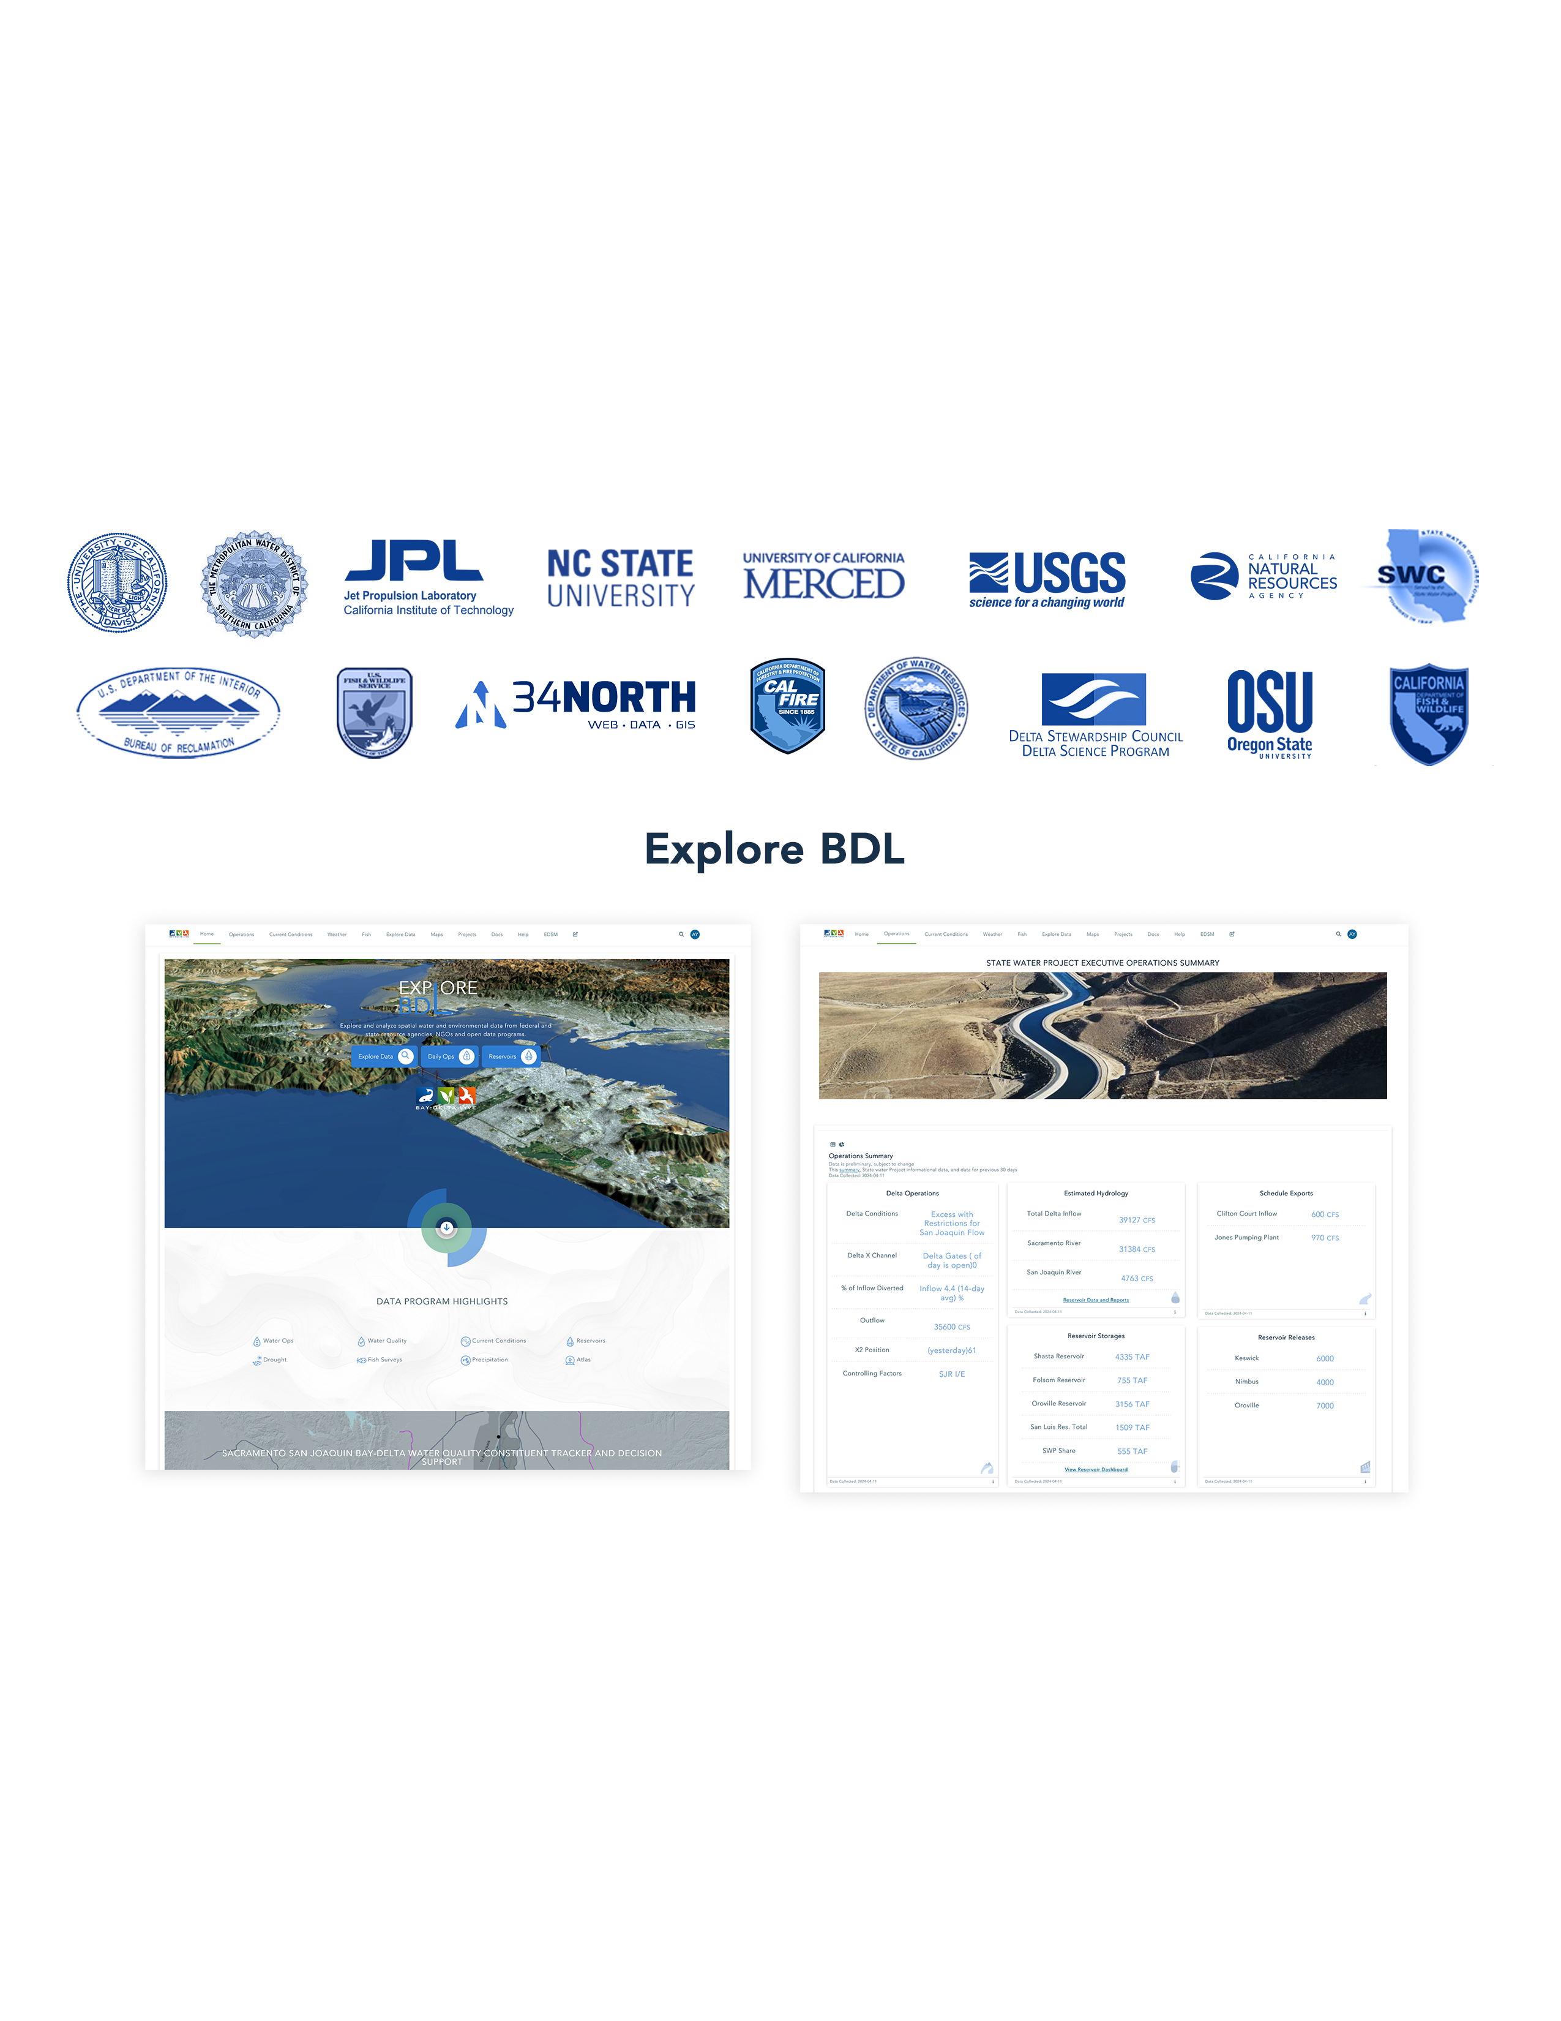

Slide 12
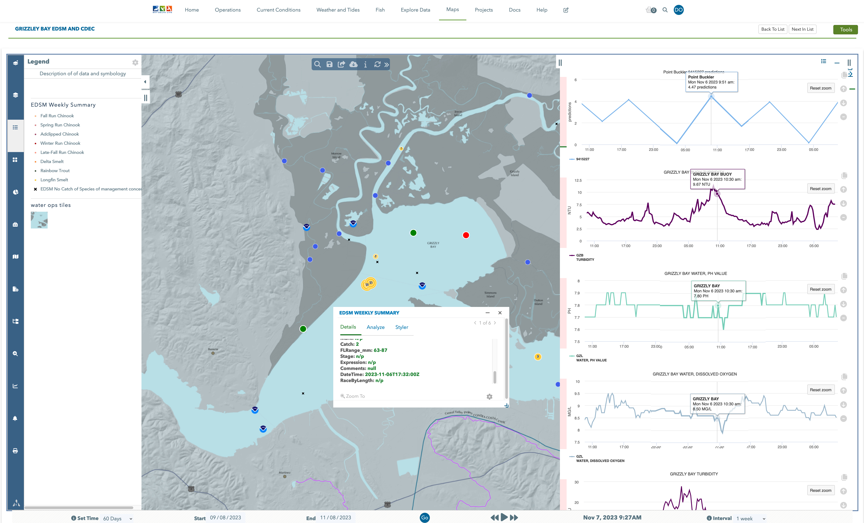
Compare CDEC/NWIS/NOAA Data to EDSM/DJFMP
Notes:
Grizzyly Bay Load EDSM data and Load NOAA and NWIS data to view conditions at the time of catch

Slide 13
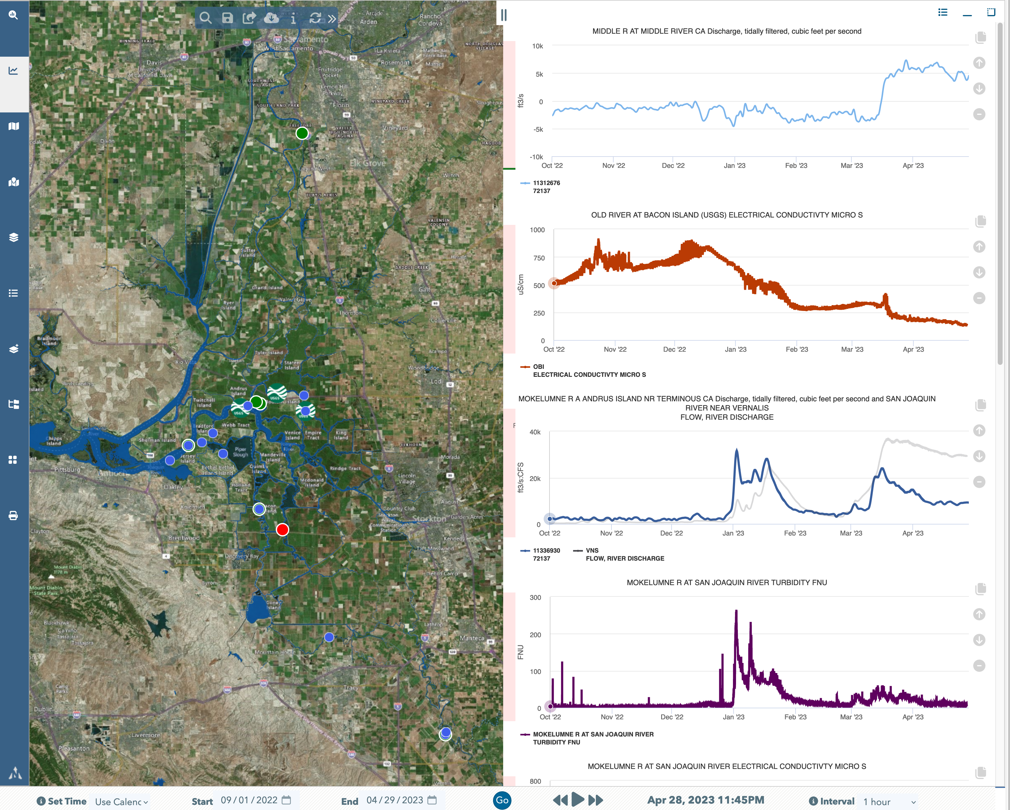
Current Data Access Methods
Tidally Filtered Flow Data @MOK (NWIS)
EC @ Old River (CDEC)
Tidally Filtered Data @MOK (NWIS) & Vernalis (CDEC)
Timeframe: 9/01/22 – 4/29/23
Turbidity @ MOK (CDEC)
Notes:
BDL Explore Data
Choose from a Variety of Databases Using Data API’s
Map & Access Data from NWIS, CDEC, NOAA, EDSMP/DJFMP, EMP, and add GIS Data Services
Use Data Visualization Tools to Draw Time Series Data and Organize to Display Environmental Conditions
Save, Share, Download & Build Data Dashboards
WDL Database will add needed QA/QC’d Data

Slide 14
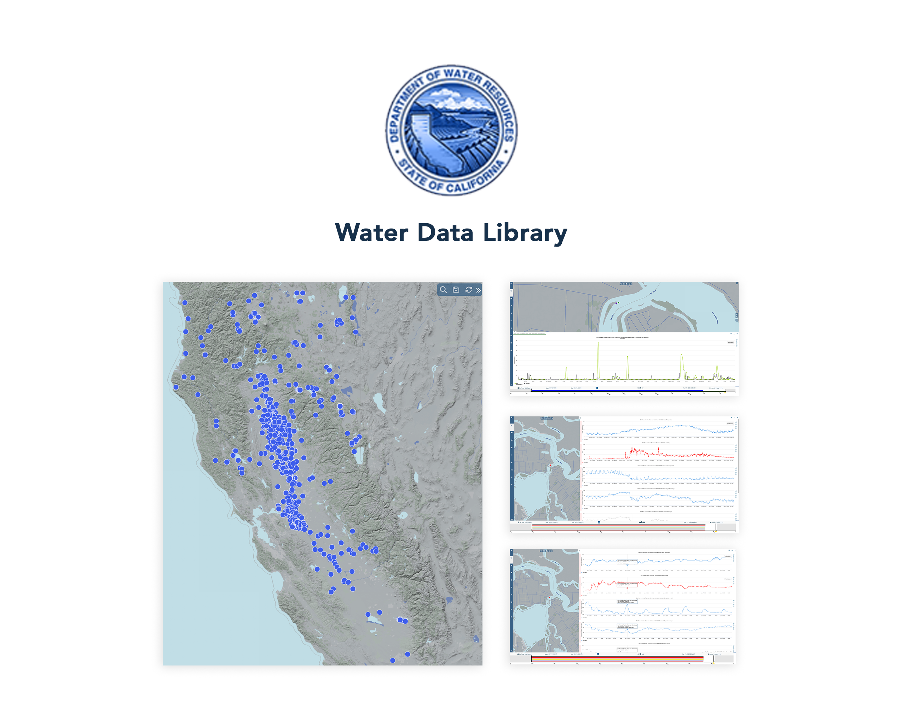

Slide 15
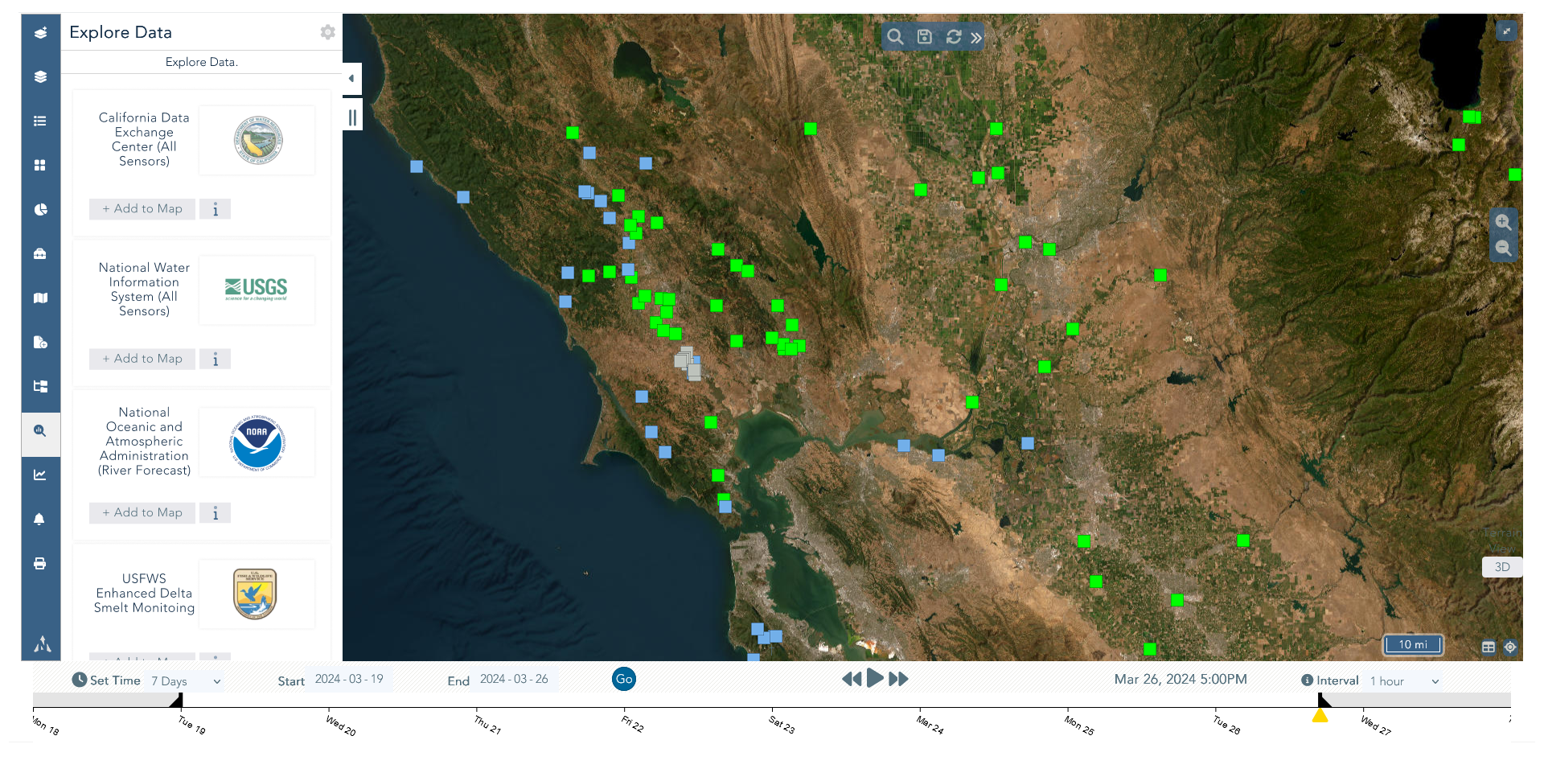
Explore BDL Data Access & Download Methods
Notes:
BDL Explore Data
BDL helps in answering questions to understand an event based scenarios at specific time extents by easy access to multiple database.

Slide 16
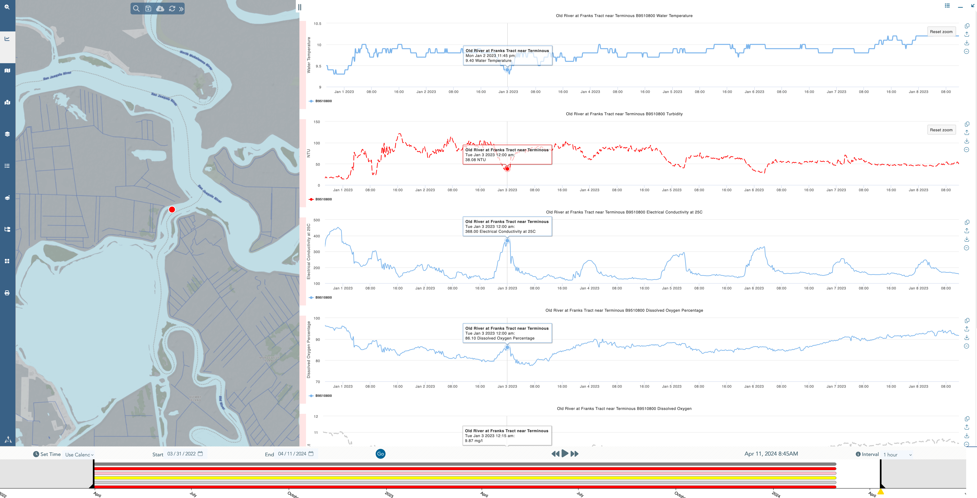

Slide 17
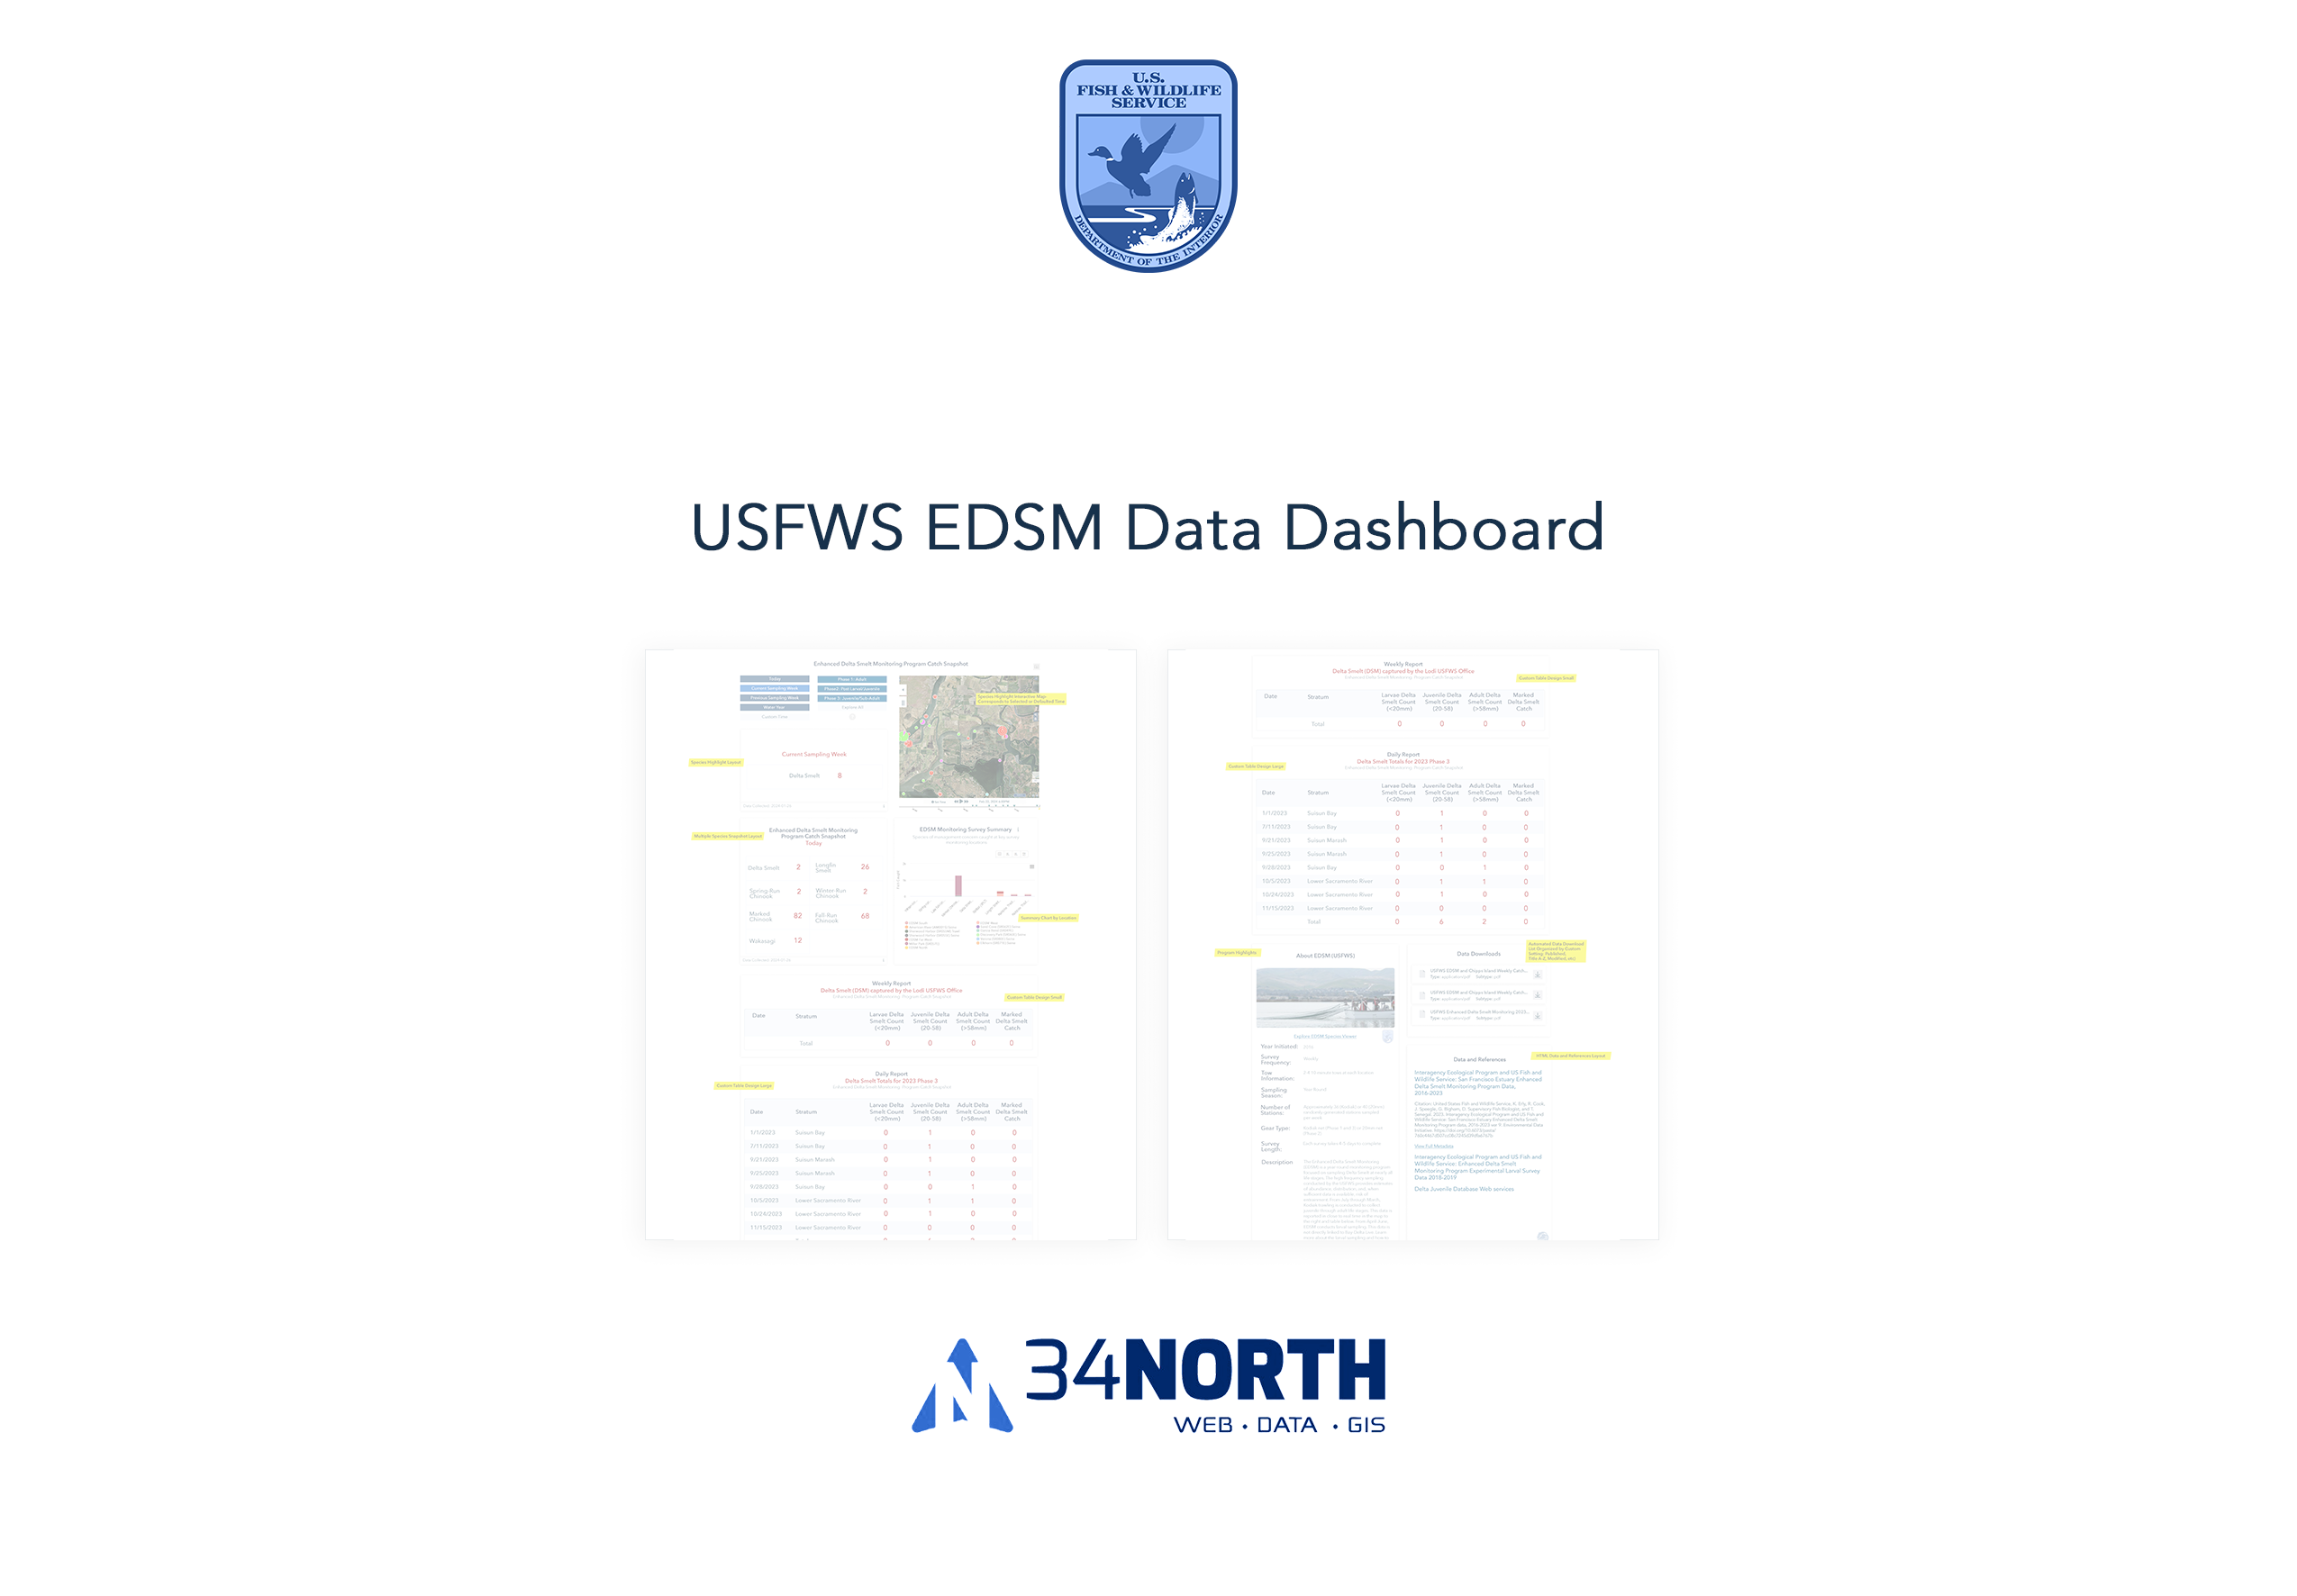

Slide 18
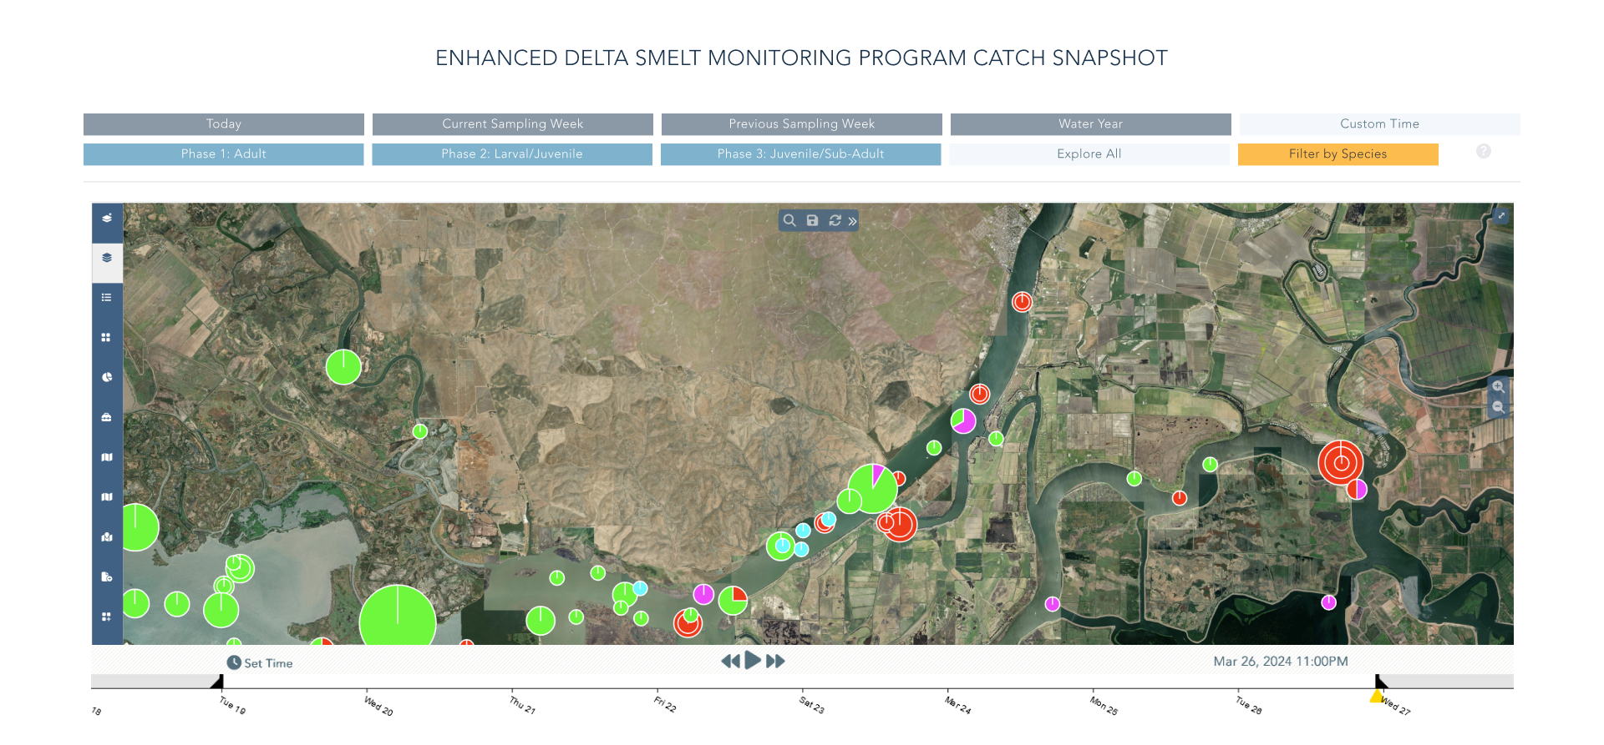
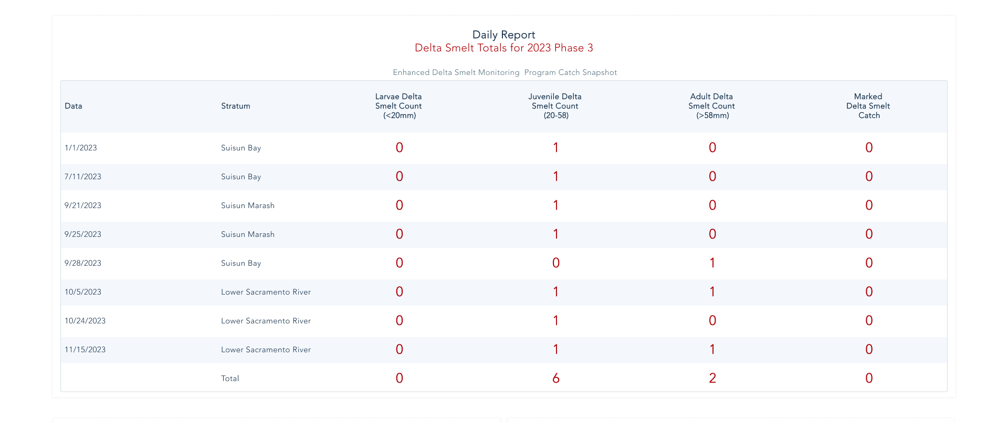

Slide 19
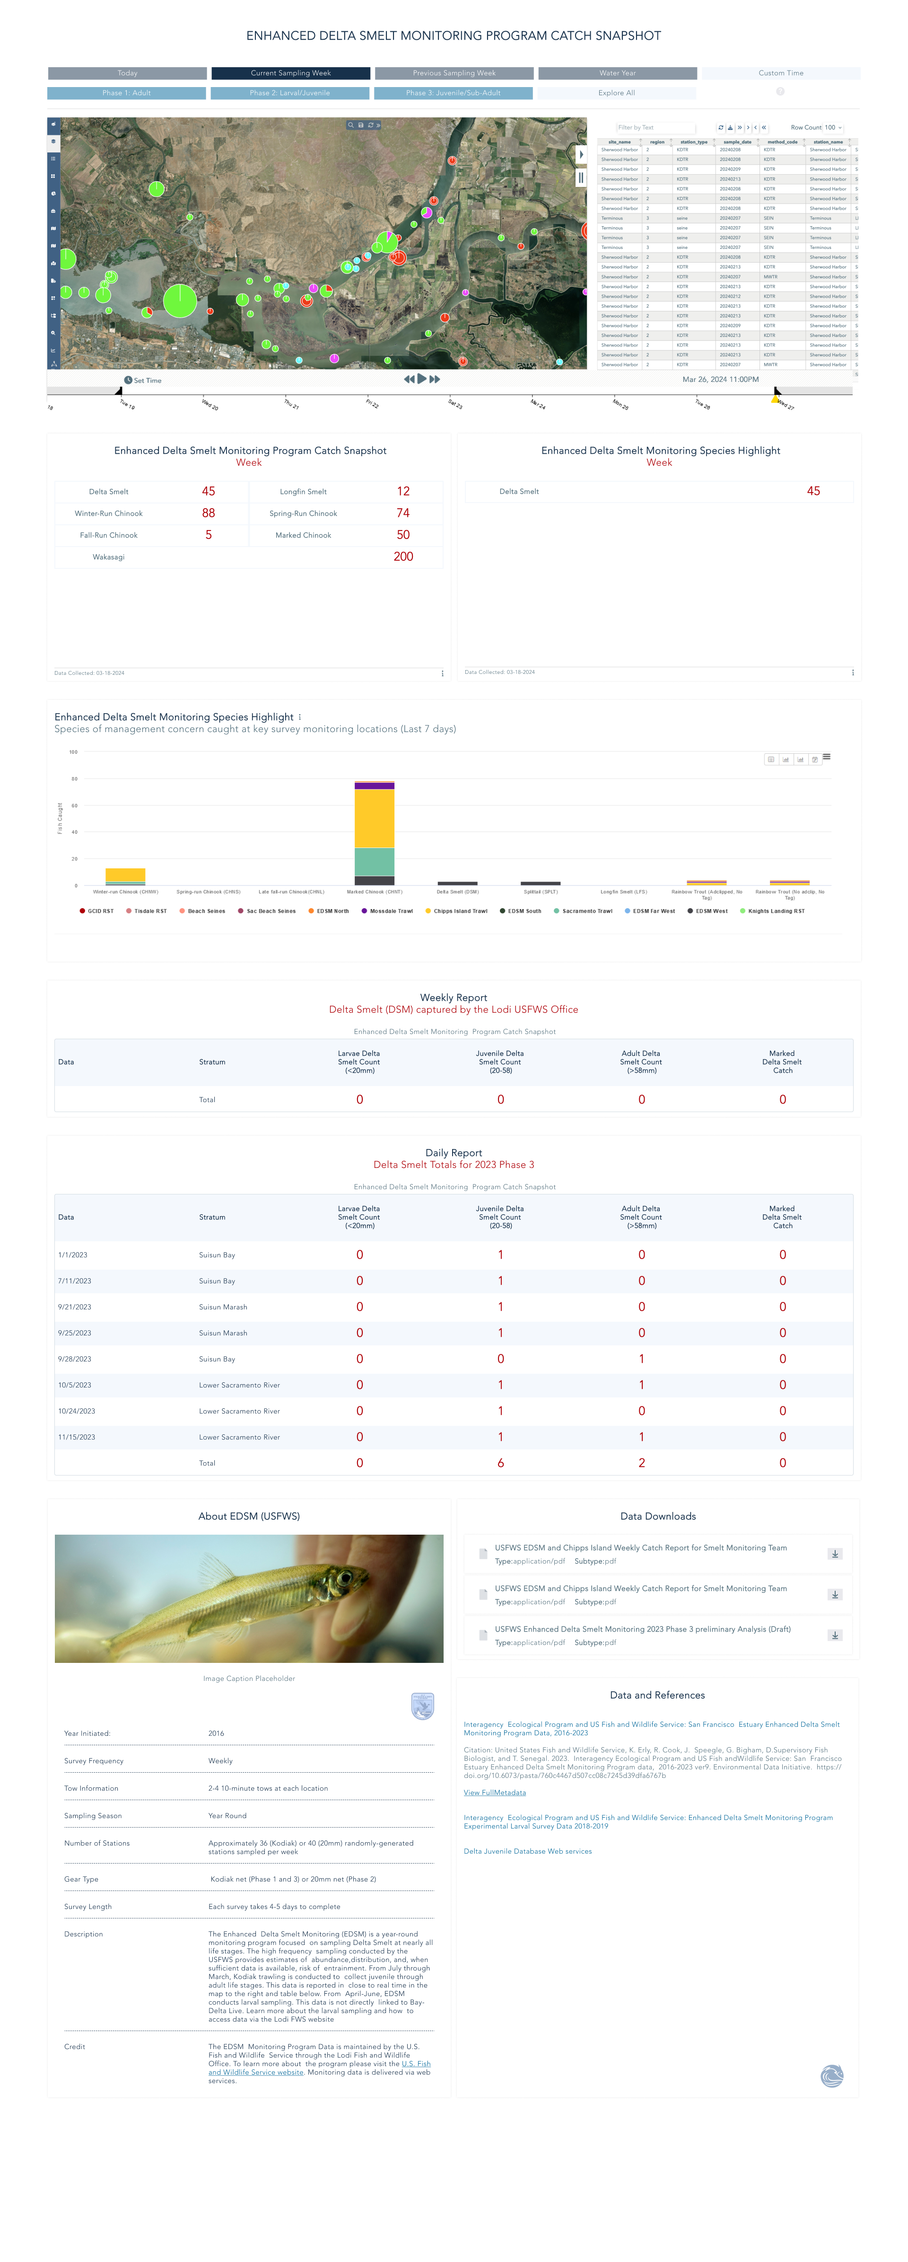

Slide 20
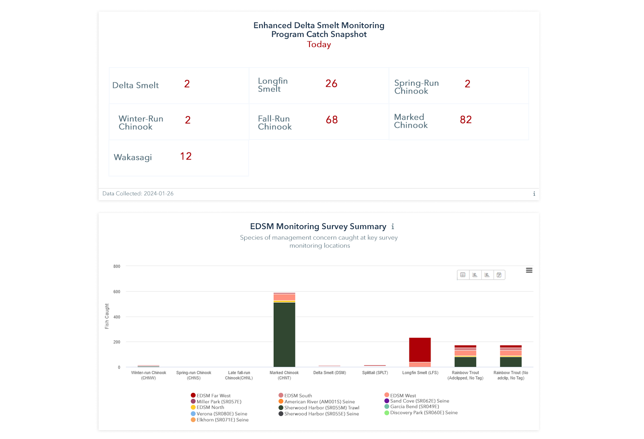

Slide 21
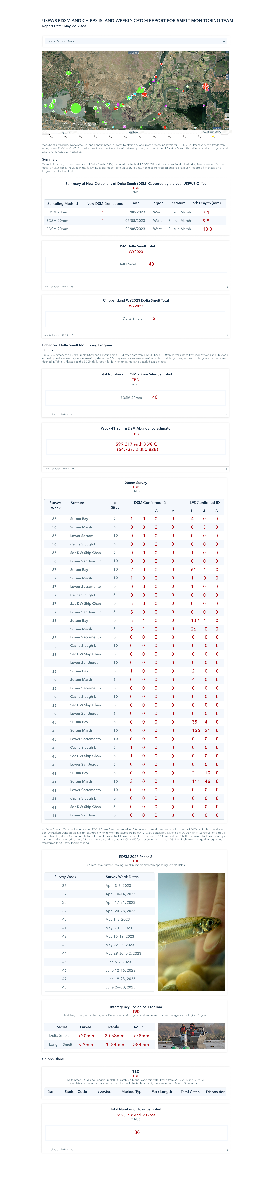

Slide 22
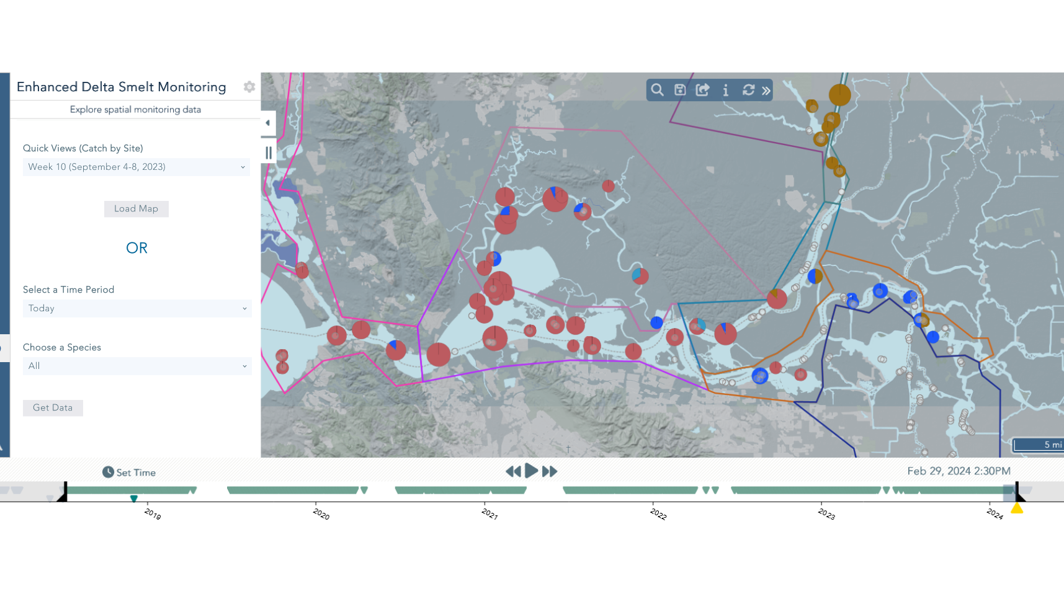

Slide 23
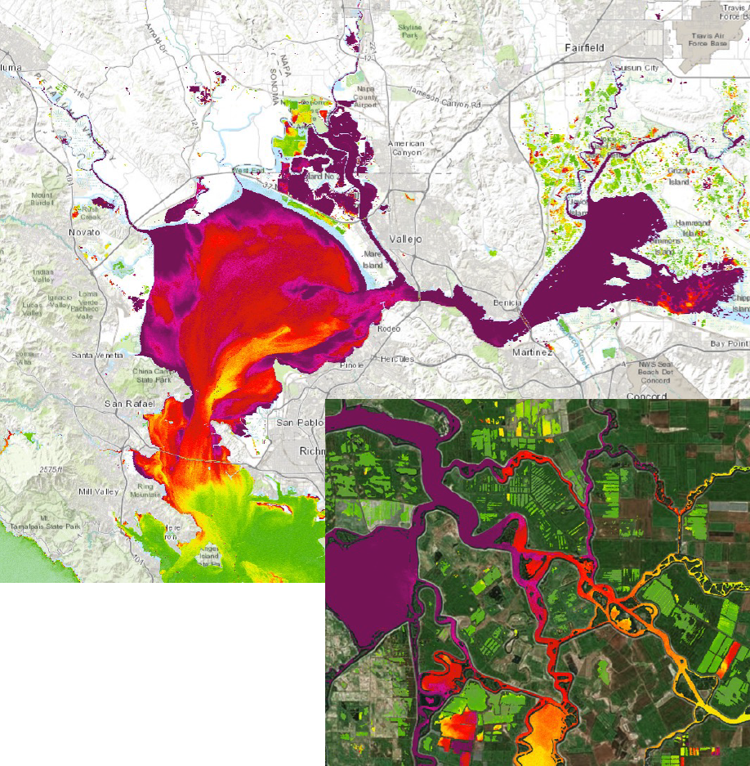

Remote Sensing Data Maps –NASA/JPL Collaboration
What Does it Do?
Provides data and decision support tools to view and analyze current research in the remote sensing space
Repository for Remote Sensing Data for and by the science community
Who is Using it?
Managers
Science Community
Water Ops

Slide 24
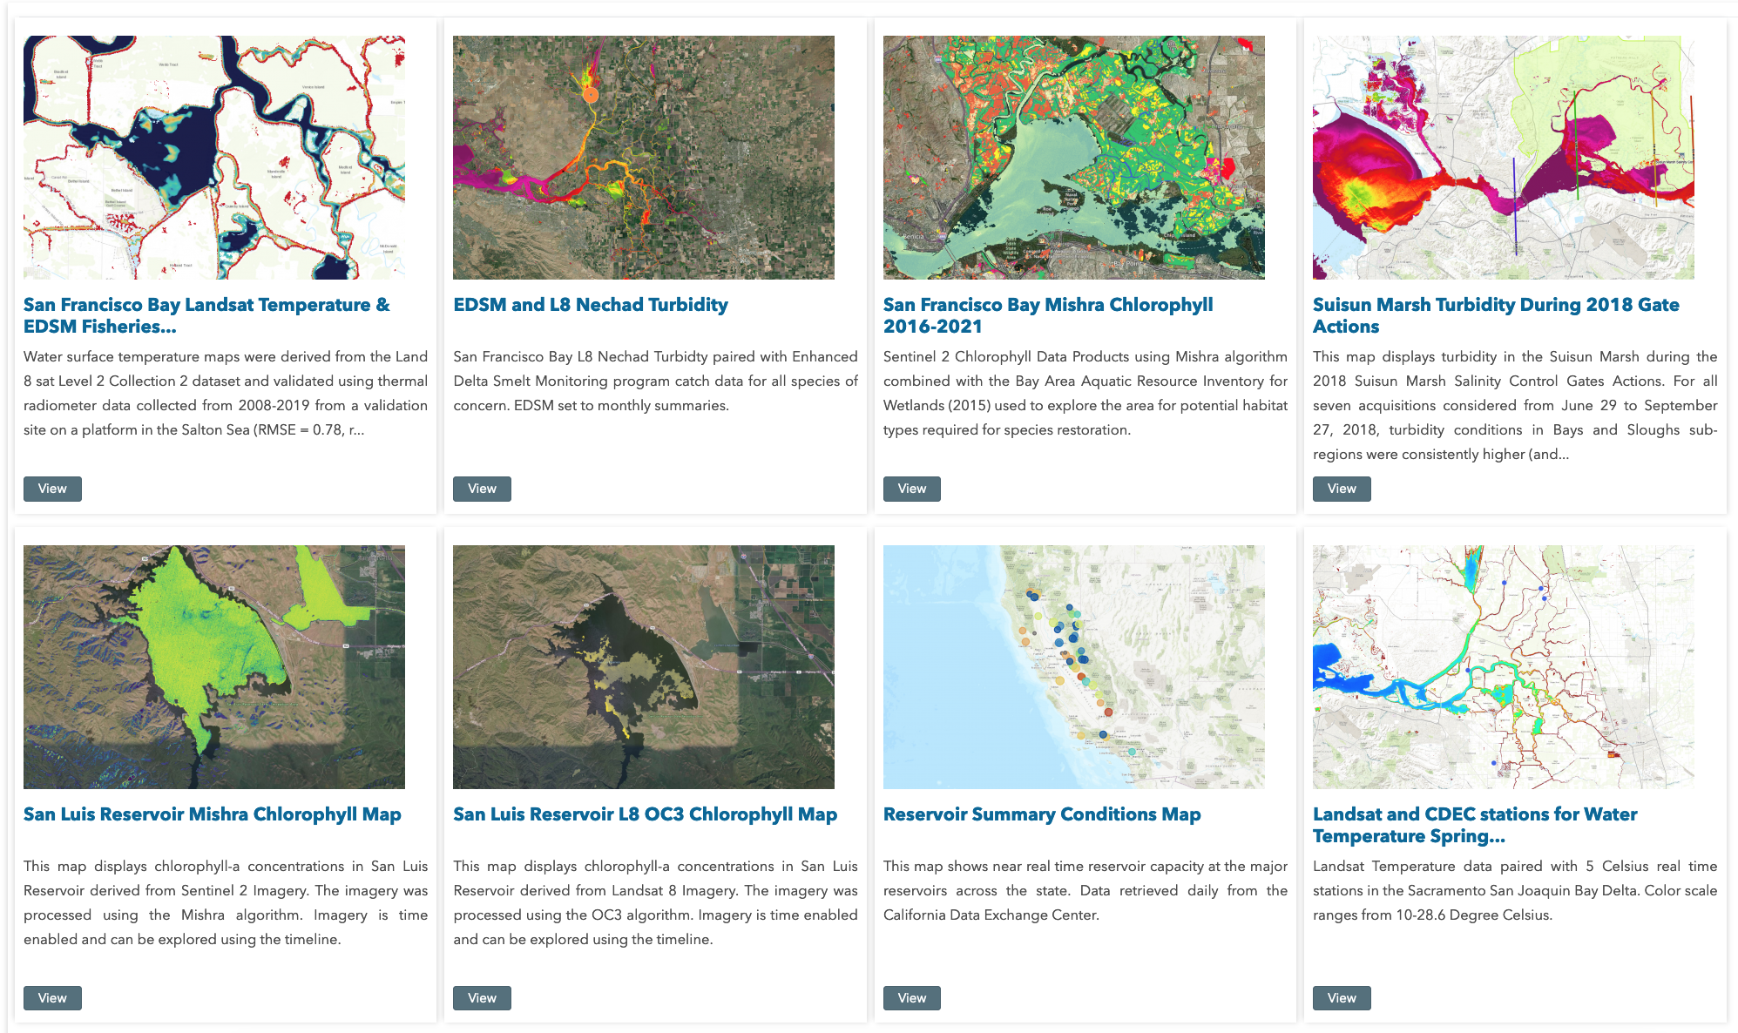
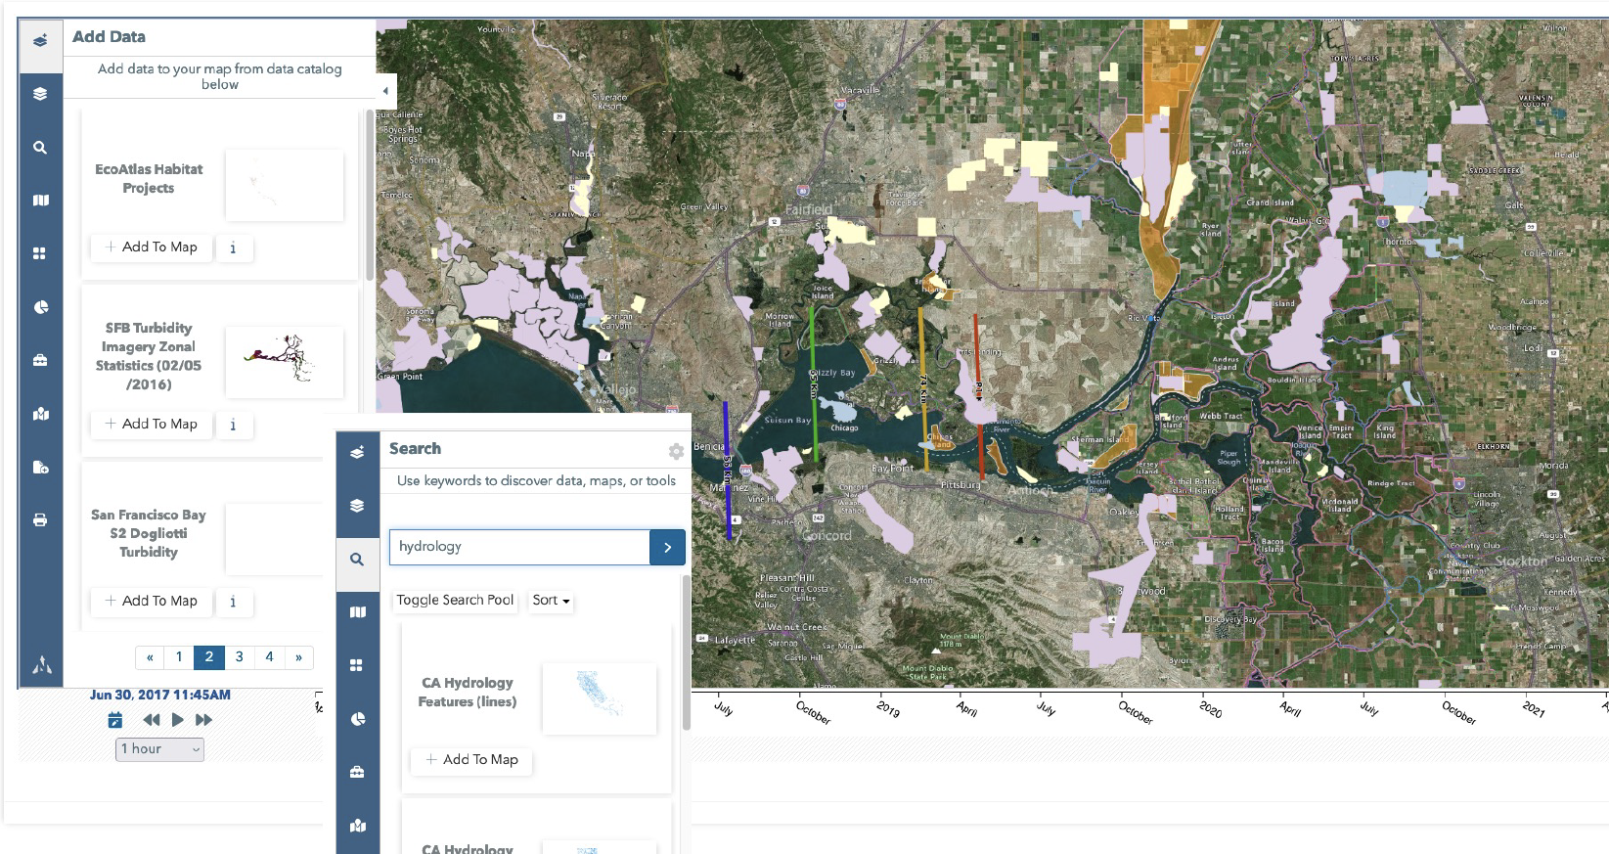
Geospatial Resources
Notes:
Access to Multiple GIS Databases using ESRI REST Services and hosted both locally on the BDL Server.

Slide 25
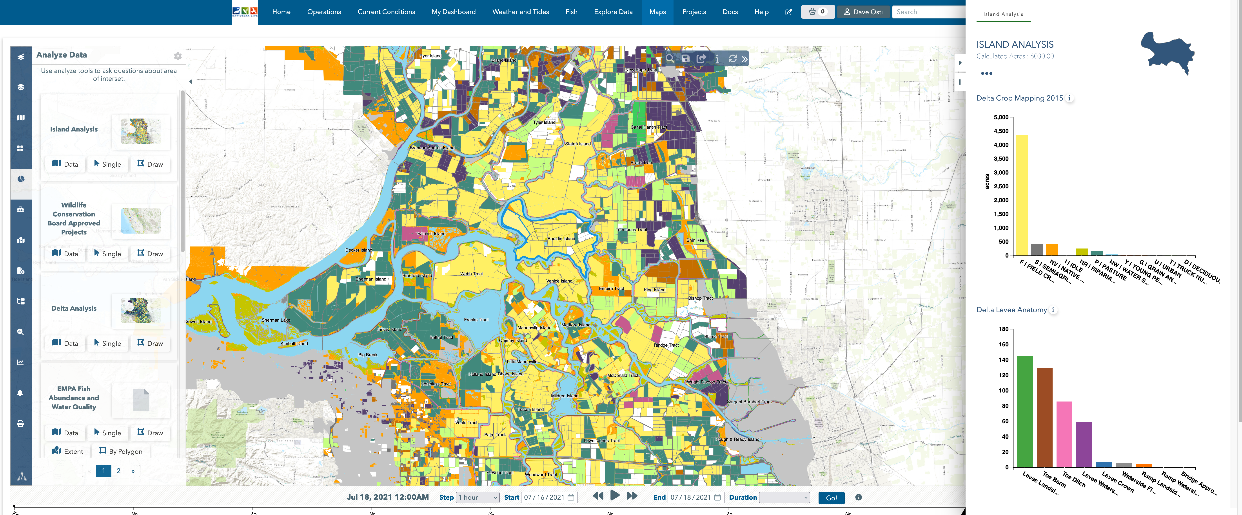
Geospatial Resources – GIS Reporting
Notes:
BDL Can Run Analysis Report on GIS Data and Attributes

Slide 26
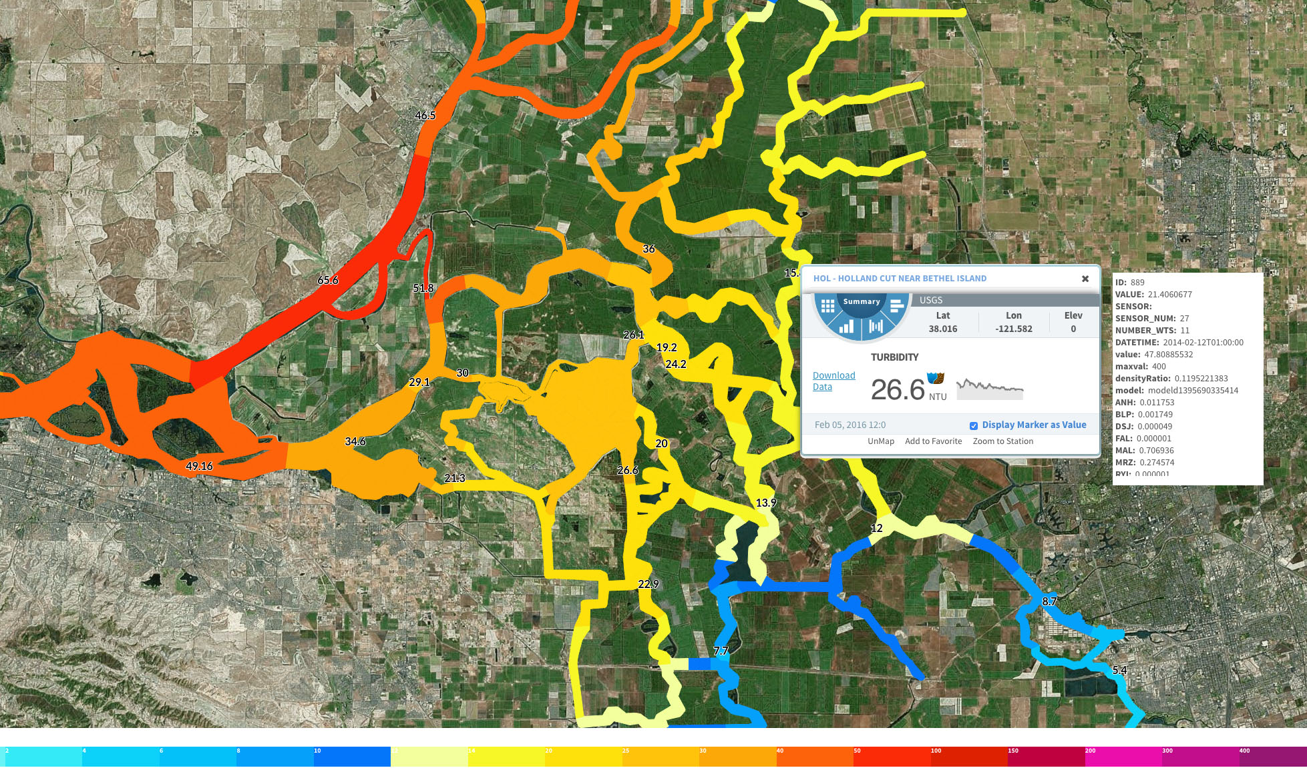
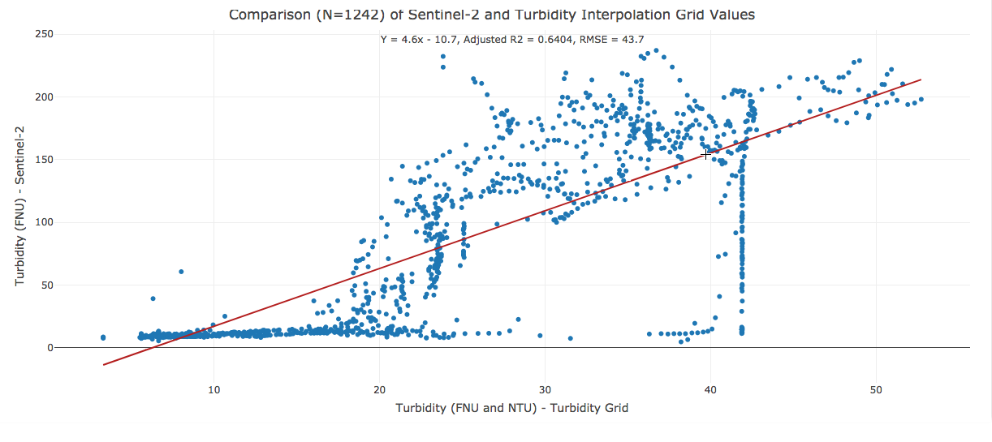
Constituent Tracker – Conditions Modeling
What Does it Do?
Data Assimilation Model
Animated Spatial Maps for Real Time Constituent Tracking
View Data at both 15-minute intervals or a Constant Point in Tide
Advance data modeling algorithms
Collaboration with USGS
Who is Using it?
Drought Monitoring
Trawl Managers
Science Community
Water Ops

Slide 27
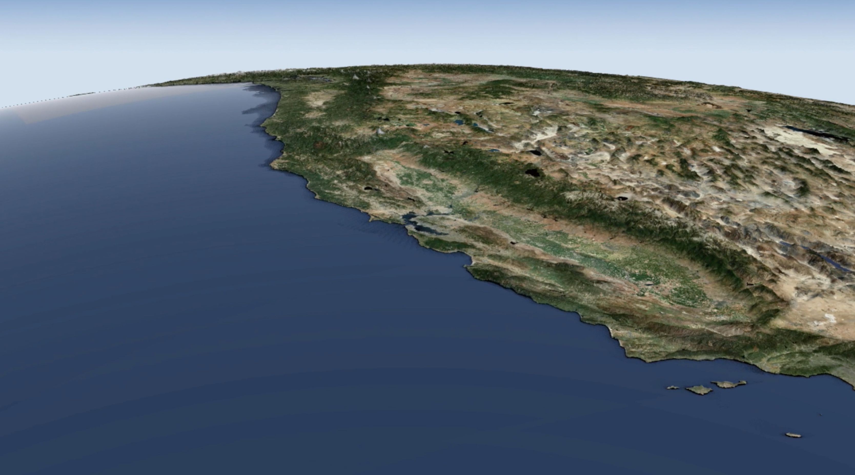
2024-25 New Data and Tools
Operationalize Water Data Library
Operationalize ECOSTRESS NASA Remote Sensing
Aquatic Vegetation Mapping
EDSM/DJFMP Daily and Weekly Reports
Integrate OpenET Models
LiDAR and Forest Assessment: Upper Sacramento Watershed
Forest Health Fuels Peduction Projects

Slide 28


JOIN BDL BUILD
THANK YOU!

Slide 29
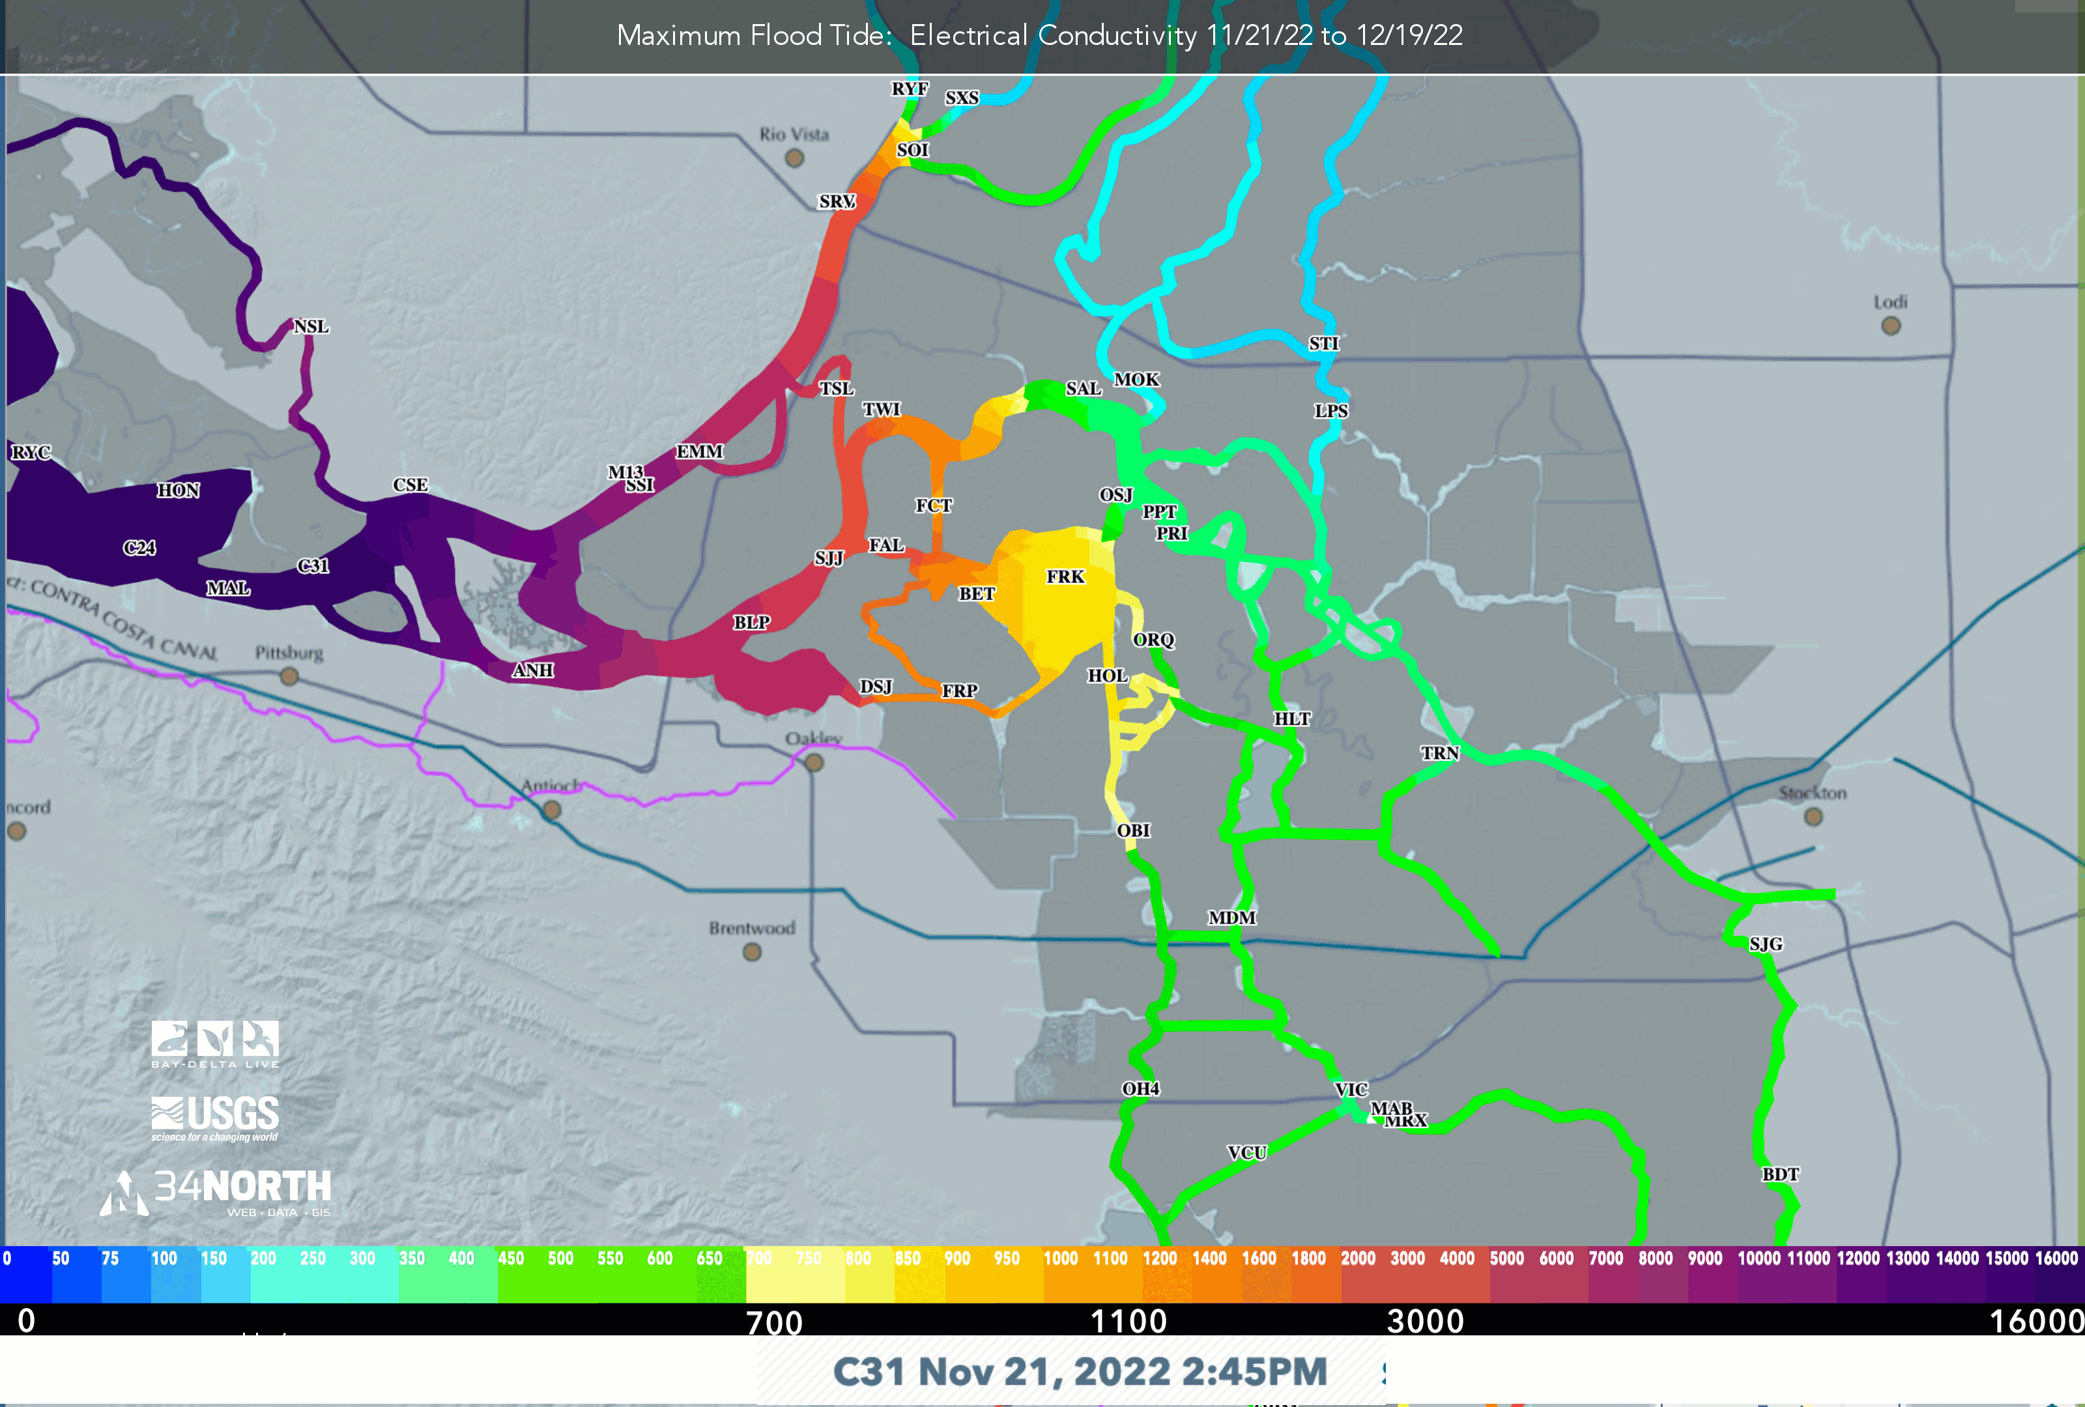
Constituent Tracker Drought Monitoring Oct. – Dec. 2022

Slide 30
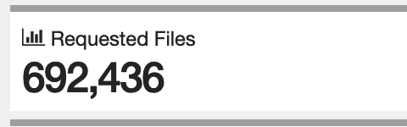
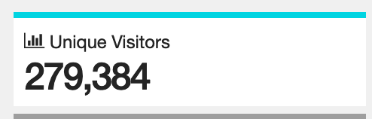
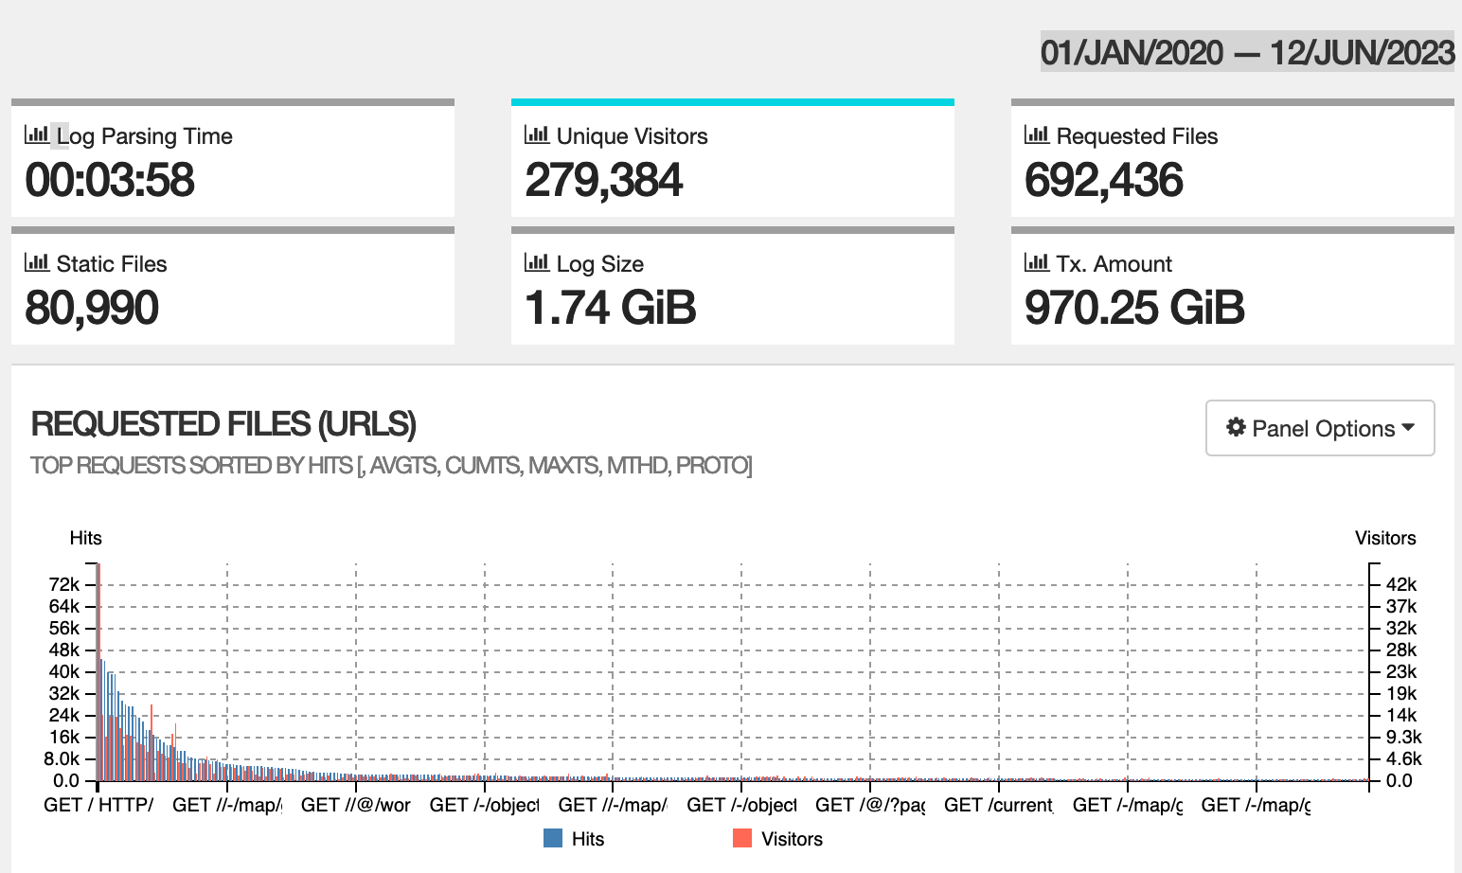
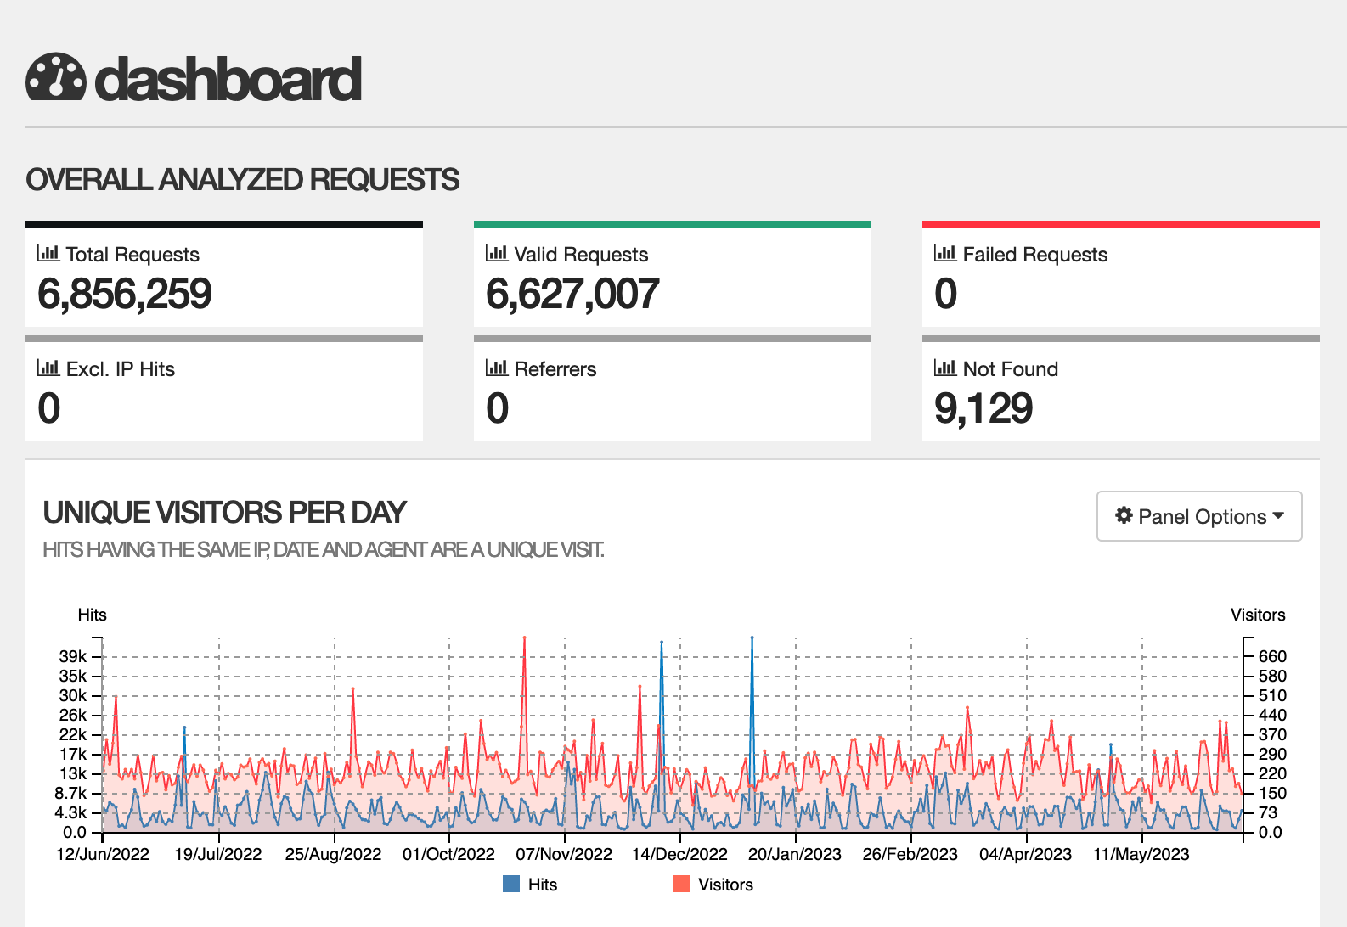
User Community 2020-2023

