Slide 1
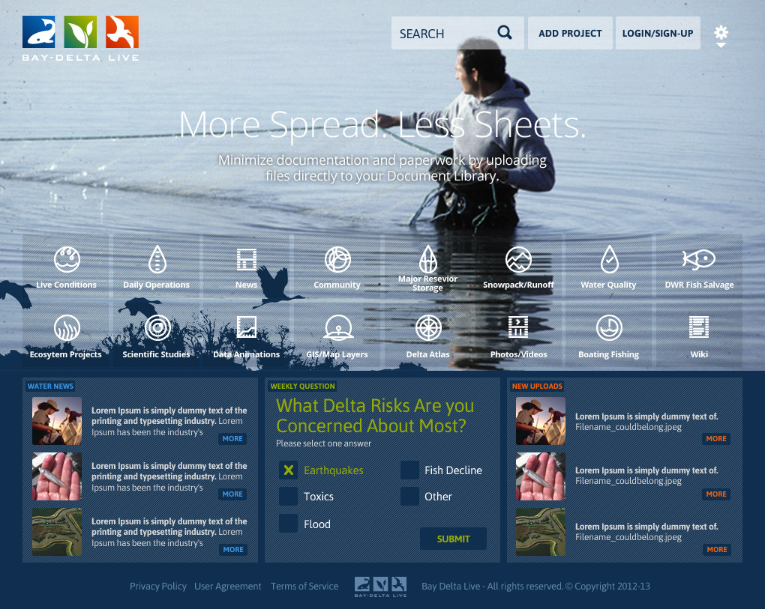

Notes:
Initial discussion about the effort historically
This effort began roughly five years ago when it was known that publically held databases existed in different locations throughout the state. With the assistance of our consultant (34 North), a web-based tool to access, analyze and visualize these databases was developed as www.baydeltalive.com.
Some of the databases that we are talking about include CDEC (California Data Exchange Center), CEDEN (Database for environmental information), IEP (Interagency Ecological Program), and databases from other agencies such as the USGS.
The website is robust enough to incorporate future databases that will, no doubt, be created as the BDCP and Habitat Restoration move into the implementation/construction phases.
I’m going to go over the benefits for this concept using the website and iphone applications and then show you a few examples of the tools that can be accessed through Bay-Delta Live.

Slide 2

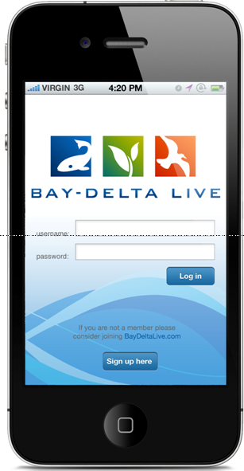
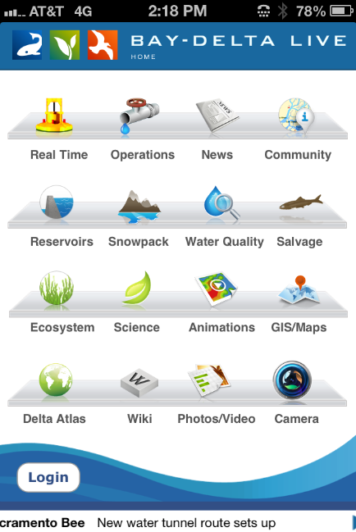
BAY-DELTA LIVE
One-stop easy access to data
Daylights data & studies not online
Future access to BDCP habitat restoration & implementation updates
Online collaborative science pages
Visual dashboard of project operations
Notes:
Serves multiple platforms (web site/iPhone, iPad application)
Design to organization’s specifications & needs
Collaborative capabilities (public/secured)
Maintain full control over data (secured/unsecured)
SLDMWA
View daily operational decisions
Query existing station real-time data
Discuss/view same data with others
Develop/Manage Project Pages
Other uses

Slide 3









Irrigated Lands Regulatory Program
DATABASES

Slide 4
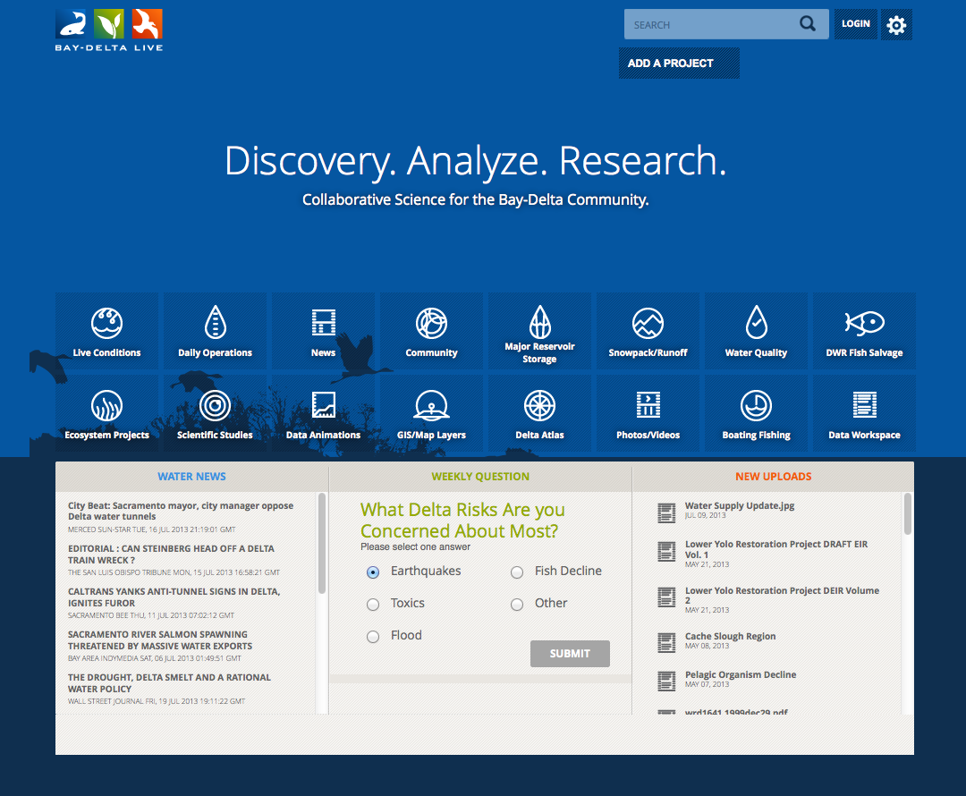
www.baydeltalive.com
Notes:
Telling the story of a complicated system.
Interpreting results to managers and stakeholders
Easily share data stories, project data, monitoring results, document libraries, interactive maps and datasets.

Slide 5
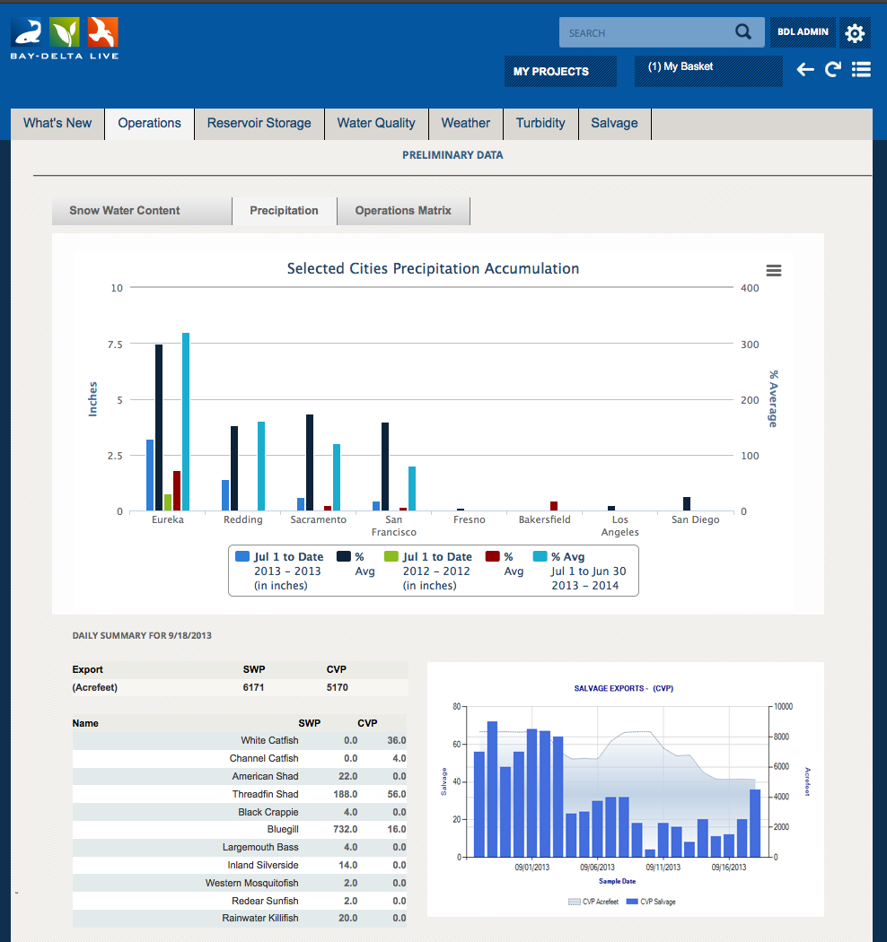

OPERATIONS DASHBOARD

Slide 6
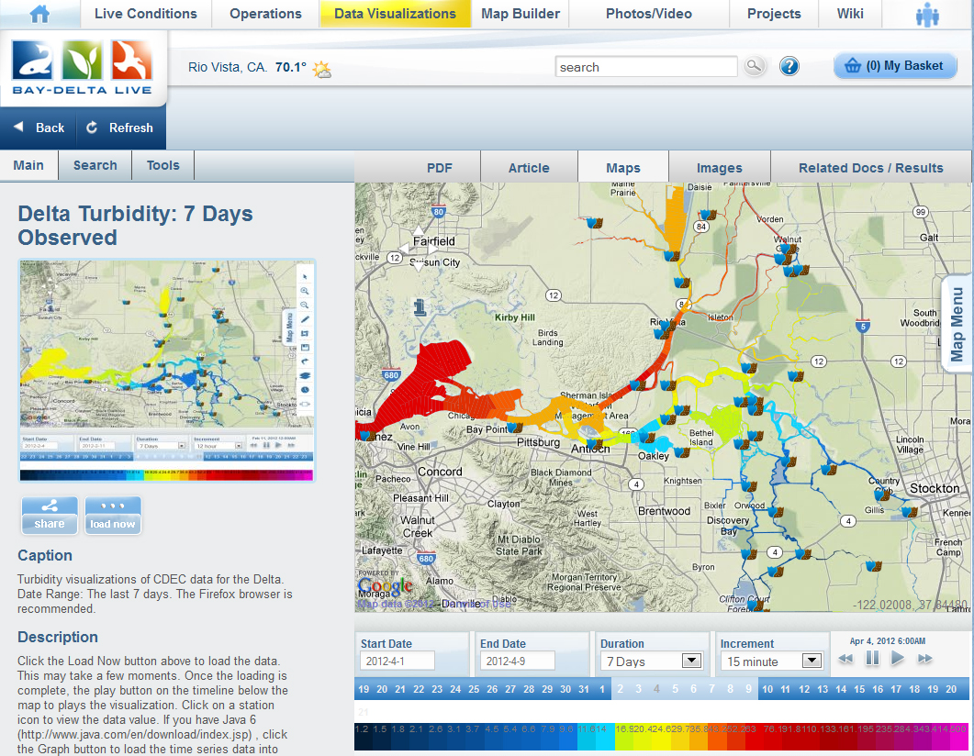
OPERATIONS DASHBOARD

Slide 7
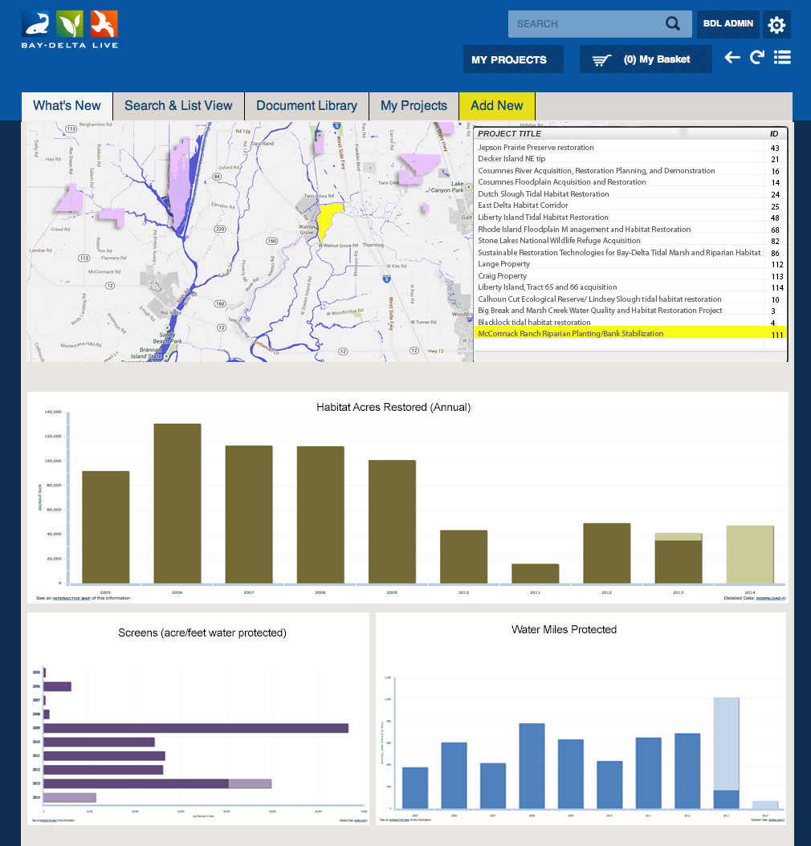
PROJECTS DASHBOARD

Slide 8
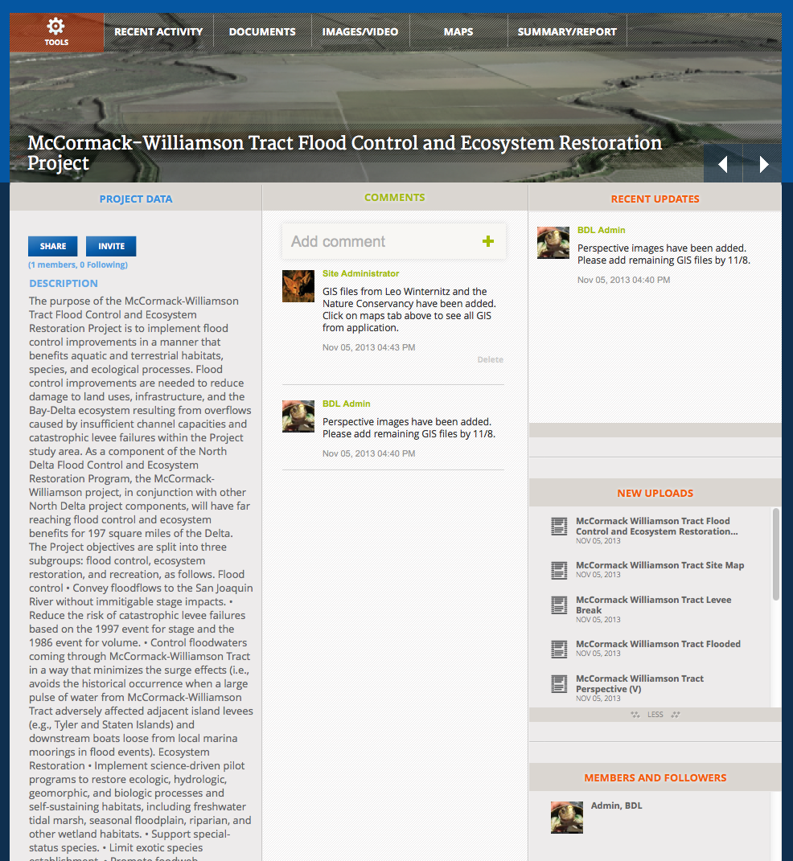
COLLABORATIVE

Slide 9
COLLABORATIVE

Slide 10
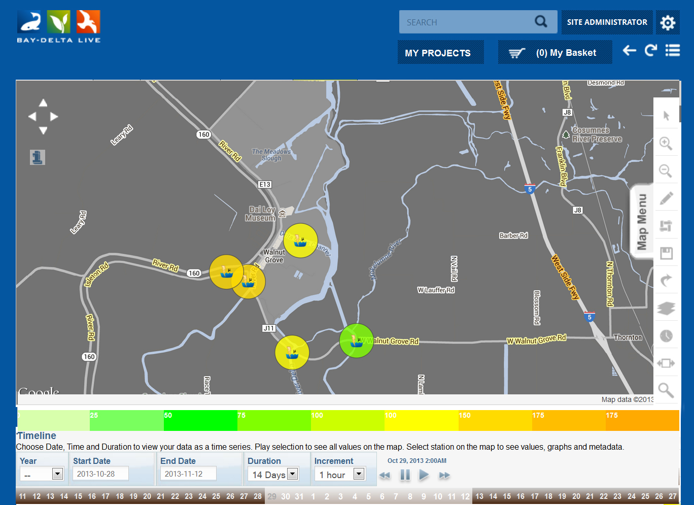
COLLABORATIVE

Slide 11
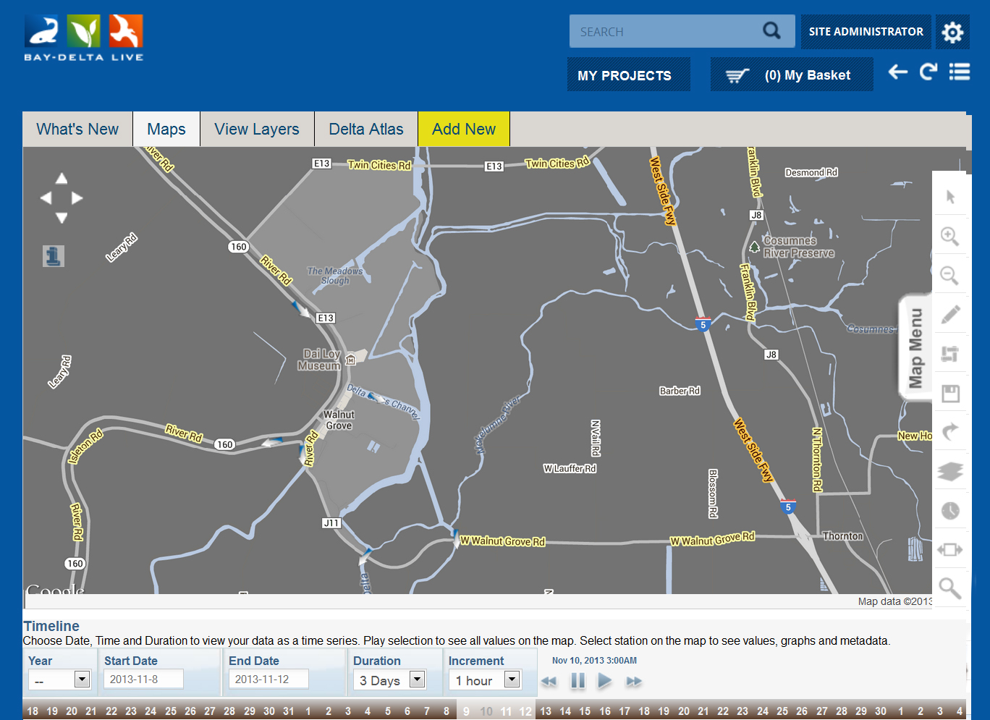
COLLABORATIVE

Slide 12
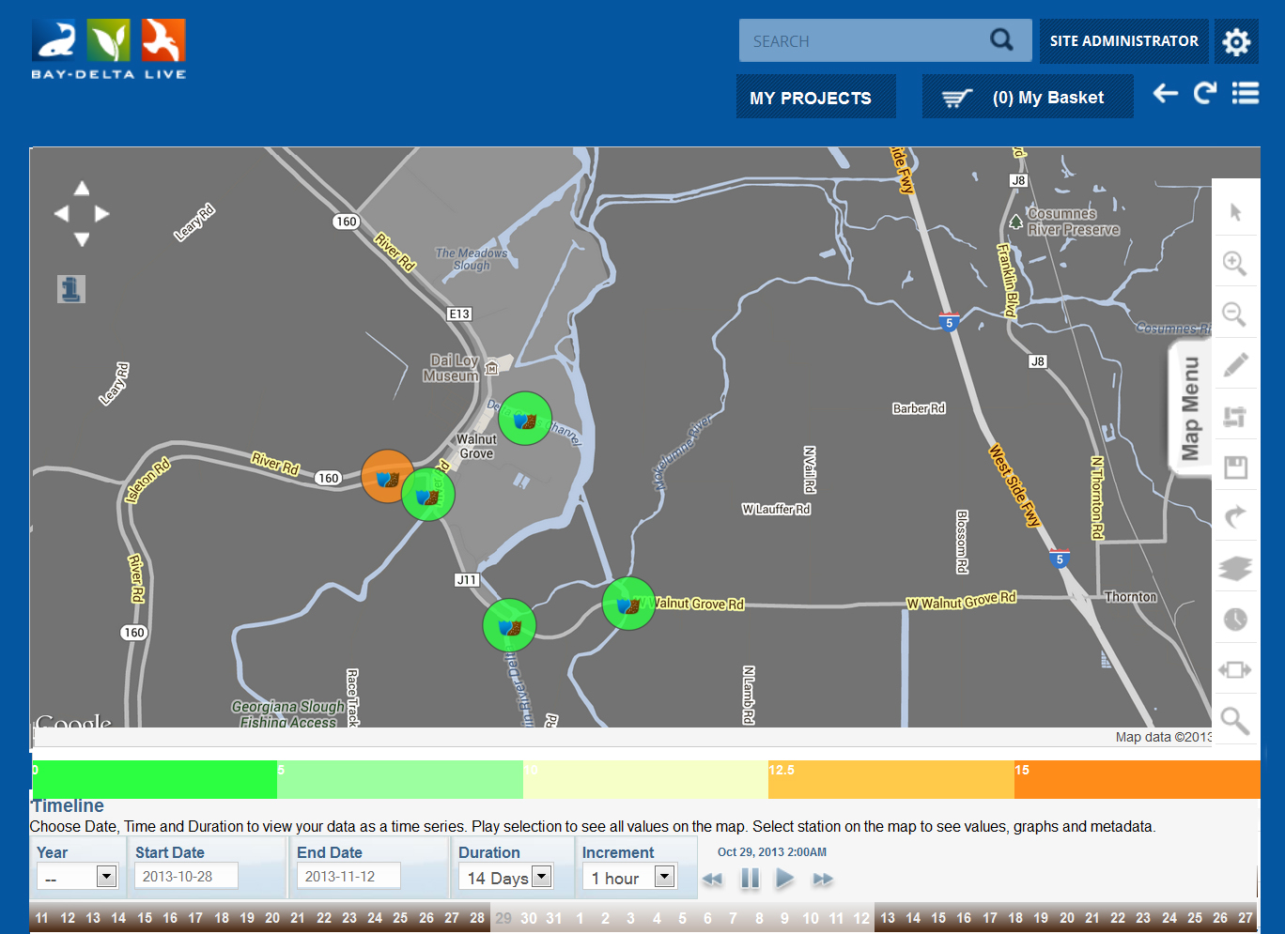
COLLABORATIVE

Slide 13
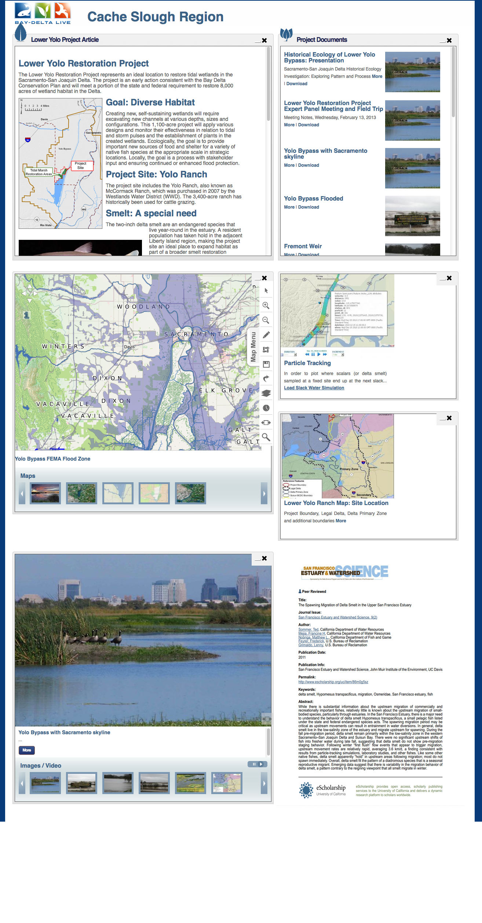
CUSTOM DASHBOARDS

Slide 14
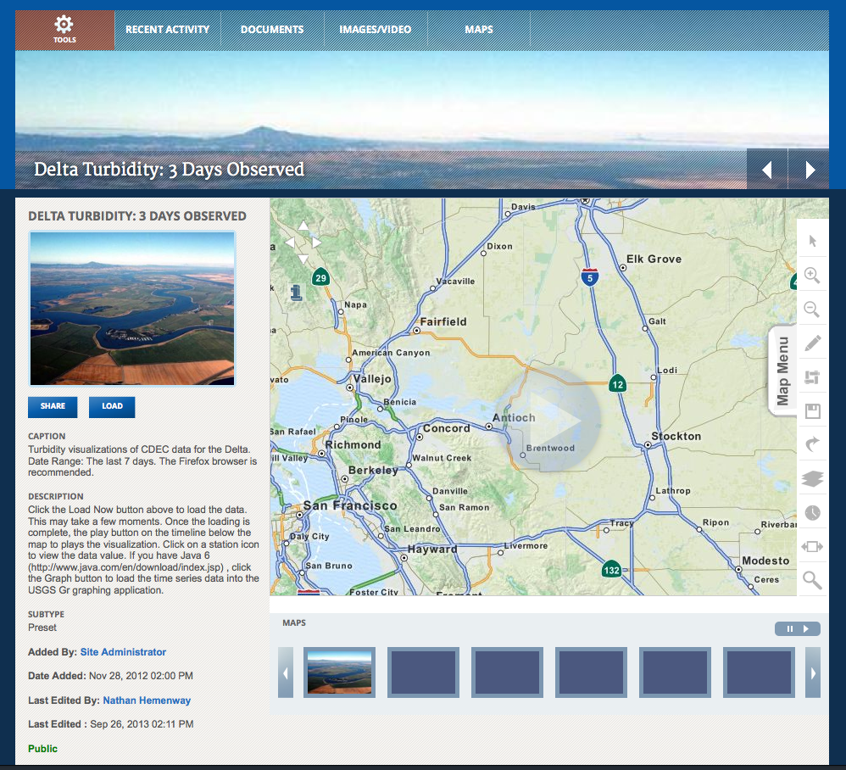
DATA ANALYSIS

Slide 15
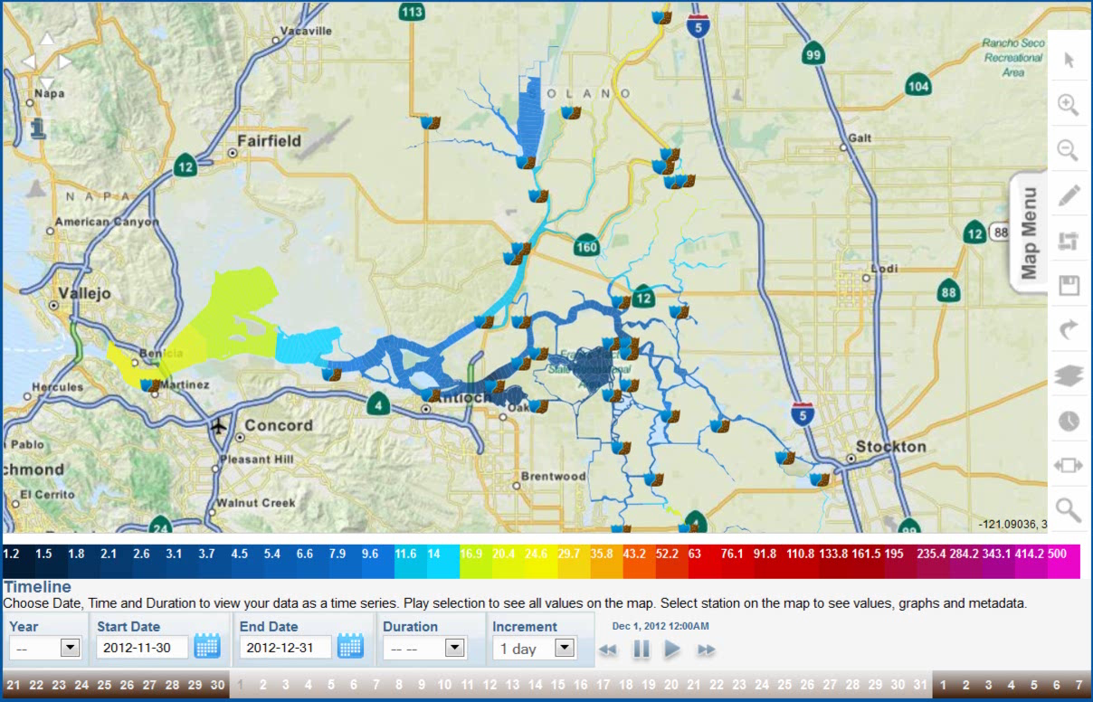
DATA ANALYSIS

Slide 16
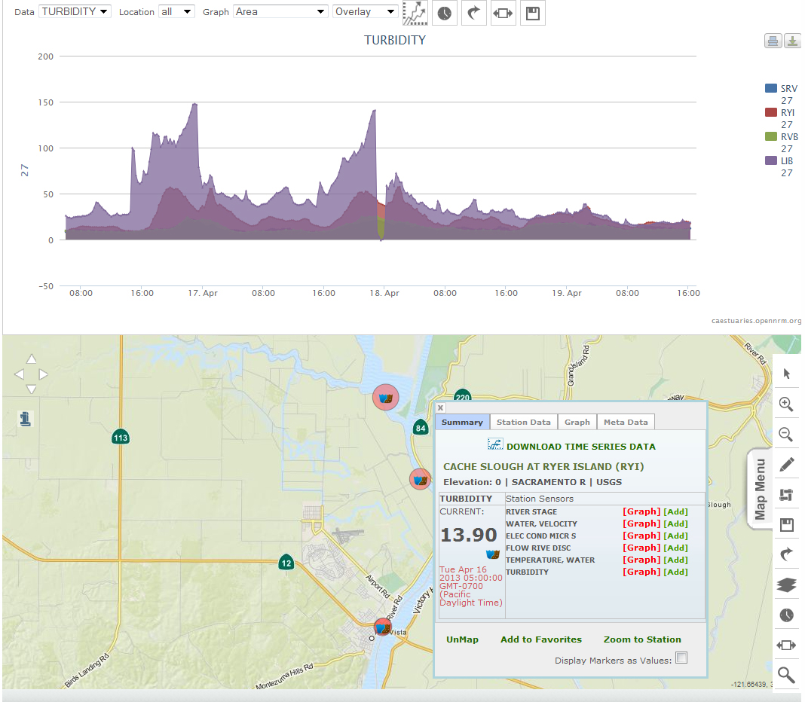
DETAILED DATA PICTURES

Slide 17
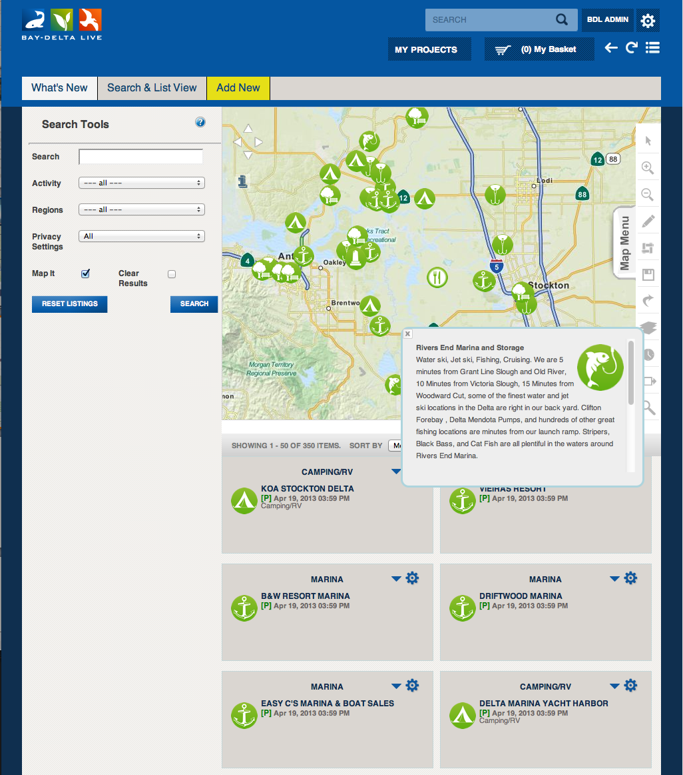
DELTA COMMUNITY

Slide 18
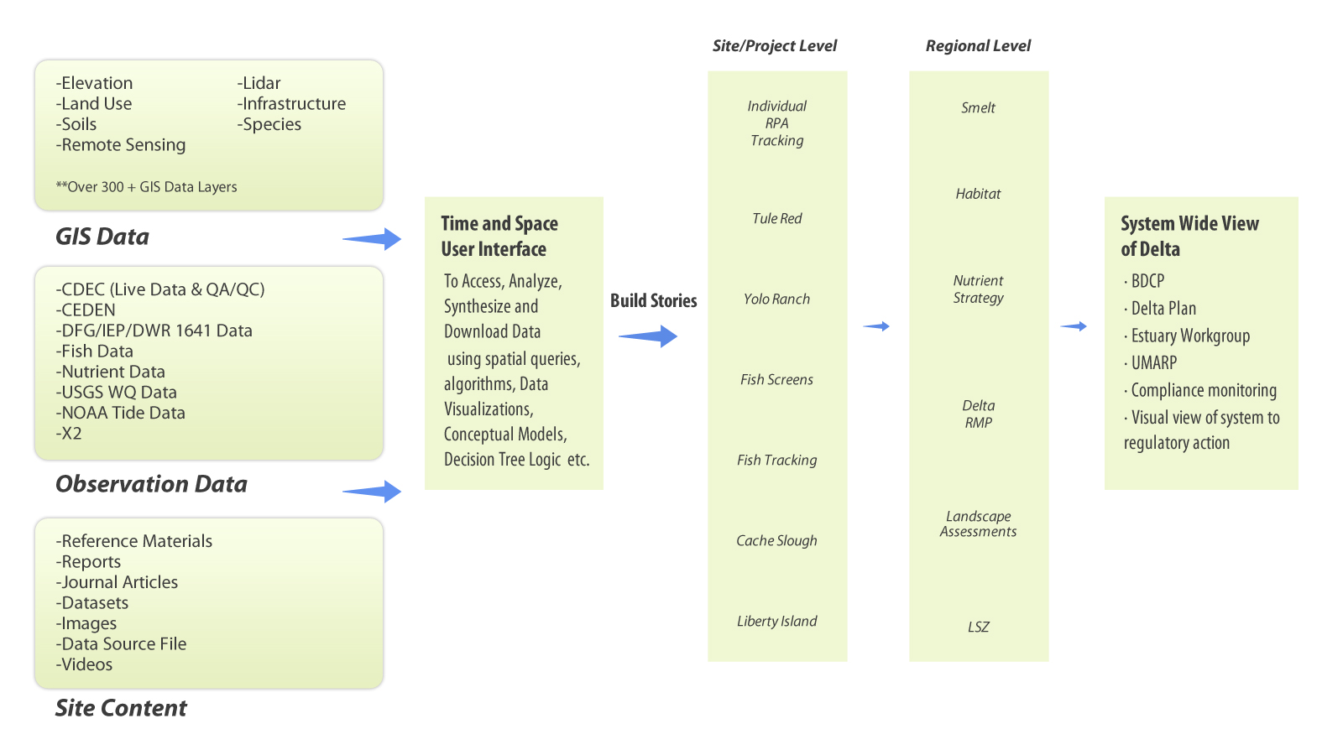
BAY-DELTA LIVE
Project Management Tool

Slide 19
Visit …
iPhone App Store
www.BayDeltaLive.com

