Slide 1
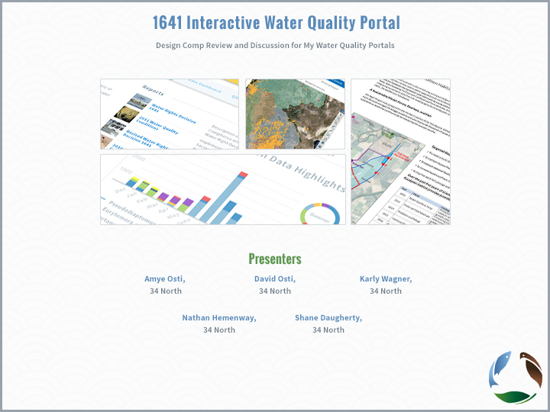

Slide 2
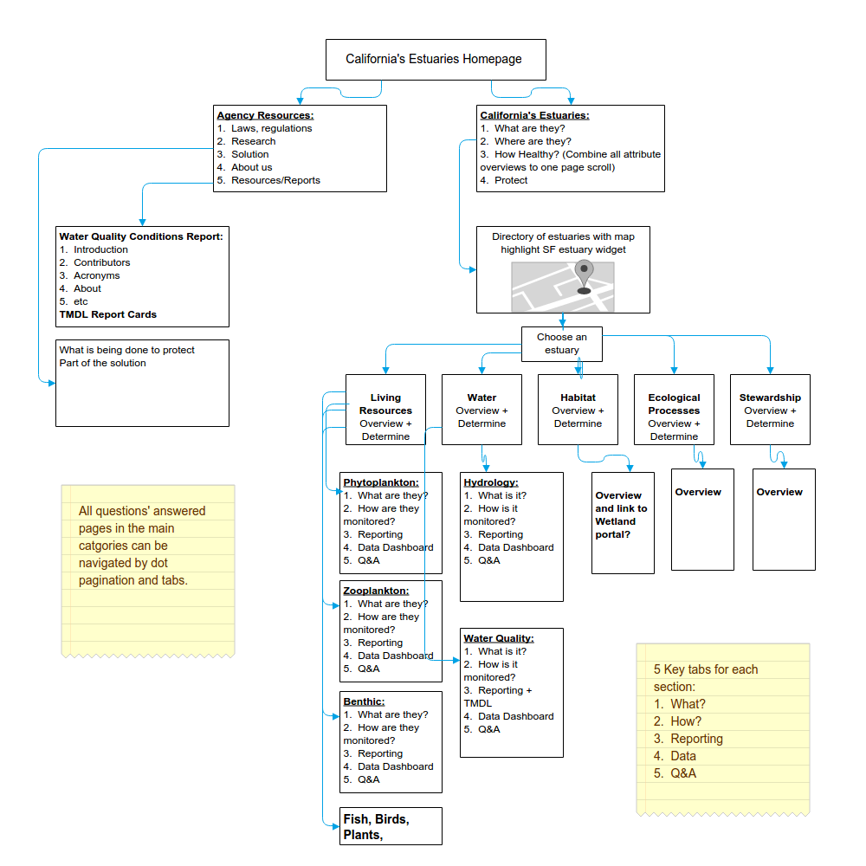
Design 1: Portal Site Map

Slide 3
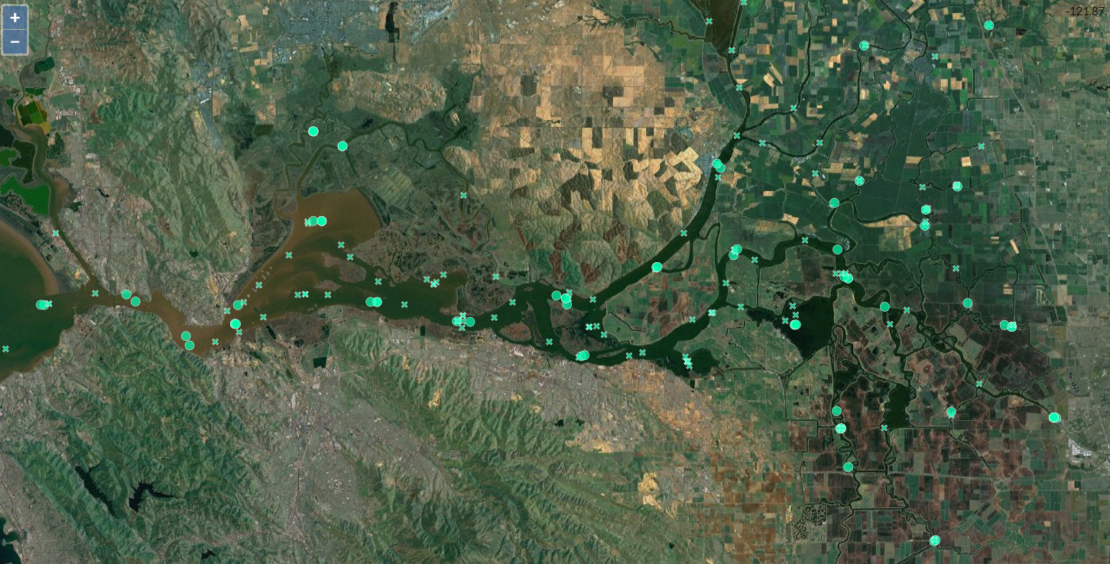
EMP: All Stations
SRWP: Projects

Slide 4
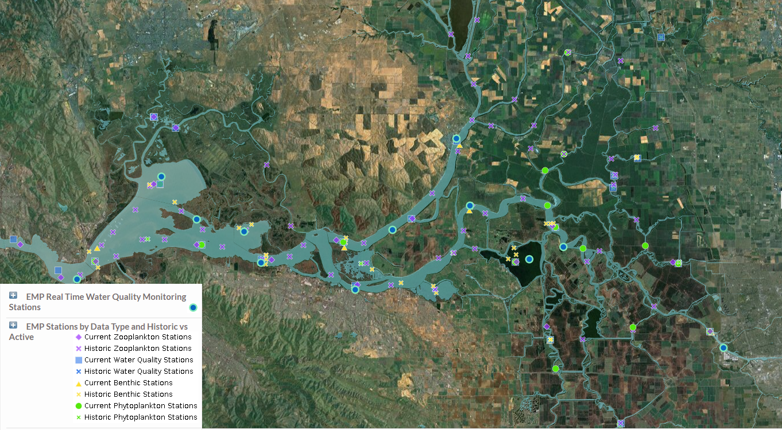
EMP: All Stations

Slide 5
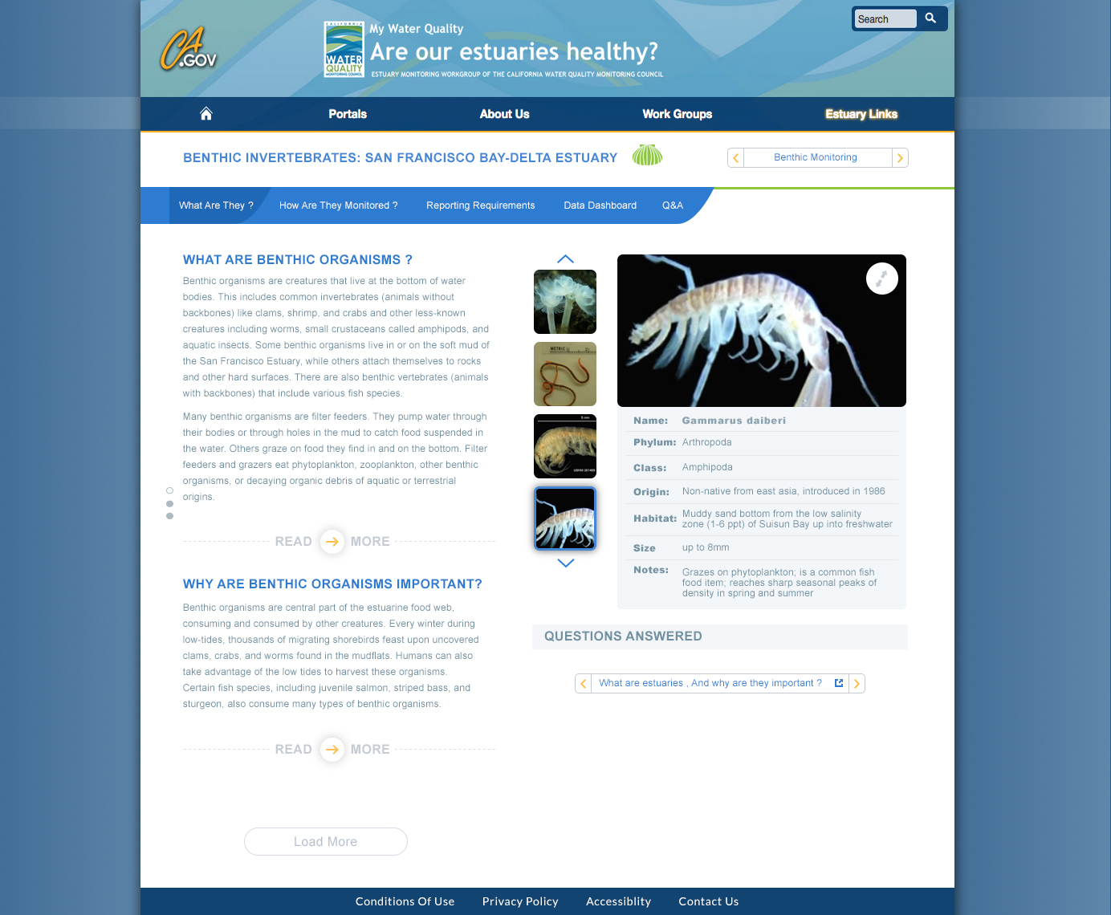
Design 1: Benthic What? (A)
Notes:
Set up a species database for the viewer widget

Slide 6
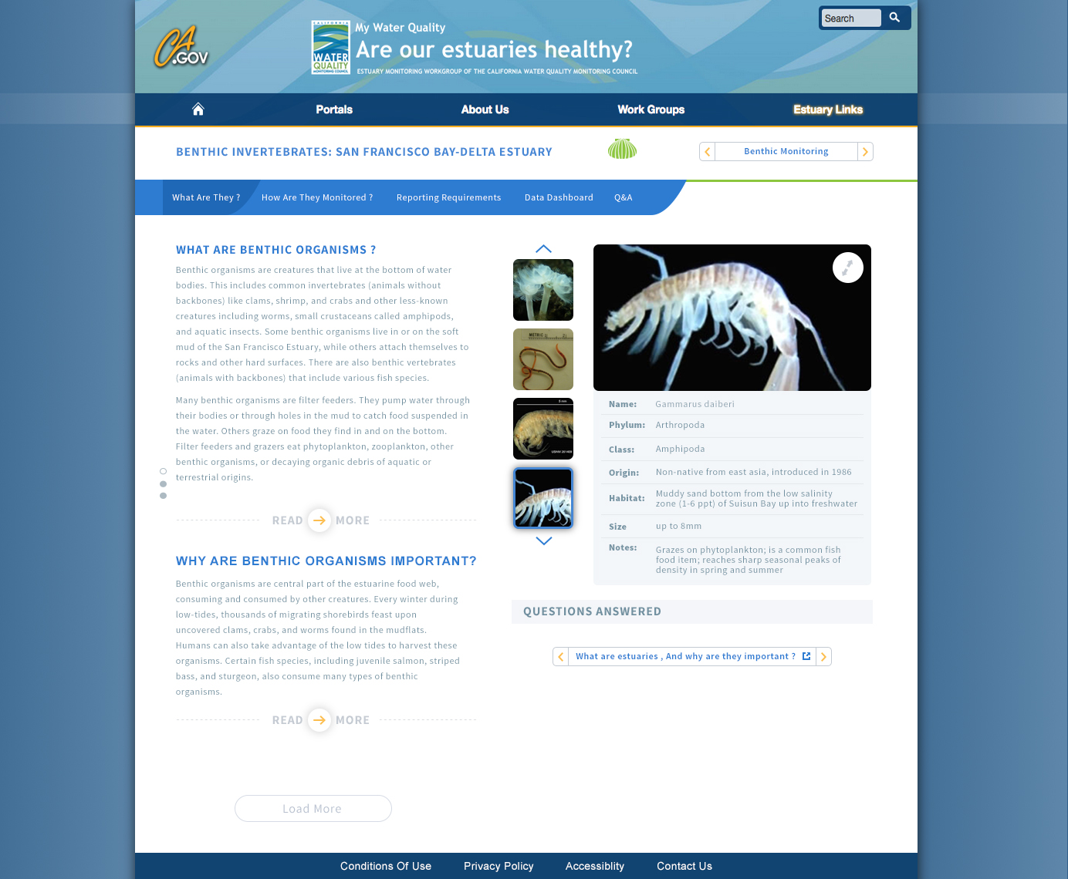
Design 1: Benthic What? (P)
Notes:
Set up a species database for the viewer widget

Slide 7
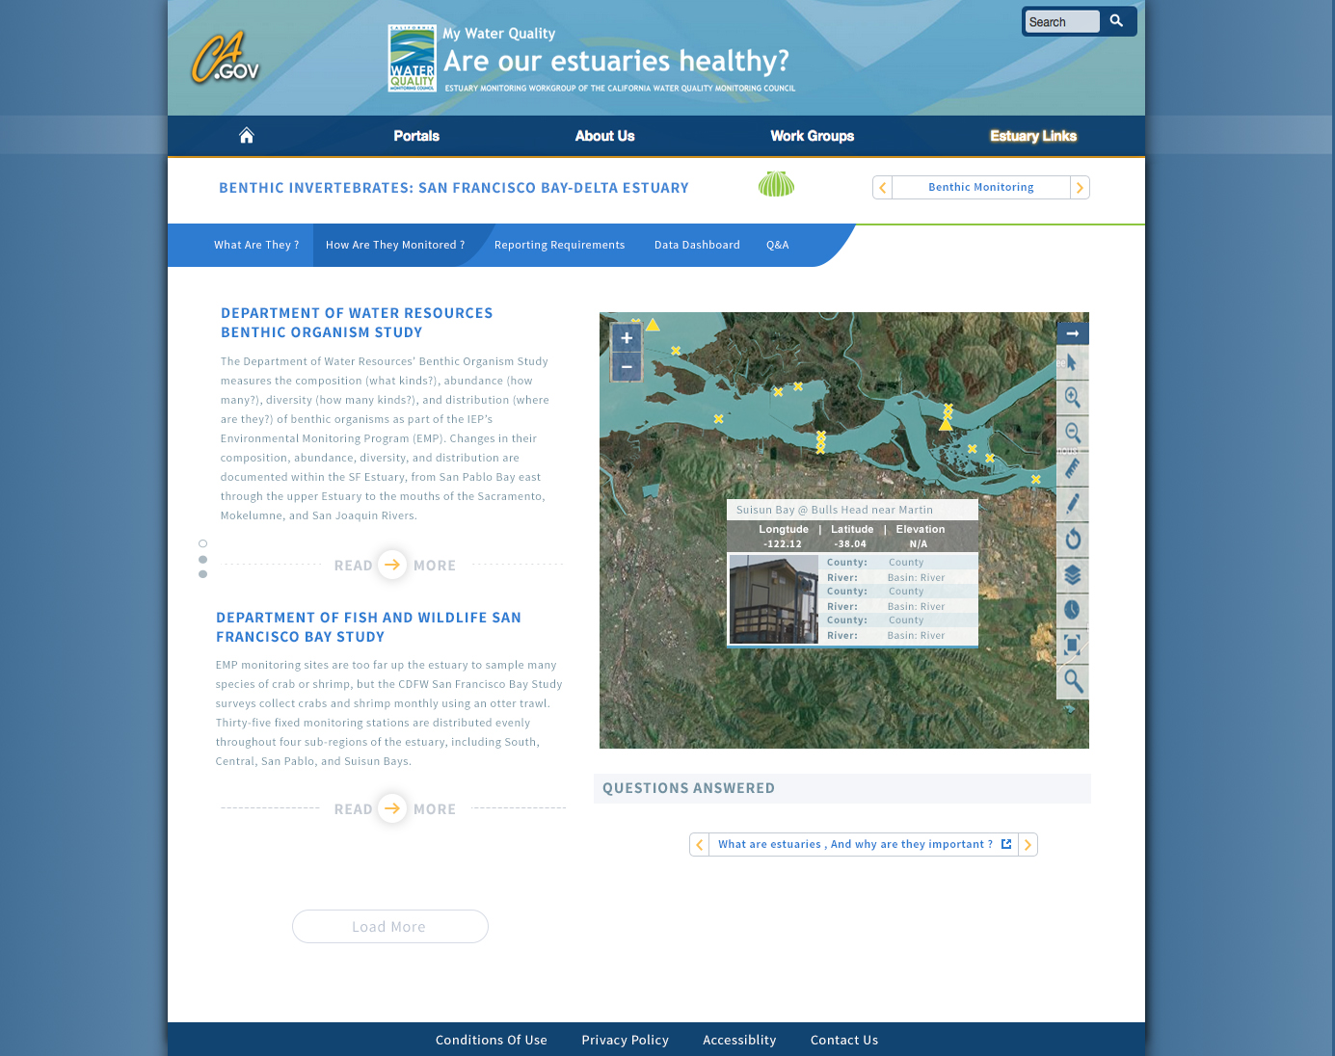
Design 1: Benthic How?

Slide 8
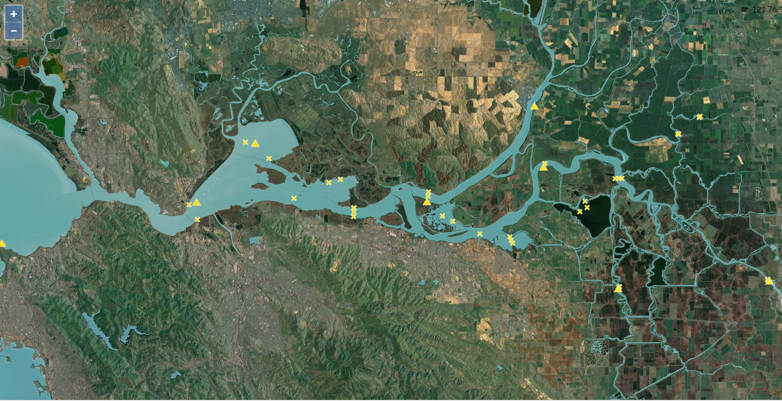
EMP: Benthic

Slide 9
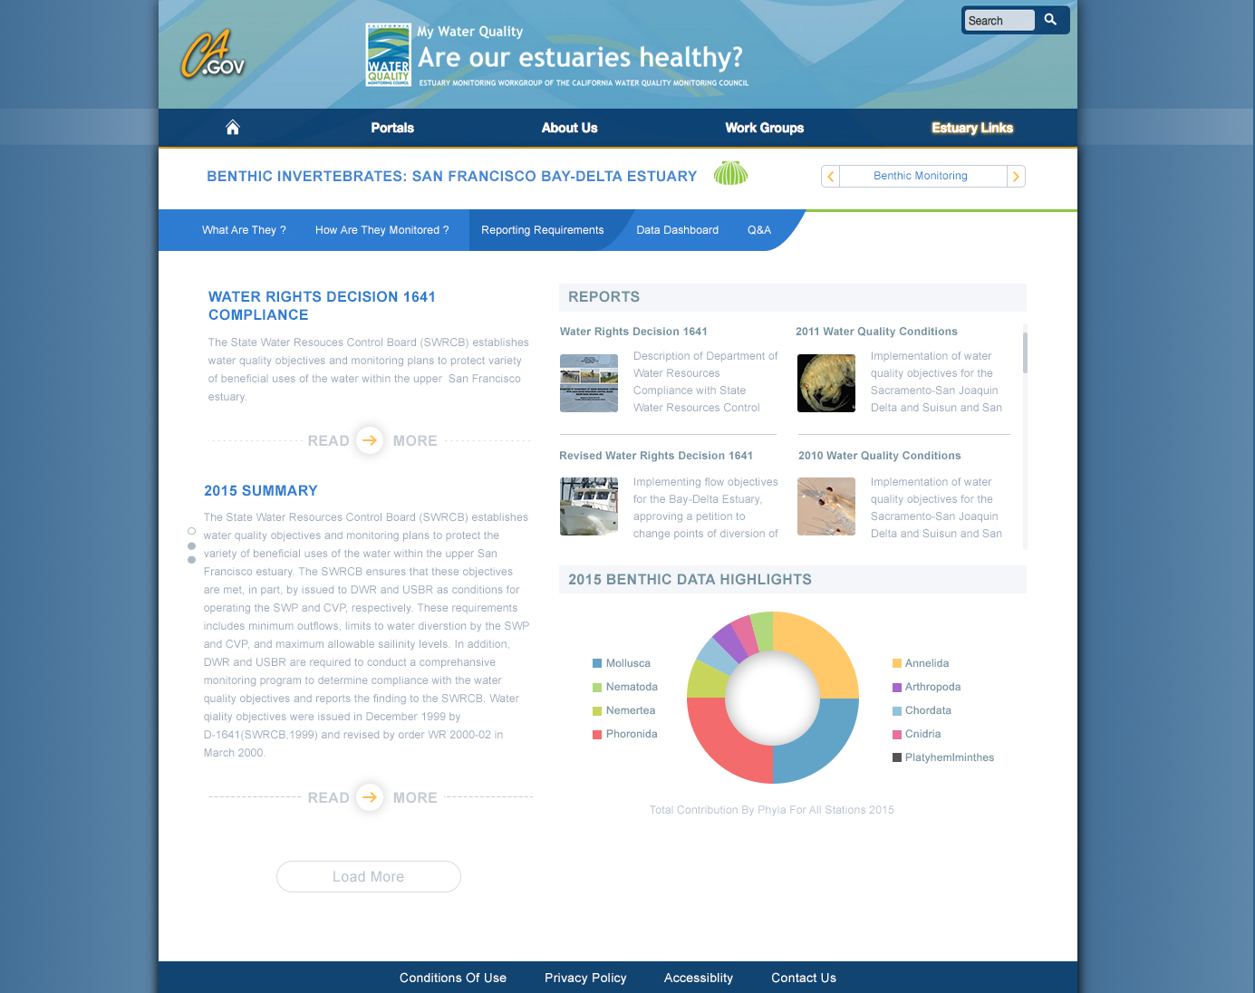
Design 1: Benthic Reporting? (PS)
Notes:
Pro-Source Sans

Slide 10

Design 1: Benthic Reporting (A)
Notes:
Arial

Slide 11
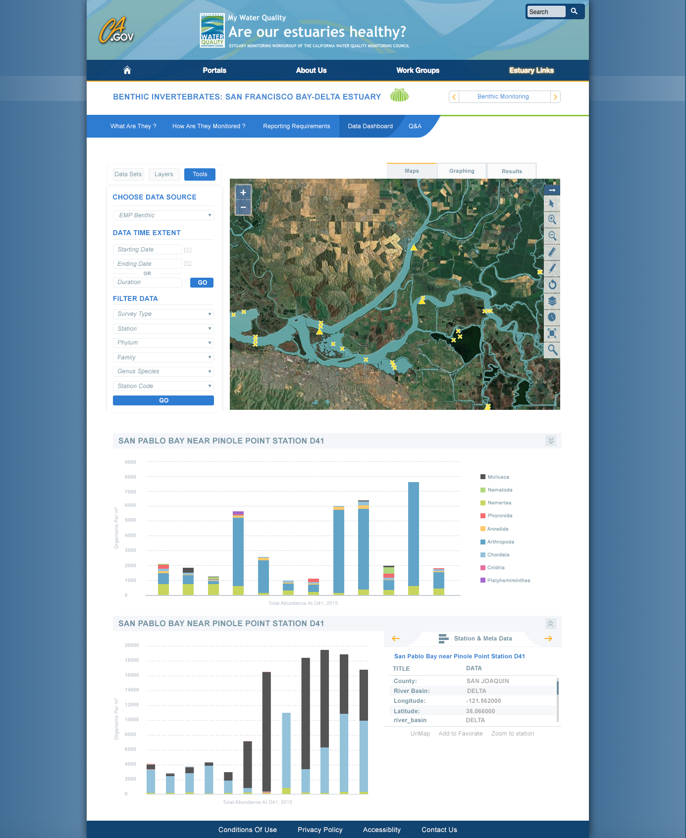
Design 1: Benthic Dashboard

Slide 12
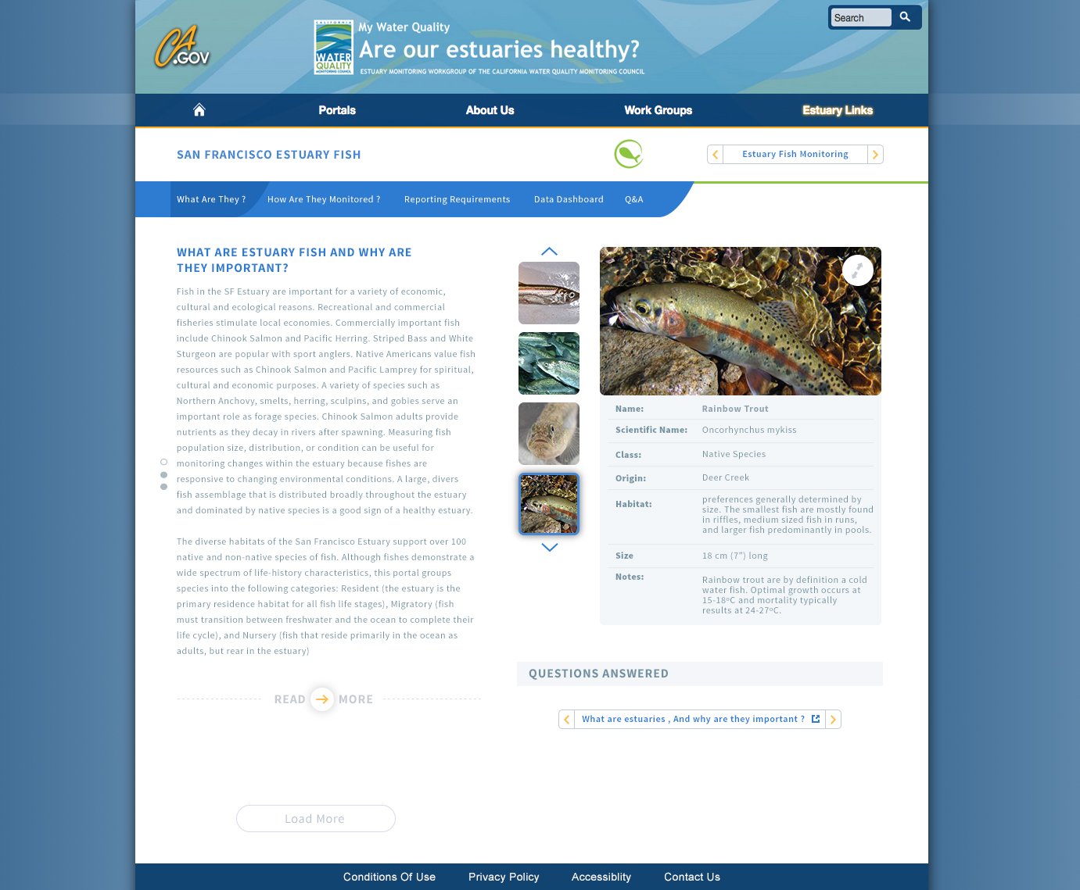
Design 1: Fish What?

Slide 13
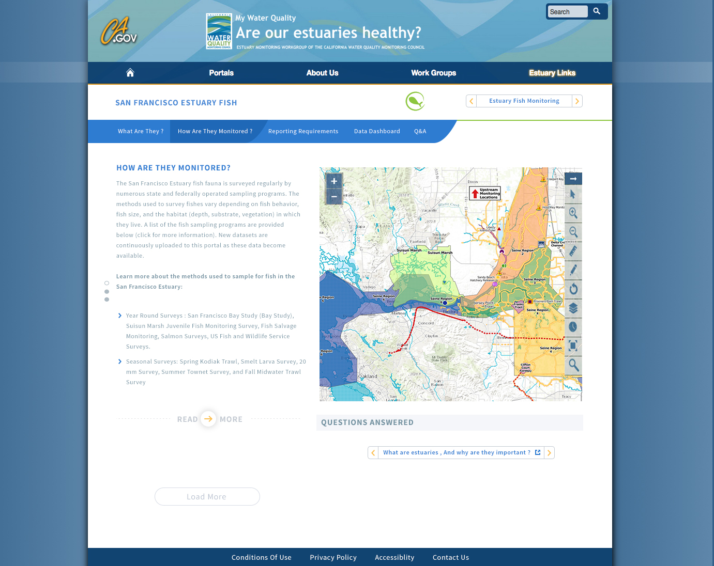
Design 1: Fish How?

Slide 14
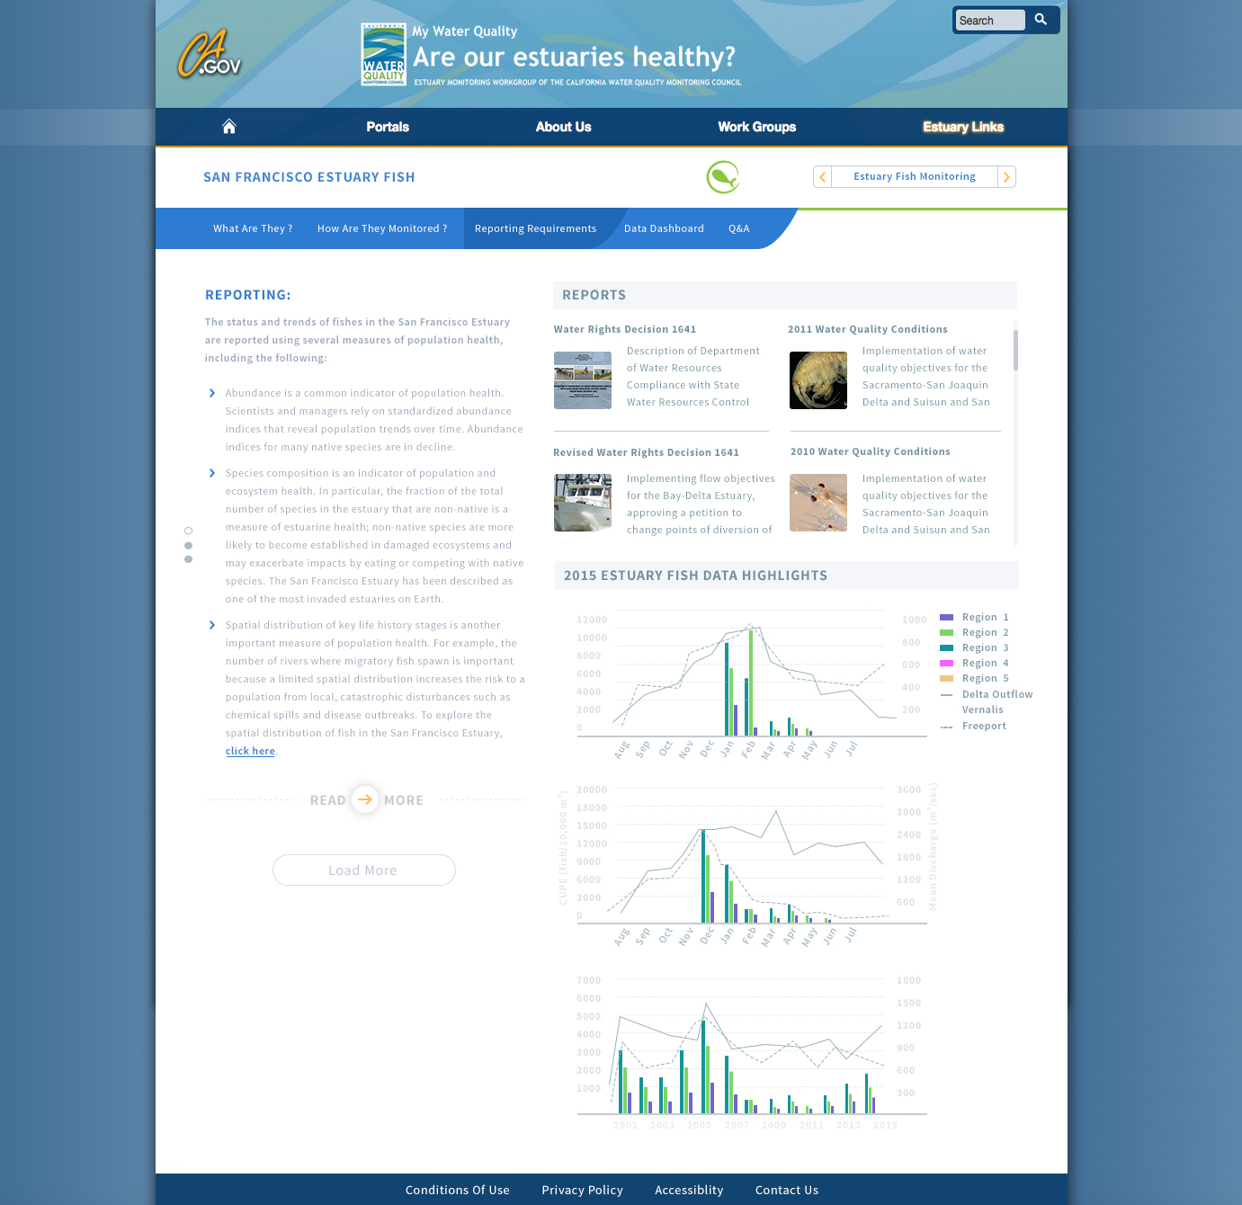
Design 1: Fish Reporting?

Slide 15
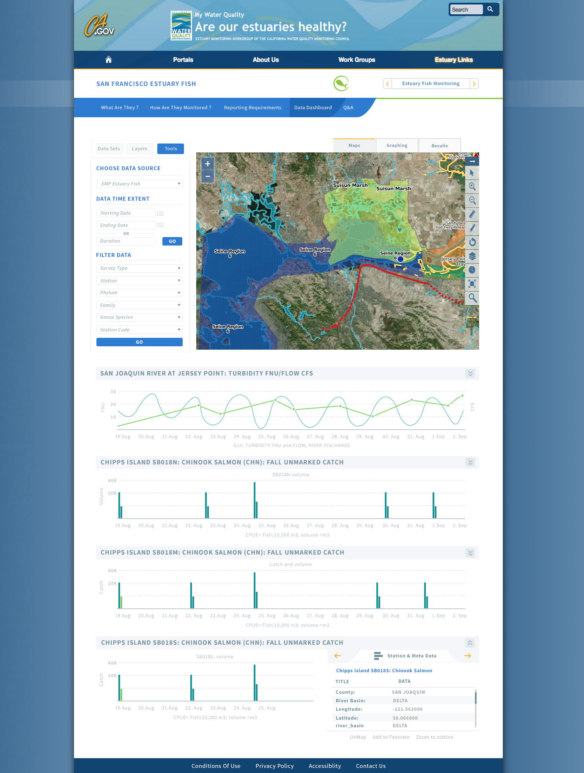
Design 1: Dashboard

Slide 16
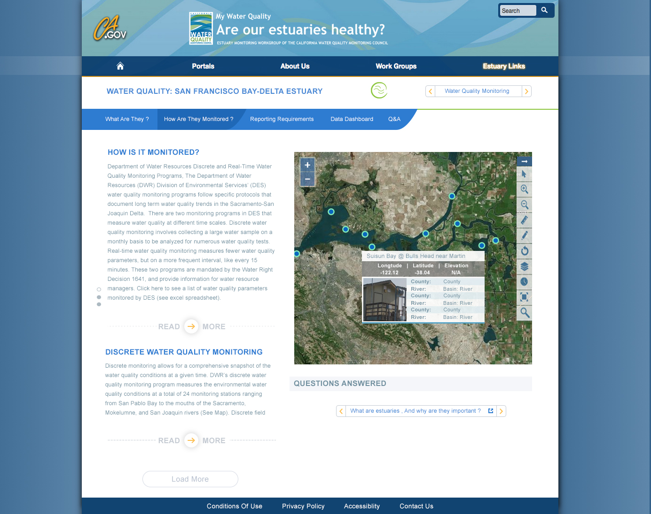
Design 1: WQ How?

Slide 17
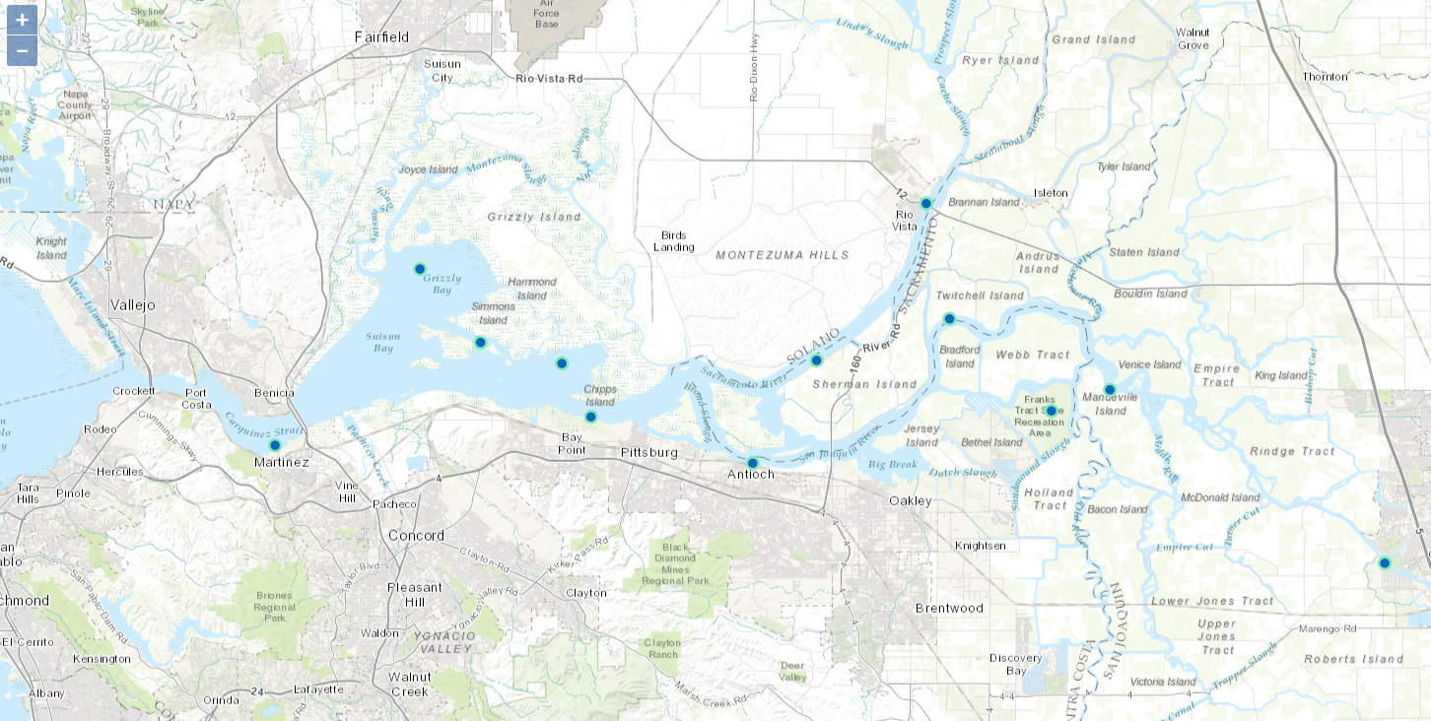
EMP: Water Quality

Slide 18
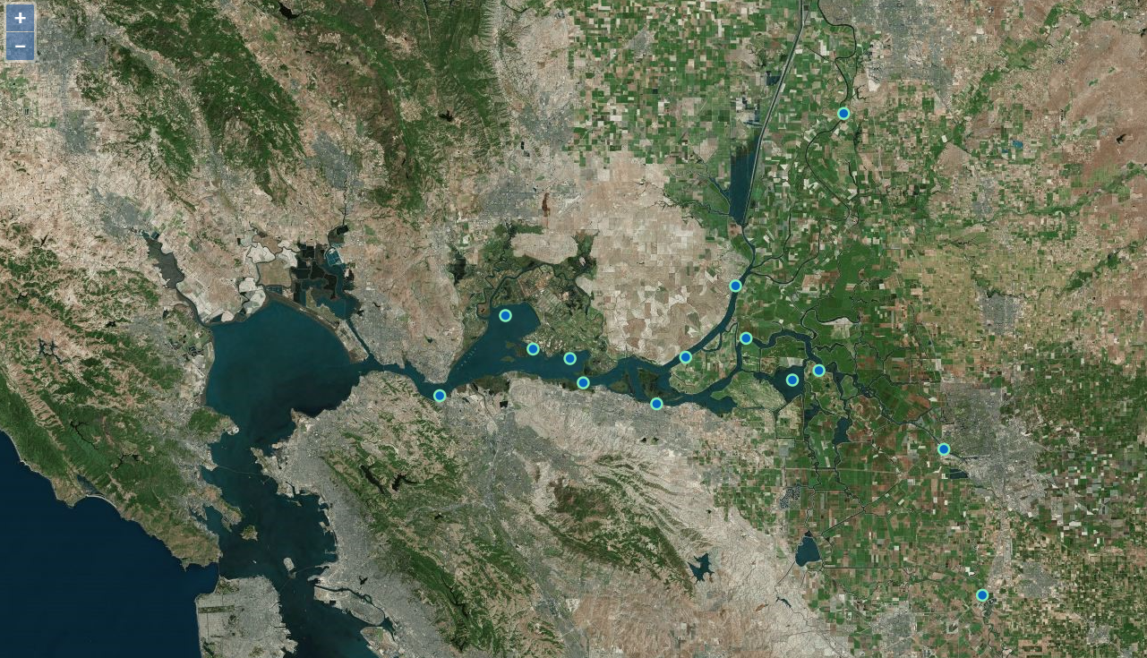
EMP: Continuous WQ

Slide 19
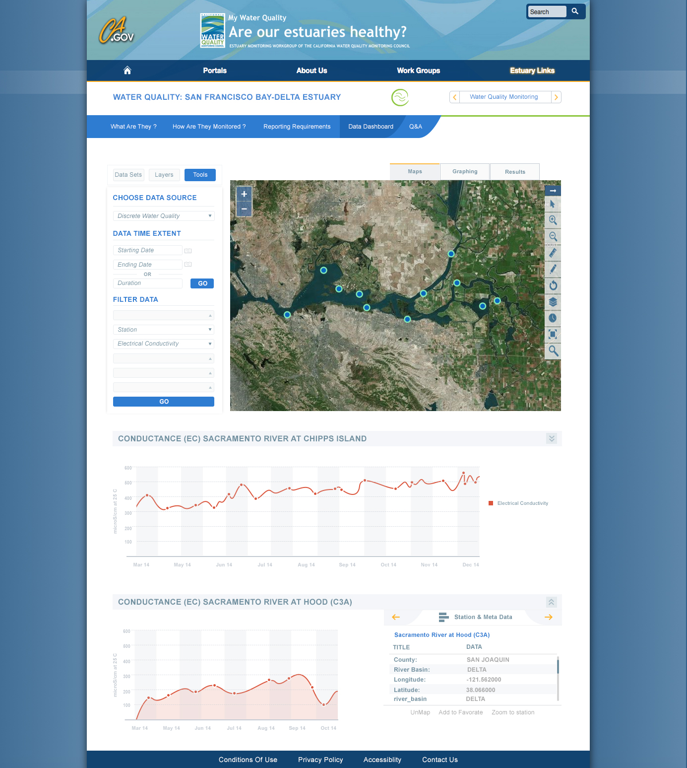
Design 1: WQ Dashboard?

Slide 20
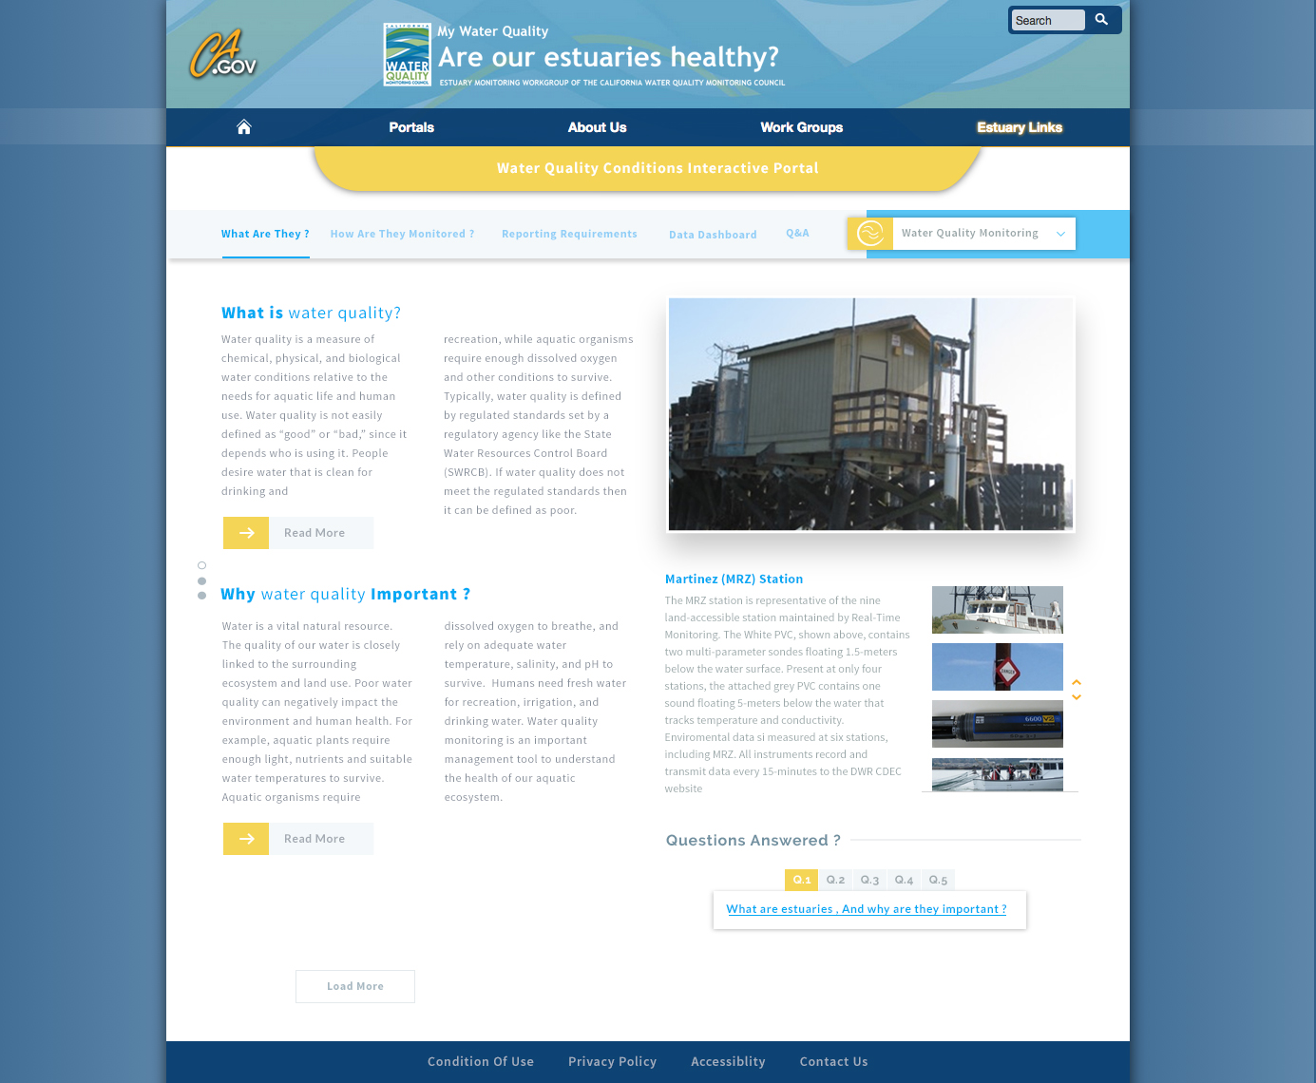
Design 2: WQ What?

Slide 21
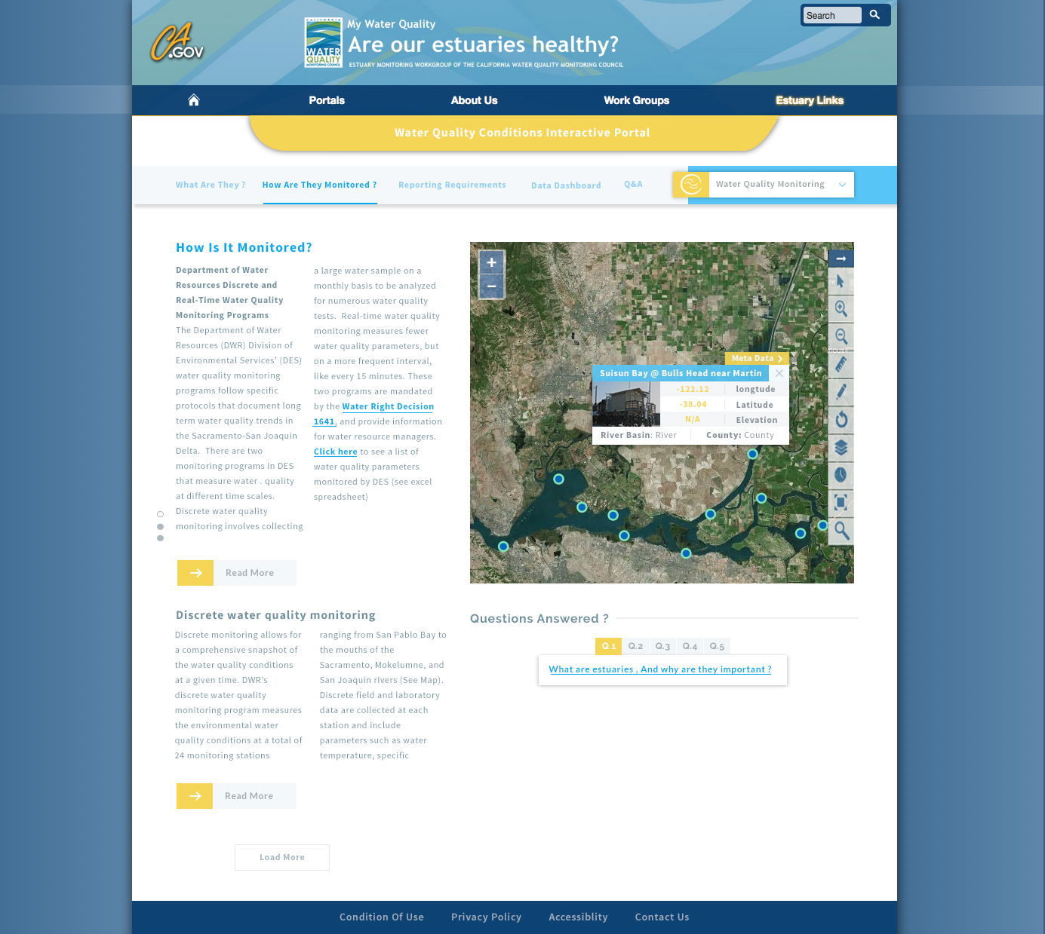
Design 2: WQ How?

Slide 22
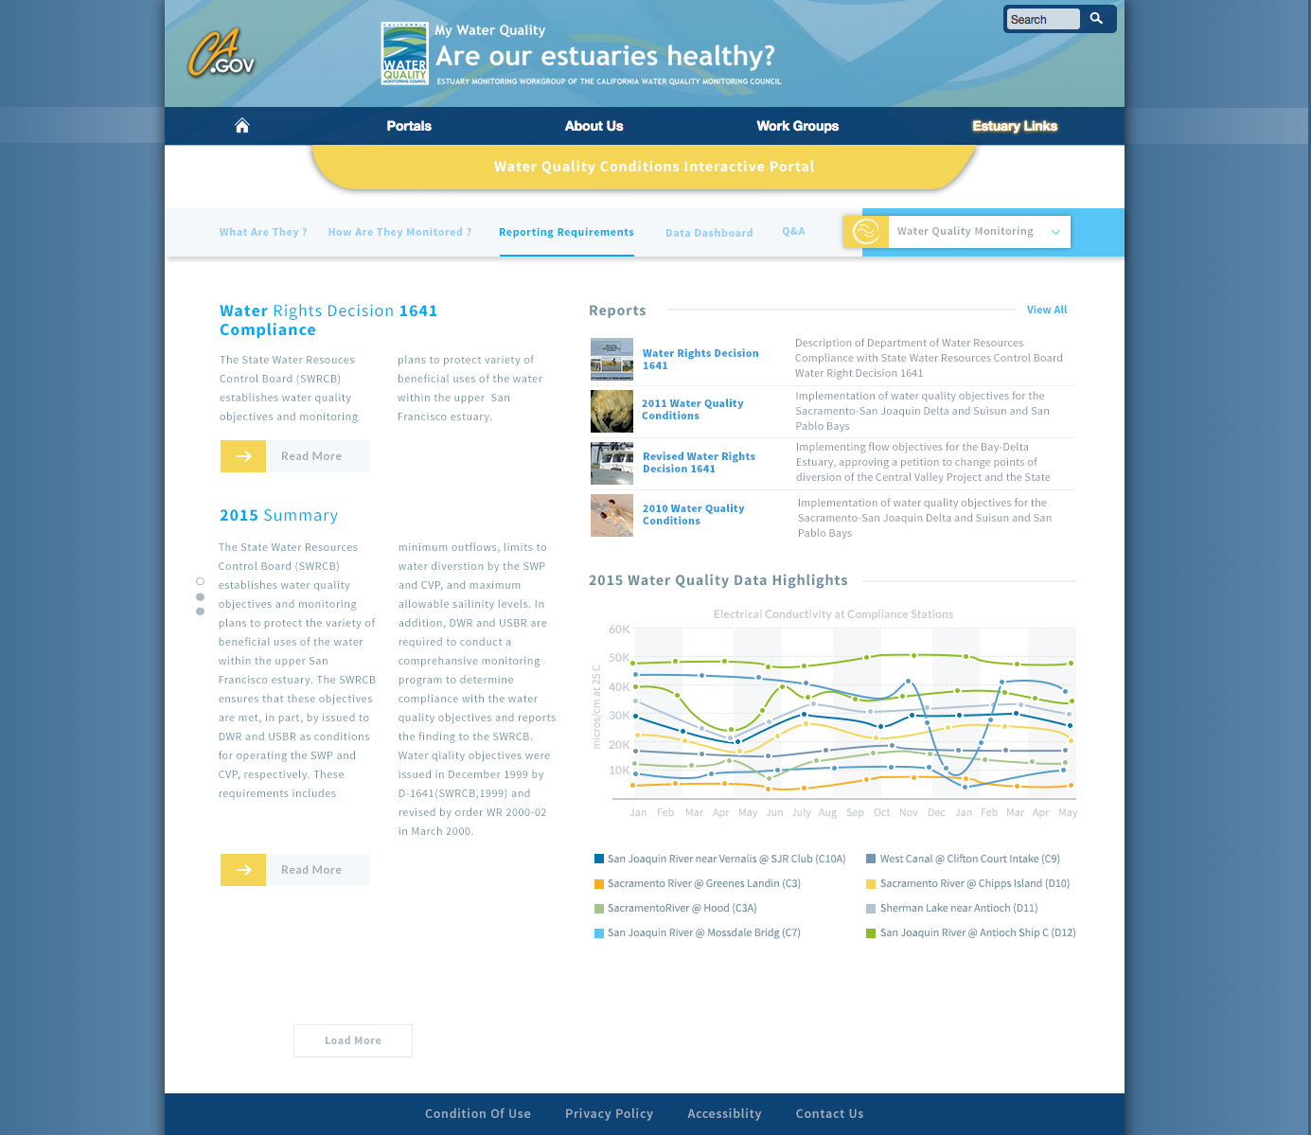
Design 2: WQ Reporting?

Slide 23
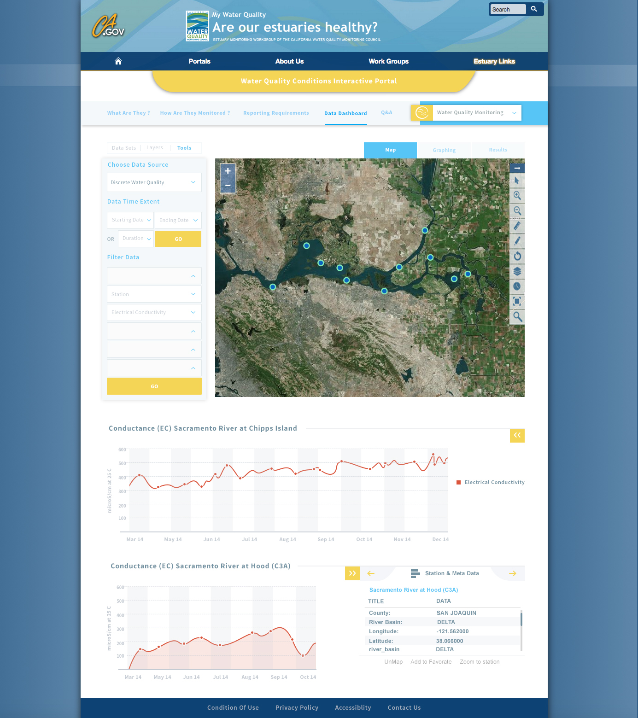
Design 2: WQ Dashboard?

Slide 24
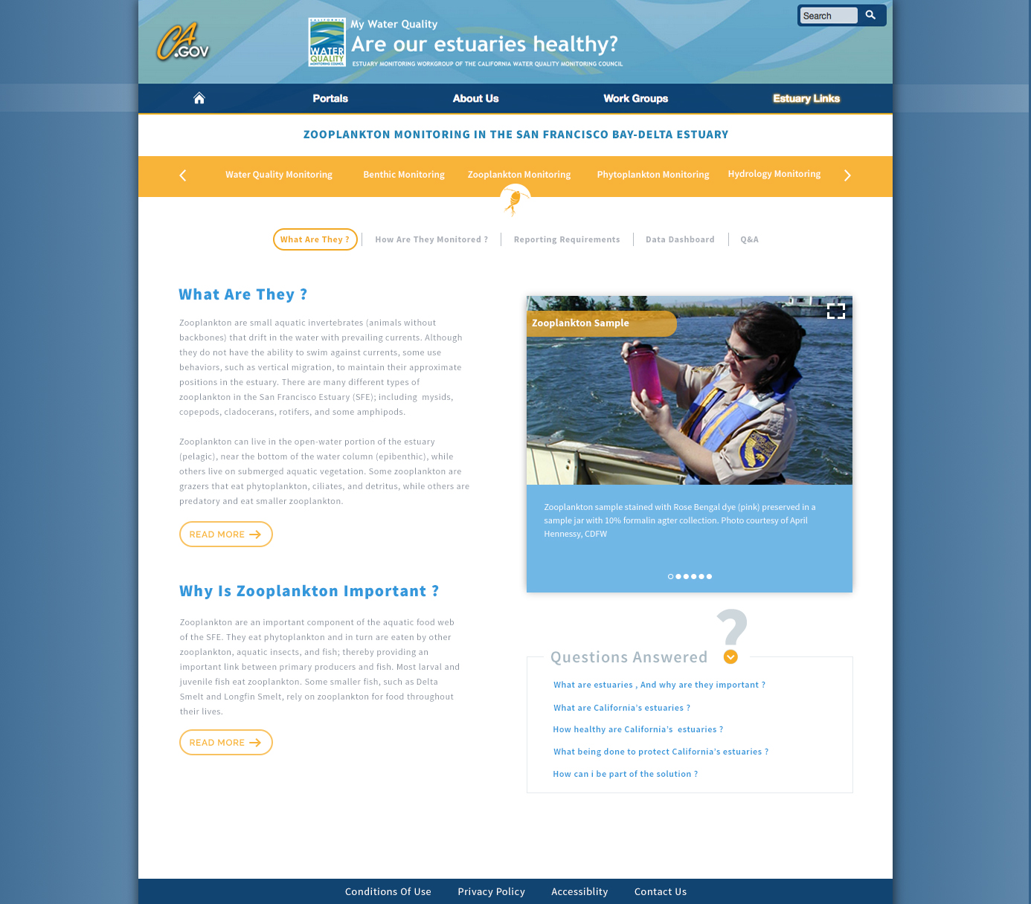
Design 3: Zooplankton What?

Slide 25
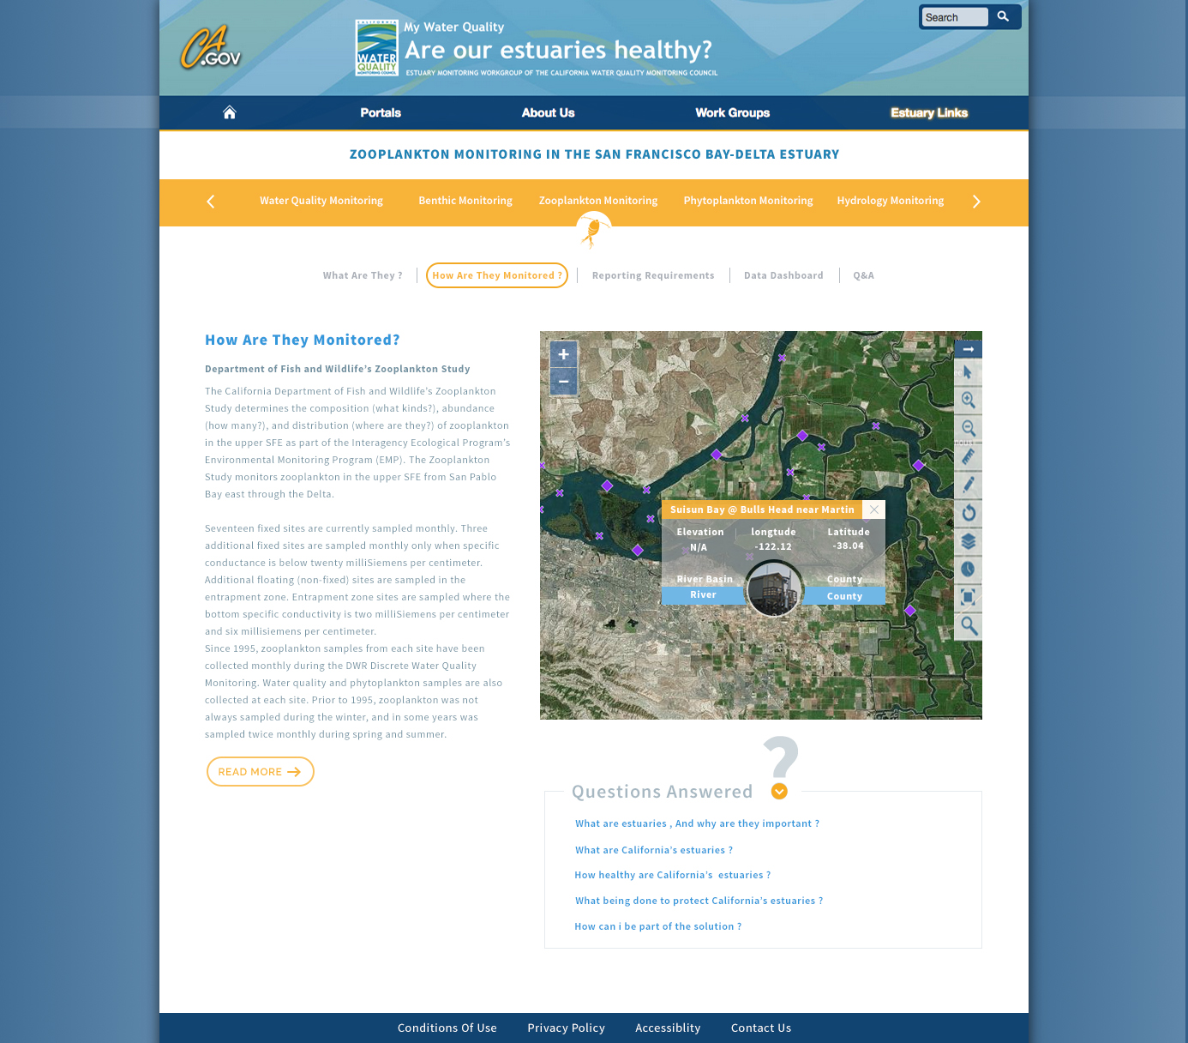
Design 3: Zooplankton How?

Slide 26
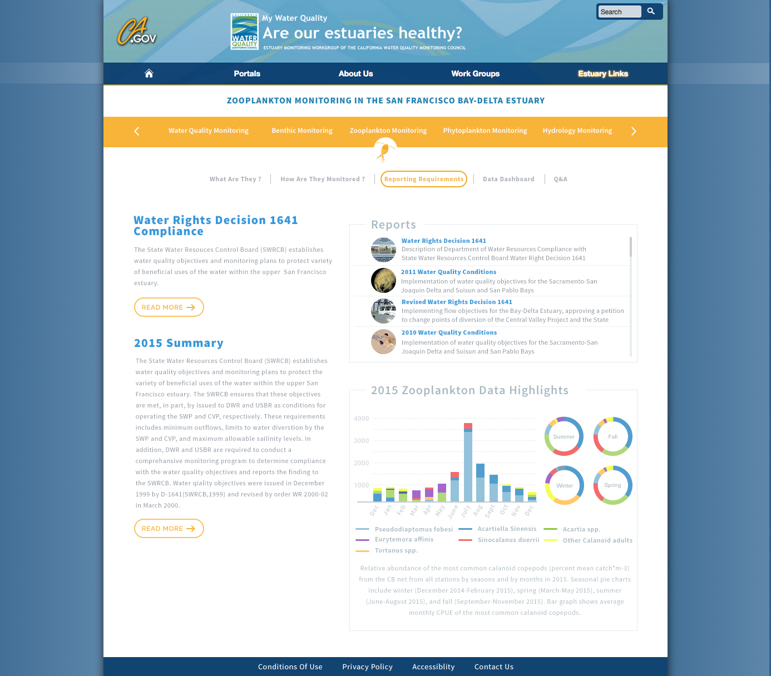
Design 3: Zooplankton Reporting?

Slide 27
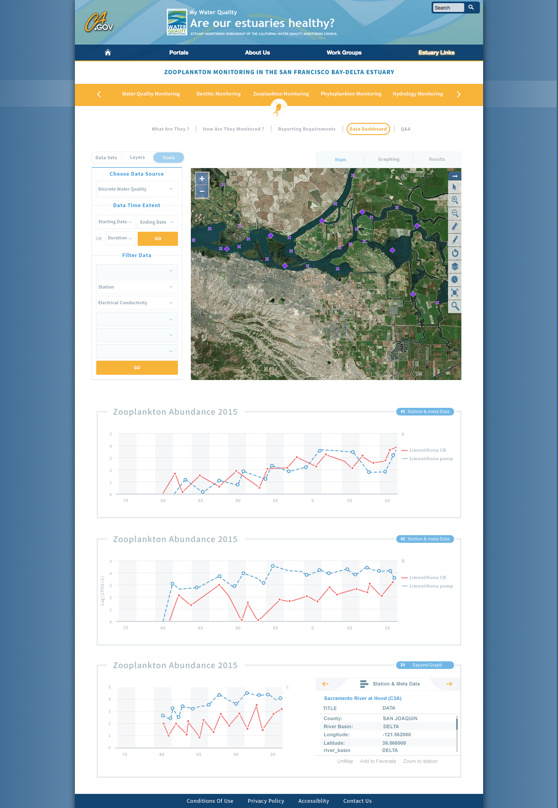
Design 3: Zooplankton Dashboard

Slide 28
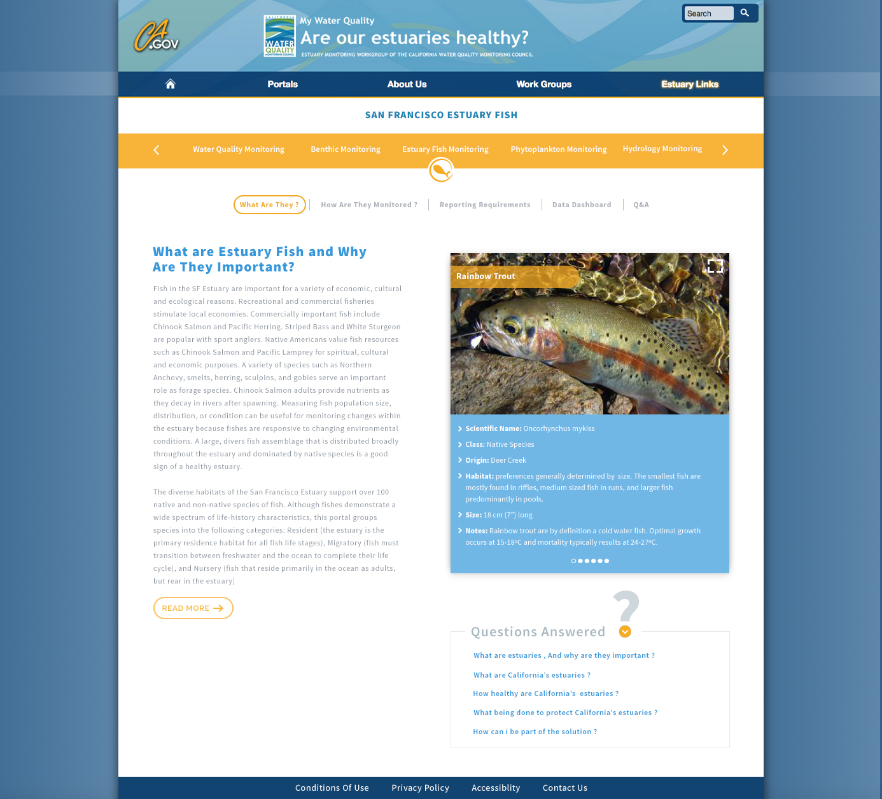
Design 3: What? Fish (A)

Slide 29
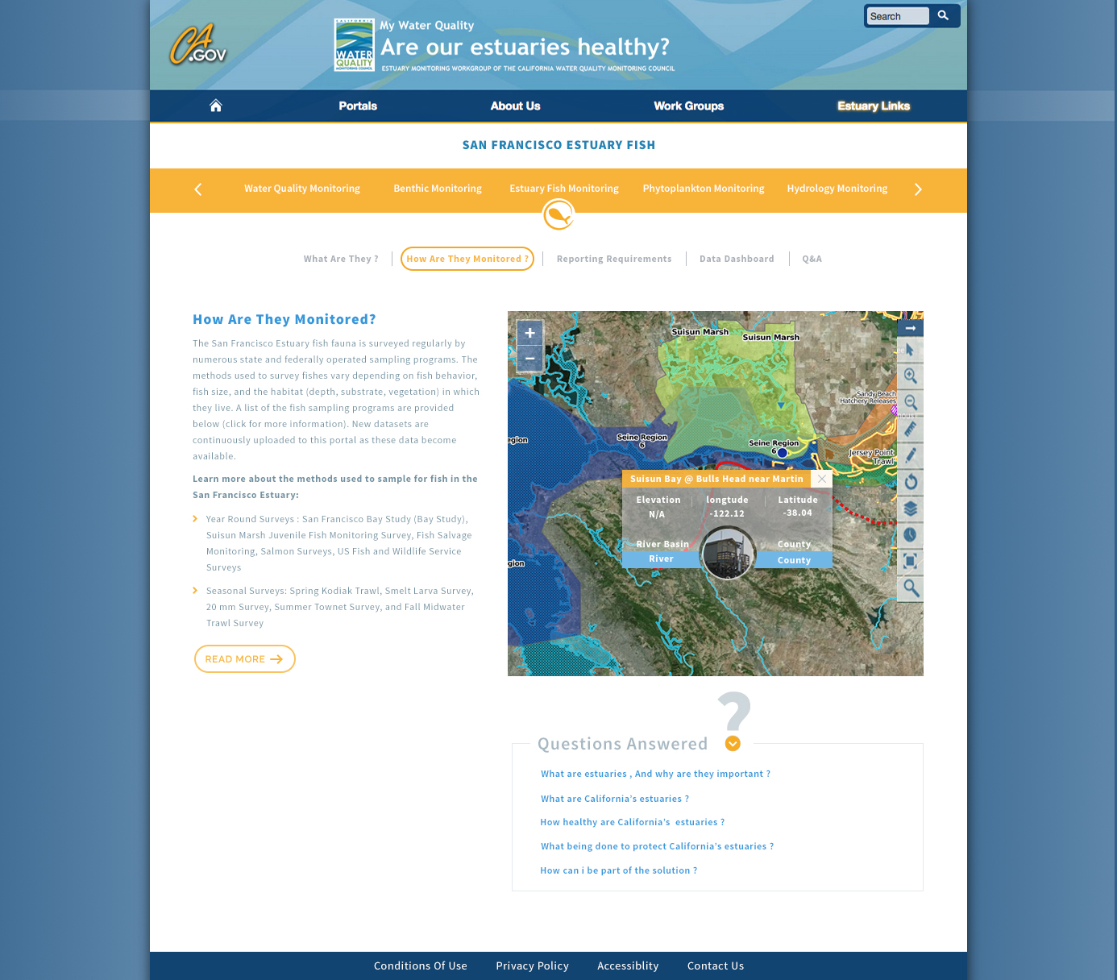
Design 3: How? Fish (A)

Slide 30
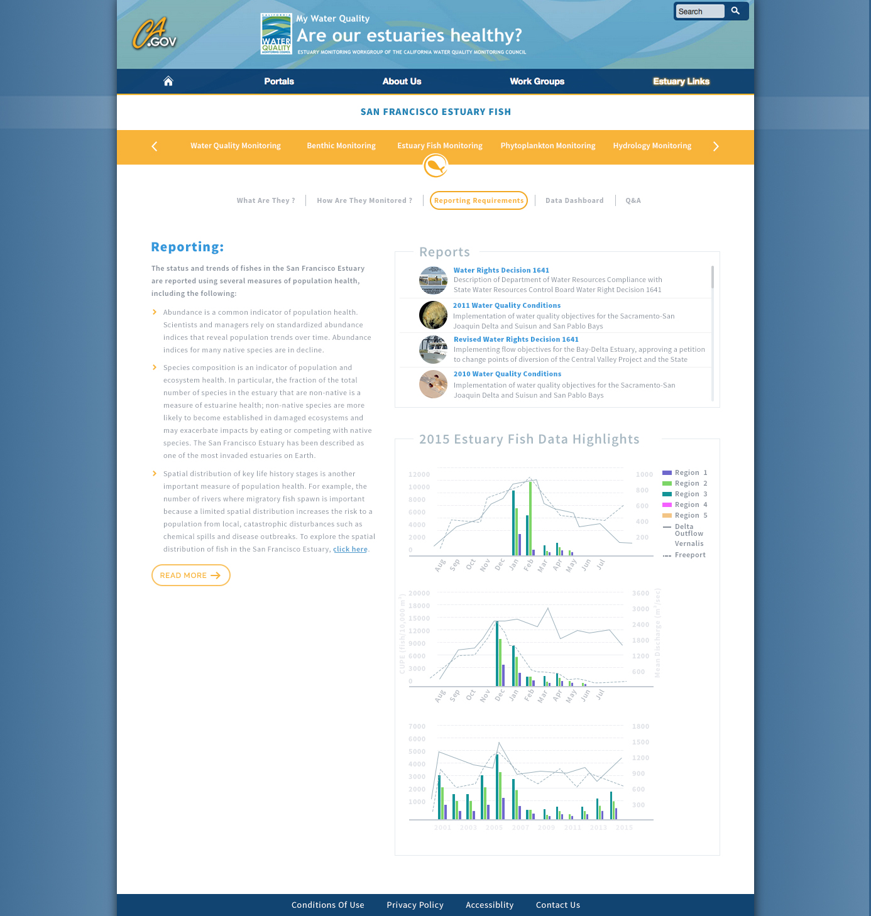
Design 3: Reporting? Fish (A)

Slide 31
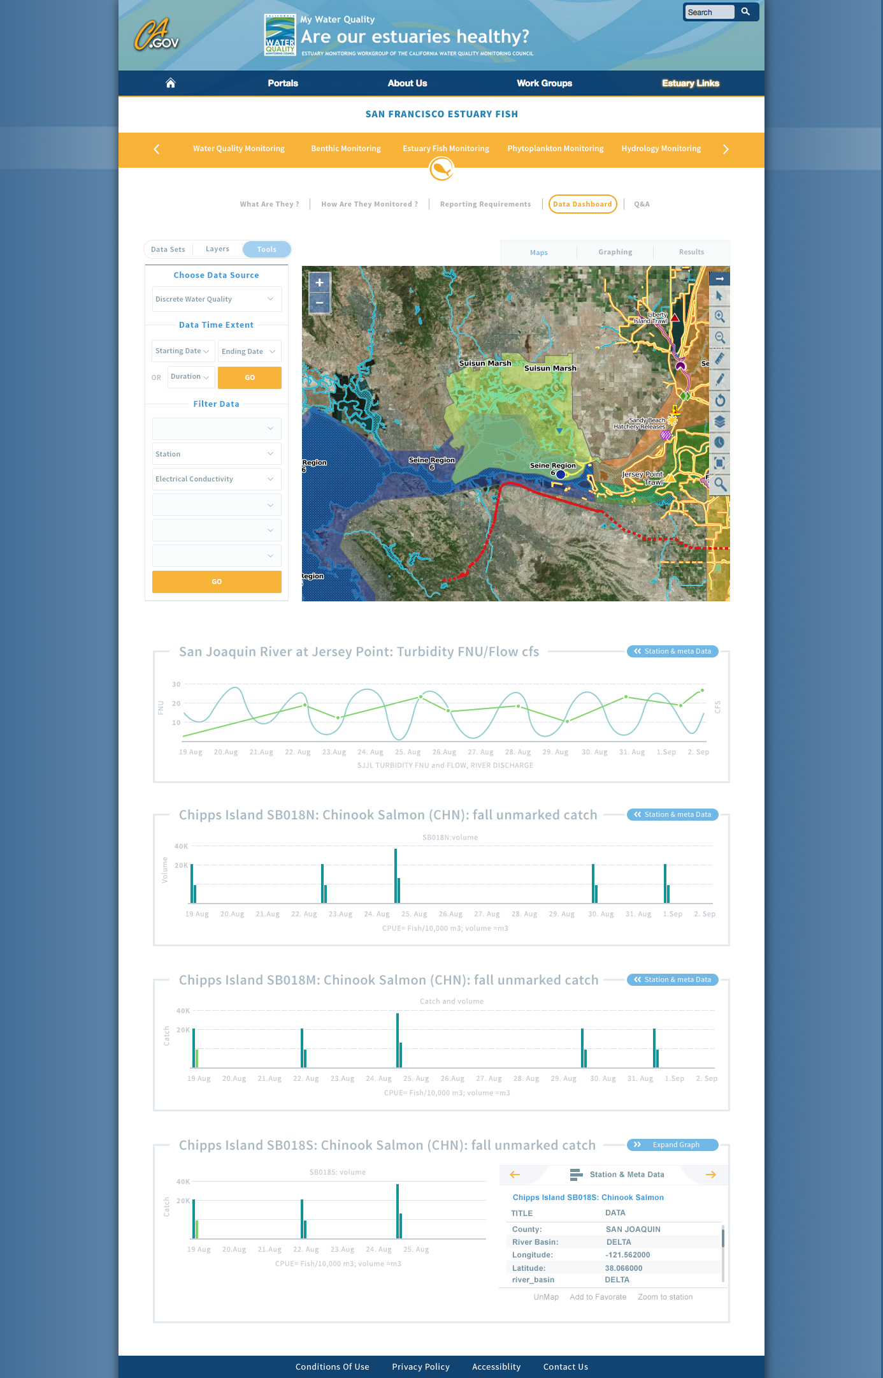
Design 3: Dashboard? Fish (A)

Slide 32
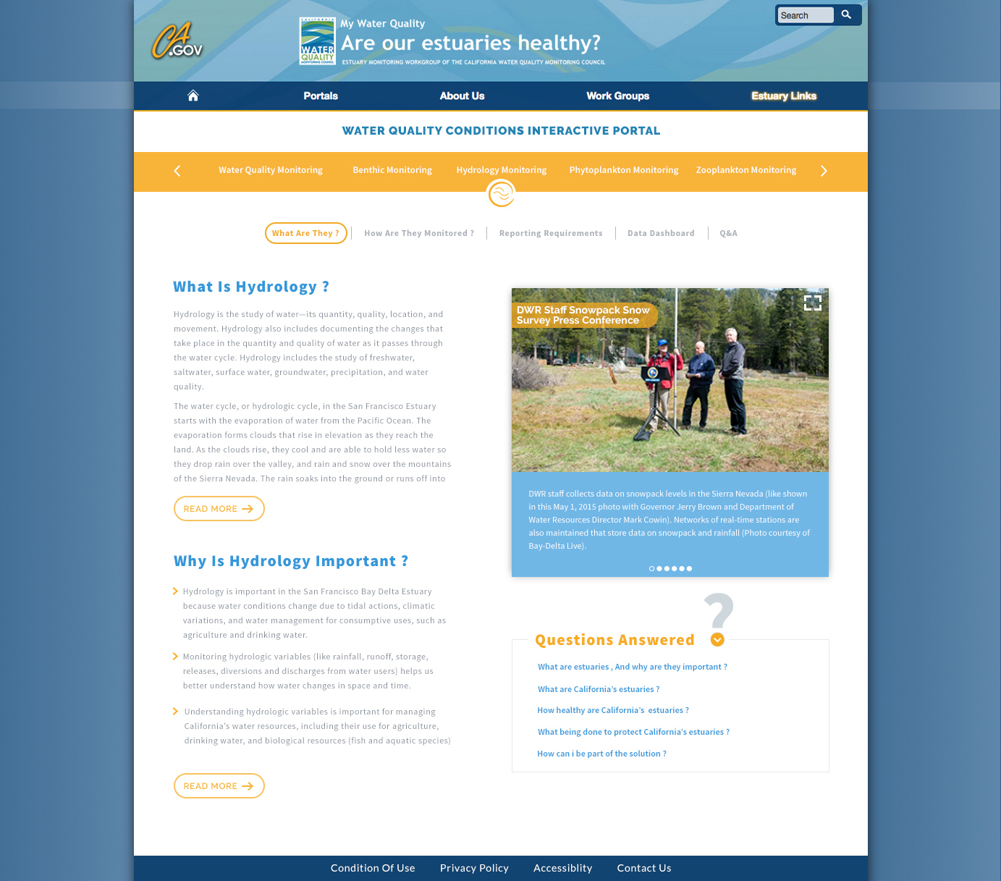
Design 3: Hydrology What?

Slide 33
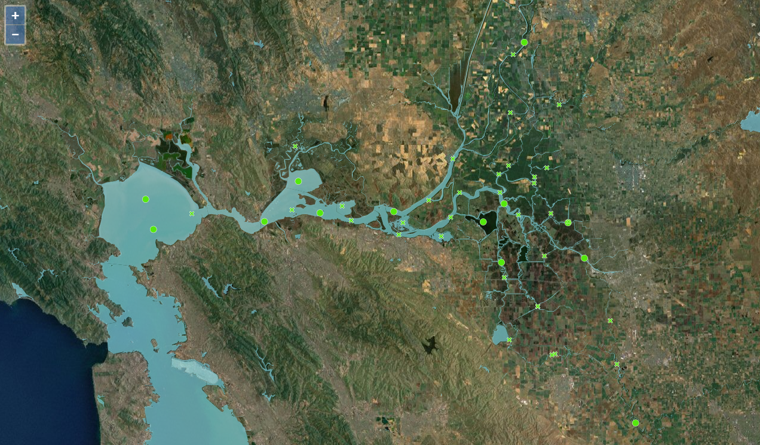
EMP: Phytoplankton

Slide 34
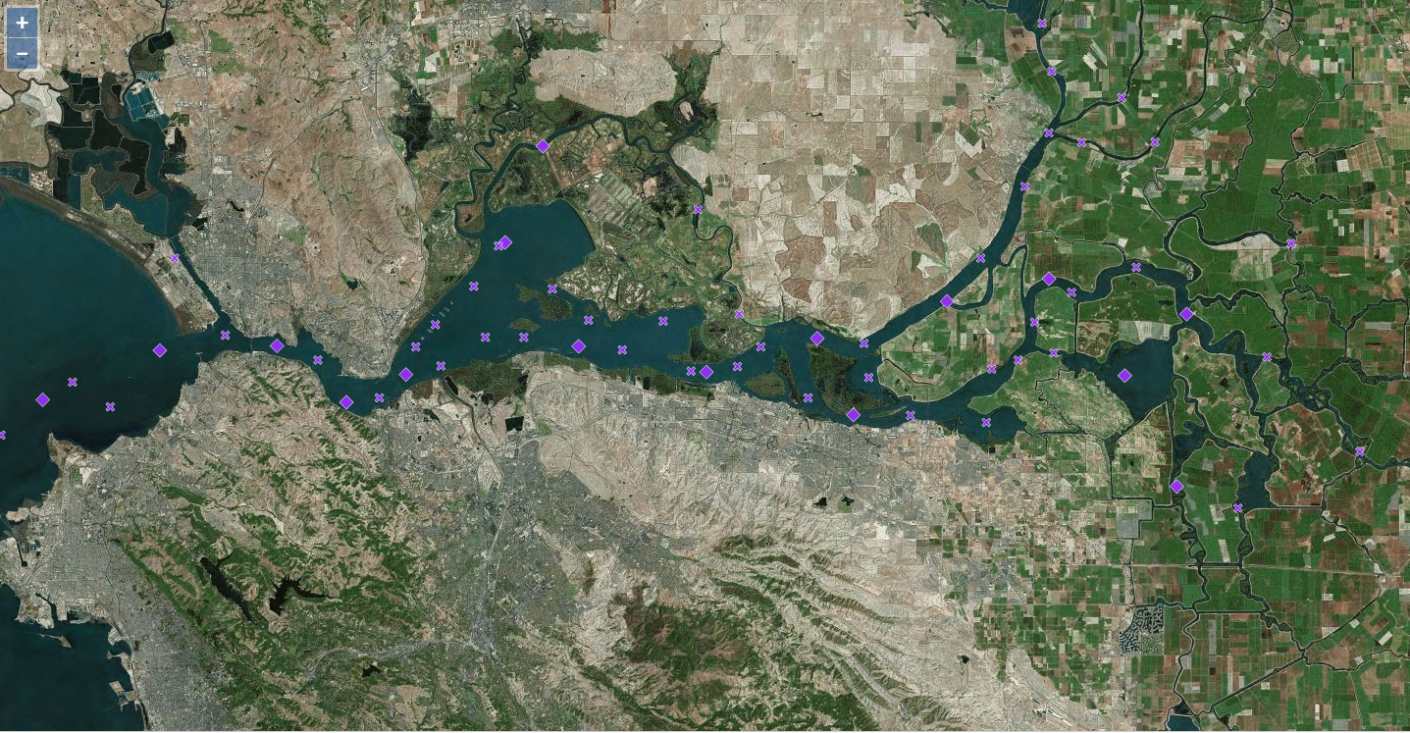
EMP: Zooplankton

Slide 35
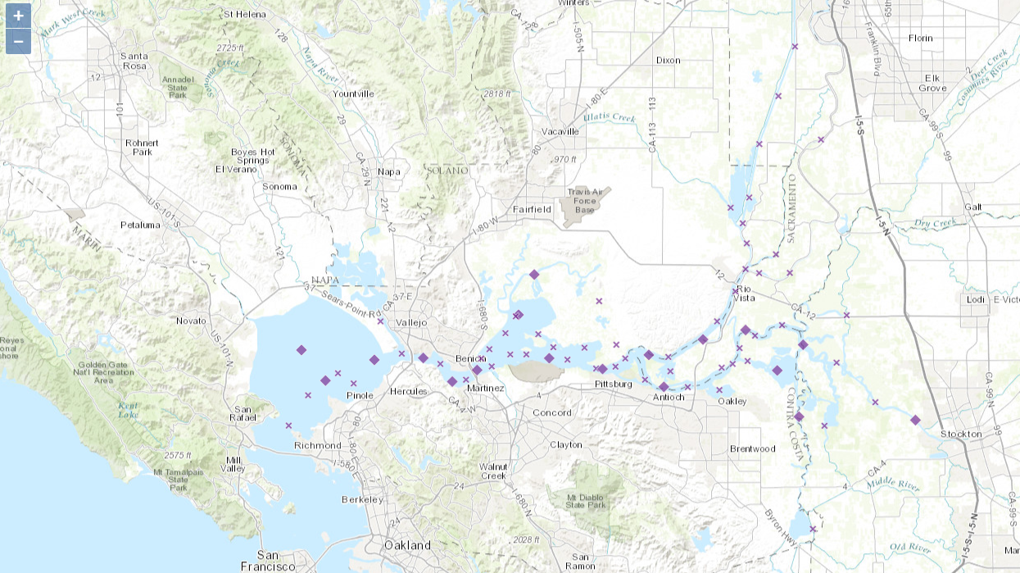
EMP: Zooplankton

Slide 36
