Slide 1
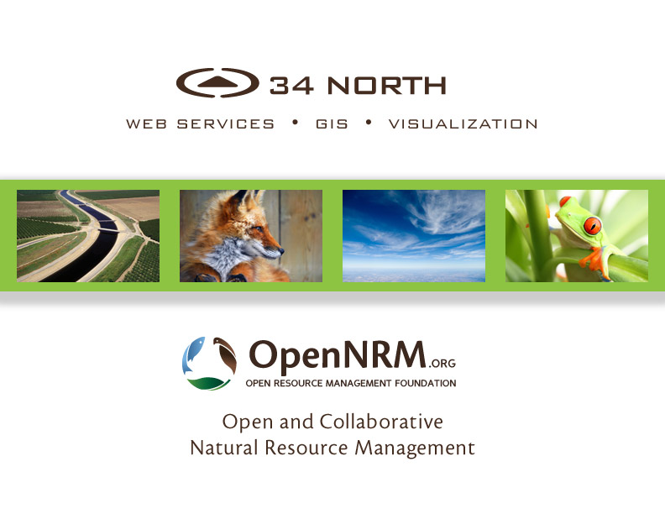

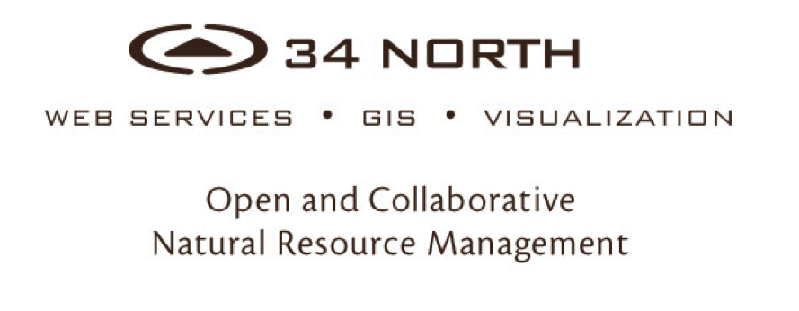

Slide 2


Water Quality Pages
Interactive TMDL Pages
Acoustic Telemetry: Real Time Fish Tracking
WARMF Online: Real Time Salinity Management in the SJR Basin
Data Stories
Progress Report

Slide 3
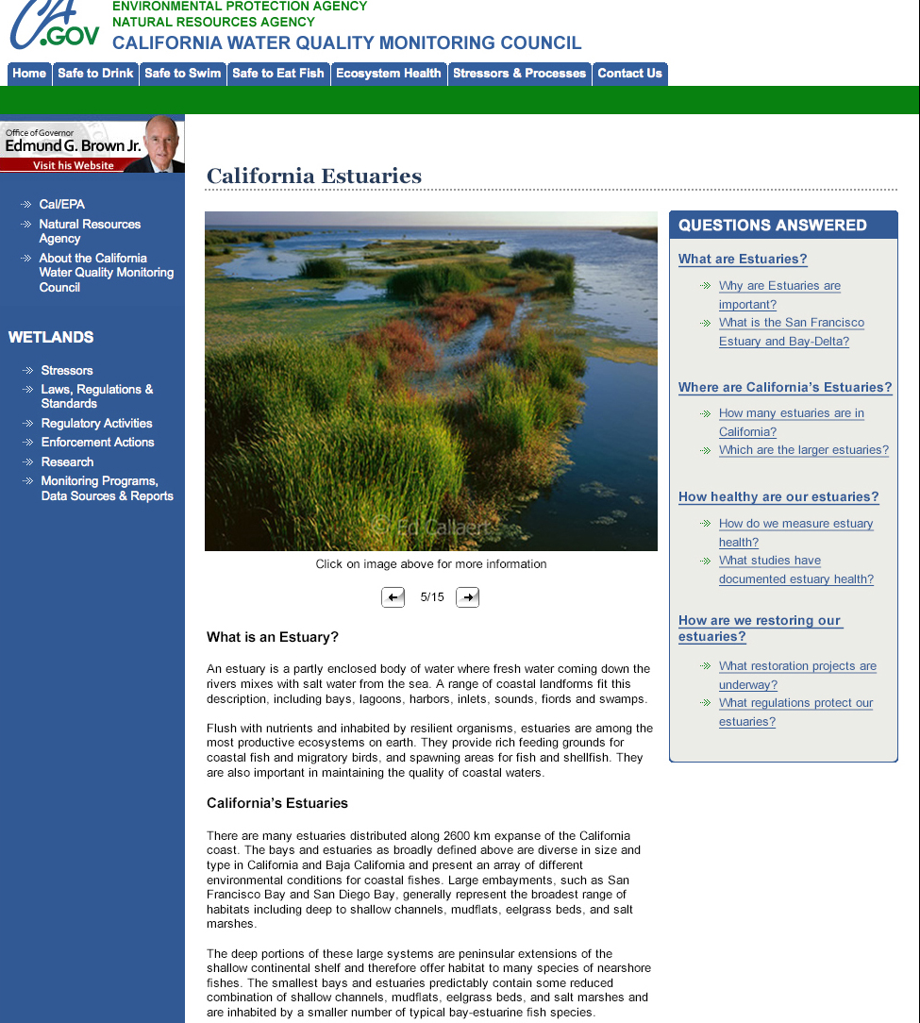
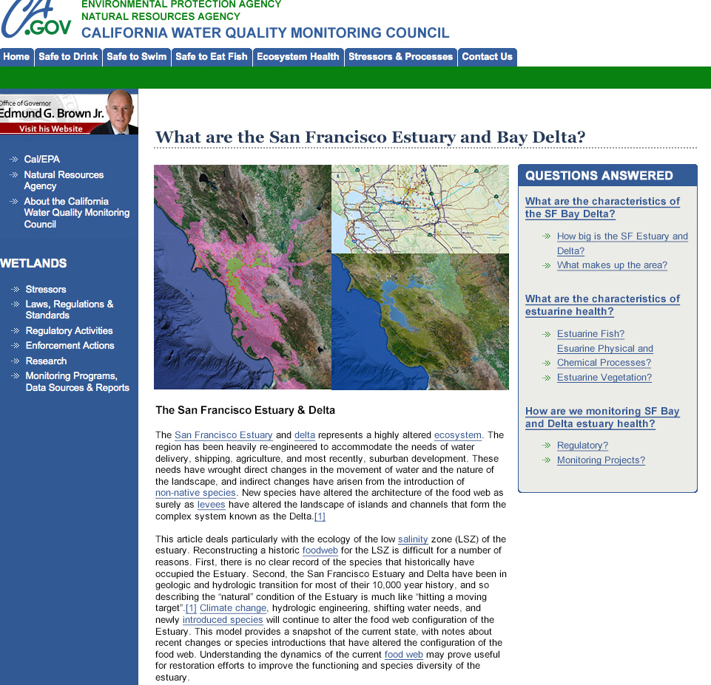
MY WATER QUALITY PORTALS
Notes:
INFORMING THE PUBLIC

Slide 4
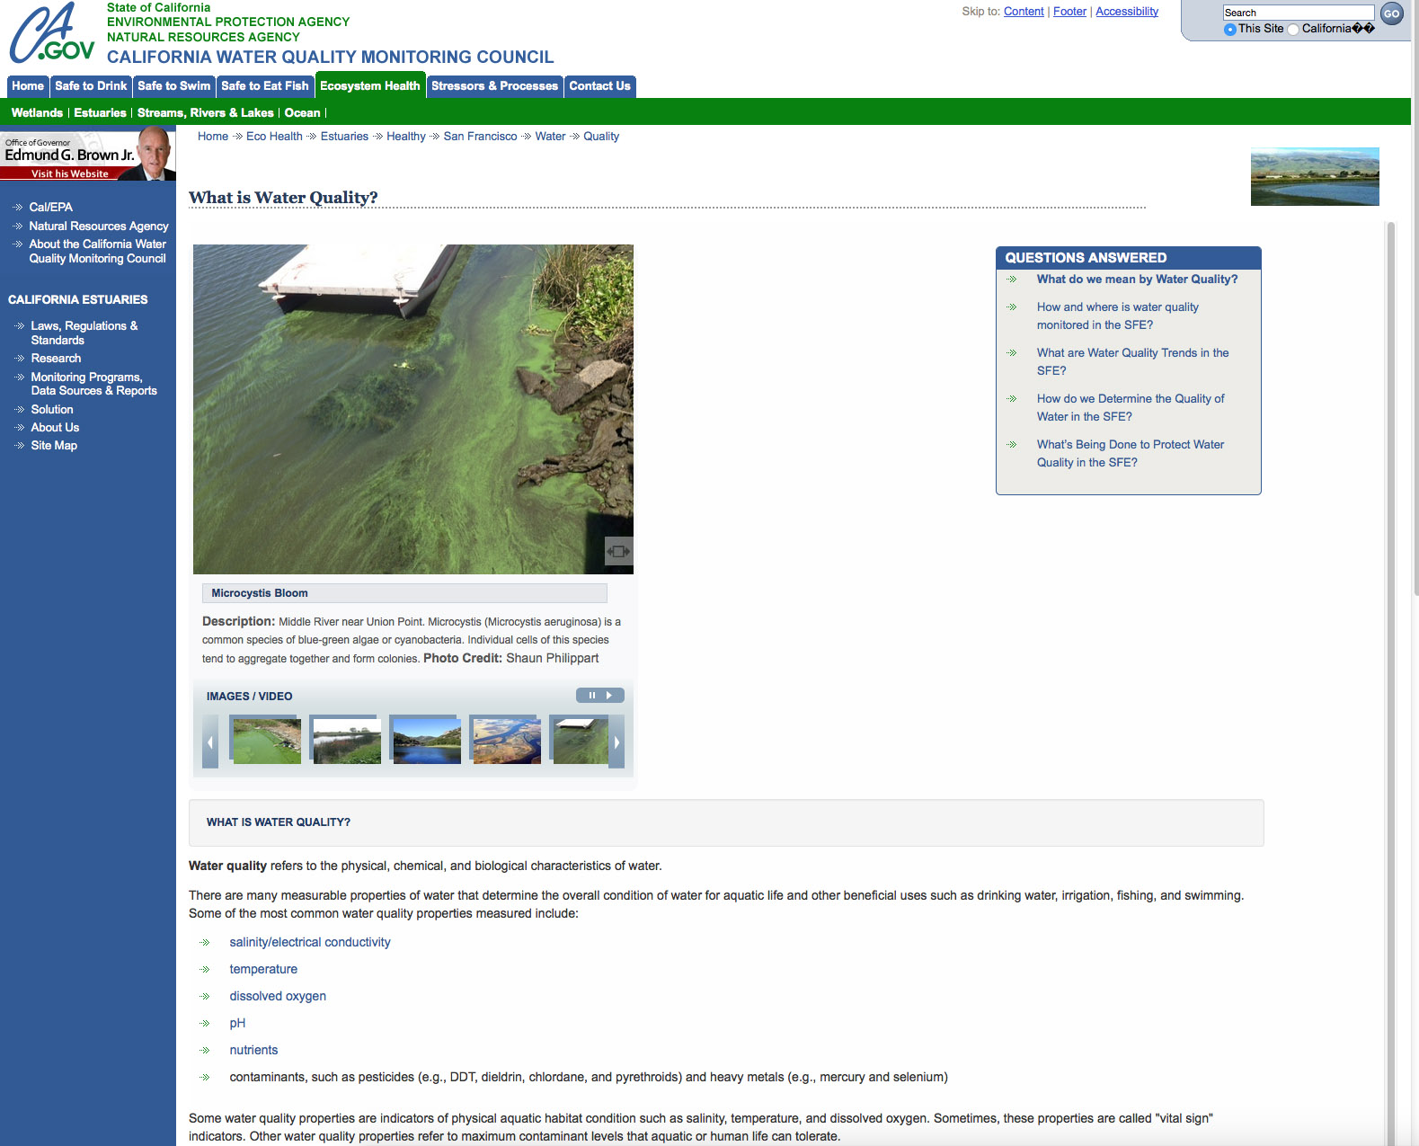
Notes:
Clients include: Honeywell, USGS, DWR, MWD, History Channel,

Slide 5
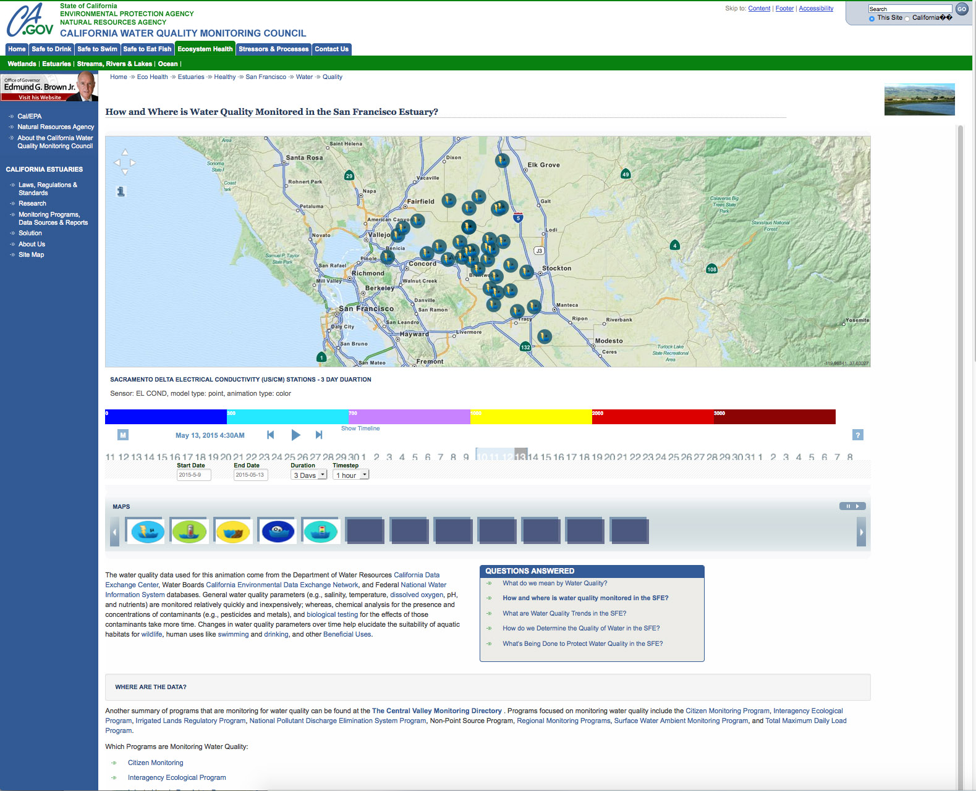
Notes:
Clients include: Honeywell, USGS, DWR, MWD, History Channel,

Slide 6
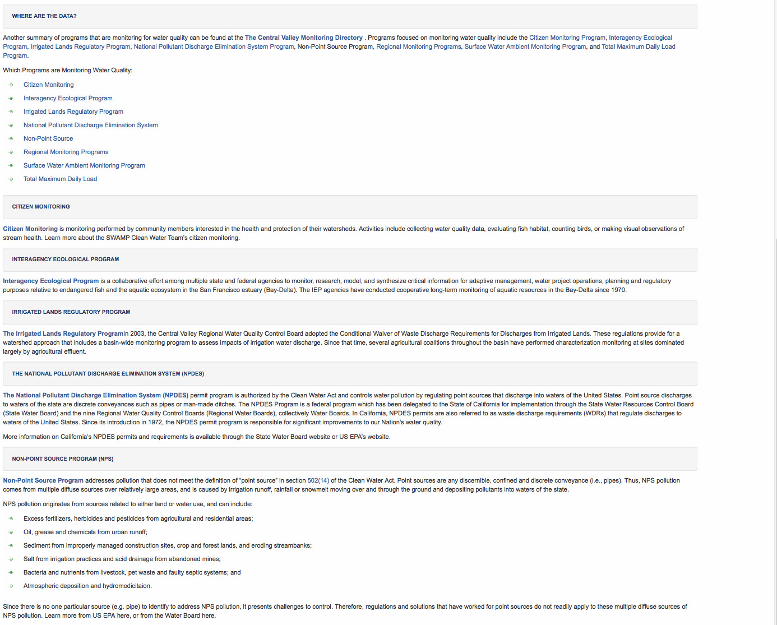
Notes:
Clients include: Honeywell, USGS, DWR, MWD, History Channel,

Slide 7
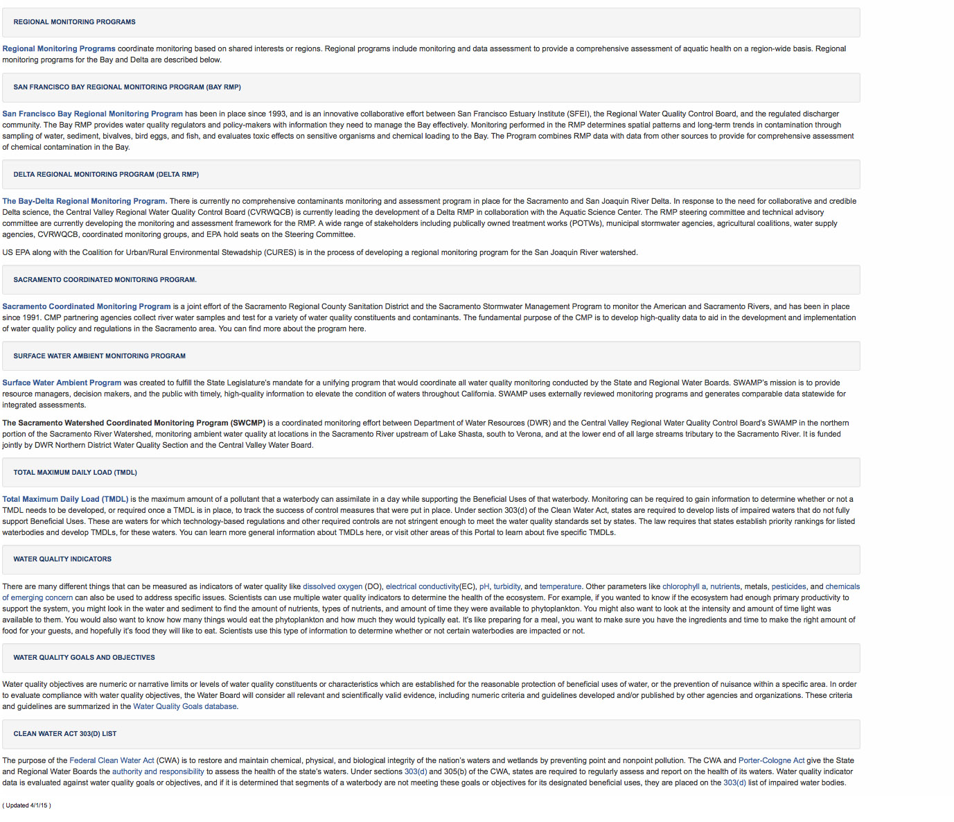
Notes:
Clients include: Honeywell, USGS, DWR, MWD, History Channel,

Slide 8
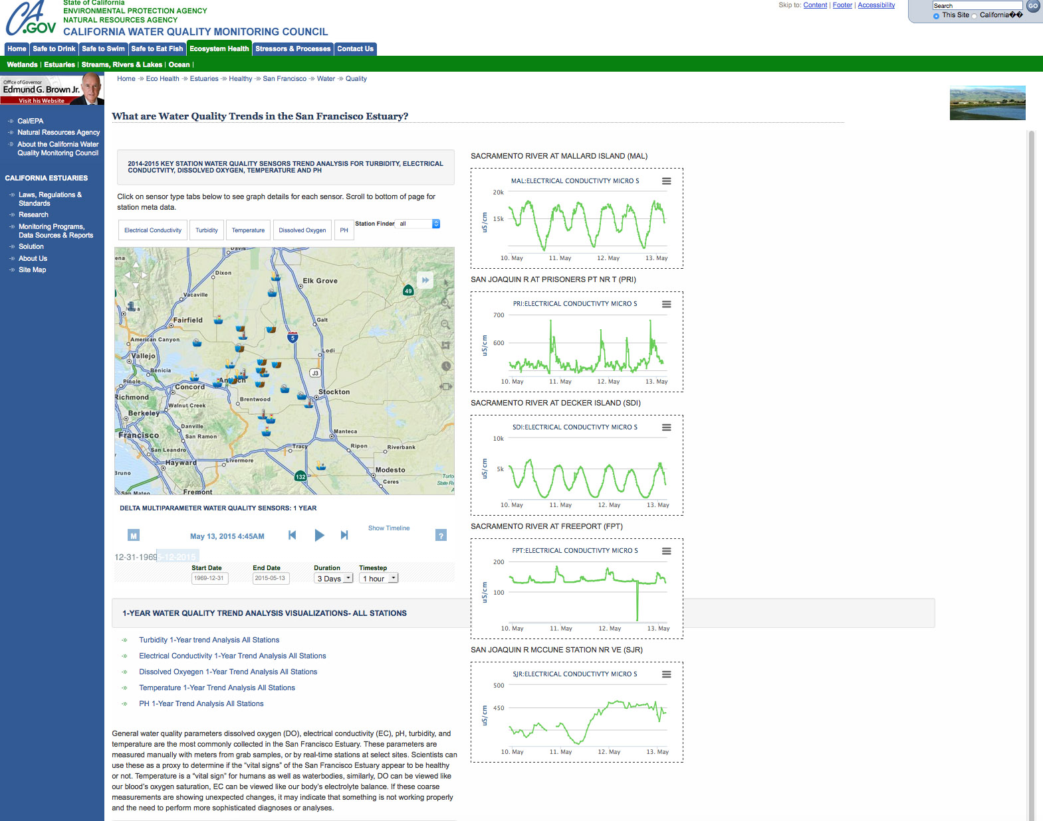
Notes:
Clients include: Honeywell, USGS, DWR, MWD, History Channel,

Slide 9
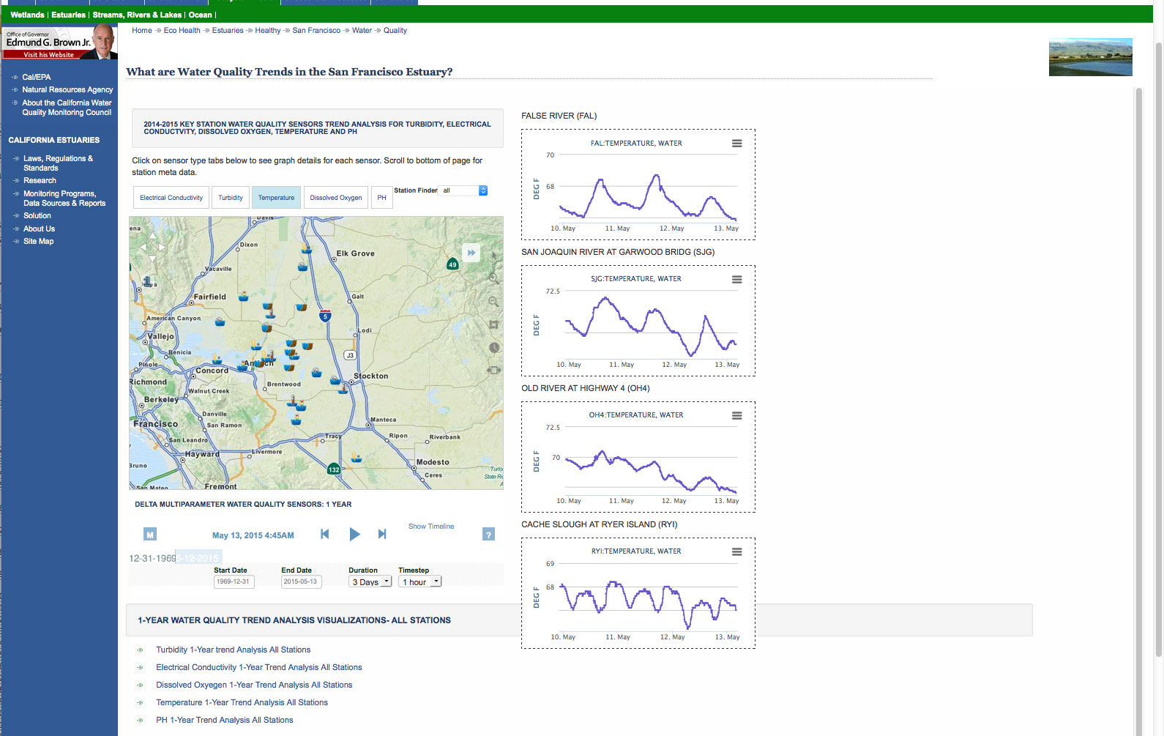
Notes:
Clients include: Honeywell, USGS, DWR, MWD, History Channel,

Slide 10
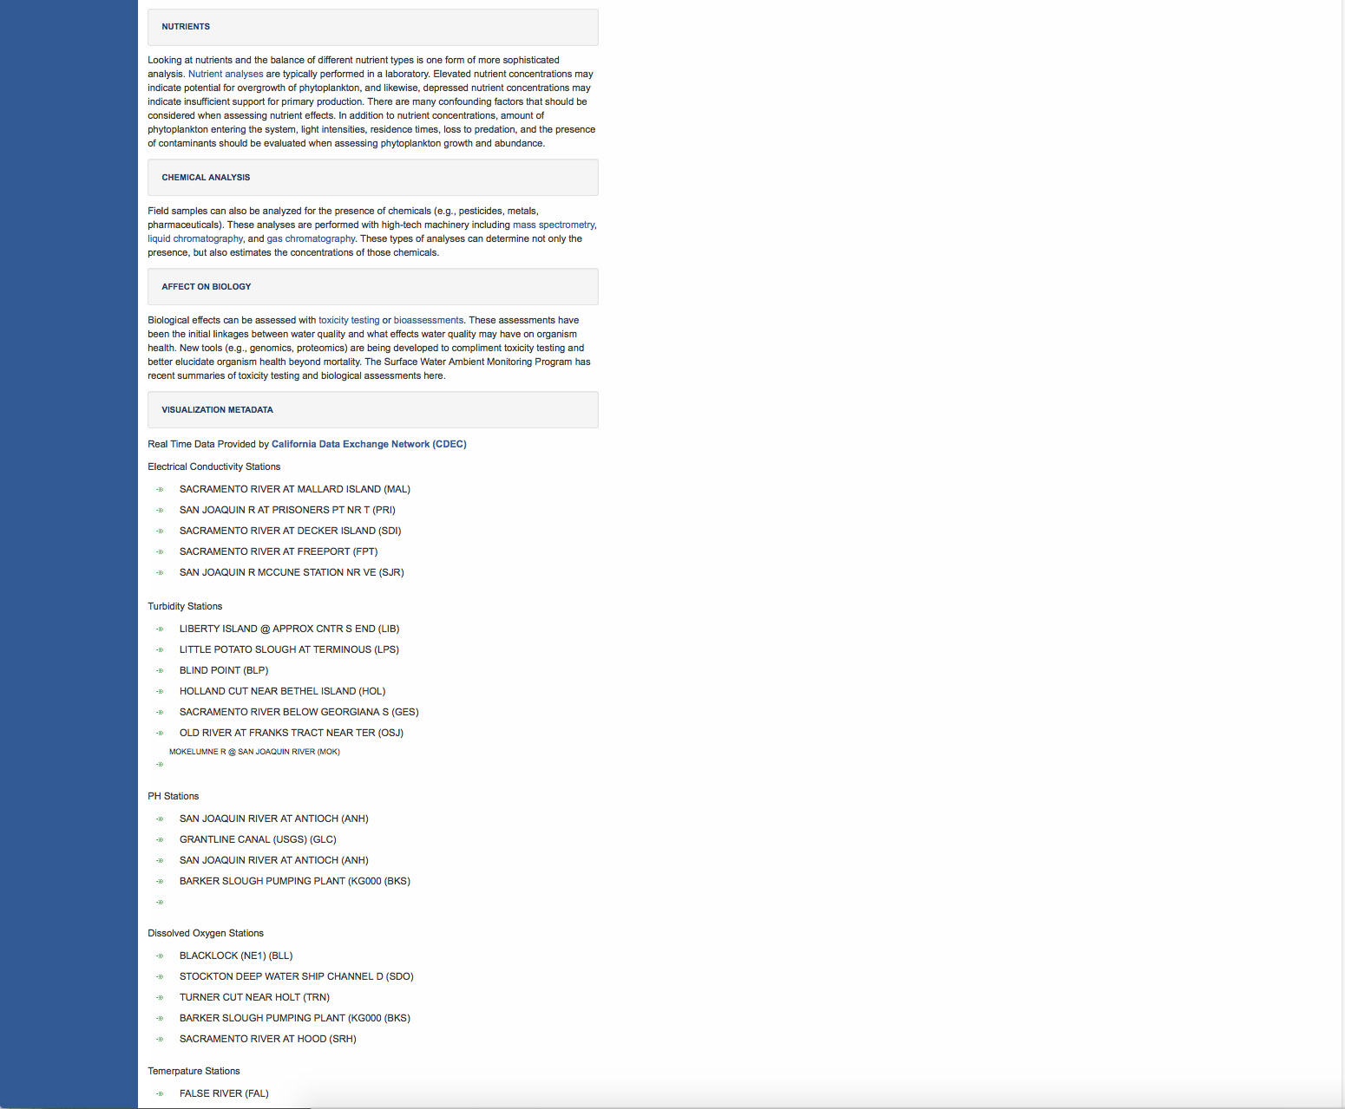
Notes:
Clients include: Honeywell, USGS, DWR, MWD, History Channel,

Slide 11
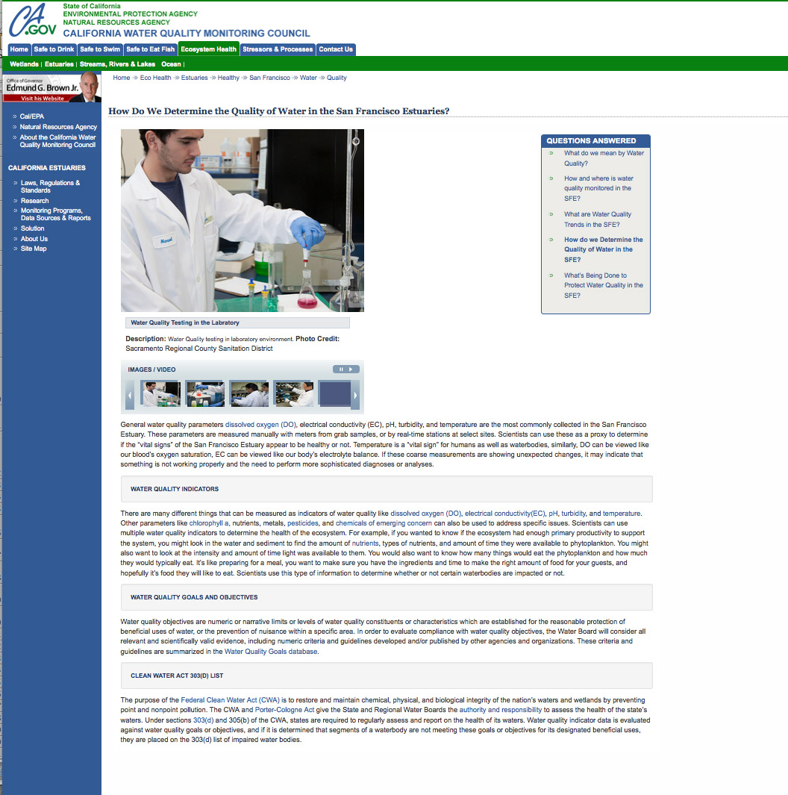
Notes:
Clients include: Honeywell, USGS, DWR, MWD, History Channel,

Slide 12
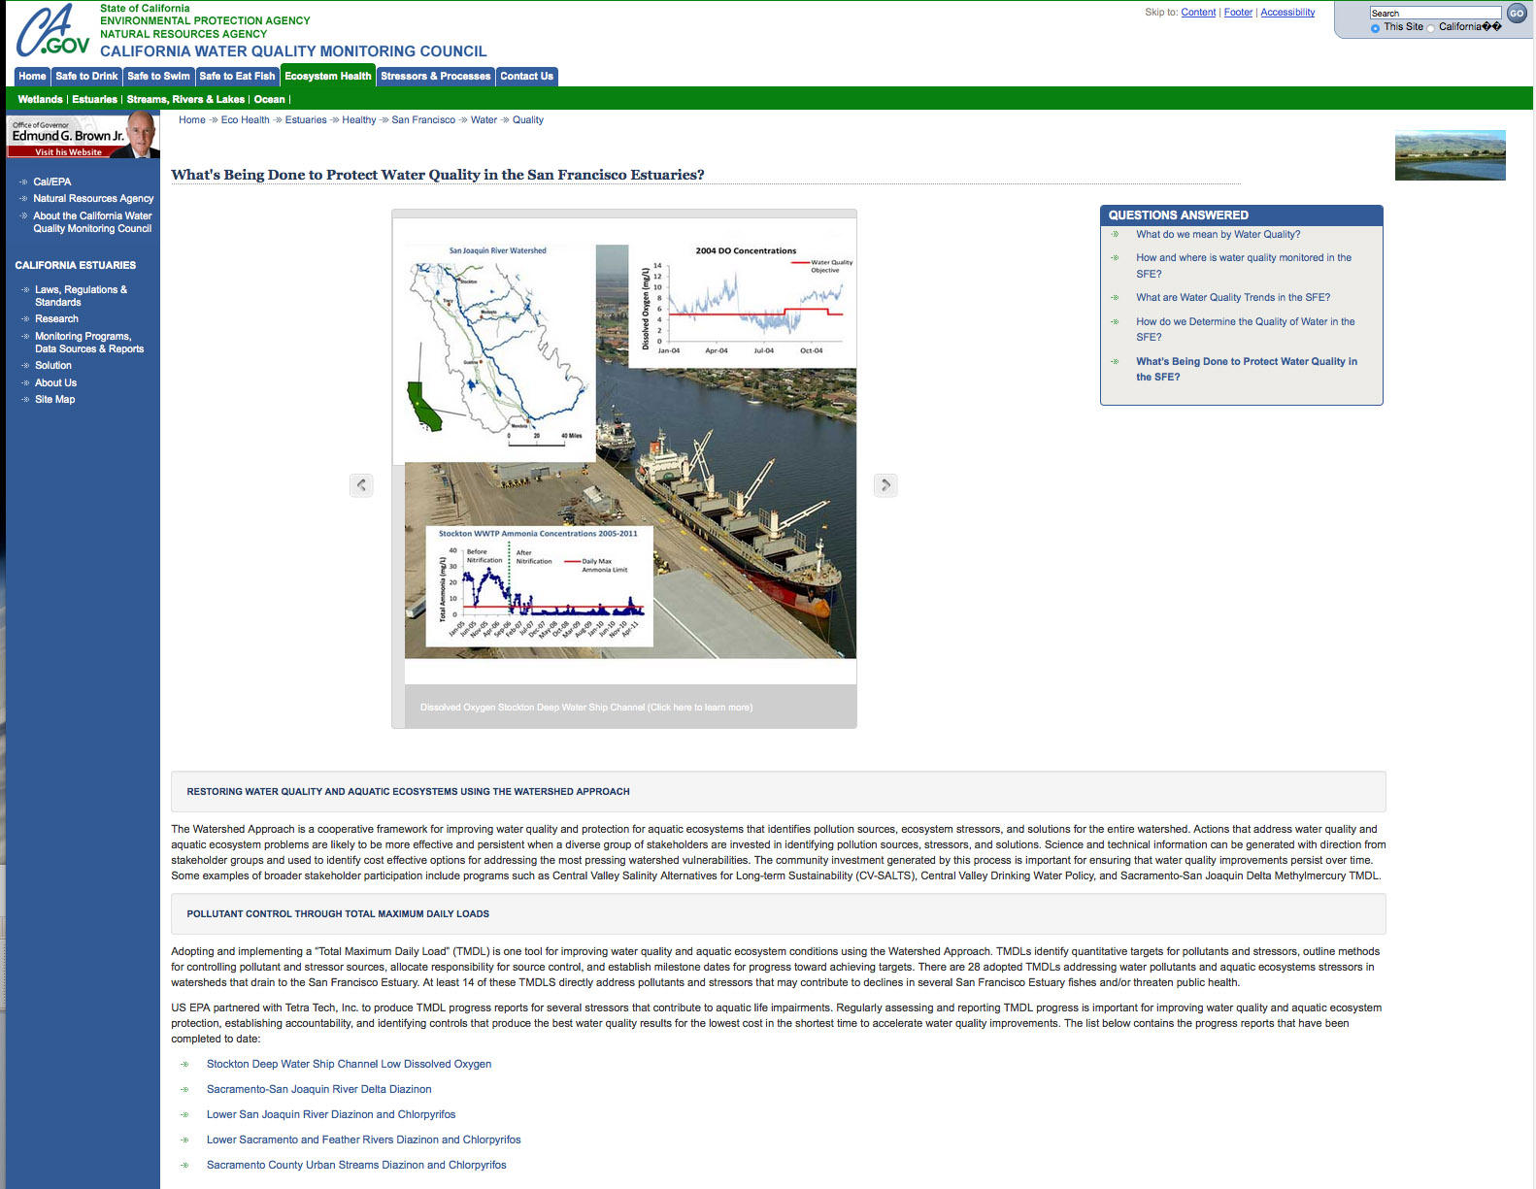
Notes:
Clients include: Honeywell, USGS, DWR, MWD, History Channel,

Slide 13
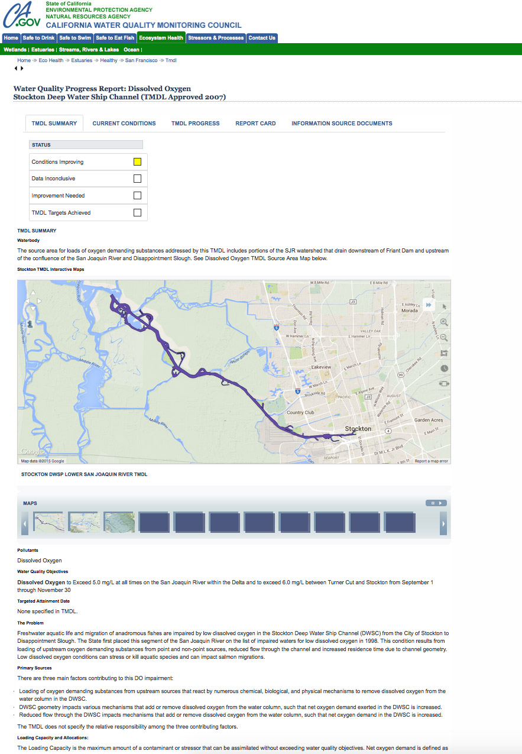
TMDL REPORT CARDS
Notes:
Clients include: Honeywell, USGS, DWR, MWD, History Channel,

Slide 14
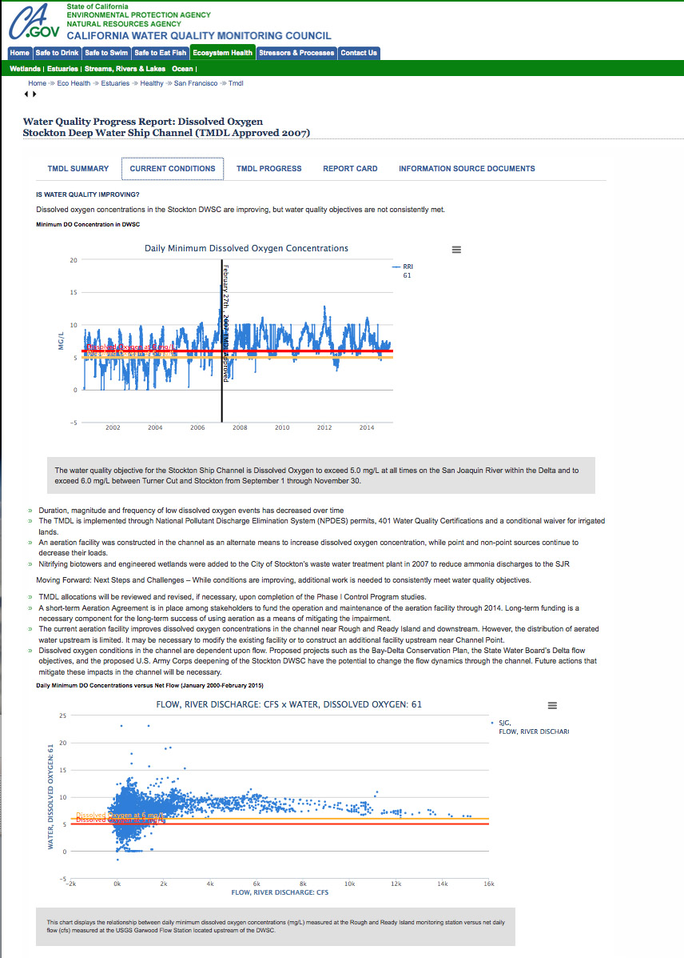
Notes:
Clients include: Honeywell, USGS, DWR, MWD, History Channel,

Slide 15
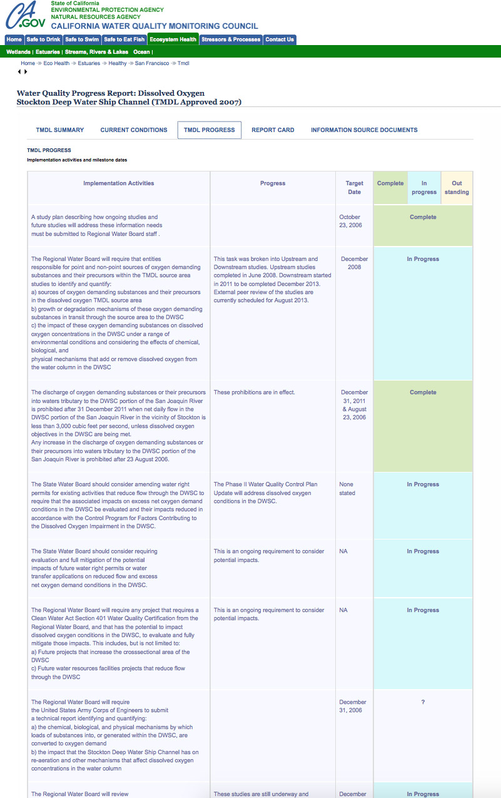
Notes:
Clients include: Honeywell, USGS, DWR, MWD, History Channel,

Slide 16
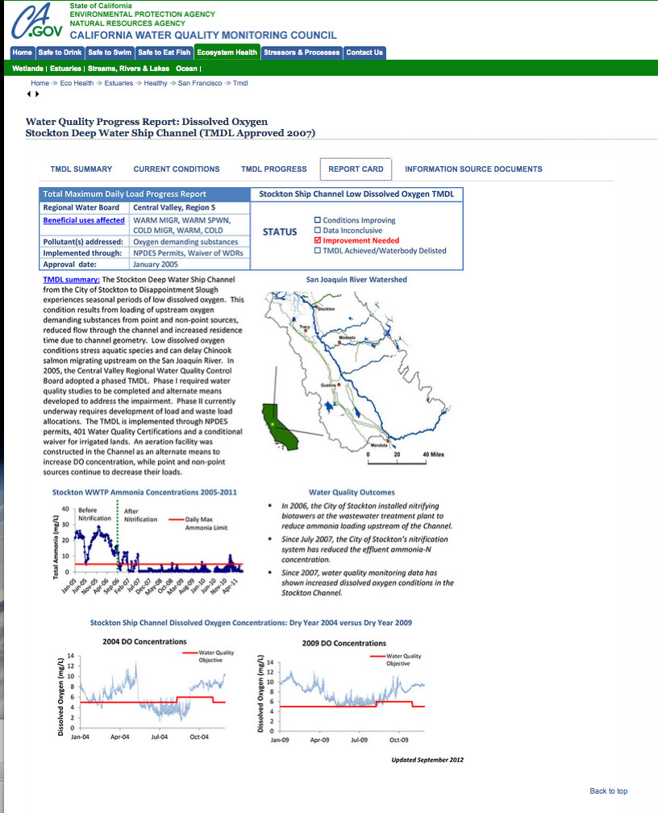
Notes:
Clients include: Honeywell, USGS, DWR, MWD, History Channel,

Slide 17
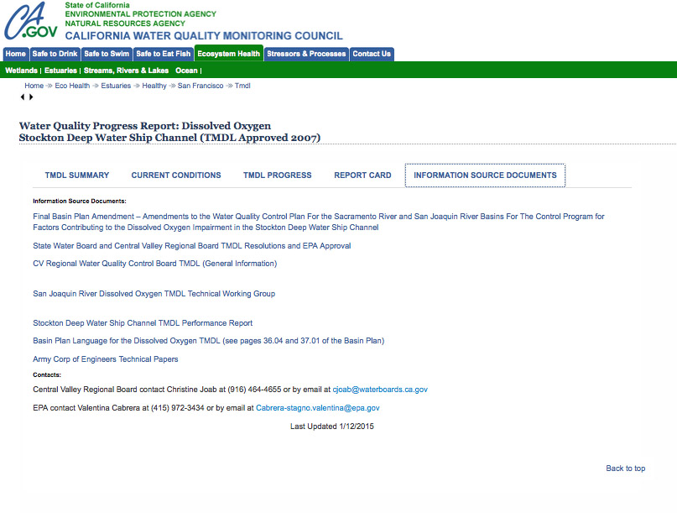
Notes:
Clients include: Honeywell, USGS, DWR, MWD, History Channel,

Slide 18
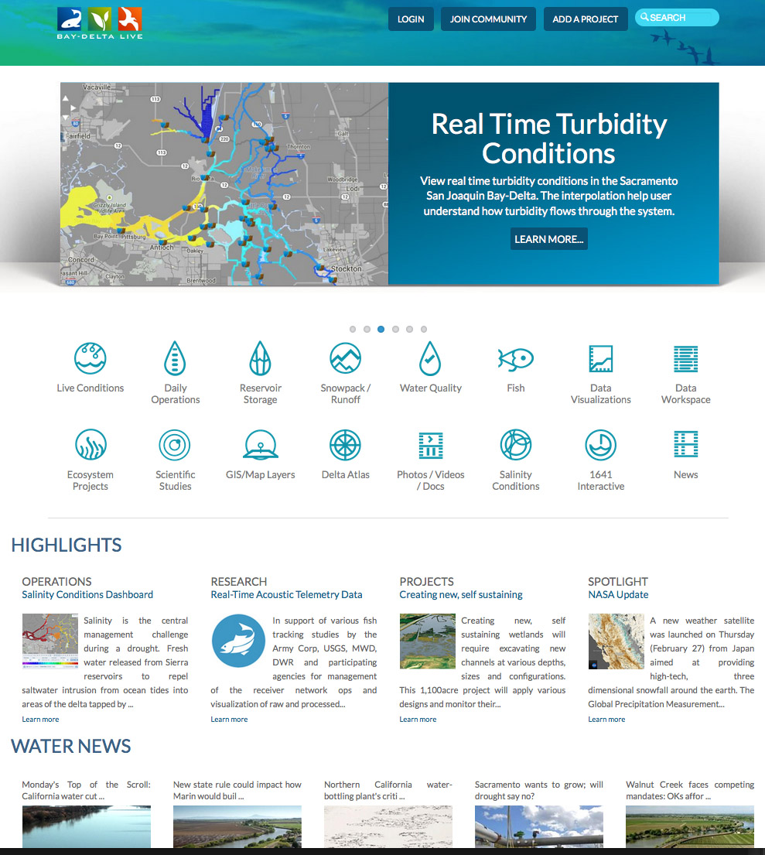
FISH TRACKING (ACOUSTIC TELEMETRY)
Notes:
Clients include: Honeywell, USGS, DWR, MWD, History Channel,

Slide 19
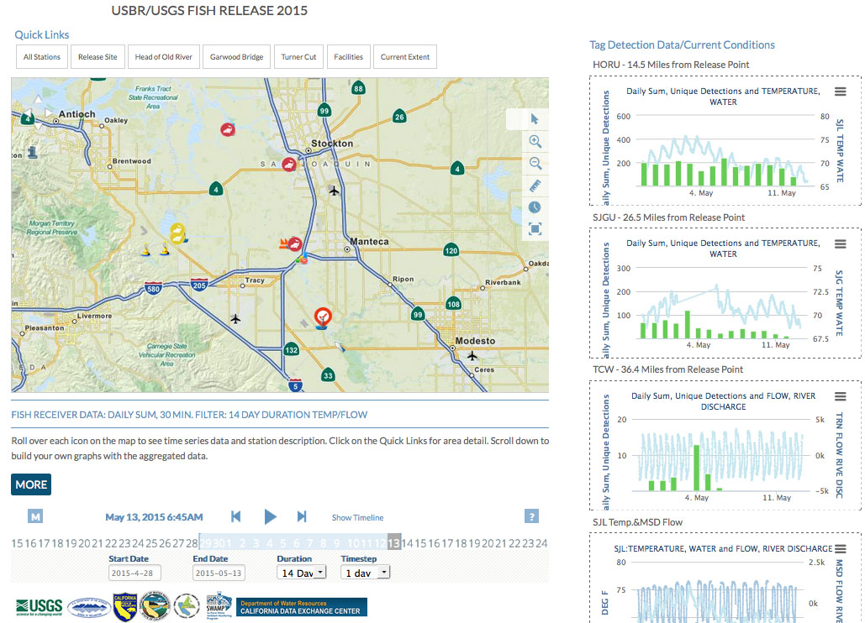
Notes:
UNIQUE DETECTIONS AND DAILY SUM (using 30 minute unique detections filter and then sums)

Slide 20
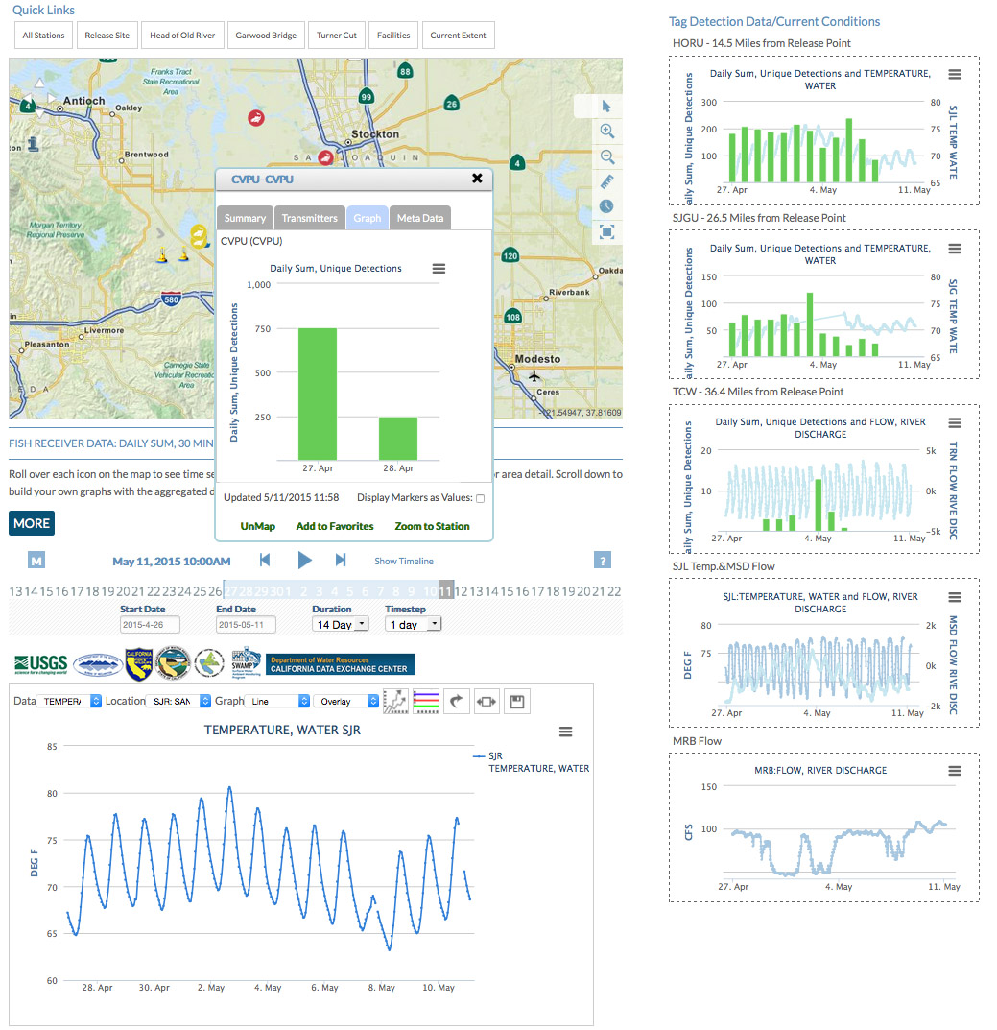
Notes:
Clients include: Honeywell, USGS, DWR, MWD, History Channel,

Slide 21
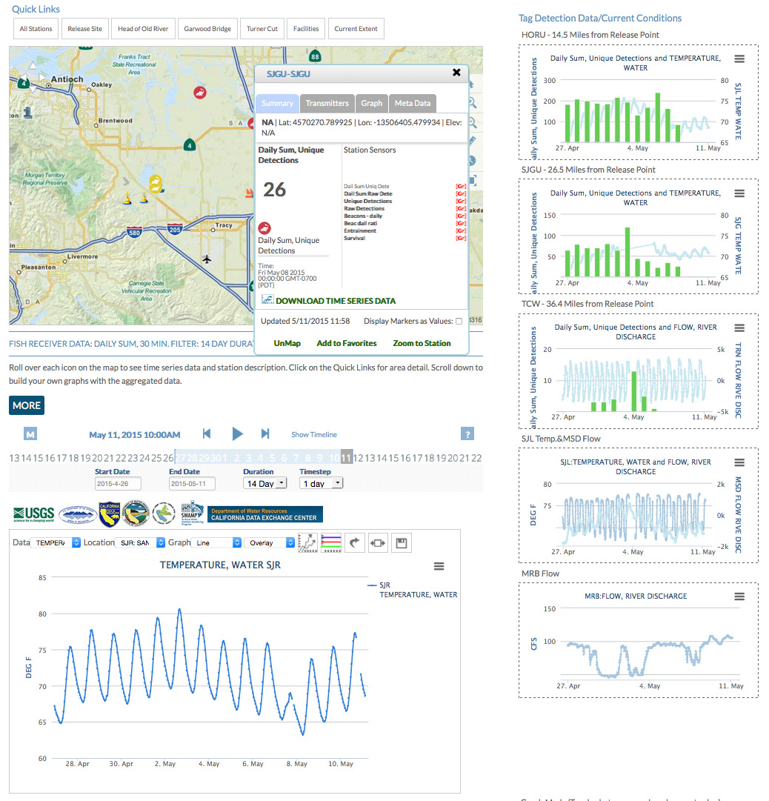
Notes:
Clients include: Honeywell, USGS, DWR, MWD, History Channel,

Slide 22
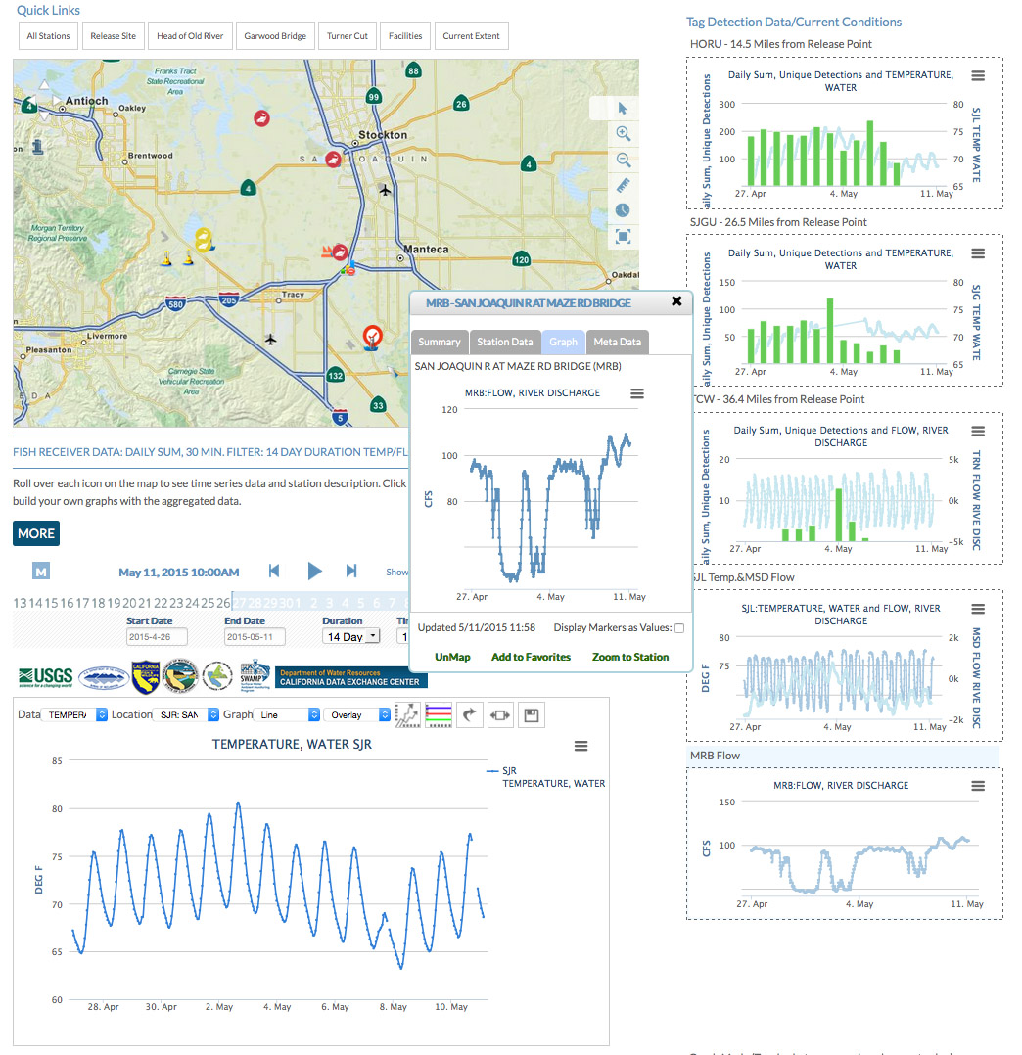
Notes:
Clients include: Honeywell, USGS, DWR, MWD, History Channel,

Slide 23
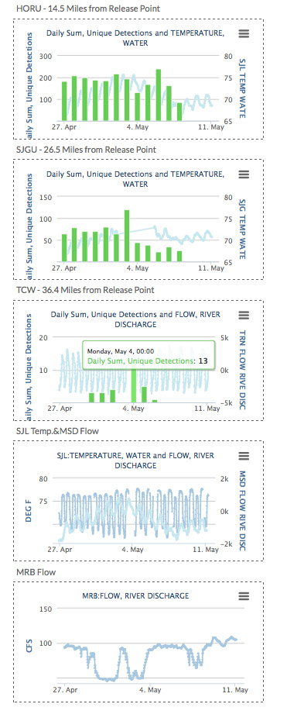
Notes:
Clients include: Honeywell, USGS, DWR, MWD, History Channel,

Slide 24
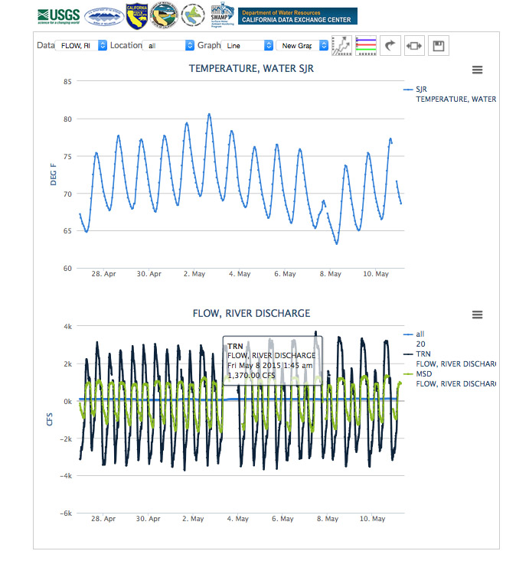
Notes:
Clients include: Honeywell, USGS, DWR, MWD, History Channel,

Slide 25
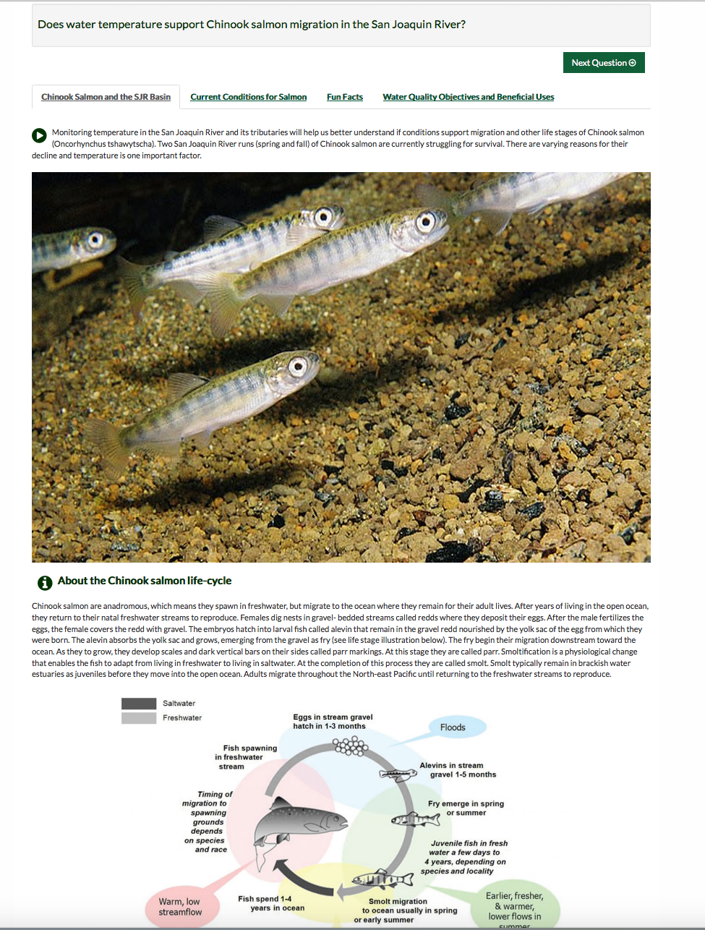
QUESTION TEMPLATES
SENSOR NETWORKS

Slide 26
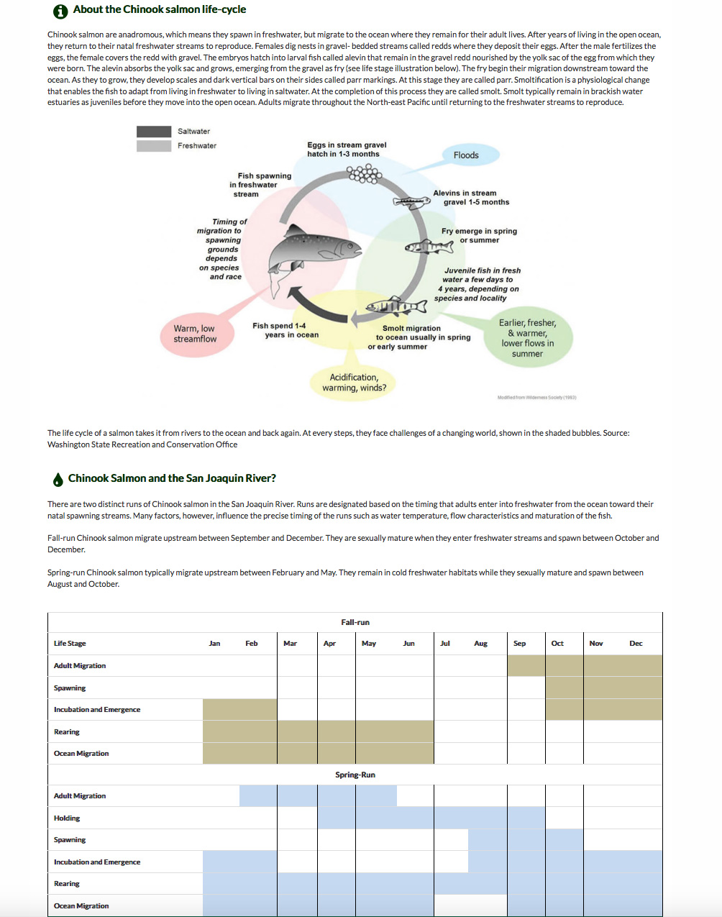
SENSOR NETWORKS

Slide 27
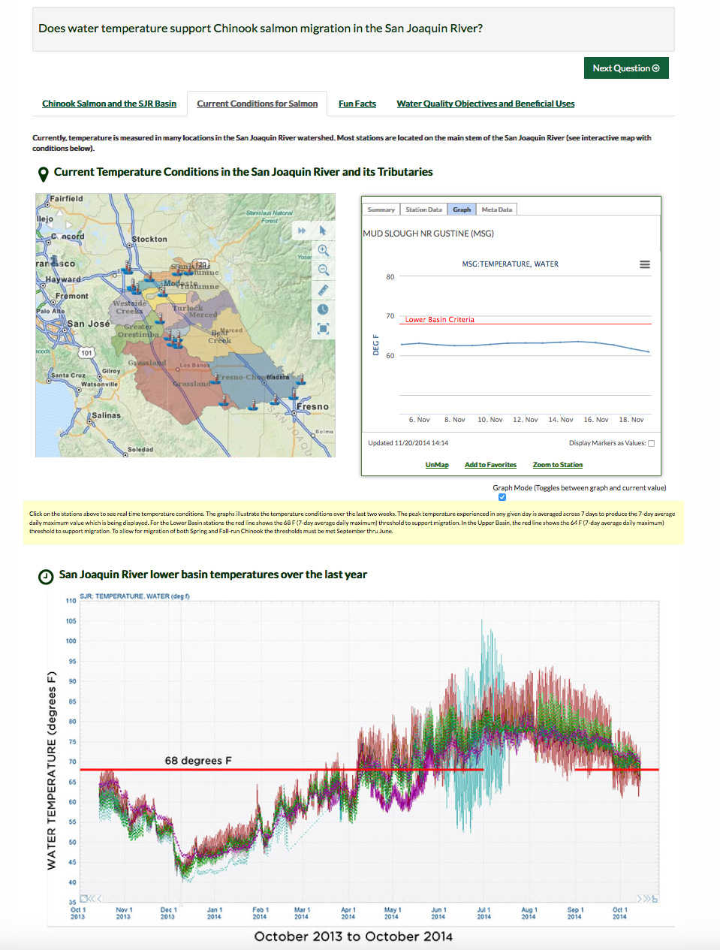
SENSOR NETWORKS

Slide 28
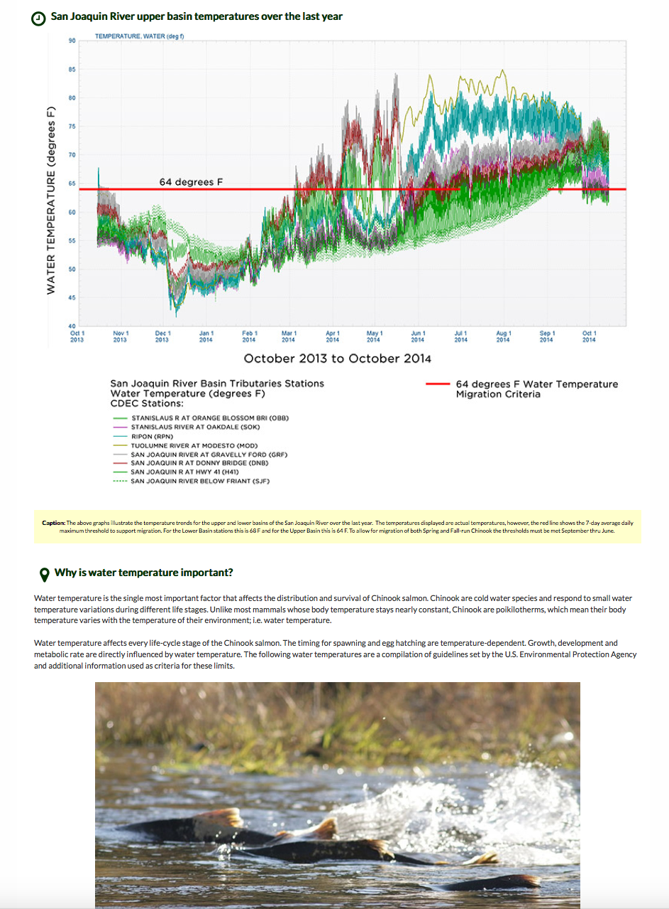
SENSOR NETWORKS

Slide 29
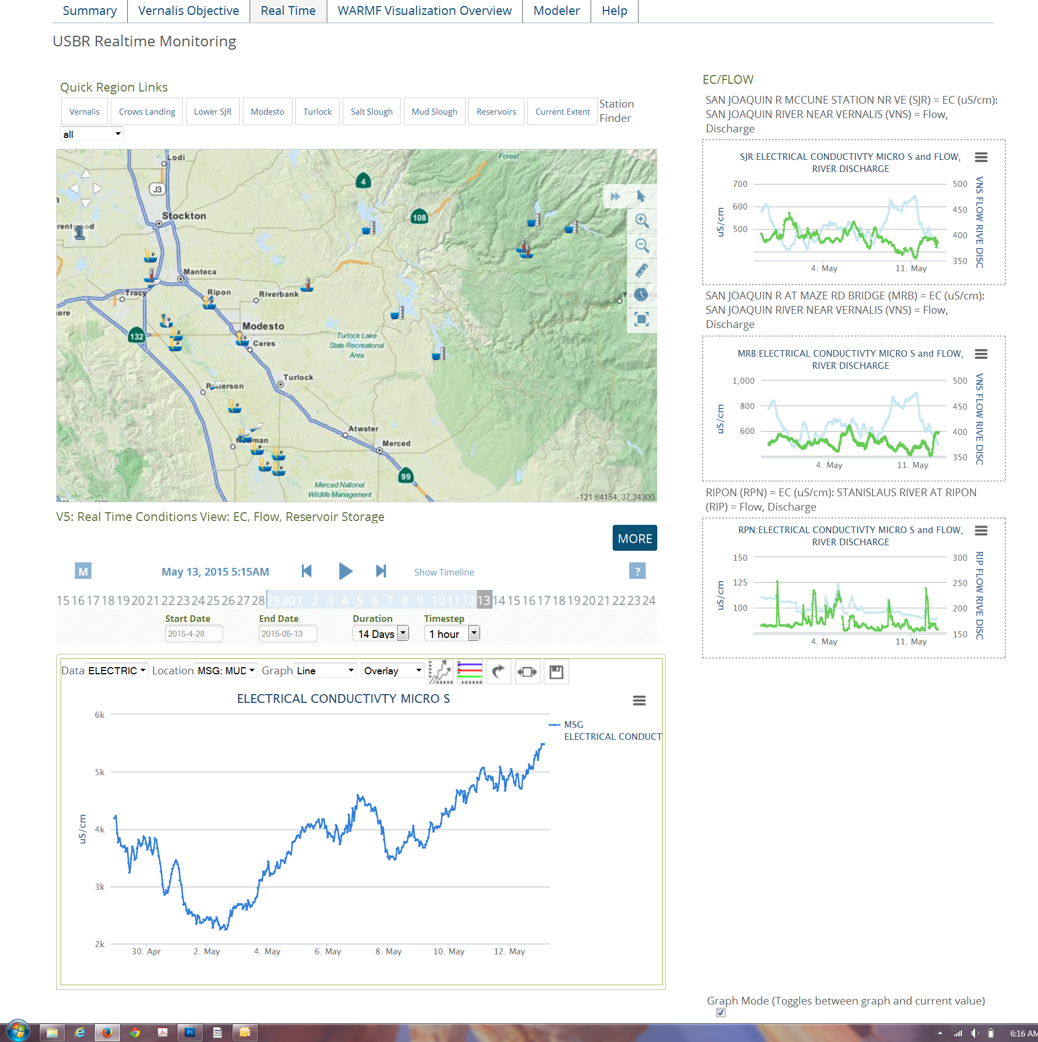
REAL TIME TMDL MANAGEMENT

Slide 30
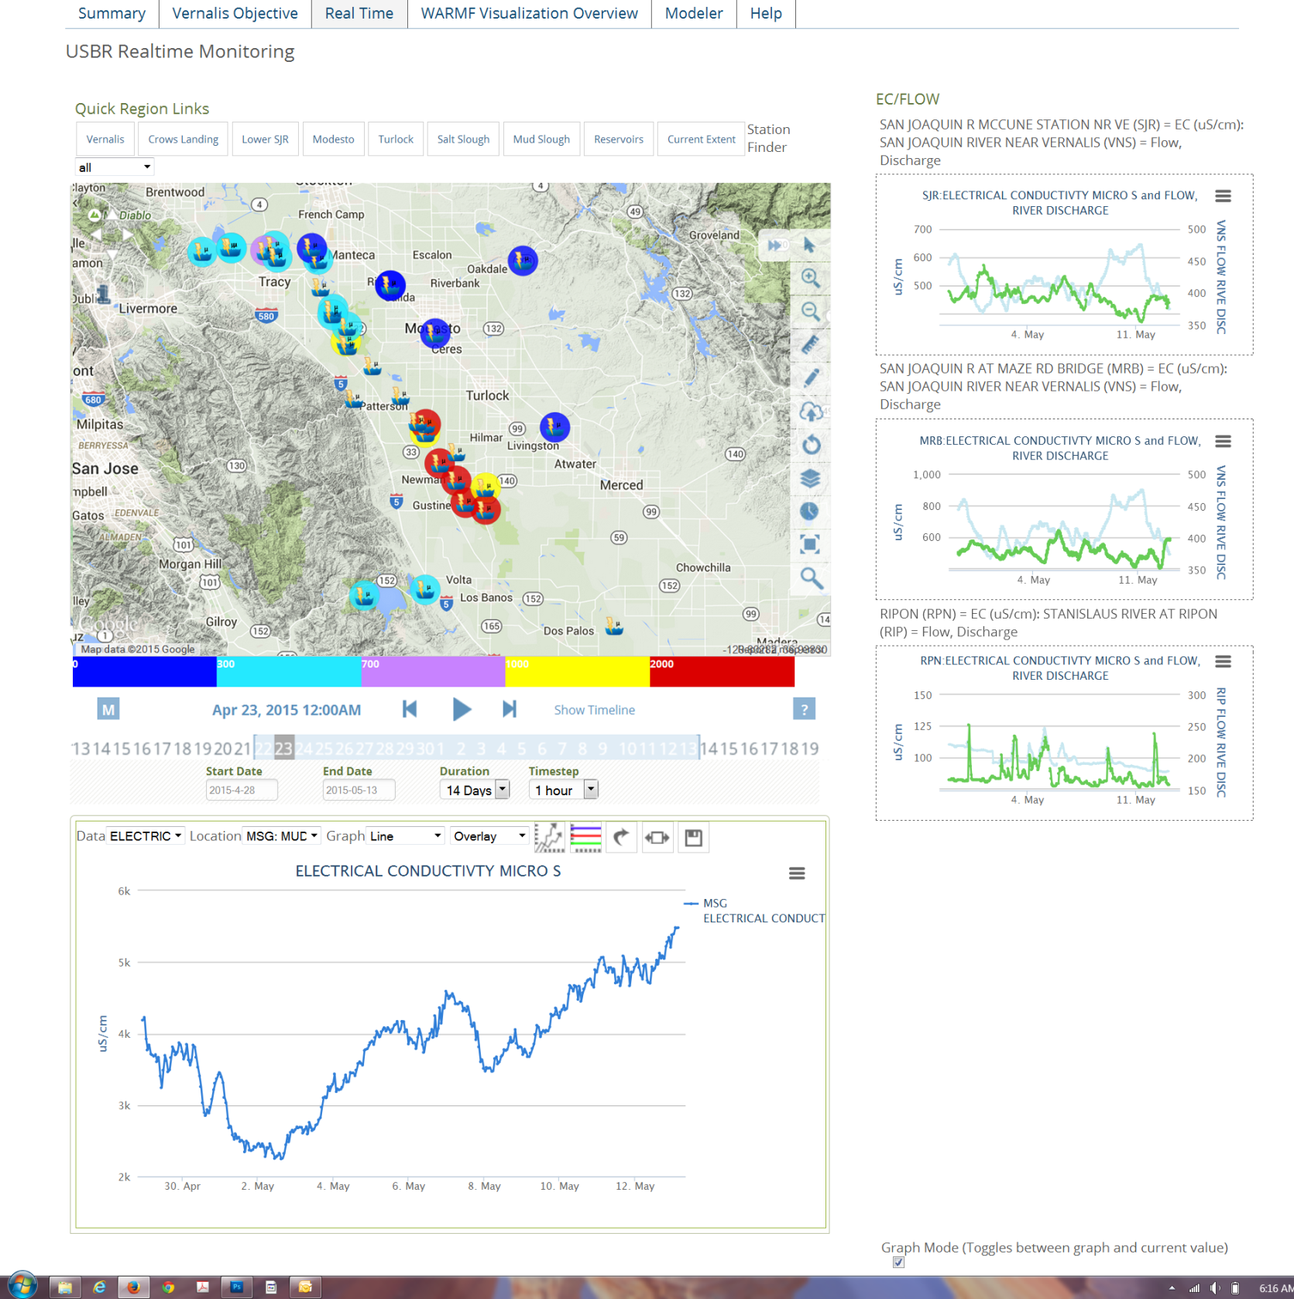

Slide 32
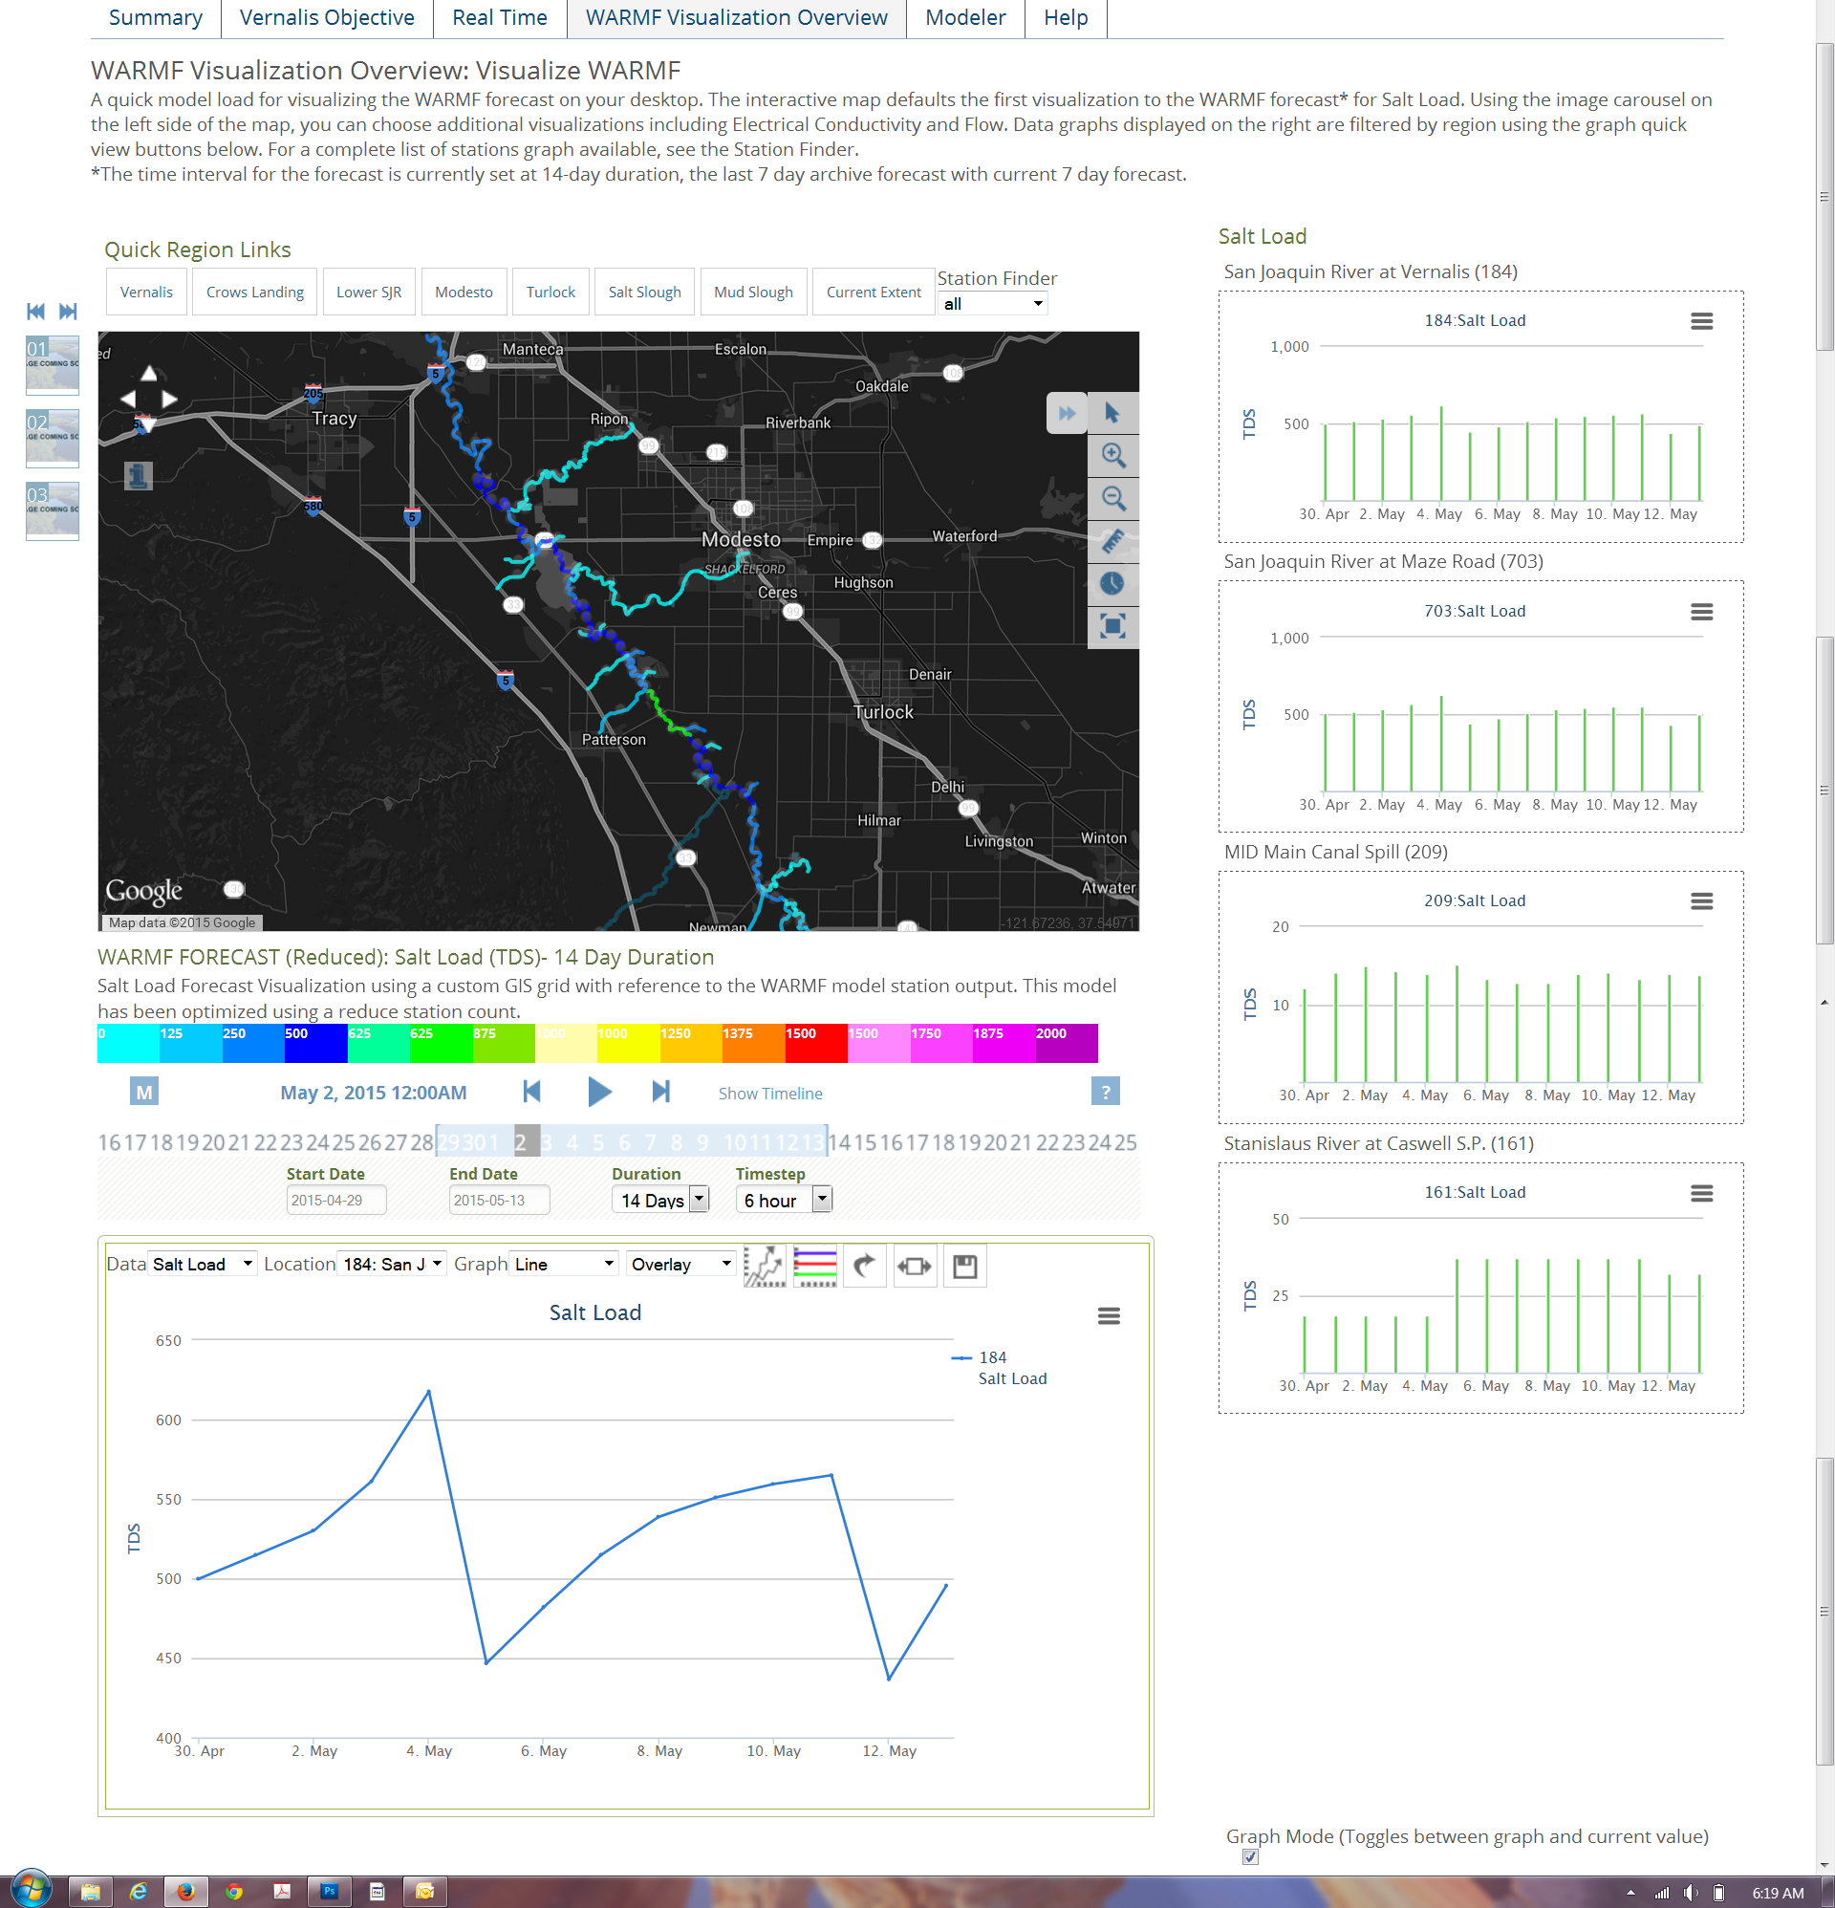

Slide 33
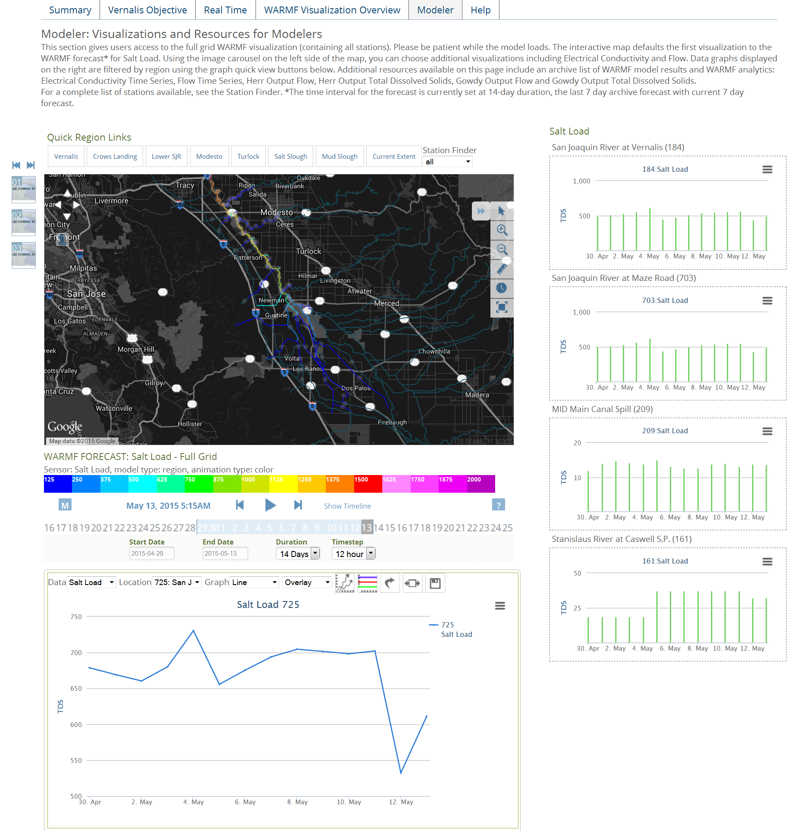

Slide 34
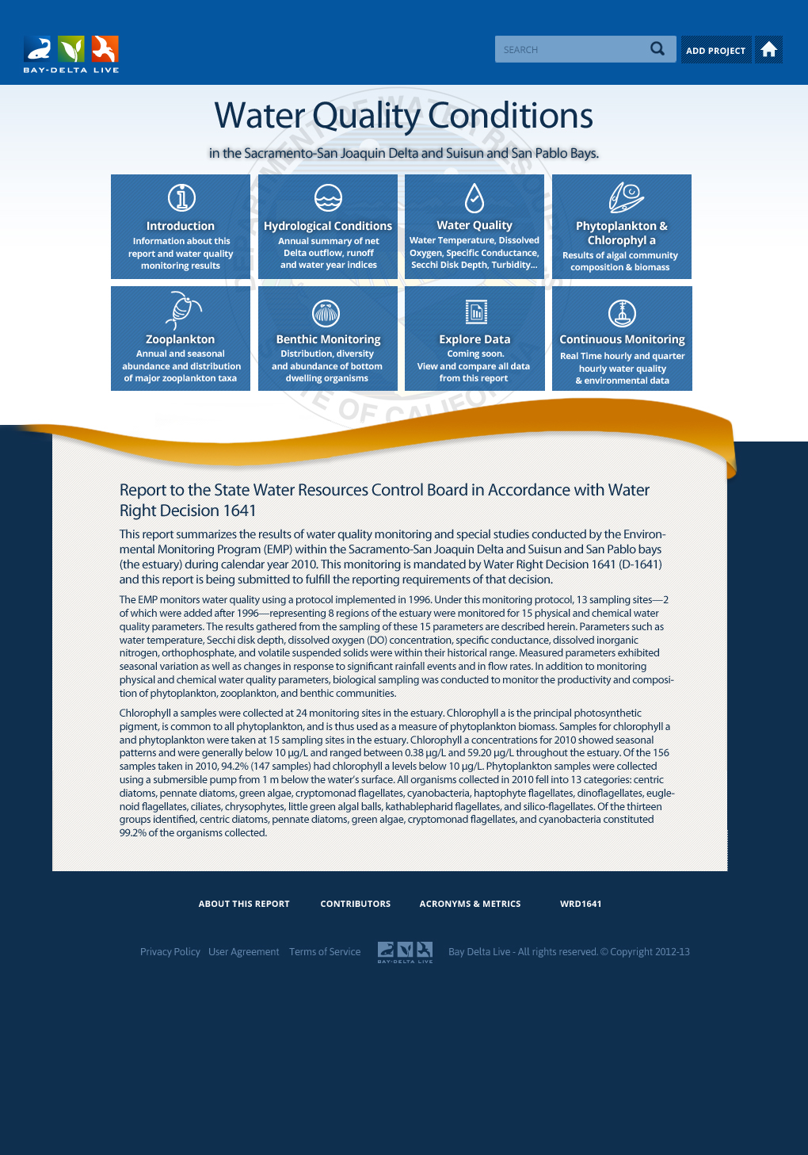


REGULATORY REPORTING
WATER QUALITY DATA (Phase 2):
Environmental Monitoring Program (EMP) water quality monitoring and special studies for:
Redeisgn
Hydrolologic Conditions
Water Quality
Phytoplankton and Chlorophyll a
Zooplankton
Benthic
Nutrients
Special Studies

Slide 35
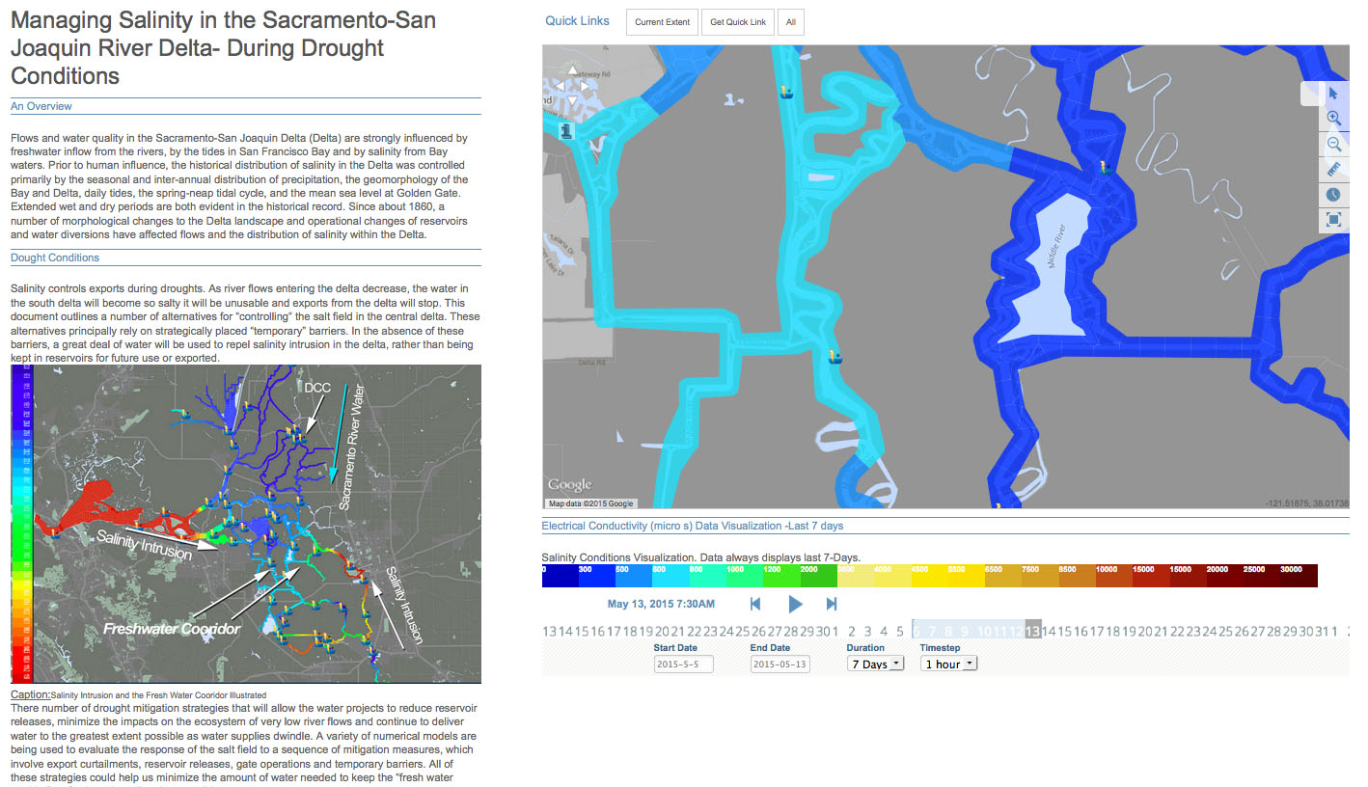
DATA STORIES
Notes:
Clients include: Honeywell, USGS, DWR, MWD, History Channel,

Slide 36
Notes:
Clients include: Honeywell, USGS, DWR, MWD, History Channel,

Slide 37

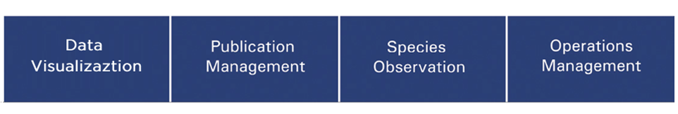
Using the OpenNRM Workspace to build stories using Spatial Data, Observations Data, and Site Content to build stories at various scales.
(Site Level, Regional Level and System Wide)
Notes:
Using the OpenNRM Workspace to build stories using Spatial Data, Observations Data, and Site Content to build stories at various scales.
(Site Level, Regional Level and System Wide

Slide 38
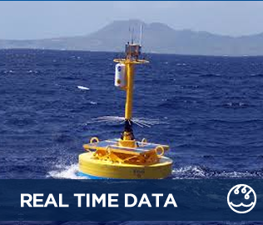
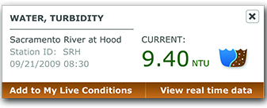
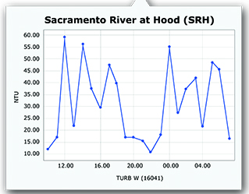
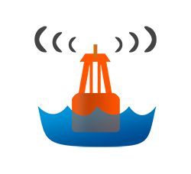



REAL TIME DATA
HUNDREDS OF DATA PARAMETERS:
CALIFORNIA DATA EXCHANGE CENTER (CDEC)
NATIONAL WATER INFORMATION SYSTEM (NWIS)
NATIONAL OCEANIC & ATMOSPHERIC AGENCY
(NOAA)
CALIFORNIA IRRIGATION MANAGEMENT SYSTEM
(CIMIS)
CALIFORNIA ENVIRONMENTAL DATA EXCHANGE NETWORK (CEDEN)
(Hydrodynamic, Water Quality, Meteorlogical)

Slide 39
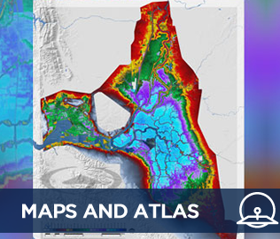
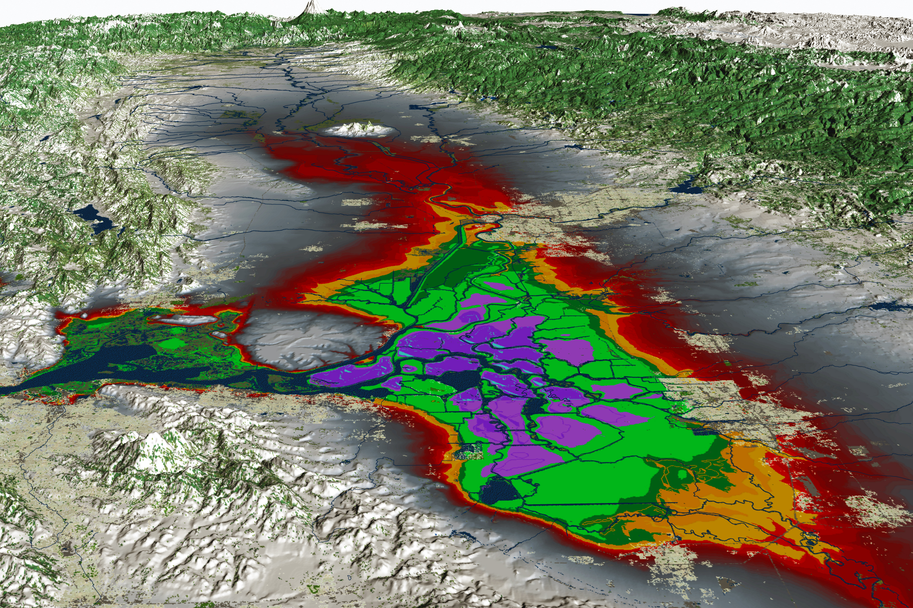
VISUALIZATIONS
VISUALIZE DATA ON THE WEB:
Real-Time Data
Discrete Data added by user
GIS Data
Projects
Documents
Interpolate, Model, Graphs, Maps, Analytics. Associate with
anything.

Slide 40
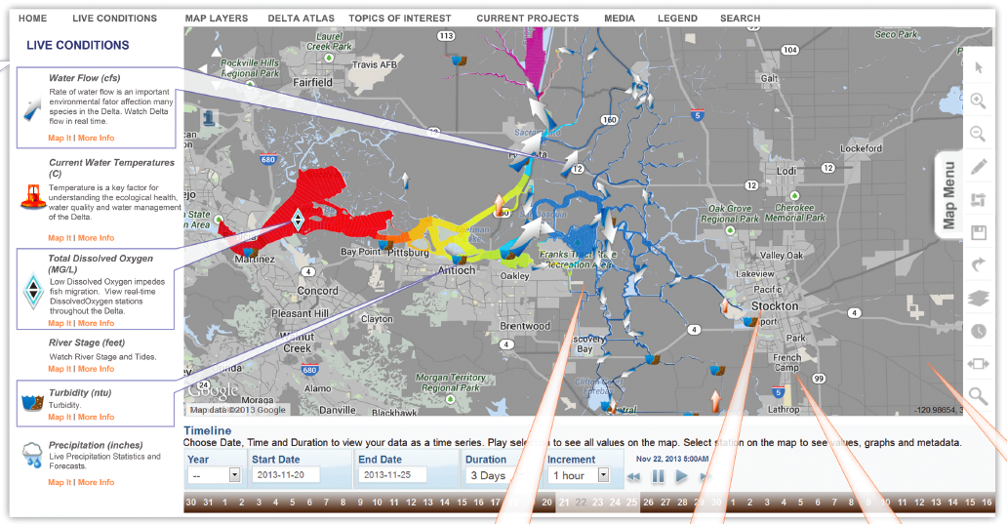
MULTI PARAMETER VISUALIZATIONS

Slide 41
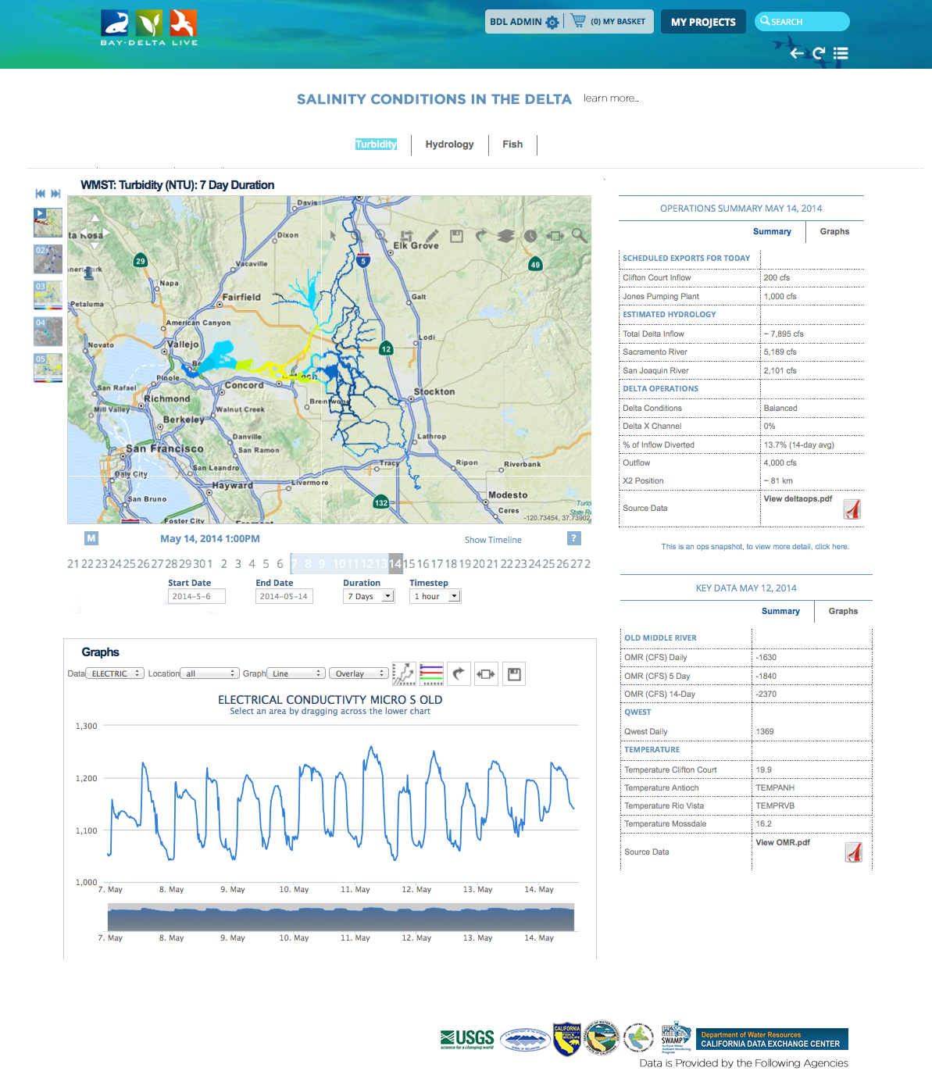
DATA DASHBOARDS
ONE VIEW DATA (Visualize, Map, Graph)
Custom view of data compilations
Project management dashboards

Slide 42
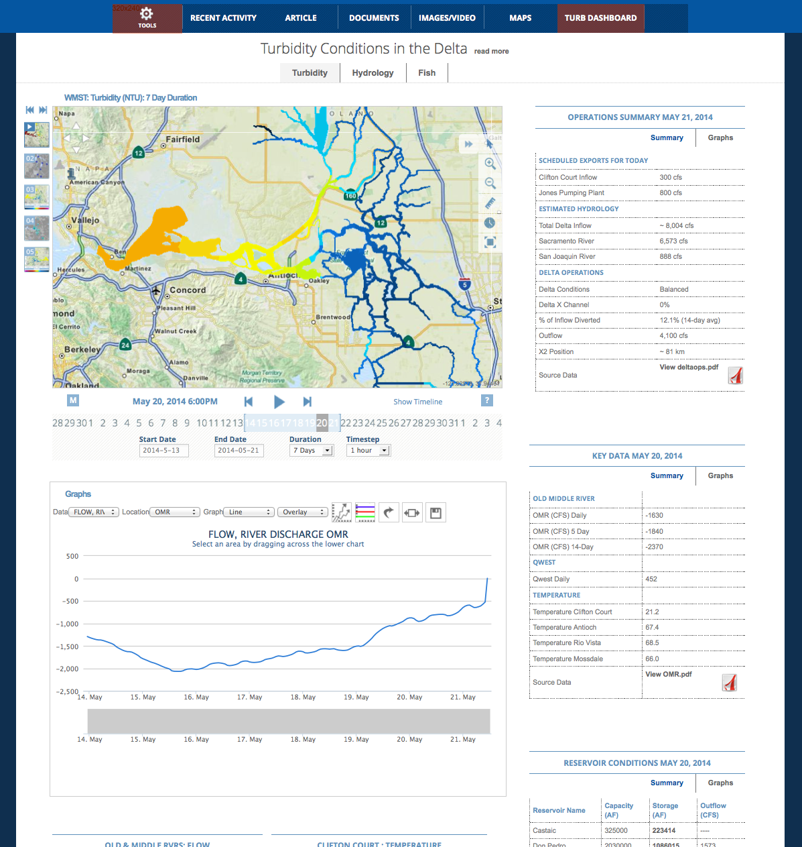
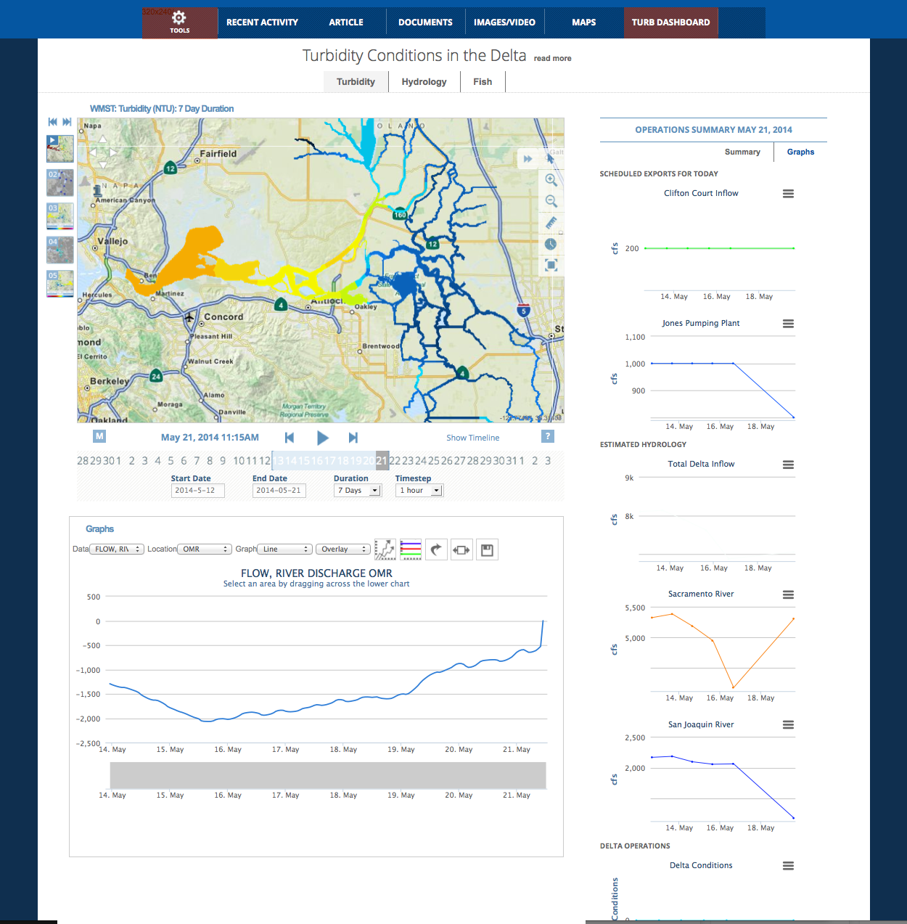
DASHBOARDS

Slide 43
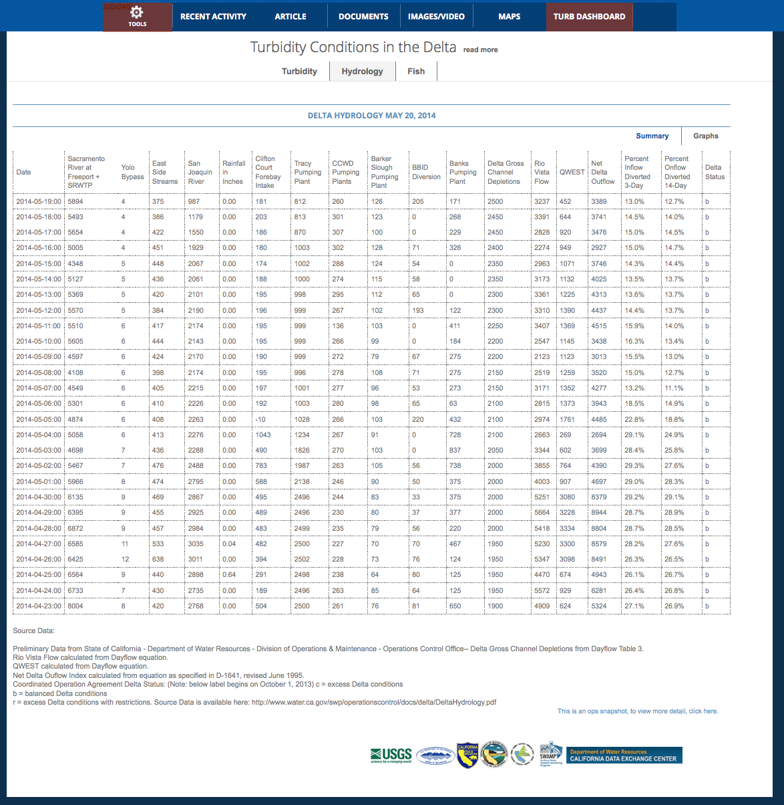
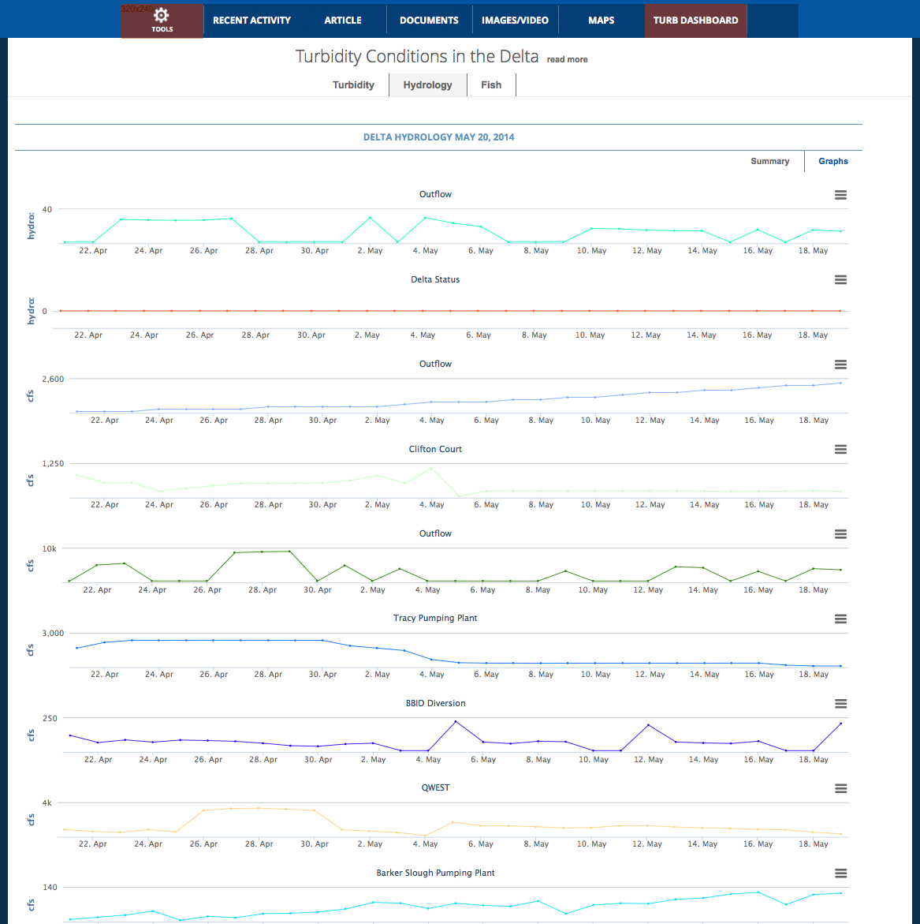
DATA DASHBOARDS

Slide 44
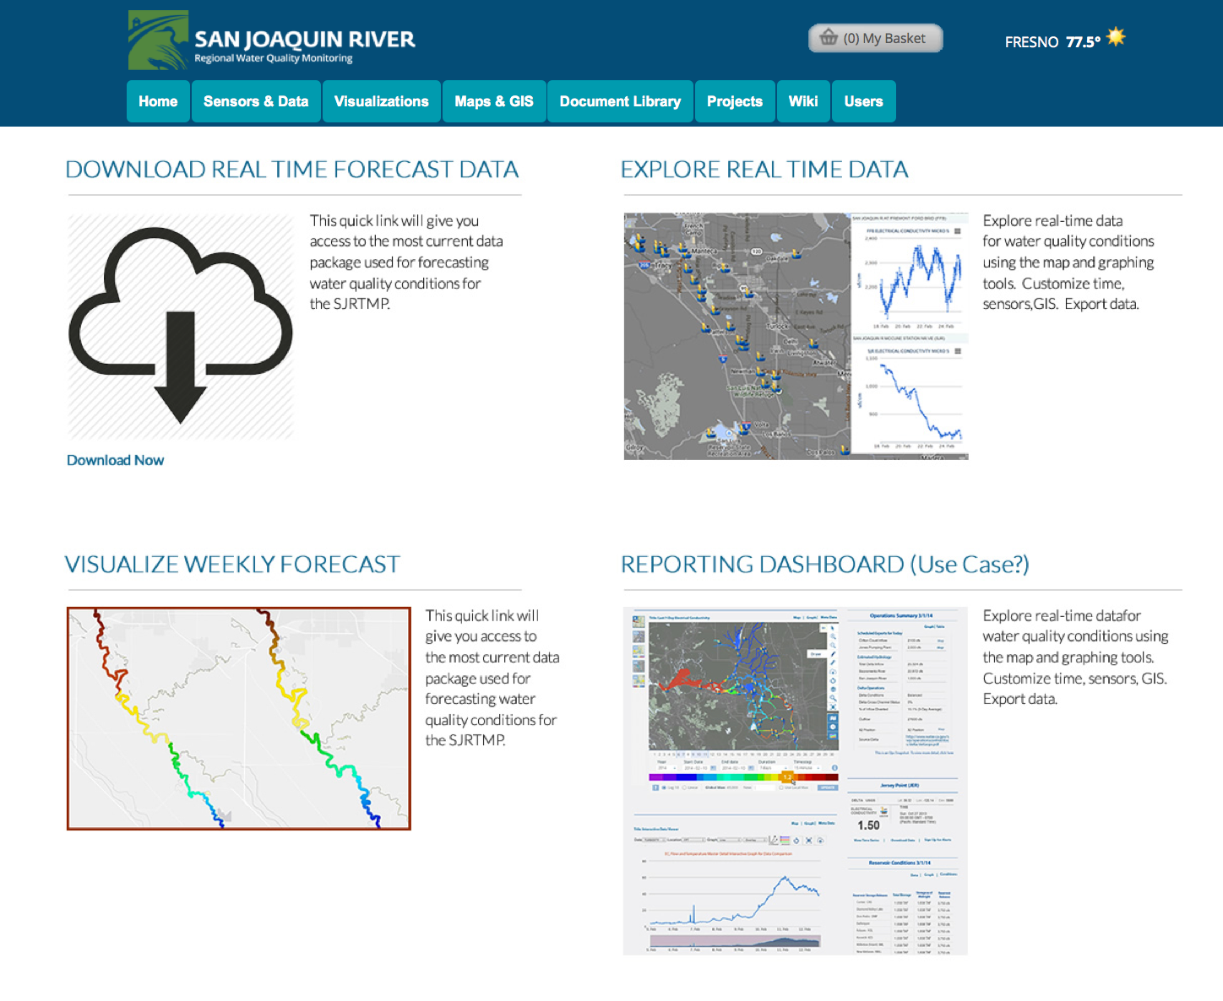
Notes:
Implementation: SJRRTM

Slide 45
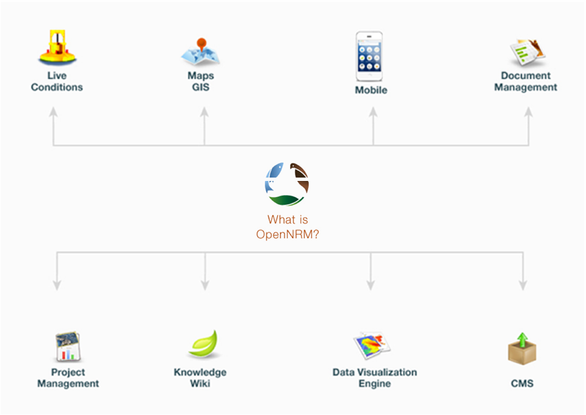
A collaborative resource management workspace and project management application for data collection, analysis, reporting and visualization
A collaborative resource management workspace and project management application for data collection, analysis, reporting and visualization
Notes:
What is OpenNRM?
Built using many of the OS projects you see here this week, OpenNRM is a collection of integrated components to help natural resource managers, scientists, policy makers, conservationists, SEE AND MANAGE THE BIG PICTURE. The platform is made up of: ……

Slide 46

INTEROPERABILITY
Notes:
With the knowledge from California knew we needed to build a highly module and interoperable platform that
Aggregated data both hosted and remote.
The data then needed to be organized and used as information.
Then the software that displayed this information needed to be to give the users maximum flexibility to accomplish their individual needs.

Slide 47


Slide 48


