Slide 1
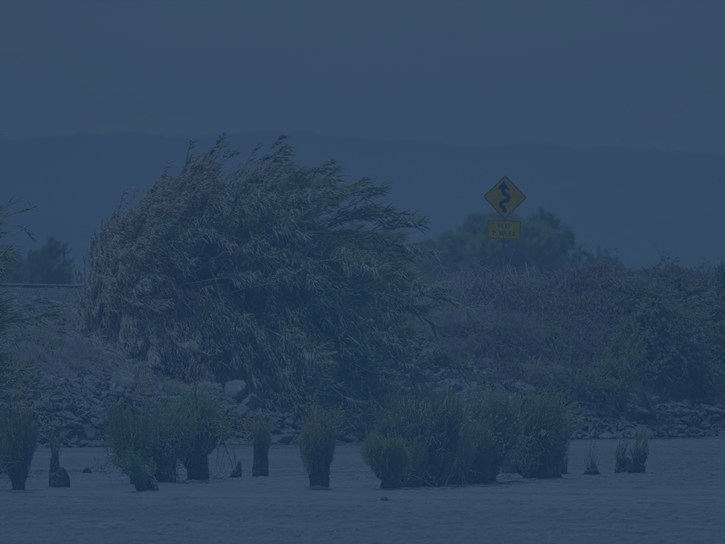
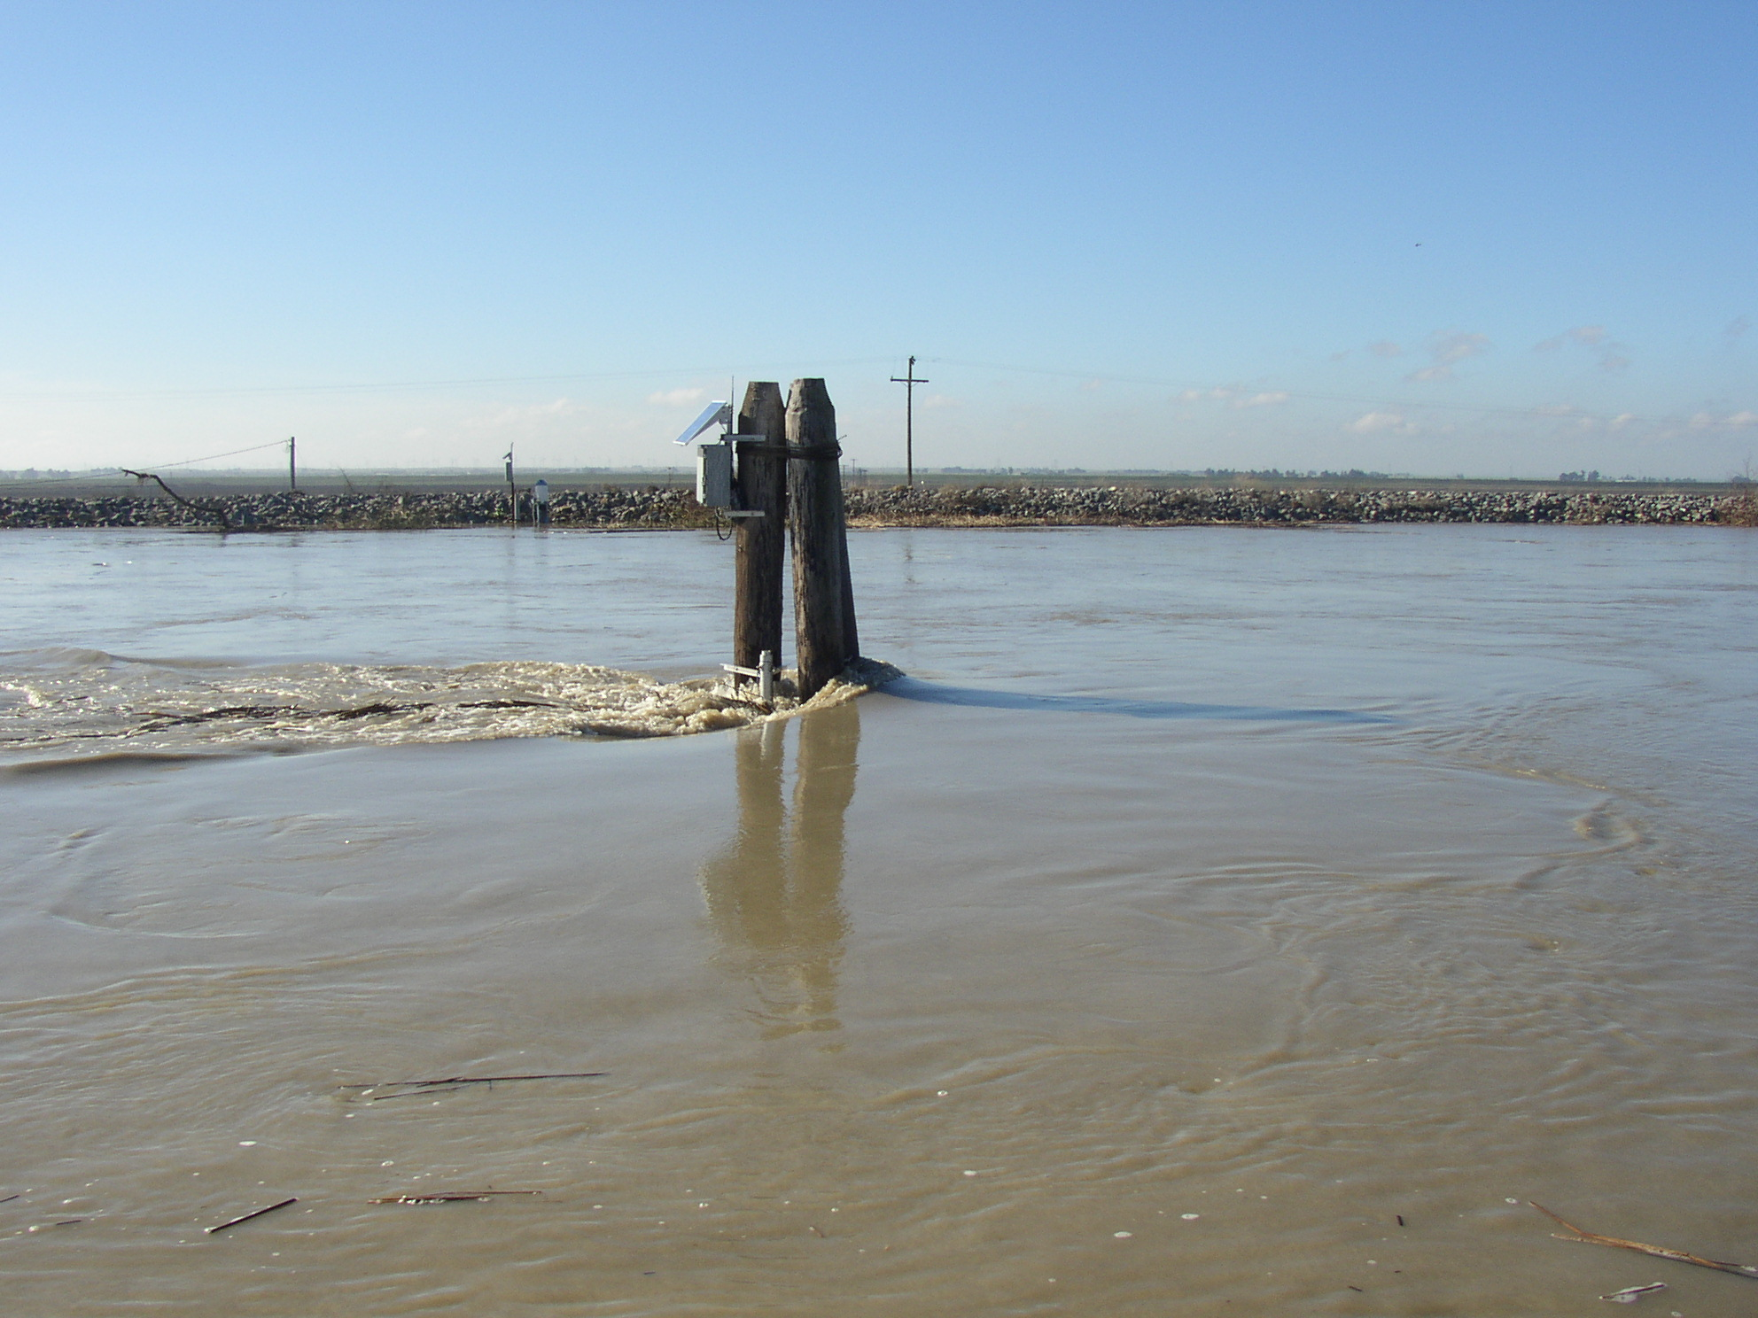
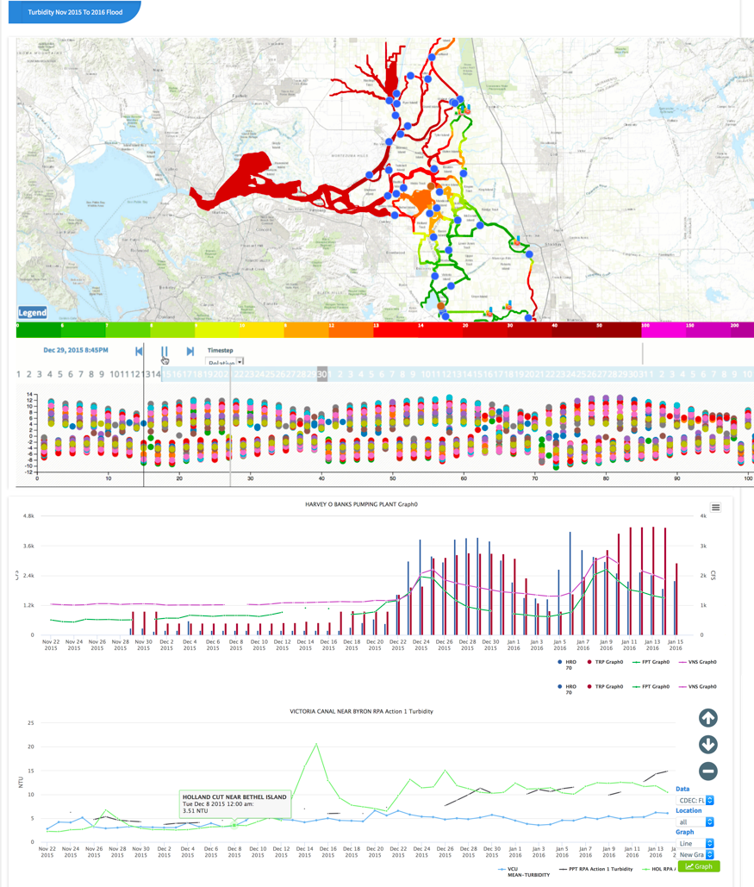


Modeling ‘Delta-Scale’ Water Quality Fields
Nathan Hemenway, Dave Osti, Jon Burau, Jon Donovan, Amye Osti

Slide 2
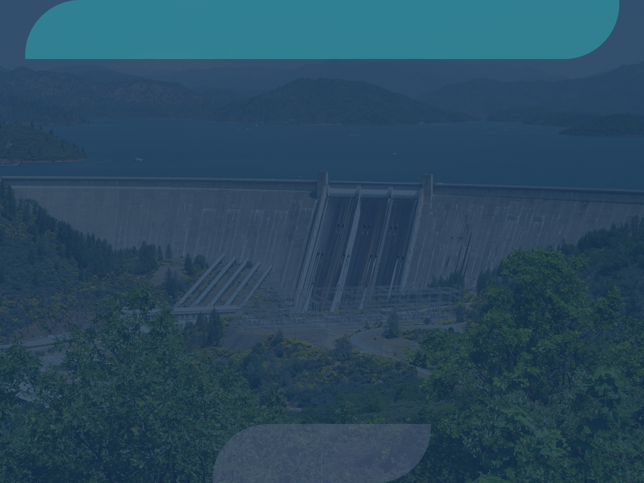







A Collaborative Effort
USGS
Metropolitan Water District
California Department of Water Resources
State and Federal Contractors Water Agency
USBR
34 North

Slide 3
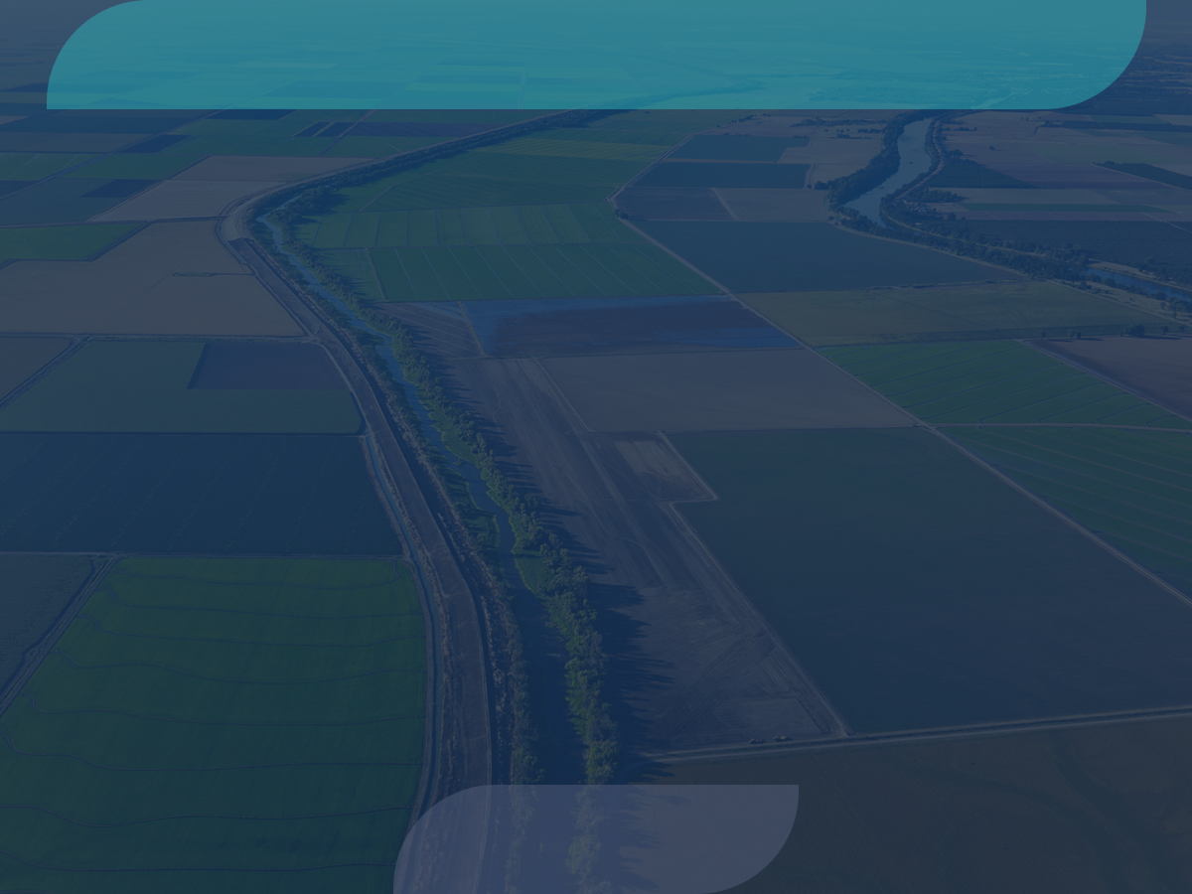
Water Project Operation Issues
Water projects are managed by large scale processes.
Water project operational response to water quality variability is slow (days to weeks).
Water quality conditions are governed by constituent fields that move at variable timescales.
Water quality conditions are influenced by twice daily rapid and powerful tidal cycles (affecting up to 8 miles of water quality conditions in the western Delta).
Other factors impacting the constituent field and further complicate issues are river flows, spring/neap (14-day) cycle and pumping.
Delta Smelt Working Group reliance on DWR turbidity transect data and maps are misleading (tidal currents can move the turbidity field back and forth in these channels on the order of 5 miles twice a day, every day).

Slide 4
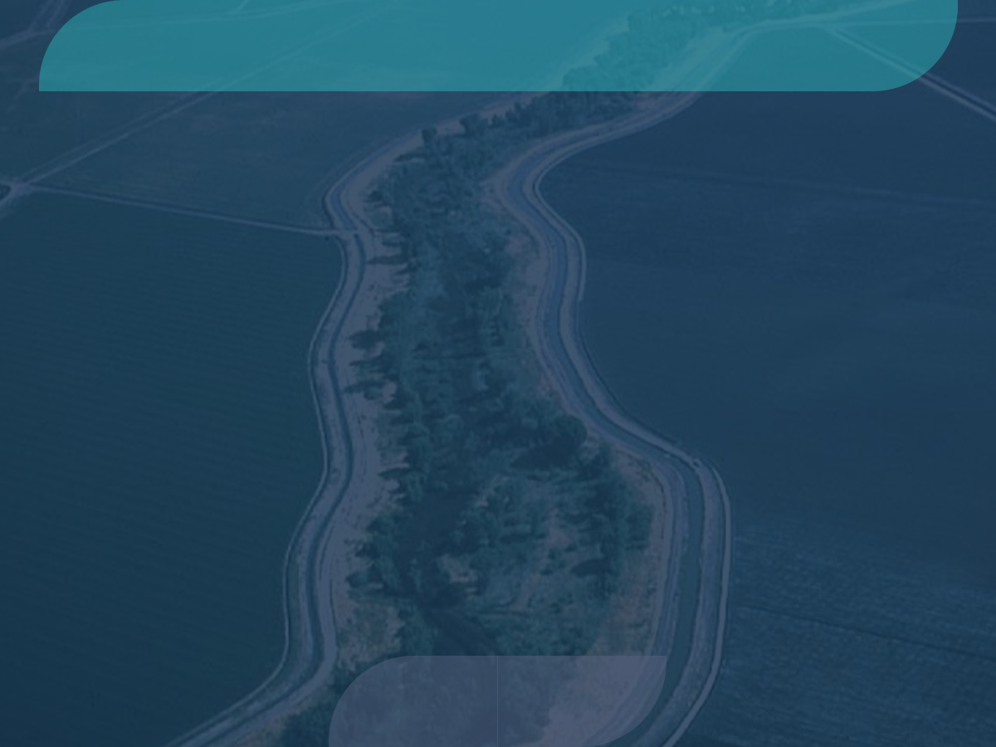
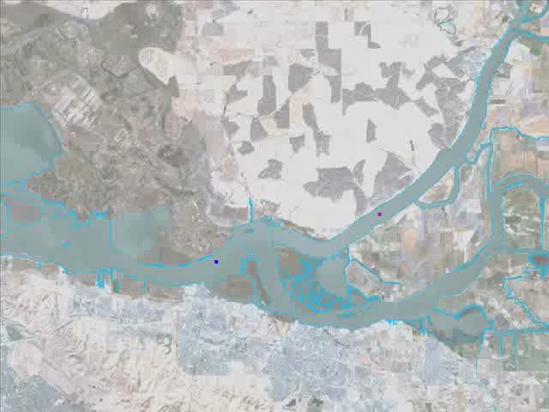
What is Tidal Excursion
(Courtesy of John DeGeorge, RMA)

Slide 5
Research and Model Objectives
Develop a predictive tool using measured observations of water quality constituents or proxies (specific conductivity and turbidity) and measured velocities to demonstrate the constituent field at a constant point in tide.
Develop and prepare daily graphical products showing excursion of these constituents from their slack-water distributions. This work will be performed in order to reduce the need for in situ measurements of turbidity.
Develop heat maps and animations (3-week duration) of the constituent field interpolated at slack water to show the tidally-averaged movement of the maximum incursion of turbidity into the South Delta.
Allow users to build their own models and combine with other data.
Apply model infrastructure to evaluate additional constituents including temperature, chlorophyll and food web transport.

Slide 6
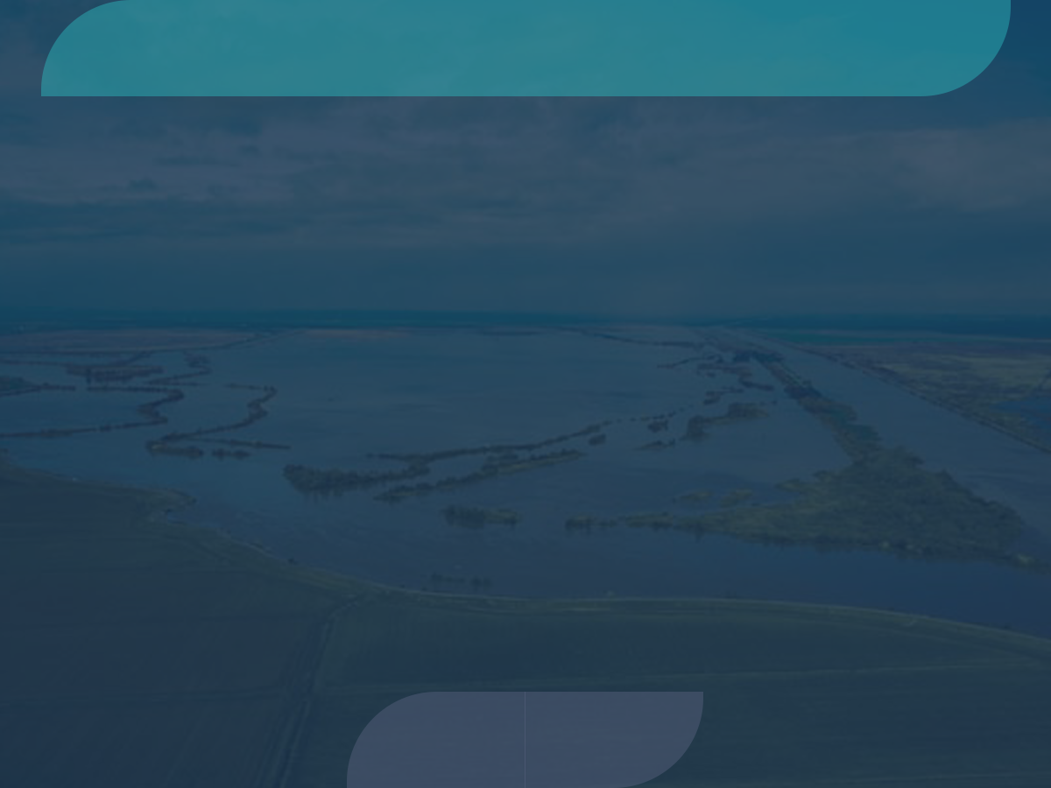
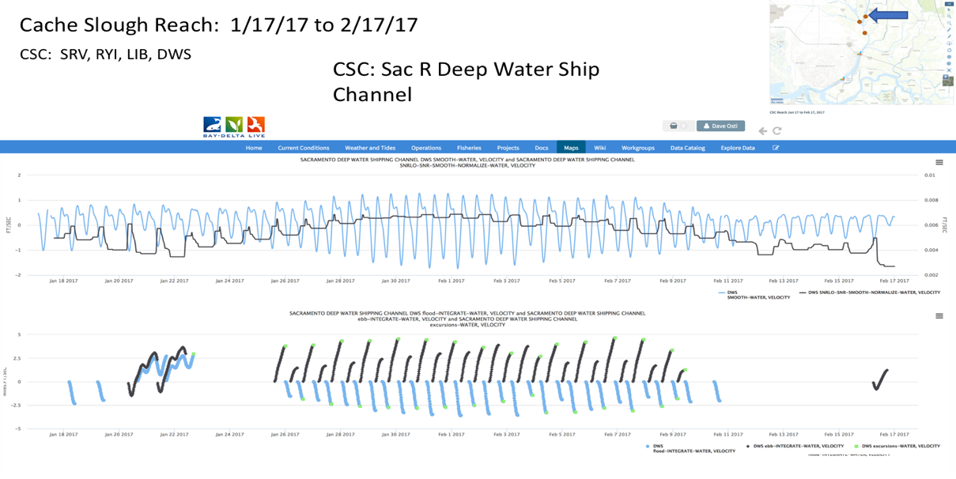
Research and Model 1.0 Objectives
Modeling constituent transport (EC)
Aggregate and develop database for capturing velocity and constituent at each station downstream/upstream.
Generate a time series of normalized velocity values for each station
Generate a time series of Signal To Noise Ratio (SNR).
Generate a time series of the lowest SNR for each tidal cycle.
Implement a conservative tracer (EC) in ARC geometry
Train and visualize data.

Slide 7
Model 1.1 Objectives
Implement model at Delta Scale
Train algorithm to run with network and or data issues
Implement Turbidity
Train and visualize data
Implement evaluation models and dashboards

Slide 8
Model 2.0 Objectives
In partnership with DWR and USGS, proceed with model training and validation with retrospective data. Daily monitoring.
Continued model training and for extreme conditions/edge cases (high flow, spring/neap tides, station failure). Develop tools to automate validation procedures.
Implementation of advection, signal to noise algorithms and plots for constituent excursion tracking points.
Model automation.

Slide 9
Model 2.0 Objectives
User Interface and User Experience: Tideline, model result interaction and reporting, visualization. Build your own model workspace.
Adapt model to additional constituents.
DSWG Dashboard.
Integrate additional operations data: fish trawls, operations, GIS.
Conditions prediction methods and research.
Reporting dashboards, syndication.
Develop model scenarios for network evaluation.
Review and feedback for further development by IEP.
Research paper.

Slide 10
Future Model Applications
Salinity Tracker (Salinity Intrusion, conservative tracer)
Turbidity Tracker (Delta Smelt Working Group, Water Project Ops)
Bloom Tracker (Chl-a - Flow Pulse, Salinity control gates exp.)
Nutrient Tracker (Operation Baseline)

Slide 11
Model Review

Slide 12
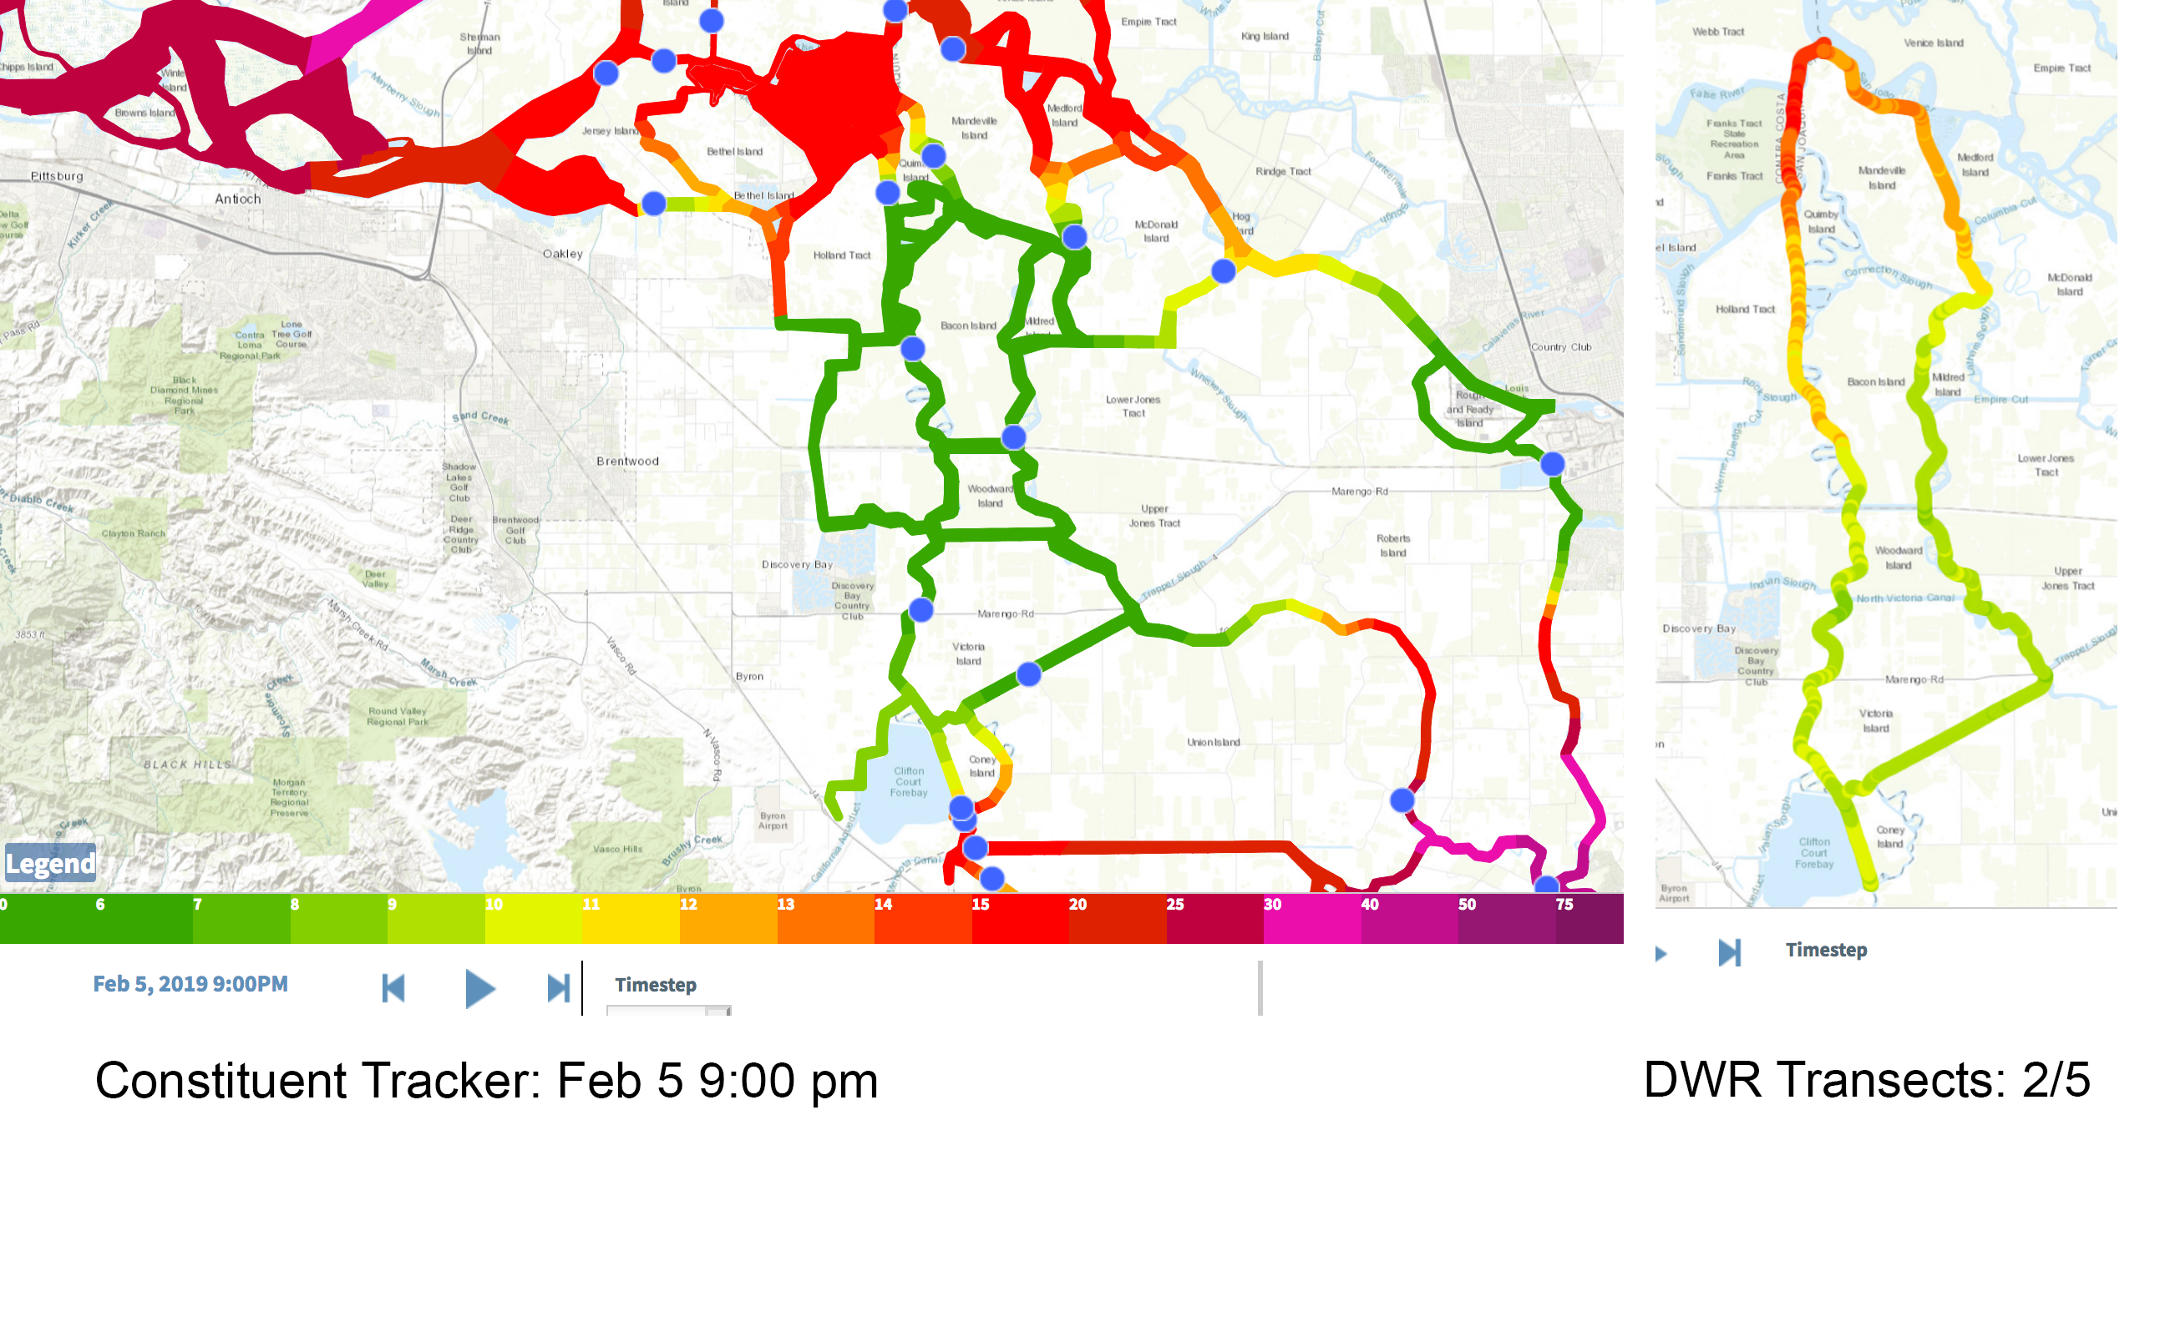
Transect Comparisons

Slide 13
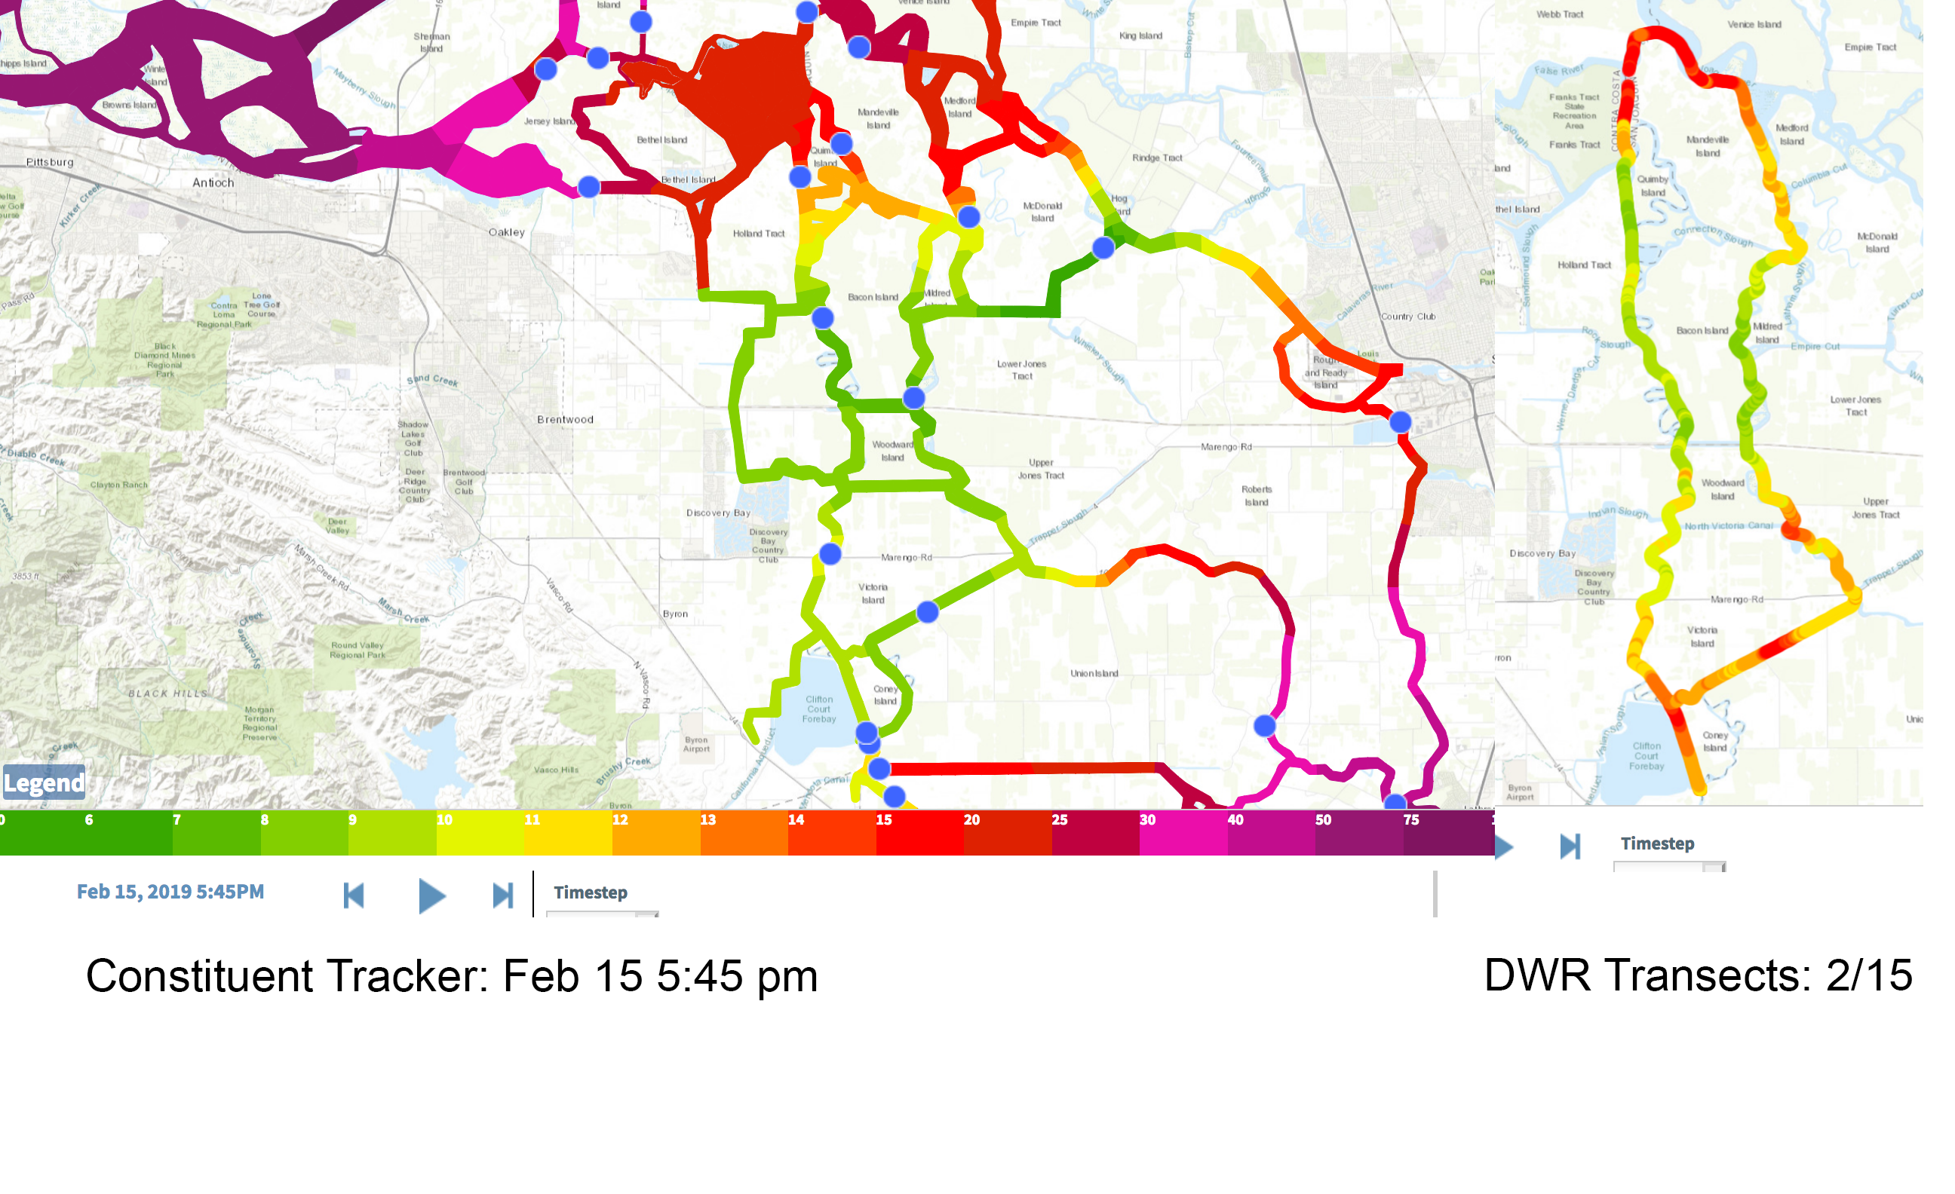
Transect Comparisons

