Slide 1
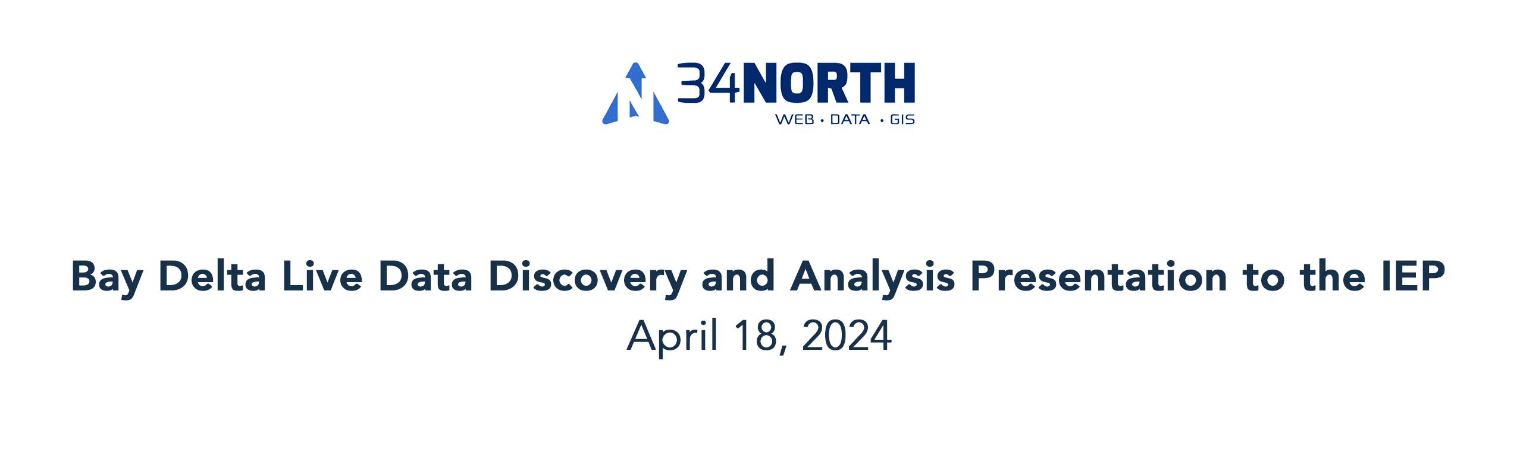
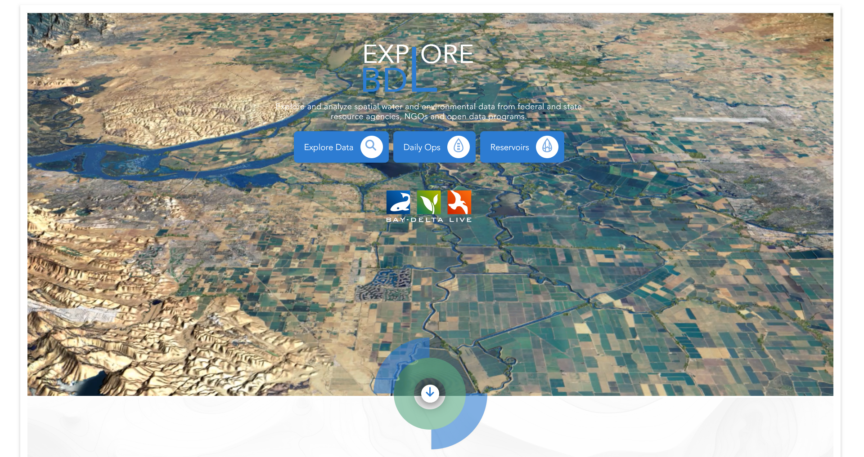

Slide 2
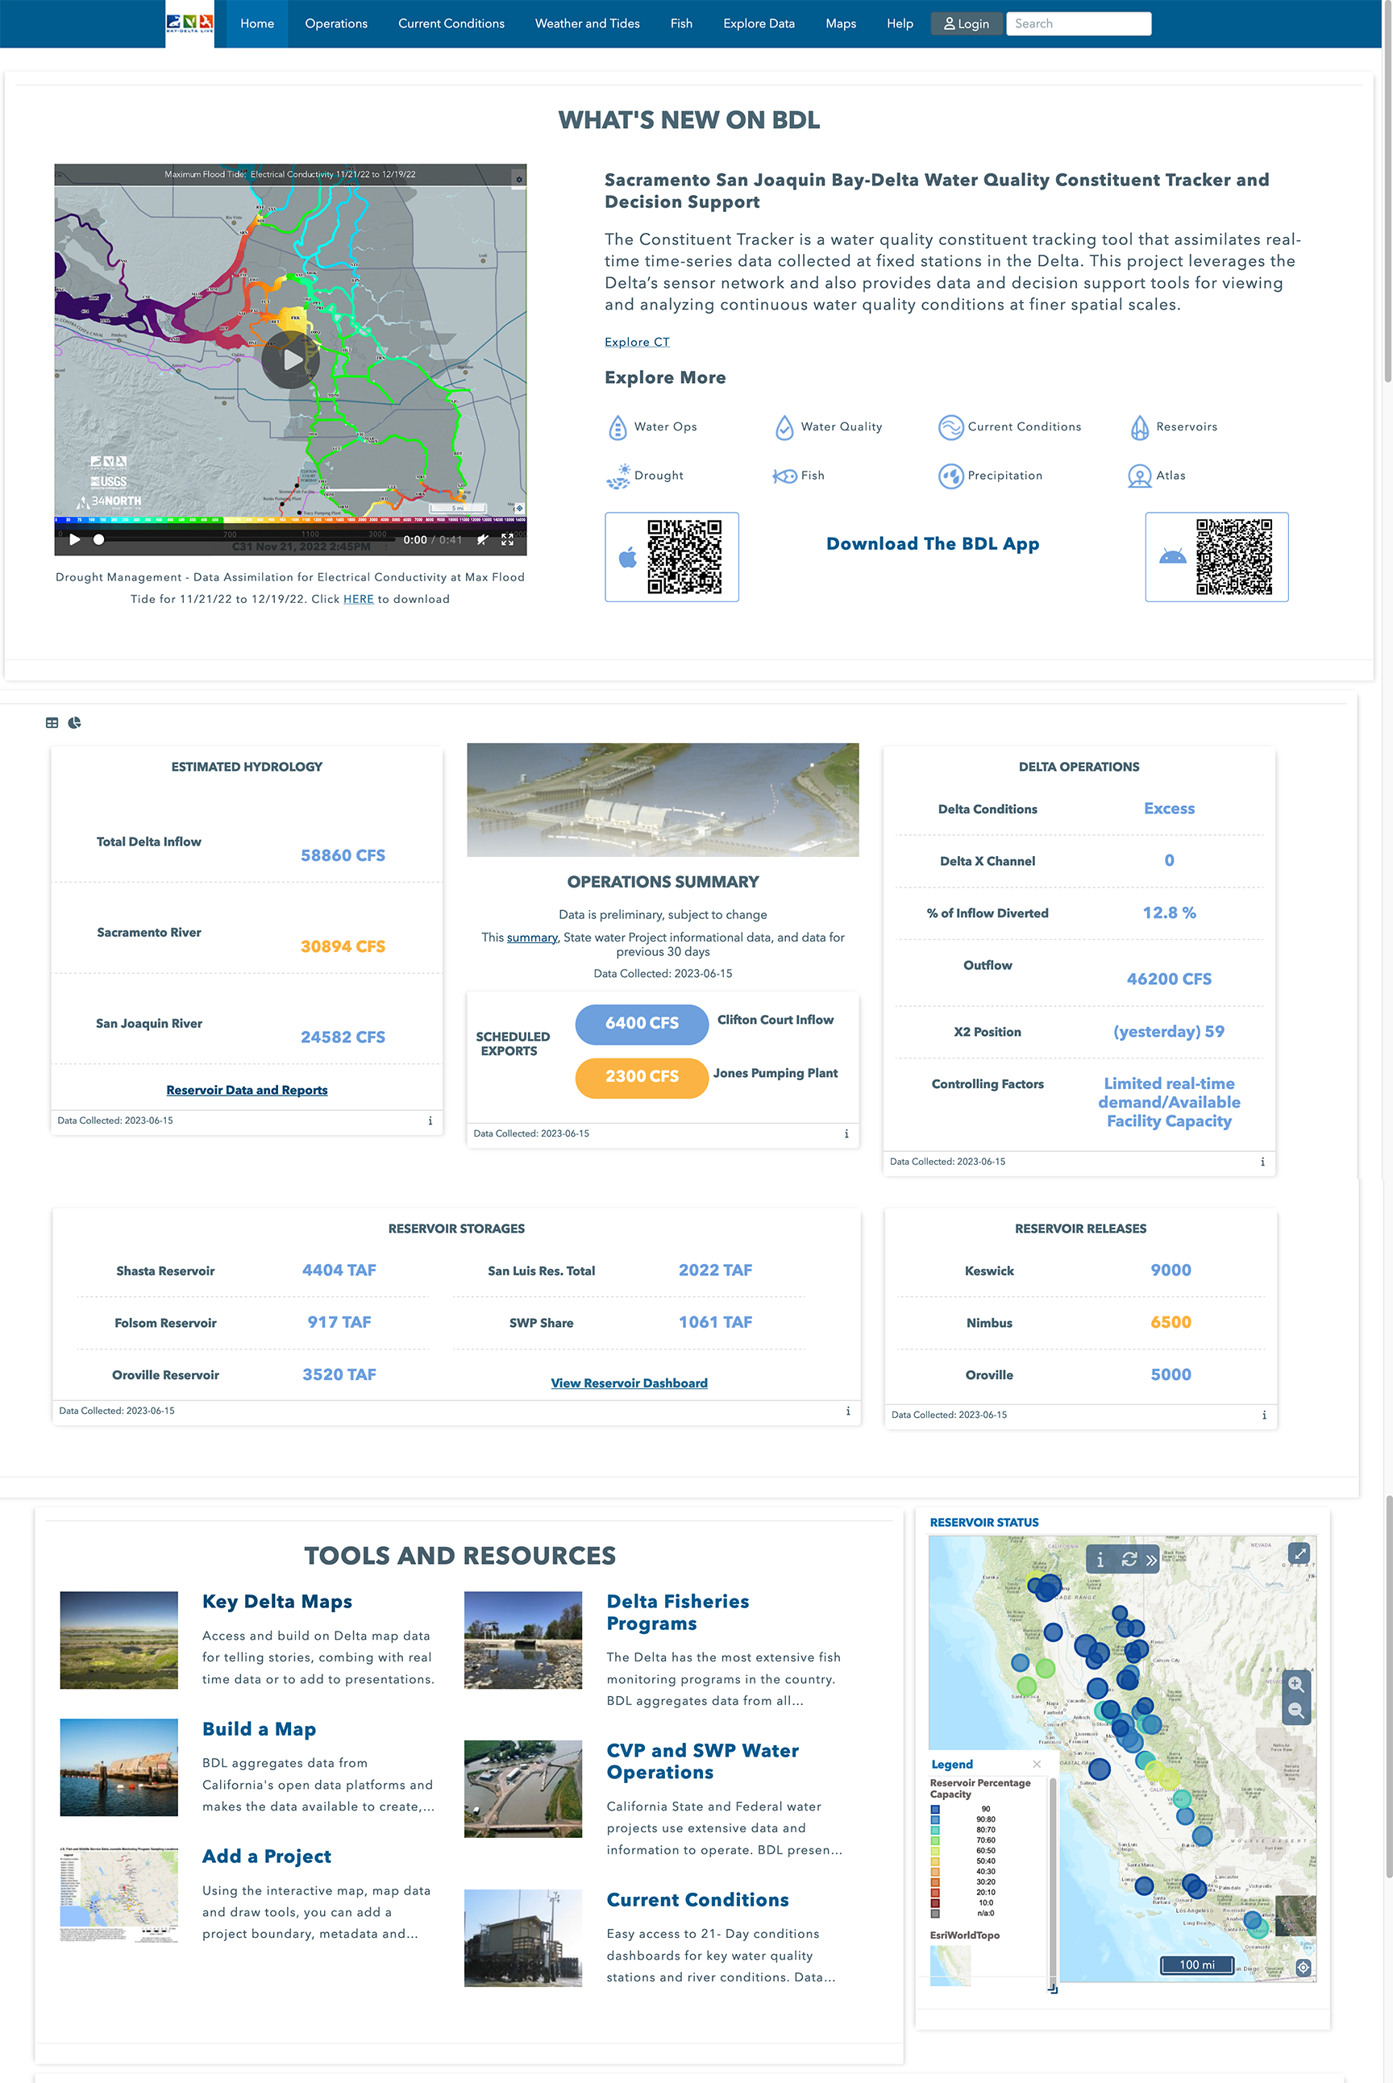
www.baydeltalive.com (BDL)
Presentation Overview
User Community 2022-23
BDL Overview
Funding Partners and Investments
What is BDL?
Review of Past Work
2024 New Data and Tools
Notes:
Today I will give a briefing on the BayDeltaLive data portal. Review
1. User Community Numbers
2. Elements of the BDL site
3. BDL powered sub domains
-NASA/JPL
-BDL iPhone and Android App
-CSAMP Website

Slide 3
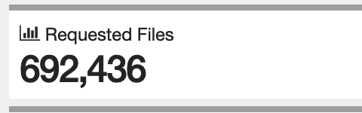
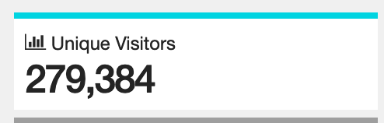
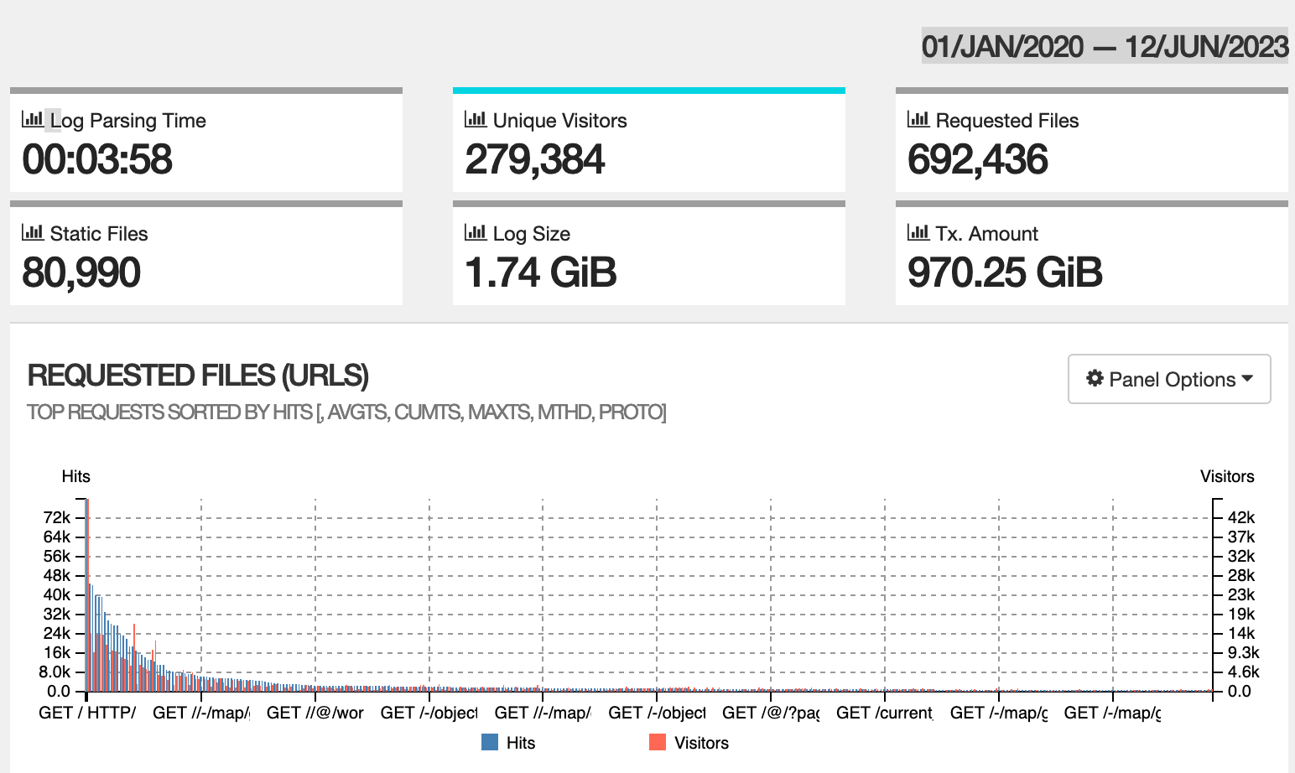
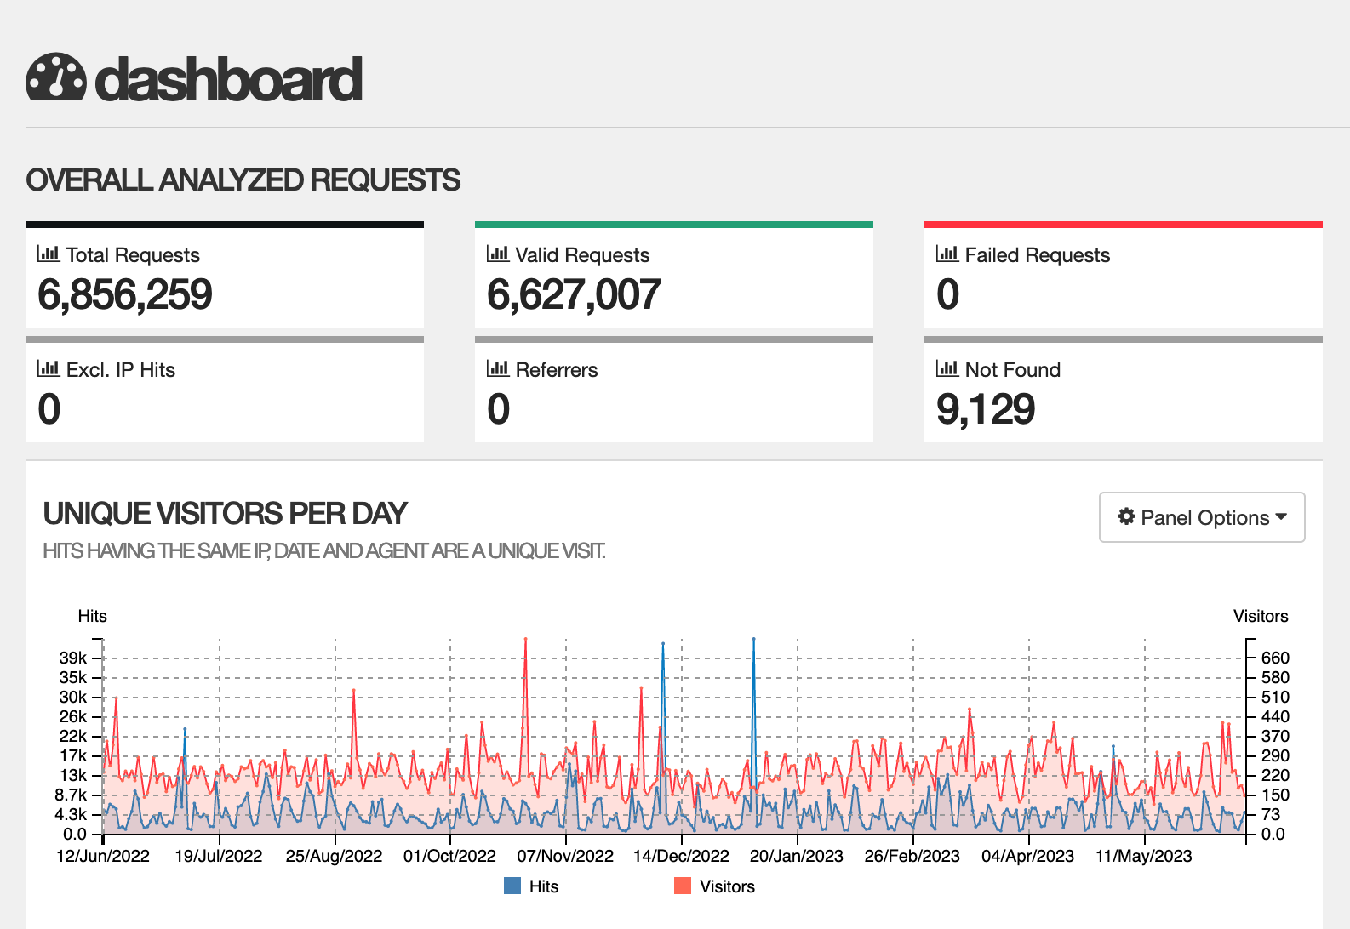

User Community 2020-2023

Slide 4
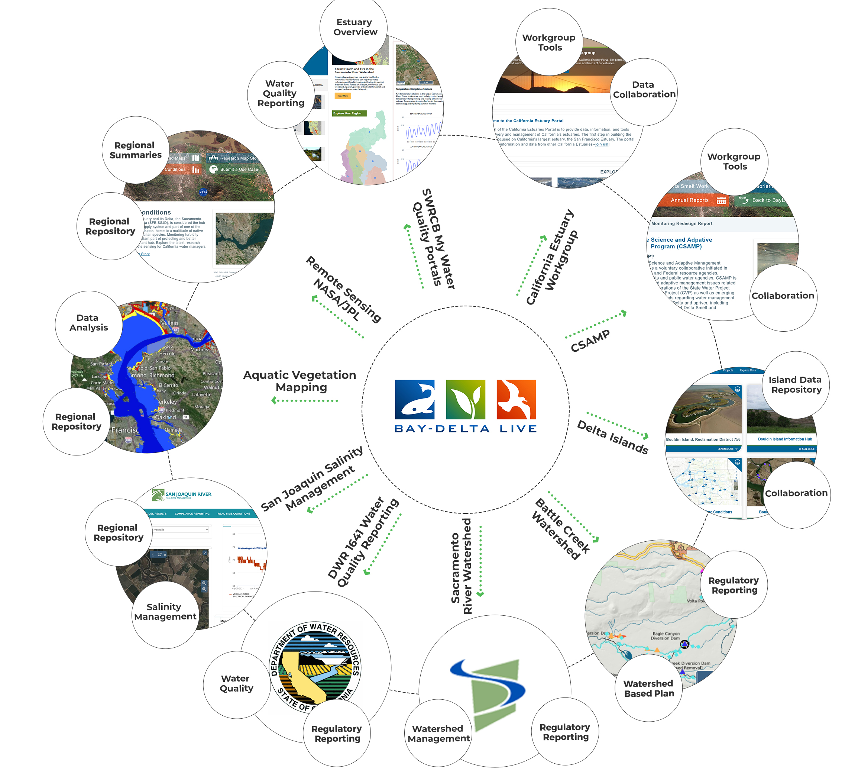















Funding Partners & Regional Programs
Community Investment
SFCWA - $477k
USBR - $100k
DWR EMP - $360k
SWC -$330k
MWD - $500k
JPL/NASA – $130k
CalFire - $300k
SNC-$400K
Battle Creek- $140k
SWRCB- $150k
RCDs & FSCs - $500K
DSC-$45K
Notes:
Funding and PORTAL EcoSystem

Slide 5
What is BDL?
Open Data Access Platform
Data Federation that aggregates data from hundreds of sources. NWIS, CDEC, NOAA, DWR, USBR, USFWS, CADFWS, Academia, NGOs, NASA, OpenET, AGOL
API Consumer
Web application provides tools use federated data through custom templates, dashboards, maps
Sensor network observations. View many monitoring programs in one location
Map based data analytics
Provides collaborative and special project workspaces (Fisheries, CSAMP, Sutter, Islands, Estuary Workgroup, Remote Sensing)
Notes:
with an integrated and holistic approach to water management that recognizes the interconnectedness of water resources and aims to optimize their use for the benefit of both human and environmental needs

Slide 6
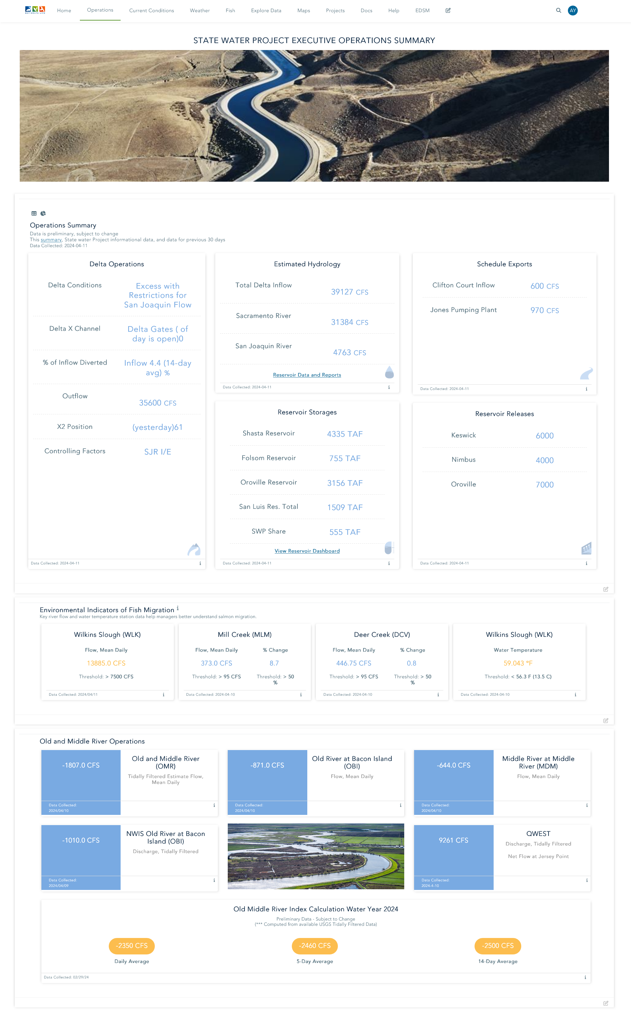

Slide 8
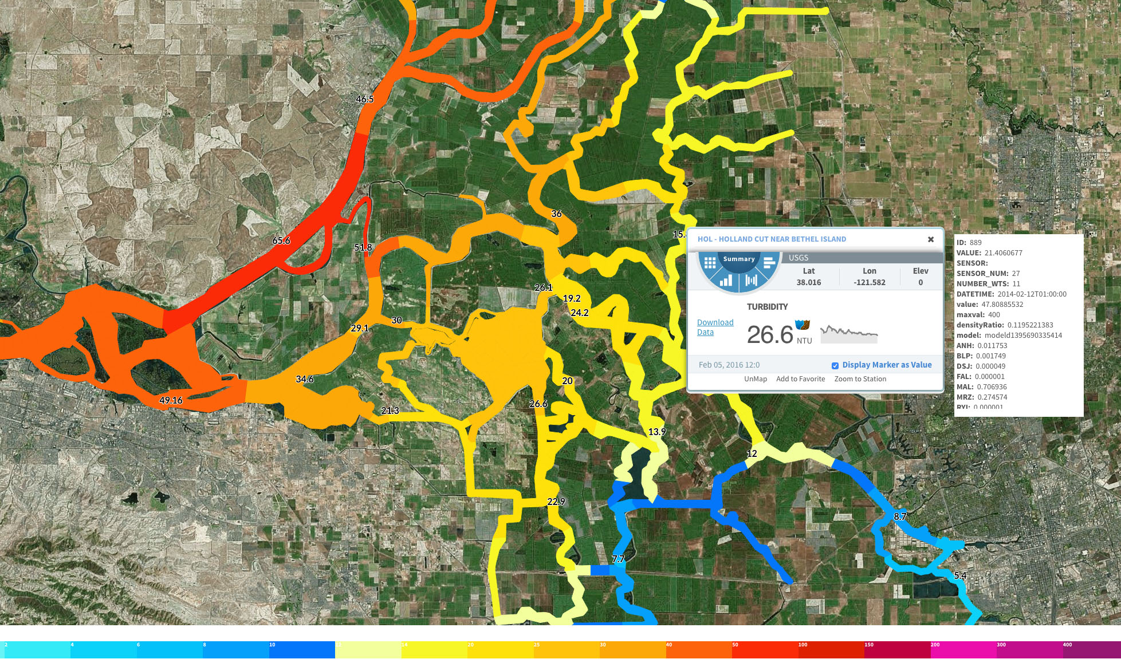
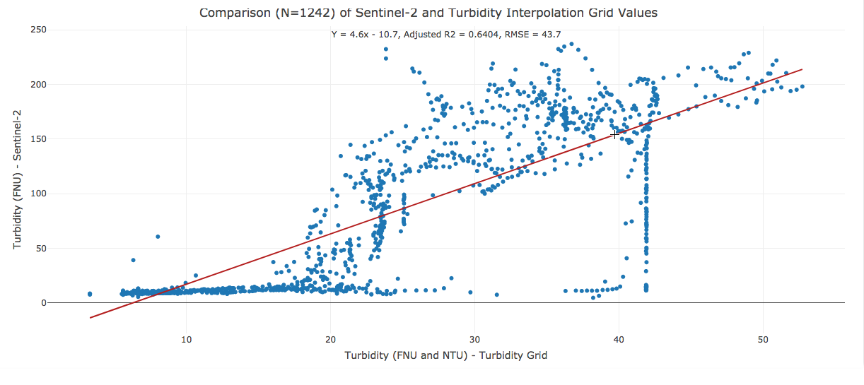
Constituent Tracker – Drought Monitoring and First Flush
What Does it Do?
Data Assimilation Model
Animated Spatial Maps for Real Time Constituent Tracking
View Data at both 15-minute intervals or a Constant Point in Tide
Advance data modeling algorithms
Collaboration with USGS
Who is Using it?
Drought Monitoring
Trawl Managers
Science Community
Water Ops

Slide 9
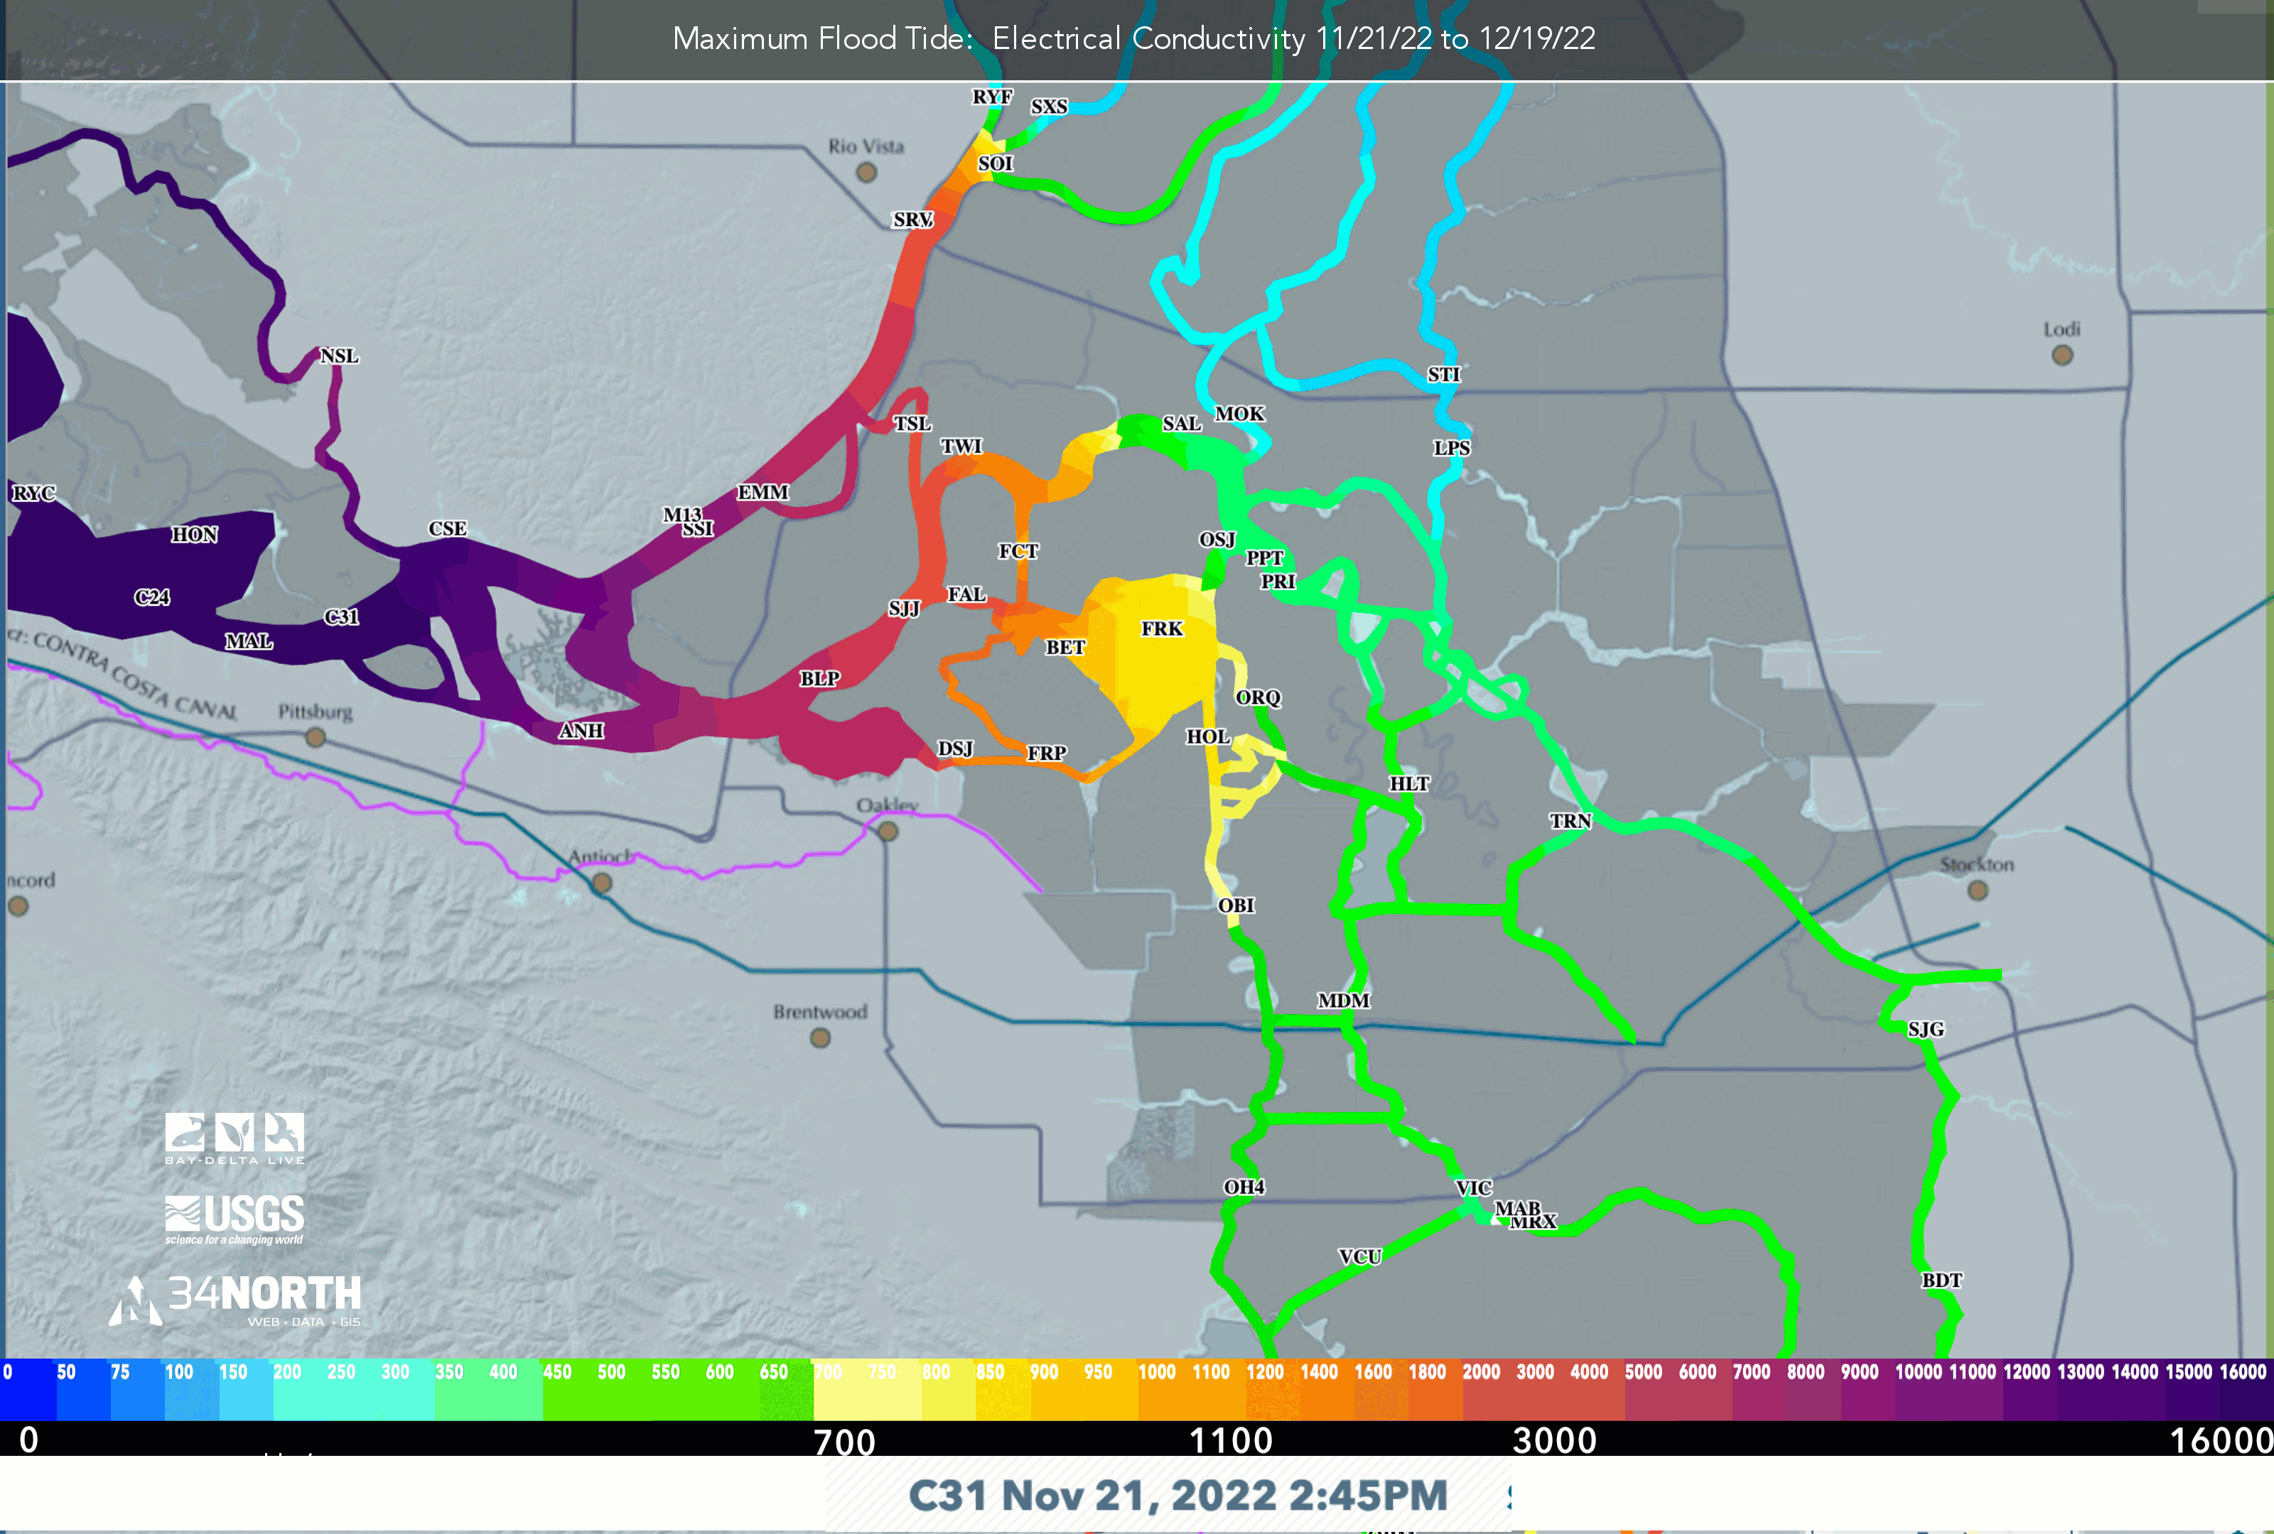
Constituent Tracker Drought Monitoring Oct. – Dec. 2022

Slide 10
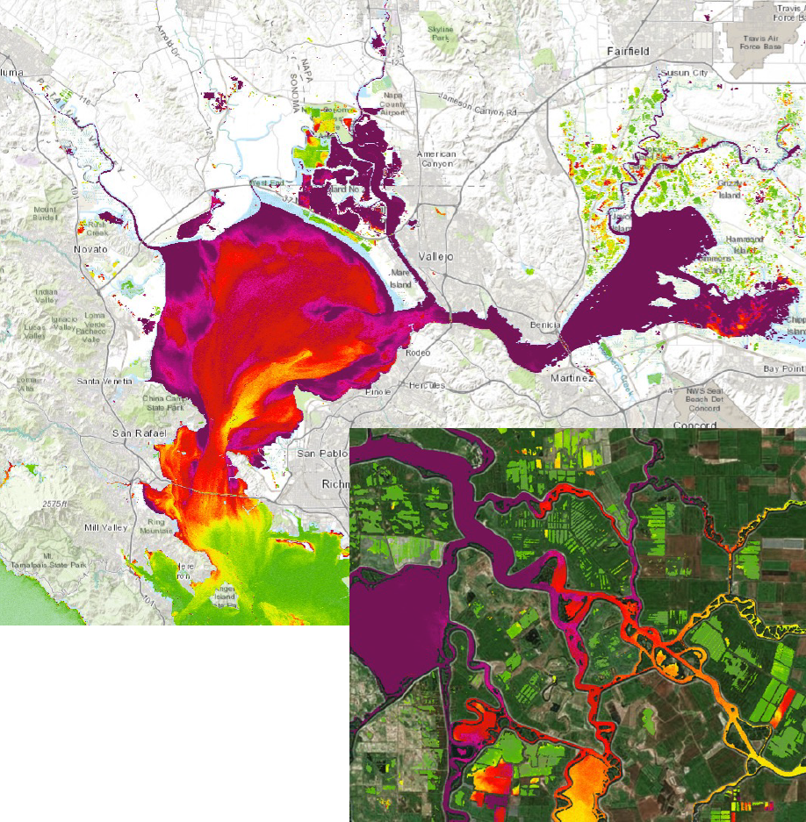
Remote Sensing –NASA/JPL Collaboration
What Does it Do?
Provides data and decision support tools to view and analyze current research in the remote sensing space
Repository for Remote Sensing Data for and by the science community
Who is Using it?
Managers
Science Community
Water Ops

Slide 11
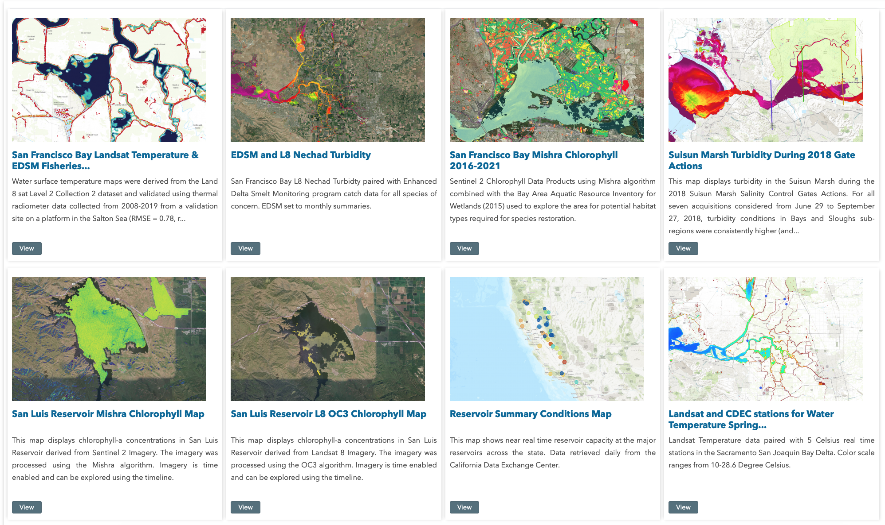
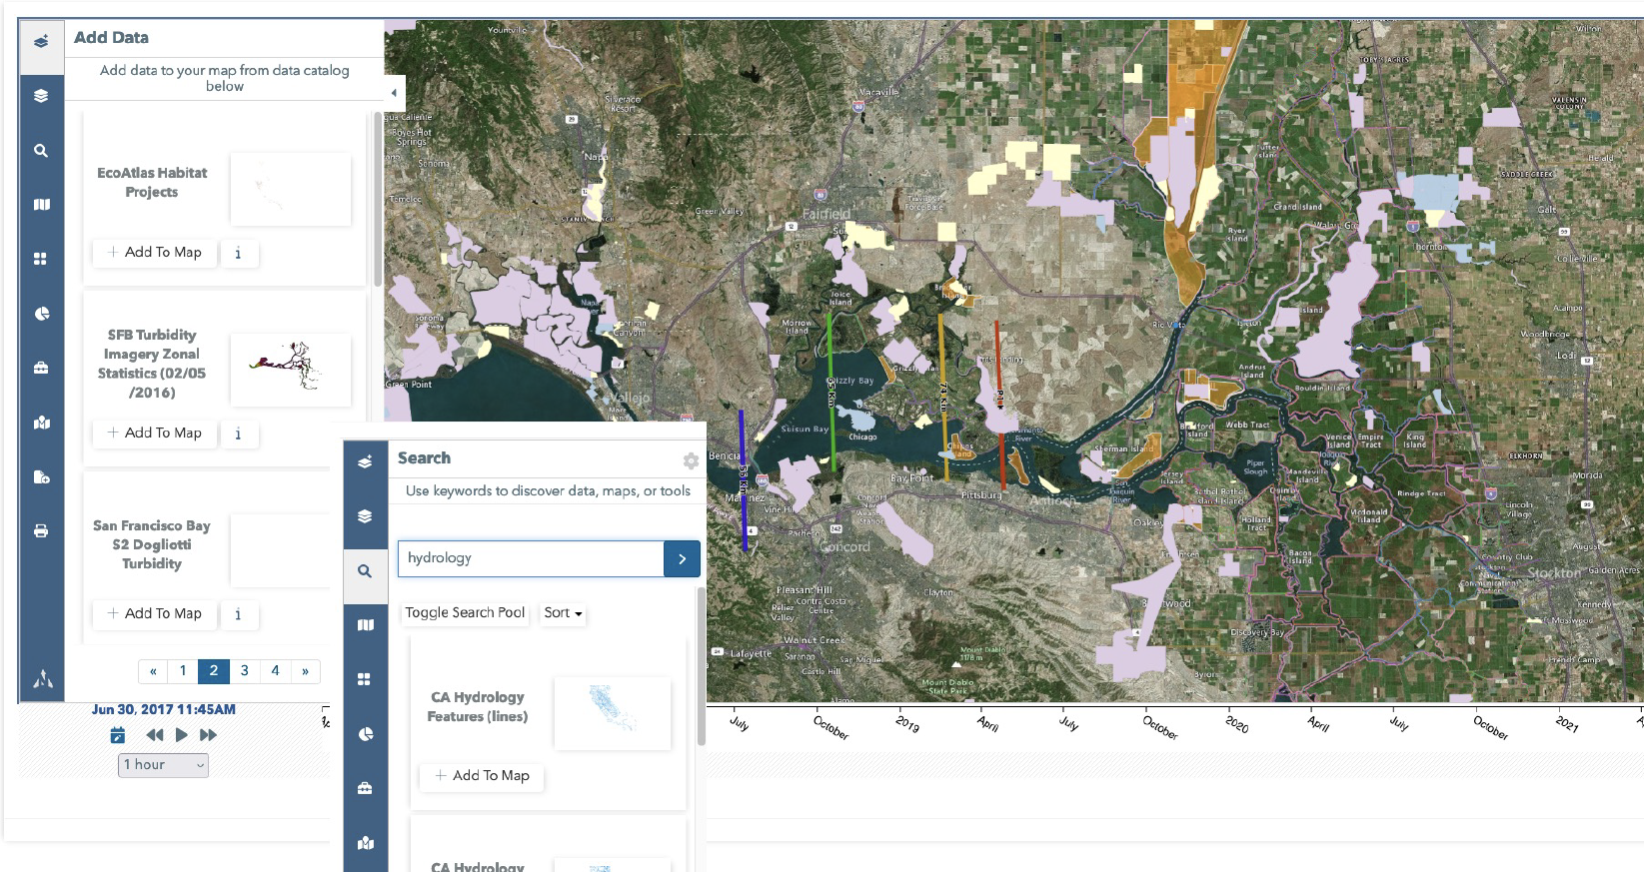
Geospatial Resources from Open Data Portals
Notes:
Access to Multiple GIS Databases using ESRI REST Services and hosted both locally on the BDL Server.

Slide 12
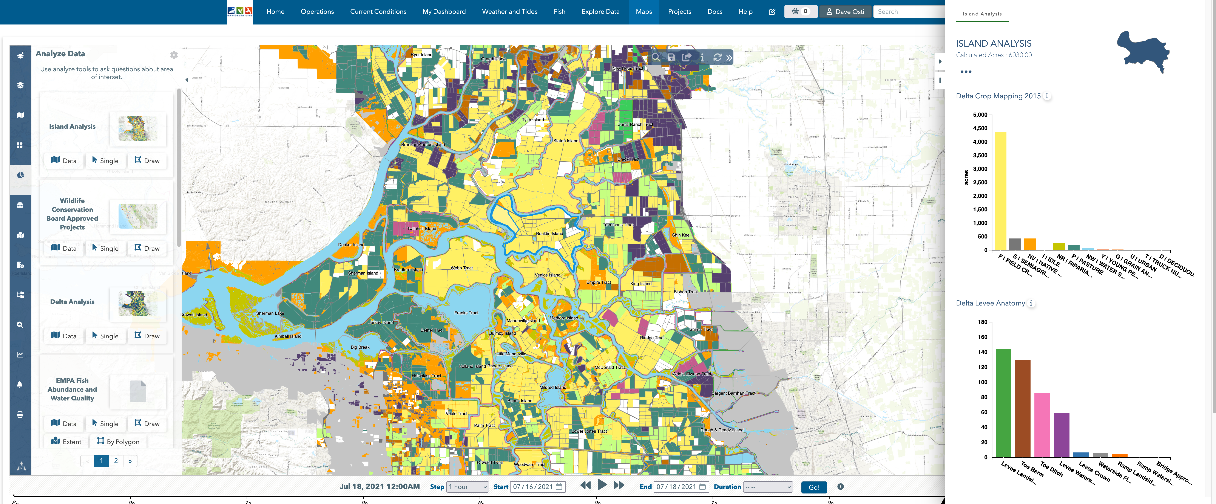
Geospatial Resources – GIS Reporting
Notes:
BDL Can Run Analysis Report on GIS Data and Attributes

Slide 13
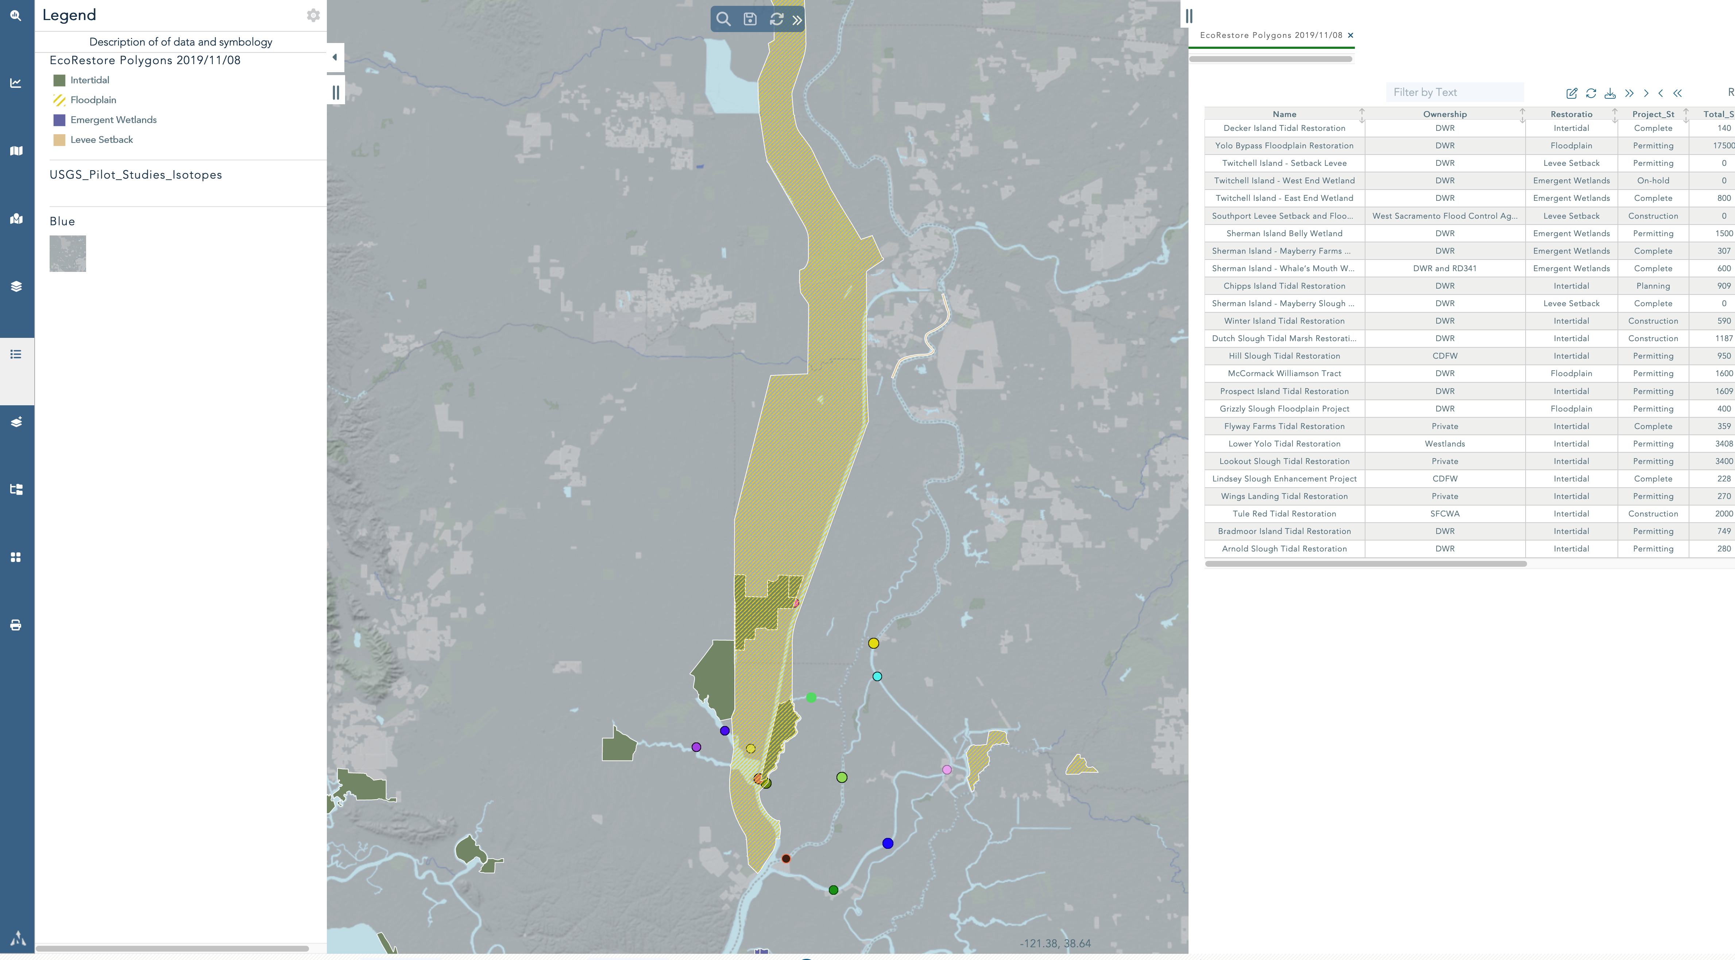

Slide 14
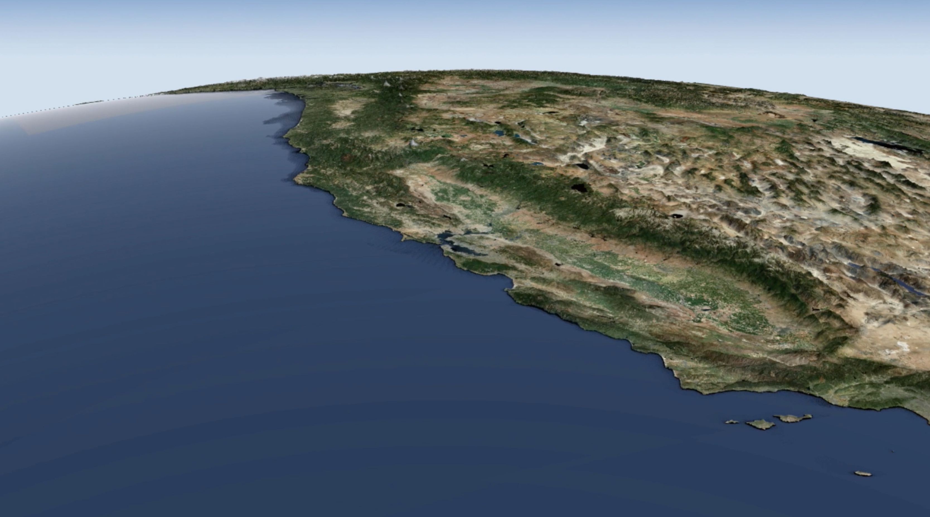
2024 New Data and Tools
Operationalize Water Data Library
Operationalize ECOSTRESS NASA Remote Sensing
Aquatic Vegetation Mapping
Upgrade EDSM/DJFMP Daily and Weekly Reports
Integrate OpenET Models
LiDAR
Upper Watersheds

Slide 15
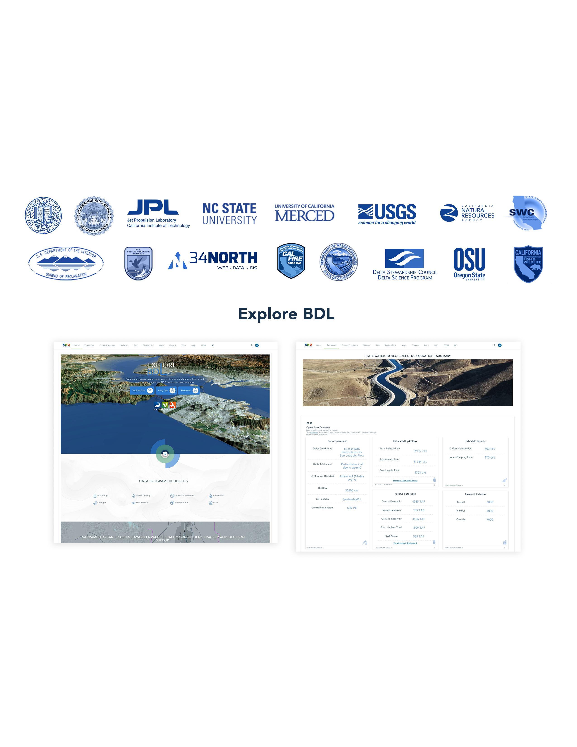

Slide 16
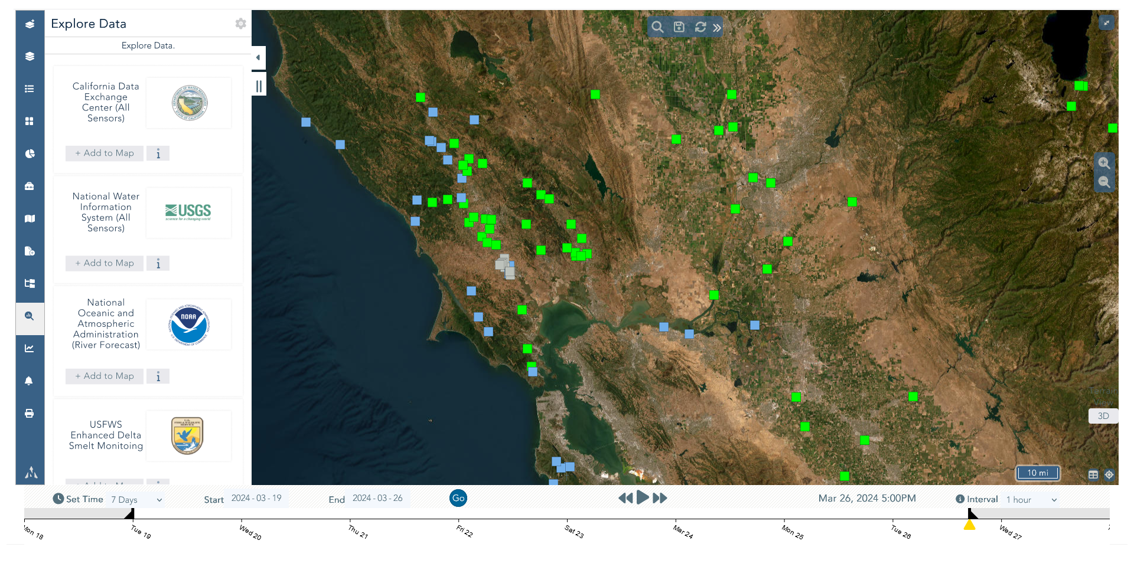

Slide 17
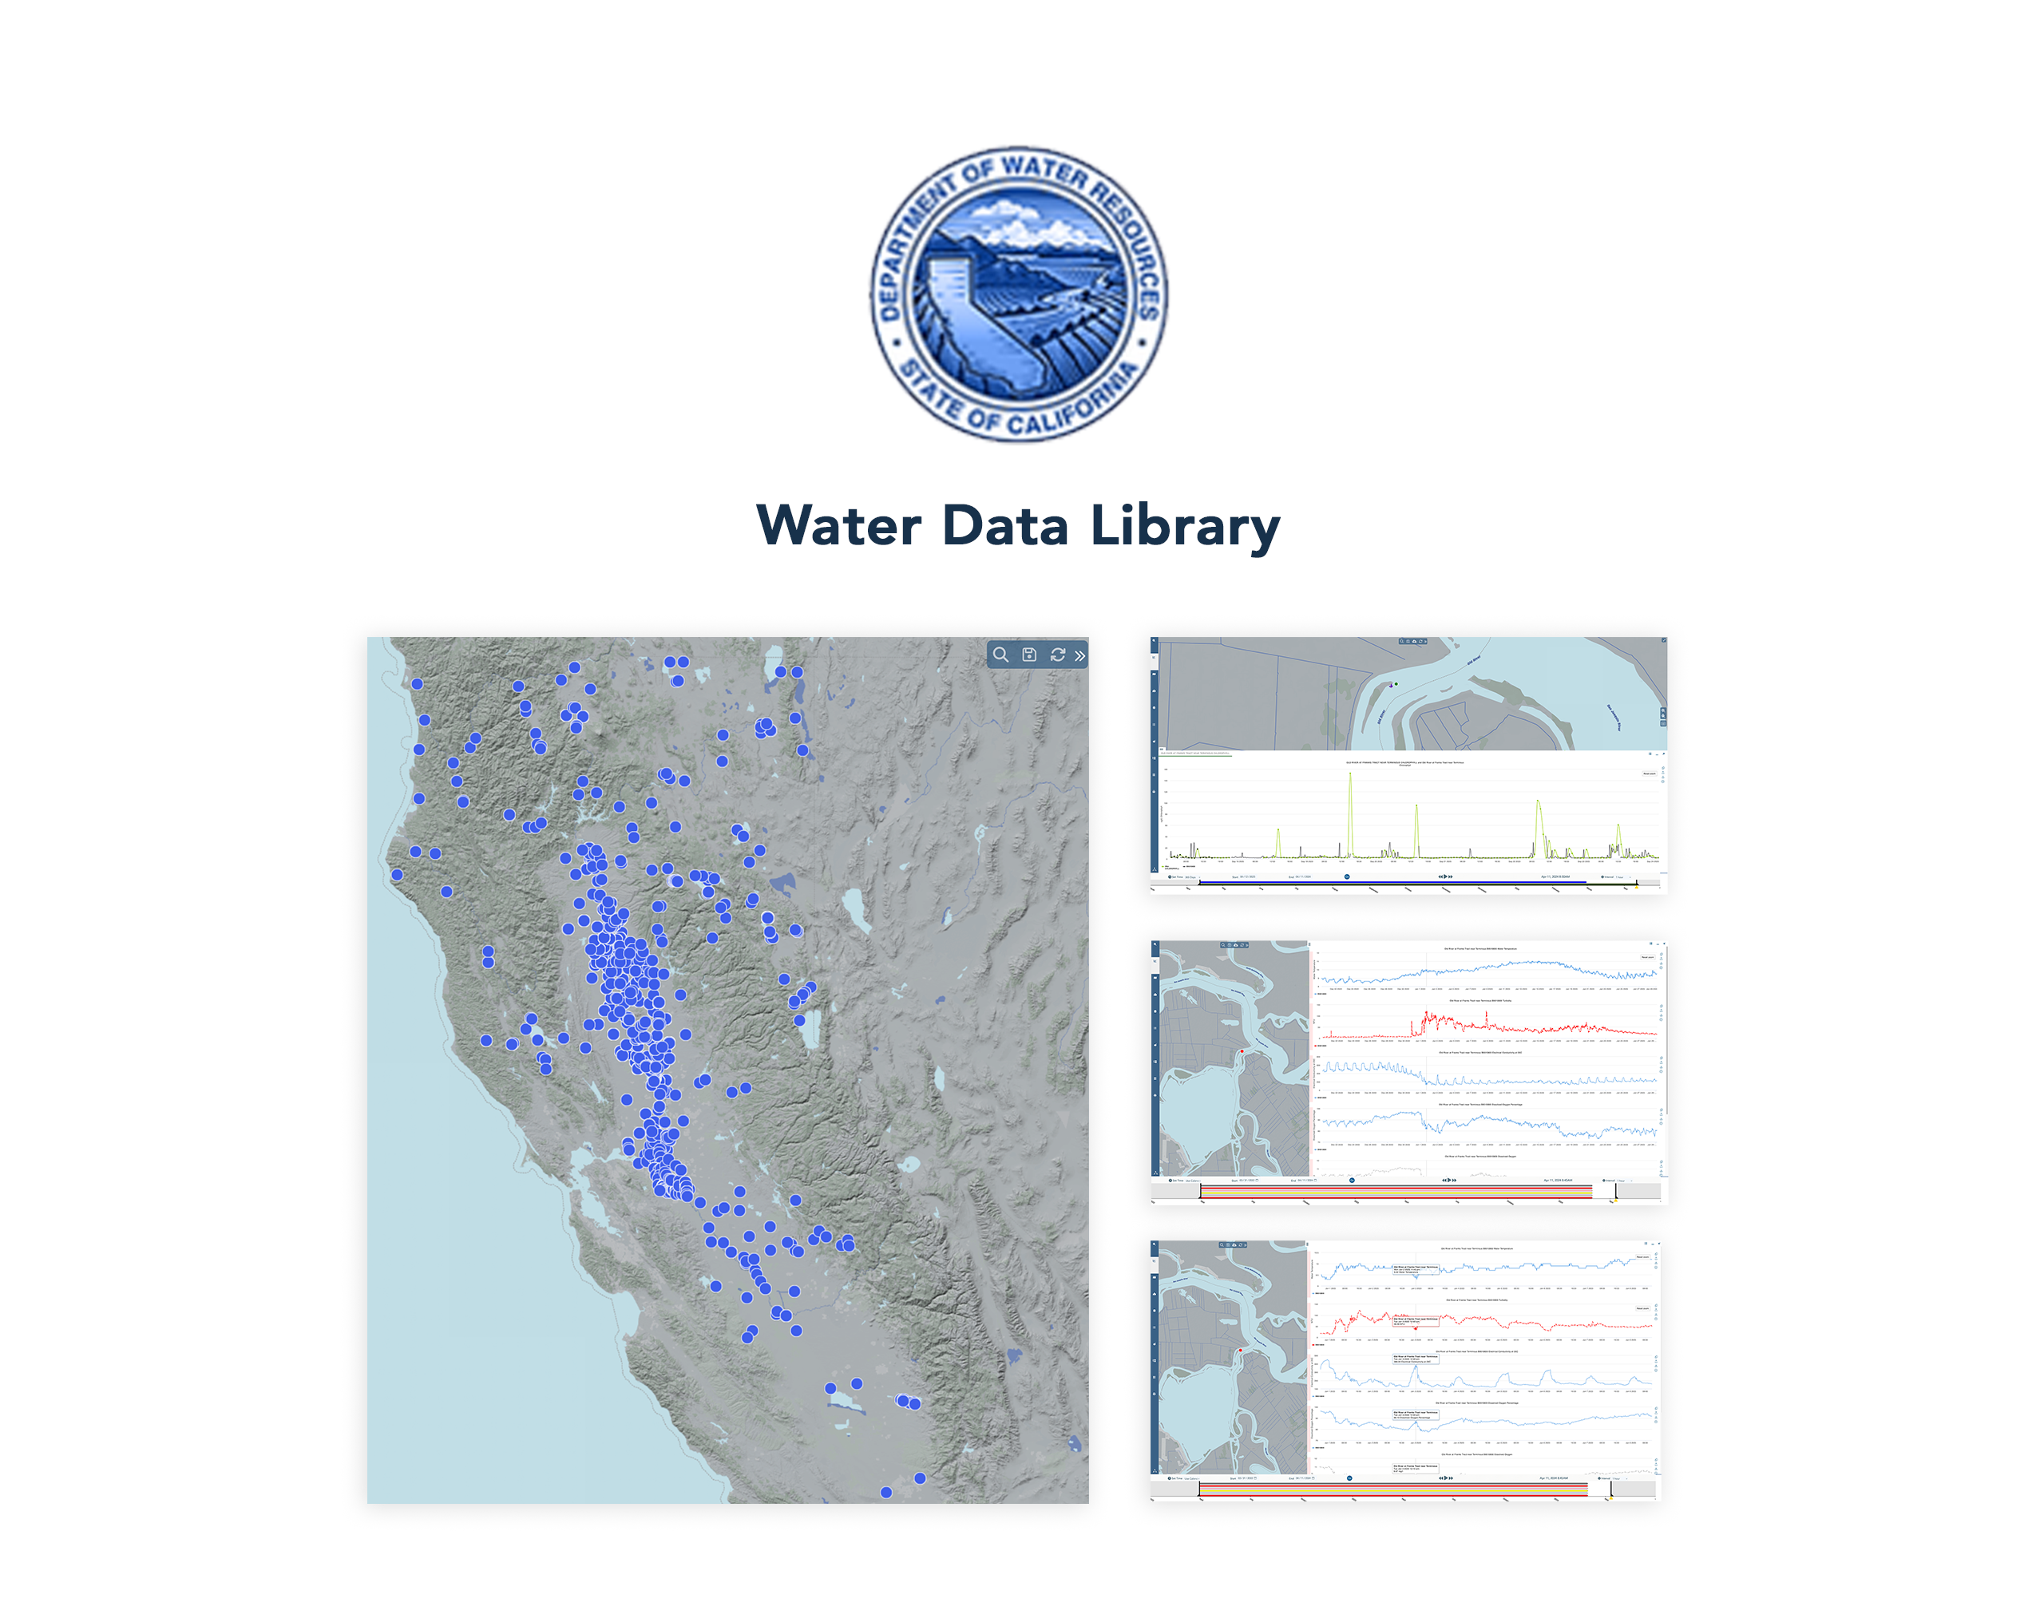

Slide 18
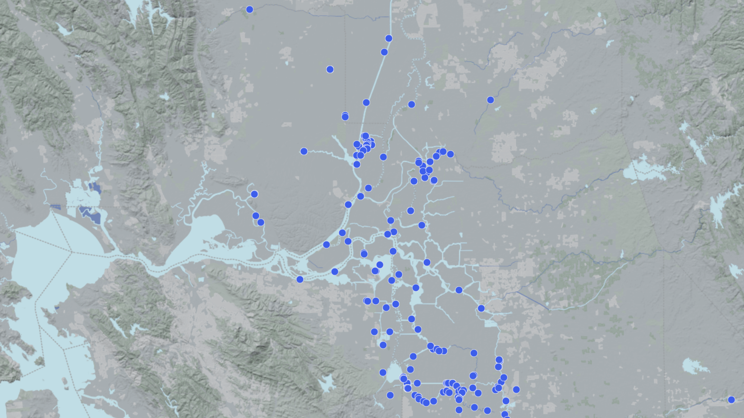

Slide 19
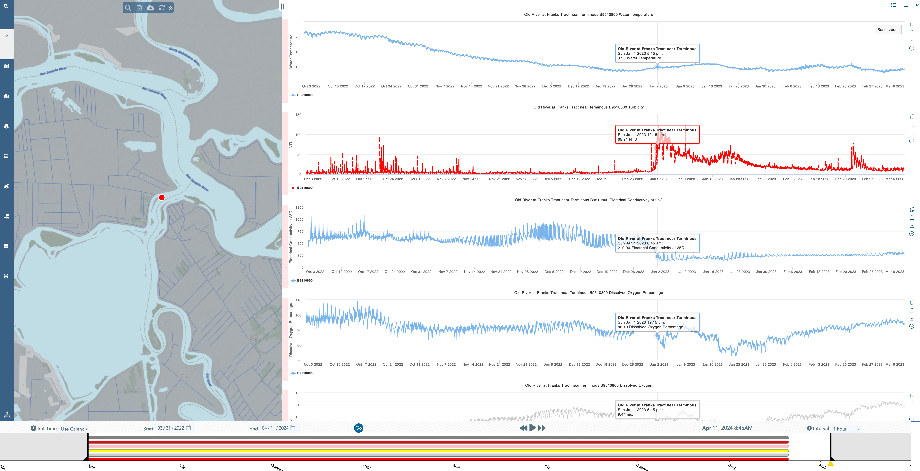

Slide 20
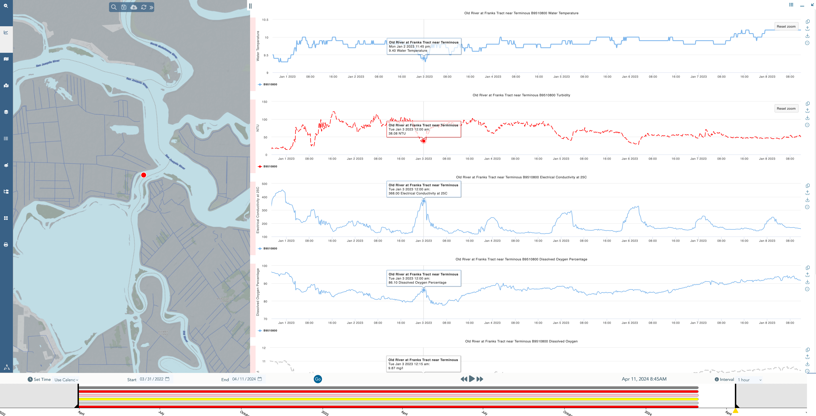

Slide 21
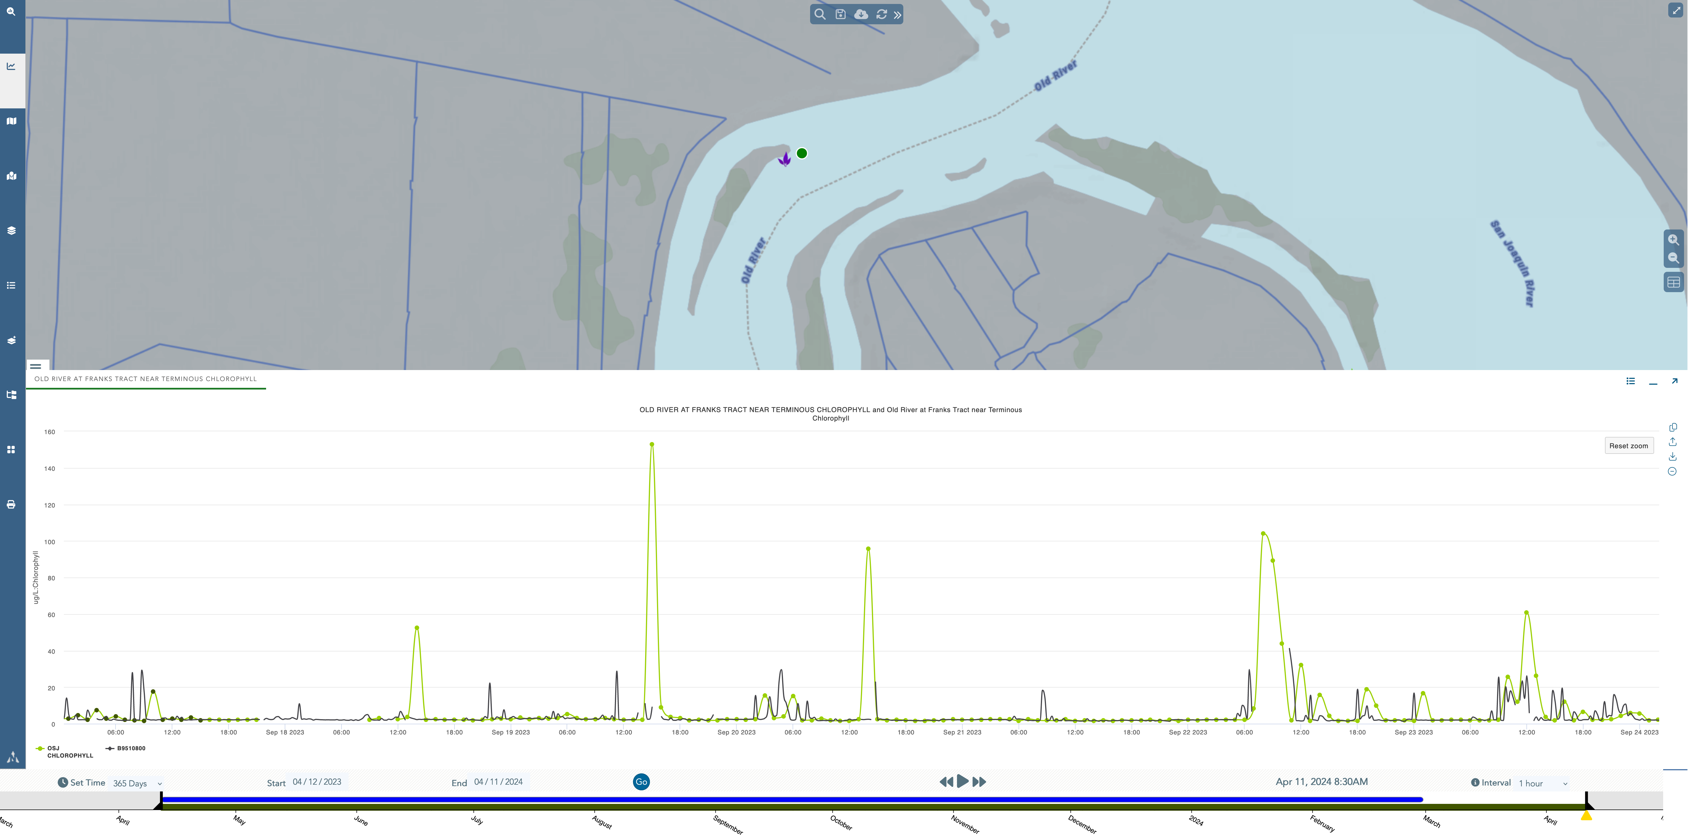

Slide 22
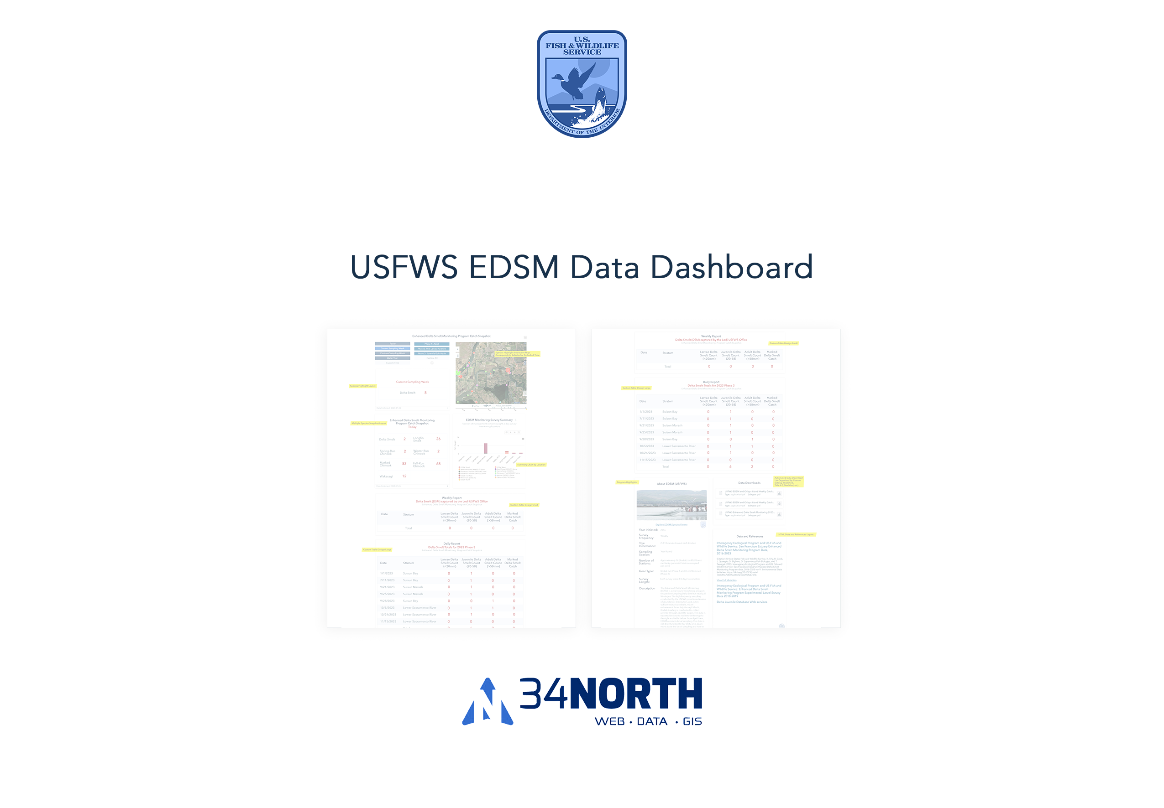

Slide 23
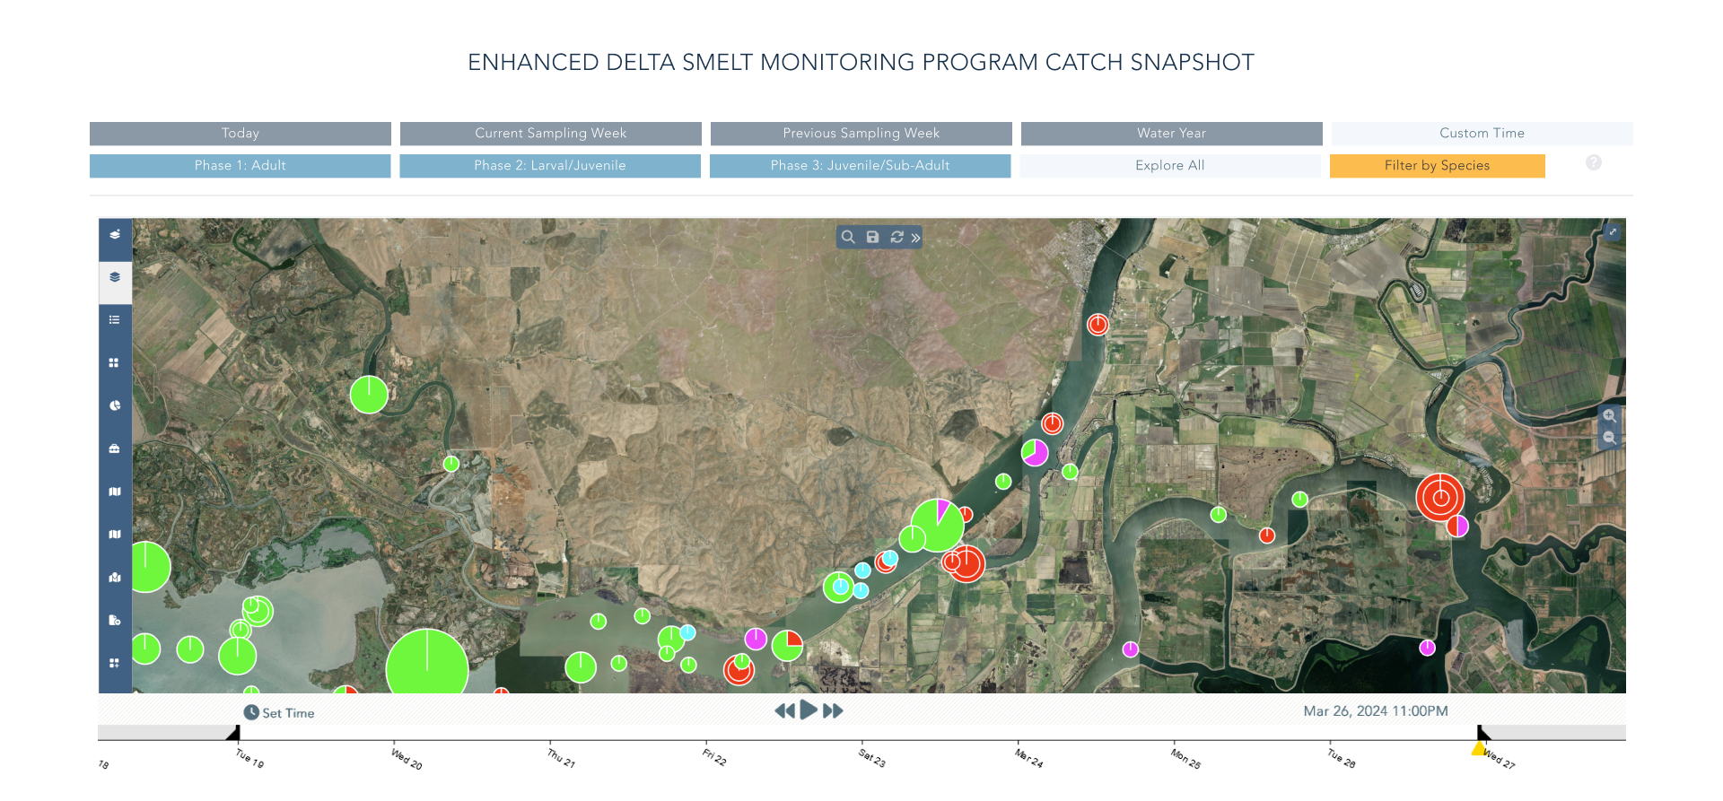
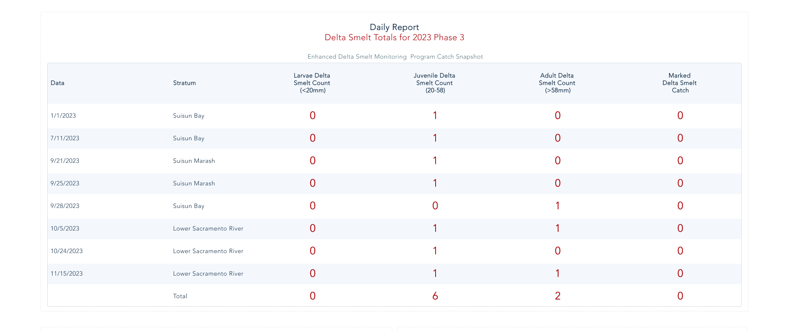

Slide 24
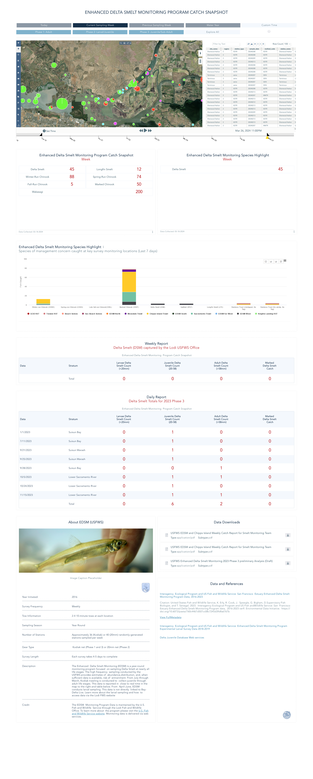

Slide 25
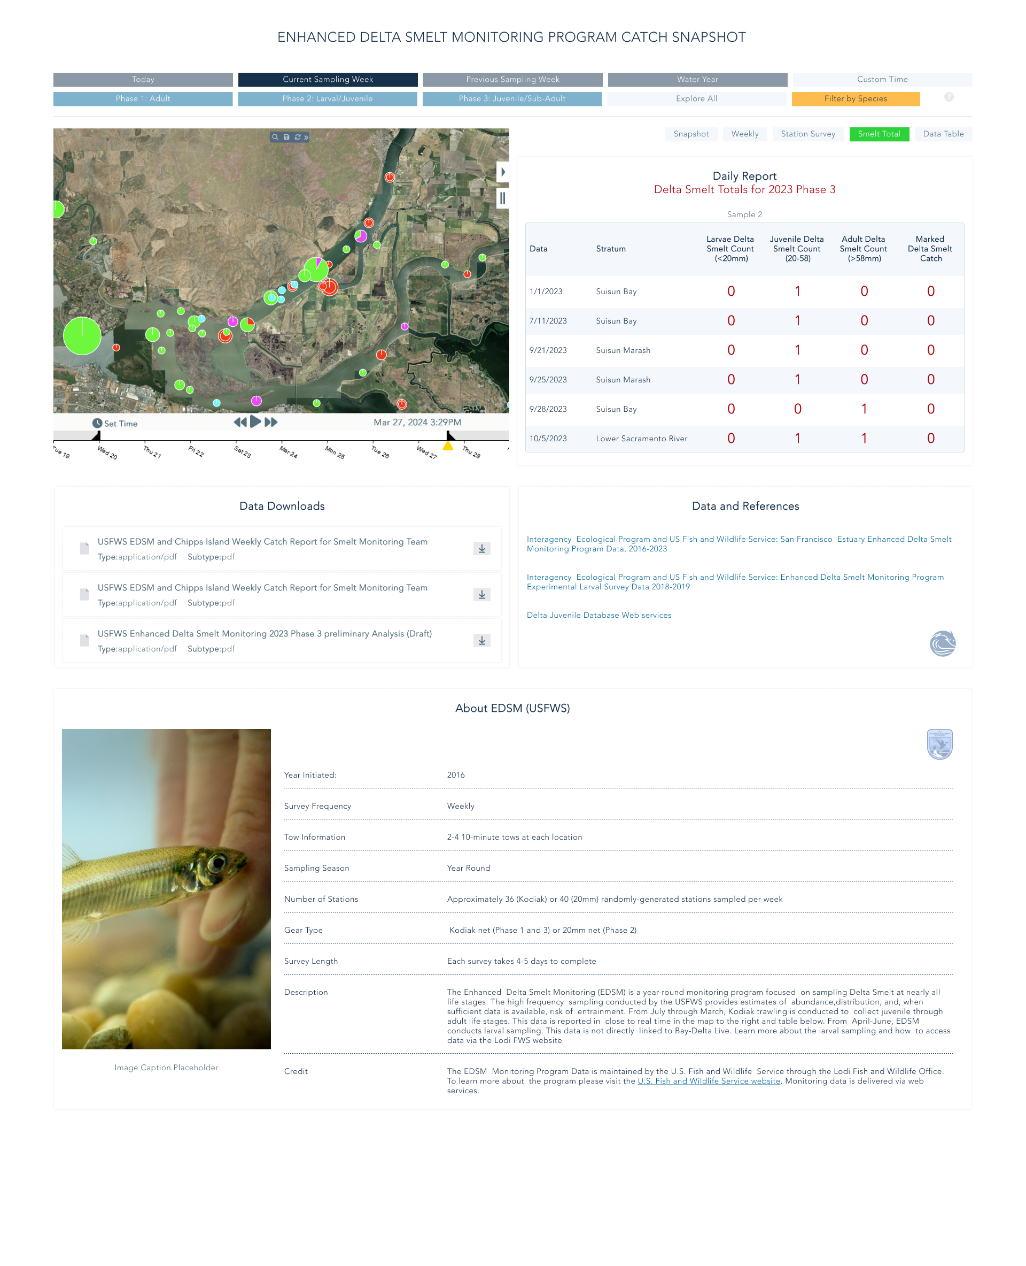

Slide 26
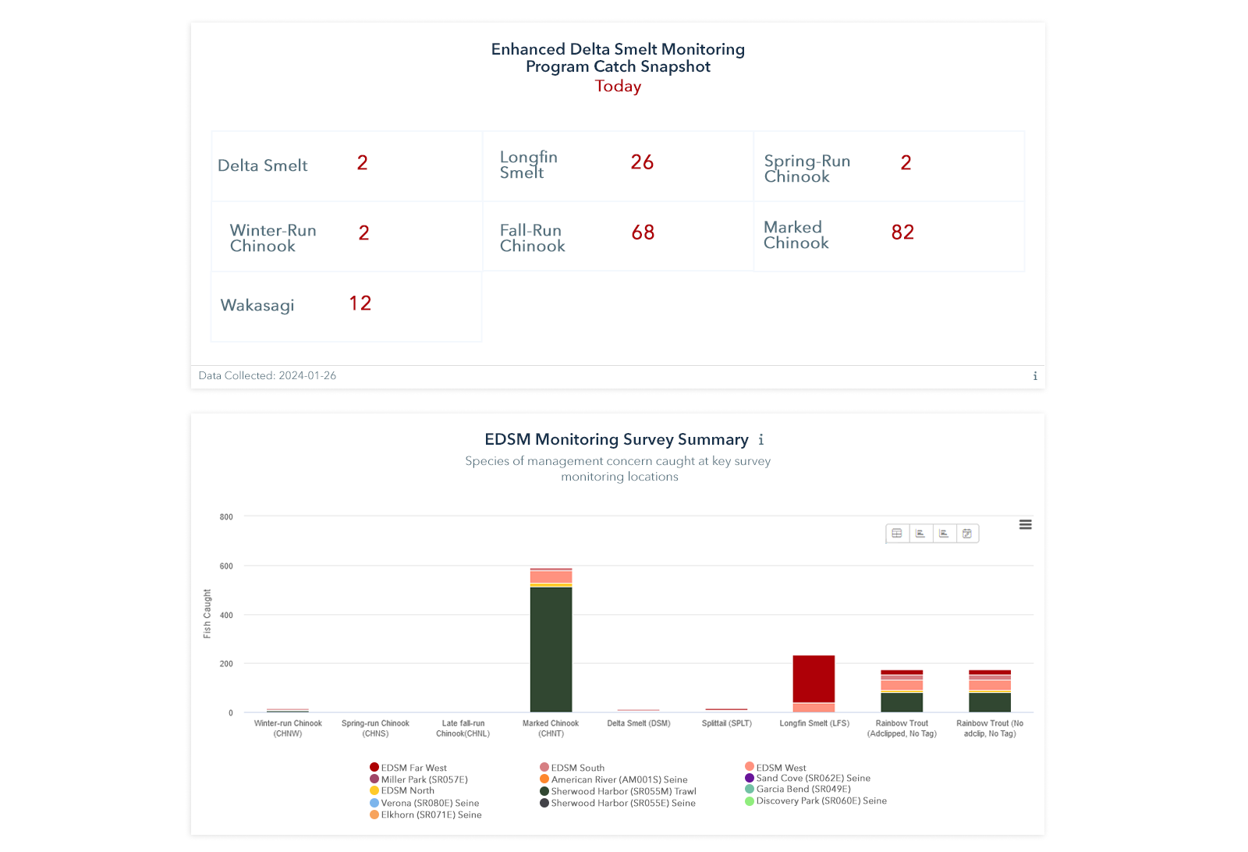

Slide 27
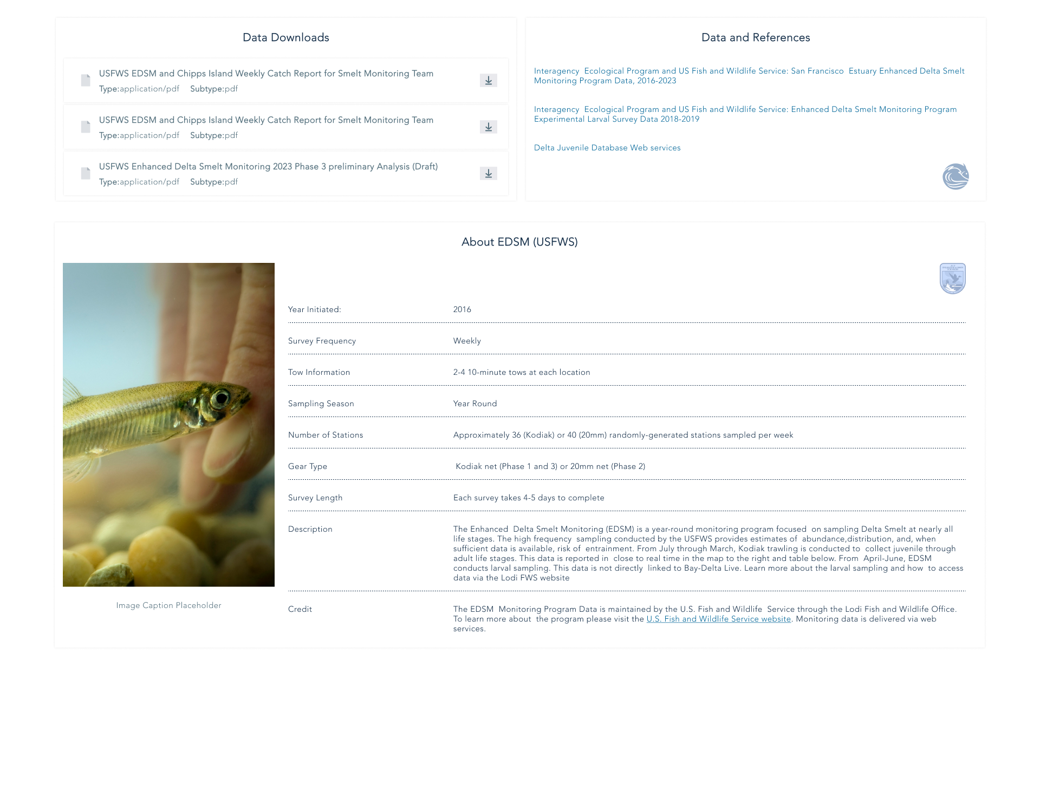

Slide 28
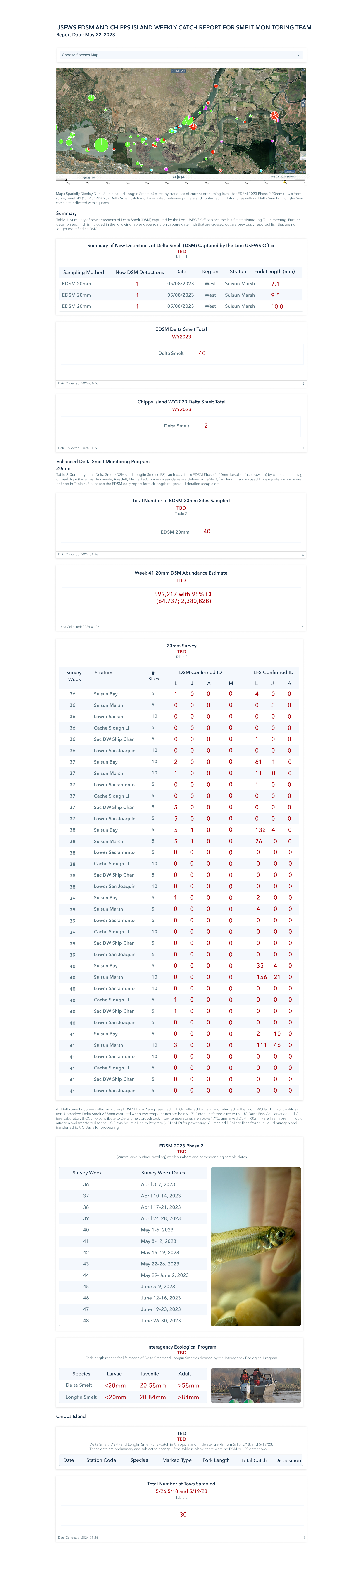

Slide 30
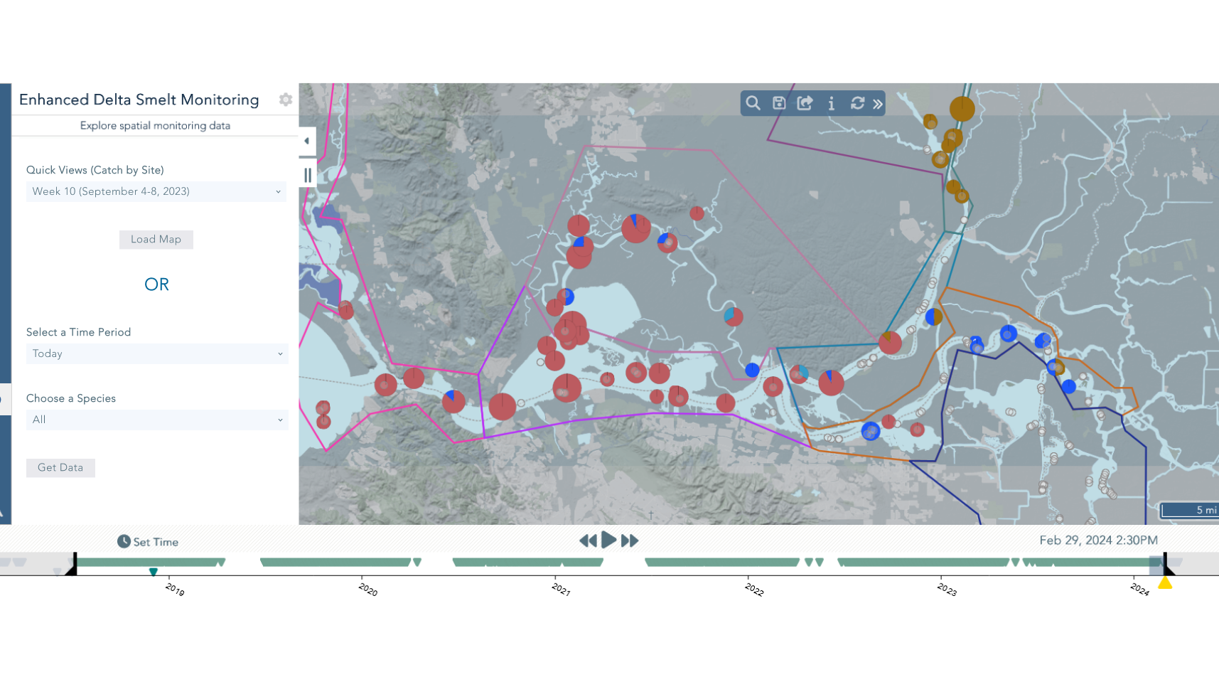

Slide 31
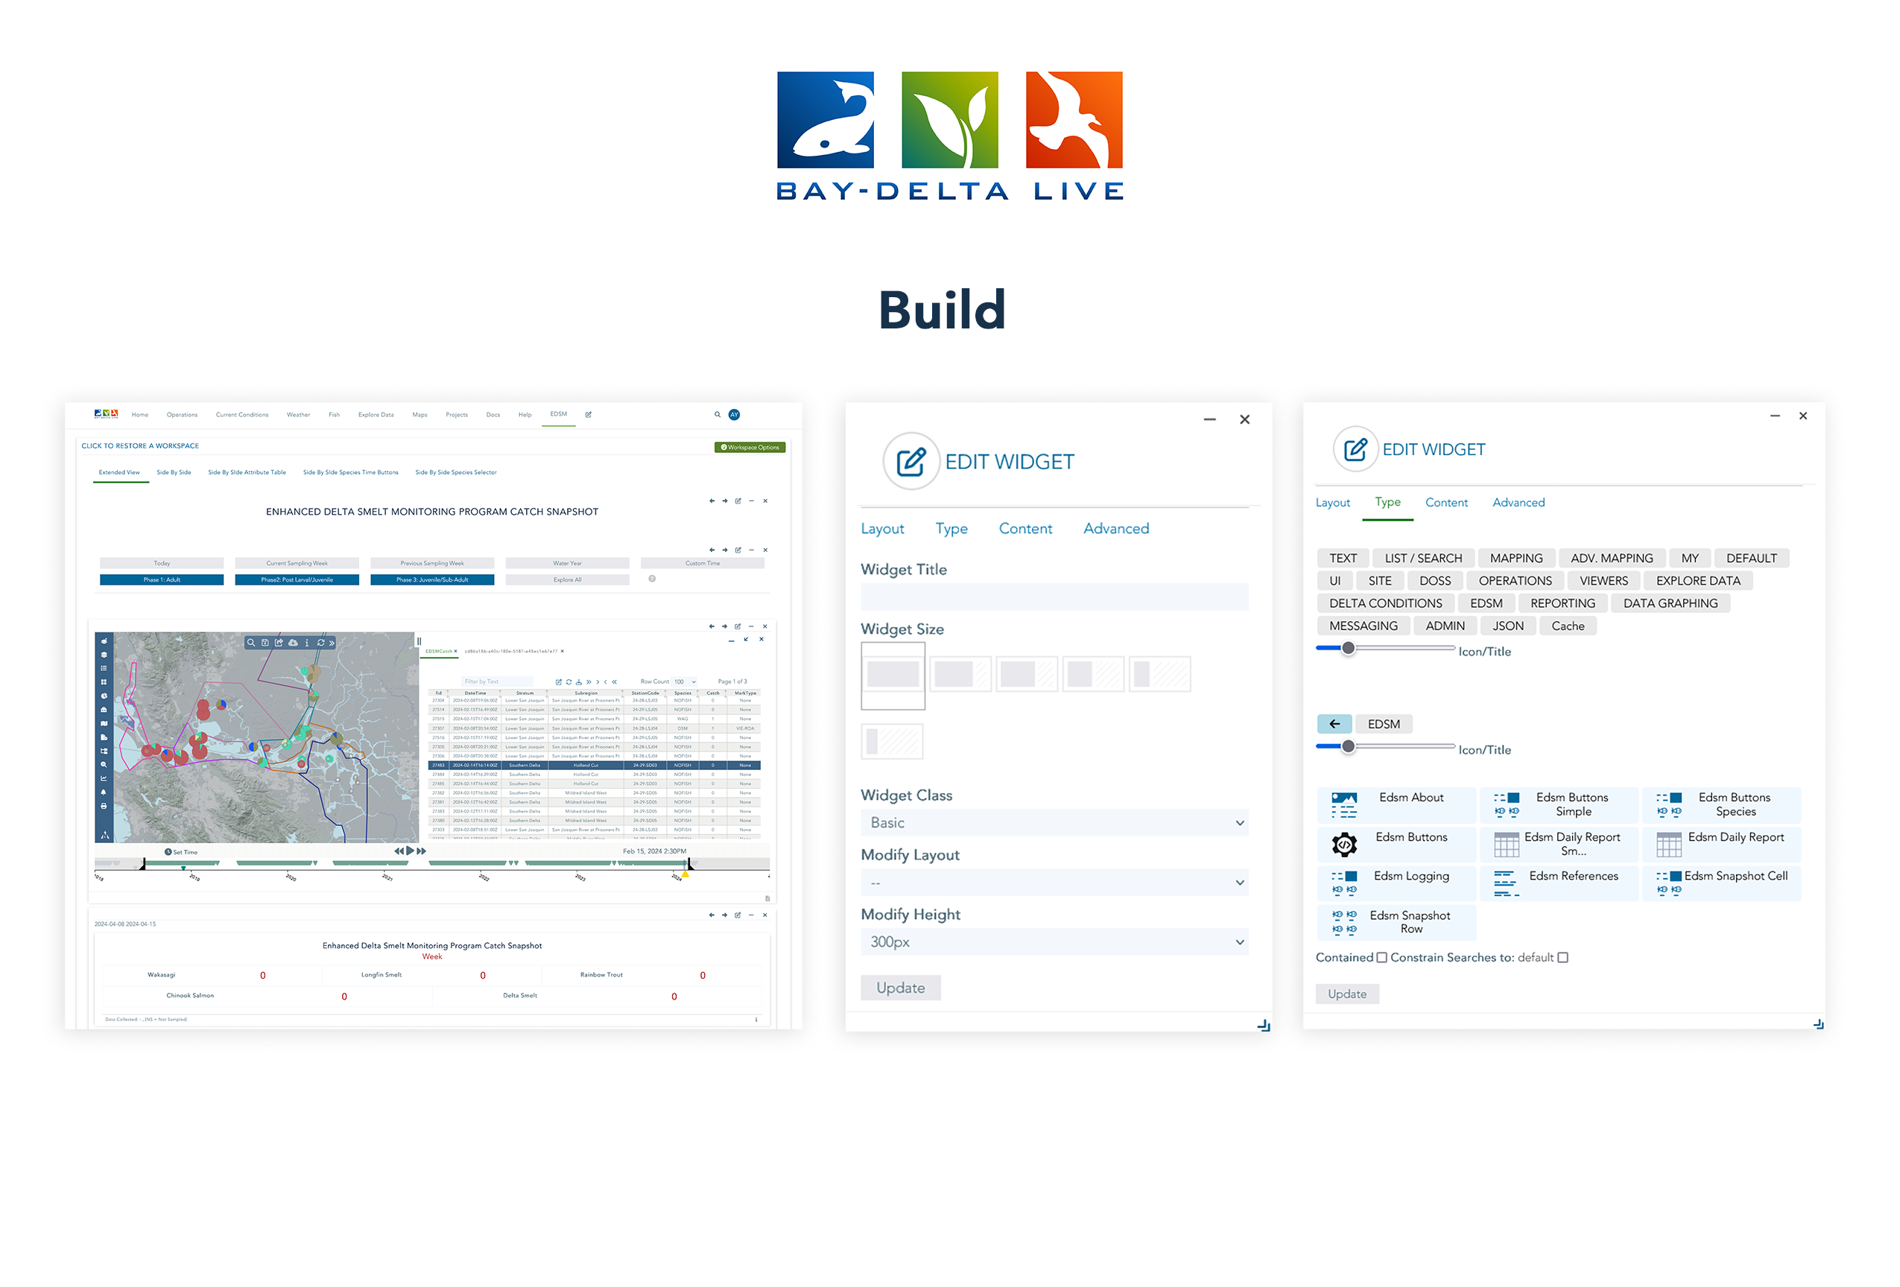

Slide 32
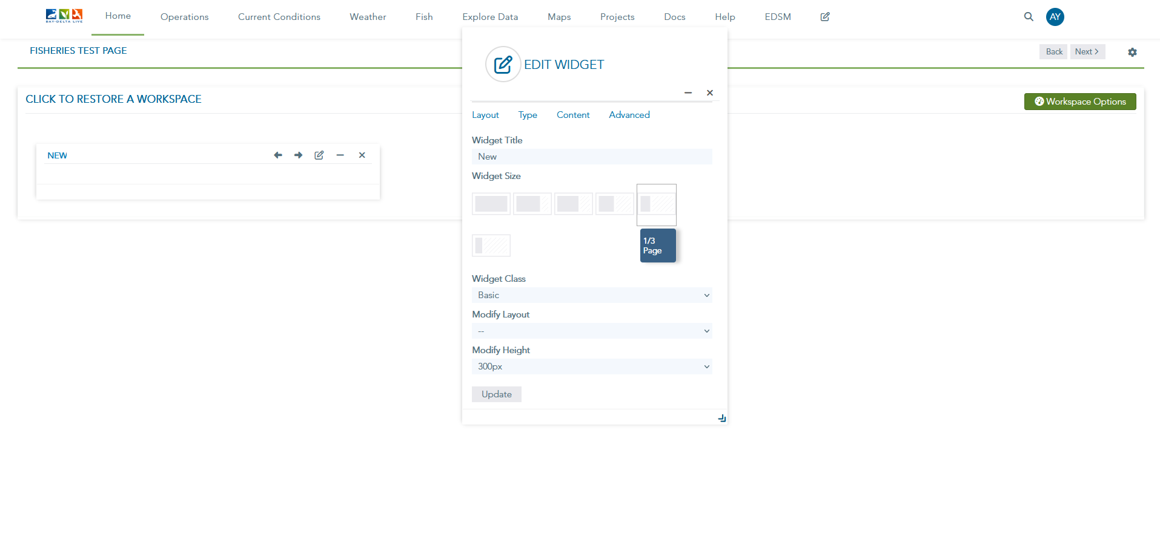
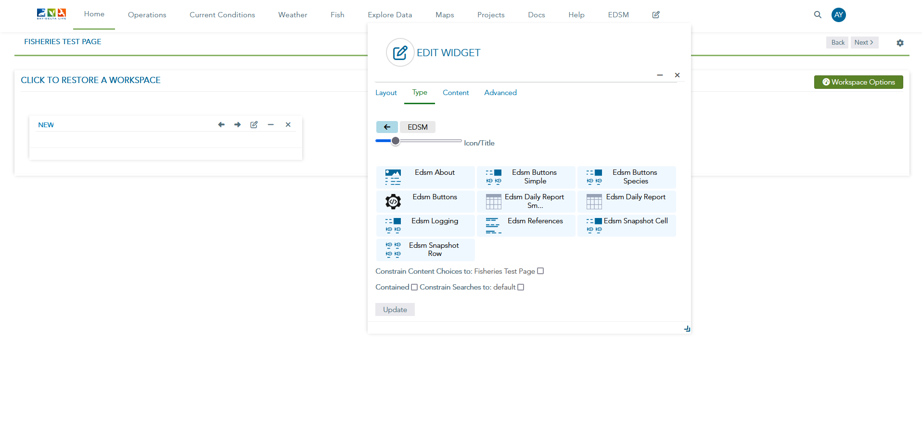
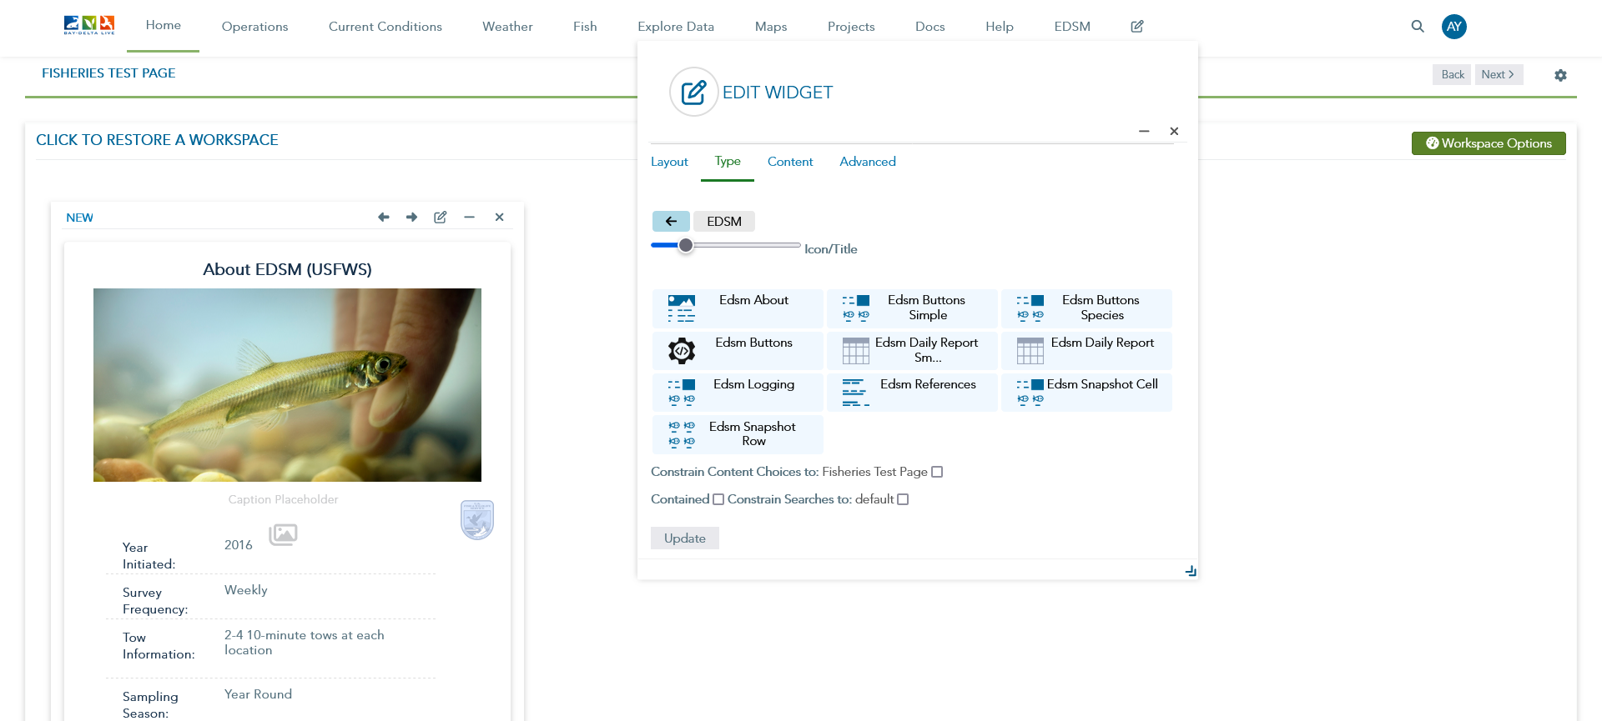

Slide 33


https://www.baydeltalive.com
THANK YOU!

