Slide 1
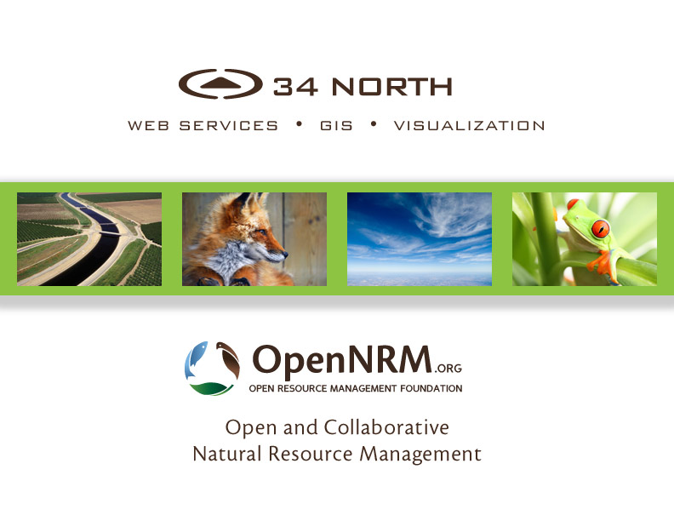

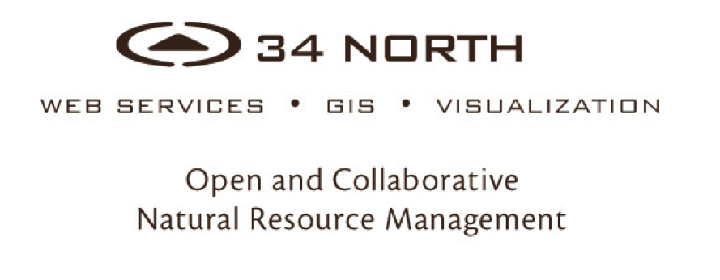

Slide 2
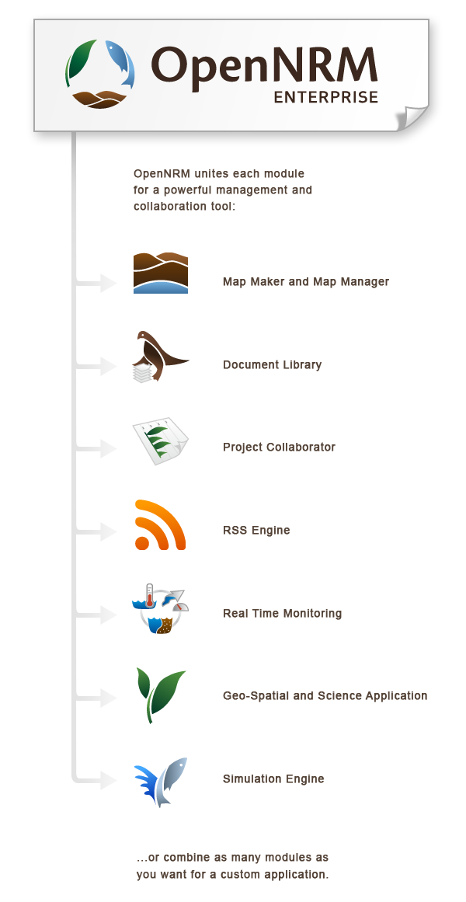
A Collaborative resource management workspace and project management application for data collection, analysis, reporting and visualization
Notes:
The interchangeable modules include:
Real Time Data Management Module
Map Module
Asset Management Module
Project Management
Wiki
Data Visualization Engine
Style CMS
And Mobile component

Slide 3

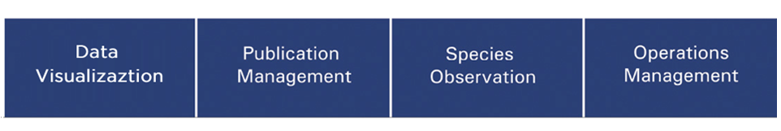
OPENNRM Workspaces are used to build data stories using Spatial Data, Observations Data, and Site Content at various scales.
(Site Level, Regional Level and System Wide)
Notes:
Government Agencies, Public Utilities and NGOs
Special Interest Groups
NRM Consulting and Engineering Firms
Restoration, Conservation and Watershed Groups
Workgroups
Special Projects
34 North specifically works with:
US Bureau of Reclamation, UGSS, DWR, MWD, SFCWA, EPA, CURES, USFWS, CAFWS, SWRCB, AG Industry

Slide 4






A COLLABORATIVE EFFORT
BAYDELTALIVE.COM (Primary investor)
CAESTUARIES.OPENNRM.ORG
MY WATER QUALITY PORTALS
SAN JOAQUIN WATER QUALITY
SAN JOAQUIN REAL TIME MANAGEMENT
1641 INTERACTIVE
Notes:
Multi Stakeholder Collaboration
Data Aggregation and Data Management
Data Analysis and Visualizations Mapping and GIS
Regional Document Libraries Operations Dashboards
Ecosystem Projects
Special Studies
Acoustic Telemetry Nutrients
Web Service Development
Regulatory Reporting

Slide 5
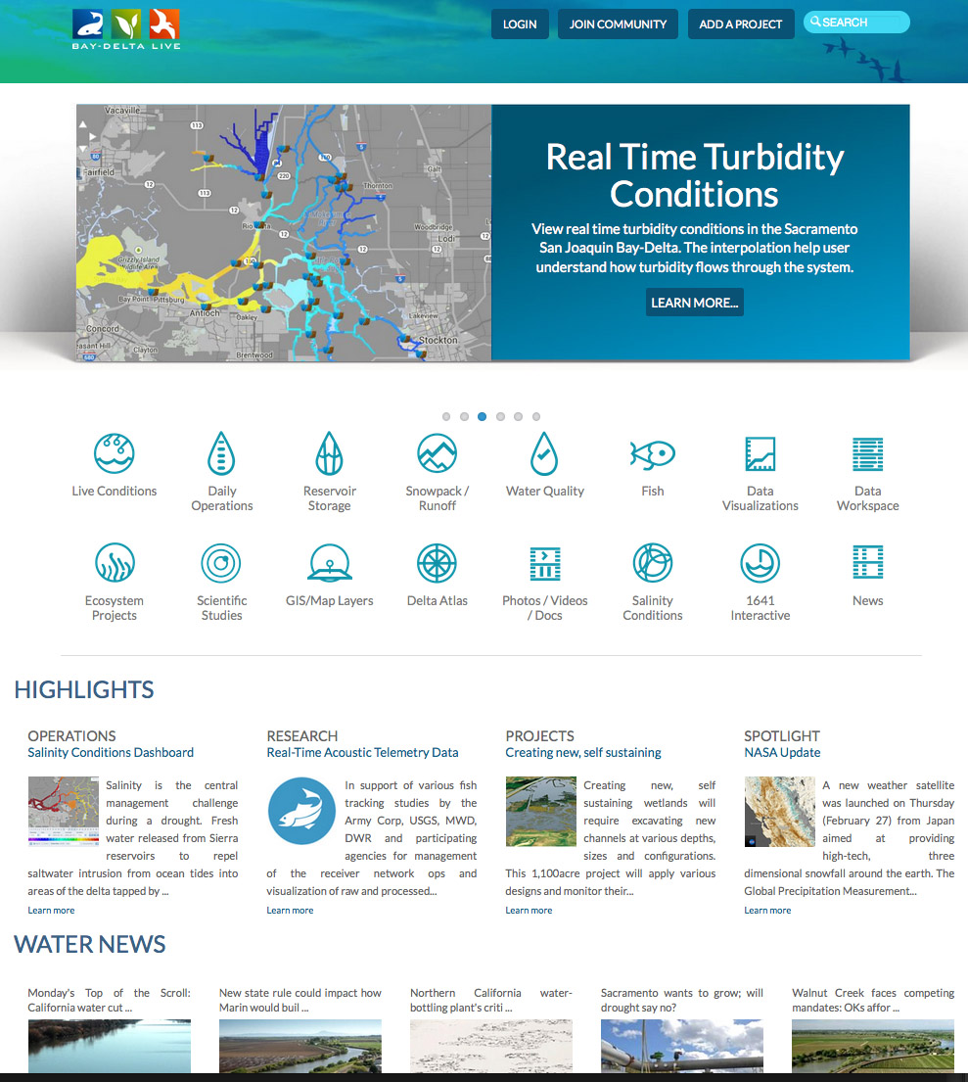
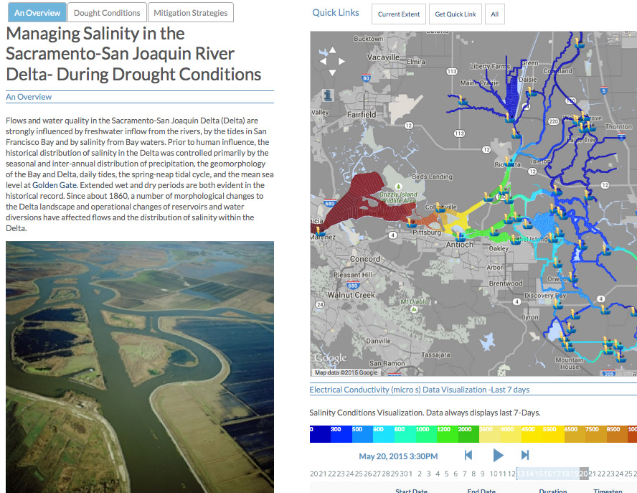
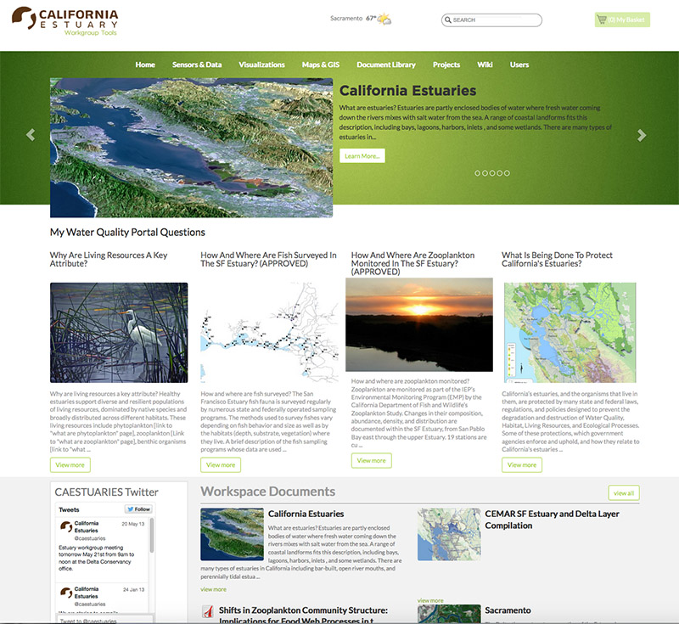
BUILDING ON EACH OTHER’S PROGRAMS
  Each region’s needs are different:
  Multi Stakeholder Collaboration
  Data Aggregation and Data Management
  Data Analysis and Visualizations Mapping and GIS
  Regional Document Libraries Operations Dashboards
  Ecosystem Projects
  Special Studies
  Web Service Development
  Regulatory Reporting
  …The sharing with other portal’s for system wide view
Notes:
The SRWP is participating in a on-going regional monitoring and resource management tool development initiative: OPENNRM. SRWP is building on the current portal platform developed for managing data for Ca Estuaries, The San Joaquin Regional Monitoring Program, San Joaquin River Real Time Management Program, The Bay delta: Baydeltalive.com and DWR’s 1641 interactive reporting tools for California. New SRWP development investments are contributed back to community portals. The primary objective of the initiative is provide regional stakeholders with the tools to manage their own data. These data are then made available to the larger community for broader assessment of the California watershed.

Slide 6
BUILDING ON EACH OTHER’S PROGRAMS
Benefit and learn from each other’s regional monitoring programs and assessment efforts.
All investments are contributed back to the community: Content, GIS, data sets, mapping tools
Data is managed at the regional level and shared with all stakeholders for larger watershed assessment and analysis
Notes:
The SRWP is participating in a on-going regional monitoring and resource management tool development initiative: OPENNRM. SRWP is building on the current portal platform developed for managing data for Ca Estuaries, The San Joaquin Regional Monitoring Program, San Joaquin River Real Time Management Program, The Bay delta: Baydeltalive.com and DWR’s 1641 interactive reporting tools for California. New SRWP development investments are contributed back to community portals. The primary objective of the initiative is provide regional stakeholders with the tools to manage their own data. These data are then made available to the larger community for broader assessment of the California watershed.

Slide 7
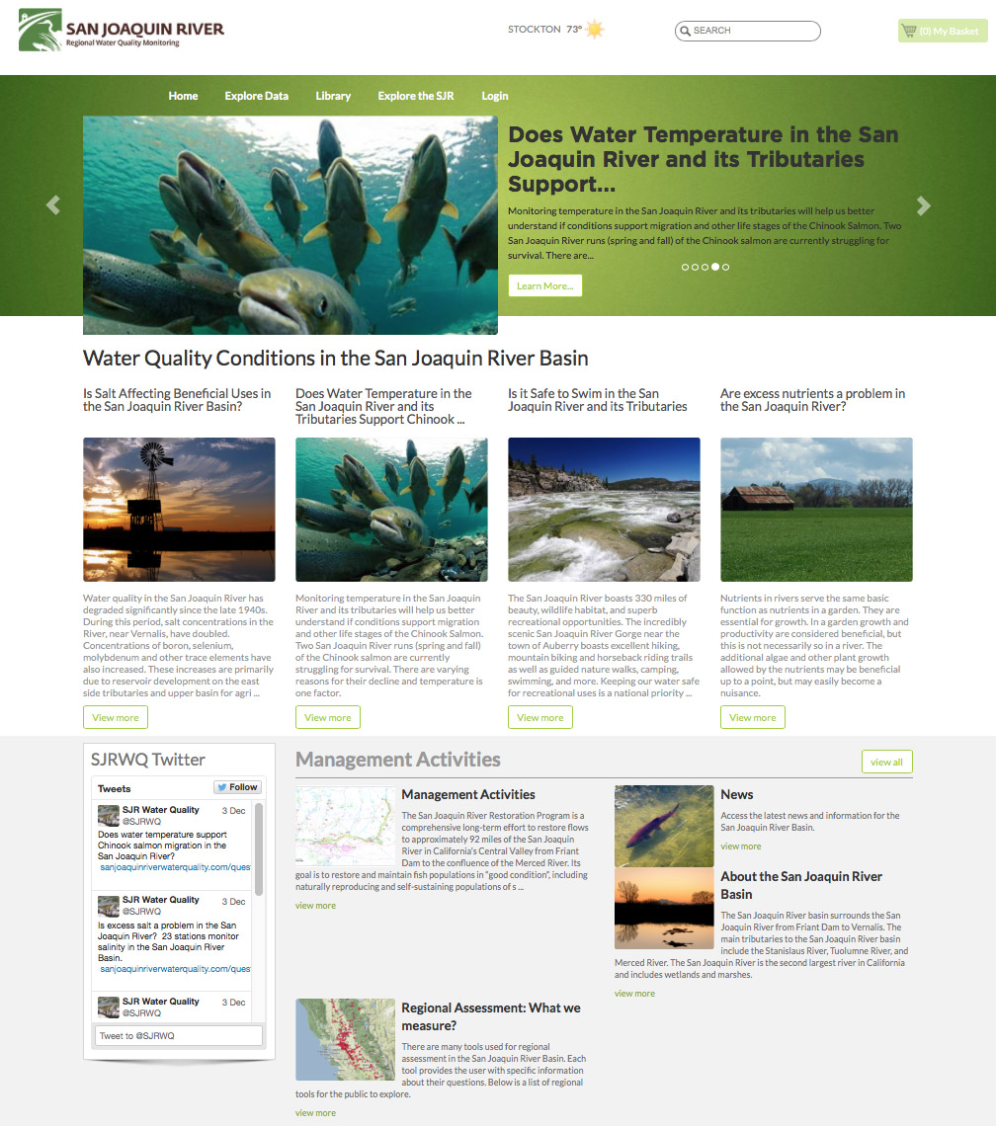
SJR REGIONAL MONITORING AND REAL TIME MANAGEMENT
50+ Datasets contributed for multi-stakeholder use and evaluation
Real Time WQ Assessments for Temperature, Salinity, Nutrients, etc. available to the public
Current phase SJR Real Time WQ Management
View model results and data dashboards
Notes:
SRWP will have access to data and GIS: Specifically NWIS and CIMIS that was contributed to the community by this project
SRWP will build on and improve upon question templates for data assessments developed by the SJRRMP. Benefit from stakeholder knowledge developed during this process.
3SRWP will benefit from and build on important data filters and analysis tools for examining WQ criteria: ex: Temperature calculations for fish migration during specific life stages, analysis of salinity discharges and the effects on water quality, data presentation methods for understanding pesticides and other contaminant data in the Sac River watershed.
This knowledge will then be contributed back to other regions for use in local initiatives.

Slide 8
CA ESTUARIES PORTAL
Workspace for My water quality portal content. 85+ questions answered
Source project for critical estuary data: EMP, Estuary GIS, 1641 and Trawl Data
On-going effort for estuary wiki
Custom GIS files
Notes:
The caestuaries workspace and stakeholder group is responsible for the development of:
25+ Key datasets: IEP data, trawl and slavage data, 1641 reporting project
85+ question driven WQ pages on mywaterquality.ca.gov
Important space for incubation of ideas, assessment criteria and concepts.
Key development of data visualization tools.

Slide 9


Slide 10


BDL WORKGROUP COLLABORATORS
US Bureau of Reclamation
NOAA
NMFS
US Geological Survey
CA Department of Water Resources
Metropolitan Water District
State and Federal Contractor
US Fish and Wildlife
SWRCB
AG Industry
_________________________________
25,000 Unique Visits (Annual)
400+ Registered Users
1500 + Images, Documents, Research Articles
100+ Ecosystem Projects
250+ Downloadable Datasets
Feed Libraries
Directing development and new data investments
Notes:
Clients include: Honeywell, USGS, DWR, MWD, History Channel,

Slide 11
BAYDELTALIVE.COM
Data central to the Delta
Extensive libraries for Delta data, photos, reports
Real time reporting dashboards: salinity, WQ
Weekly survey results, fish tracking
Relevant news
Collaborator workspace
Ecosystem projects
Delta Community
Post and view model results
Notes:
1. Primary project

Slide 12
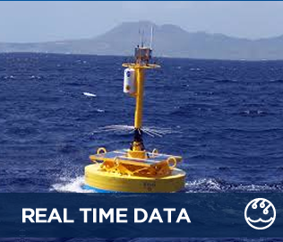
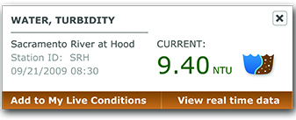
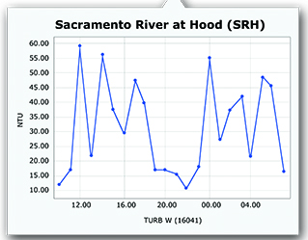
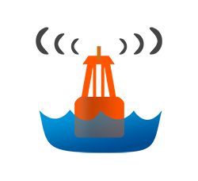



EXPLORE DATA
HUNDREDS OF DATA PARAMETERS:
CALIFORNIA DATA EXCHANGE CENTER (CDEC)
NATIONAL WATER INFORMATION SYSTEM (NWIS)
NATIONAL OCEANIC & ATMOSPHERIC AGENCY
(NOAA)
CALIFORNIA IRRIGATION MANAGEMENT SYSTEM
(CIMIS)
CALIFORNIA ENVIRONMENTAL DATA EXCHANGE NETWORK (CEDEN)
(Hydrodynamic, Water Quality, Meteorlogical)

Slide 13
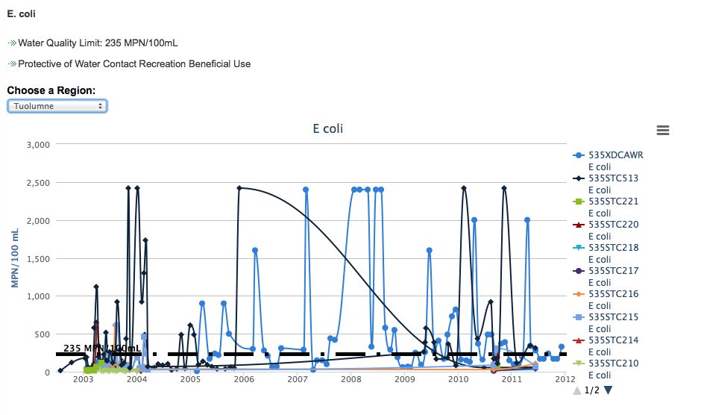
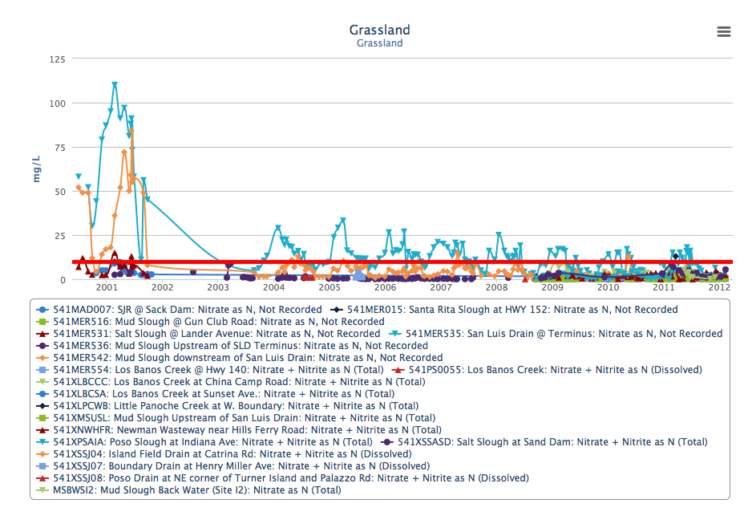

DATA CATALOG
Extensive Data Catalog
250+ Datasets
Real-Time Data
Discrete Data: CEDEN, EMP Data, CEDEN
GIS Data
CEDEN
Operations Data
Flow
X2
Fish Data

Slide 14
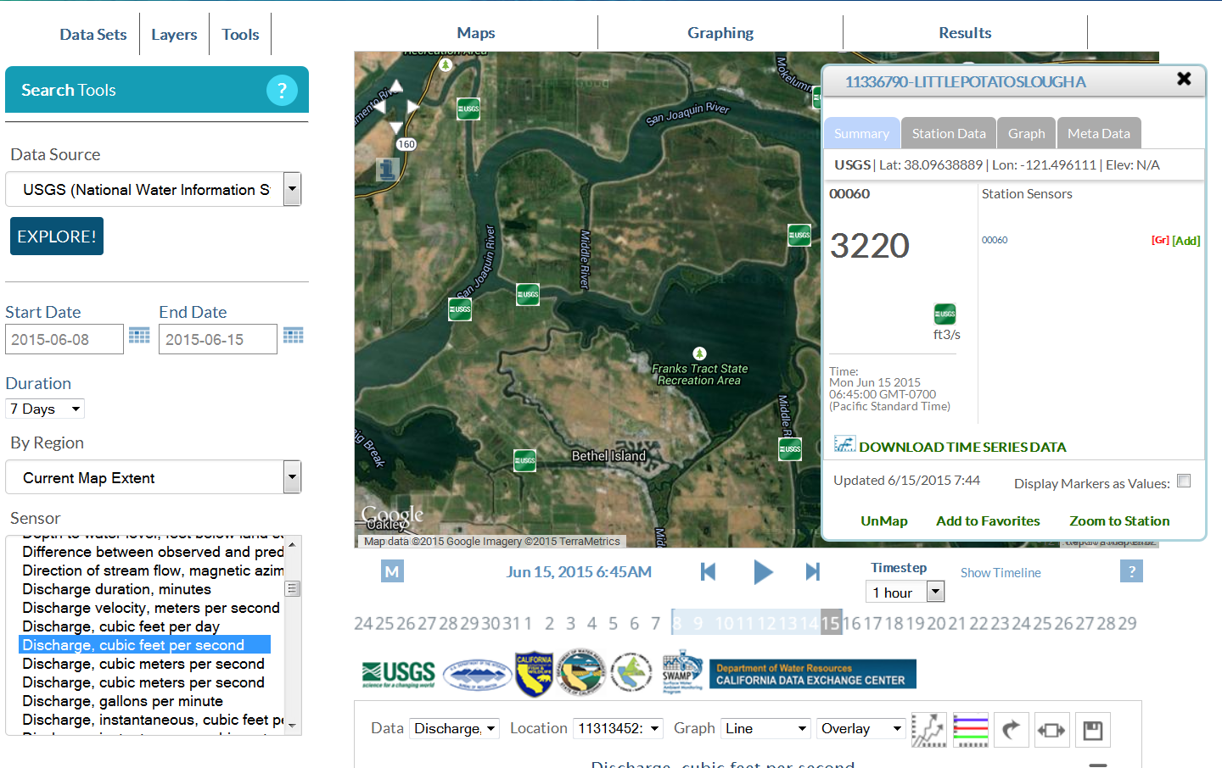
SENSOR NETWORKS

Slide 15
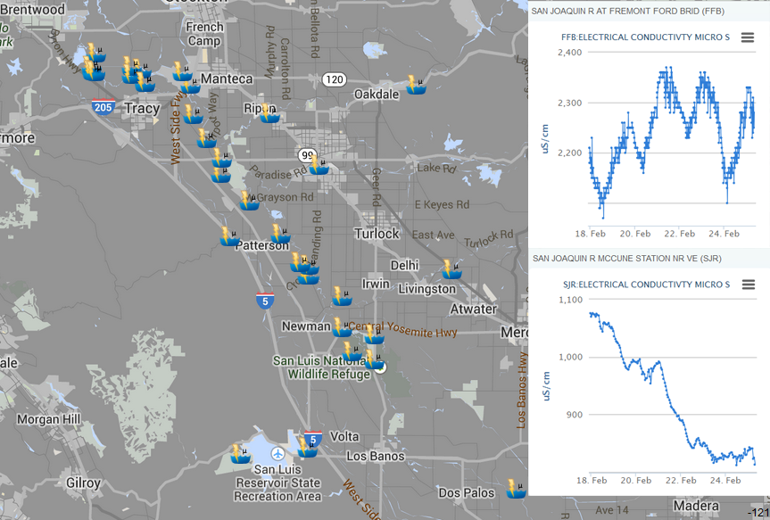
SENSOR NETWORKS

Slide 16

DOCUMENT MANAGEMENT
Add and Share Documents
Geo-locate for data synthesis
Customizable Metadata
Add Images, Videos, Reports, Data
Easy portability for use in site
Support for Dashboards
Keep private or make public
Work in the Field: Sync with Mobile App
HTML Templates for supporting descriptions and documentation

Slide 17
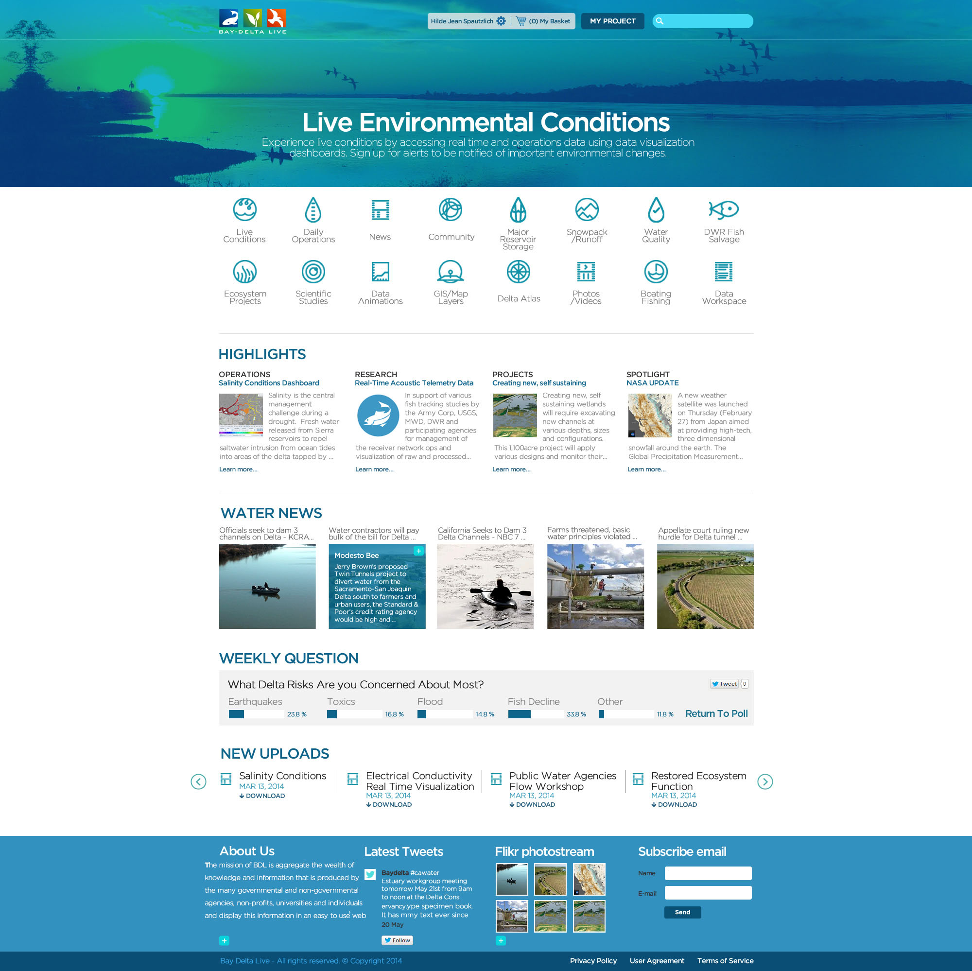
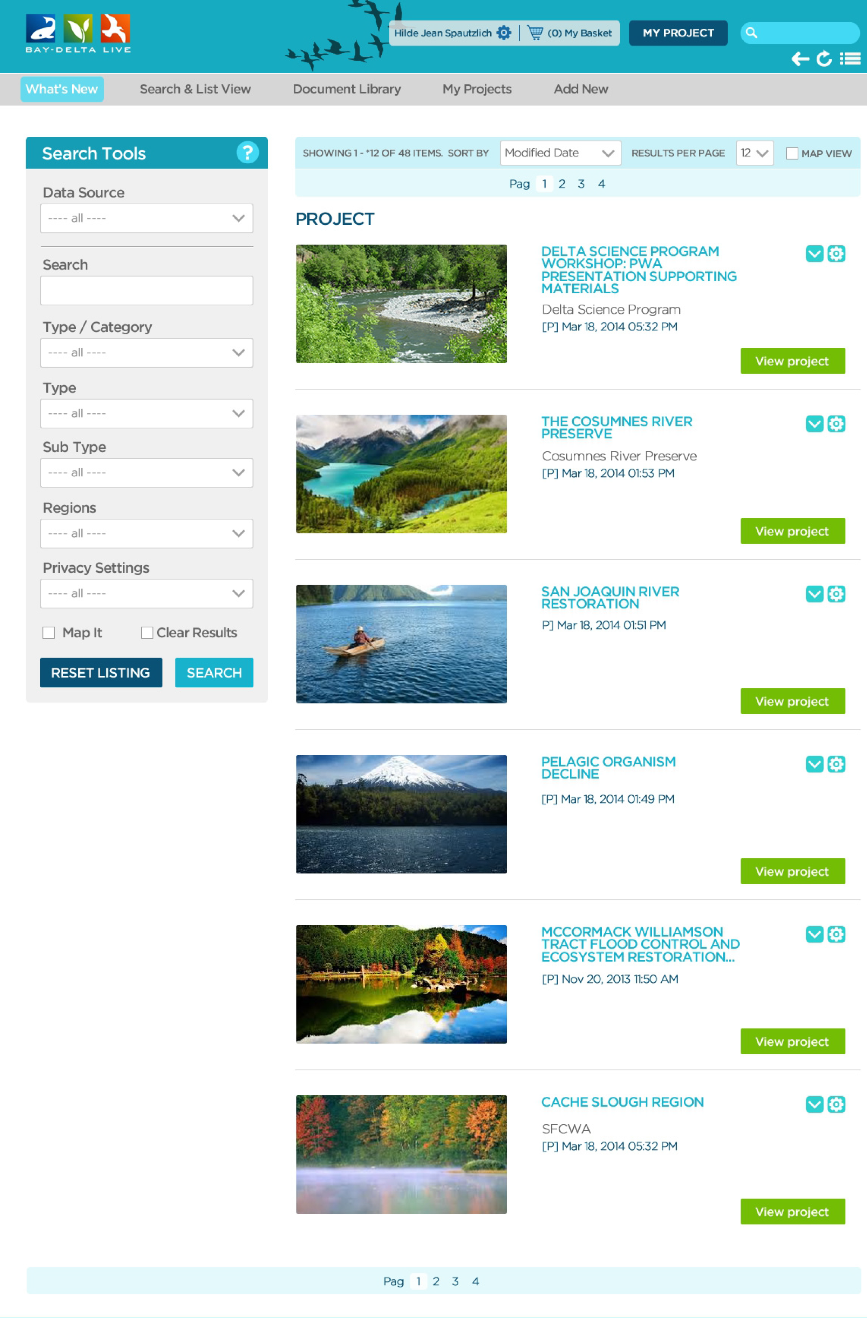
DOCUMENT MANAGEMENT

Slide 18
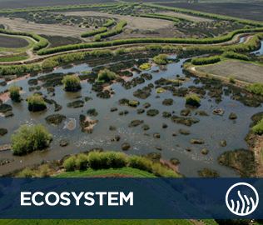
PROJECTS
BUILD YOUR OWN PROJECT PAGES:
Customizable Metadata
Add Images, Videos, Reports, Data, Interactive maps
Community Features: Comments, Groups, Follow
Project Data Dashboards
Invite Members
Keep private or make public
Work in the Field: Sync with Mobile App
HTML Templates

Slide 19
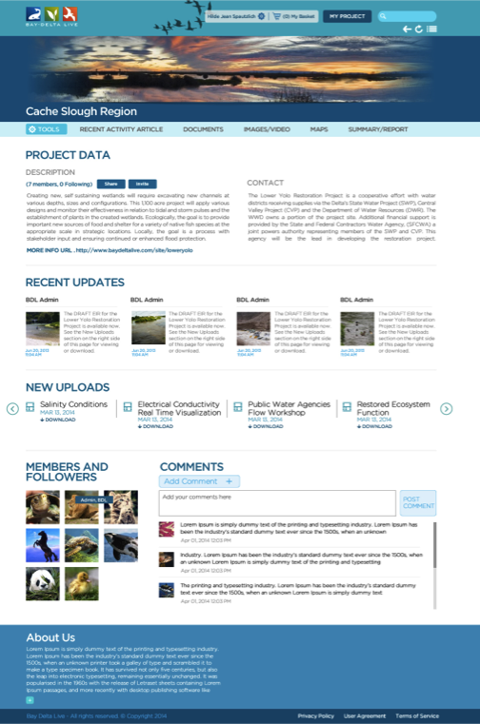
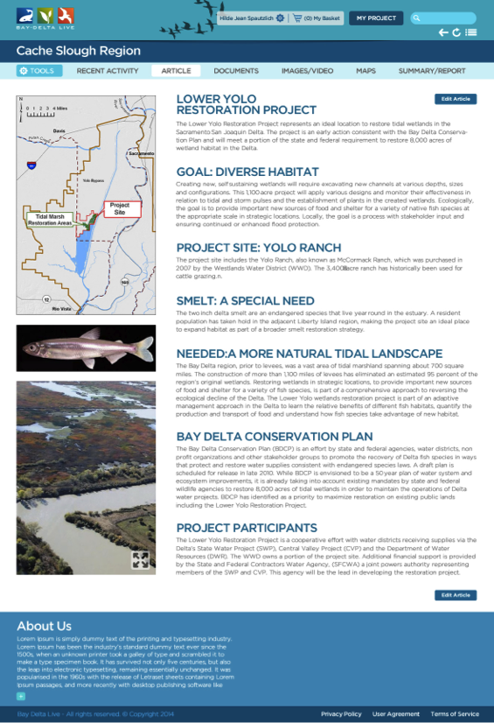
PROJECTS

Slide 20
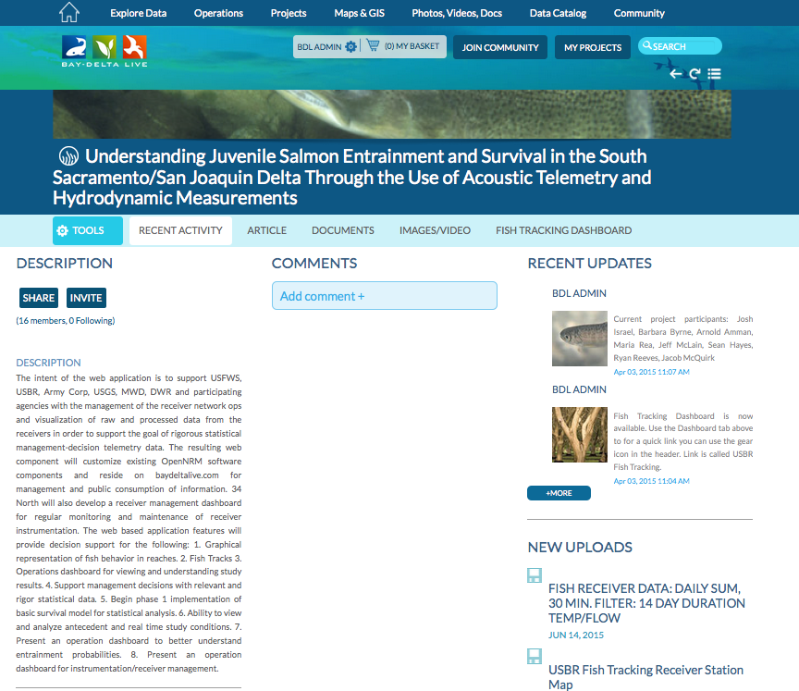

Slide 21
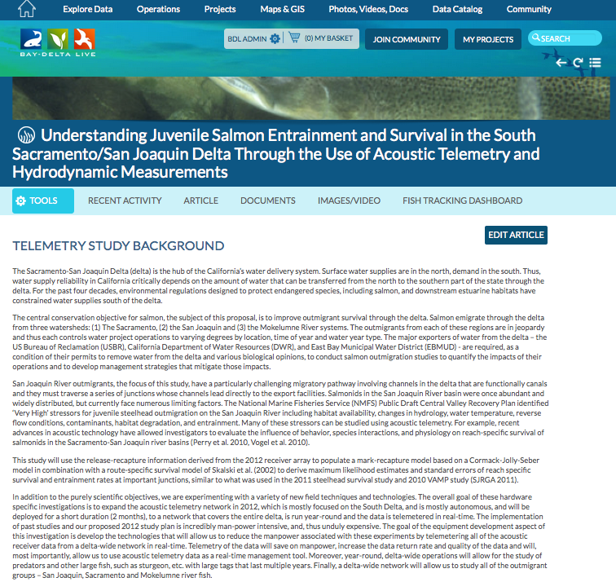

Slide 22
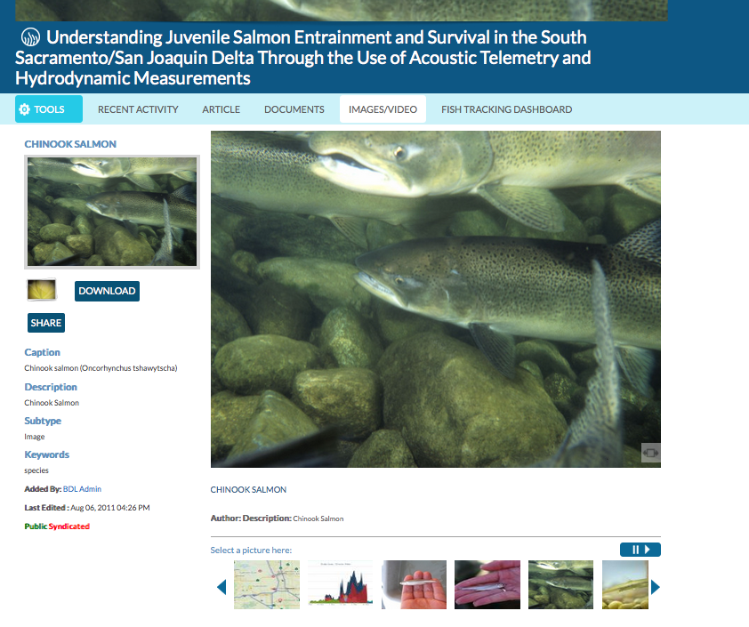

Slide 23
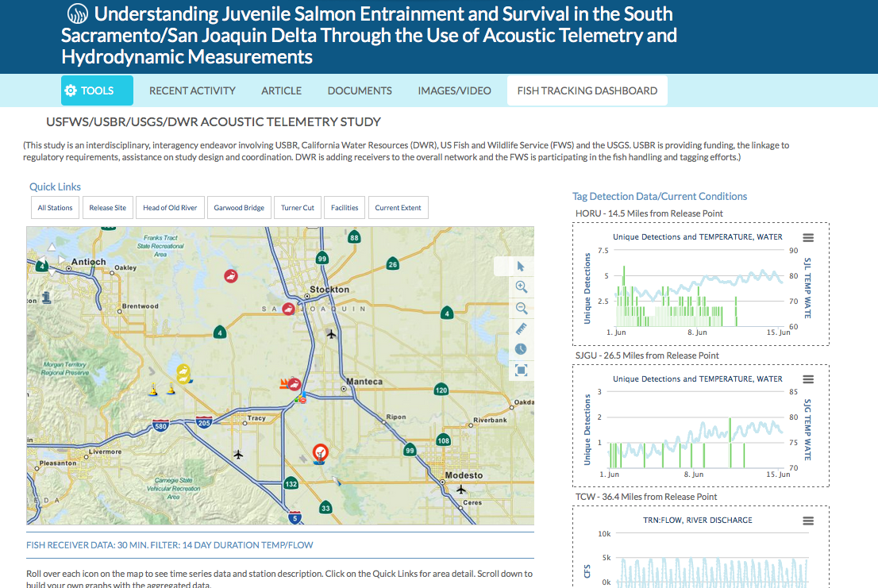

Slide 24
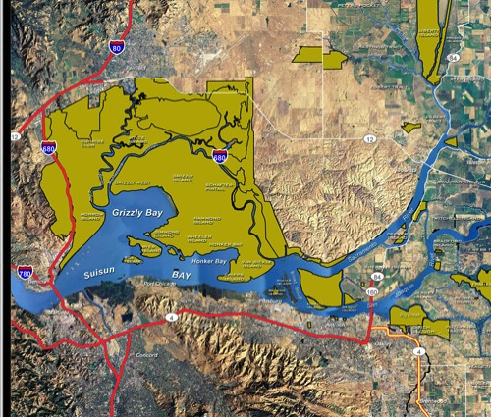
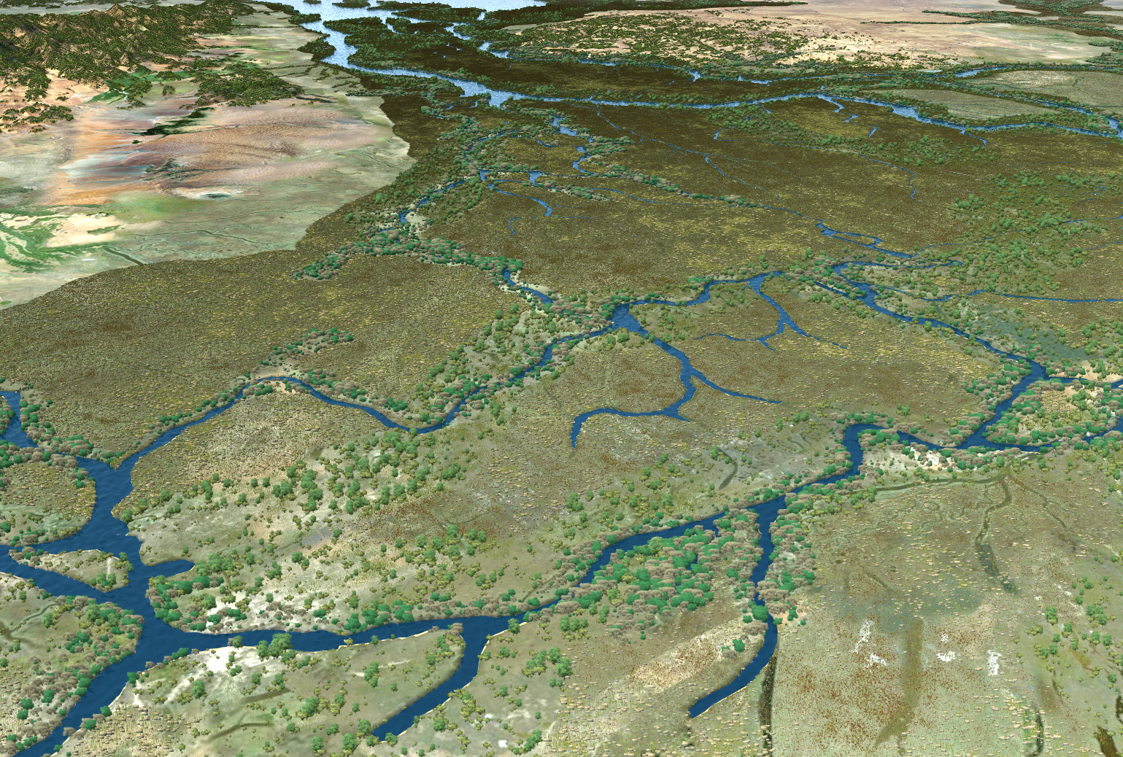
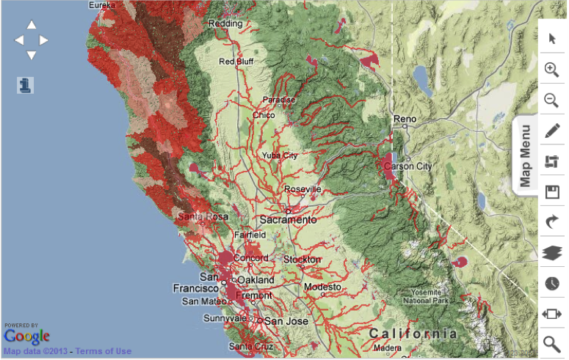
MAPPING AND GIS
Explore and analyze GIS layers
Species
Water Bodies
Infrastructure
Delta Atlas
Land designation
Transporation & Infrastructure
Geopolitical
Live Conditions

Slide 25
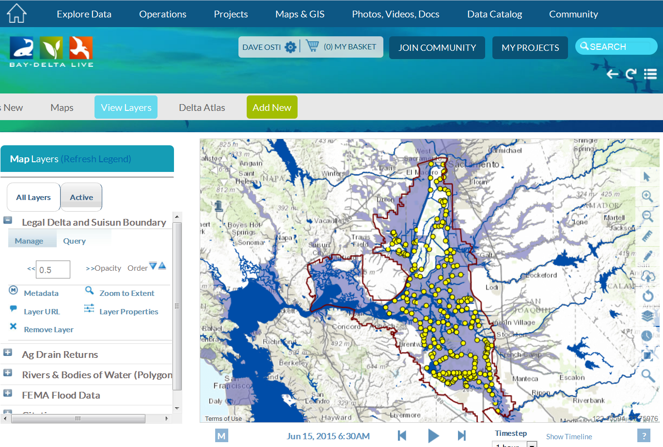
Maps

Slide 26
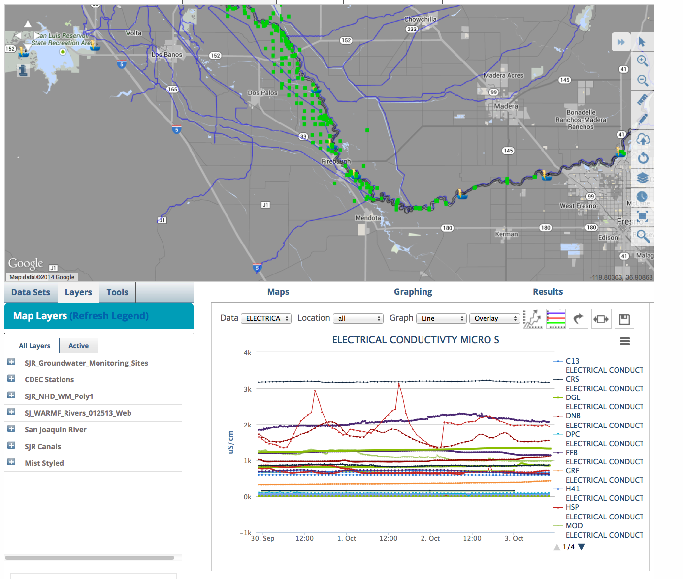
SENSOR NETWORKS

Slide 27
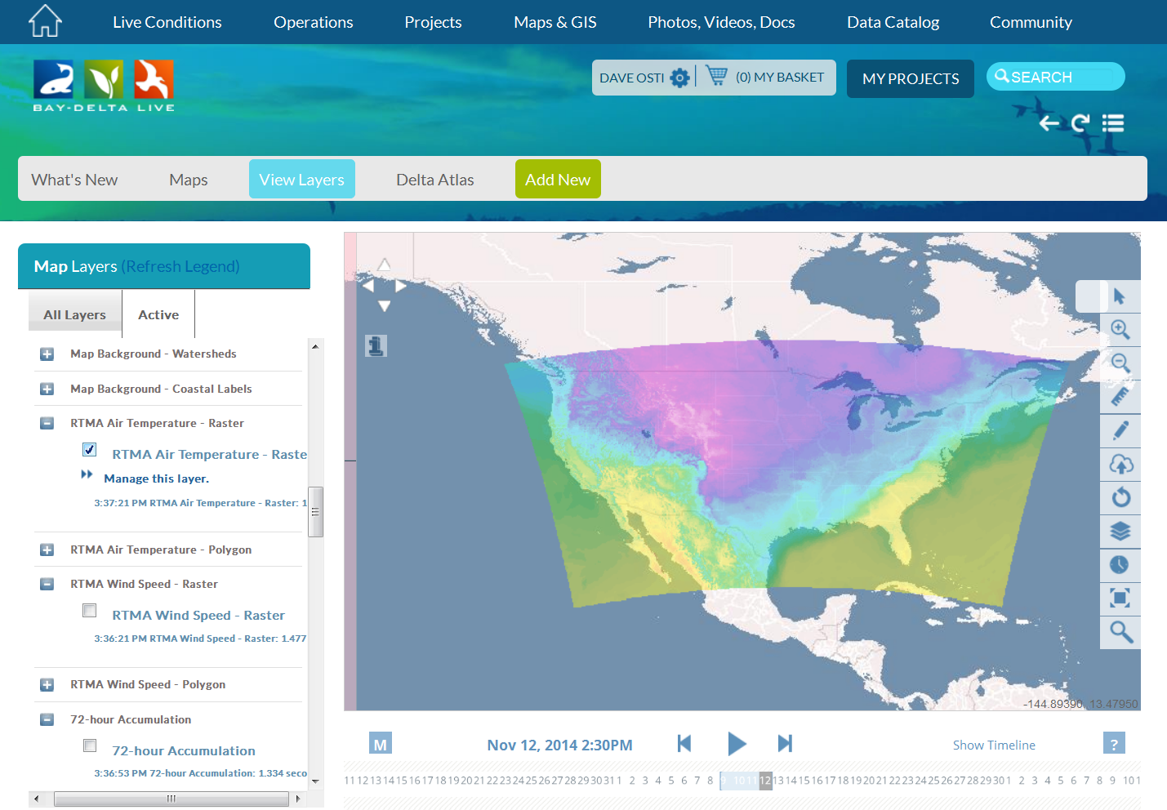
DATA DASHBOARDS

Slide 28
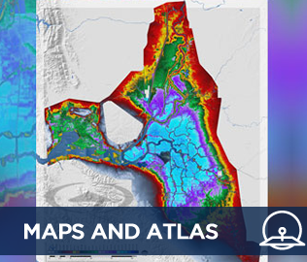
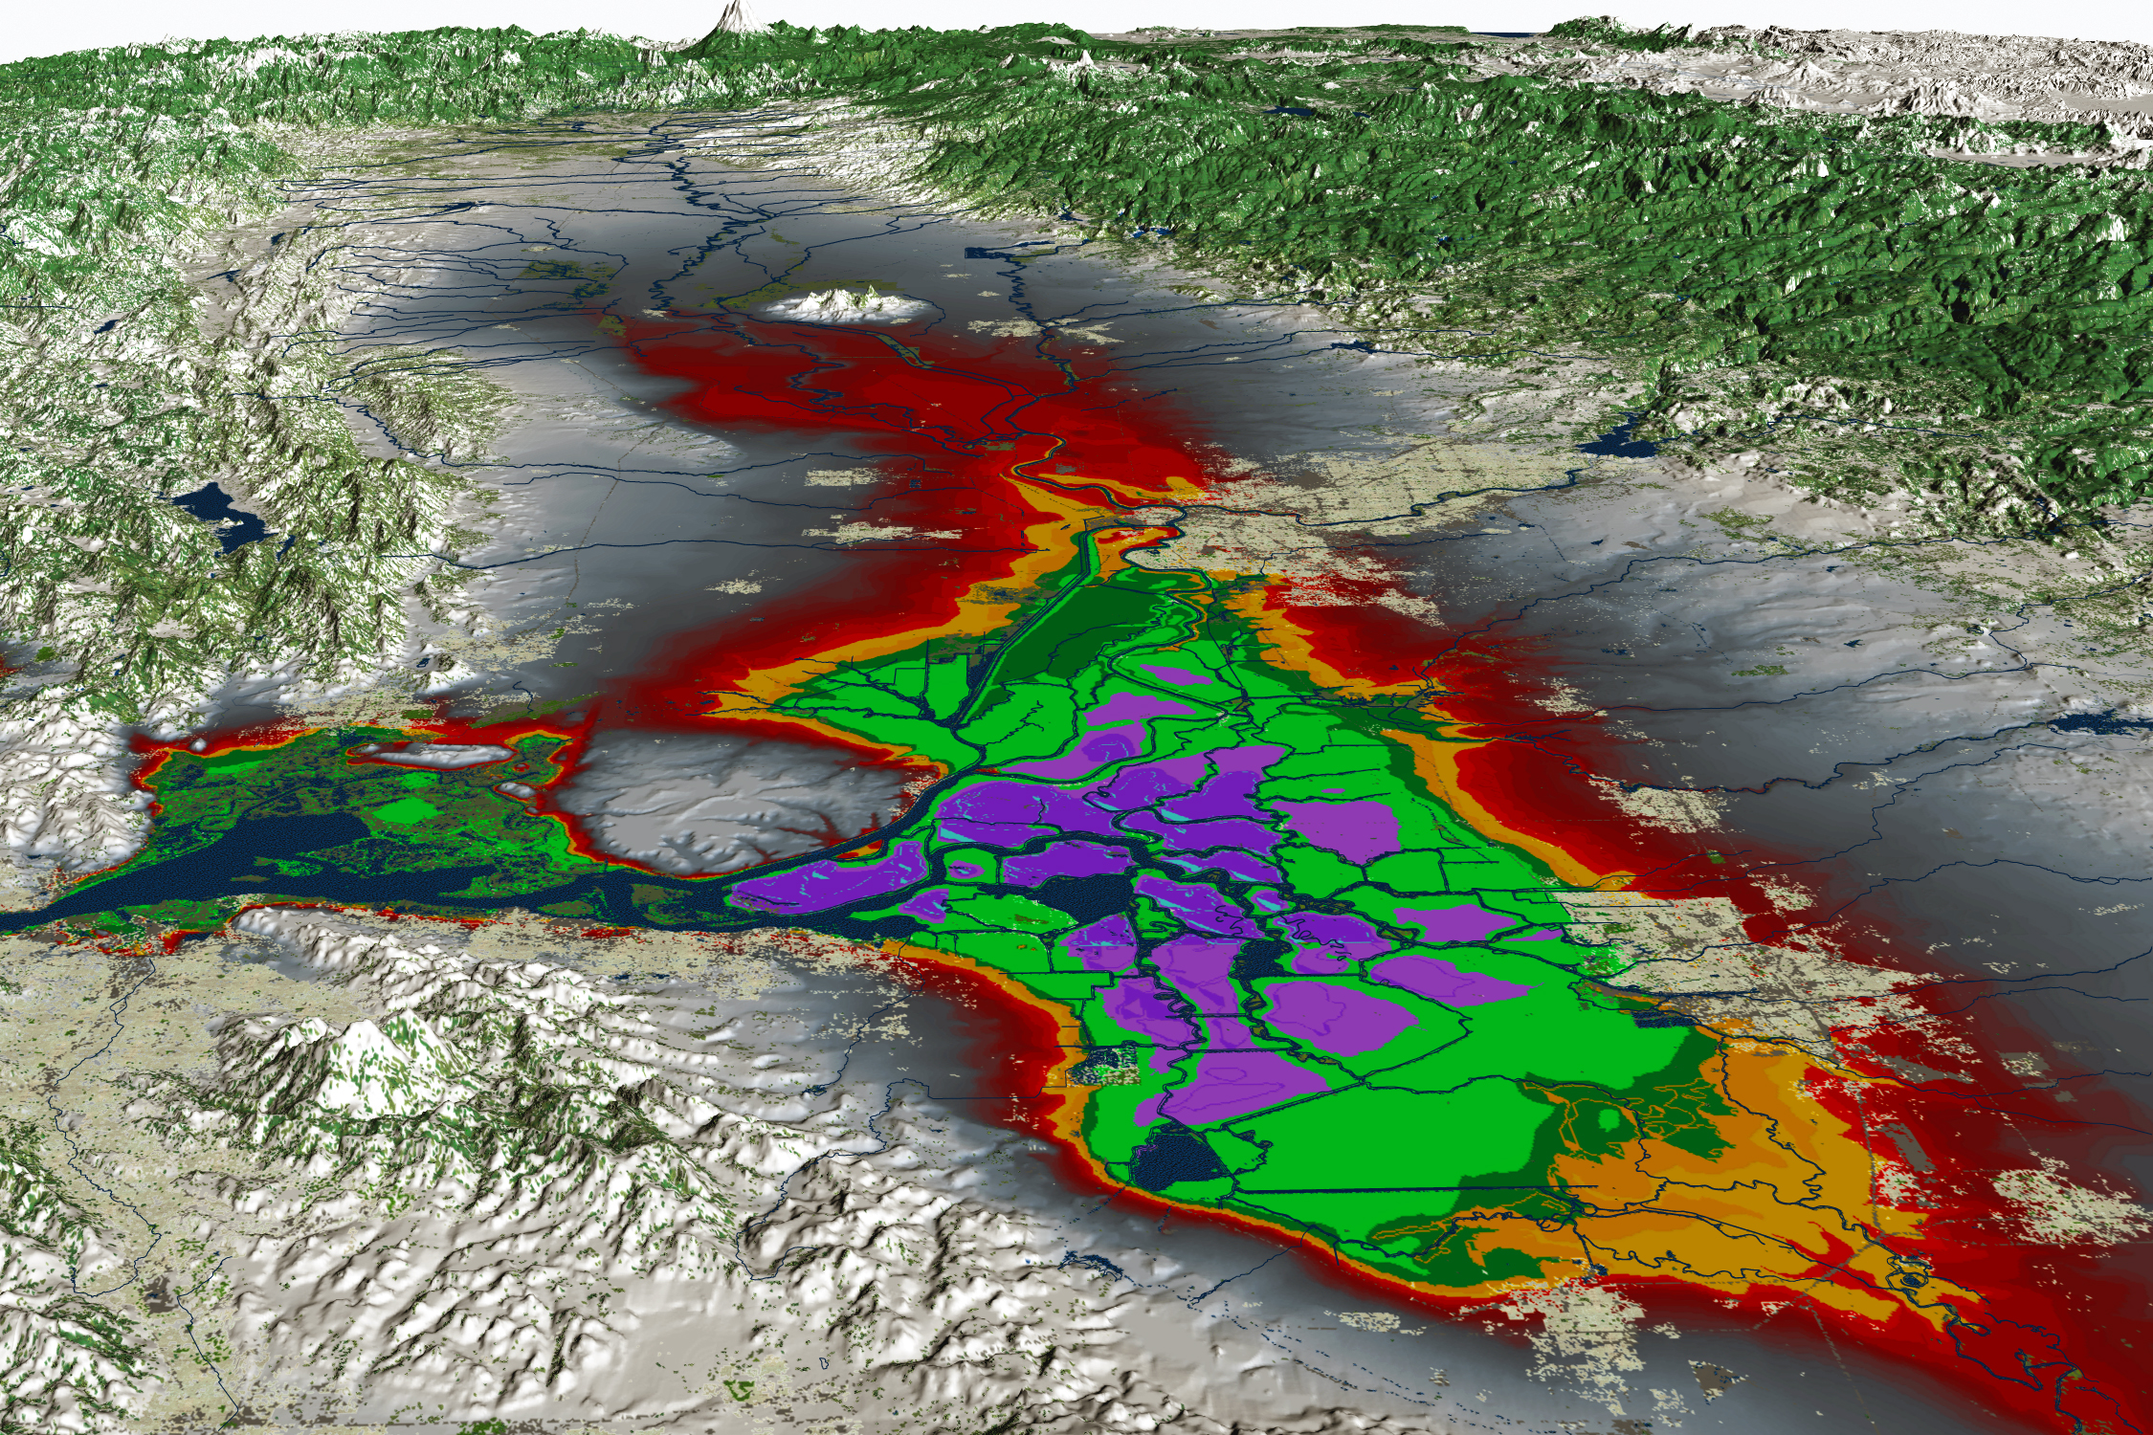
VISUALIZATIONS
VISUALIZE DATA ON THE WEB:
Real-Time Data
Discrete Data added by user
GIS Data
Projects
Documents
Interpolate, Model, Graphs, Maps, Analytics.

Slide 29
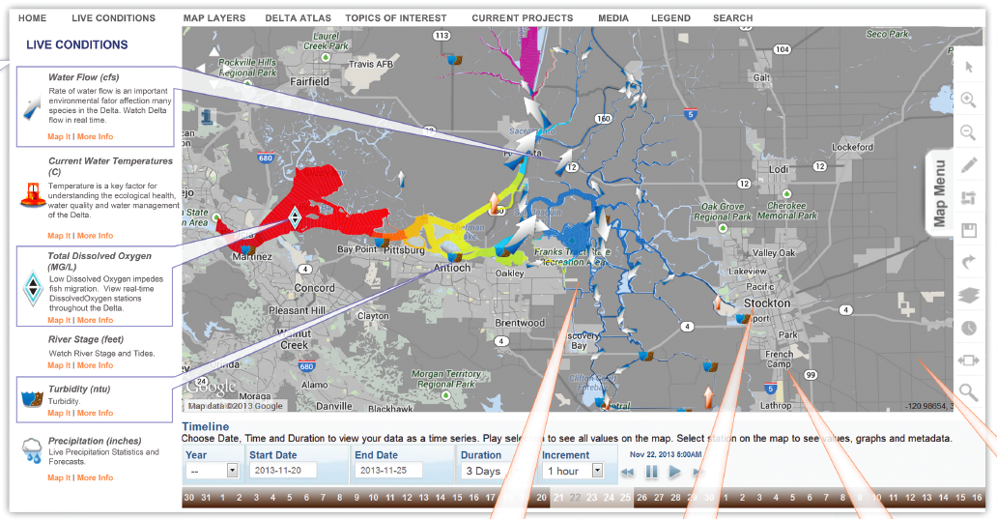
MULTI PARAMETER VISUALIZATIONS

Slide 30
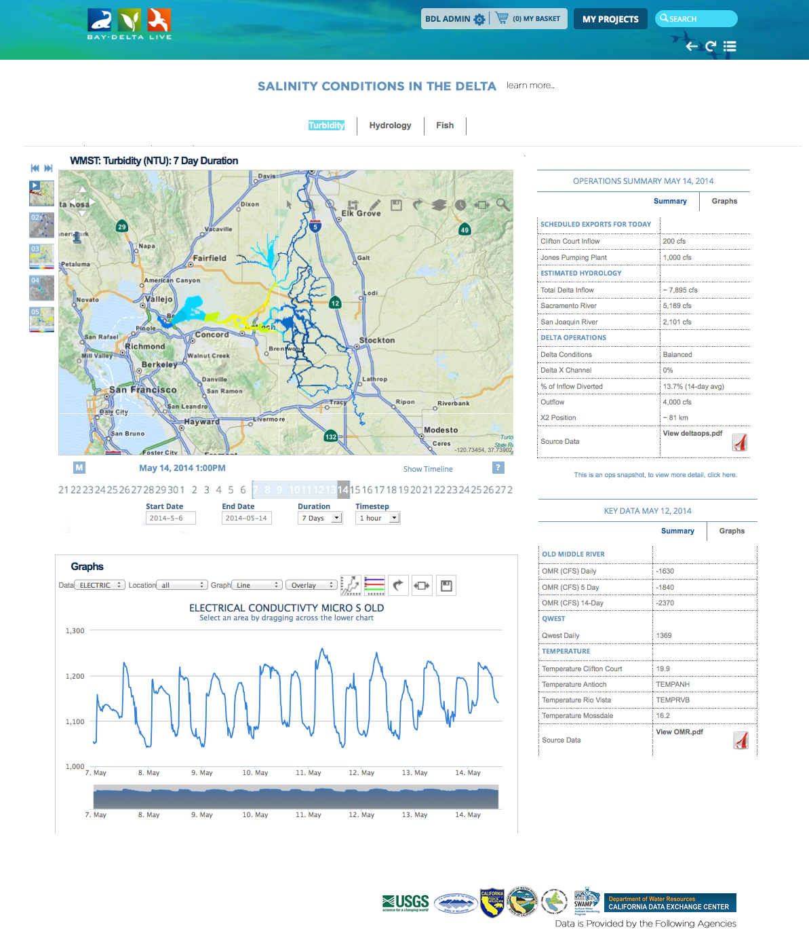
DATA DASHBOARDS
ONE VIEW DATA (Visualize, Map, Graph)
Custom view of data compilations
Project management dashboards

Slide 31
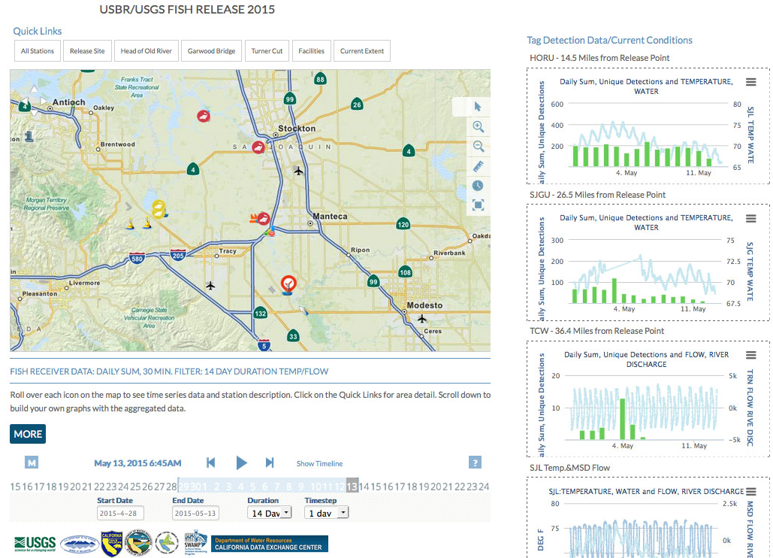
Notes:
UNIQUE DETECTIONS AND DAILY SUM (using 30 minute unique detections filter and then sums)
Data dashboard templates and filters for our use.

Slide 32
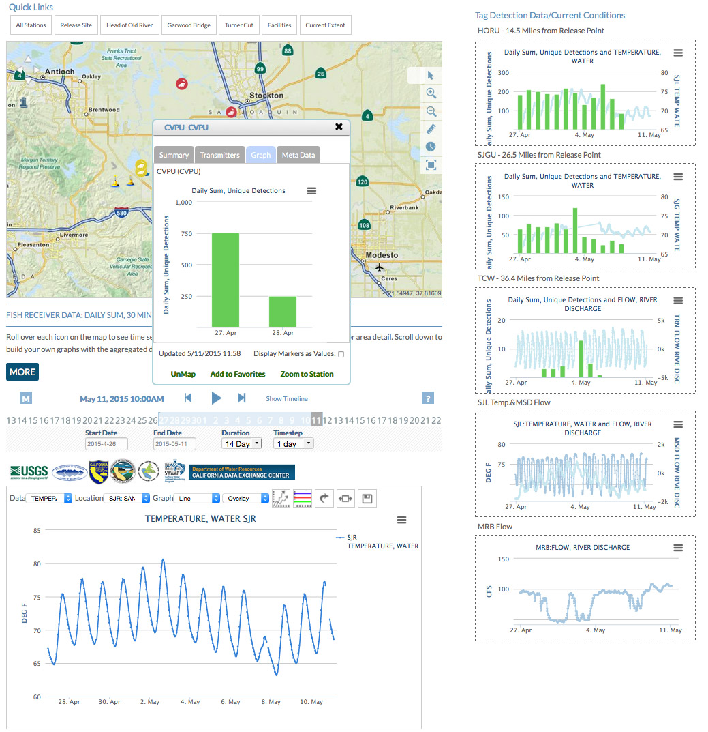
Notes:
Clients include: Honeywell, USGS, DWR, MWD, History Channel,

Slide 33
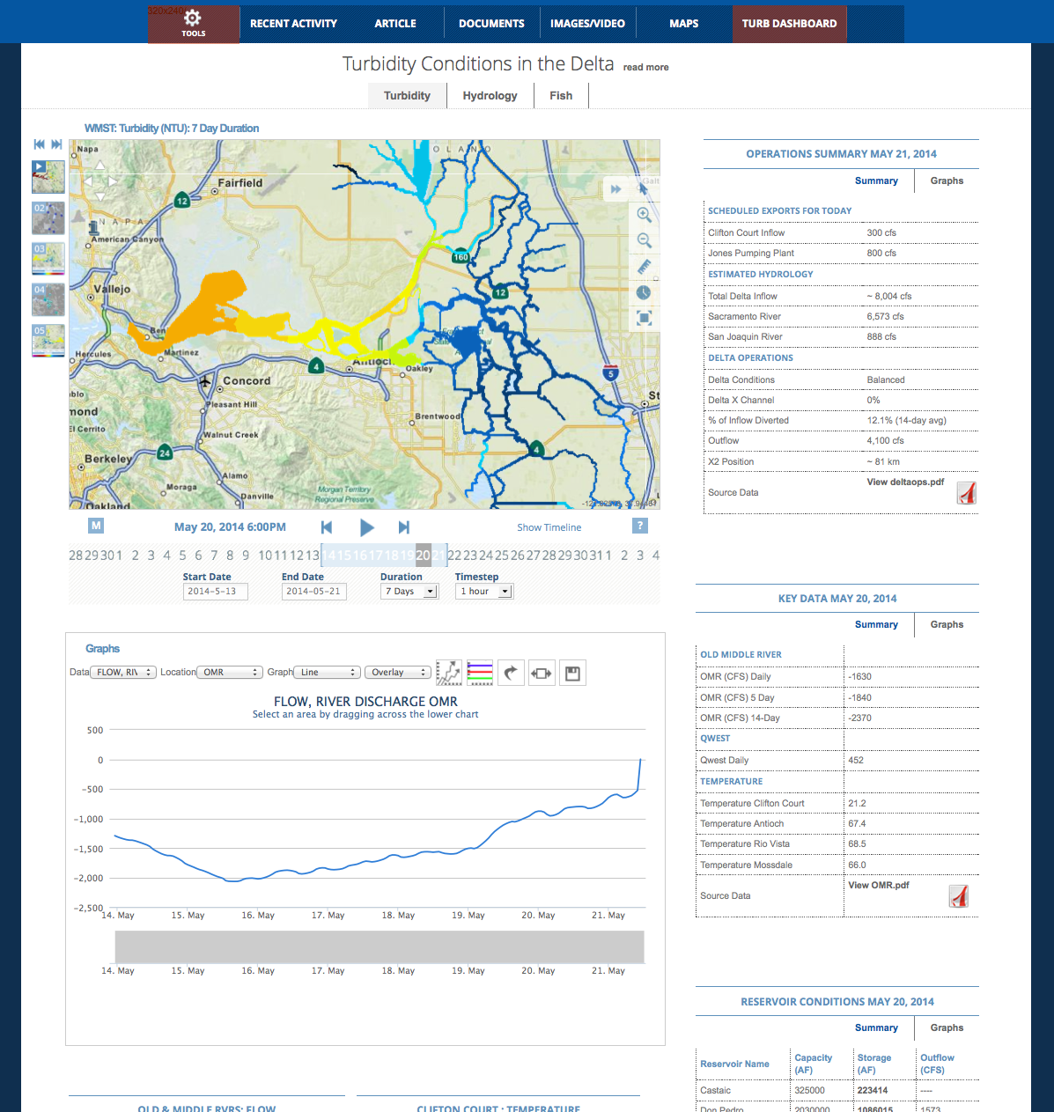
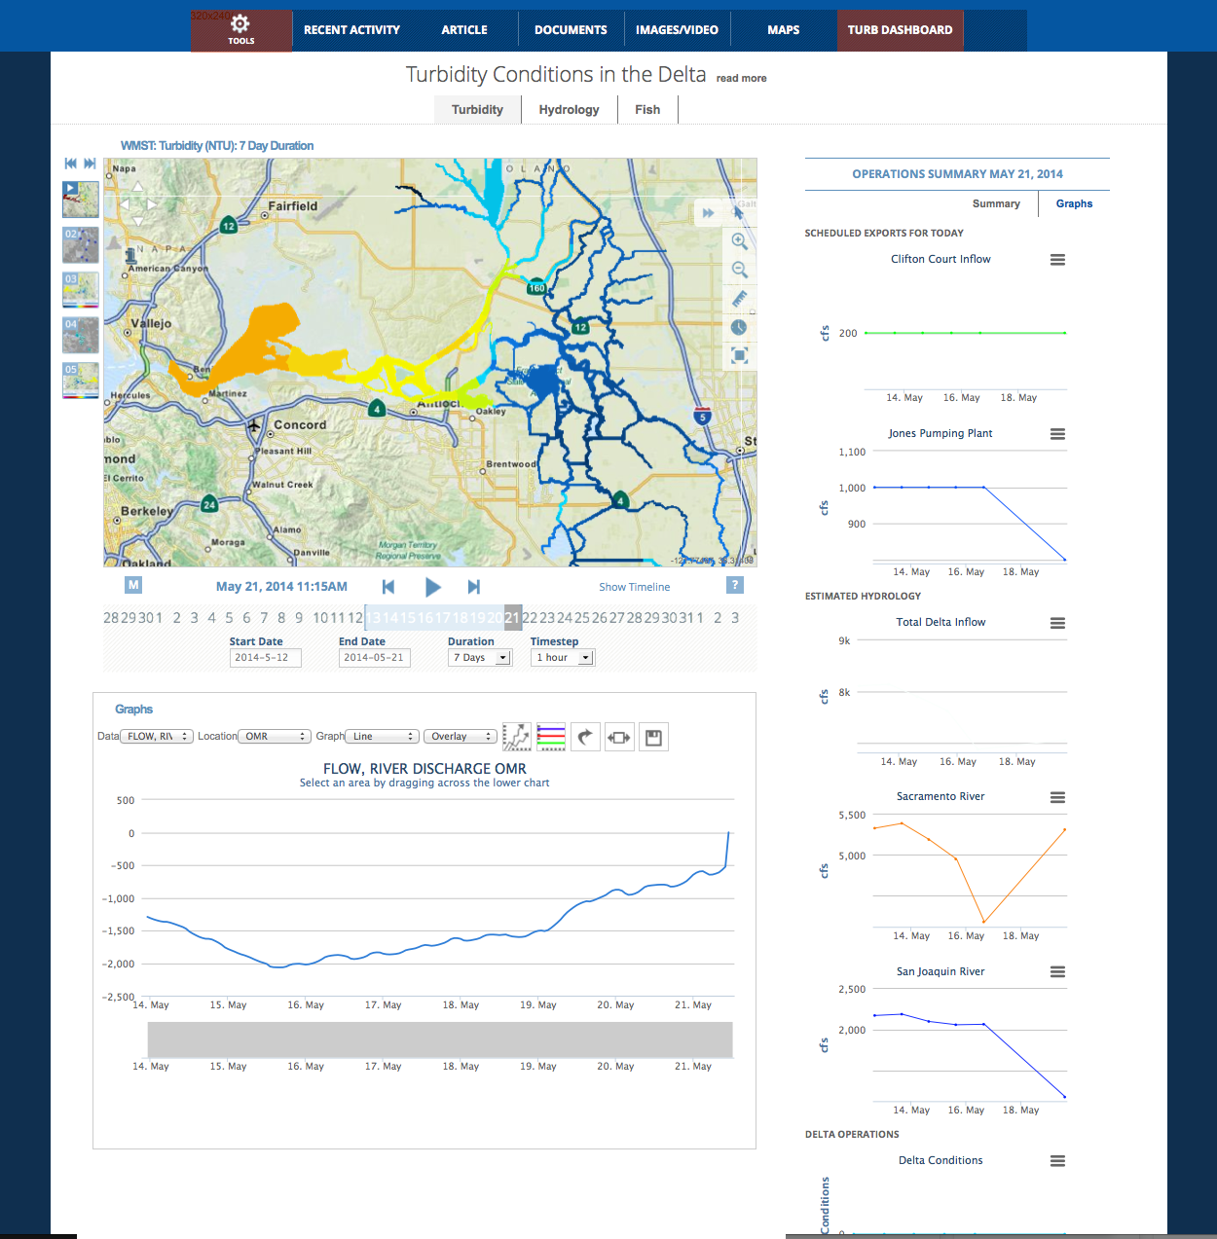
DASHBOARDS

Slide 34
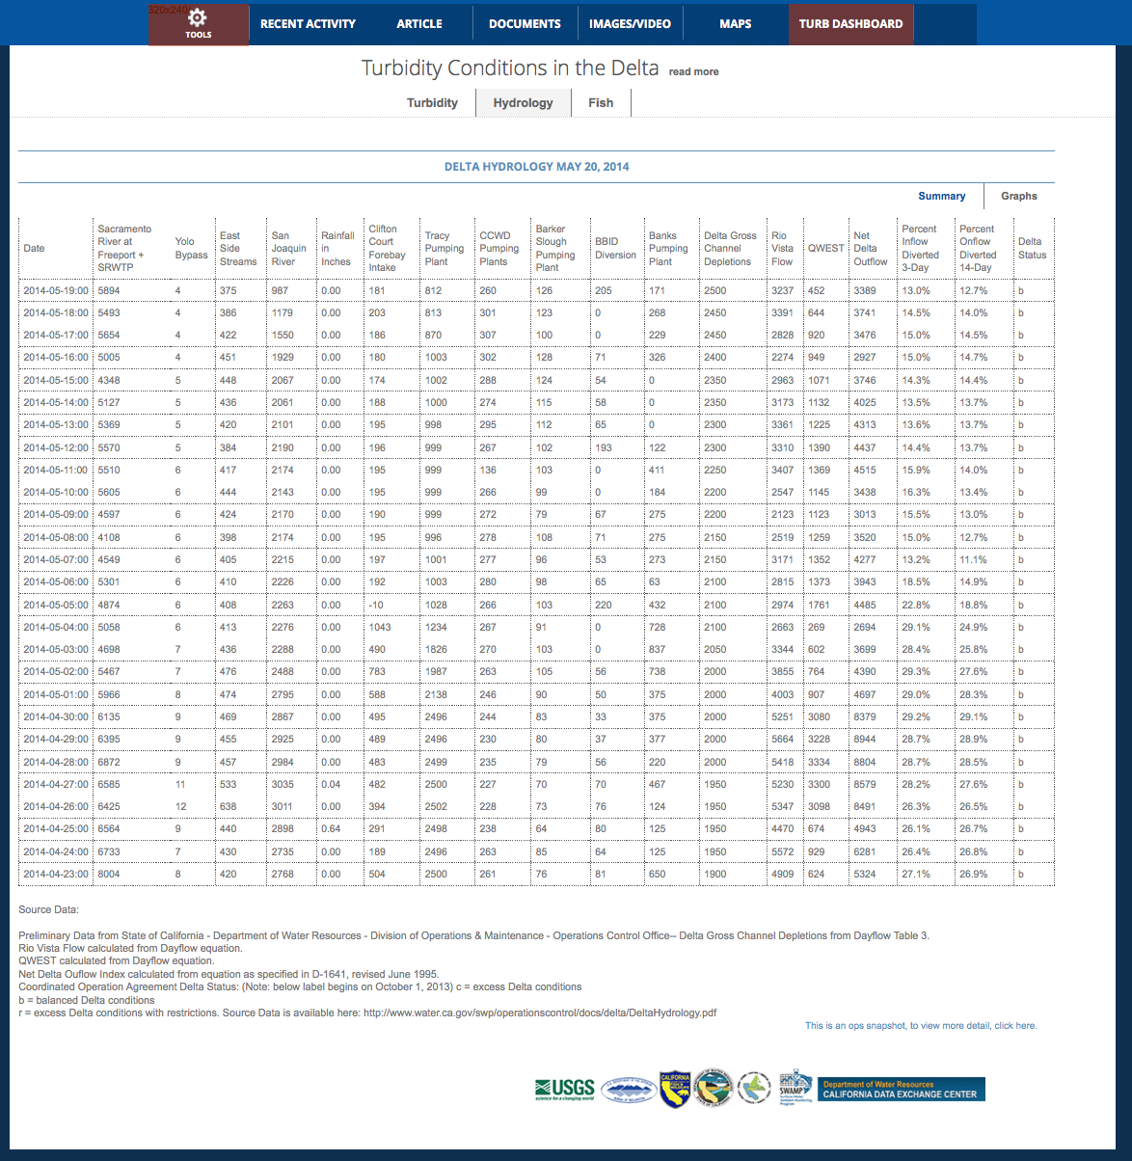
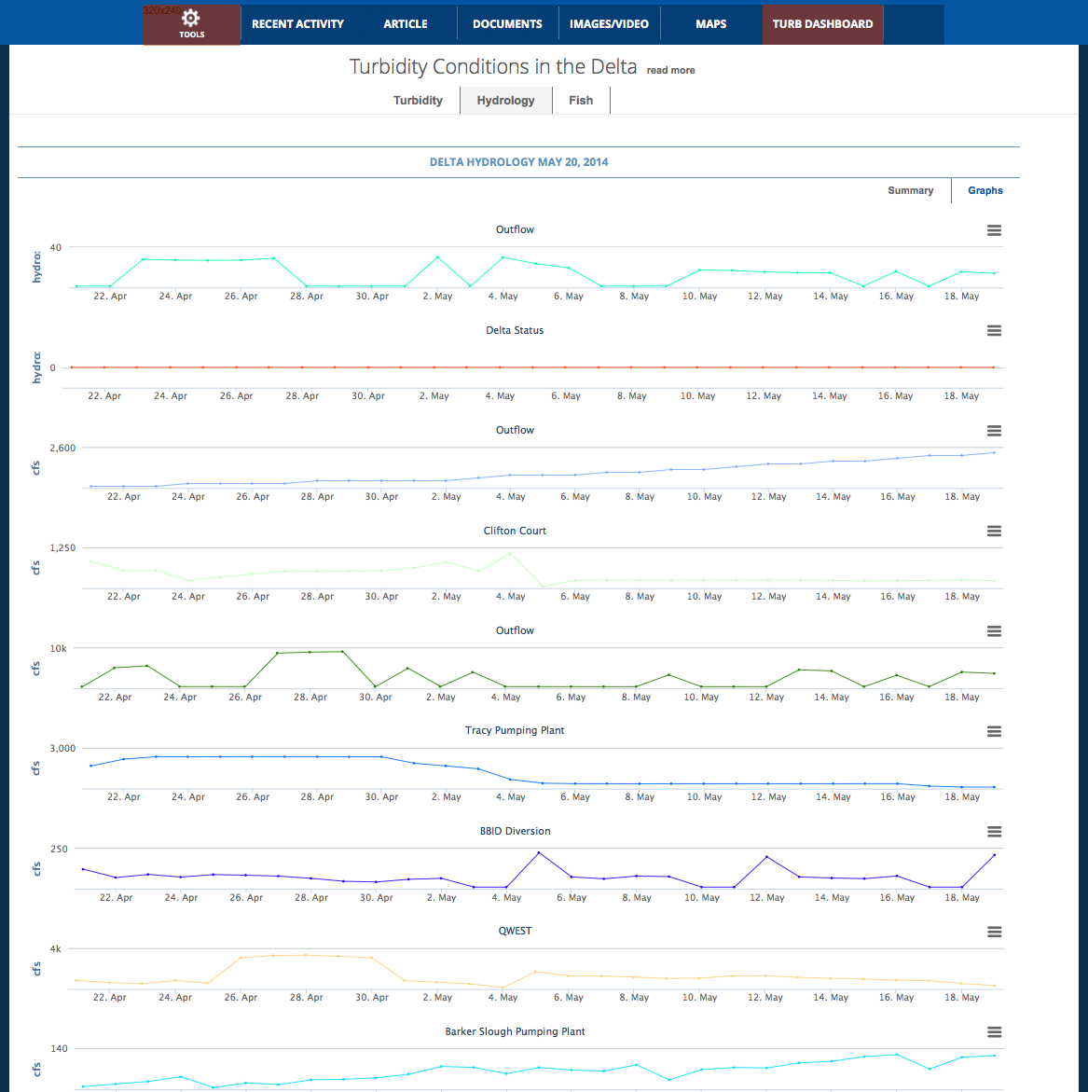
DATA DASHBOARDS

Slide 35
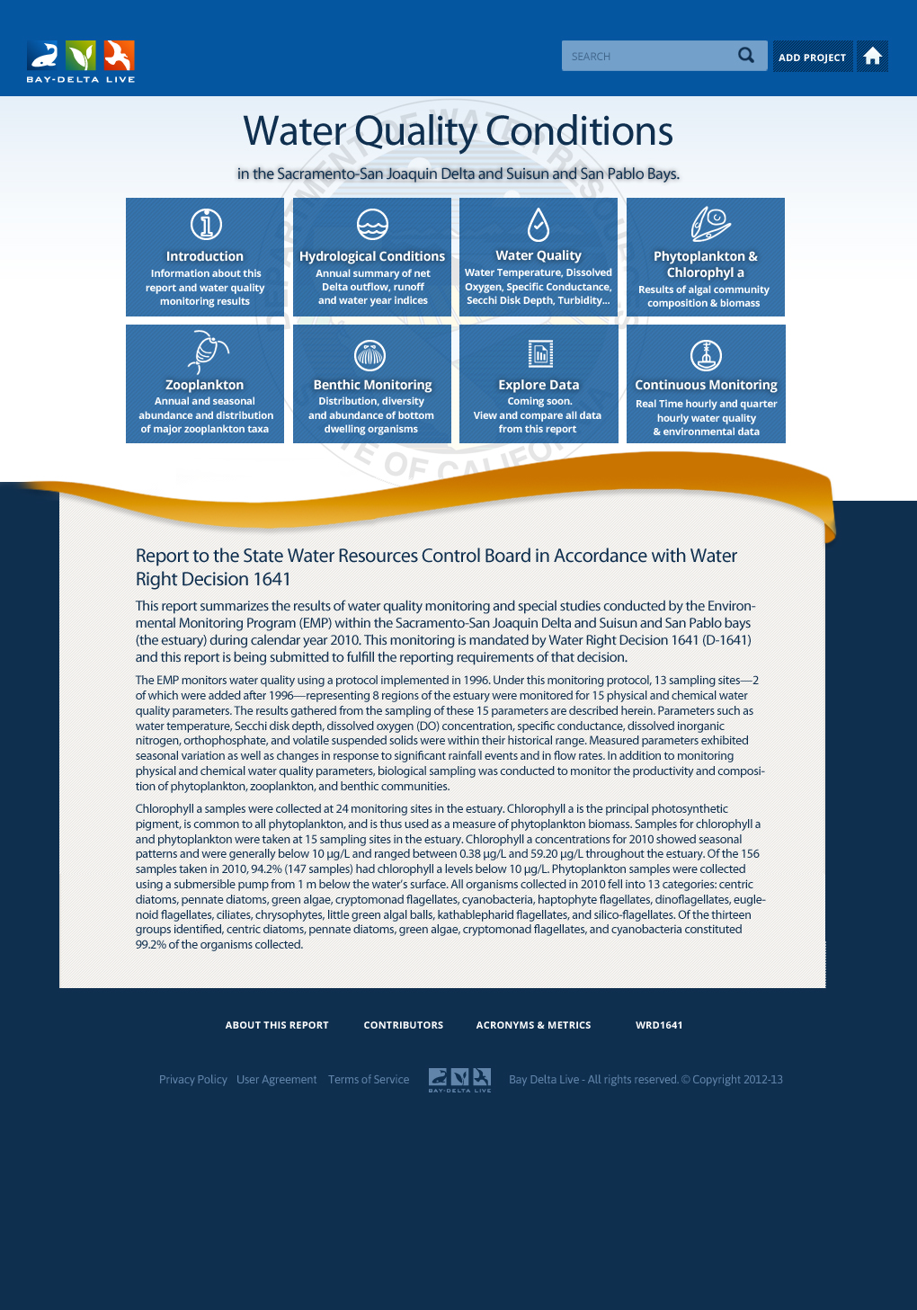
REGULATORY REPORTING
WATER QUALITY DATA:
Environmental Monitoring Program (EMP) water quality monitoring and special studies for:
Redeisgn
Hydrolologic Conditions
Water Quality
Phytoplankton and Chlorophyll a
Zooplankton
Benthic
Nutrients
Special Studies

Slide 36
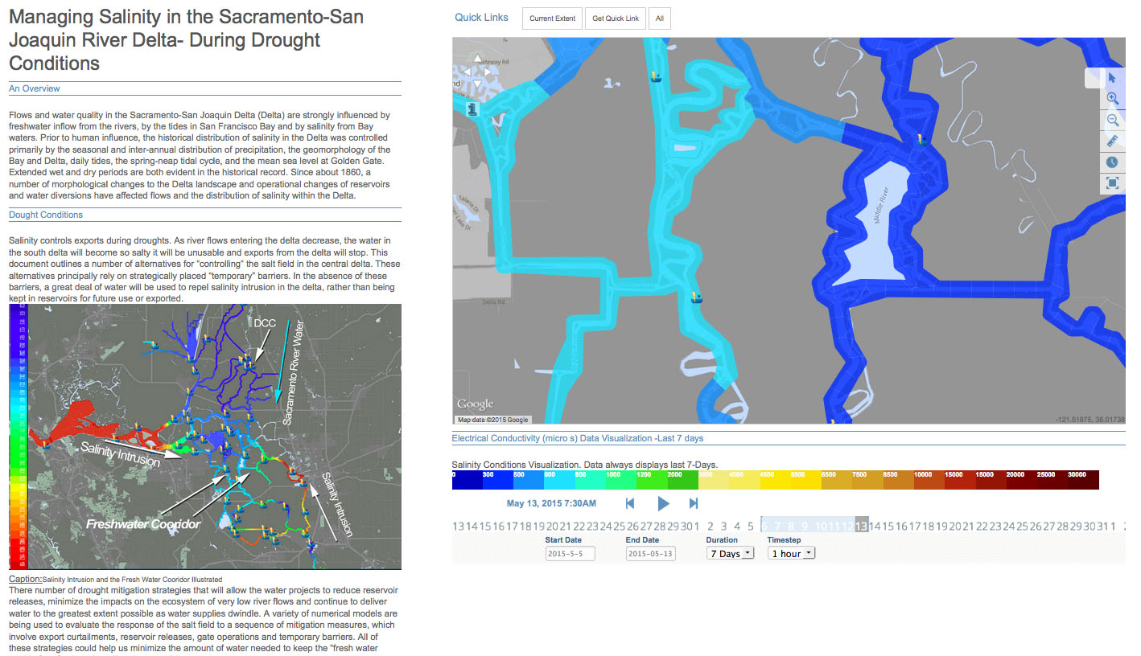
DATA STORIES
Notes:
New data story layout templates for simplifying data story for the public.

Slide 37
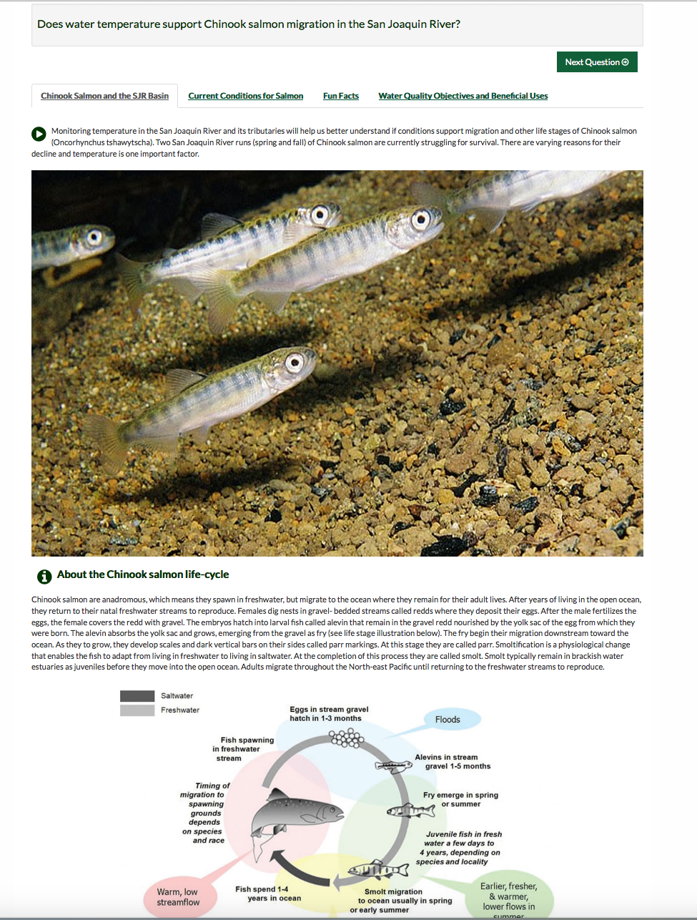
QUESTION TEMPLATES
SENSOR NETWORKS
Notes:
Sample question templates

Slide 38
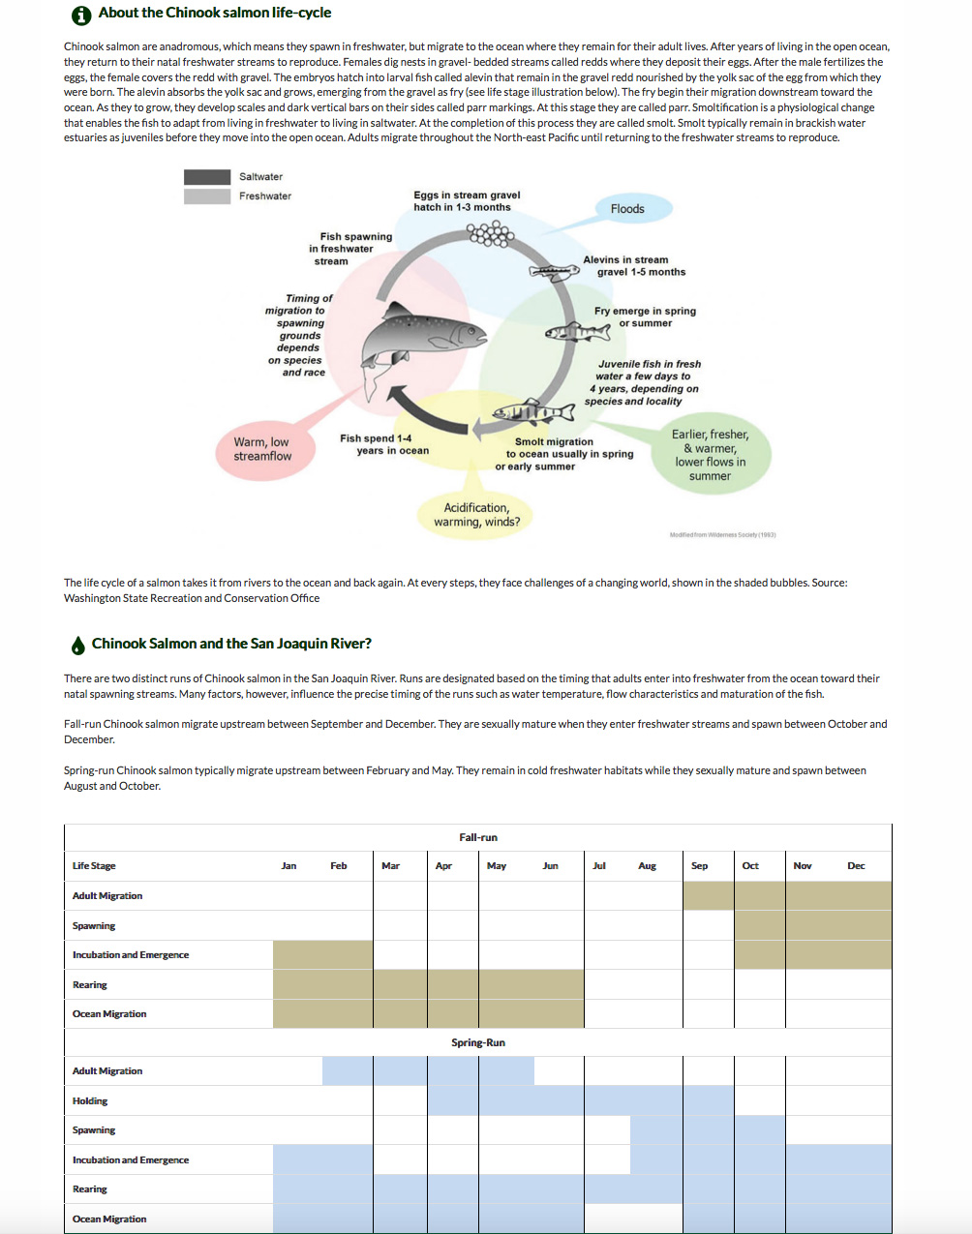
SENSOR NETWORKS

Slide 39
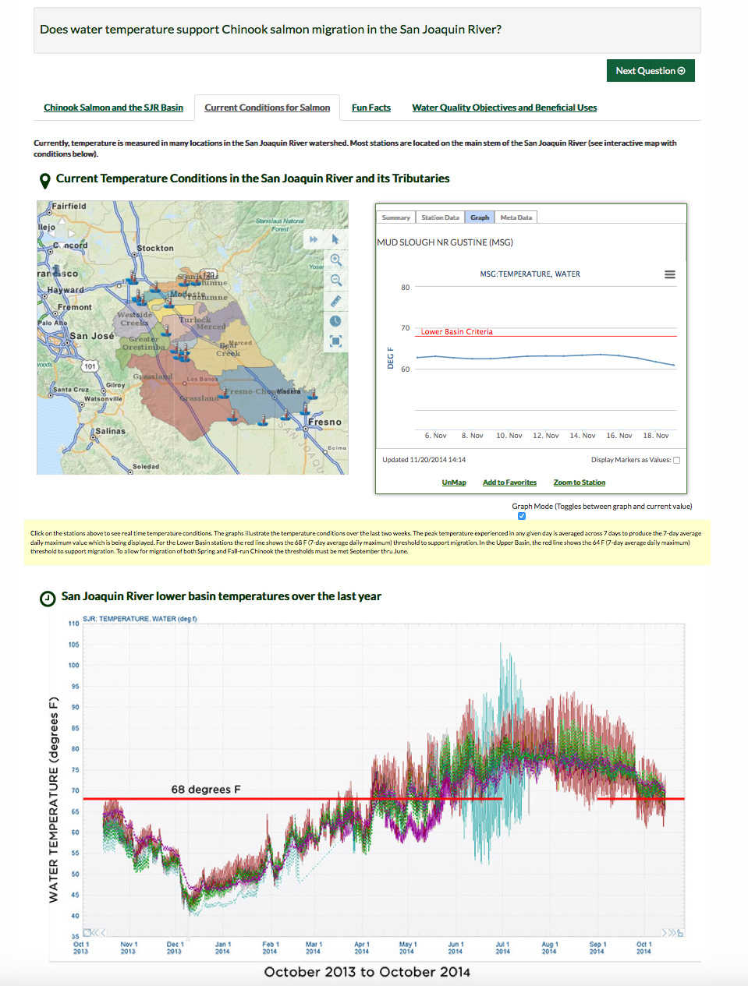
SENSOR NETWORKS

Slide 40
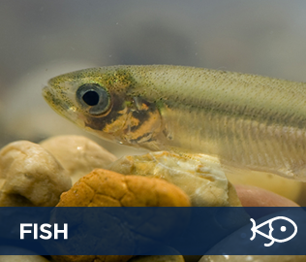
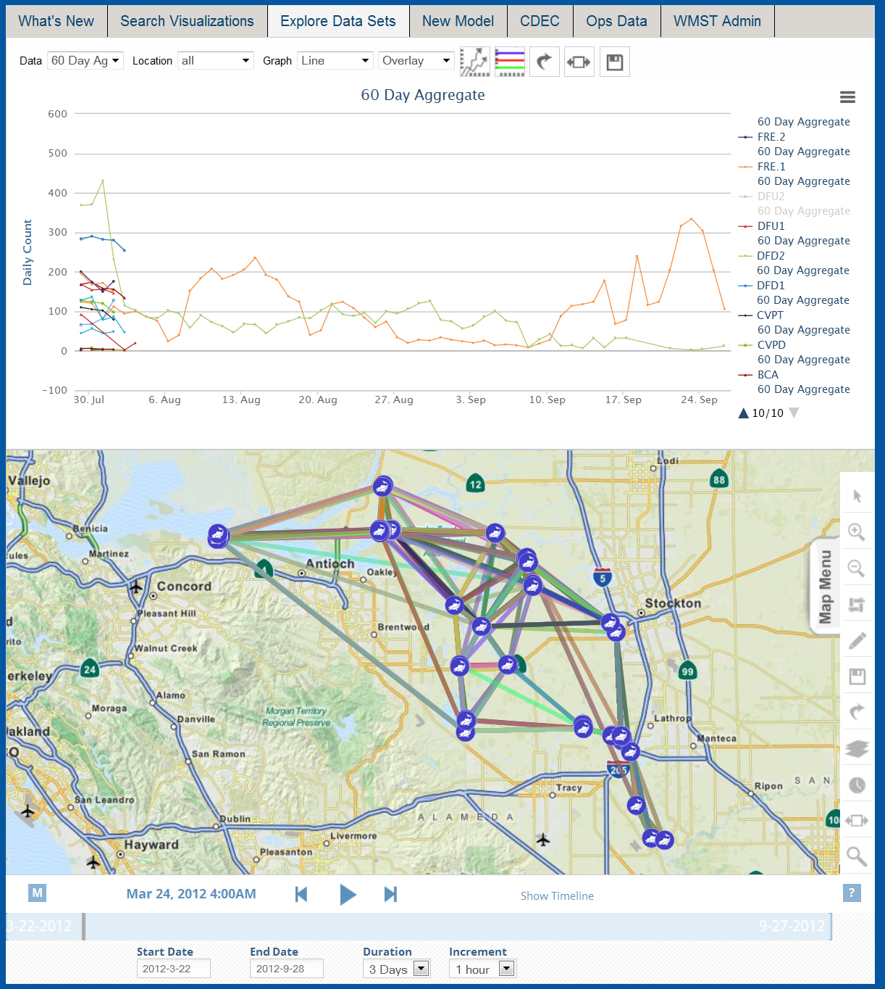

SPECIAL STUDIES
FISH TRACKING RESEARCH
Tracking Fish
Analyze Fish Tracks
Integrate Real Time Conditions
Survival Rates
Tides
Flow
X2

Slide 41
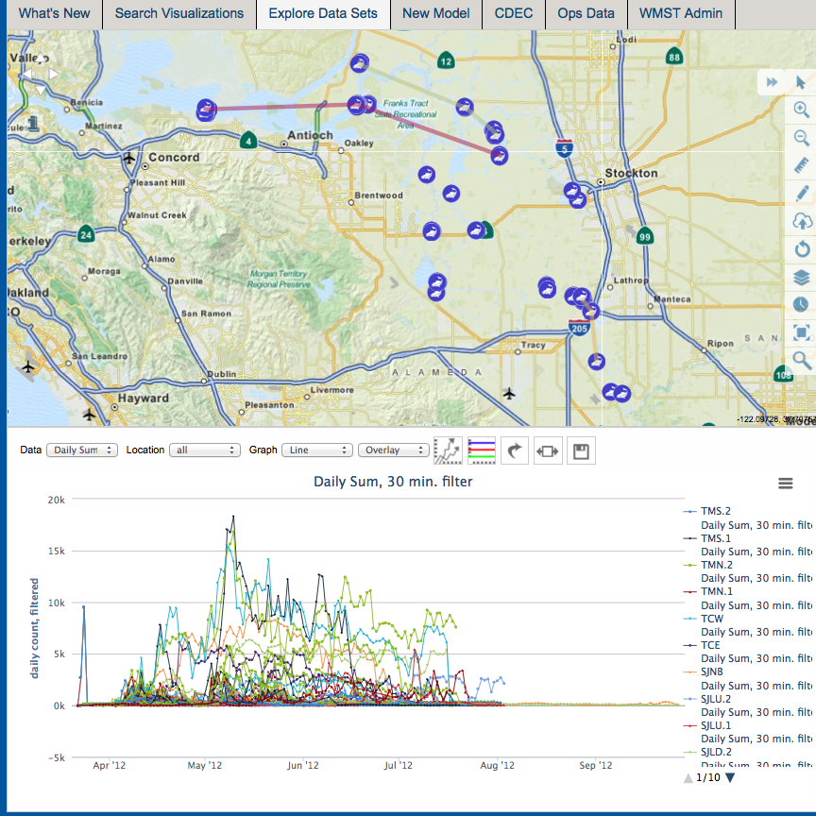
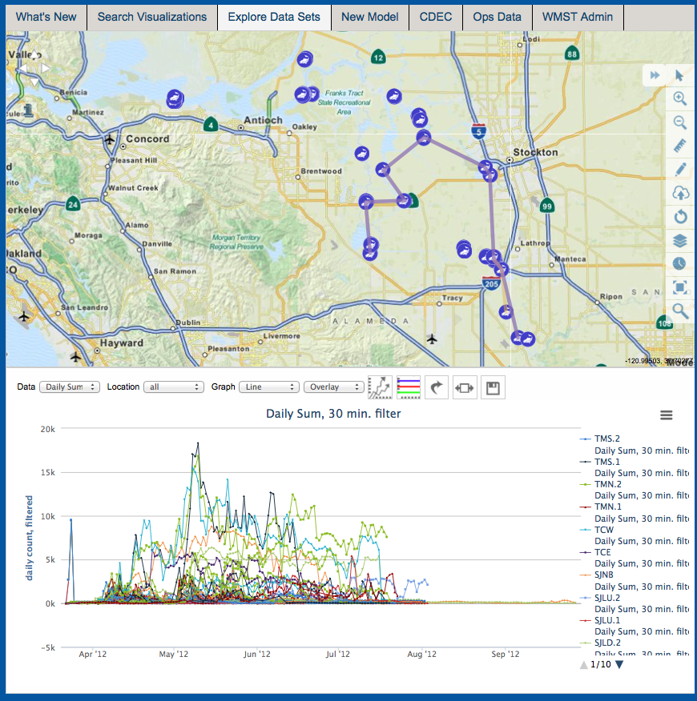
No Prior Detections
Fastest Way Out

Slide 42

REAL TIME TMDL MANAGEMENT: SJRRTM
Notes:
Stakeholder driven real time salinity management in the SJR Basin.
More than 50 + active stakeholder involved in real time analysis and assessment of SJR salinity.
Data dashboards customized for each stakeholder’s data needs
Collaborative forum for posting operations data: Diversions and Discharges.

Slide 43

Notes:
Real time data dashboard for SJR stakeholders. Data display is multiparameter

Slide 44

Notes:
Incorporates model forecast results for predictive analysis of SJR Conditions.

Slide 45


MOBILE APP
MOBILE ACCESS TO DATA, PROJECTS, VISUALIZATIONS…

Slide 46



ON DEMAND NOTIFICATIONS
MOBILE PUSH NOTIFICATIONS:
Alert users to changes in
operations and environmental conditions:
Daily Operations
Hydrologic Conditions
Reservoir Conditions
Fish Facilities
Station Data
Project Data
Turbidity and Salinity Visualizations
Precipitation and Snow Pack
Other

Slide 47


Slide 48


Slide 49

INTEROPERABILITY
Notes:
With the knowledge from California knew we needed to build a highly module and interoperable platform that
Aggregated data both hosted and remote.
The data then needed to be organized and used as information.
Then the software that displayed this information needed to be to give the users maximum flexibility to accomplish their individual needs.

Slide 50
REVENUE MODELS
SAAS
OPENNRM.ORG
ENTERPRISE CUSTOM
APPLICATION DEVELOPMENT
SUPPORT CONTRACTS

Slide 51
VALUE PROPOSITION
A” Classic” Value Proposition in an virtually untapped market:
Organize and report data and information between agencies, NGO’s, universities and collaborators
Better understand and communicate real time continuous and discrete data with colleagues and management
Visualize data live and with as many supporting resources as possible
Create a workspace where all collaborators can better view and comment on data to create reports to operational managers
View and archive data in one common interface
Create a data dashboard where agencies can monitor and comment on water quality in real time
Develop alerts generated from data thresholds and report in real time via apps and web portals
Notes:
Clients include: Honeywell, USGS, DWR, MWD, History Channel,

Slide 52


COMMUNITY
COMMUNITY MAP-BASED TOOLS:
USERS | BDL COMMUNITY MEMBERS
Explore | Keep users Informed:
Find | Provide Detail
Contribute | Manage Your Listing
Follow | Add Images, Videos, Documents
Be Notified | Post Comments
 | Notify Followers

Slide 53

COMMUNITY

Slide 54


