Slide 1
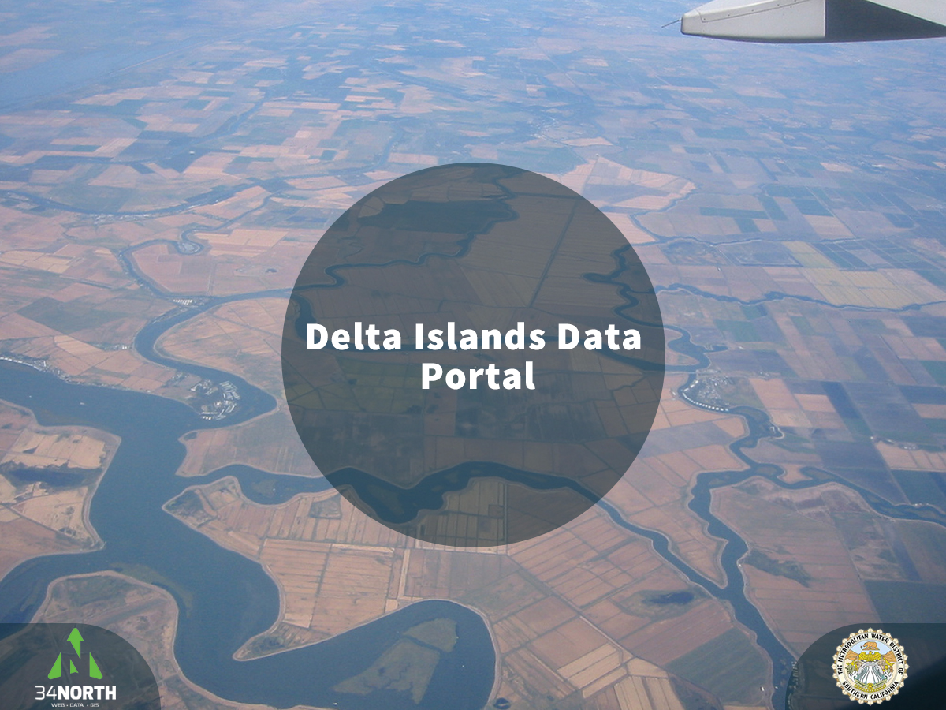

Slide 2
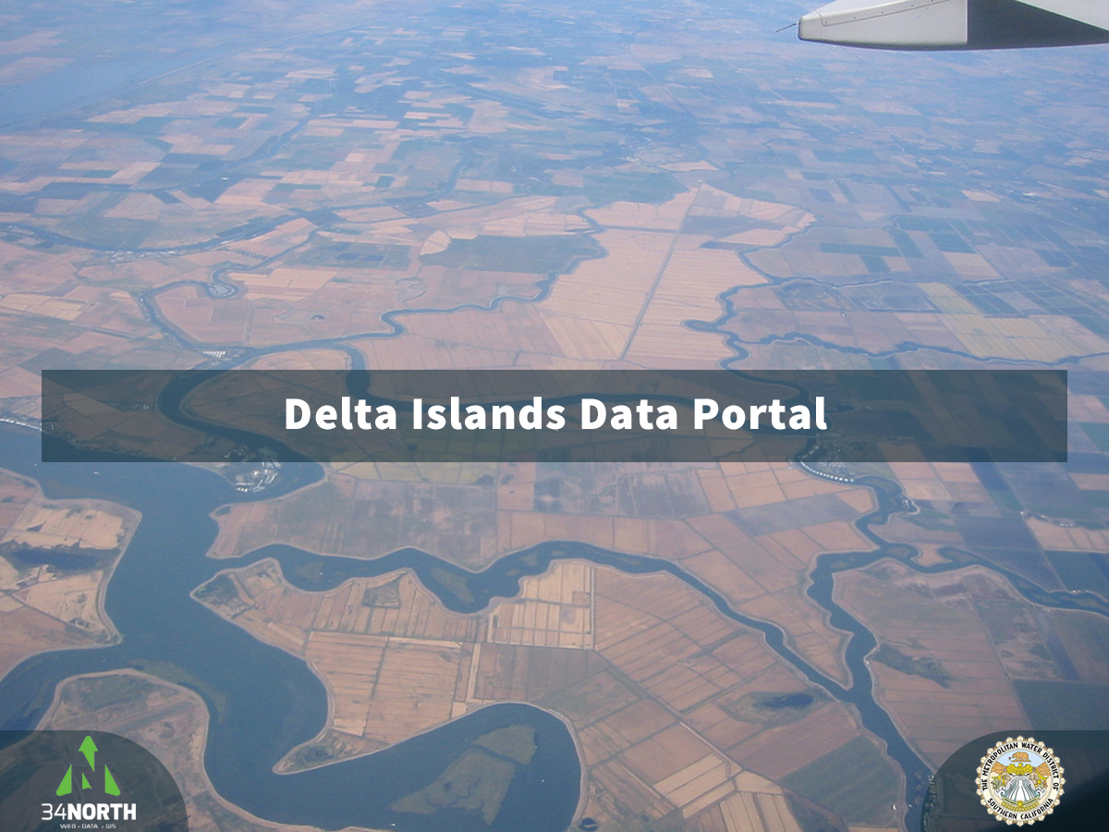

Slide 3
Purpose
Comprehensive data management platform for Delta islands and levees
Regulatory compliance and reporting for island management
Cyber infrastructure to support portions of California WaterFix
Platform for demonstrating objectives for attaining the state's co-equal goals
Facilitate collaboration between land owners, consultants, reclamation districts
Notes:
Metropolitan Water District of Southern California purchased four islands and tracts that are strategically located in the center of the Delta
Bacon Island
Bouldin Island
Holland Tract
Webb Tract
Part of Chipps Island

Slide 4
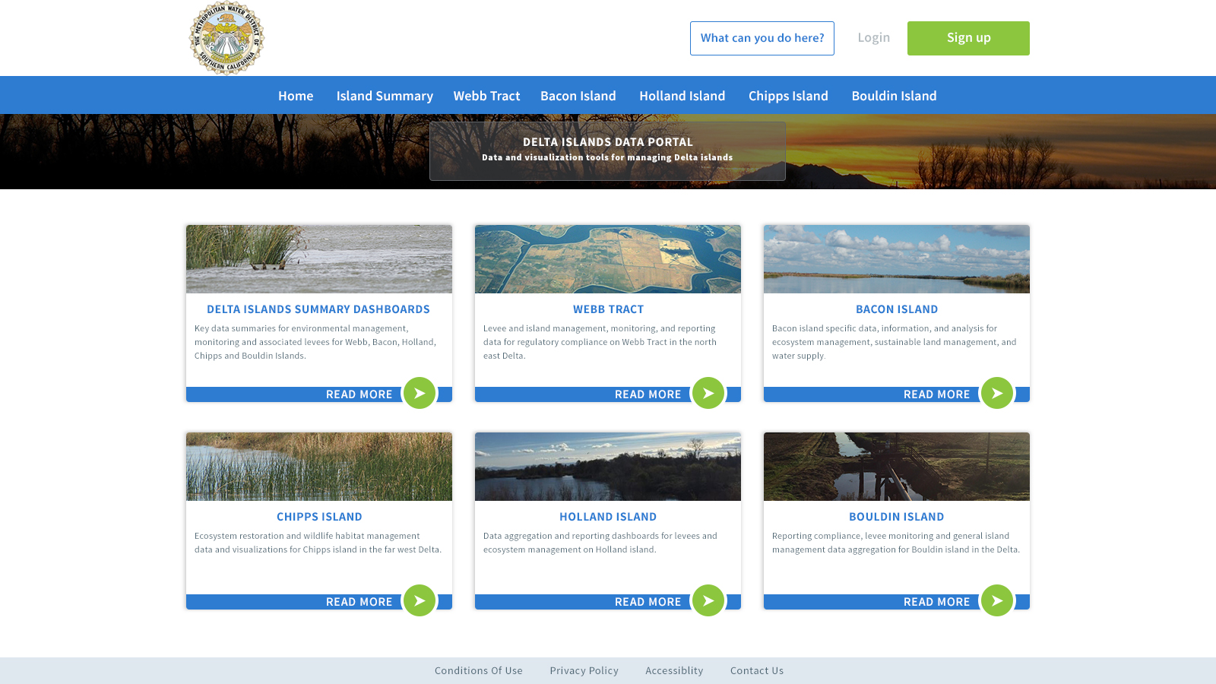

Slide 5
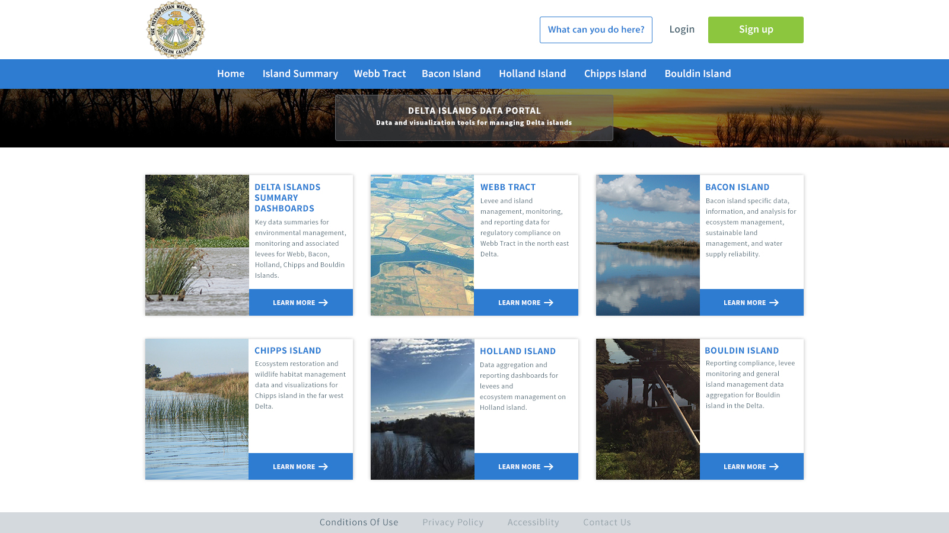

Slide 6
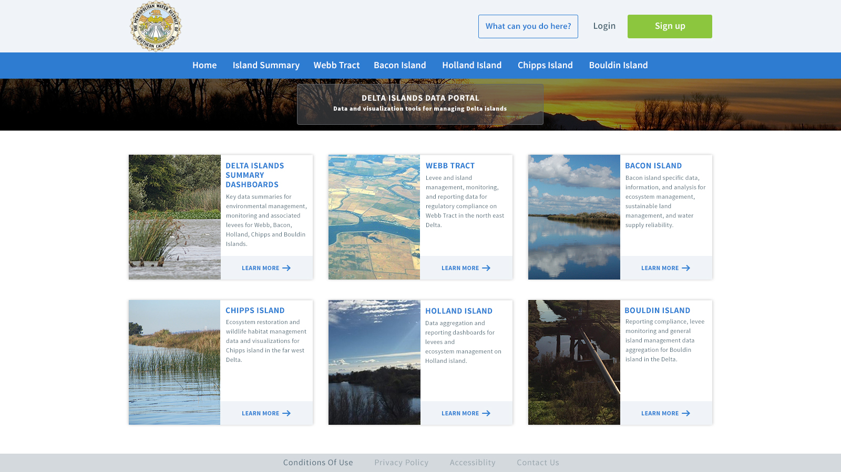

Slide 7
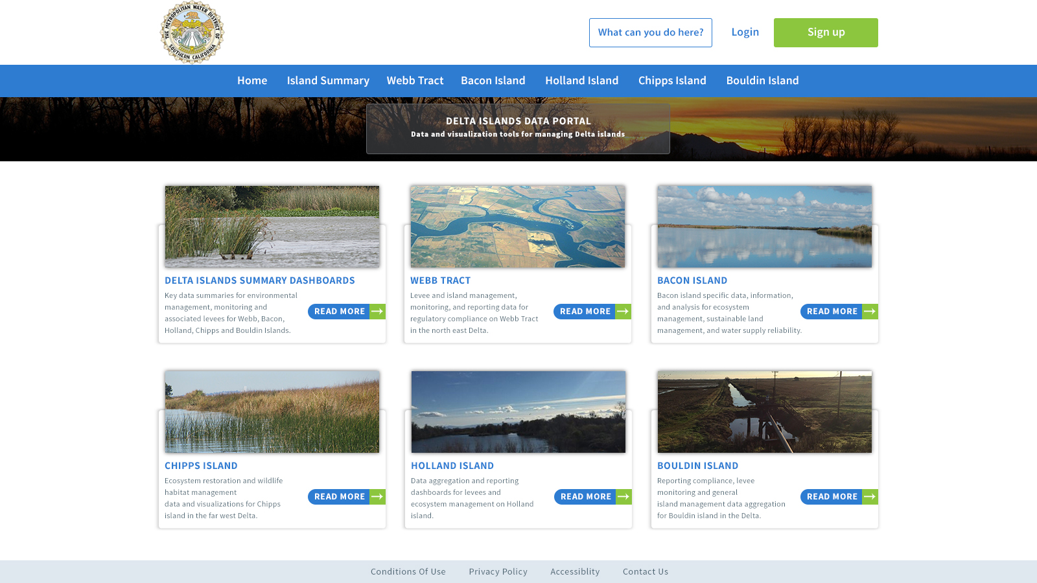

Slide 8


Slide 9


Slide 10
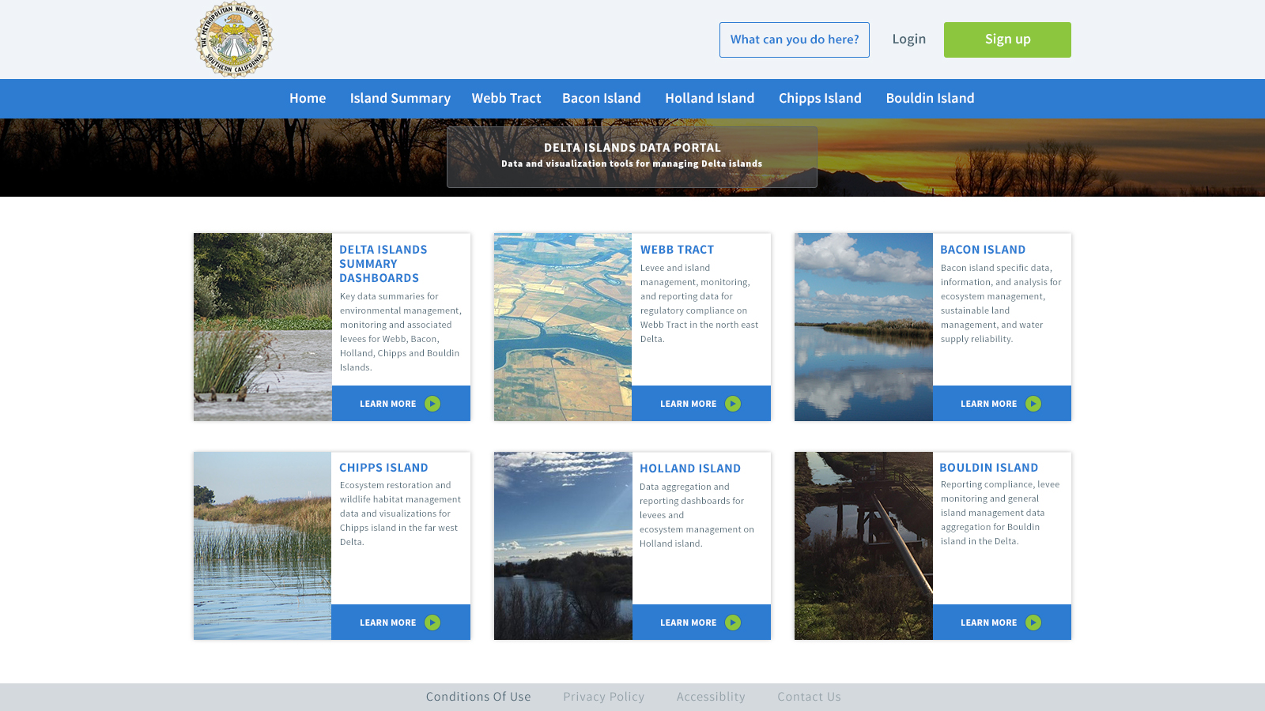

Slide 11
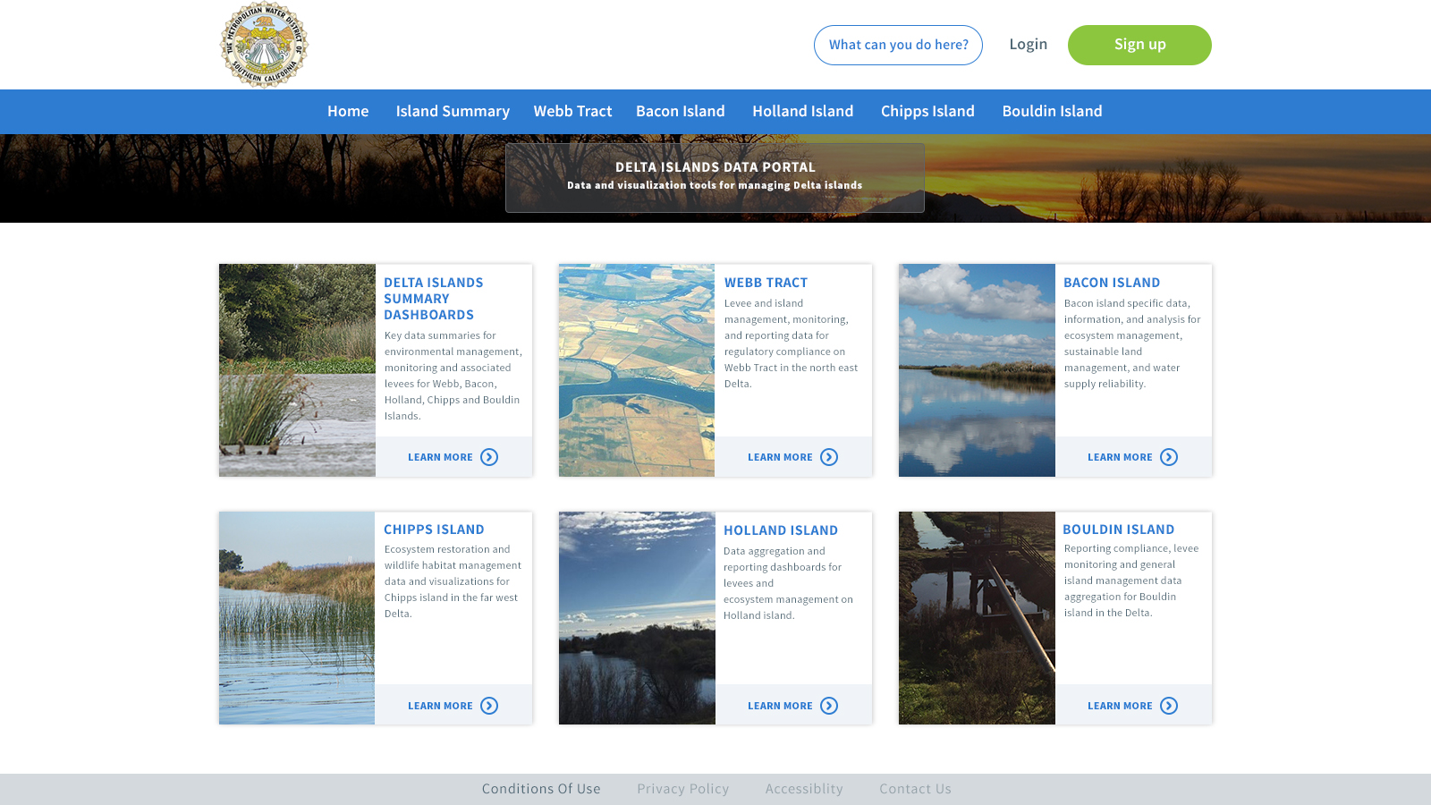

Slide 12
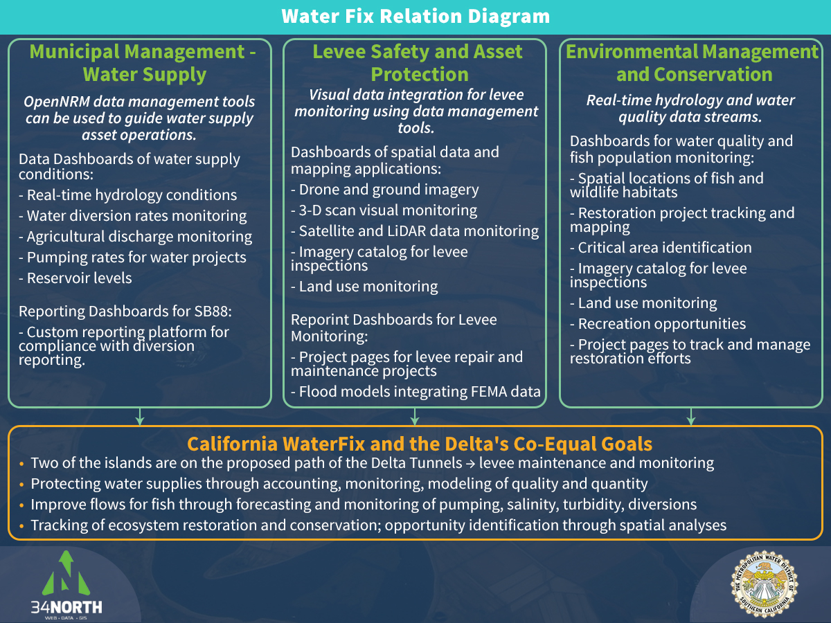
Notes:
Assessment of the relationship between California WaterFix, island management, and OpenNRM capabilities came from an analysis of the Biological Assessment for California Water Fix, prepared by the California Natural Resources Agency. The key topics in this diagram are reflected as the key issues in the Biological assessment and in the Delta’s Co-Equal goals. cms.capitoltechsolutions.com/ClientData/CaliforniaWaterFix/uploads/FIX_BA_TOC_Rev1.pdf

Slide 13
California Water Fix Monitoring and Collaboration
California Water Fix requires substantial monitoring and reporting to minimize environmental impacts
Data collected for island management can be integrated into reporting and mitigation for the Water Fix project
Monitoring and reporting mandated in the EIR for Water Fix integrated into OpenNRM
Types of data collected will have crossover with existing research efforts and island management strategies
Monitoring topics for California Water Fix include:
  Flows management
  Turbidity
  Salinity
  pH
  Fish rescue and salvage
  Biological monitoring of listed and endangered species
  Storm water quality monitoring
  Compliance with all existing environmental standards and regulations
Notes:
The key monitoring topics listed here come directly from the California Natural Resources Agencie’s Biological Assessment for the preferred alternative (4A) for California Water Fix. cms.capitoltechsolutions.com/ClientData/CaliforniaWaterFix/uploads/FIX_BA_TOC_Rev1.pdf

Slide 14
General Island Management
Levees in poor shape due to subsidence
Diversions and discharges to and from islands
Flood protection
Wildlife Habitat
Water Supply and Quality
Emergency Management and Planning

Slide 15
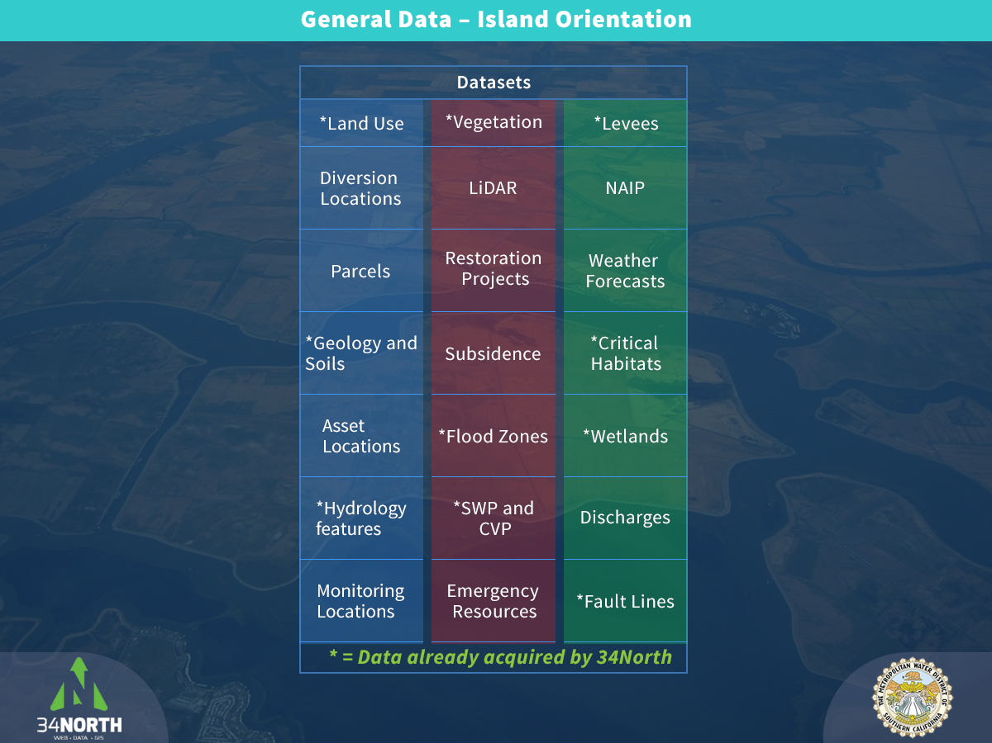

Slide 16

Sacramento River in the Delta

Slide 17
Value to Customer
Management, monitoring and reporting topics include:
General Island Management
Water Supply Reliability: Levee Management and Maintenance, Emergency Freshwater, Salinity Management
Emergency Management Planning
Habitat Restoration and Monitoring: Tidal Wetlands, Food Production, Flyways
Monitoring Migration Pathways of Important Species: Salmon and Delta Smelt
Regulatory Compliance and Reporting: Diversions (SB88), Water Quality
Conservation
Reducing Carbon Emissions
Improve Air Quality
California Water Fix

Slide 18
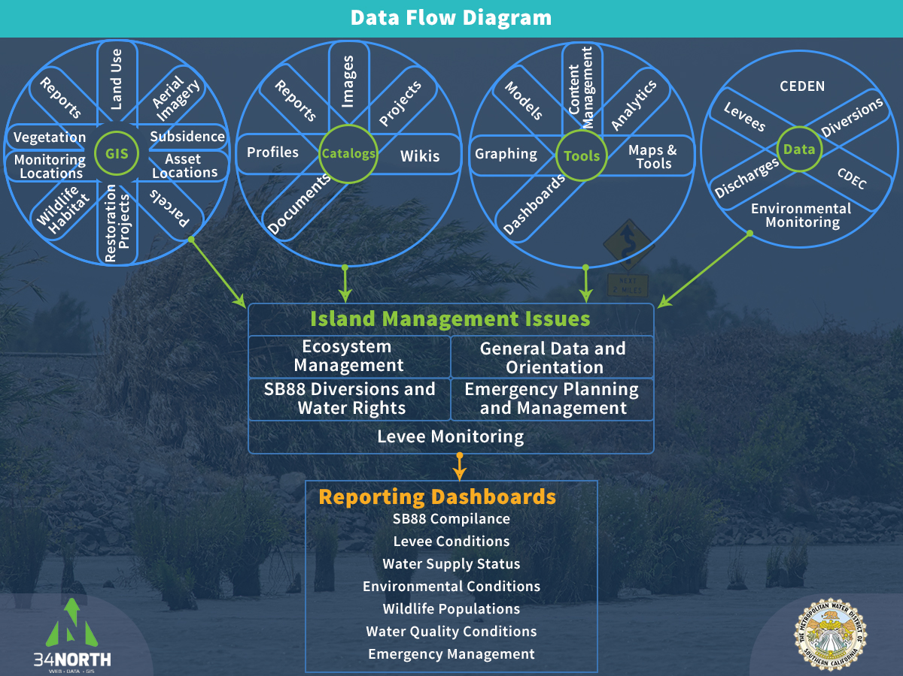

Slide 19
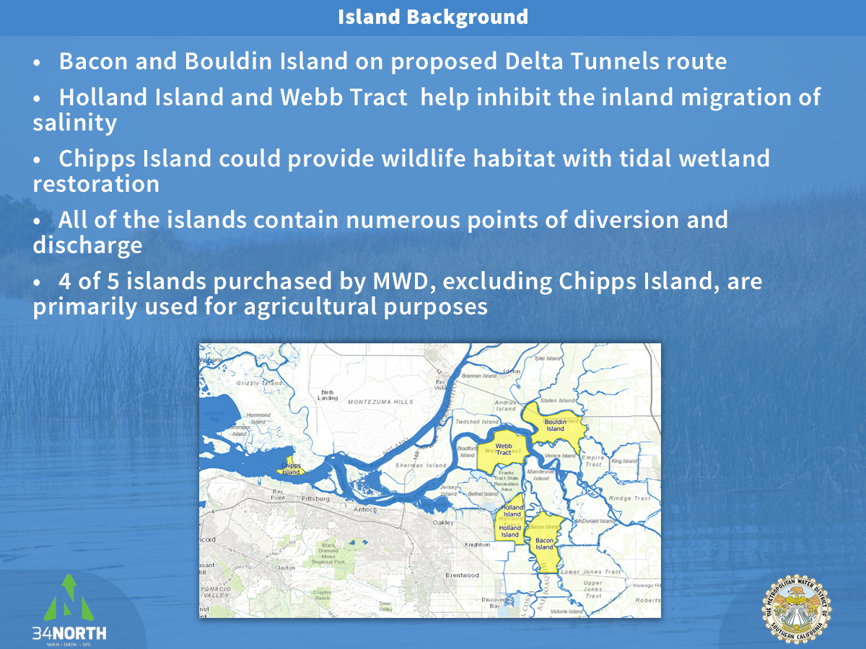

Slide 20
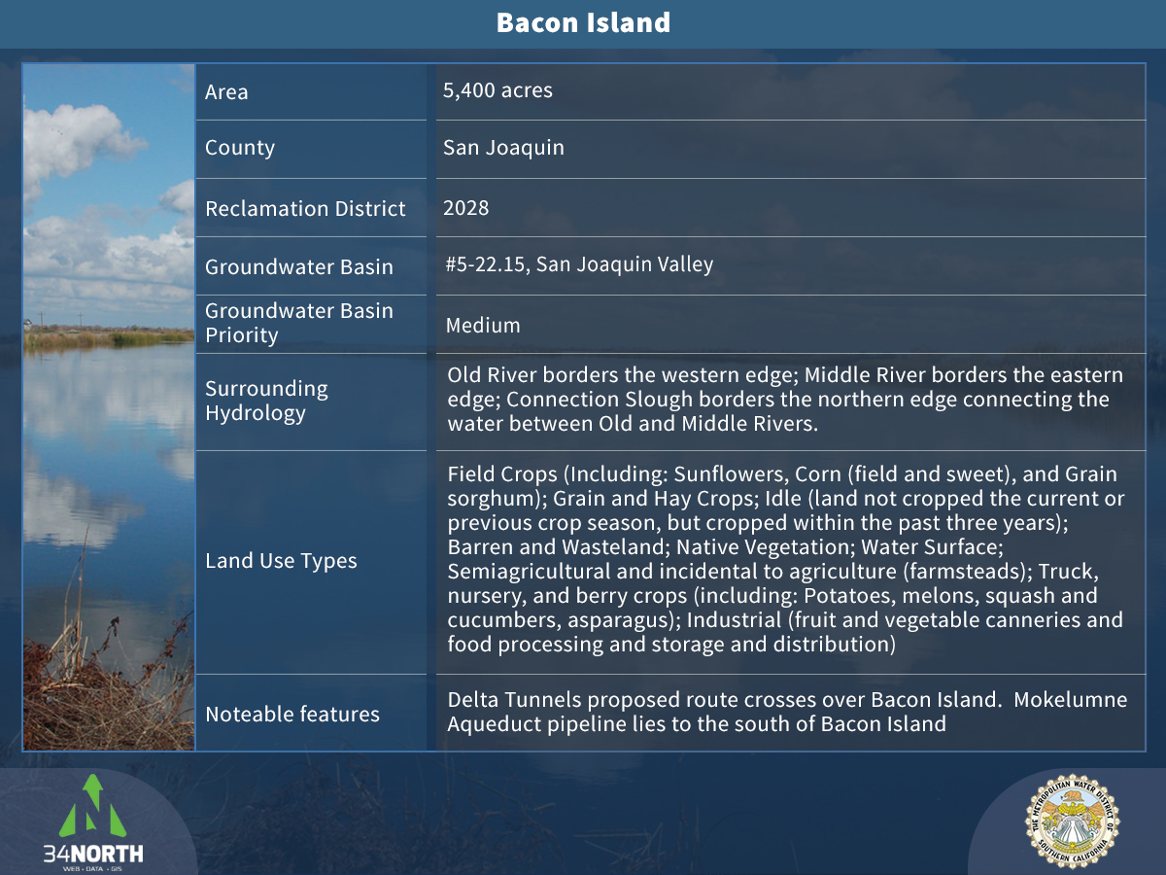

Slide 21
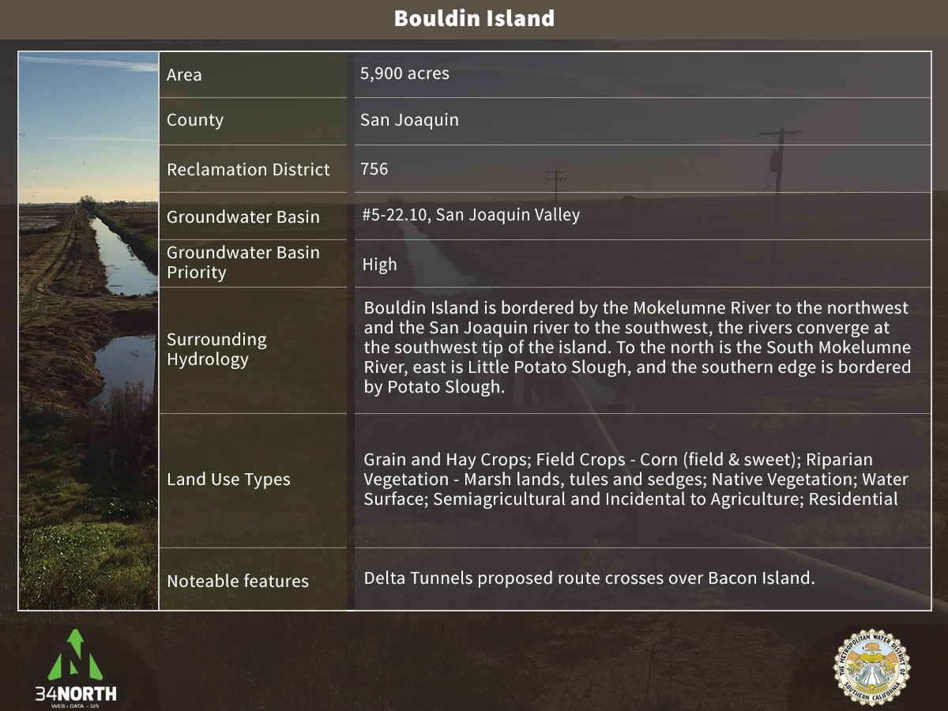

Slide 22
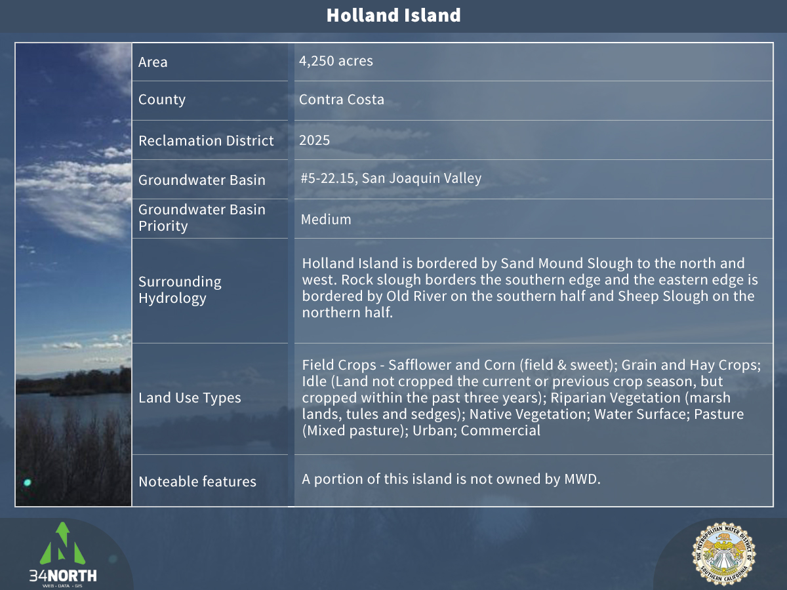

Slide 23
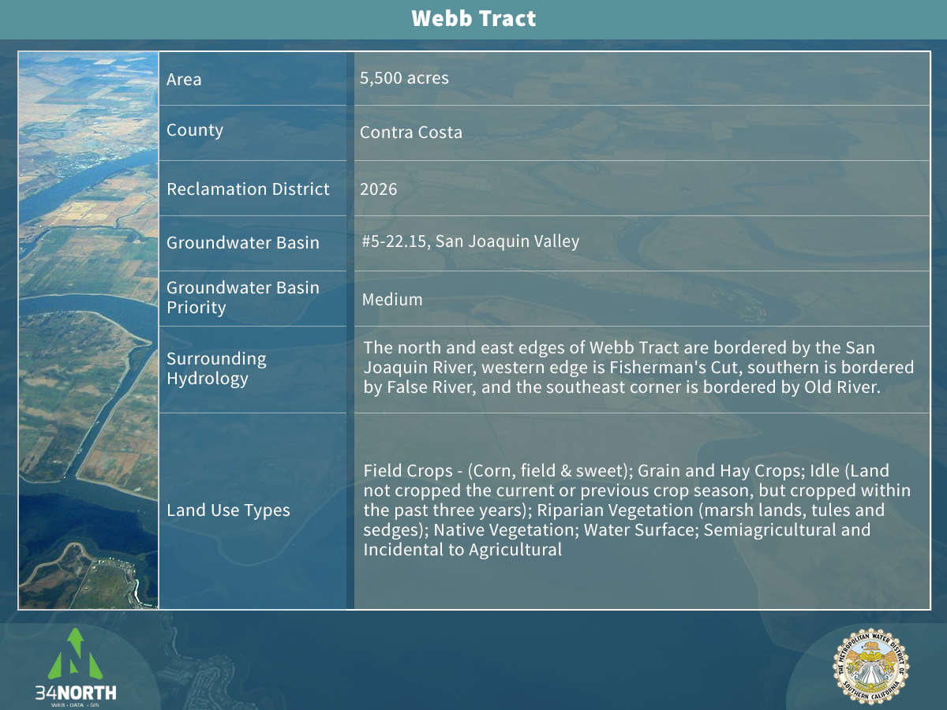

Slide 24
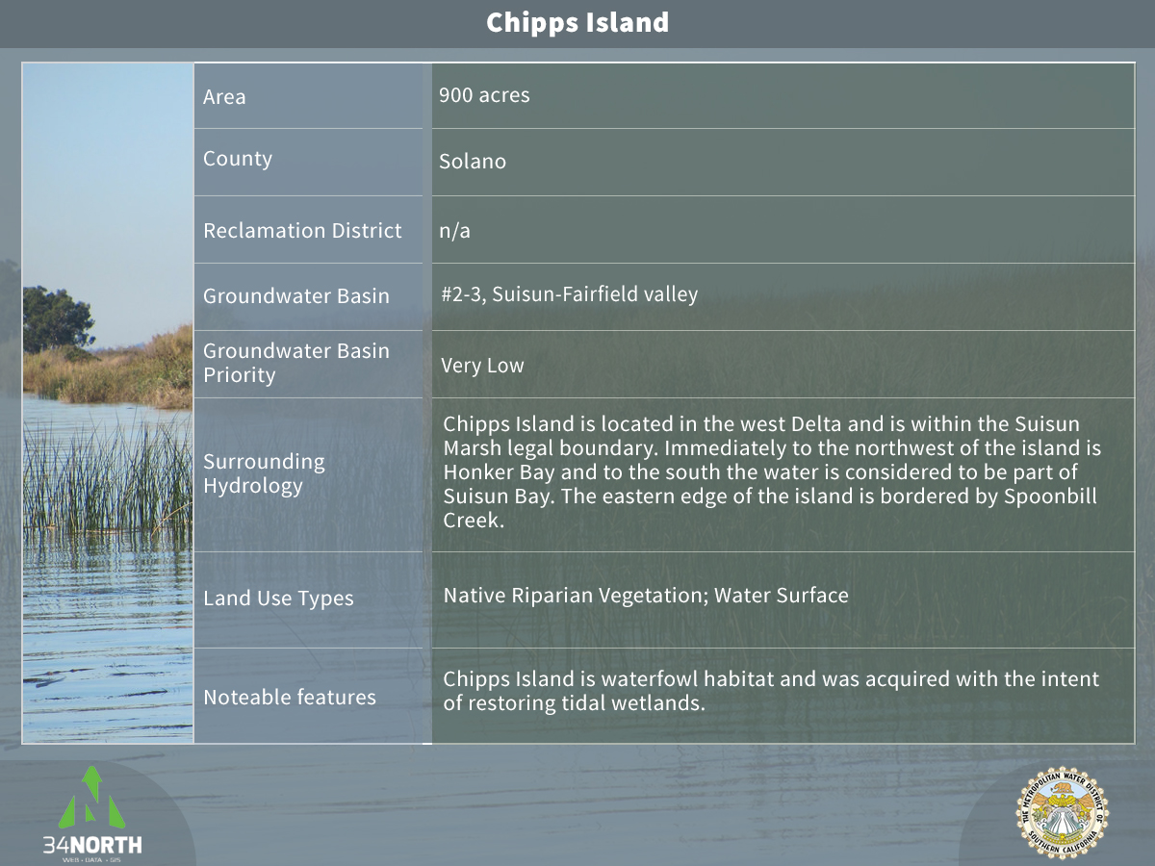

Slide 25
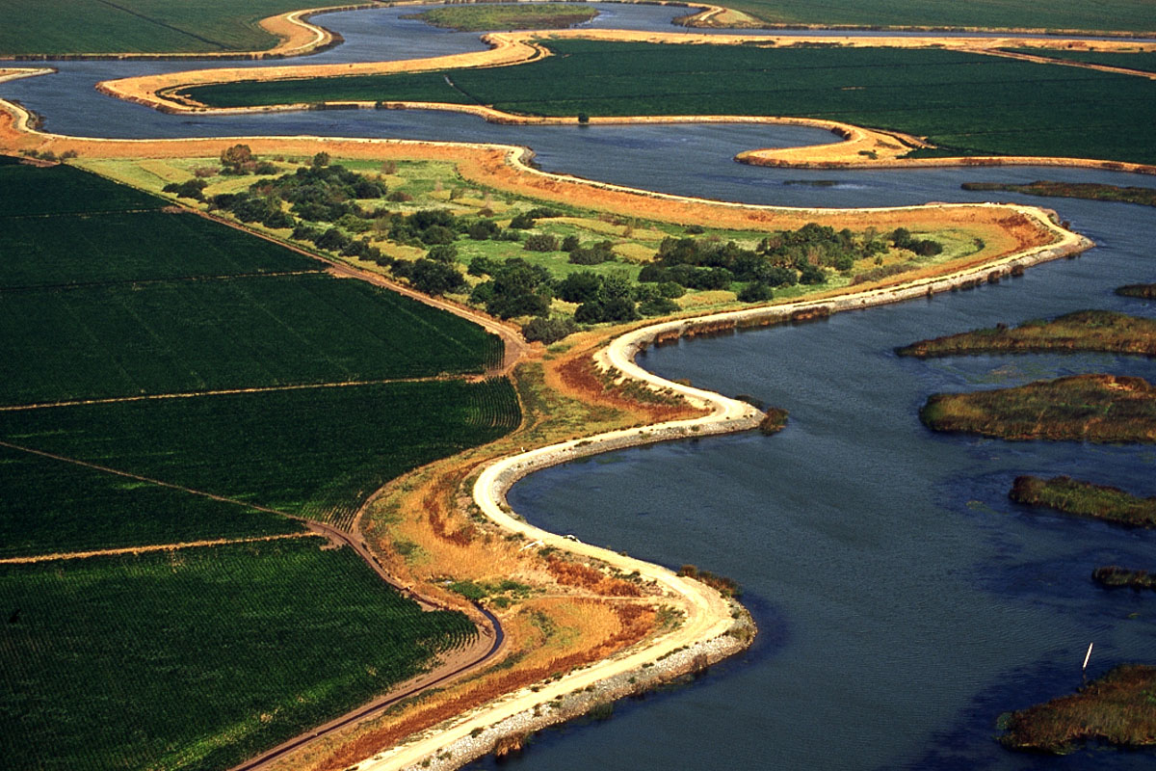
Water Supply Reliability and Emergency Planning
Issues include:
  Levee Management and Maintenance
  Emergency Freshwater
  Salinity Management
  Emergency Management Planning

Slide 26
Levee Management and Maintenance
Levees are integral to maintaining freshwater supplies in California
Levee function is a factor in flood management and planning
Levees are subject to regulations and standards for asset and flood protection
Maintenance is the responsibility of Reclamation District
FEMA HMP
USACE PL 84-99

Slide 27
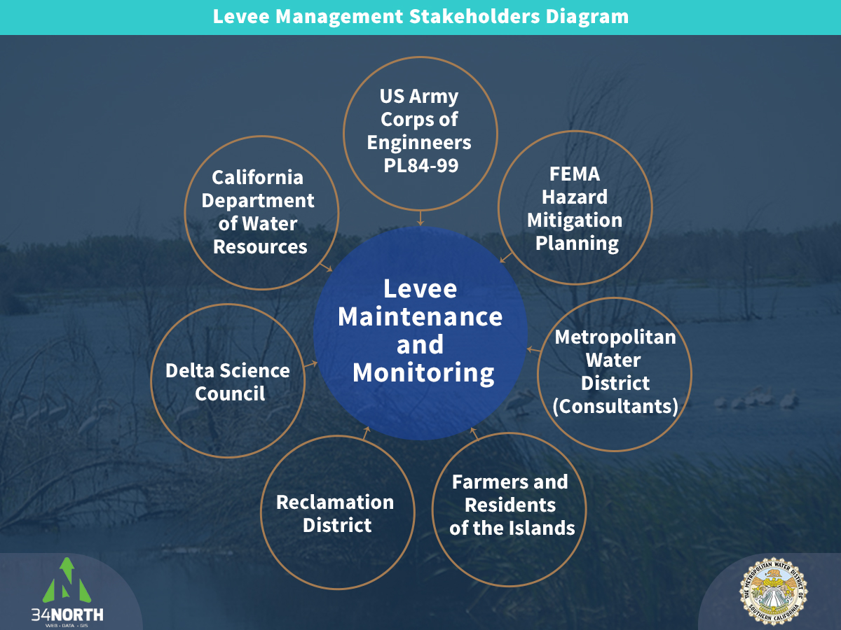

Slide 28
Levee Monitoring
Key requirements for levee monitoring:
  Daily, weekly and monthly visual inspections
  Profile surveys with CORS GPS
  Piezometer and inclinometer readings
  Terrestrial 3-D scanning
  Aerial LiDAR and photogrammetry
  GIS analyses
Notes:
Levee monitoring includes surveys for stability, subsidence, cracking, vegetation growth, erosion, settlement, depressions, animal control, riprap condition, and elevation changes. Visual inspections are conducted by farmers, members of the reclamation district, residents, and land owners. Levee monitoring is conducted by the responsible Reclamation District as well as the USACE if the levee is included in the Levee Safety Program. Levees not included in the USACE Levee Safety Program still require regular monitoring and maintenance to ensure proper functioning and flood protection. CORS GPS monitoring, 3-D scanning, and aerial LiDAR and photogrametry scanning would be conducted by contractors with appropriate equipment and training. CORS or Continuous Operating Reference Stations, are used to constrain the GPS used to measure the primary control network. The measurements are taken twice a year in October and April to compare values to initial and previous coordinates and elevations to detect and report horizontal and vertical movement. Terrestrial 3-D scanning of levees will also be conducted twice a year to generate point cloud data that can be converted into 3-D models. Piezometer and Inclinometers are used to monitor the general integrity of levees by collecting data on groundwater levels, island subsidence, settlement and depressions, levee elevation and width, and slope stability. Specifically, inclinometers measure horizontal deflections of levee embankments, an indication of how much the levee has shifted in any direction since the last measurement. Pneumatic piezometers operate by gas pressure and are used to measure pore water pressure in saturated soils which can help monitor slope stability, effects of ground improvement systems, safe rates of fill or excavation, and to check the performance of embankments. Standpipe piezometers also measure pore water pressure in a more basic fashion, indicating groundwater levels and contributing to analyses of slope stability, subsidence, settlement, and levee integrity. The data output from the inclinometers and piezometers would be an excel spreadsheet of meter readings at the various stations over time.

Slide 29
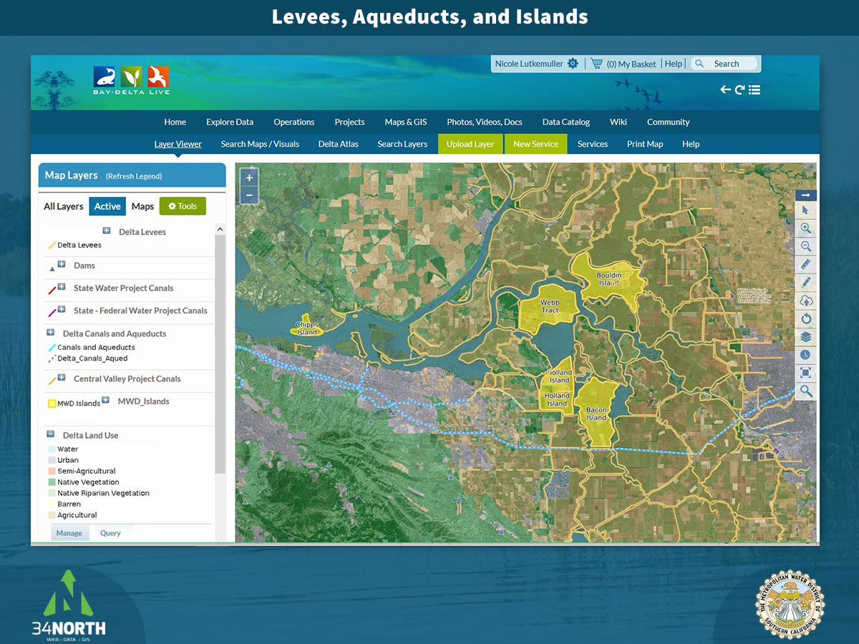

Slide 30
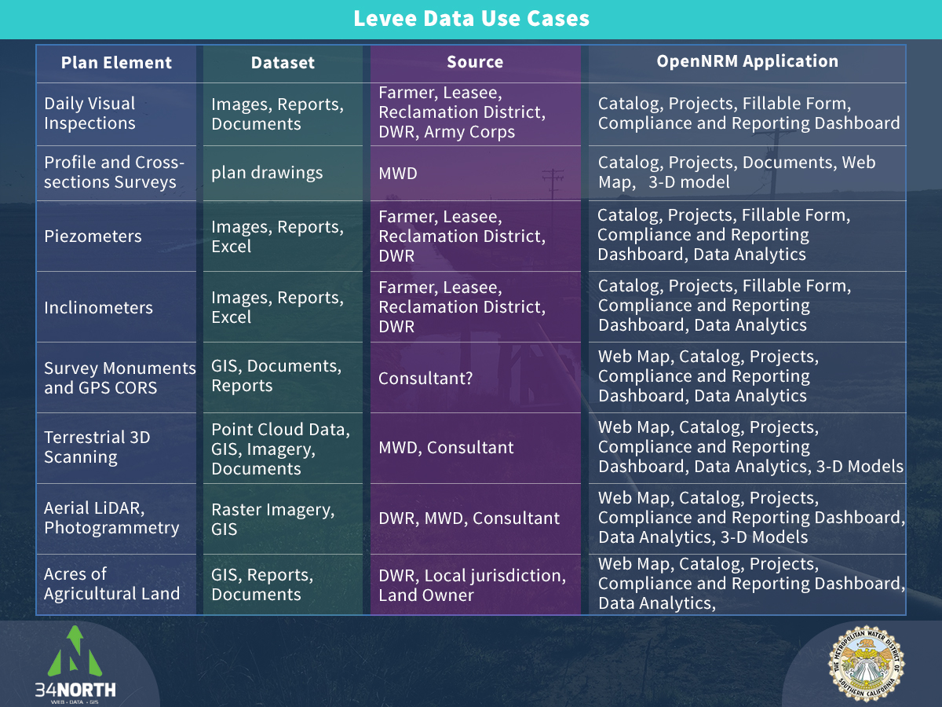
Notes:
Plan elements come from levee monitoring requirements of both Army Corps PL 84-99 and FEMA HMP compliance requirements, as well as state levee monitoring guidelines from the Department of Water Resources and Delta Stewardship Council’s levee maintenance programs.

Slide 31
USACE PL 84-99 Compliance
Levee Safety Program – provides eligibility for federal rehab assistance to levees if maintained to standards
Under program: “eligible damage” restored to pre-event condition:
  At no cost to federal system owners
  At 20% of cost to non-federal system owners
Regularly inspected by USACE
Surveyed parameters include:
  Stability (Piezometers, Inclinometers)
  Subsidence (LiDAR, Profile and Cross-section Surveys, 3D scanning)
  Cracking (Daily visual inspections, 3D scanning, Photogrammetry)
  Vegetation growth (Daily visual inspections, LiDAR)
  Erosion (Daily visual inspections)
  Settlement and depressions (Daily visual inspections, LiDAR, Profile and Cross-section Surveys, 3D scanning)
  Animal control (Daily visual inspections)
  Rip-rap condition (Daily visual inspections)
  Elevation changes (LiDAR, Profile and Cross-section Surveys, 3D scanning, inclinometer)
Notes:
The US Army Corps of Engineer's PL-84-99 is similar to FEMA HMP in mandating certain levee condition standards be met to remain eligible for disaster relief funding in the event of a natural disaster. The USACE regularly inspects levees that are a part of its Levee Safety Program to monitor condition and compliance with PL-84-99. PL-84-99 mandates that a levee sponsor must maintain a levee to at least “minimally acceptable standard” to remain eligible for federal rehabilitation assistance from the USACE.

Slide 32
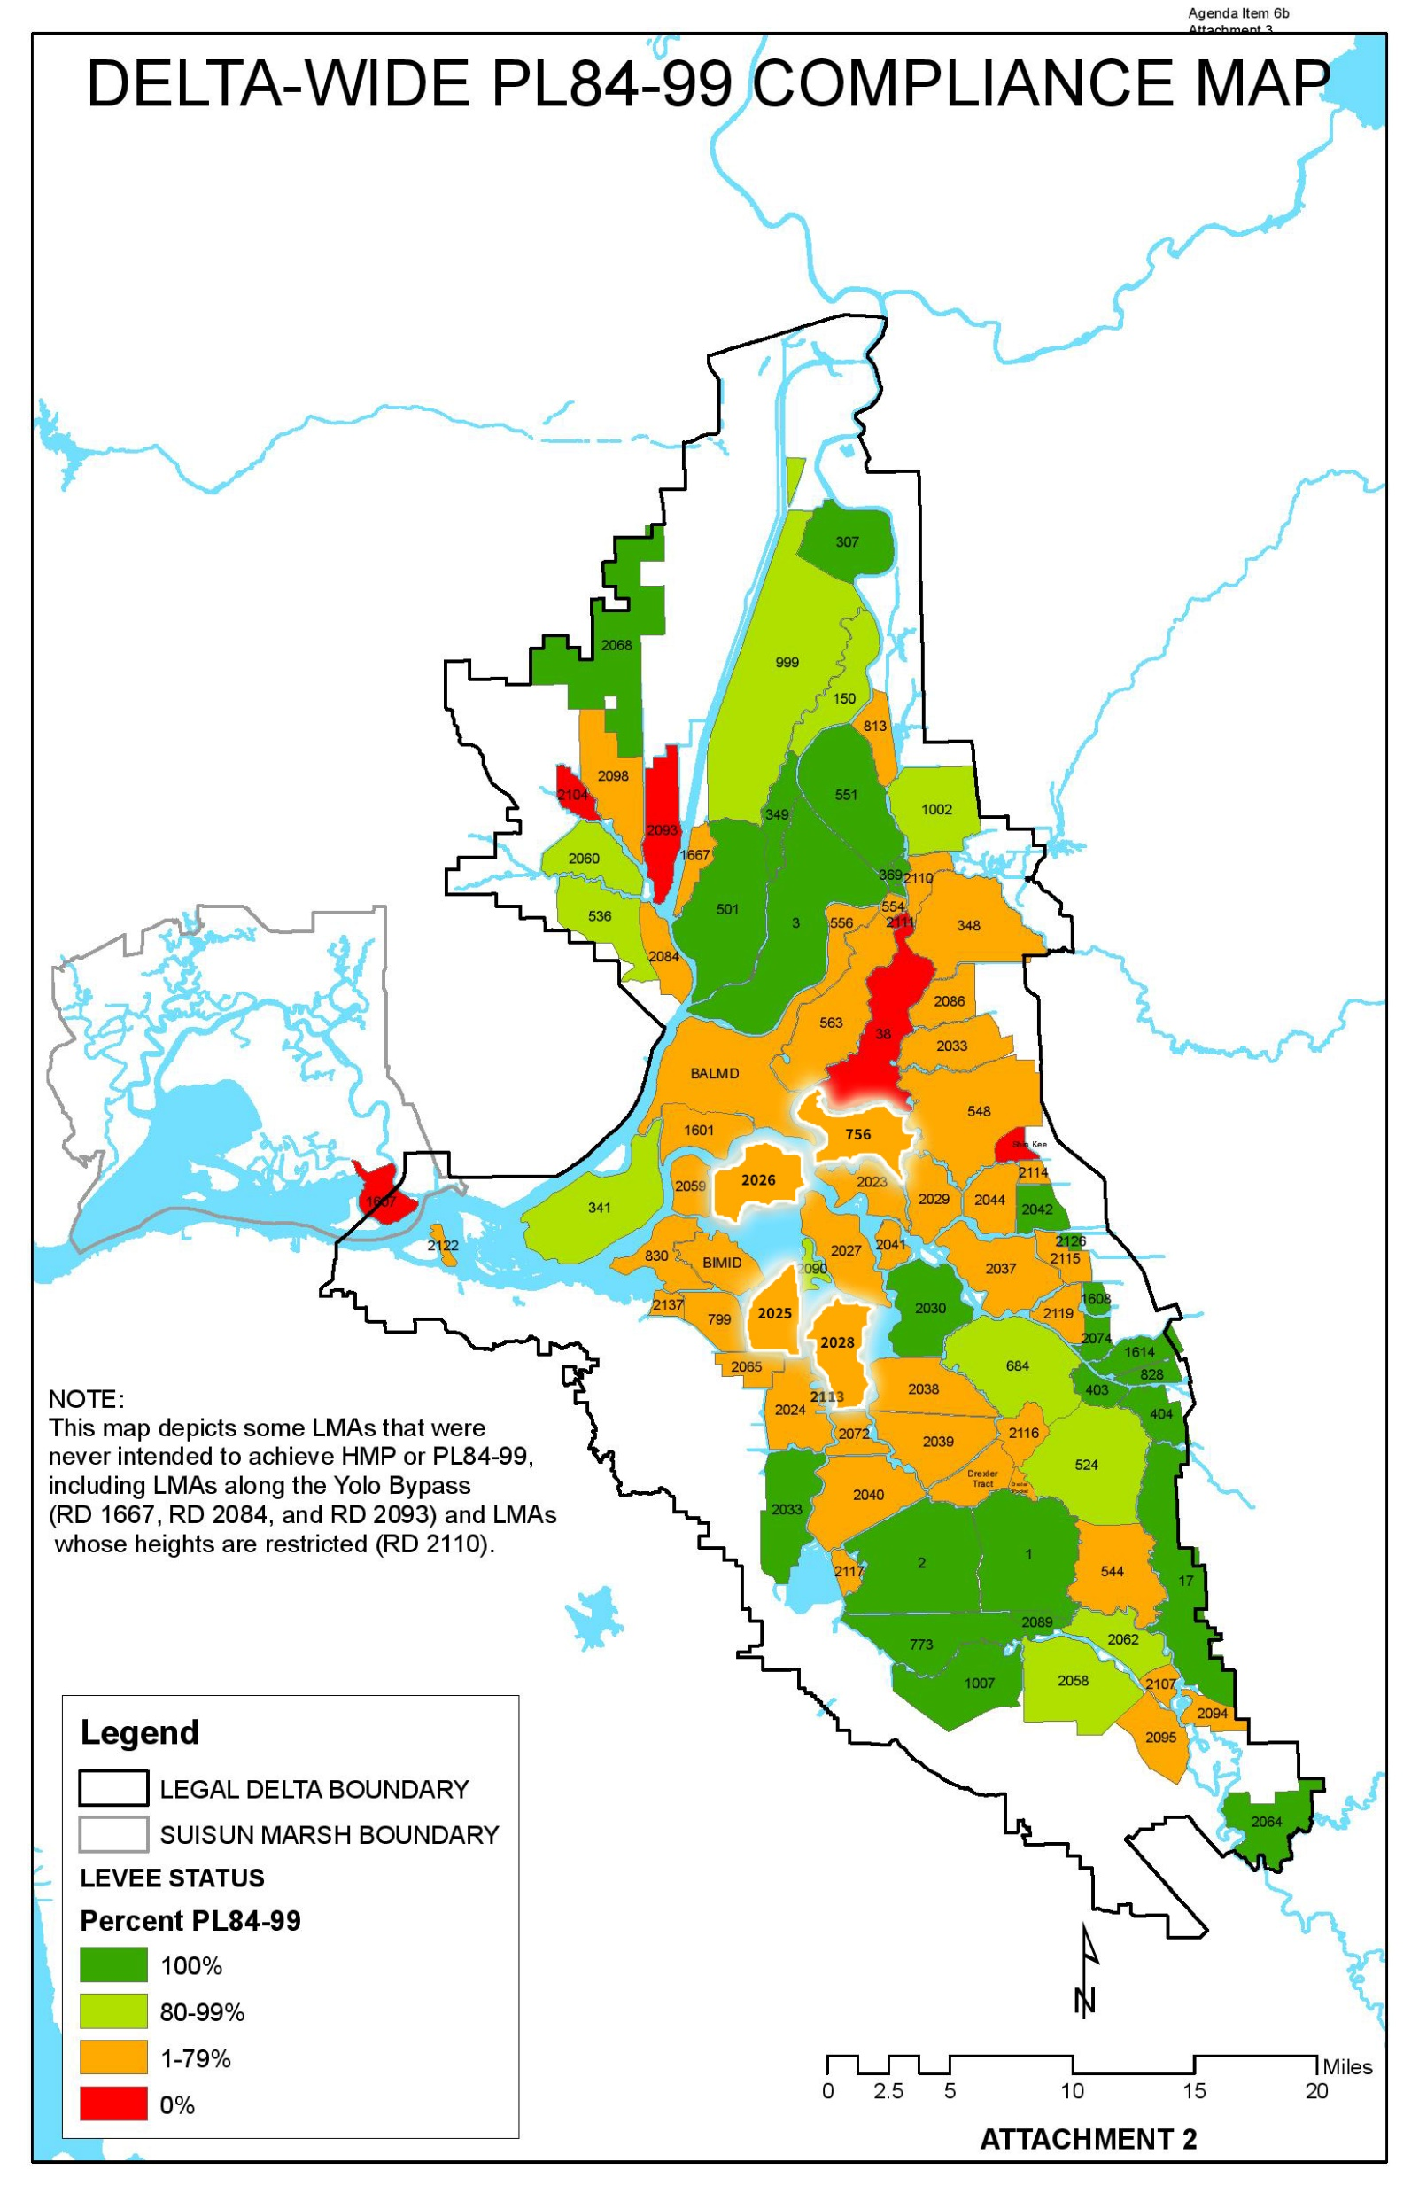
Notes:
map from the Department of Water Resources portrays Delta Islands percent compliance with PL84-99

Slide 33
FEMA HMP
Hazard Mitigation Plans – reduce loss of life and property during disasters
Levee conditions are part of HMP's
Must comply with HMP to qualify for certain funding from FEMA
Numerous sections of levees in Delta not in compliance
DWR maps of HMP compliance
Notes:
FEMA Hazard Mitigation Plans are intended to reduce the loss of life and property by lessening the impact of disasters. The plans are developed and active across the Delta and require certain standards and conditions be met for flood control facilities. Levees conditions are included in these plans and must meet certain standards to maintain compliance with the HMP. There are numerous sections of the levees along the MWD islands that are not in compliance with their applicable FEMA HMP

Slide 34
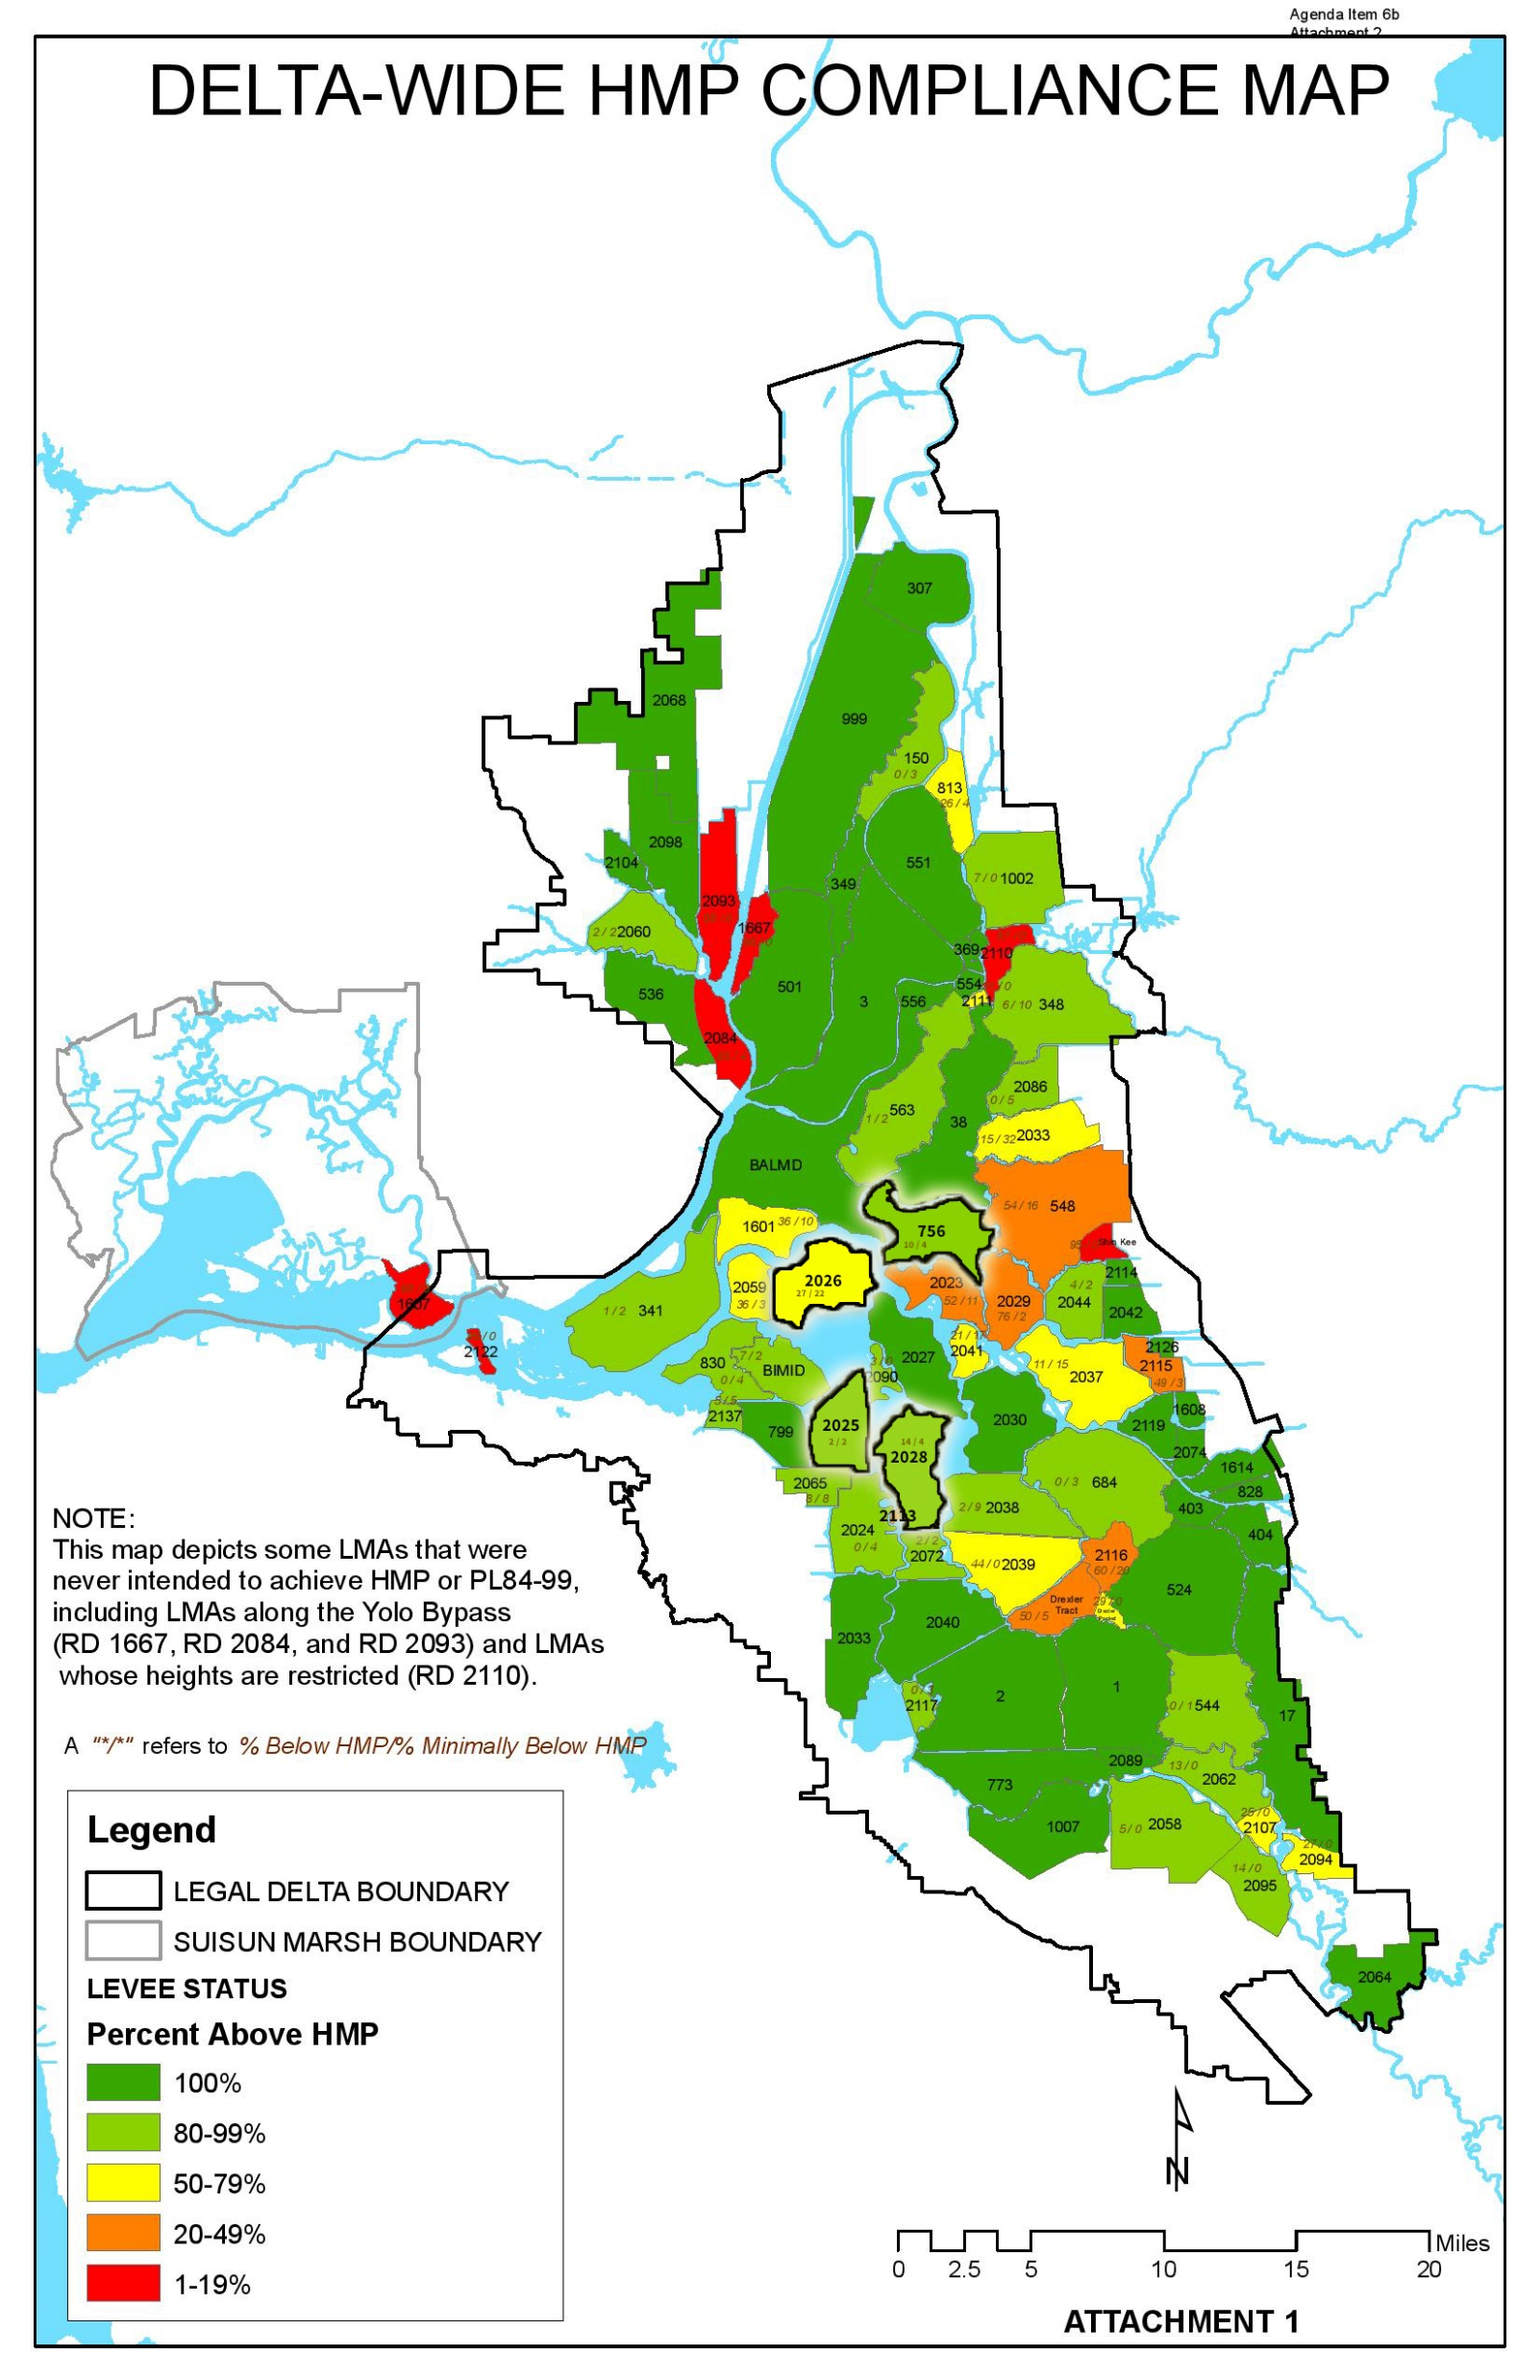
Notes:
Department of Water Resources has released maps that portray Delta Islands percent compliance with HMPs.

Slide 35
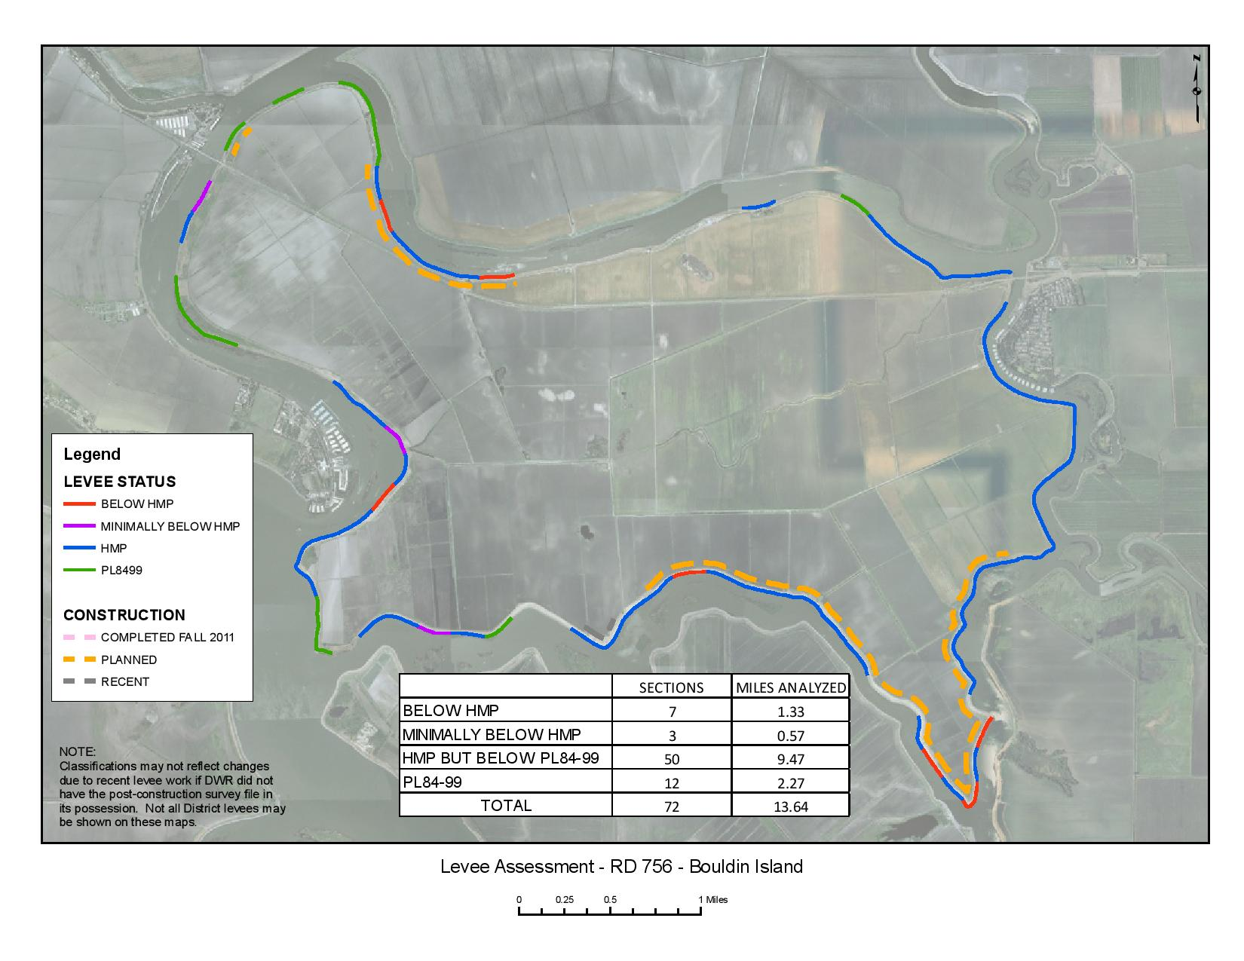
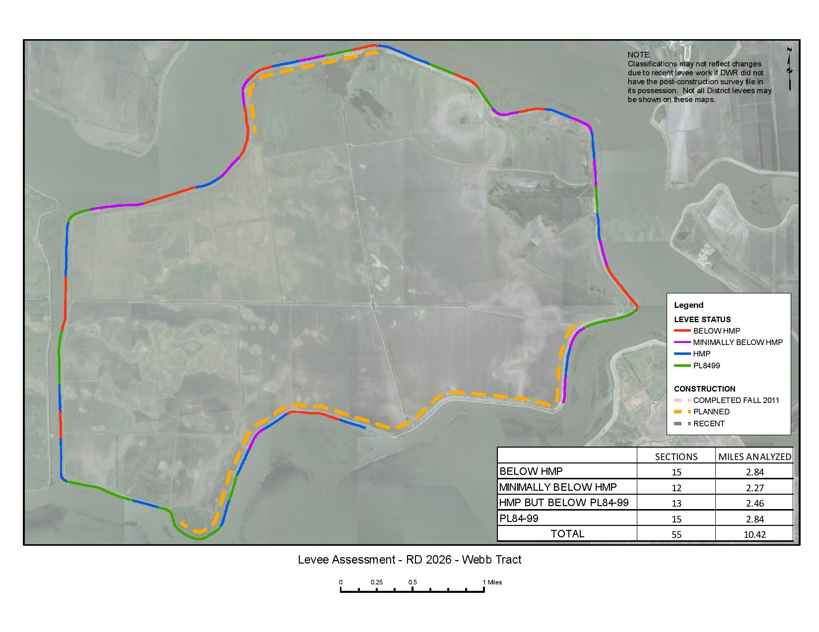
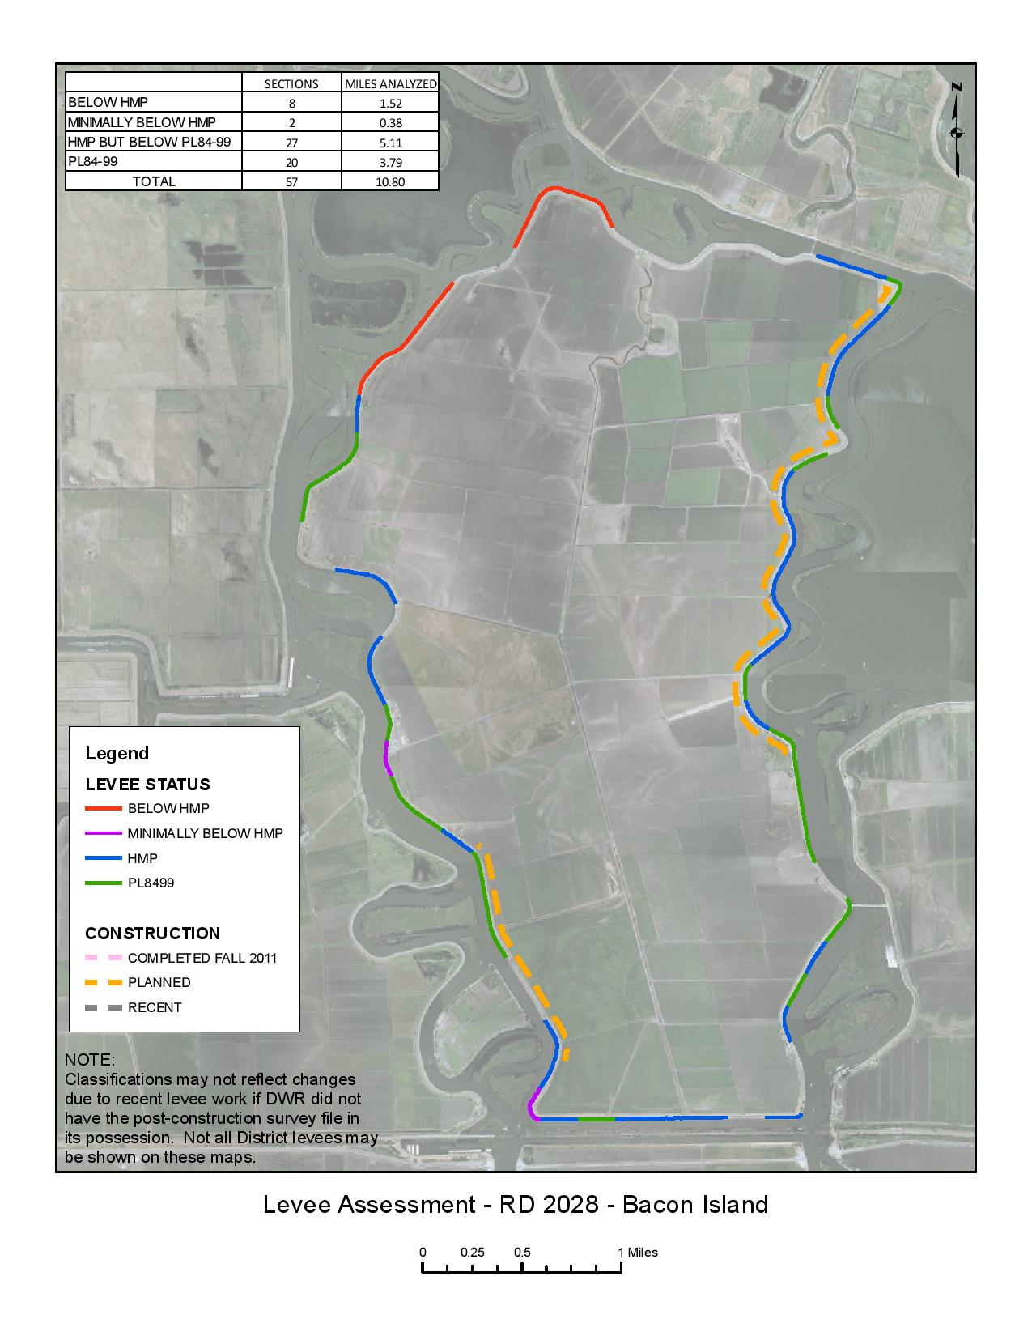
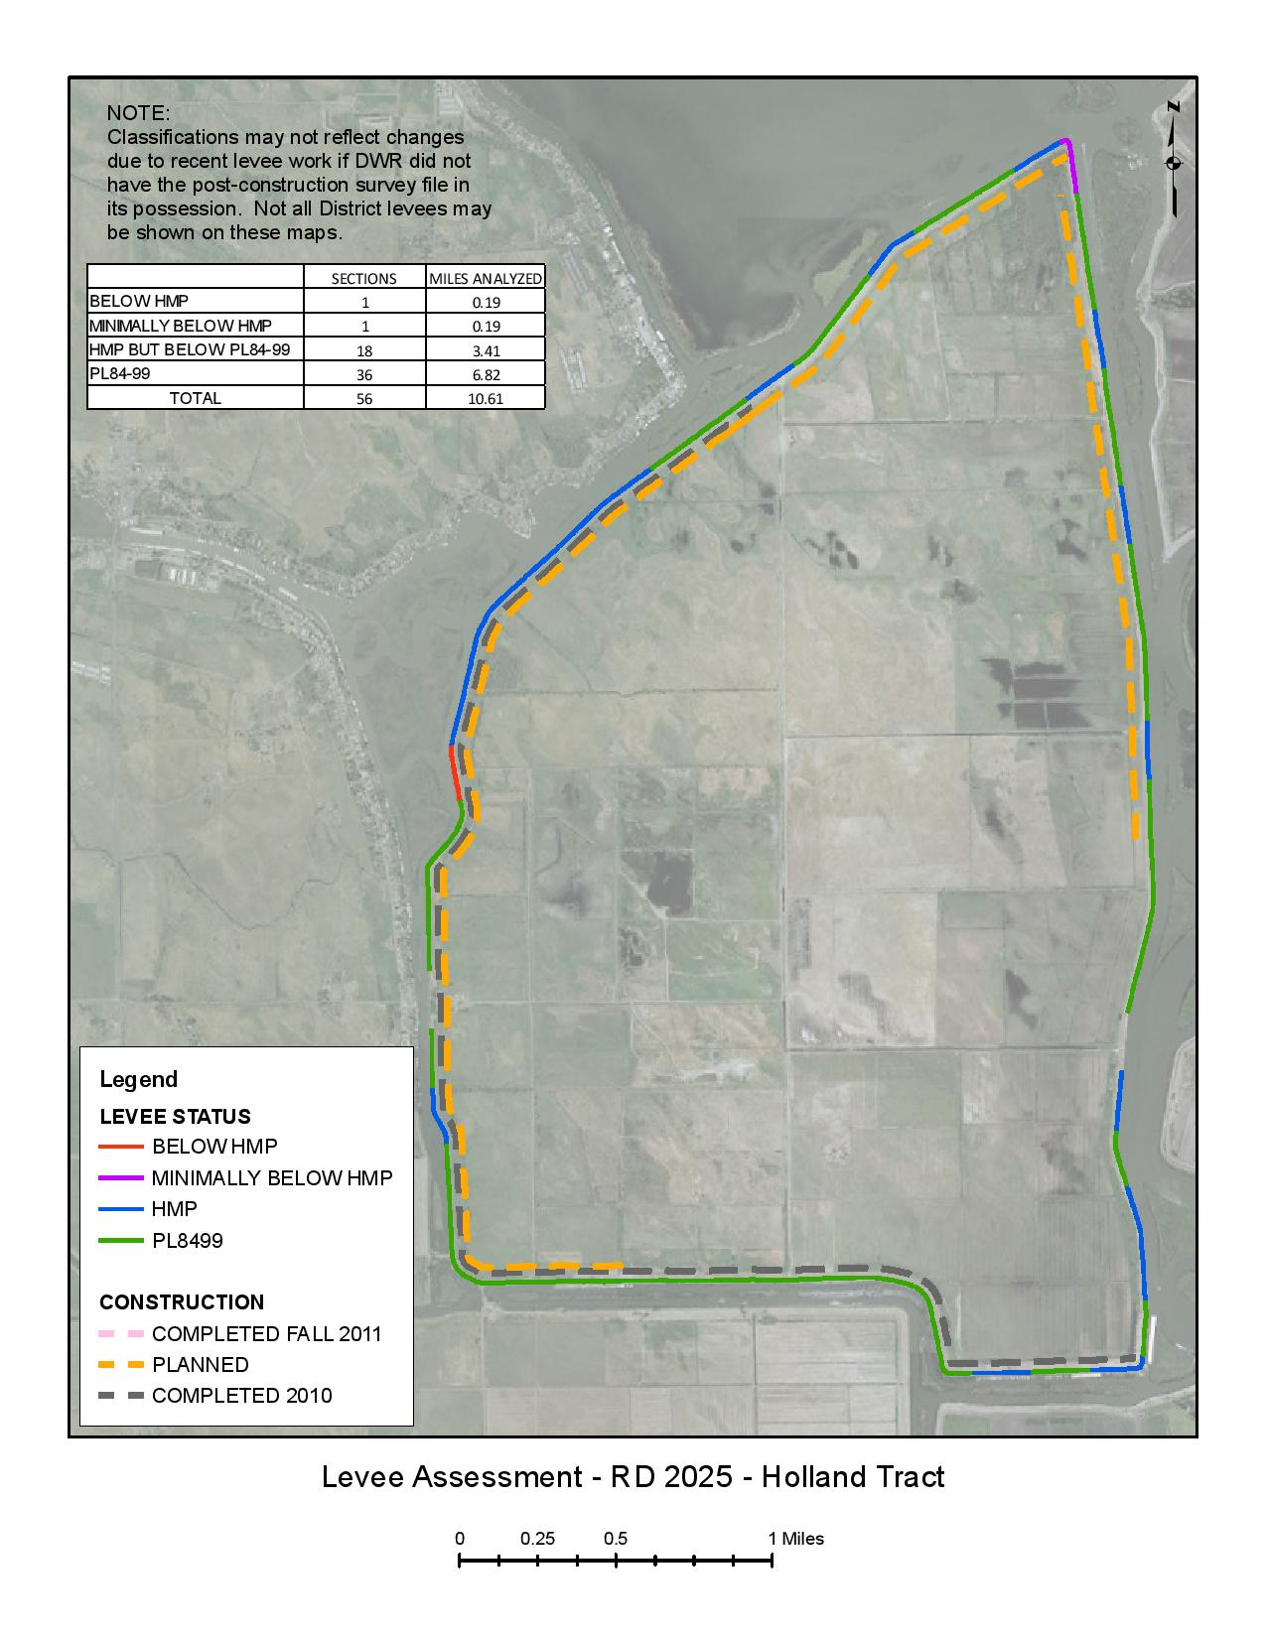
Notes:
The Department of Water Resources (DWR) has provided to the Delta Stewardship Council (DSC) maps and other information relating to the existing conditions of Delta levees. This information includes maps constructed by DWR indicating its best estimate of levee miles conforming to existing levee guidance and standards. http://deltacouncil.ca.gov/delta-maps

Slide 36
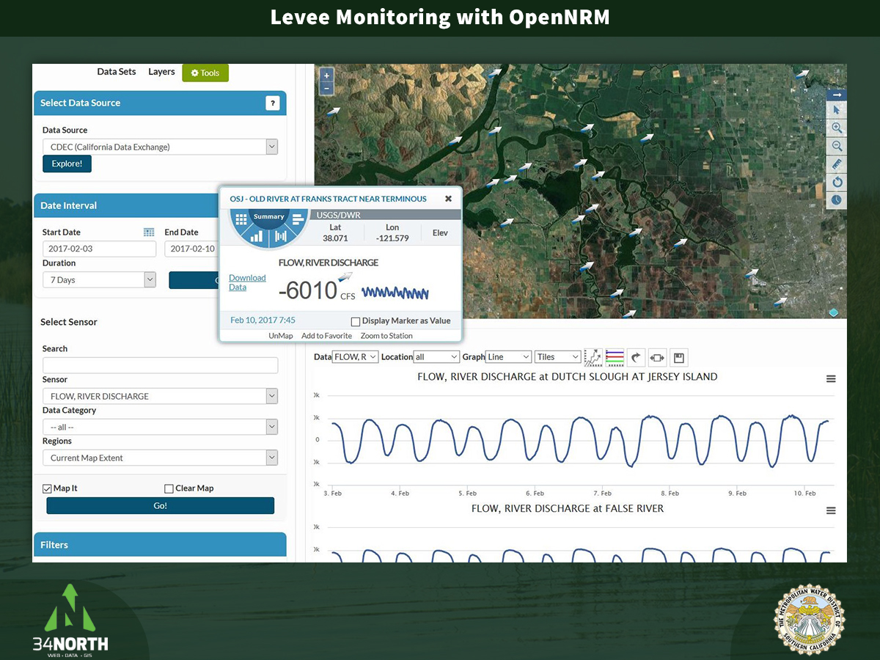
Notes:
This visualization is an example of how data for levee monitoring from piezometers and inclinometers and diversion monitoring instruments could be visualized.

Slide 37
Emergency Management Planning
California has FEMA approved State Hazard Mitigation Plan
  Many local jurisdictions also have more specific FEMA approved HMPs
Hazard Mitigation Plans identify:
  Hazards and potential impacts on life and property
  Actions to reduce losses from hazards
  Coordinated process to respond and mitigate hazard impacts
Response relies on:
  Ability to communicate risk
  Identify immediate mitigation actions and relief efforts
Emergency Response Dashboard using OpenNRM tools
Notes:
Hazard Mitigation Plan elements come from FEMA’s Hazard Mitigation Planning website and resources: https://www.fema.gov/hazard-mitigation-planning-resources. Key elements of hazard mitigation plans were extracted from planning and resource documents provided by FEMA. Appallicious is creating a Disaster Assessment and Assistance Dashboard for the city of San Francisco that could also be created with OpenNRM software: http://www.govtech.com/data/Appallicious-Launches-FEMA-Disaster-Dashboard.html

Slide 38
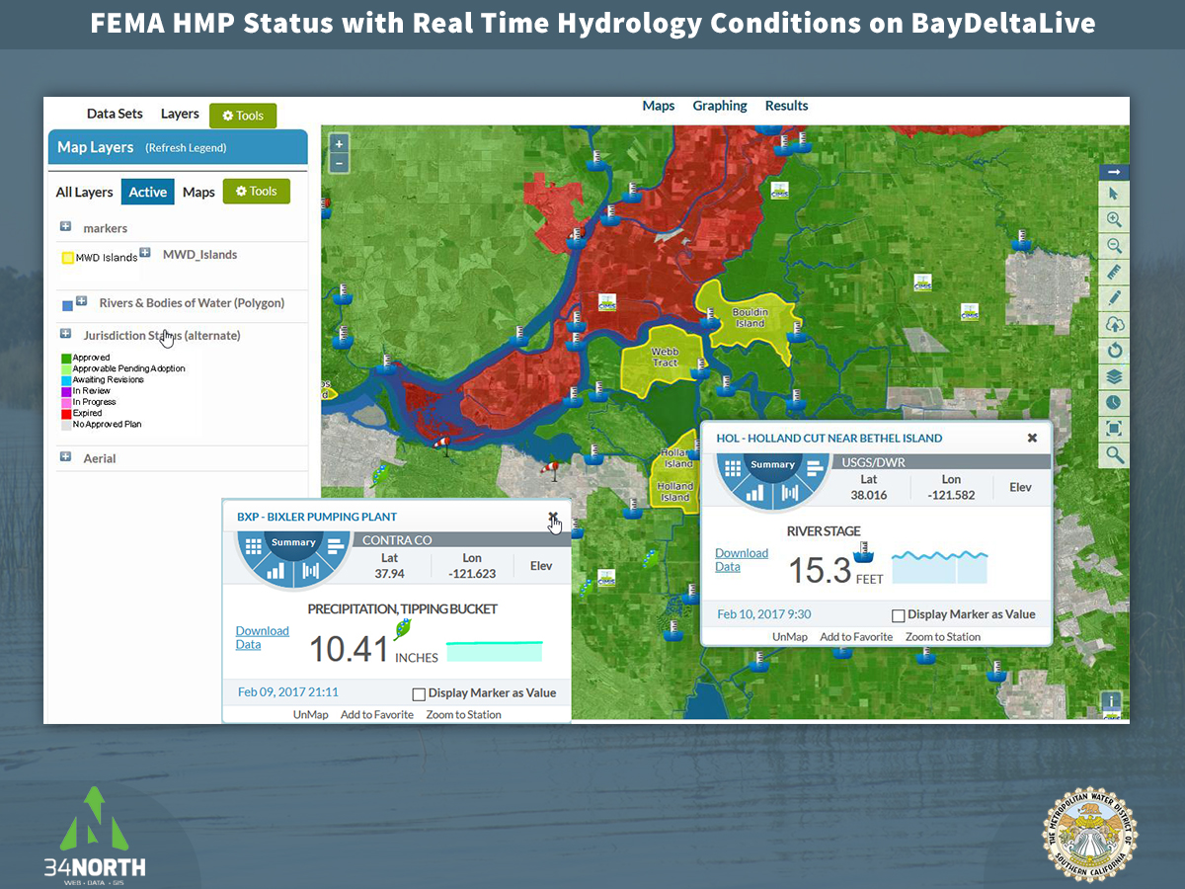

Slide 39
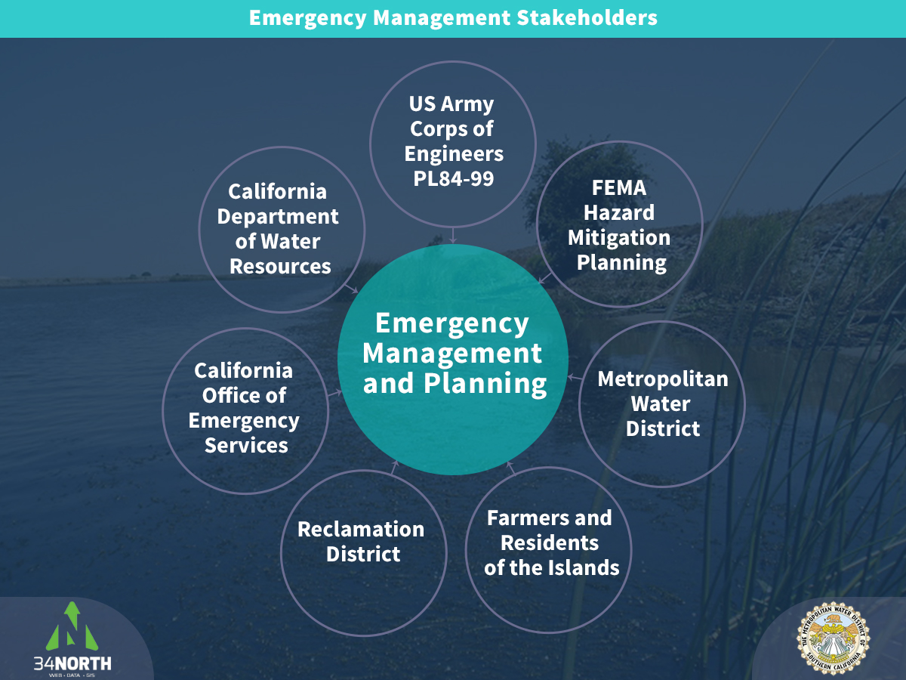

Slide 40
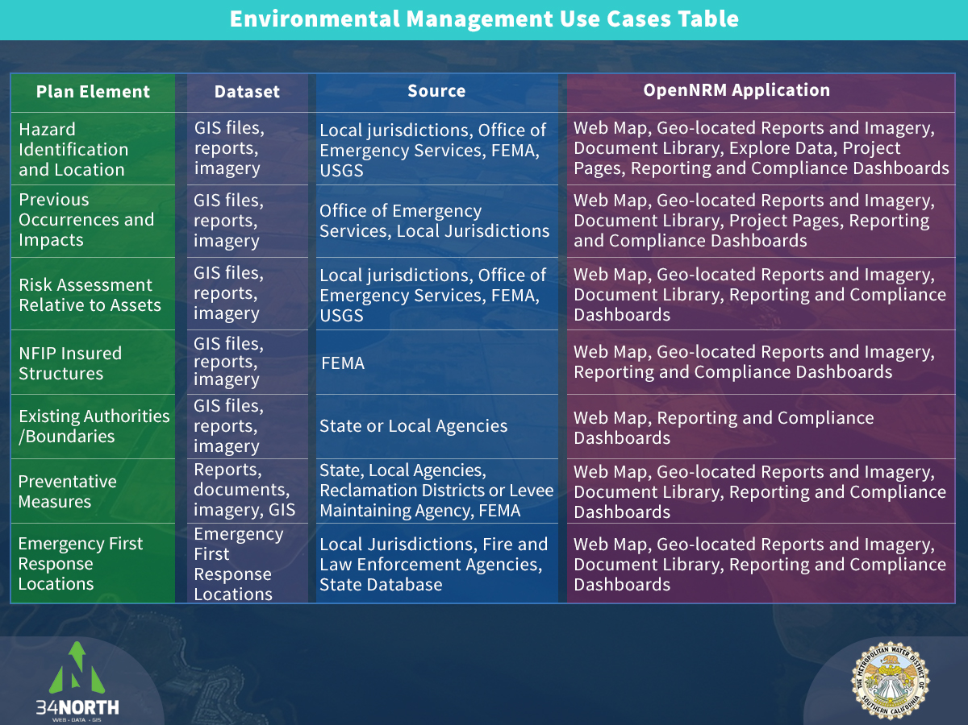
Notes:
Plan elements in this table are extracted from FEMA Hazard Mitigation Plan guidance documents and resources and from existing hazard mitigation plans for California.

Slide 41
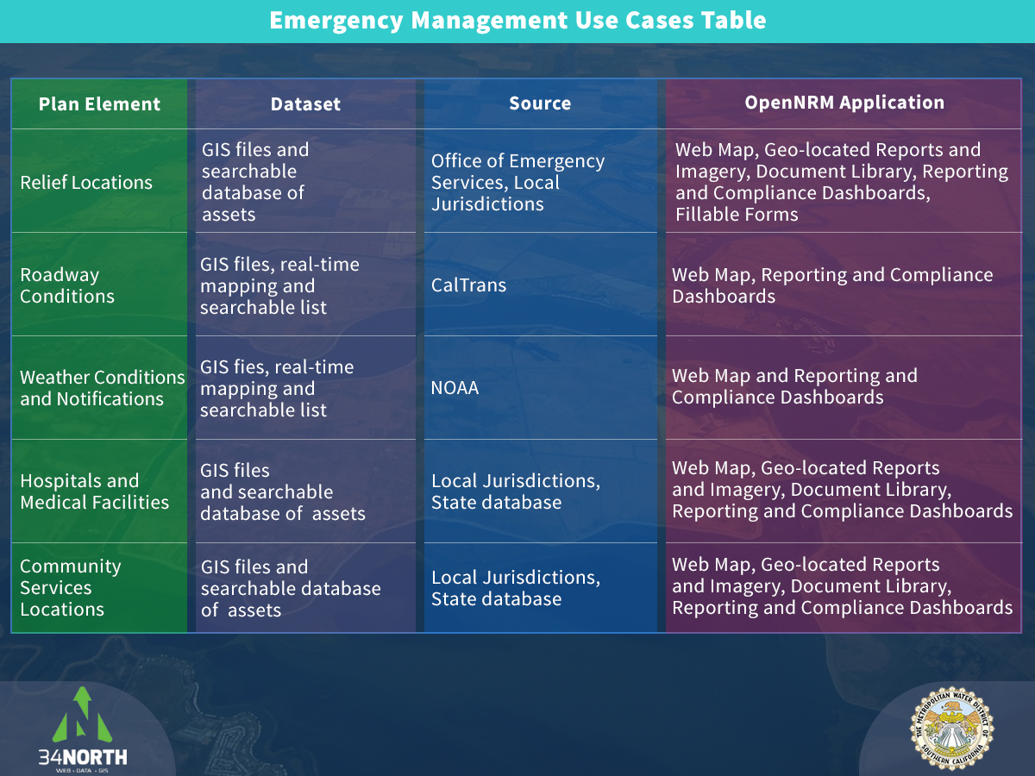
Notes:
Plan elements in this table are extracted from FEMA Hazard Mitigation Plan guidance documents and resources and from existing hazard mitigation plans for California.

Slide 42
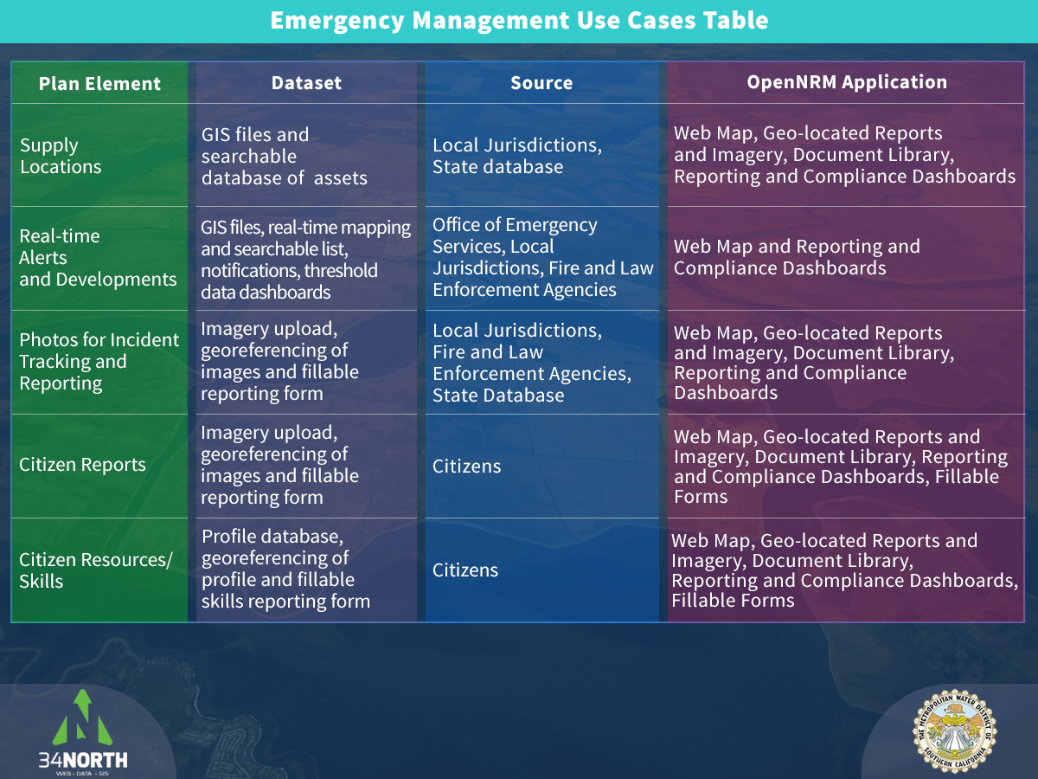
Notes:
Plan elements in this table are extracted from FEMA Hazard Mitigation Plan guidance documents and resources and from existing hazard mitigation plans for California.

Slide 43
Island Diversions and SB 88
Water diversions made from adjacent rivers and sloughs onto islands
After use, water often discharged back into adjacent waterways
California Water code requires monitoring and reporting of diversions
Monitoring and reporting diversions asissts in ensuring proper allocation of State's water resources
SB88 – Emergency Regulation for Measuring and Reporting the Diversion of Water
  Signed by Governor Brown on June 24, 2015
  Waterboard implemented law on January 19, 2016
  Reporting requirements begin January 1, 2017
  Requires person/organization diverting 10 acre-feet or more per year to meet specific measurement, accuracy, and reporting requirements
Notes:
Diversion monitoring is regulated by the State Water Resources Control Board. Existing diversion reporting is accomplished with eWRIMS.

Slide 44
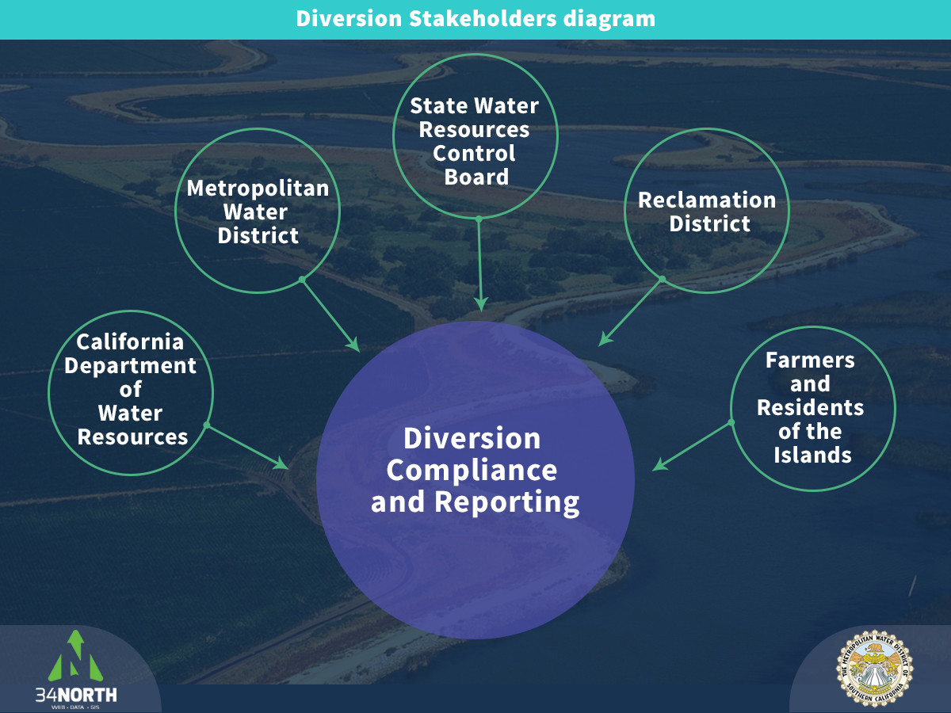

Slide 45
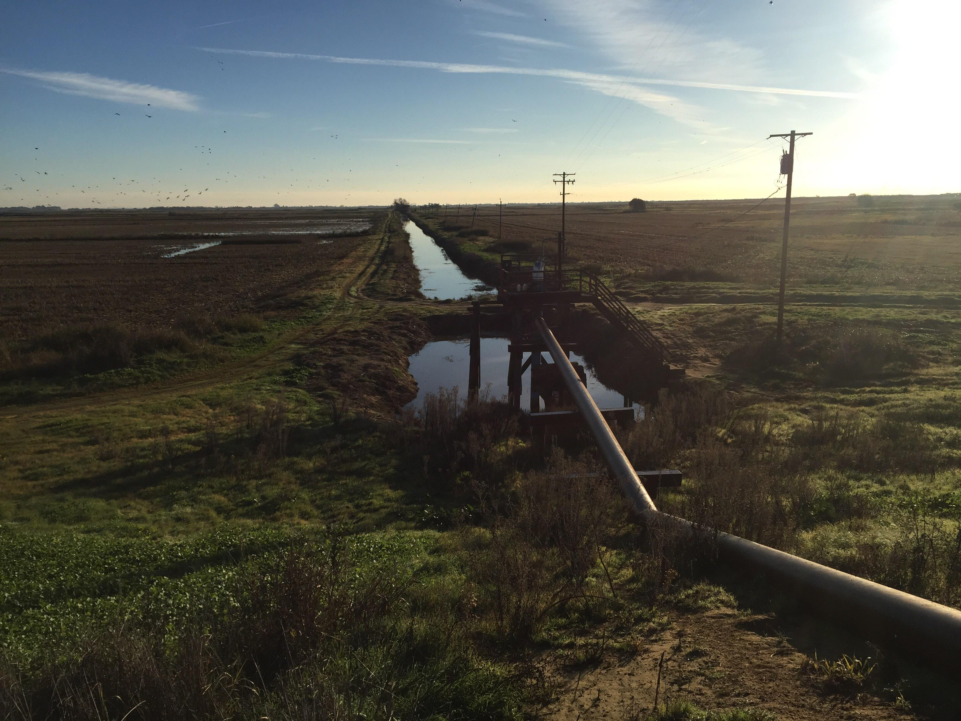
SB88 Regulation Requirements
Reporting includes:
Water right holder information
Geographic location
Monitoring frequency
Monthly diversion rates and amounts
Purposes of use
Water transfers or changes in information

Slide 46
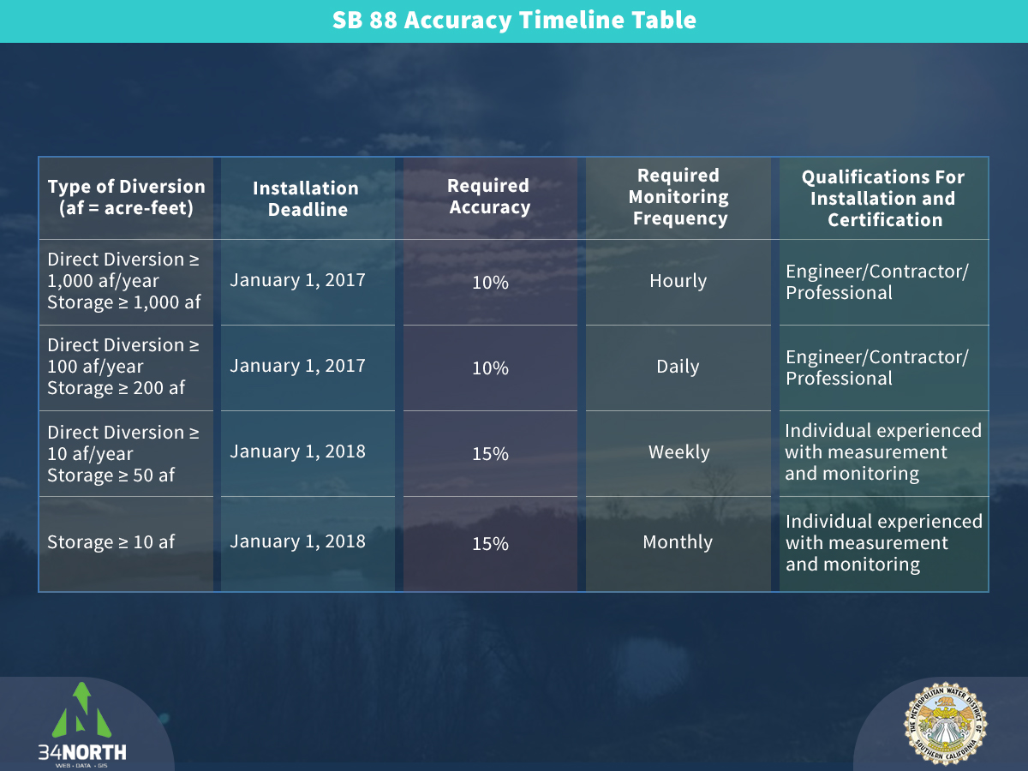

Slide 47
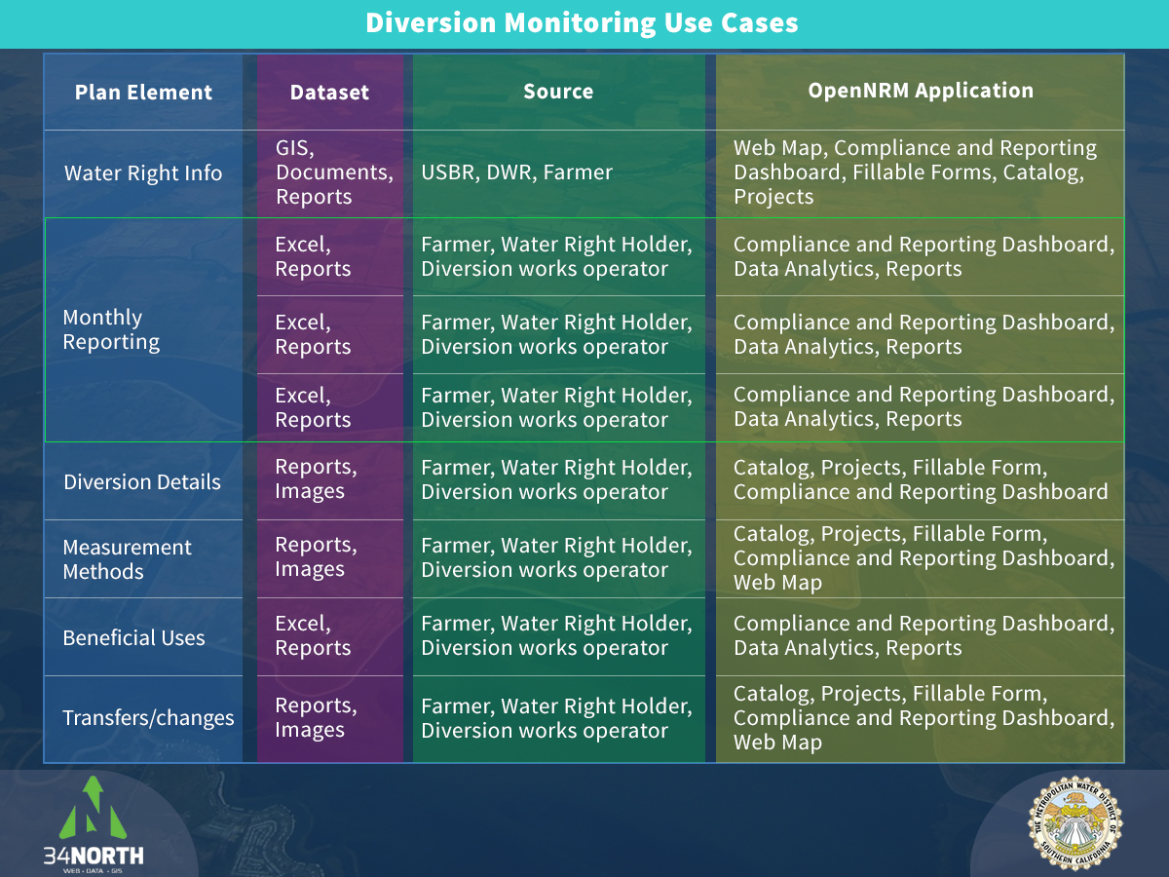
Notes:
Plan elements are extracted from required monitoring and reporting elements laid out in the final regulation of Senate Bill 88 – Emergency Regulation for Measuring and Reporting Water Diversions http://www.waterboards.ca.gov/waterrights/water_issues/programs/measurement_regulation/

Slide 48
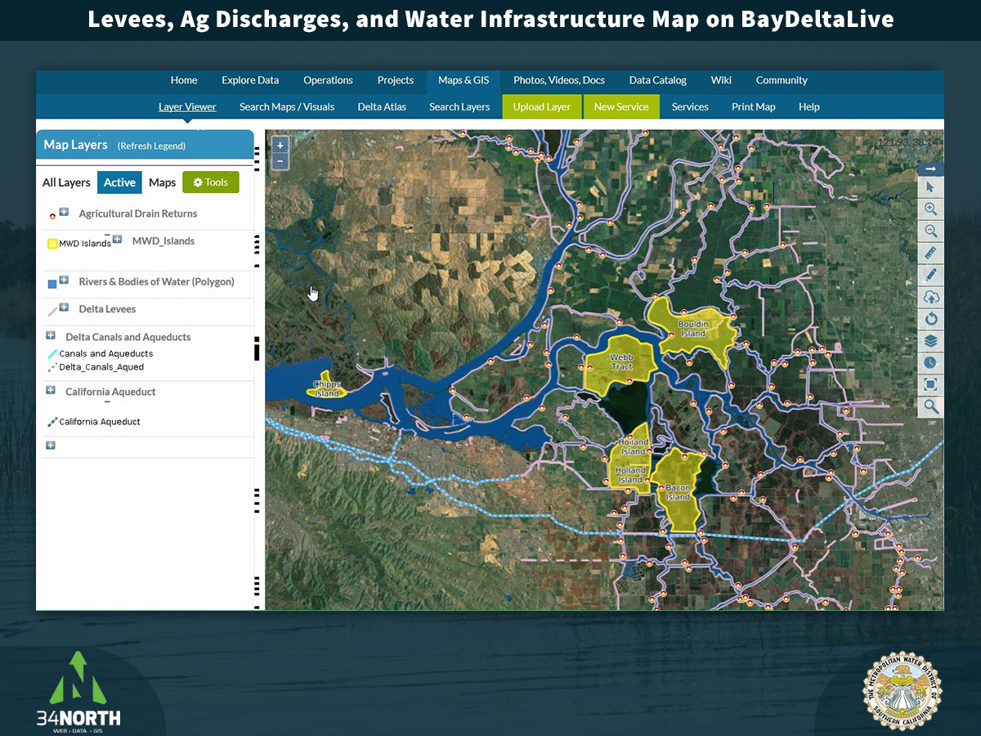

Slide 49
Environmental Management
Islands purchased by MWD are in critical areas:
  on Pacific Flyway
  In Delta smelt and Chinook salmon habitat
  Western islands act as salinity buffer
  Chipps island intended for tidal wetland restoration
    Food and habitat for Delta Smelt
Restoring native tule vegetation could help rebuild peat soils
  Increase island elevations
  Reduce carbon emissions from soil decay
An OpenNRM island portal could be a resource and repository for natural resource management information.
Notes:
Environmental management issues come from MWD’s documentation of island purchases and current research on Delta islands and ecosystem.

Slide 50
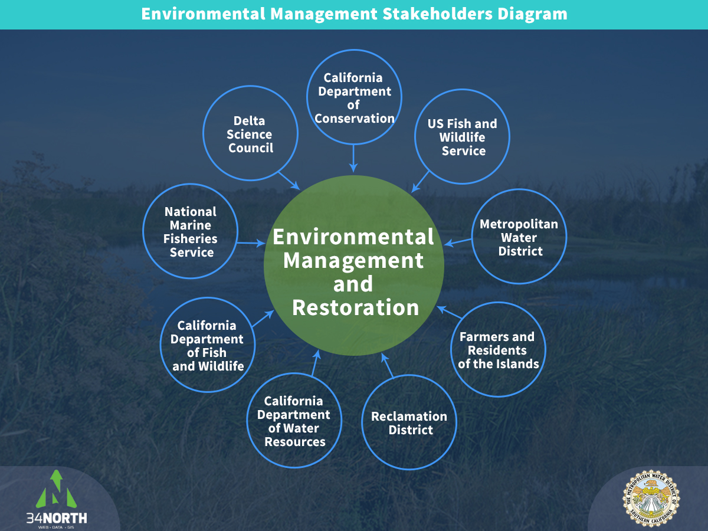

Slide 51
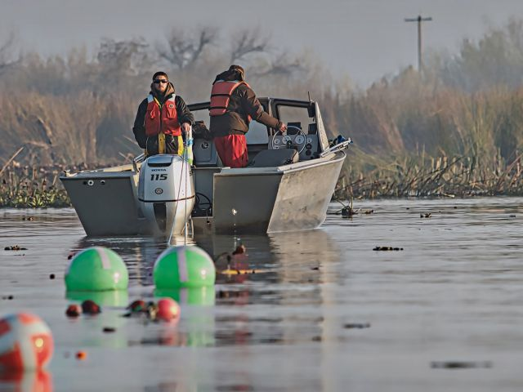
Environmental Management Data Use Cases
Key topics:
  Restoration of wetlands
  Fish population and entrainment monitoring
  Water quality monitoring
  Land and habitat conservation
  Reducing carbon emissions from decaying island peat soils
Notes:
Key topics are extracted from California Water Fix Biological Assessment, Delta Stewardship Council co-equal goals, and MWD objectives for island purchases.

Slide 52
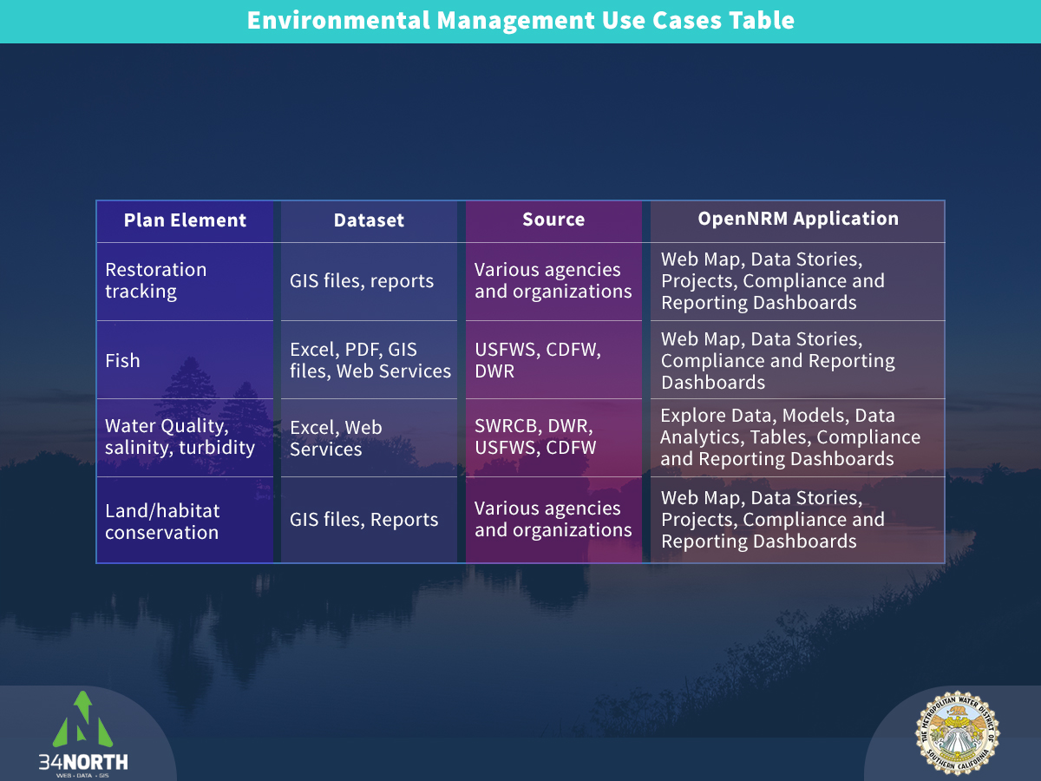
Notes:
Plan elements extracted from California Water Fix Biological Assessment, Delta Stewardship Council co-equal goals, and MWD objectives for island purchases.

Slide 53
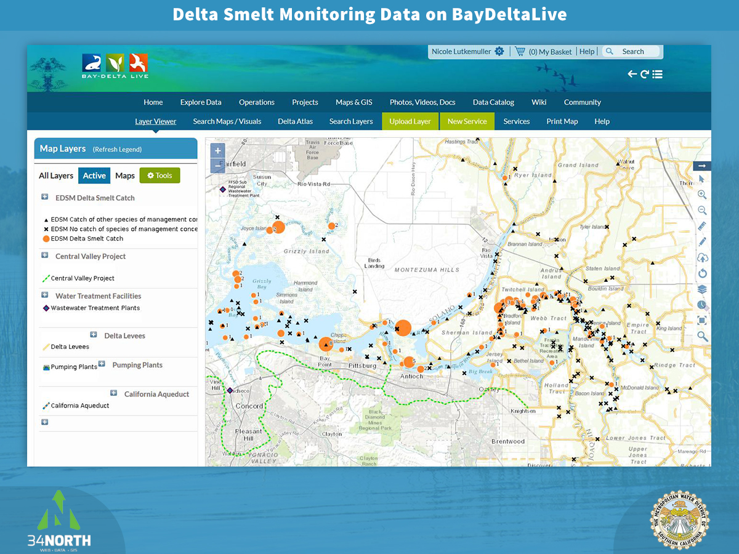

Slide 54
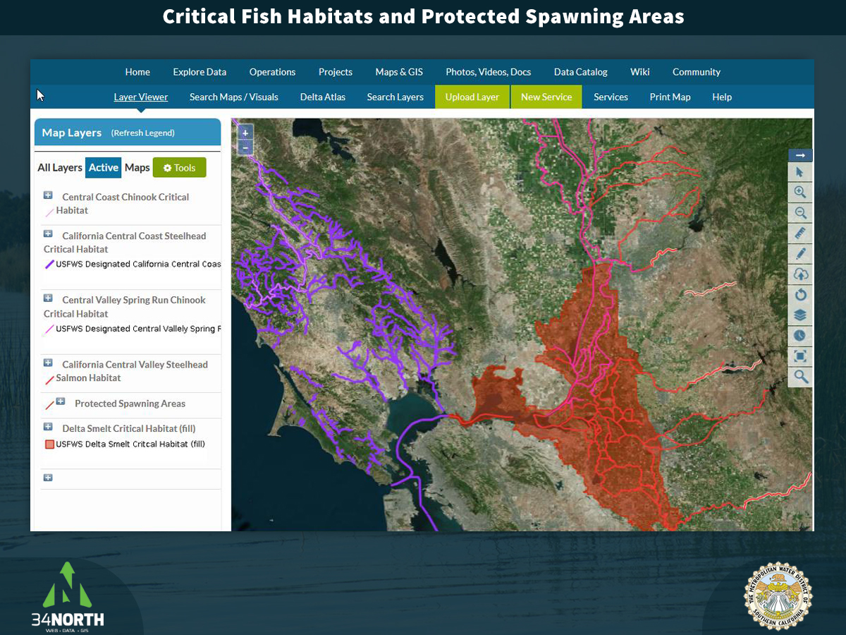

Slide 55
Connecting with Existing Research
- Delta is a food limited and tidal wetland
- Research and monitoring conducted to identifying effective restoration practices and locations
- Islands can be used for research or to supplement ongoing research
- Data can contribute to Delta studies
- The Arc Study (Peter Moyle and John
Durand) and other Cache and Susuin
studies can be used to inform
management of islands
- Other ongoing monitoring and research
can be expanded to other Delta islands

Slide 56
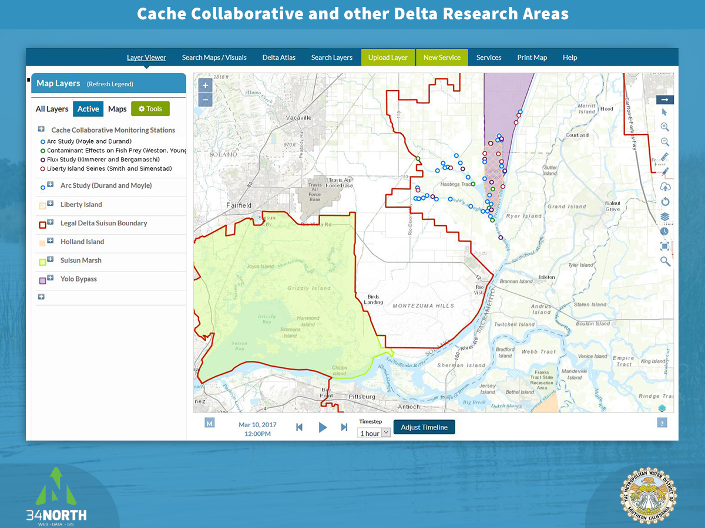

Slide 57
The Solution
Bay Delta Live already used for environmental management and monitoring
Delta Juvenile Fish Monitoring Program Dashboard
CDEC Data Stream
300+ GIS layers in Mapping Application
Tools provide ability to turn data into understandable, usable information
Customizable enhancements to handle island management

Slide 58
Tools and Capabilities
GIS Library, WMS, WFS, and WMST
Interactive Mapping Tools
Database and Data Management Services
Data Visualization, Analytics, Animations, and 3-D Mapping
Explore Data Real-time Data Streams and Web Services
Configurable Dashboards for index and threshold management
Catalogs for images, videos, documents, reports, and research

Slide 59
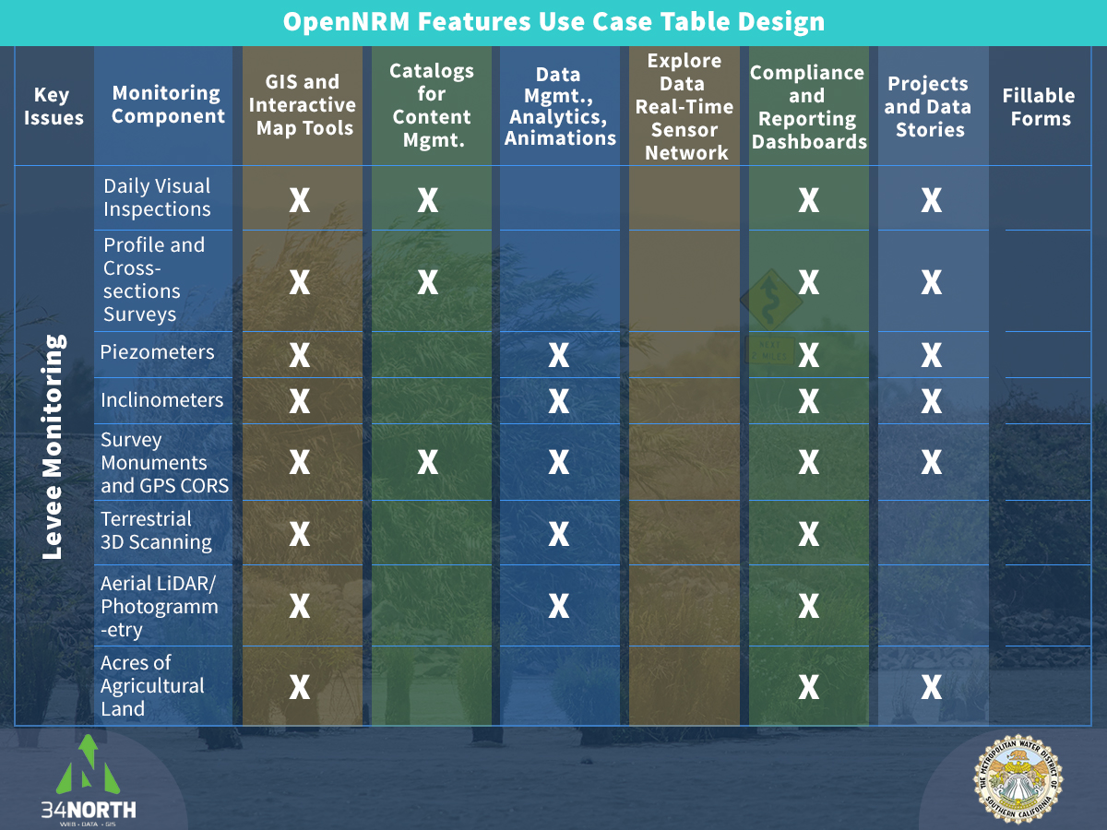

Slide 60
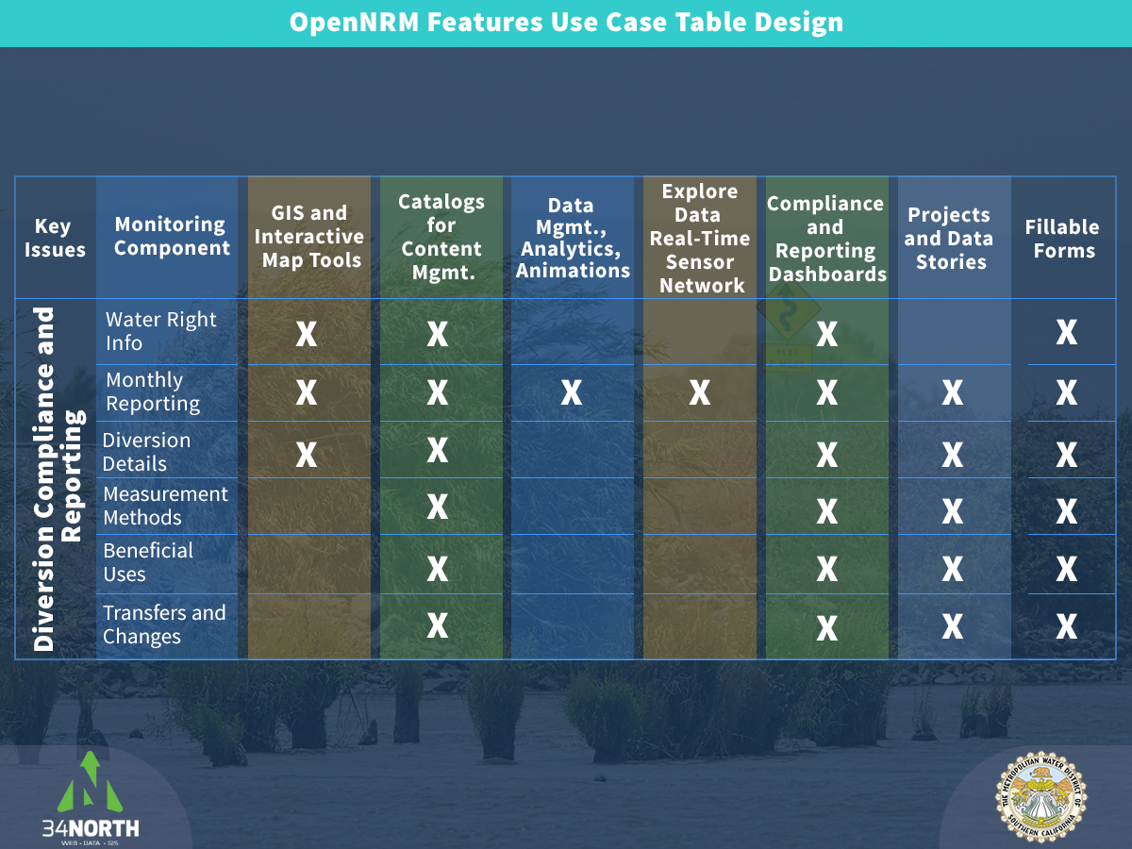

Slide 61
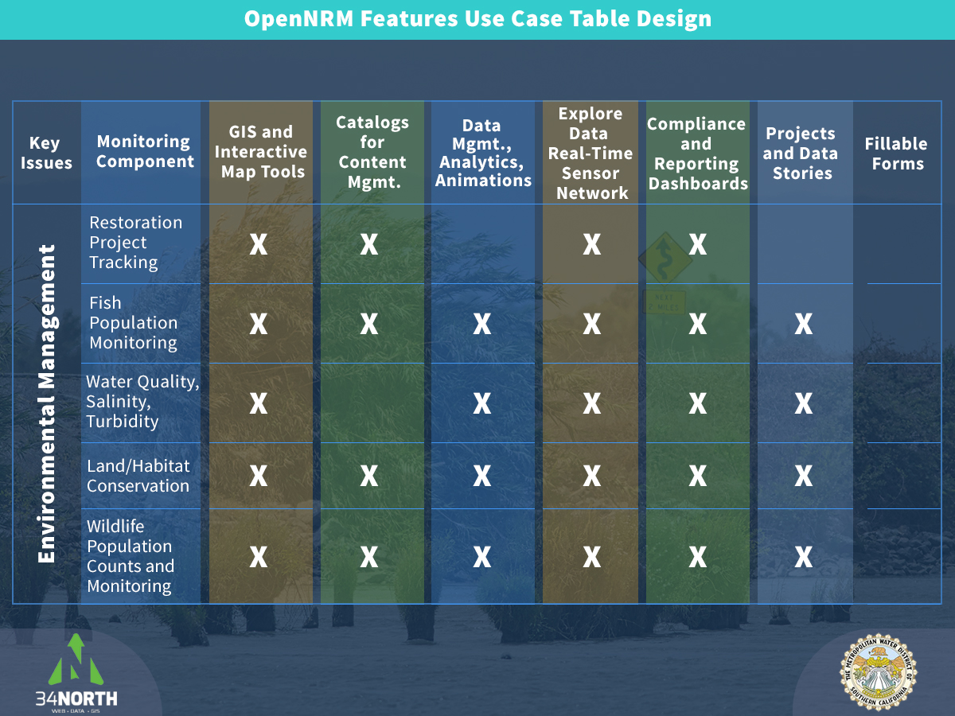

Slide 62
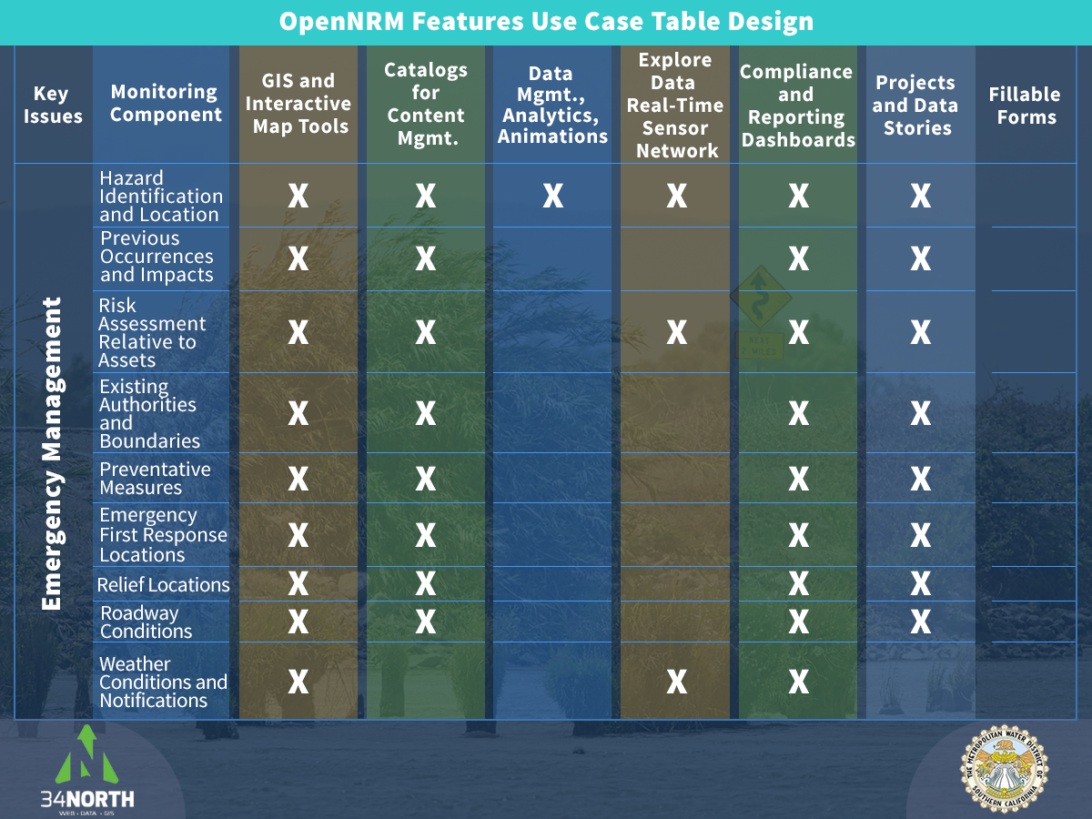

Slide 63
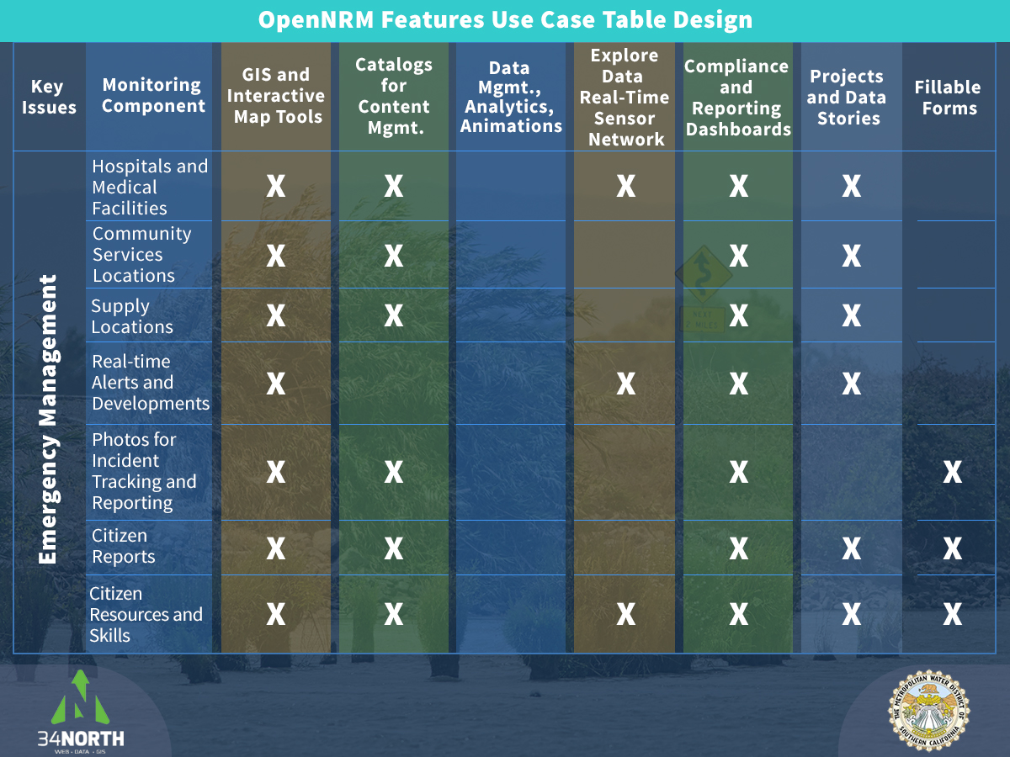

Slide 64
Services and Implementation
  Data Aggregation and Inventory
Develop data management plan and data workflow, including data provenance
UX for user interaction with data
Content management schema and aggregation
Database set up and architecture
New instance of OpenNRM: set up management themed sub sections (catalogs, GIS, data libraries, wikis)
Customize management admin for data contributors
Custom GIS
Databases and data interoperability
Reporting Dashboards
QA/QC, Debugging
Project Management

