Slide 1
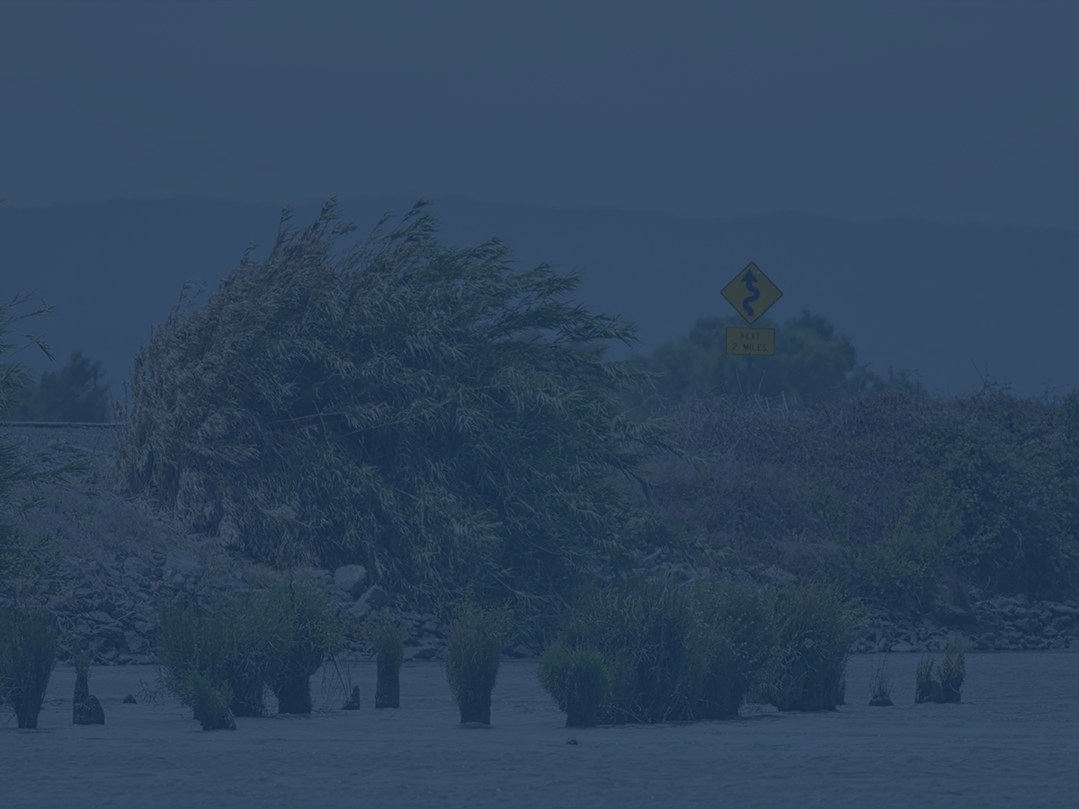
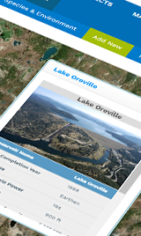
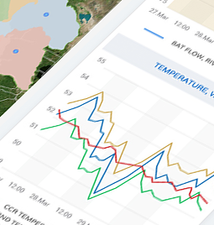
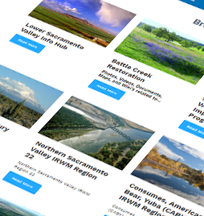
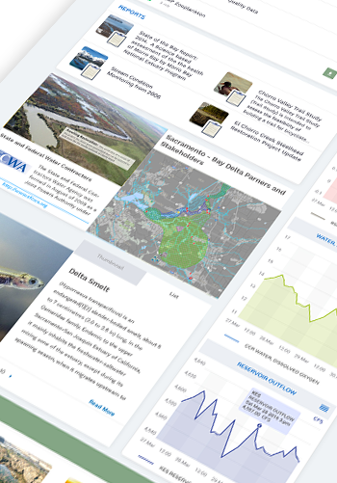
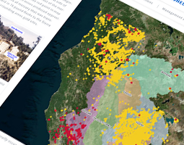
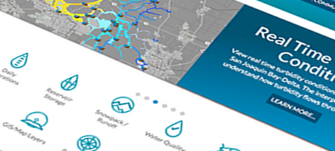


BDL 2018 Review
Amye Osti/Dave Osti-34 North
An Opportunity for Collaboration and Data Synthesis

Slide 2
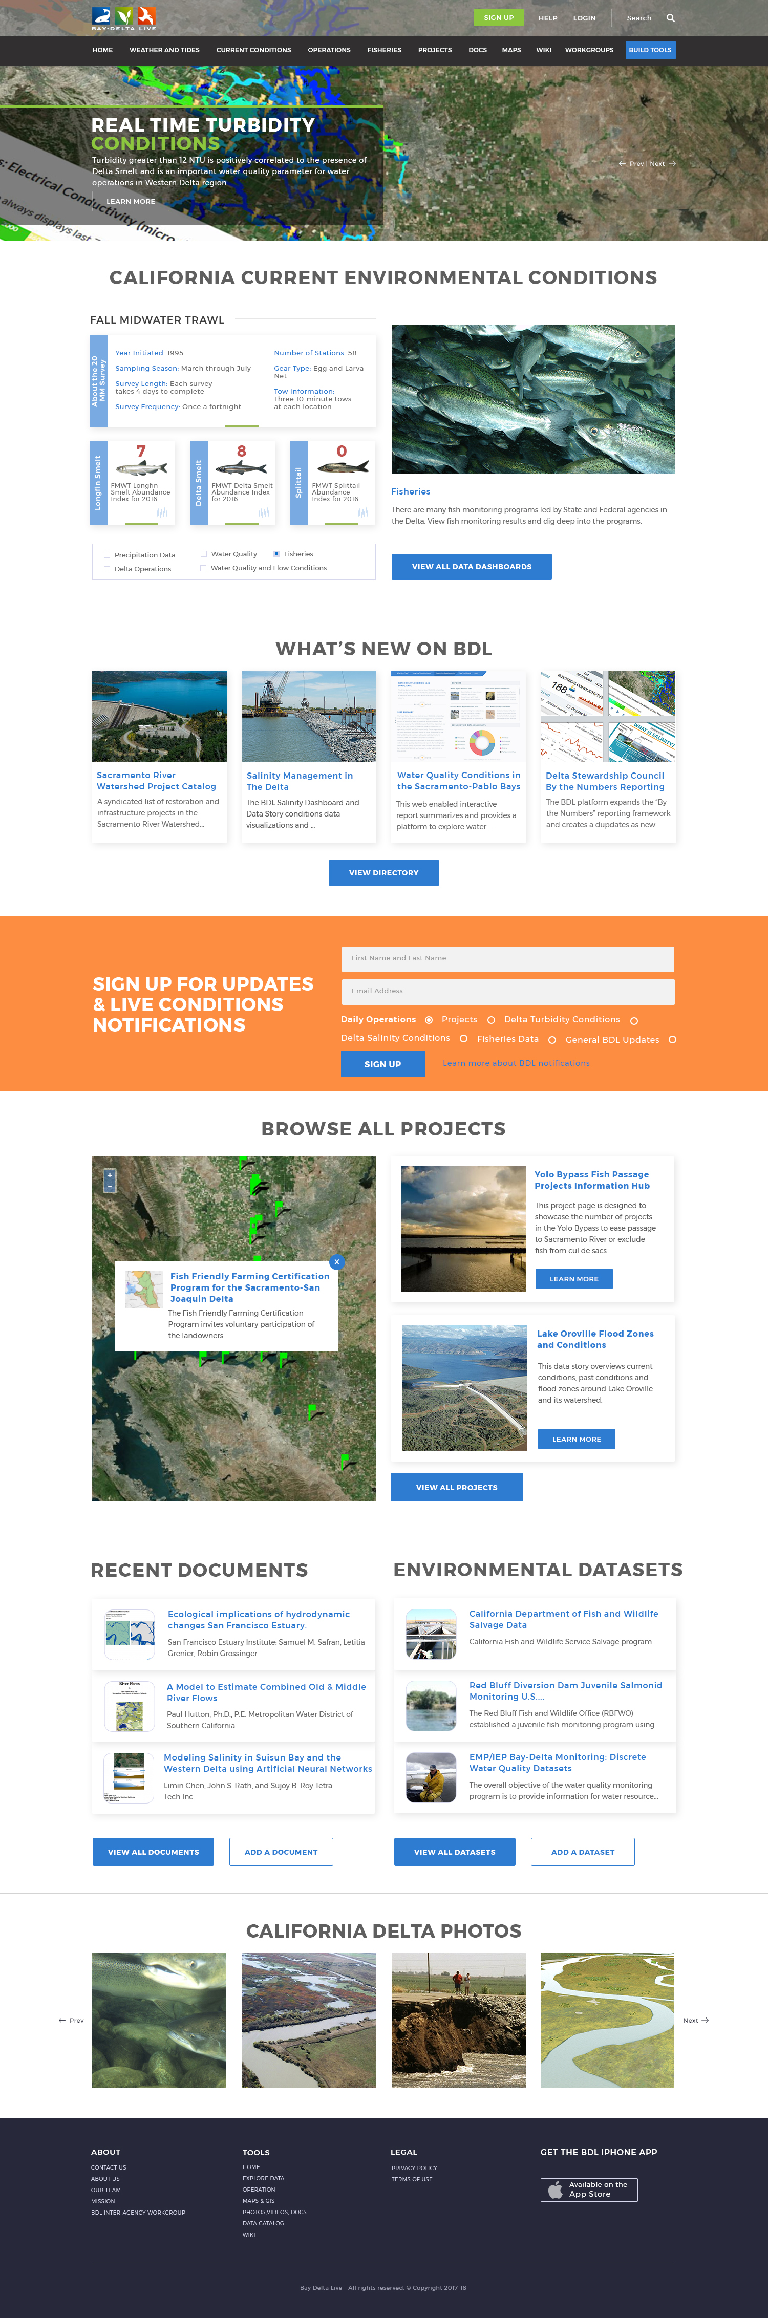

Slide 3
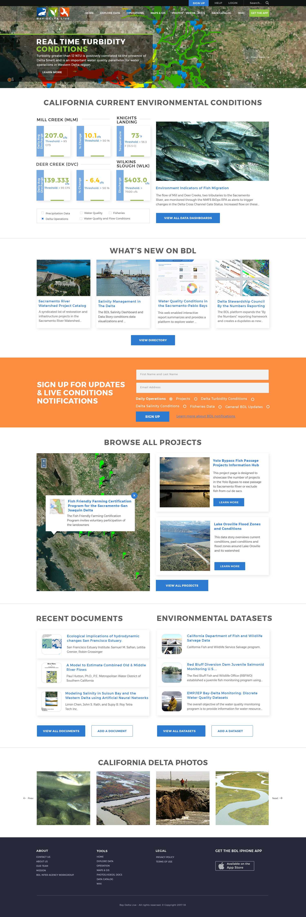

Slide 4
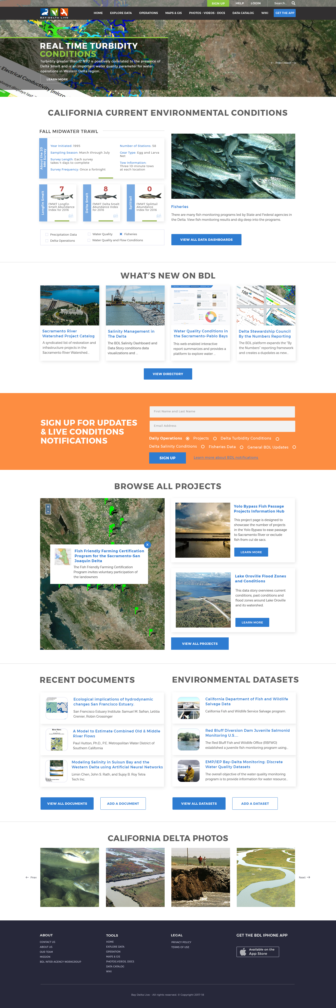

Slide 5
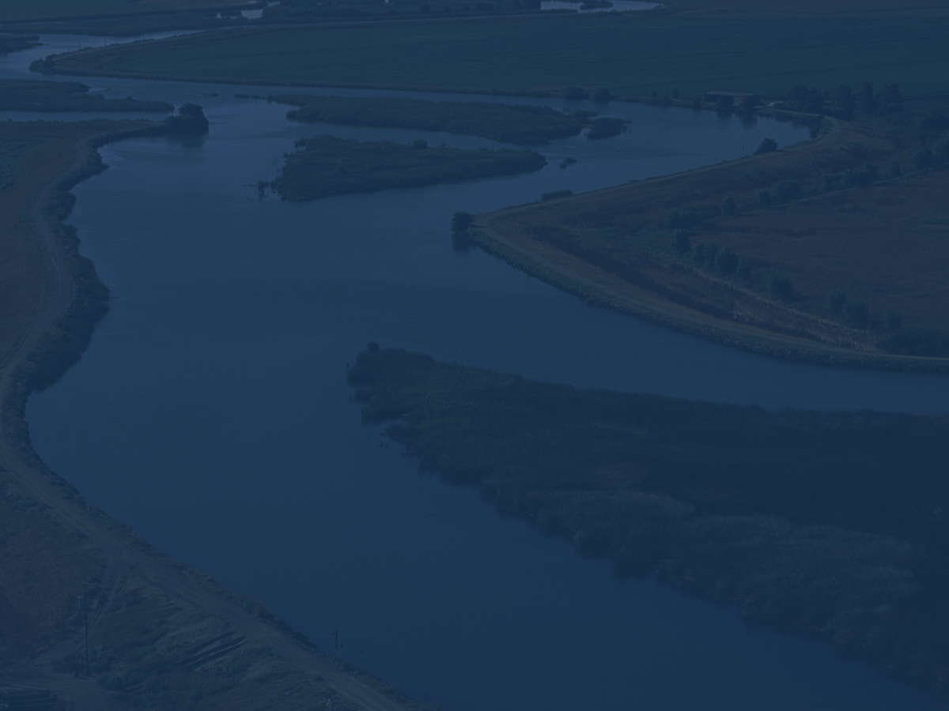






App Icons

Slide 6
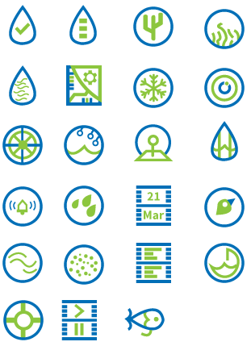
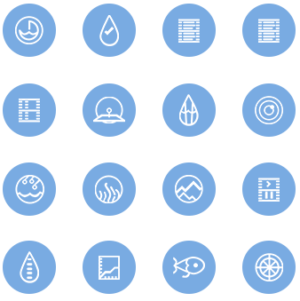
Icons

Slide 7
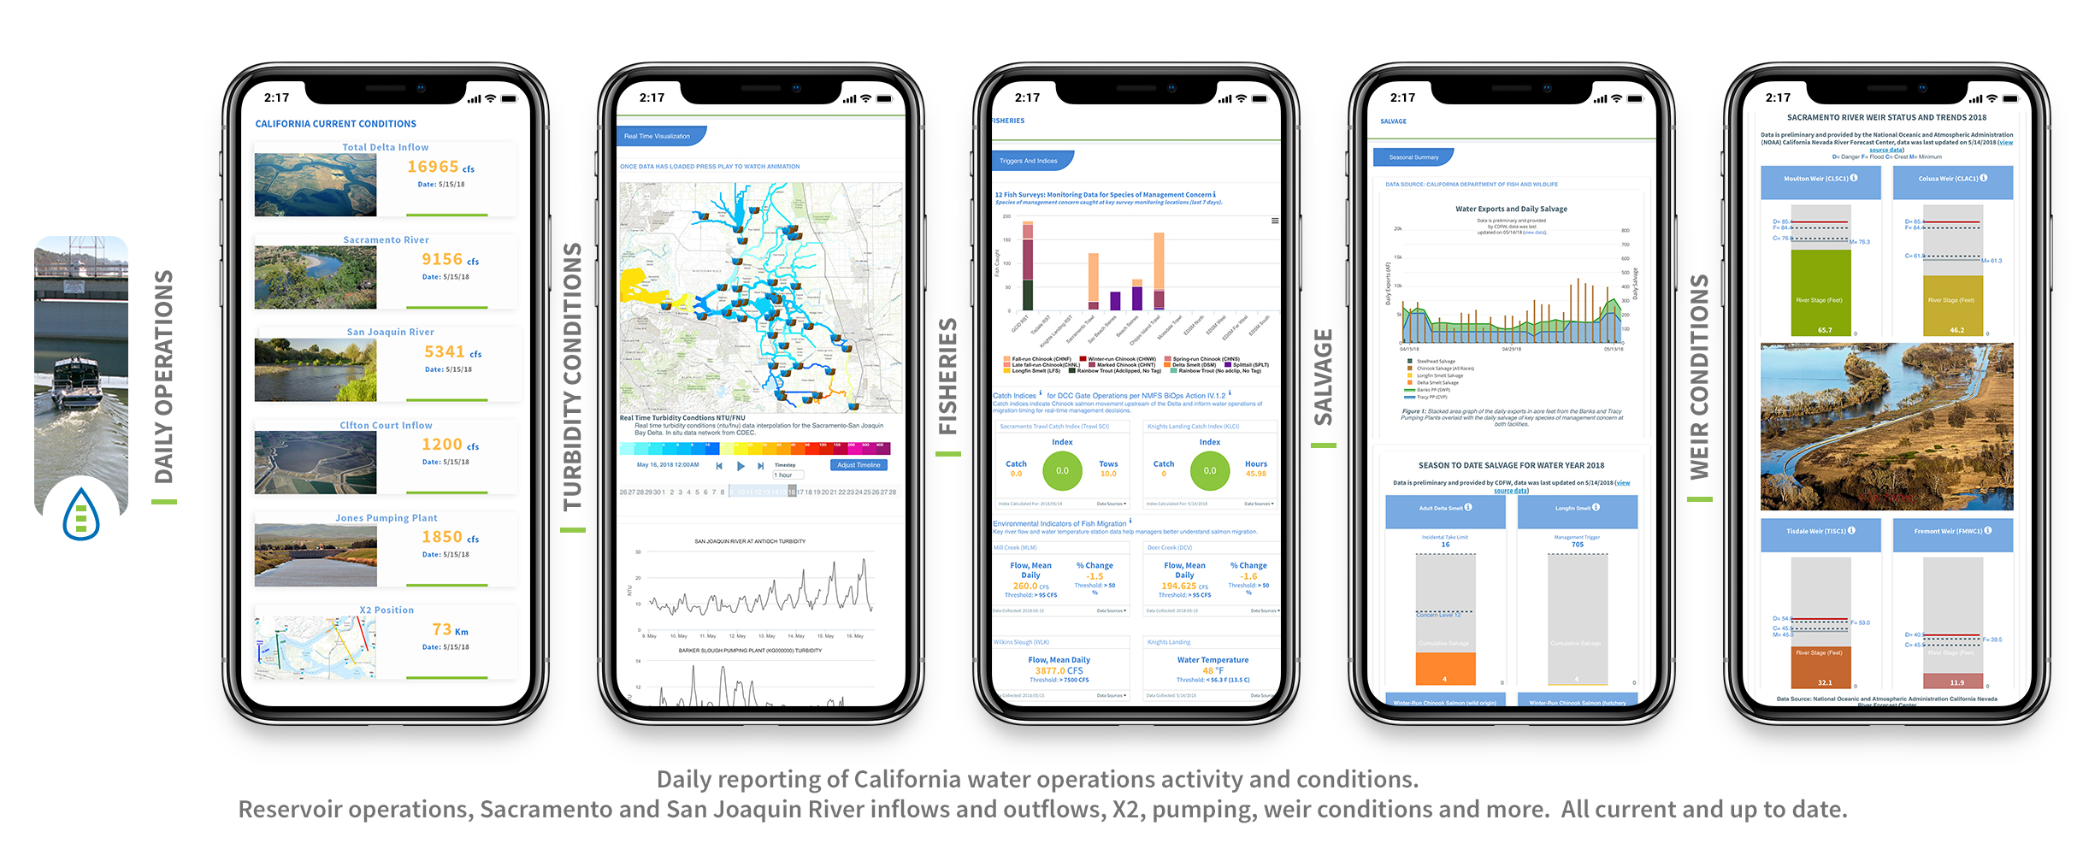

Slide 8
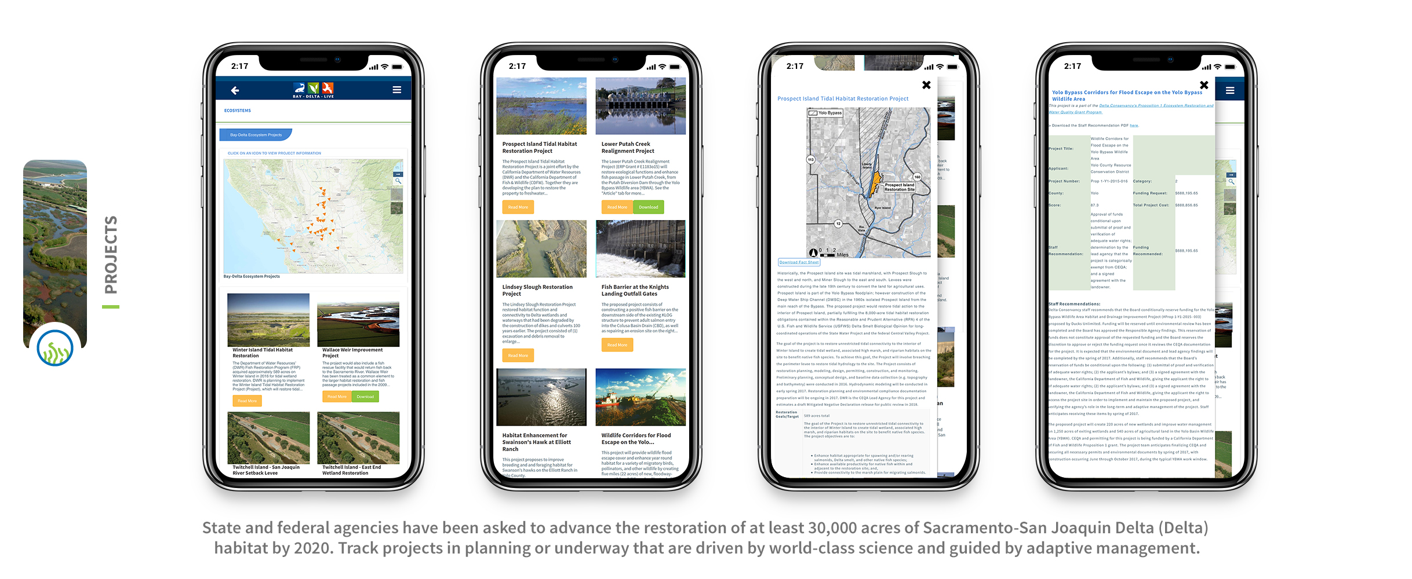

Slide 9
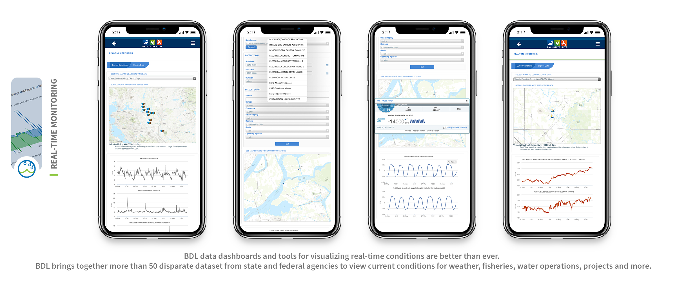

Slide 10
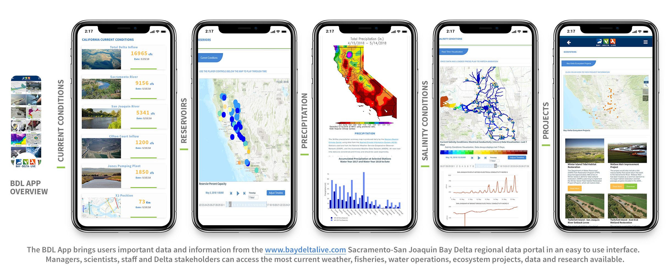

Slide 11
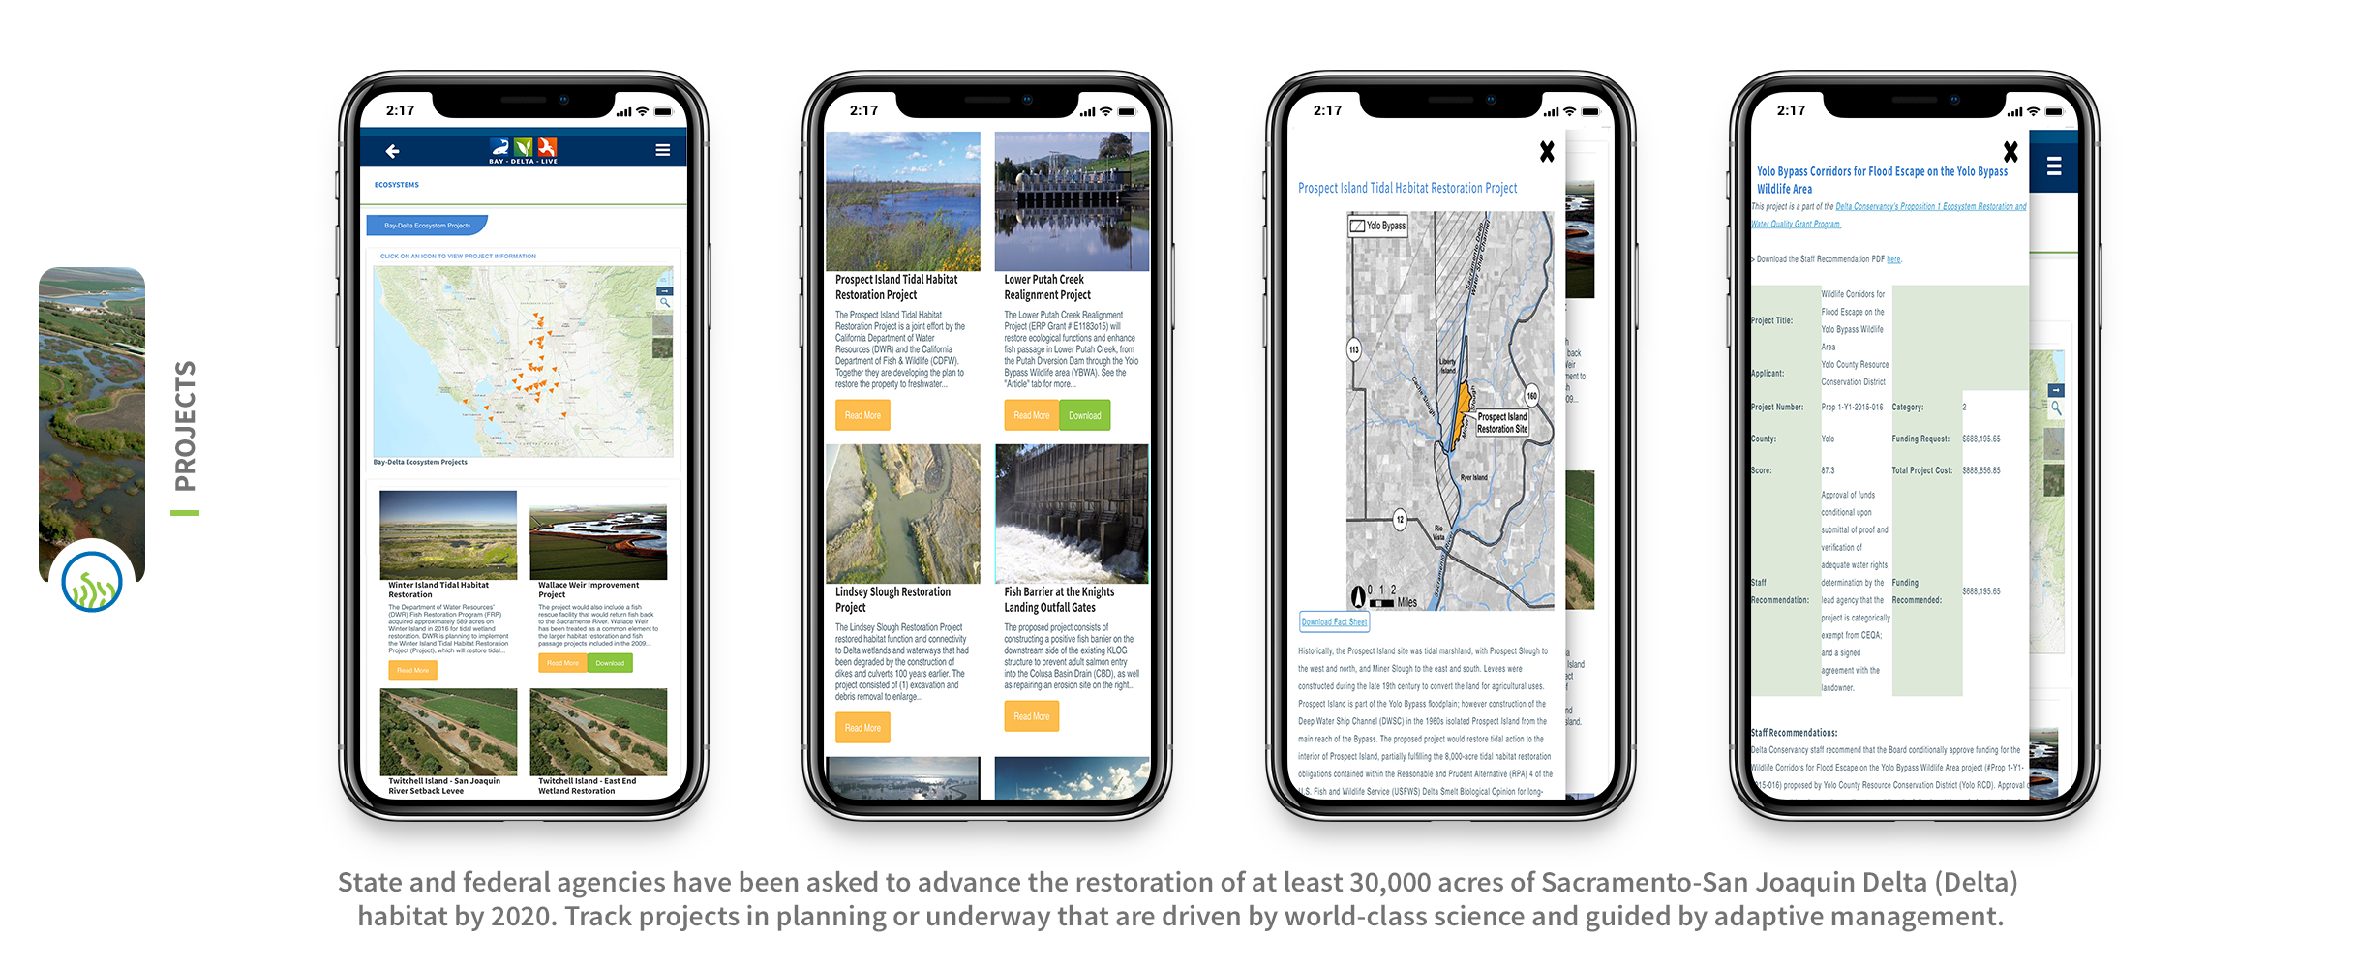

Slide 12
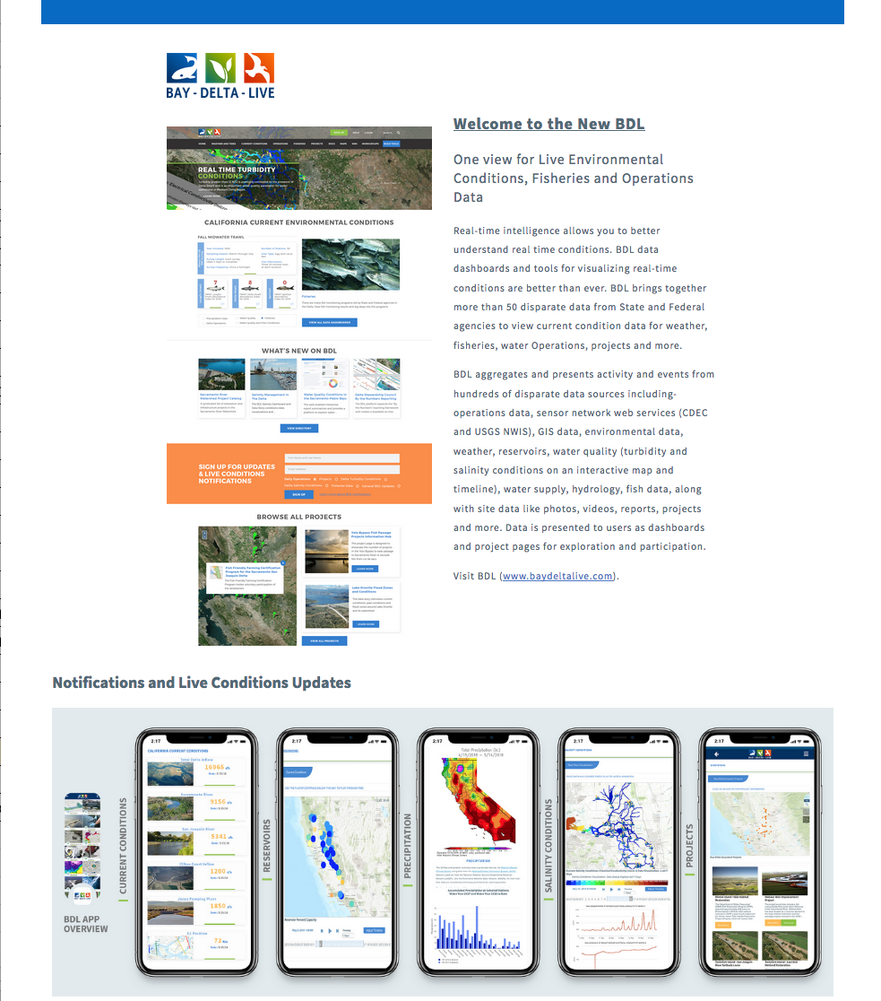
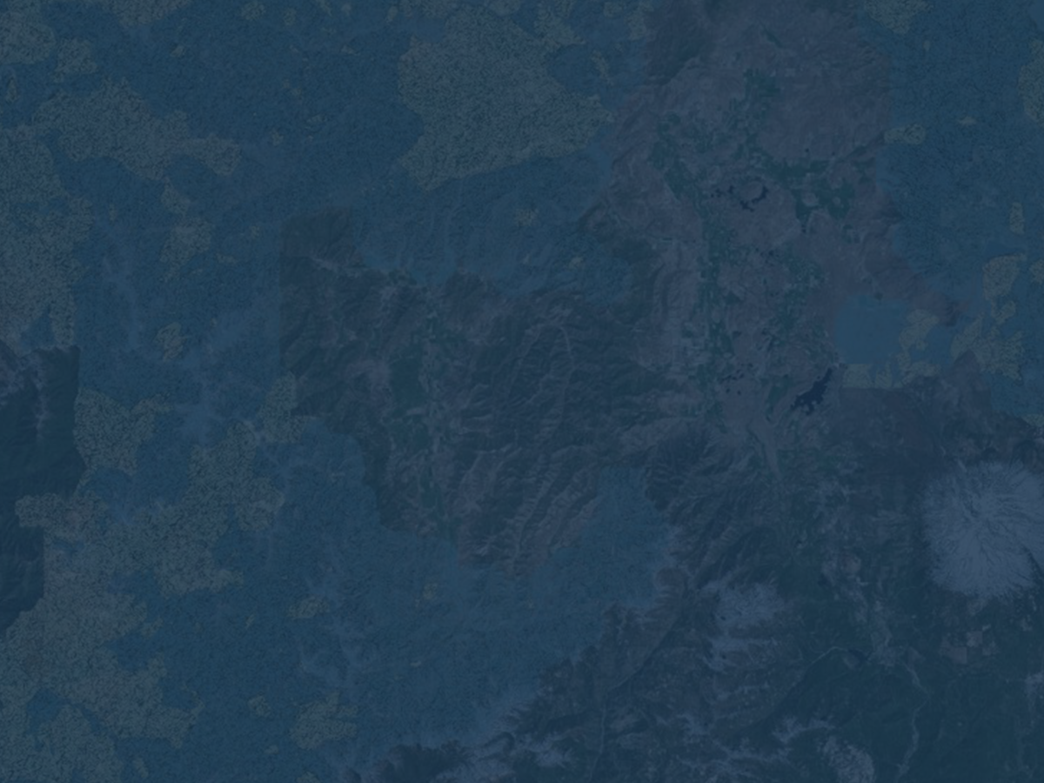
Newsletter
https://dev.baydeltalive.com/wiki/17314

Slide 13
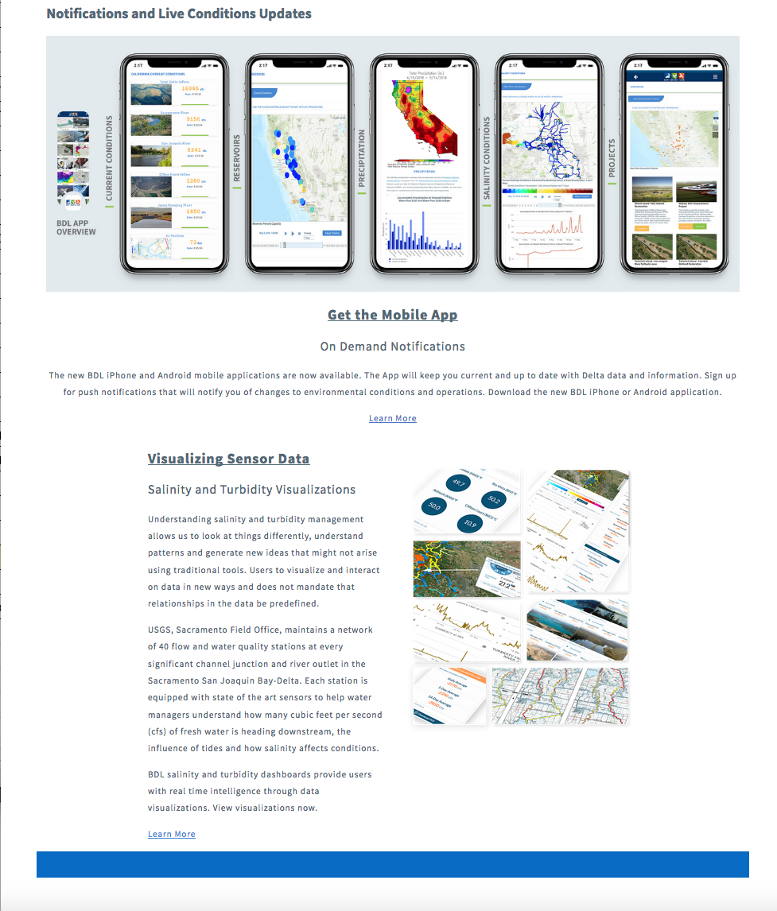
Newsletter
https://dev.baydeltalive.com/wiki/17314

Slide 14
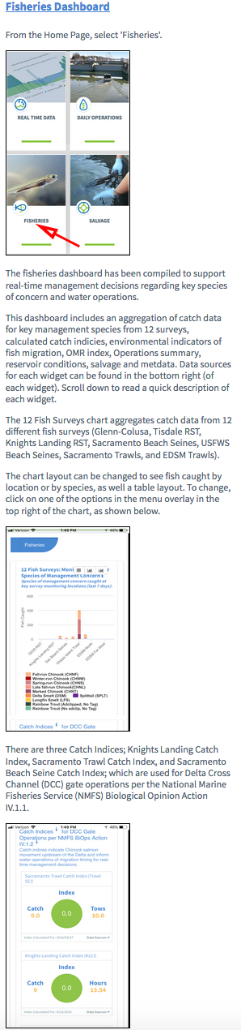
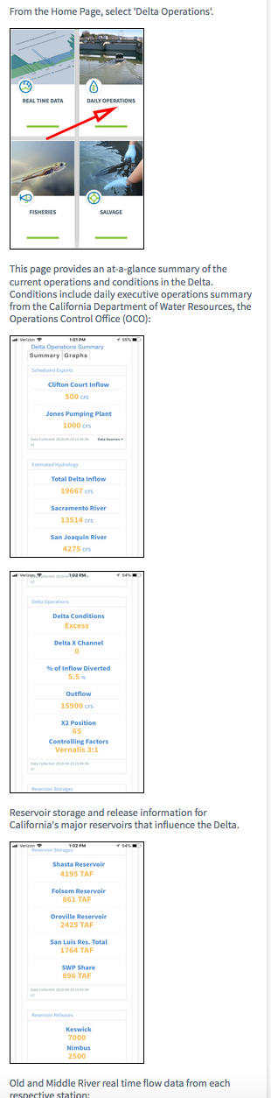
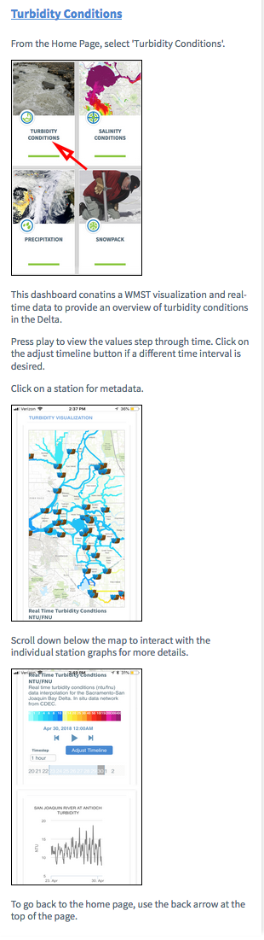
App Help

Slide 15
http://dev.baydeltalive.com/projects/16198

Slide 16
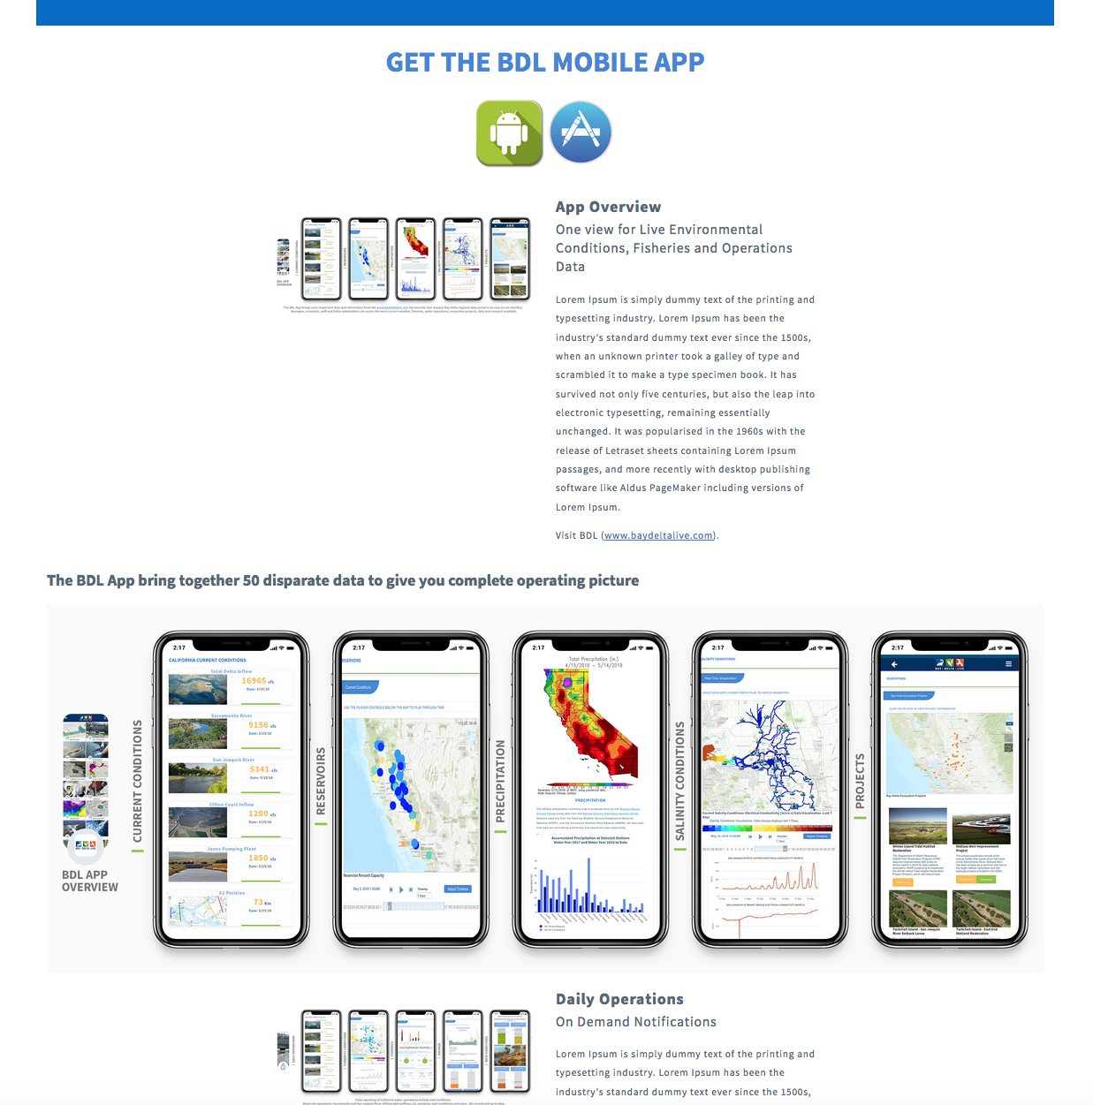
Get the App
https://dev.baydeltalive.com/wiki/17315

Slide 17
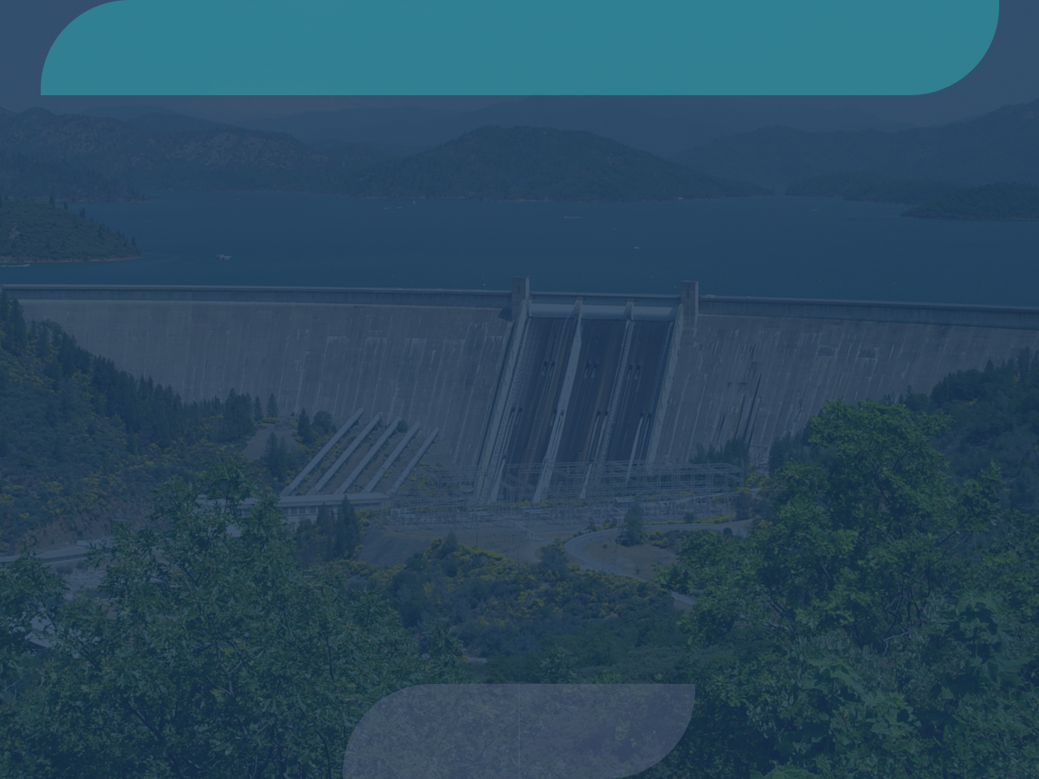
Next Steps
Soft launch new site: DWR web infrastructure changes has rendered much of BDL obsolete.
Advance efforts to aggregate and develop content for technical teams: CAMT, DPPIC, SWG

Slide 18
Proposed Improvements Before Hard Launch
Complete Tasks in TO3: Build Tools, Content Polish, GIS upgrade, Enhance DCT to be complete, CDEC/NWIS web service upgrade, Base map and Icons styling upgrade, automate key manual data updates, add additional project and project database functionality, metadata overhaul, SEO optimization
Complete Constituent Tracker for release

Slide 19
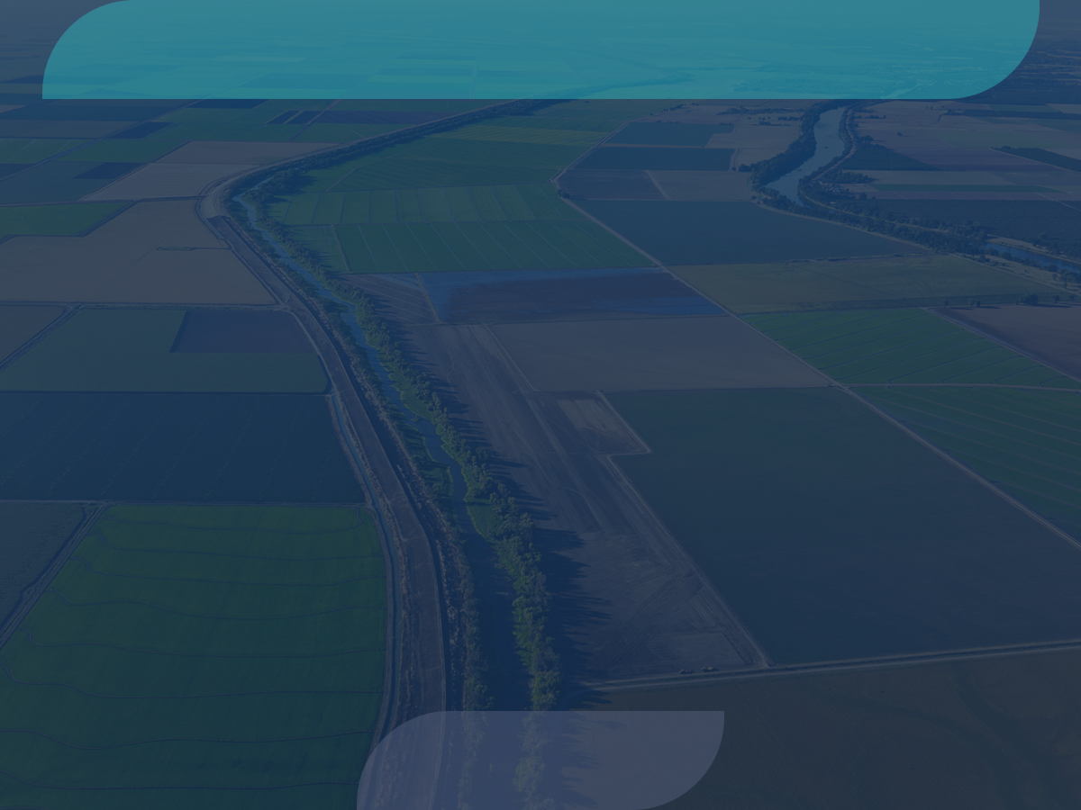
Outreach and Follow up
Bob Fukimora: Development of Web Services
Revive BDL Workgroup, consider contracting Val to facilitate until new champion is found.
Legislature

Slide 26
Operations Decision Management
CALFED Operations
Smelt Working Group (SWG)
Water Operations Management Team (WOMT)
Delta Conditions Team (DCT)
Delta Operations For Salmon and Sturgeon (DOSS)

Slide 27





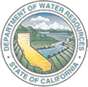

A Collaborative Effort
Regional and Statewide Programs
SACRAMENTO SAN JOAQUIN BAY-DELTA
SWRCB MY WATER QUALITY PORTALS
CALIFORNIA ESTUARY
PORTAL
SAN JOAQUIN REAL TIME MANAGEMENT
DWR 1641 WATER
QUALITY
SACRAMENTO RIVER
WATERSHED

Slide 28

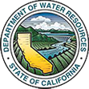









Major Data Providers
Data is aggregated from stakeholders throughout the region:
Hydrologic
Water Quality
Satellite
Meteorological
Terrestrial
Volunteer Sampling

Slide 29
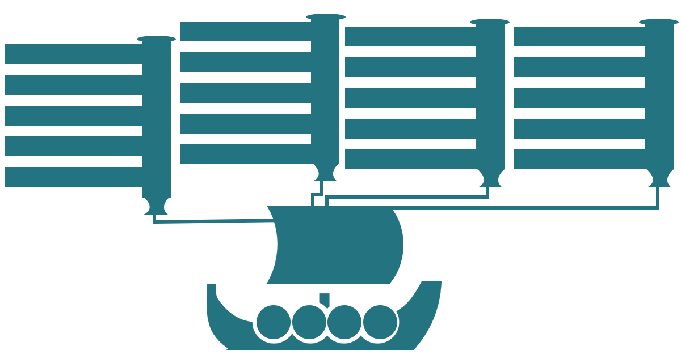

Statewide Collaborative Projects
Estuary Portal
Fisheries Dashboards
WARMF Modeling
SRWP Monitoring Programs
1641 Reporting
DOSS and DCT
Real Time Management
Forest Health and Fire
Ca Estuaries
BDL
Cache Collaborative
DSM2 Modeling
Compliance Monitoring
SJRRTM
Ecosystem Restoration
SRWP
EMP Monitoring
Real Time Operations
Reporting Dashboards
Region Data Hubs
State Estuaries Template
By the Numbers
Collaborative Management
Temperature Compliance
OPEN
NRM
Data
Research
Projects
Tools

