Slide 1





DATA PORTAL DEVELOPMENT FOR THE SACRAMENTO RIVER WATERSHED
Holly Jorgensen
Amye Osti
Chuck Lundgren
Stephen McCord, Ph.D., P.E.

Slide 2
OVERVIEW: AGENDA
Welcome and Introductions
Current News & Activities
Survey Results
Survey Feedback
Key Topics
Portal Updates
Wrap-Up

Slide 3
UPDATES: CURRENT NEWS
SWAMP: State, Regional
DWR: MWQI, Regions
ILRPs: Sac Valley, Rice
MS4s: Phase I & II
POTWs: CVCWA, indiv.
Riparian & wetland (p)reserves
Sac. Area CMP
Delta programs
CWQMC
  CA Estuaries Mon. WG
  CA Wetland Mon. WG
  Healthy Watersheds Partnership
  Data Man. WG
  BOG WG “Is it safe to eat fish?”
  Collaboration Workgroup
Notes:
KW- Again here I would just delete this slide, seems like it will confuse the audience more than aid with the presentation.

Slide 4
OVERVIEW: DEVELOPMENT PROCESS
Stakeholder commitments
Survey stakeholders for key issues, areas of concern, and data
Identify available information for the Watershed (data, GIS, maps, reports, programs, monitoring efforts, photos, etc)
Develop questions and key data dashboards
Dashboard script analyses & visualizations
Portal instance & host site
Outline future activities

Slide 5
UPDATES: ACTION ITEMS
HJ: Update list of committed SH’s
HJ: Distribute & summarize survey
SM: Upload SRWP data to CEDEN?
Team: Present at SRWP forum
HJ: ID additional stakeholders
SM/AO: Sommer ➔ USFWS (fish data)
SM: Data sources table reviews
SM: Draft storyboards for key topics
Notes:
KW- I did not change this slide, to me it seems like something that can be deleted and just talked about.

Slide 6
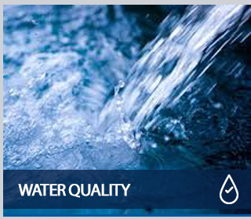
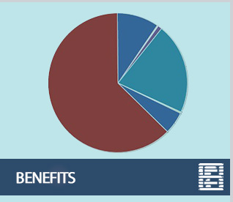
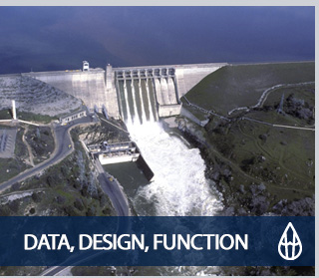
STAKEHOLDER SURVEY: RESULTS
Notes:
Review status of action items in previous mtg summary; note that CWQMC data management white paper is still in draft form

Slide 7
SURVEY RESPONSES: WHO?
State and Federal Agencies
Resource Conservation Districts
NGOs
Counties
Water Managers
Regulated Dischargers

Slide 8
SURVEY RESPONSE SUMMAY: WHAT?
Top 5 Data Sets Regularly Used:
  CEDEN
  NWIS
  CDEC
  CIWQS
  DWR Water Data Library
Top 5 GIS Layers Commonly Accessed:
  Water Bodies
  Monitoring Stations
  Mine Sites
  Land Uses
  Watershed Boundaries

Slide 9
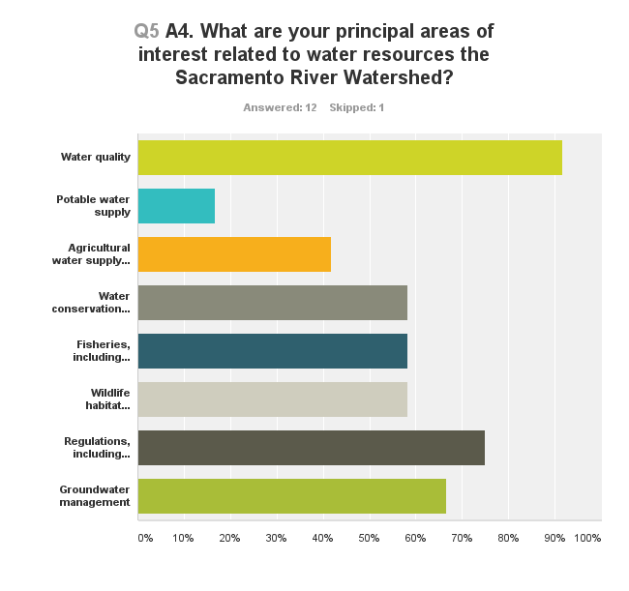
SURVEY RESPONSE SUMMAY: DETAIL

Slide 10
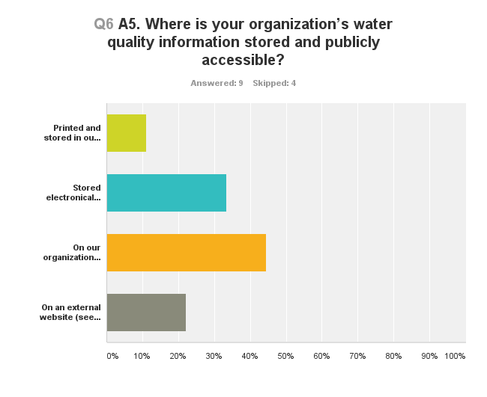
SURVEY RESPONSE SUMMAY: DETAIL?

Slide 11
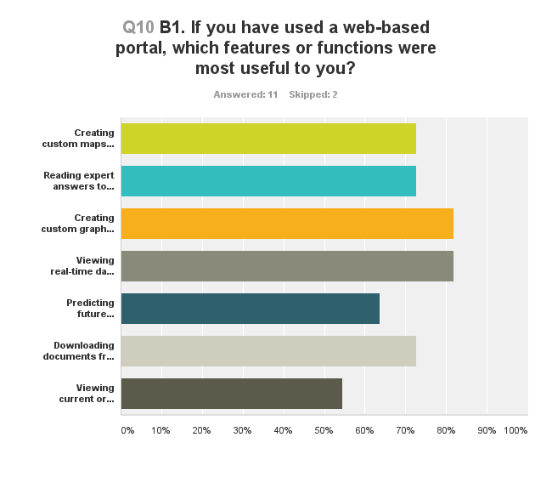
SURVEY RESPONSE SUMMAY: DETAIL

Slide 12
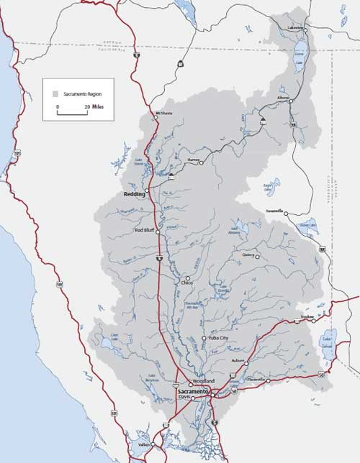
SURVEY RESPONSE SUMMAY: DETAIL
Sacramento River Watershed
Delta

Slide 13
SURVEY RESPONSE SUMMAY: KEY RESPONSES
Data and information not publicly accessible
Current monitoring activities
Mercury data
Fish data

Slide 14
SURVEY RESPONSE SUMMAY: KEY RESPONSES
Where is water quality an issue?
What is causing the water quality issue?
Is the watershed healthy?
What are the current conditions?
How successful are management efforts?

Slide 15
SURVEY: FEEDBACK AND ADDITIONAL COMMENTS
Initial thoughts in response to the Survey
Comments
Are there additional data you would like to see on the portal?
What data are you and your program collecting?
Questions
Concerns
Notes:
KW-depending on what route is decided (presenting on initial survey results or reissuing the survey) this slide may be edited or deleted

Slide 16
PORTAL DATA: IN DEVELOPMENT
CDEC: Real Time Water Quality and Hydrological Data
CEDEN: metals, pesticides, nutrients, water quality
USGS NWIS: current and historic water quality data
USGS EMMA: mercury in fish tissue, mercury in stream sediment, mercury in soils, mines (current and historic)
Local data sets (Lake Almanor, Feather River, Dry Creek Area)
Notes:
KW: have included data sets in this section which have data that is readily available for download

Slide 17
PORTAL DATA: IN DEVELOPMENT
CVRWQCB Wetland Database
CRAM Rapid assessment of wetlands and riparian habitats
GIS Data (habitat, fire, streams, watersheds, counties, endangered species, barriers to fish passage, abandoned mines, etc.)
SACRAMENTO RIVER WATERSHED PROGRAM
WDL/WQX
Notes:
KW: have included data sets in this section which have data that is readily available for download

Slide 18
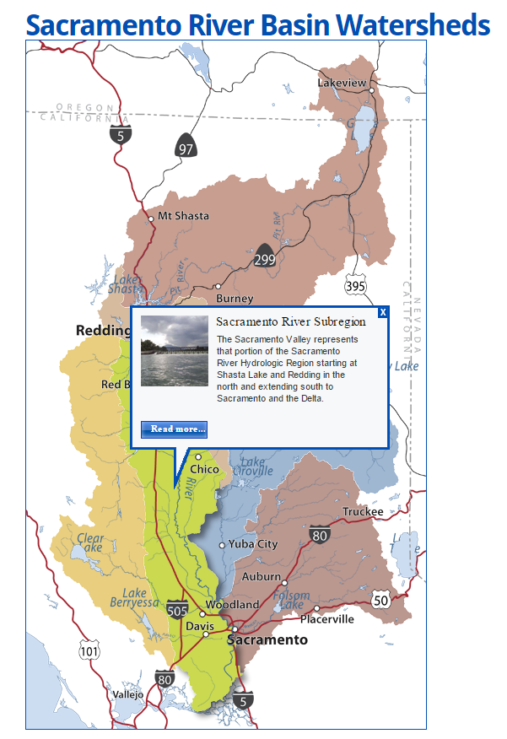
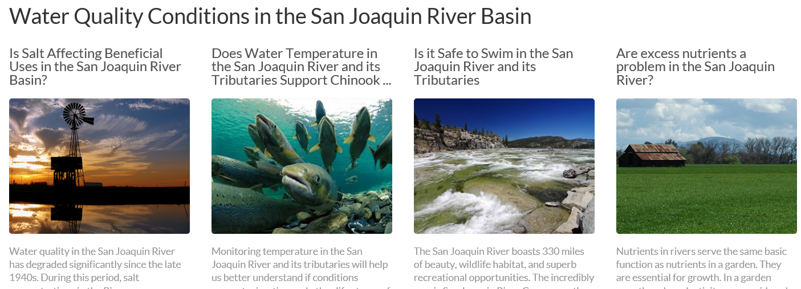
PORTAL TOPICS: WATERSHED INFORMATION
General Watershed Information
Regional and Sub-Watershed Inventory
Spotlights/Special Topics on areas of concern
Current Conditions
Data Sets: 200+ GIS layers, CEDEN, CDEC, NWIS, WDL, SRWP Data…

Slide 19
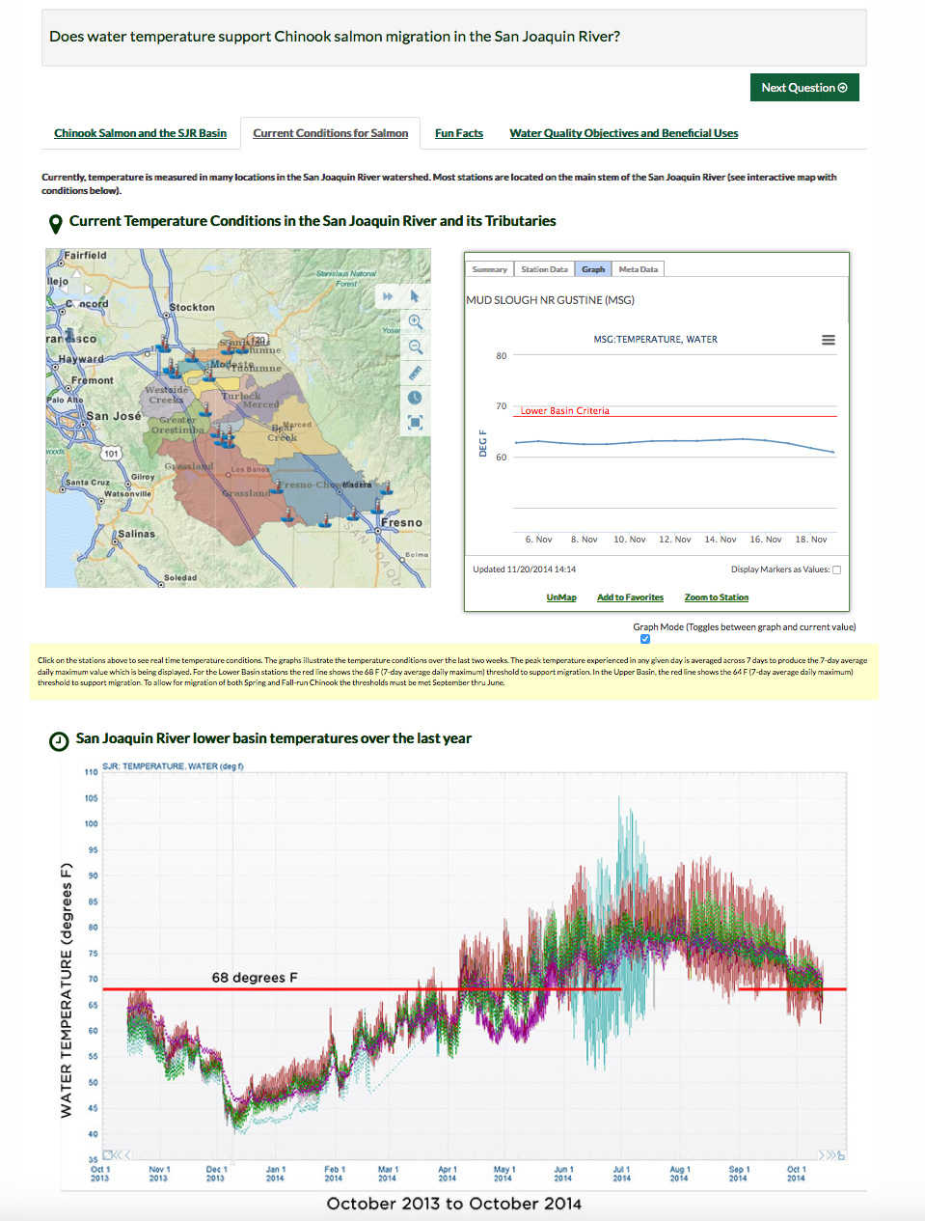
PORTAL TOPICS: REAL TIME DATA
Current Conditions:
Dissolved Oxygen
Turbidity
River Discharge
Water Temperature
Electrical Conductivity
Reservoirs
Data Sets: GIS layers, CDEC, NWIS

Slide 20
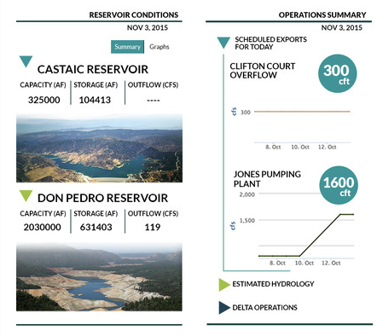
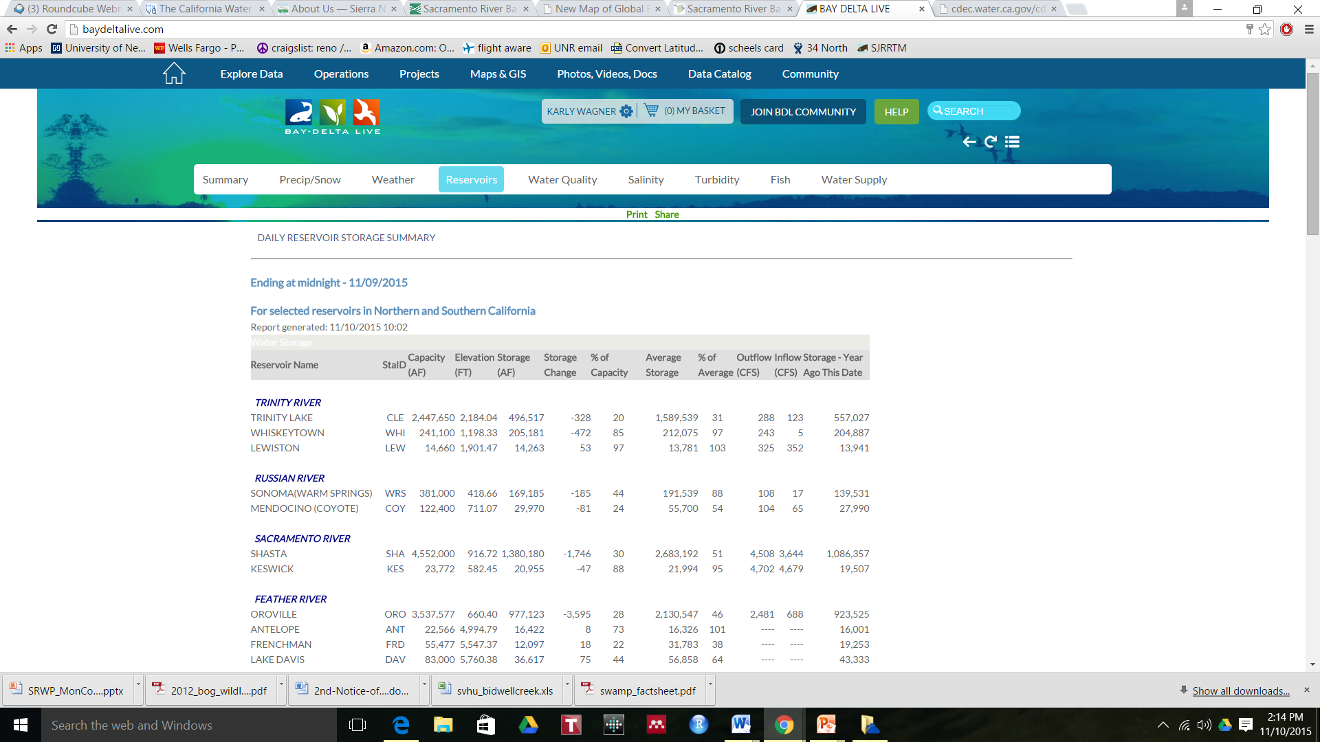
PORTAL TOPICS: RESERVOIR OPERATIONS
Current Storage
Inflow/Outflow
Storage Capacity
Lake Surface Elevation
Scheduled Releases
Gate status
Recent Releases
Trend Analysis
Data Sets: GIS layers, CDEC, NWIS

Slide 21
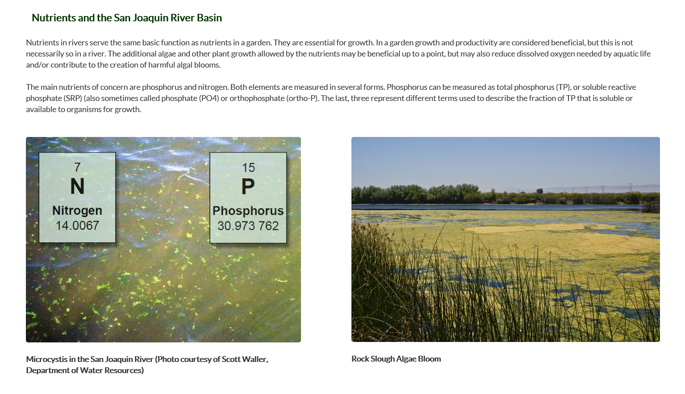
PORTAL TOPICS: NUTRIENT BACKGROUND
Data Sets: GIS layers, CDEC, NWIS, CEDEN, WDL

Slide 22
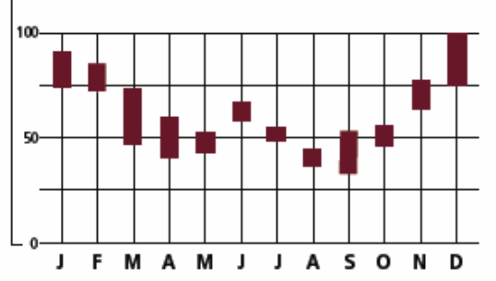
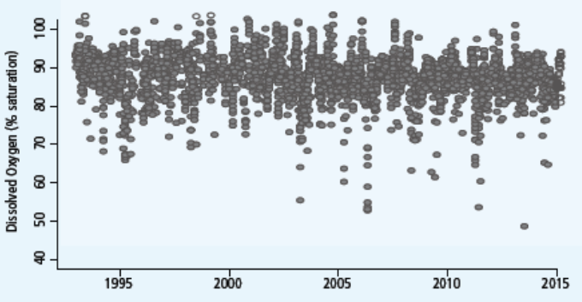
PORTAL TOPICS: NUTRIENTS
Monthly Averages
Are excess nutrients a problem in the watershed?
Nitrate
Ammonia
Phosphorus
Eutropocation Indicators (Chlorophyll a, cyanotoxins)
Time Series
Data Sets: GIS layers, CDEC, NWIS, CEDEN, WDL
Notes:
http://www2.epa.gov/nutrient-policy-data/nitrogen-and-phosphorus-pollution-data-access-tool, http://www2.epa.gov/nutrientpollution, http://www.sfei.org/projects/satellite-imaging-detect-cyanobacterial-blooms

Slide 23
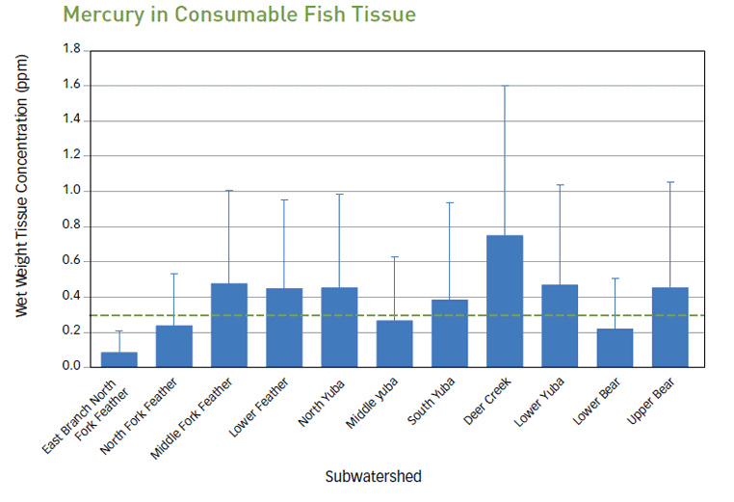
PORTAL TOPICS: MERCURY AND FISH
Sources of Mercury
Mercury Criteria (fish tissue criterion = 0.3 ppm, THg in water criterion = 50 ng/L)
Methylmercury TMDL
Where is mercury contamination an issue?
Data Sets: GIS layers, CEDEN, USGS EMMA
Notes:
KW: need to check Stephens data sets (SRWP data, 1997-2003 [MLML?], SWAMP BOG data [CEDEN], Sac R NAWQA project [NWIS], http://www2.epa.gov/fish-tech/national-lake-fish-tissue-study-reports, http://www.usgs.gov/mercury/)

Slide 24
PORTAL TOPICS: GIS for Data Stories
Fish Health
GIS Data Layer | Description/Use
Fish Abundance | Species abundance can be displayed relative to water quality conditions.
Water Temperatures | Could display water temperatures relative to necessary fish survival temps.
Dissolved Oxygen | DO levels relative to fish population locations.
Fish Passage Barriers | Barriers to fish passage.
Toxic Substances Monitoring Program | Presence of toxic substances evaluated by observed levels in fish tissue.
Principal Areas of Mining Pollution | Display fish observations relative to areas of mining pollution.

Slide 25
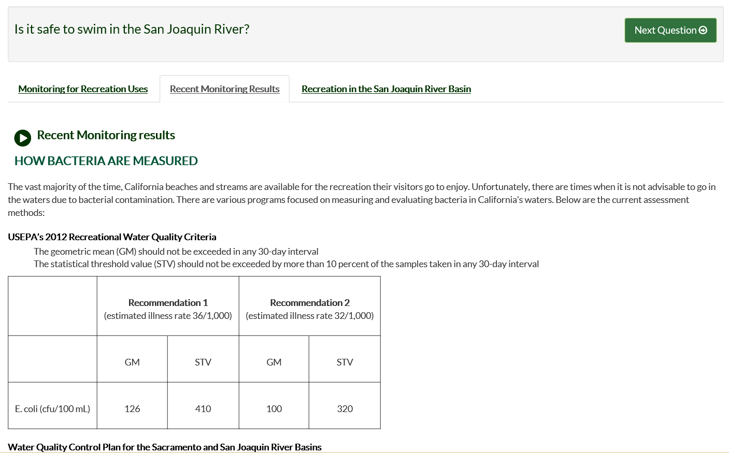
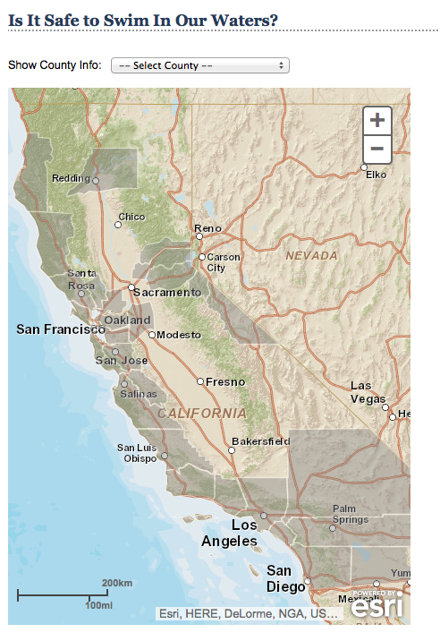
PORTAL TOPICS: SAFE TO SWIM
Sources of eColi
eColi Criteria
Current Conditions at key areas
Where is eColi
an issue?
Data Sets: GIS layers, SWAMP, CDEC, CEDEN, WDL

Slide 26
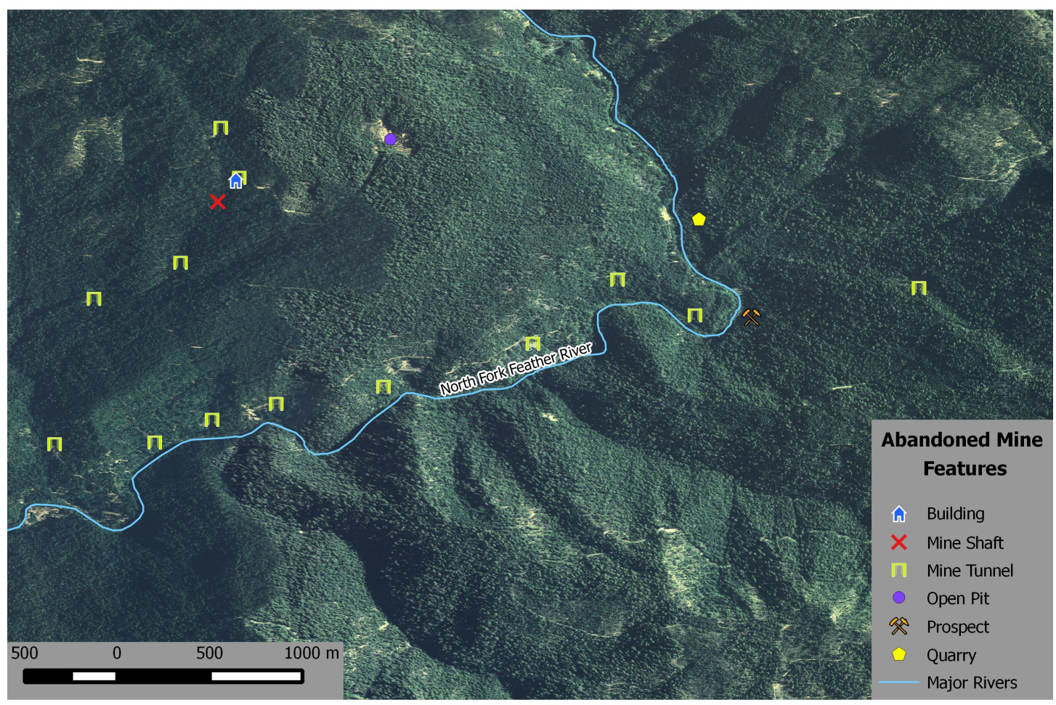
PORTAL TOPICS: ABANDONED MINES
Key Issues:
What are the remediation strategies?
Possible sources of contaminants
Distance to rivers/streams/lakes
Data Sets: GIS layers with mine location and type, water quality stations, project data, water bodies

Slide 27
PORTAL TOPICS: GIS for Data Stories
Mining Pollution
GIS Data Layer | Description/Use
Principal Areas of Mine Pollution | Areas of current and potential pollution listed with pollutant, type of mine, and point of discharge.
Historic and Current Mining Features | All topographically occurring mining features in CA.
Abandoned Mine Locations | Abandoned Mine locations could be pollution sources.
Mercury levels in Fish Tissue | Can show locations of unsafe Hg levels in fish tissue.
Fish Consumption Advisories | Locations of posted Fish Consumption Advisories due to high levels of pollutants in fish tissue.
Threatened and Endangered Species Critical Habitat | Critical habitat areas in CA could intersect mine pollution areas, abandoned mines, or active mines.

Slide 28
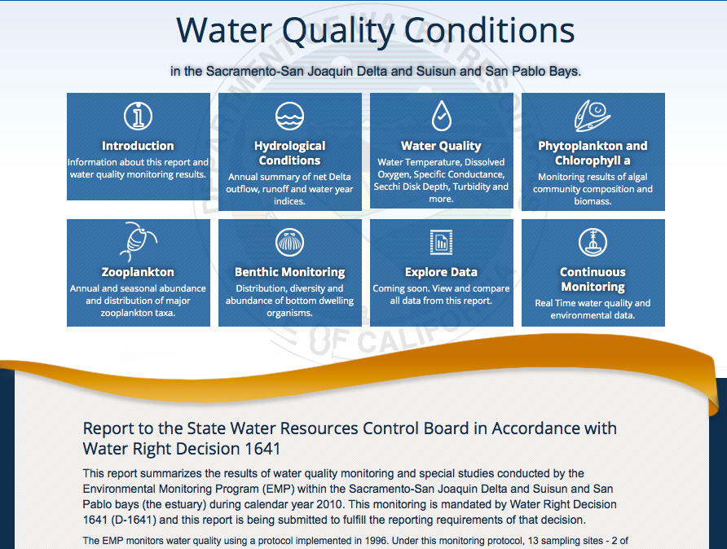
PORTAL TOPICS: WATER QUALITY and 1641 WATER QUALITY CONTROL PLAN
What is WQ
Why is WQ Important
WQ in SRW
Sources of Pollution
Reports and Links
Current Conditions
Data Sets: DWR 1641 WQ Report, CDEC, CEDEN

Slide 29
PORTAL TOPICS: WATER QUALITY MANAGEMENT
Who is doing what to manage water quality in the watershed? [Reg Bd Basin Plans; 303(d) list; TMDL Report Cards (My WQ Portal); IRWMPs; FERC relicensing; vet through Mon. Comm.]
Who is monitoring water quality? Where and how? [build on/update CV Monitoring Directory; coord w RDC, SWAMP; CDEC & USGS sites; vet through Mon. Comm.;identify monitoring stations and their current monitoring regimes for pollutants of interest]
What laws, regulations, and policies protect our water quality?

Slide 30
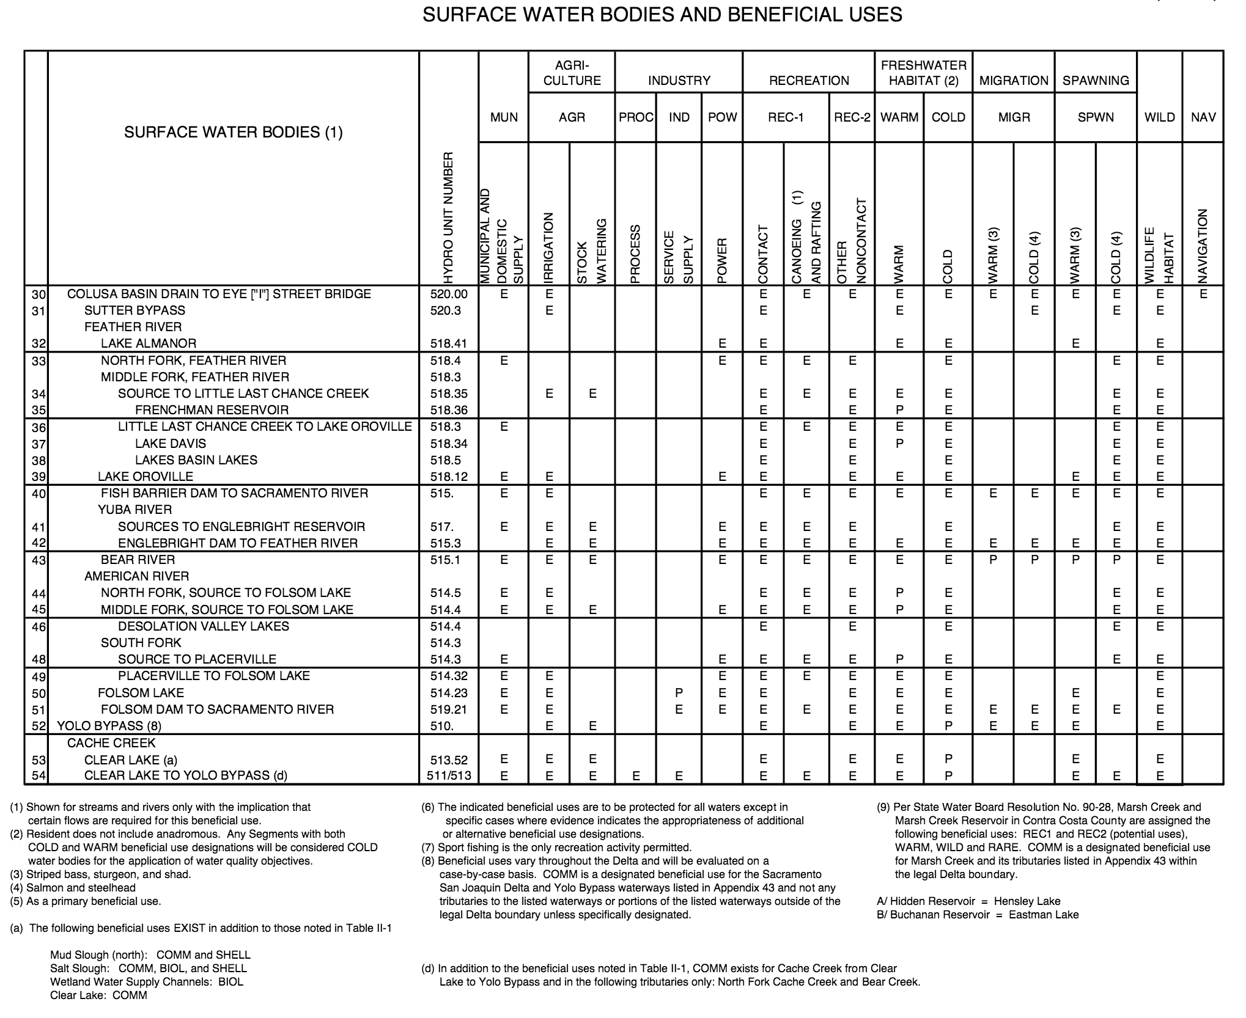
PORTAL TOPICS: BENEFICIAL USES
What are the beneficial uses in your area?
How is the water managed and monitored for those beneficial uses
What impacts does this have upstream and downstream?
Data Sets: GIS layers, 303d List

Slide 31
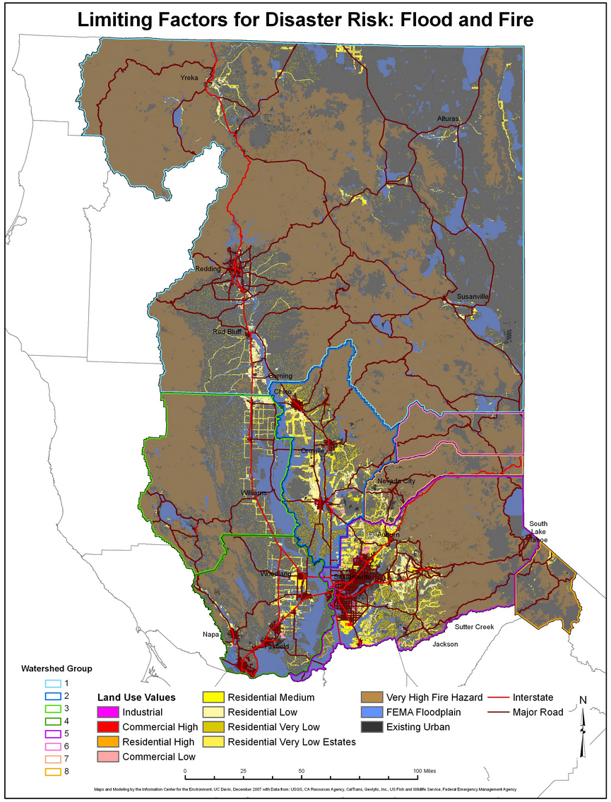
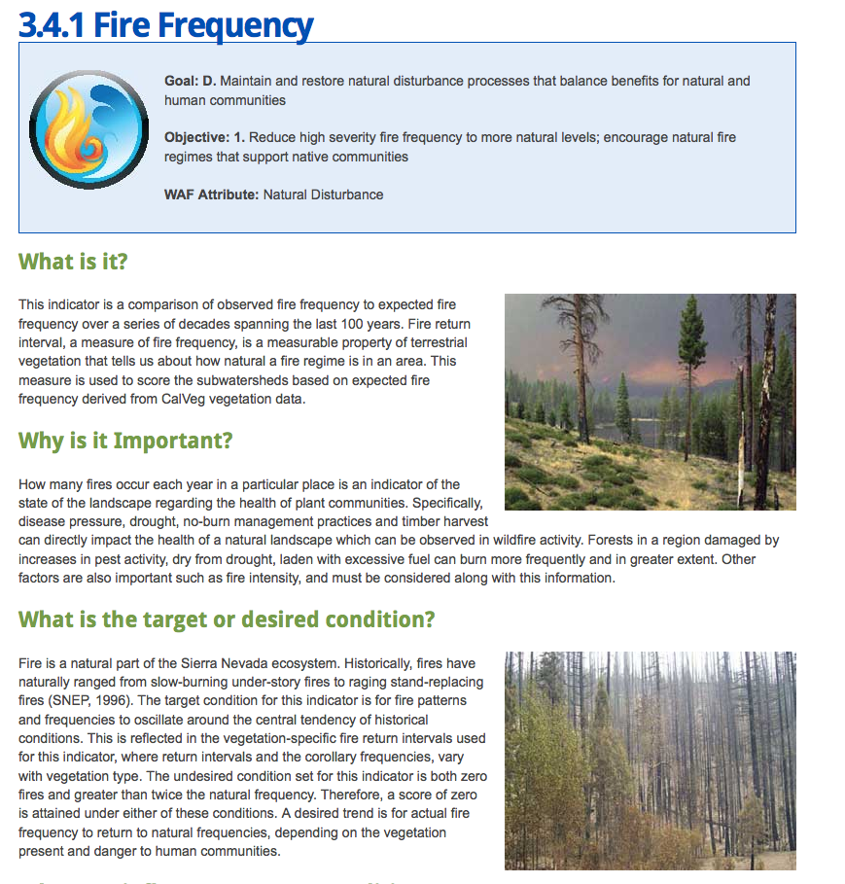
PORTAL TOPICS: FOREST HEALTH, FIRE RISK, EROSION
Data Sets: GIS, Land use, CalFire

Slide 32
PORTAL TOPICS: GIS for Data Stories
Forest Health and Fire
GIS Data Layer | Description/Use
Fuel Treatments | Areas that have received fuel treatments in California – could highlight areas lacking treatment with historic fires
Historic Fires | Historic Fires up to 2014
Fire Hazard Severity Zones | Display high severity zones relative to populated areas, meadows, hydrologic features, etc.
Vegetation Types | Highlight types more susceptible to fire
Sierra Nevada Meadows | Display proximity to historic fires and fuel treatments

Slide 33
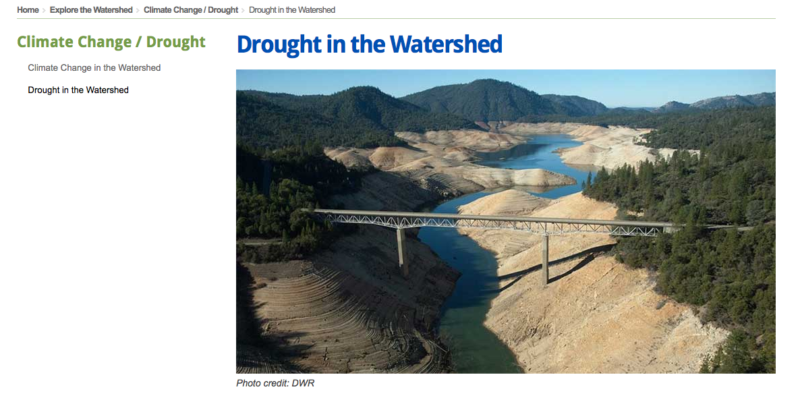
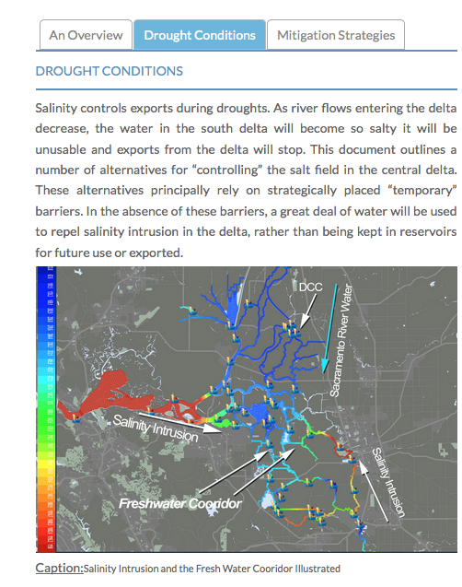
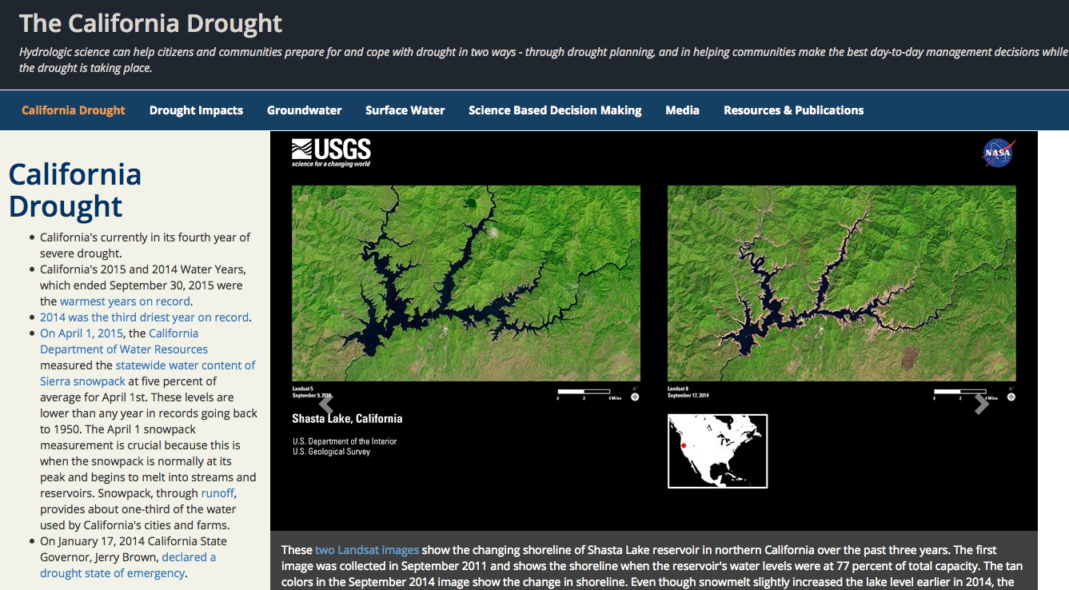
PORTAL TOPICS: DROUGHT MANAGEMENT

Slide 34
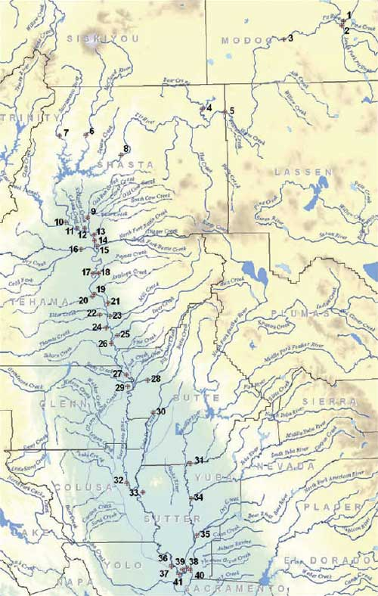
PORTAL TOPICS: SWCMP HIGHLIGHTS
Program Overview
Program Highlights
Constituent Overview
Access to Data
Reports and Assessment
Links
Data Sets: GIS, SWAMP, WDL

Slide 35
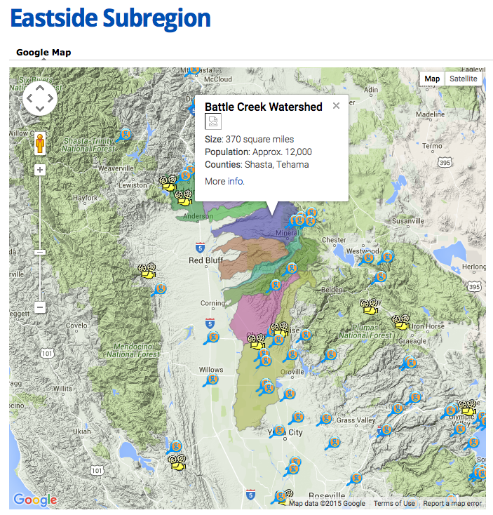
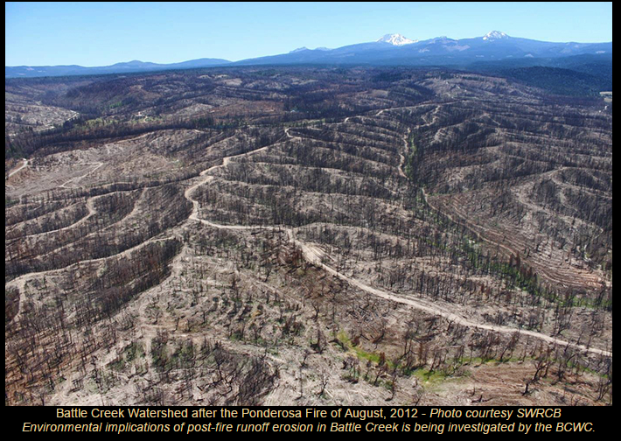
PORTAL TOPICS: BATTLE CREEK (Special)
Key Issues:
Sediment Transport
Turbidity
Flood Events
Salmon and Steelhead rearing and spawning habitat
Fire Safe
Restoration Projects

Slide 36
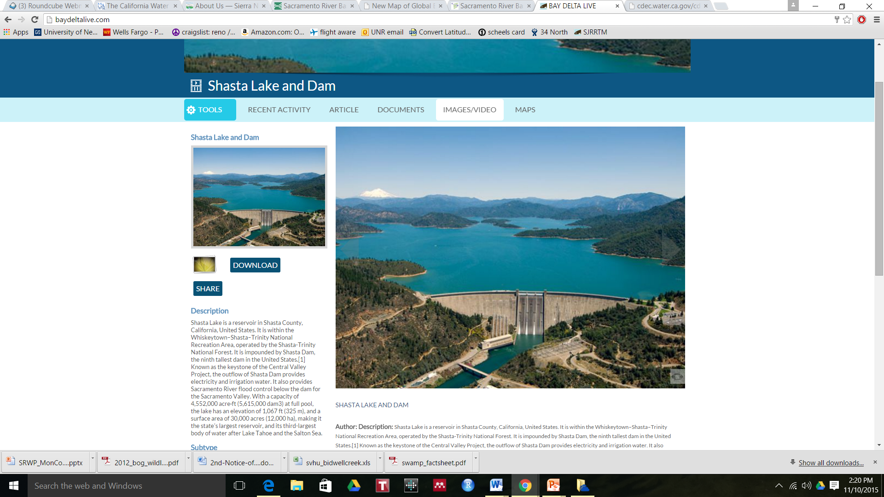
PORTAL TOPICS: LAKE SHASTA (Special)
Cold Water releases for salmonid species
Salmon life stages and water needs
Reservoir Water Quality Scheduled Releases
Inflow and Outflow
Recreational Activities
Snowpack (SWE) and snow melt
Lake Elevation

Slide 37
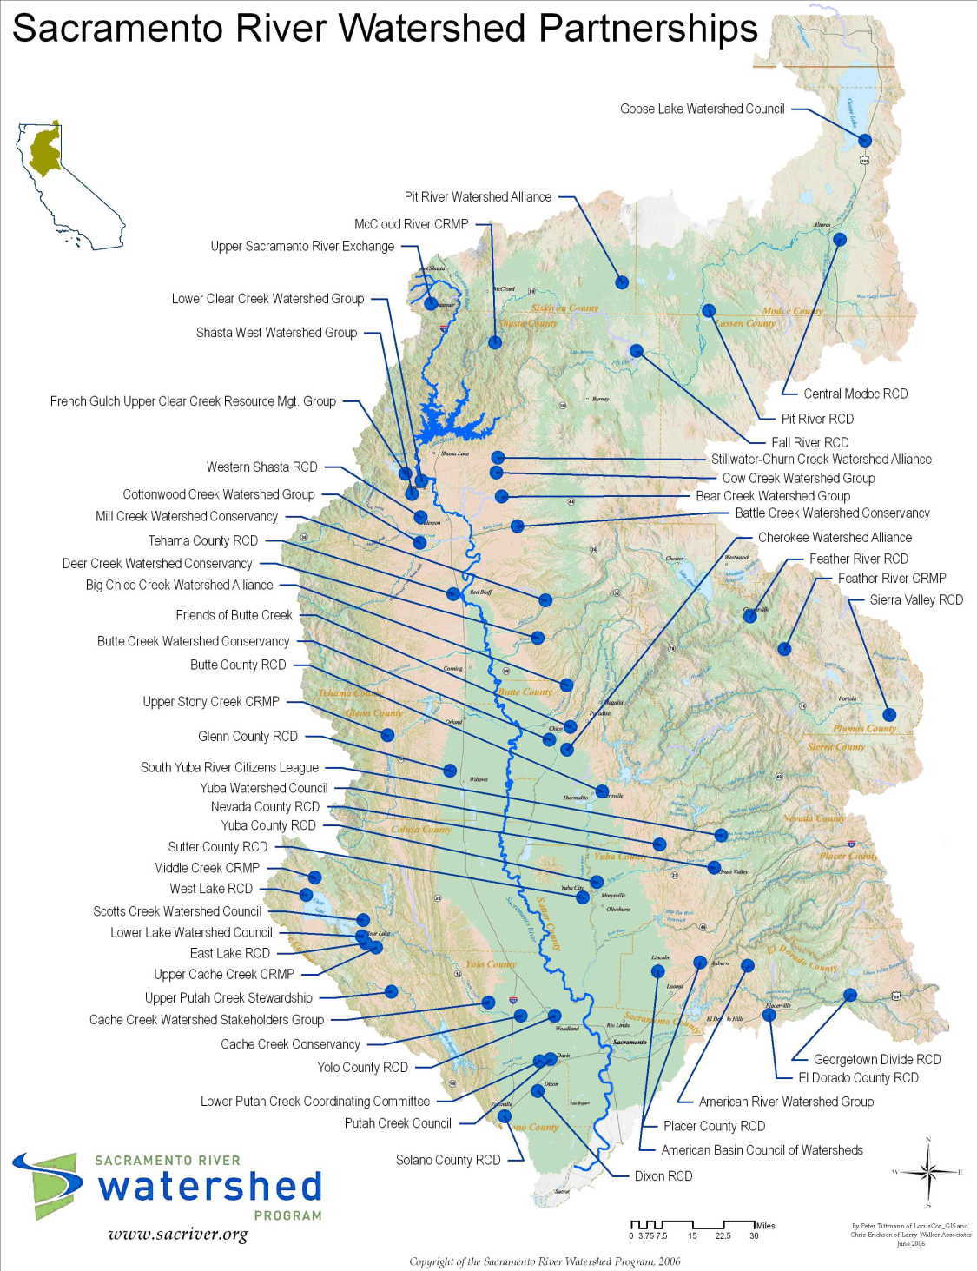
PORTAL TOPICS: COLLABORATION (Special)
Who is conducting research in the watershed?
Who is monitoring areas in the watershed?
Do studies overlap?
Regional Program
Summaries

Slide 38
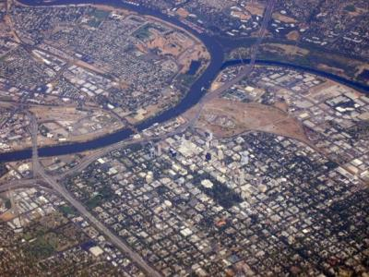
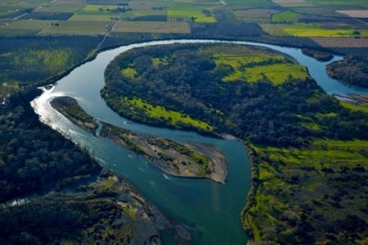
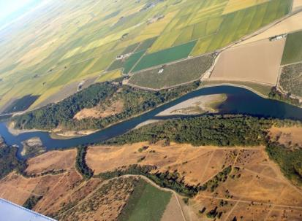
PORTAL TOPICS: ADDITIONAL QUESTIONS
Aquatic ecosystem health
Salmon run health
Riparian habitat projects & wildlife benefits
Invasive Species
Drought Management
Domestic, Municipal and Industrial Water Supply
SGMA
Hydropower
Notes:
Scoped to address 3-4 broad questions & 3-4 dashboards for specific SHs (“use cases”)
Note various types: Water quality, habitat, connections (who)
Also re salmon: Do river flows and temperatures support salmonid migration?

Slide 39
PORTAL DEVELOPMENT: UPDATES
OPENNRM Instance
200+ GIS file ported to web server, inventoried, metadata, styling
SWIM database analysis, conversion to postgres
Set up metadata schema
CEDEN, WQX, DJFMP and database/ web service review. New datasets review
Question and Topic Data Research
Notes:
Initial layout
KW: has this group seen the other OPENNRM projects? Could also be deleted, was part of original ppt

Slide 40
WRAP-UP: QUESTIONS? COMMENTS?

Slide 41
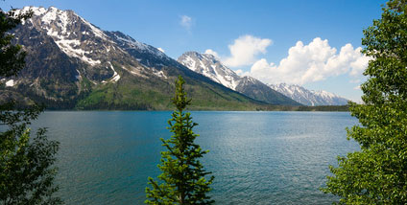
For more information
Stephen McCord
McCord Envir., Inc.
sam@mccenv.com
530-220-3165
www.mccenv.com
Holly Jorgensen
SRWP Exec. Dir.
holly@sacriver.org
530-781-2220
www.sacriver.org

Slide 42
