Slide 1
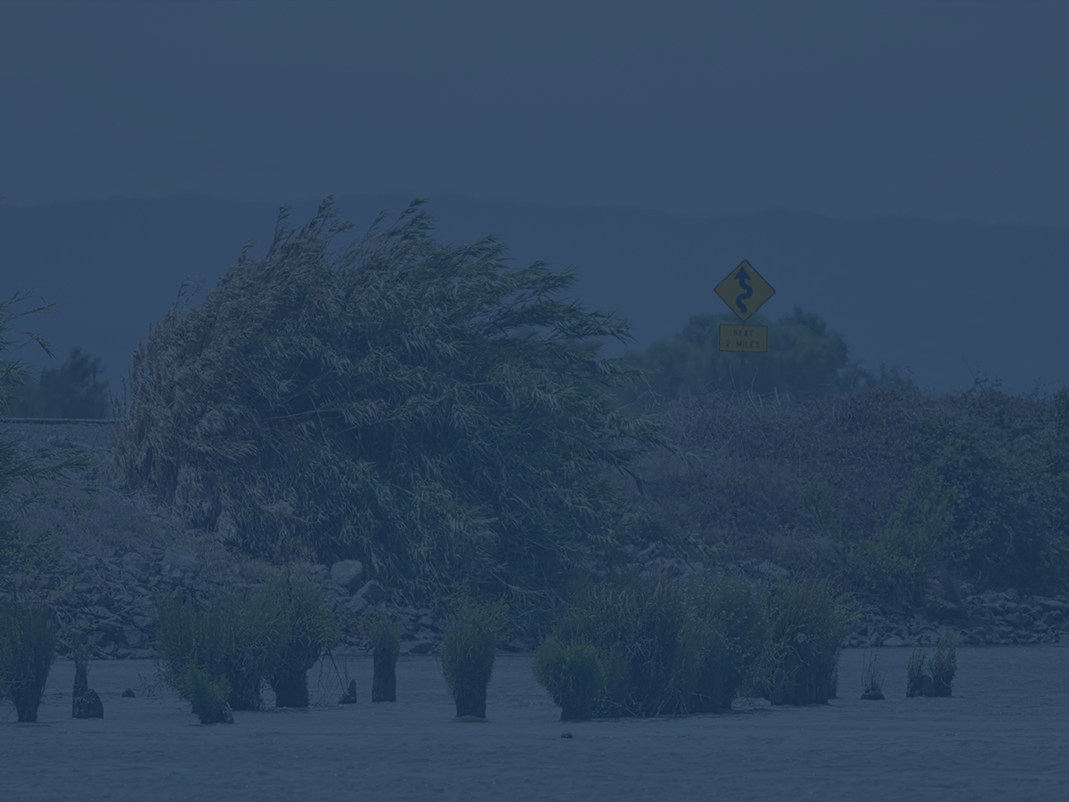
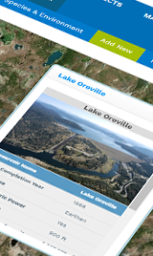
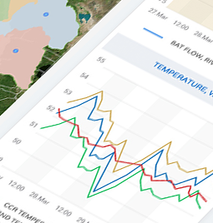
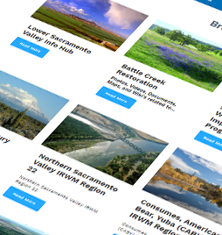
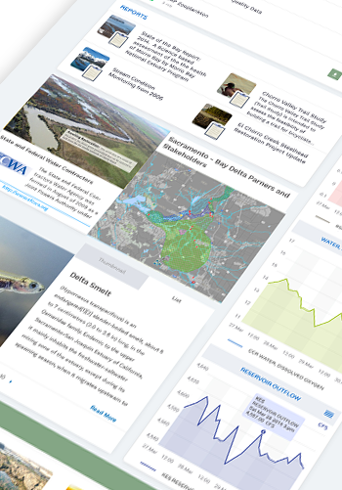
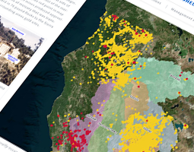
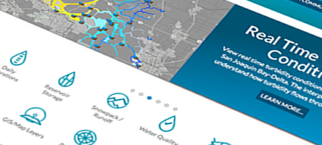


Connecting Scientific Research Projects and Data Through Software
Val Connor, GEI, Russ Ryan, MWD, Amye Osti, 34 North
An Opportunity for Collaboration and Data Synthesis

Slide 2
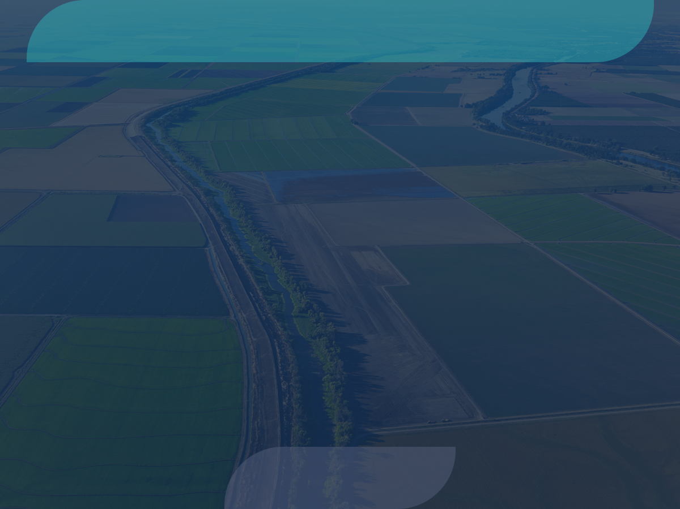

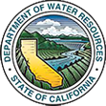









Major Data Providers
Data is aggregated from stakeholders throughout the region:
Hydrologic
Water Quality
Satellite
Meteorological
Terrestrial
Volunteer Sampling

Slide 3
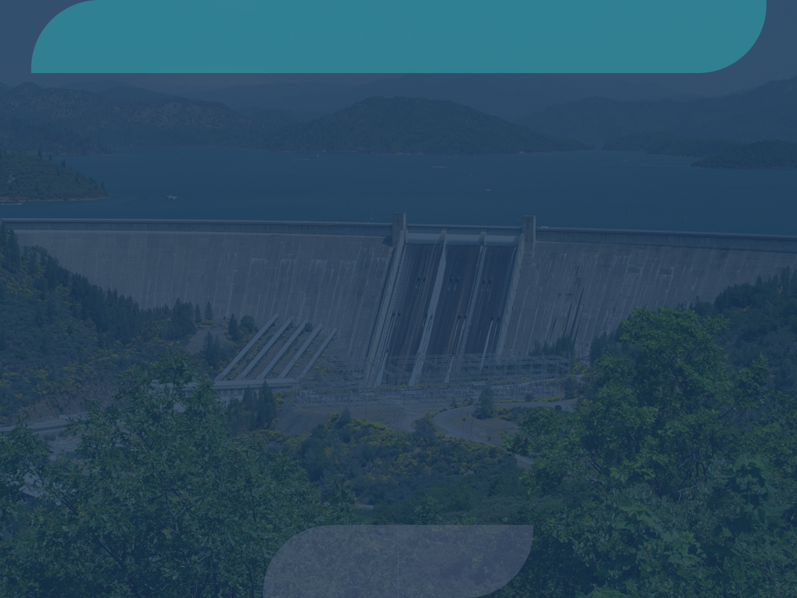





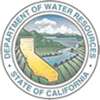

A Collaborative Effort
Regional and Statewide Programs
SACRAMENTO SAN JOAQUIN BAY-DELTA
SWRCB MY WATER QUALITY PORTALS
CALIFORNIA ESTUARY
PORTAL
SAN JOAQUIN REAL TIME MANAGEMENT
DWR 1641 WATER
QUALITY
SACRAMENTO RIVER
WATERSHED

Slide 4
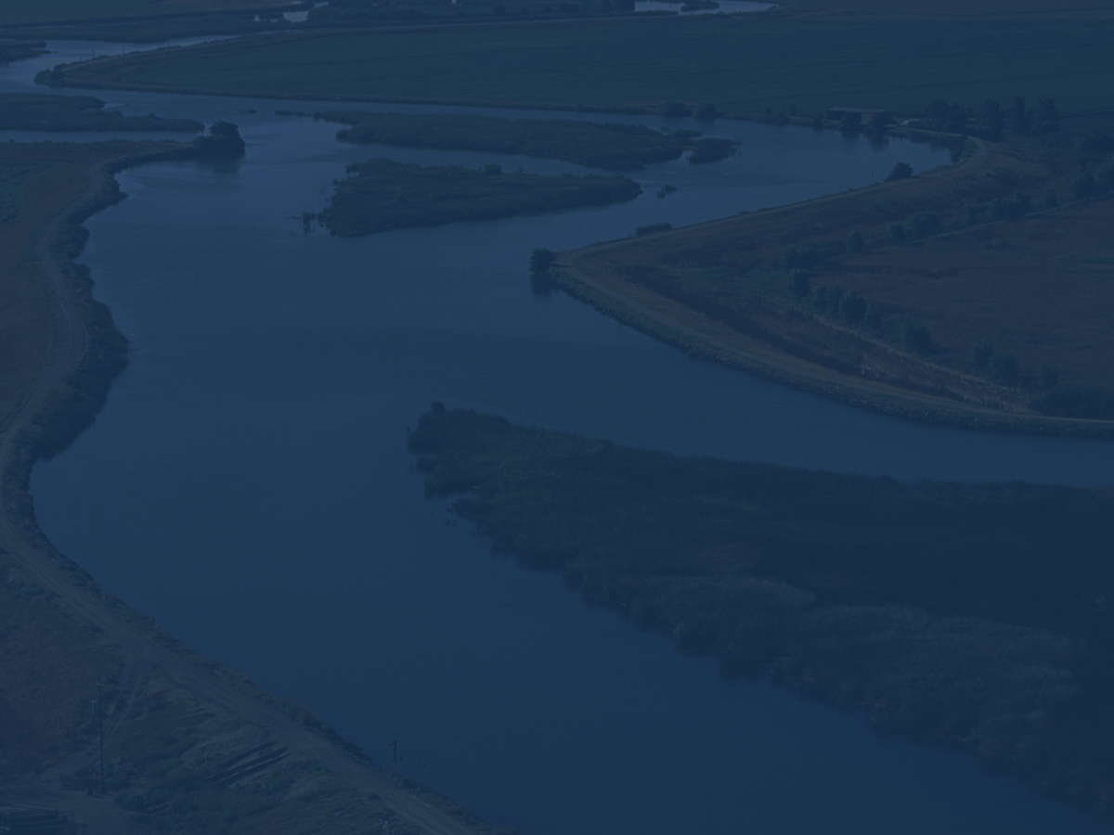
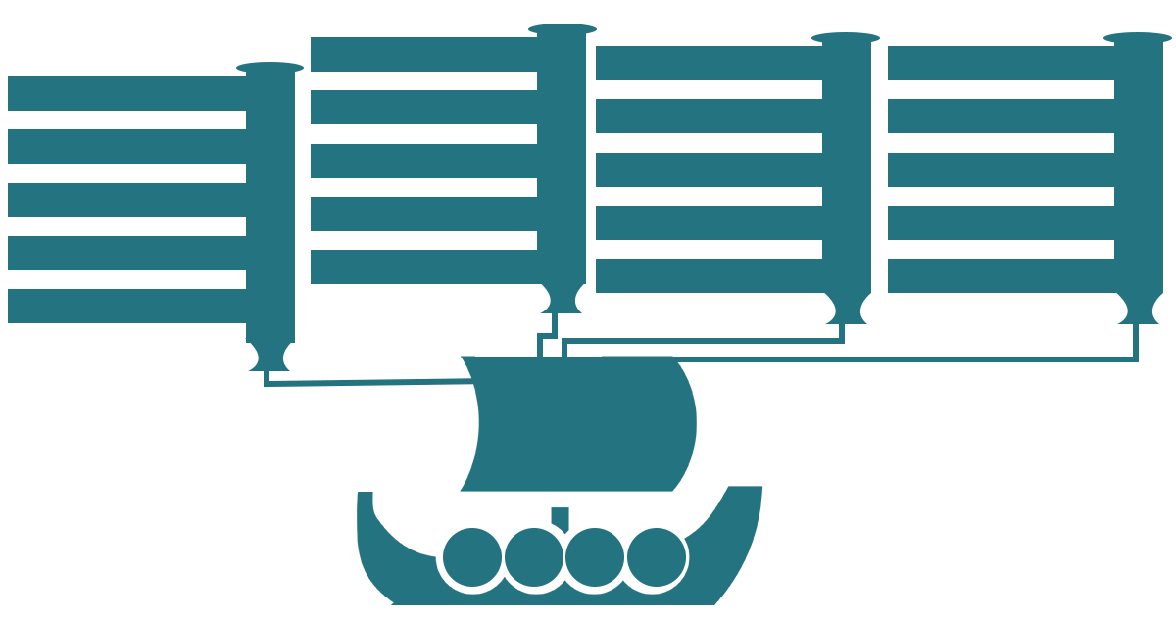

OpenNRM
Estuary Portal
Fisheries Dashboards
WARMF Modeling
SRWP Monitoring Programs
1641 Reporting
DOSS and DCT
Real Time Management
Forest Health and Fire
Ca Estuaries
BDL
Cache Collaborative
DSM2 Modeling
Compliance Monitoring
SJRRTM
Ecosystem Restoration
SRWP
EMP Monitoring
Real Time Operations
Reporting Dashboards
Region Data Hubs
State Estuaries Template
By the Numbers
Collaborative Management
Temperature Compliance
OPEN
NRM
Data
Research
Projects
Tools

Slide 5
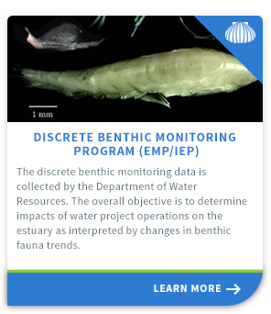
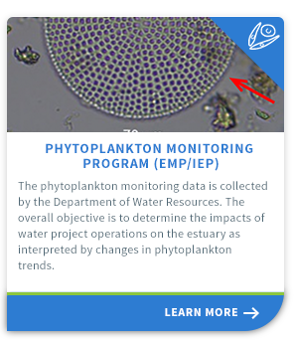
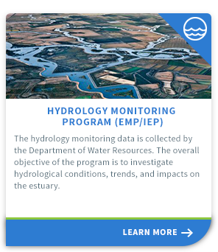
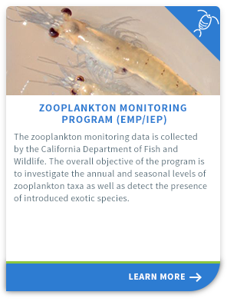
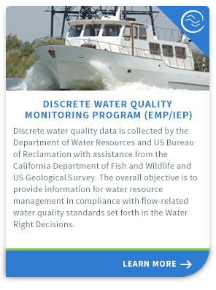
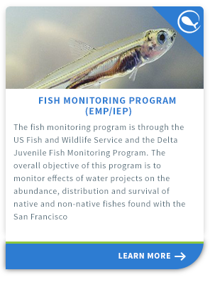
BayDeltaLive
DWR Environmental Monitoring Program Report

Slide 6
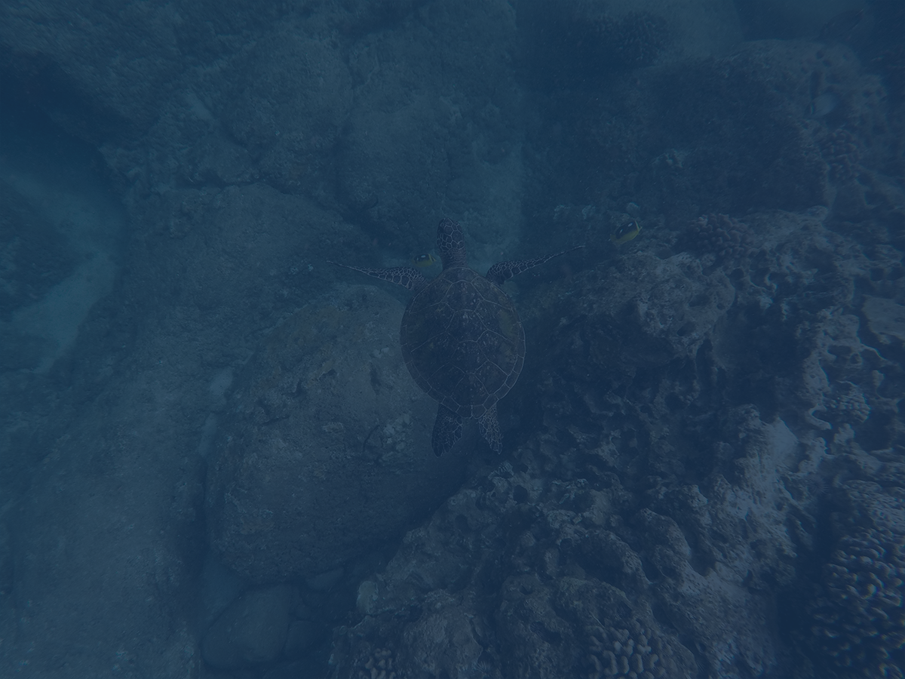
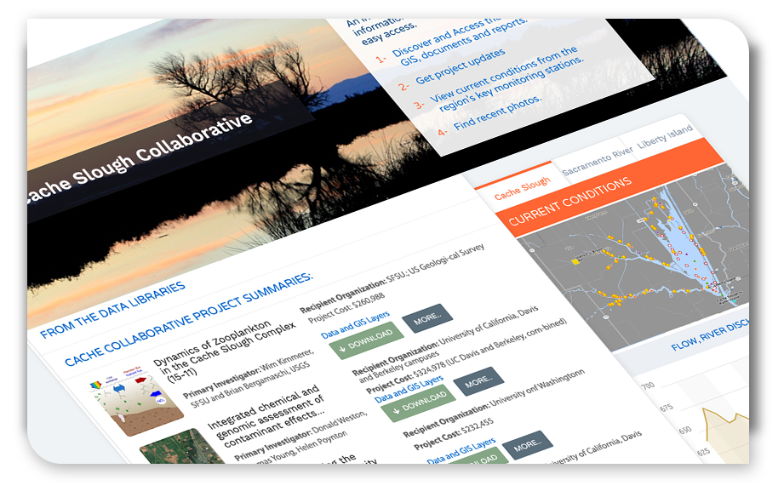
Cache Collaborative Info Hub
Regional data sets, GIS, Maps, Documents, Images, Reports
and Current Conditions

Slide 7
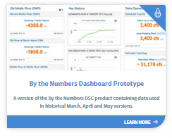
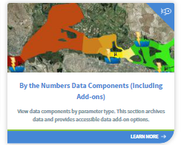
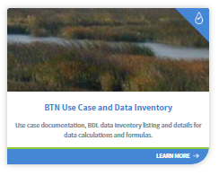
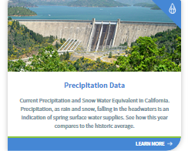
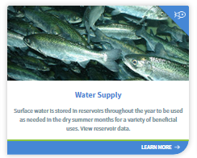
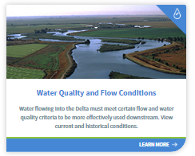
By The Numbers
Delta Conditions Reporting for the DSC

Slide 8

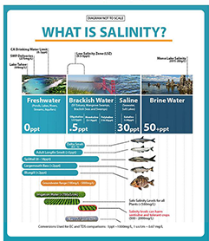
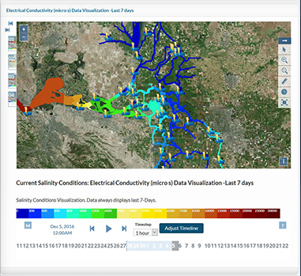
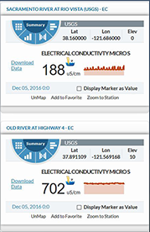
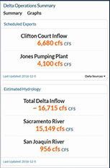
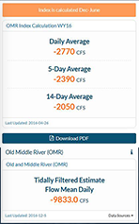
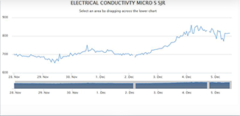
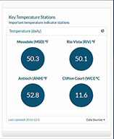
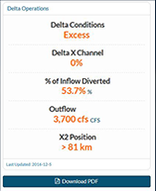
Salinity
www.baydeltalive.com/salinity

Slide 9
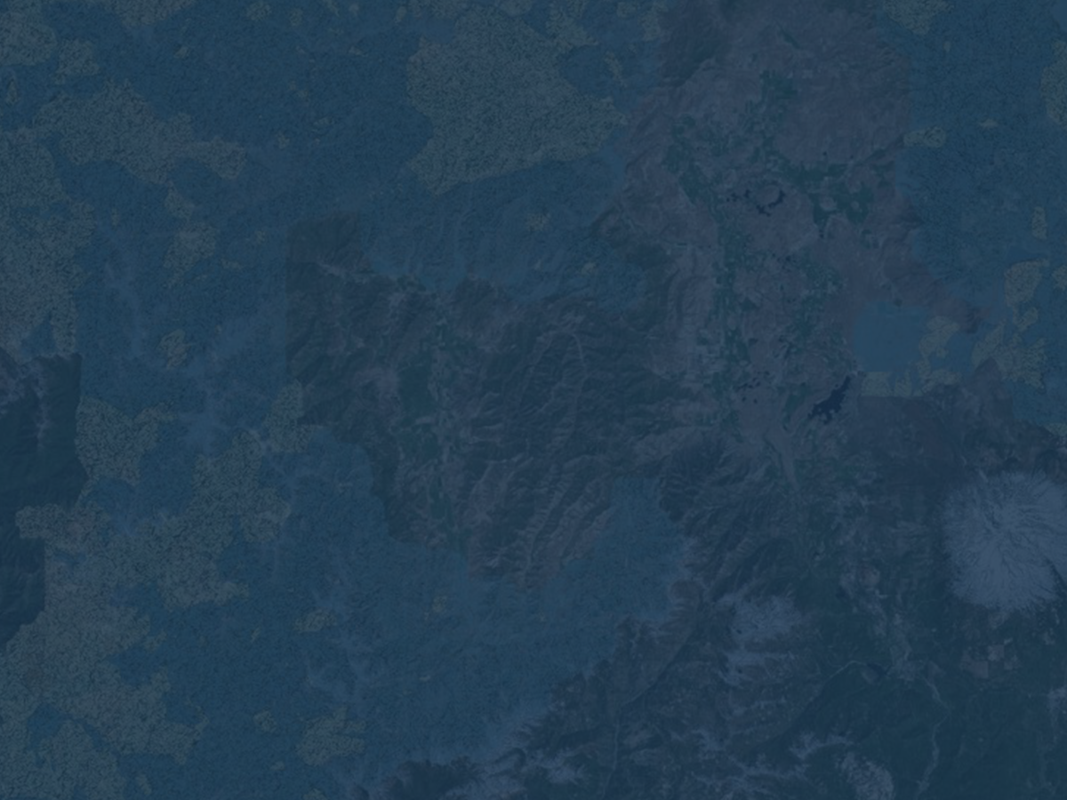
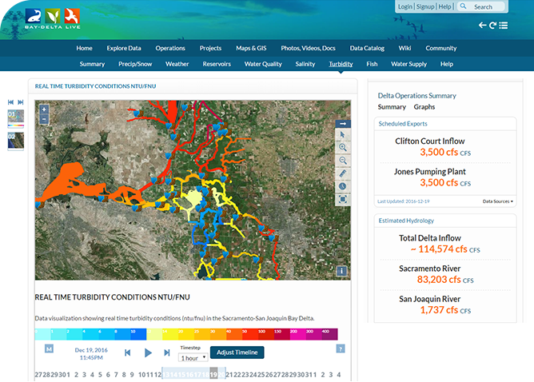
Turbidity Conditions
Turbidity Model displays real-time data from 46 CDEC Stations.
View data at various intervals (15 min, 1 r, 6 hr, 12 hr, 1 day, 1 week, 1 mo, 1 yr).
Data is 15-minute and averaged based on interval.

Slide 10
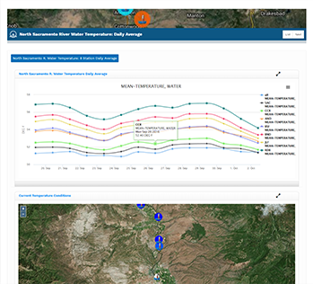
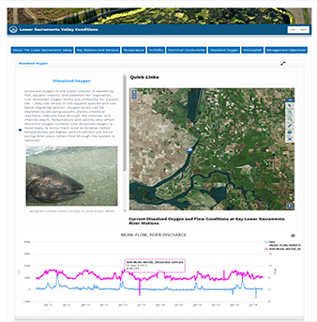
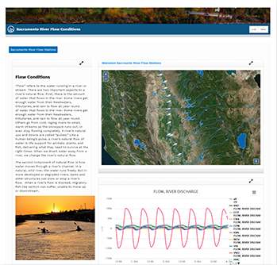
Data Dashboards and Stories
Fisheries, Reservoir Conditions, Water Quality

Slide 11
Operations Decision Management
CALFED Operations
Smelt Working Group (SWG)
Water Operations Management Team (WOMT)
Delta Conditions Team (DCT)
Delta Operations For Salmon and Sturgeon (DOSS)

Slide 12
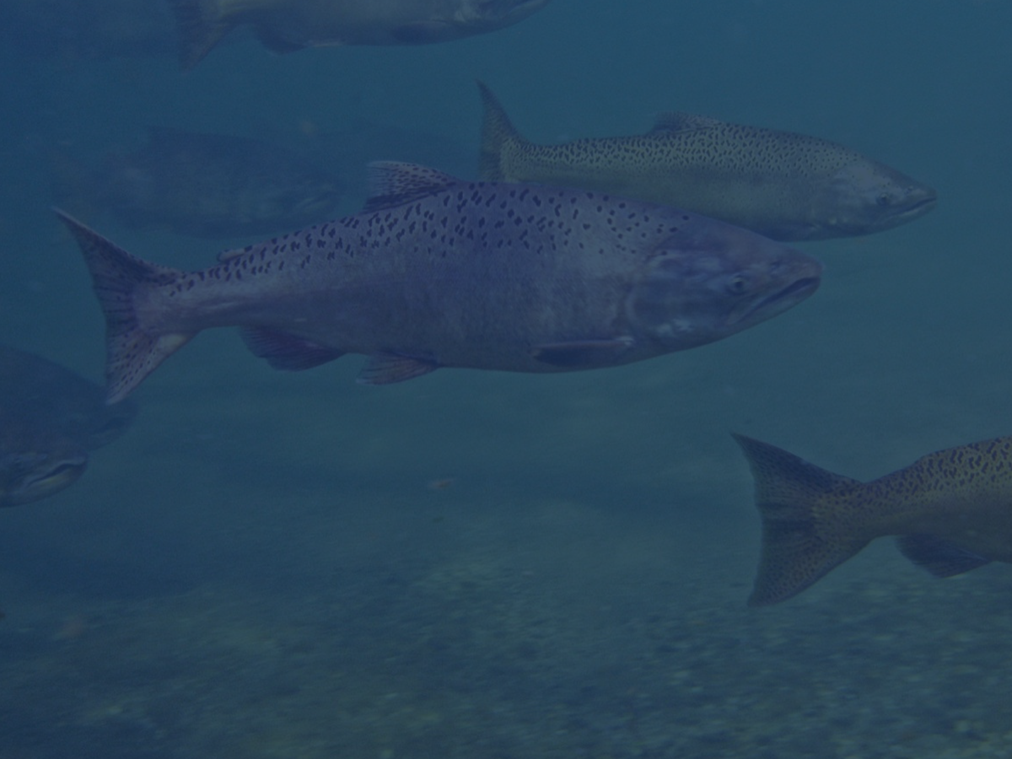

What Types of Information Do Managers
Consider?
Meteorological Forecasts
Sediment Surveys
Carcass Surveys
Juvenile Monitoring Data
Fish Production
Seine Data
Weir Counts
Water Quality
Biotelemetry Data
Redd Surveys
Reservoir Inflow
Genetic Analysis
Trawl Data
Modeling Outputs
Salvage
Stream Guage Data
Salmon Escapement
Reservoir Release Schedules

