Slide 1
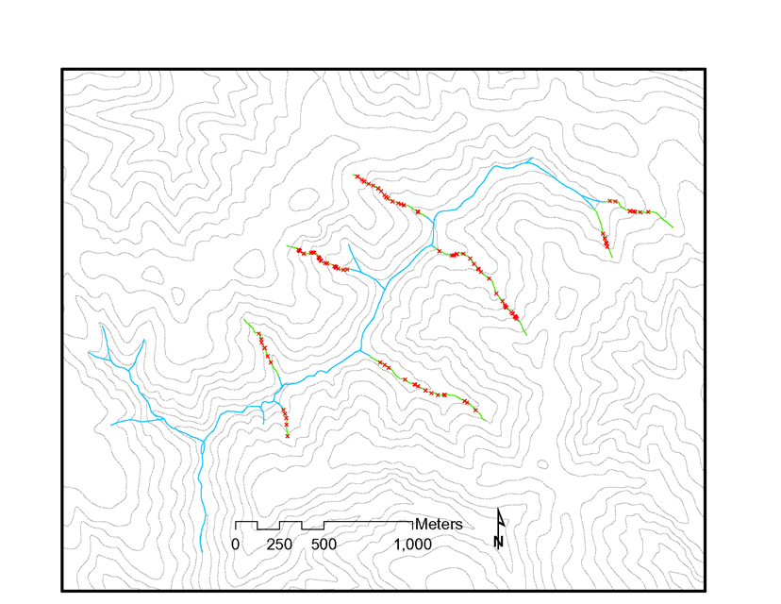
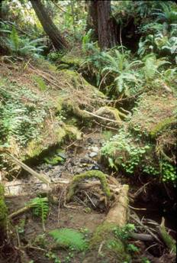
Gullied channels in North Fork Caspar Creek
headcut
X headcut >0.7 m high
gullied channel
(Dewey)

Slide 2
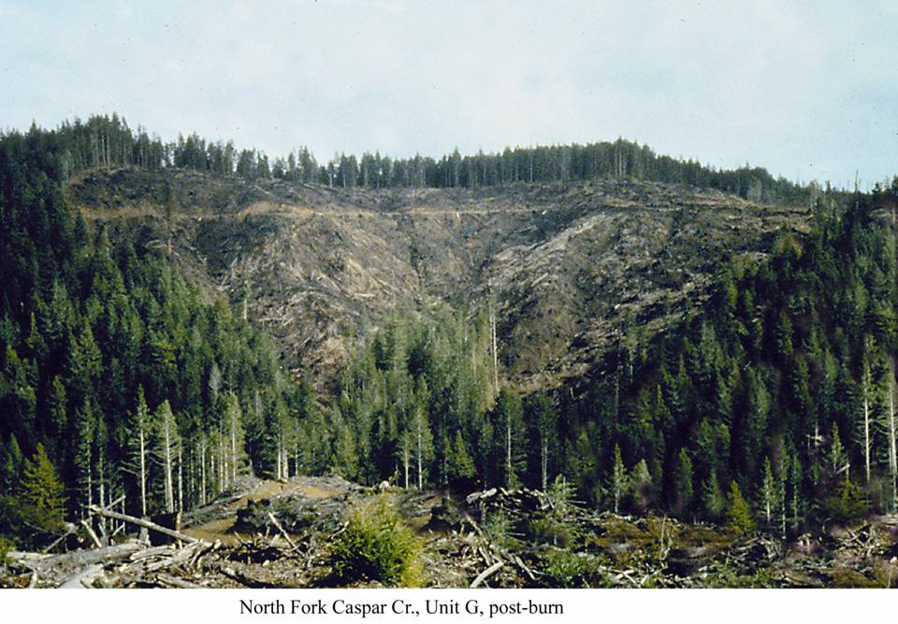
Cumulative effects of logging on watershed processes and implications for downstream ecosystems, Caspar Creek, northern California
Tom Lisle Bret Harvey
Sue Hilton Liz Keppeler
Jack Lewis Leslie Reid
PSW Research Station, Arcata, CA, in cooperation with California Dept. of Forestry

